Slide 1

Kamadhenu
कामधेनु
https://sri-dsa.github.io/Kamadhenu/
Unified Chatbot
सर्वसंयोग
Developed By : Srivathsan Karthikeyan
GitHub
LinkedIn
Website

Slide 2



Slide 3
Introductory - Inspiration
Bhashini API - Unified solution addressing
Multilingual (Unique Languages)
Multi-dialect(Vocabulary and grammar)
Multi-Accent(Geography and Social Status)
Collaborations
Kamadhenu - Motherly Goddess from whom all that is desired is drawn, resides with Sage Vashisht(वसिष्ठ)
Provides all the desires the users asks in the public sector
Raised and Fed by Sage Vashisht Optimised and input by Web Scraping of Government Data and Website
Data.Gov.In, Sarva siksha Abhiyan, Make in India, Government websites

Slide 4

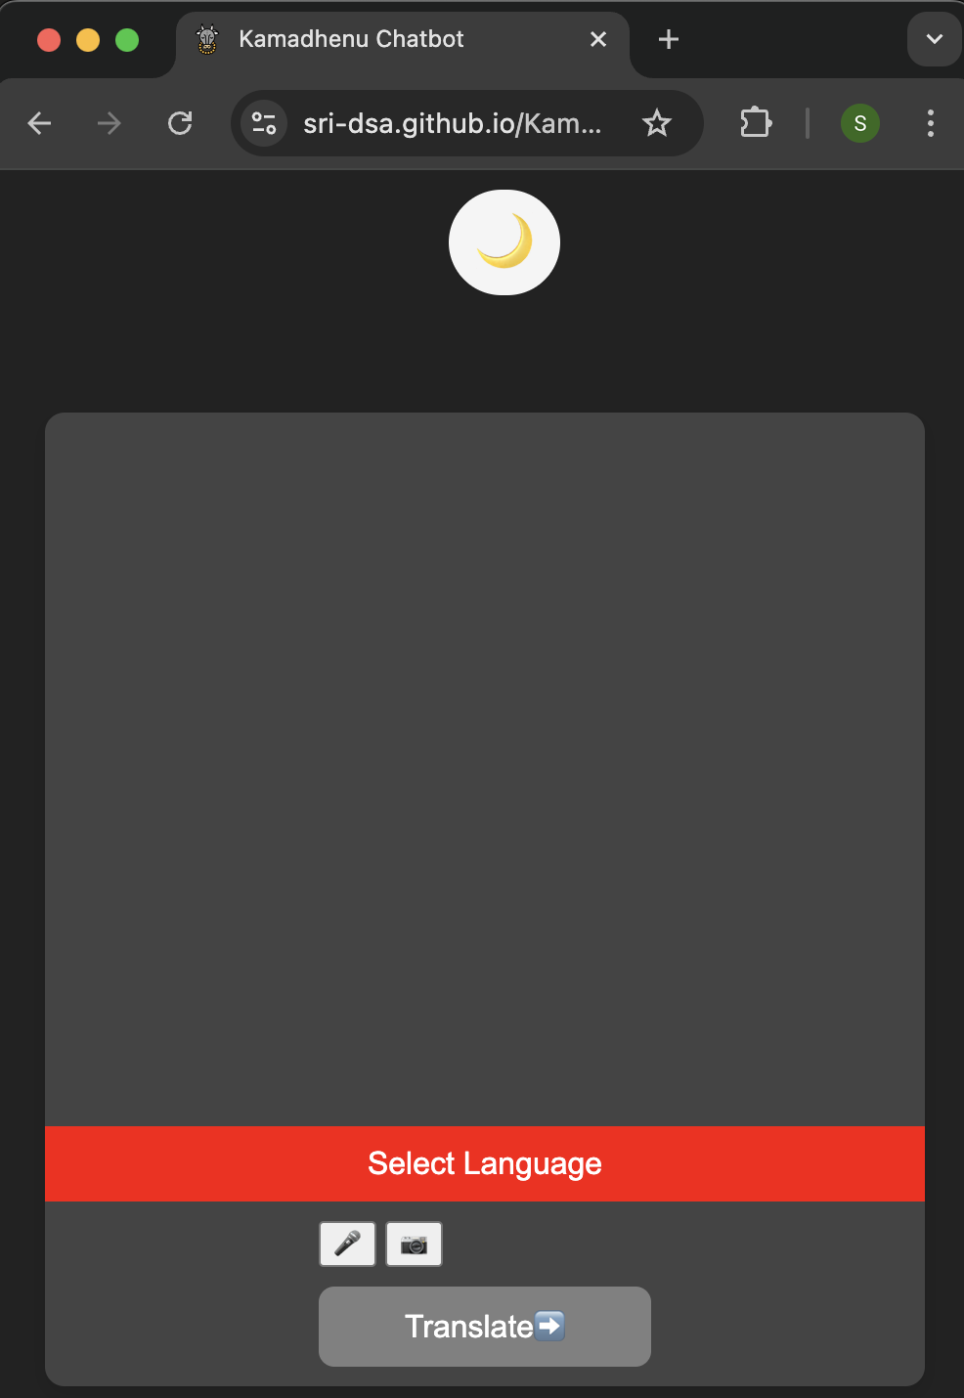
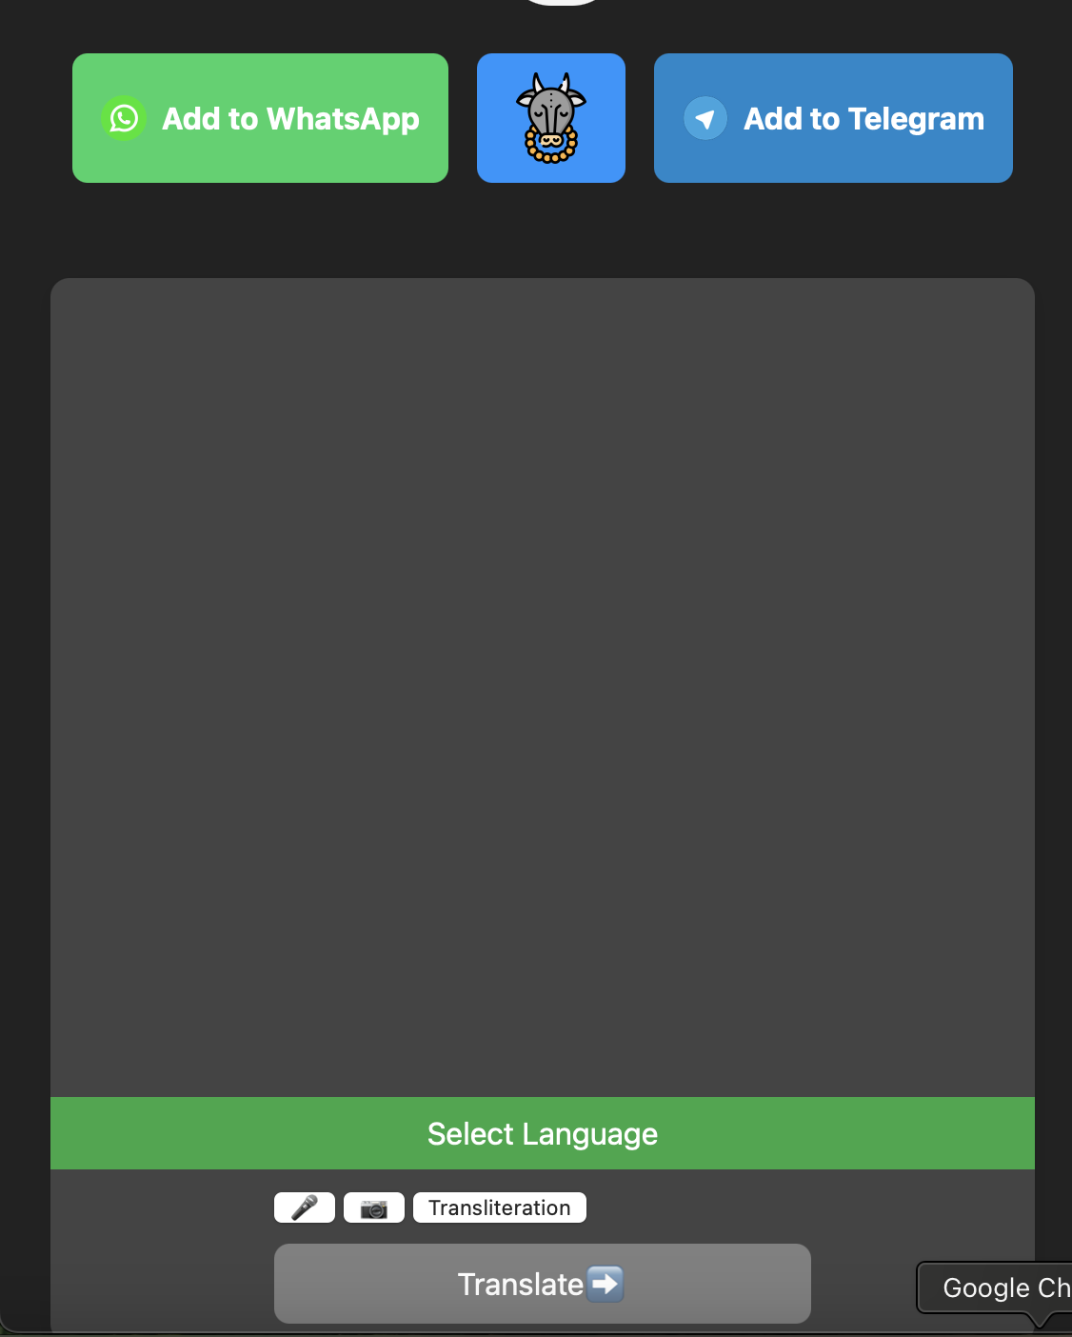

Stores Language selected and input loaded
Parallel
Changes into English
Image I/P
Loaded into the Model
Audio I/P
Chatbot Chat Interface/Front End
Text I/P
Changes into the “Language Selected”
Model’s English Output
Loads Output from Script to chat Interface as Output/Response of Chatbot

Slide 5
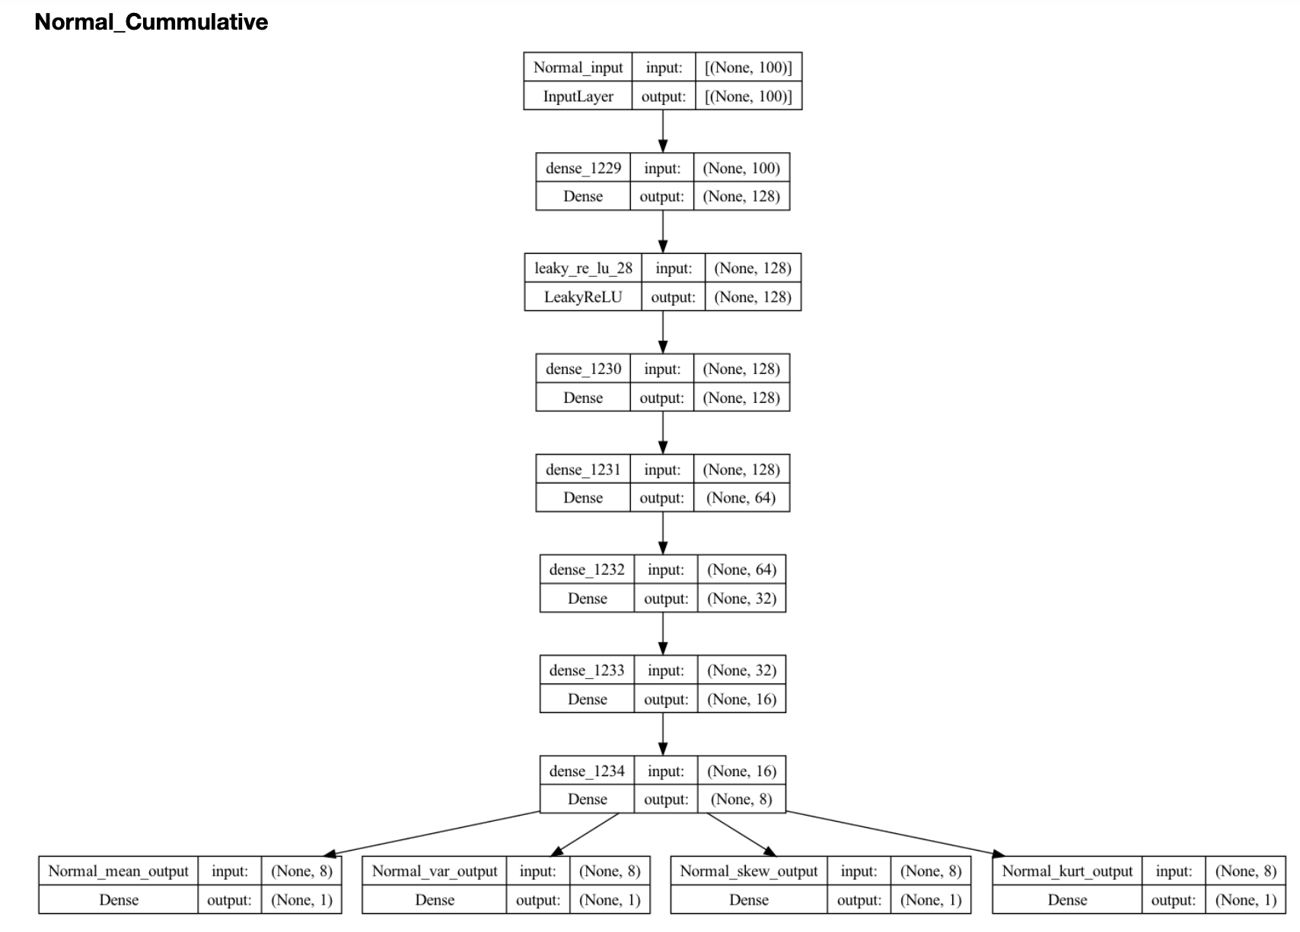
Model Architecture
Test Case of Generative O/P vs Trained O/p
Trained Output
Generative O/P
End Output

Slide 6
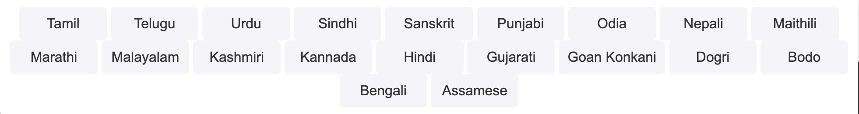
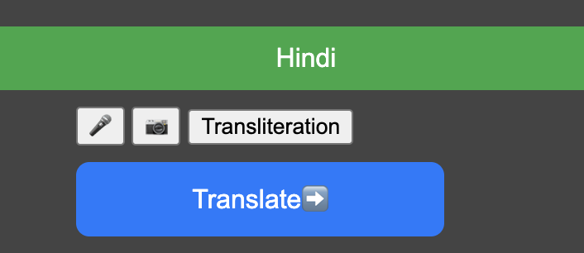
Accepts Text, Image, Audio

Slide 7


For Text Input
Native Script Text in Native Language
Only Translation(NMT) API of Bhashini -> Model
2. English Script Text in Native Language
Transliteration +Translation API of Bhashini -> Model

Slide 8
3. For Audio Input :
Only Audio Speech Recognition(ASR) API of Bhashini -> Model
4. For Image Input :
Only Image to Text (OCR) API of Bhashini -> Model
Pratichhavi-vaad

Slide 9
Current Drawbacks of the model
Synthetic Dataset obtained Manual Web Scraping of Government Data and website
Computational constraint on Generative AI to verify the Government data as the model is not integrated with government websites.
Delay in getting feedback on APIs - double calling of Bhashini API
Output is only text based

Slide 10
Potential User Base :
Sector | Potential Users | Capitalisable Users
Government Welfare and Recruitment Schemes | Potential Welfare scheme and Government job-job seekers | Around 350 million/800 million
Education, Literacy, Administrative, Bureaucracy | Students, Teachers, Trainers, Competitive exam aspirants | Students: 315 million Teachers/Trainers: 10 million
Primary Legal Advices | Citizens without primary legal access | Around 200 million
Agriculture and Primary Sector | Animal husbandry, Farmers, Peasants, MGNREGA workers, Rural population, Agricultural extension workers | Approximately 150 million
Emergency advices (Excluding from undocumented medical practices) | Potential primary Initiators towards Police Fire, Ambulance | Around 3 million everyday

Slide 11
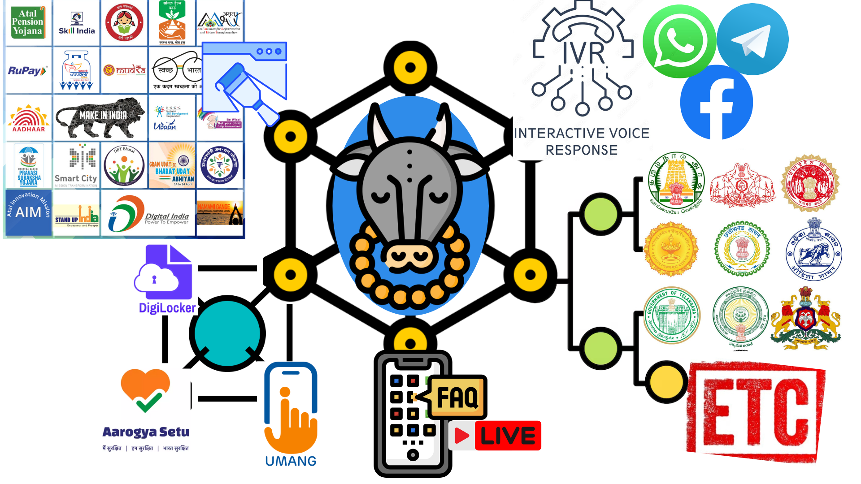
Scopes of the Project can be expanded into…

Slide 12
Kamadhenu
कामधेनु
https://sri-dsa.github.io/Kamadhenu/
Unified Chatbot
सर्वसंयोग
Developed By : Srivathsan Karthikeyan
GitHub
LinkedIn
Website

