Slide 1
PyPad
Hari Venkatesh
Sriduth Jayhari

Slide 2
What can it do?
Write and run python code in browser.
Save, edit and recover code anytime.
“Fork” and edit code.

Slide 3

Splash Screen

Slide 4
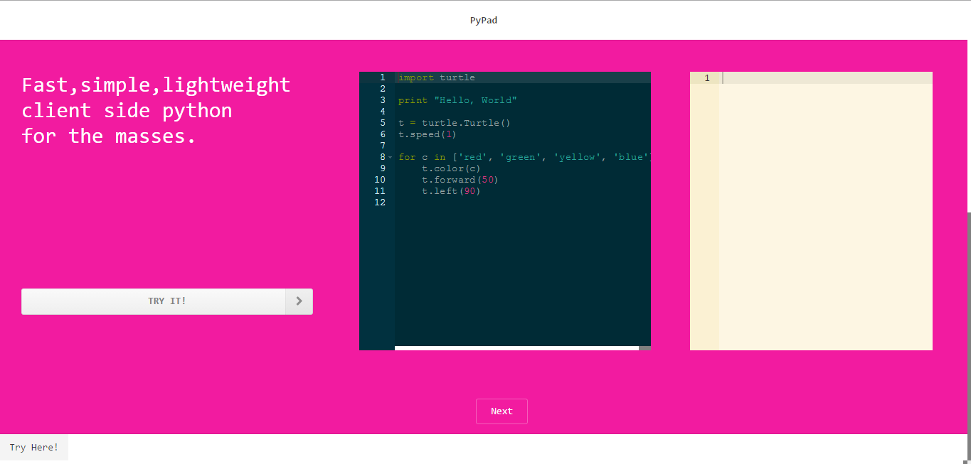
Landing Page Section 1

Slide 5
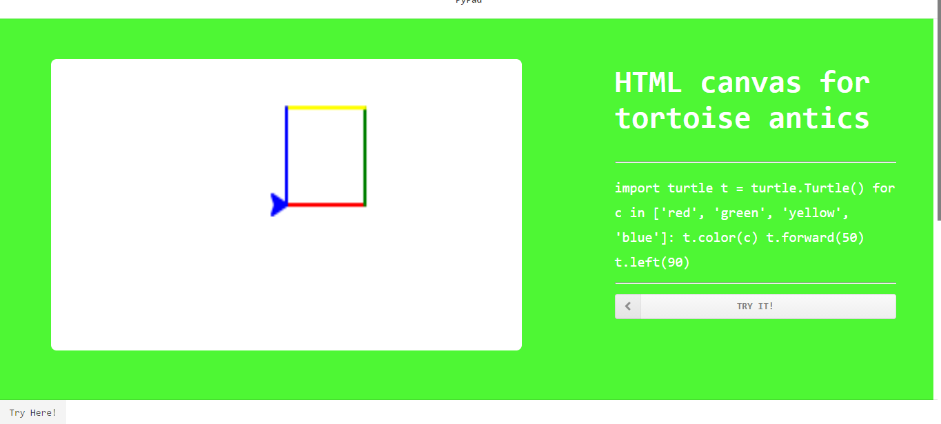
Landing Page Section 2

Slide 6
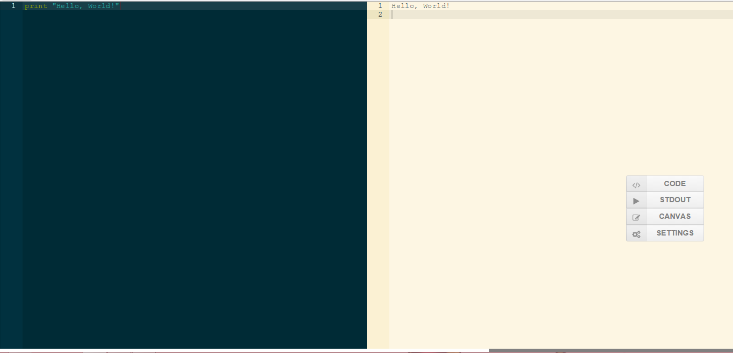
STDIN | STDOUT

Slide 7
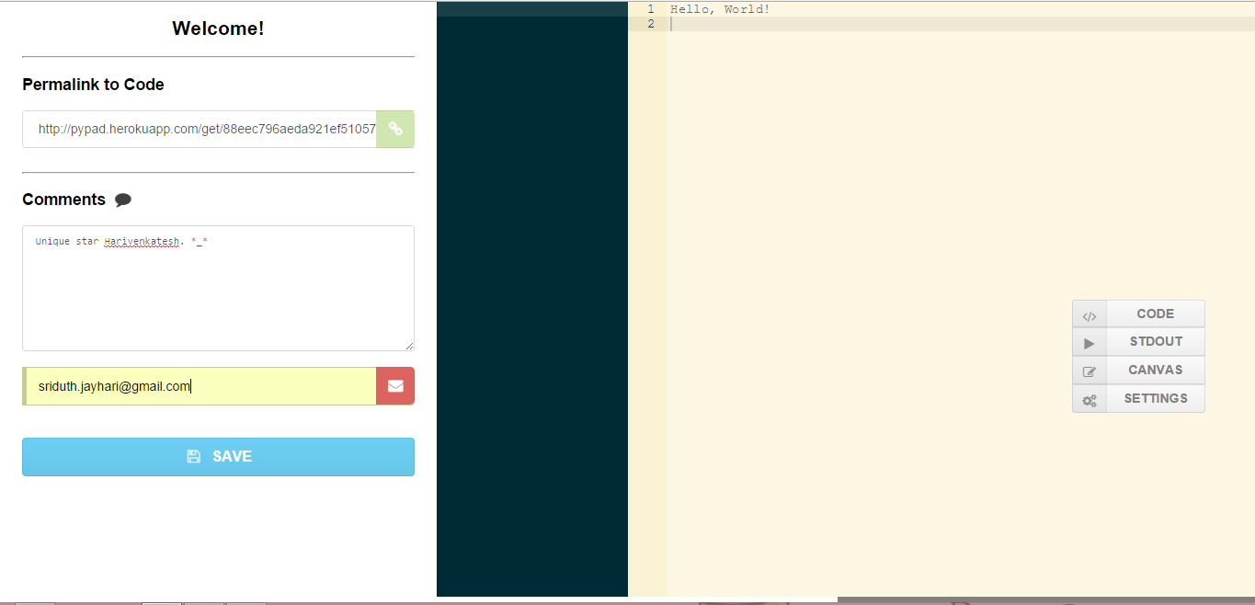
Settings Menu

