Slide 1
CS7015 (Deep Learning) : Lecture 7
Autoencoders and relation to PCA, Regularization in autoencoders, Denoising autoencoders, Sparse autoencoders, Contractive autoencoders
Mitesh M. Khapra
Department of Computer Science and Engineering Indian Institute of Technology Madras
CS7015 (Deep Learning) : Lecture 7

Slide 2
Module 7.1: Introduction to Autoencoders
CS7015 (Deep Learning) : Lecture 7

Slide 3






xˆ_{i}
_{W} ∗
h
W
x_{i}
3/1
CS7015 (Deep Learning) : Lecture 7

Slide 4
An autoencoder is a special type of feed forward neural network which does the following
xˆ_{i}
_{W} ∗
h
W
x_{i}
3/1
CS7015 (Deep Learning) : Lecture 7

Slide 5
An autoencoder is a special type of feed forward neural network which does the following
xˆ_{i}
_{W} ∗
Encodes its input x into a hidden
i
h
representation h
W
x_{i}
3/1
CS7015 (Deep Learning) : Lecture 7

Slide 6
An autoencoder is a special type of feed forward neural network which does the following
xˆ_{i}
_{W} ∗
Encodes its input x into a hidden
i
h
representation h
W
x_{i}
h = g(W x_{i} + b)
3/1
CS7015 (Deep Learning) : Lecture 7

Slide 7
An autoencoder is a special type of feed forward neural network which does the following
xˆ_{i}
_{W} ∗
Encodes its input x into a hidden
i
h
representation h
Decodes the input again from this hidden representation
W
x_{i}
h = g(W x_{i} + b)
3/1
CS7015 (Deep Learning) : Lecture 7

Slide 8
An autoencoder is a special type of feed forward neural network which does the following
xˆ_{i}
_{W} ∗
Encodes its input x into a hidden
i
h
representation h
Decodes the input again from this hidden representation
W
x_{i}
h = g(W x_{i} + b)
xˆ_{i} = f (W ∗h + c)
3/1
CS7015 (Deep Learning) : Lecture 7

Slide 9
An autoencoder is a special type of feed forward neural network which does the following
xˆ_{i}
_{W} ∗
Encodes its input x into a hidden
i
h
representation h
Decodes the input again from this hidden representation
The model is trained to minimize a certain loss function which will ensure that xˆ_{i} is close to x_{i} (we will see some such loss functions soon)
W
x_{i}
h = g(W x_{i} + b)
xˆ_{i} = f (W ∗h + c)
3/1
CS7015 (Deep Learning) : Lecture 7

Slide 10




xˆ_{i}
_{W} ∗
h
W
x_{i}
h = g(W x_{i} + b)
xˆ_{i} = f (W ∗h + c)
4/1
CS7015 (Deep Learning) : Lecture 7

Slide 11
Let us consider the case where dim(h) < dim(x_{i})
xˆ_{i}
_{W} ∗
h
W
x_{i}
h = g(W x_{i} + b)
xˆ_{i} = f (W ∗h + c)
4/1
CS7015 (Deep Learning) : Lecture 7

Slide 12
Let us consider the case where dim(h) < dim(x_{i})
If we are still able to reconstruct xˆ_{i} perfectly from h, then what does it say about h?
xˆ_{i}
_{W} ∗
h
W
x_{i}
h = g(W x_{i} + b)
xˆ_{i} = f (W ∗h + c)
4/1
CS7015 (Deep Learning) : Lecture 7

Slide 13
Let us consider the case where dim(h) < dim(x_{i})
If we are still able to reconstruct xˆ_{i} perfectly from h, then what does it say about h?
h is a loss-free encoding of x_{i}. It cap- tures all the important characteristics of x_{i}
xˆ_{i}
_{W} ∗
h
W
x_{i}
h = g(W x_{i} + b)
xˆ_{i} = f (W ∗h + c)
4/1
CS7015 (Deep Learning) : Lecture 7

Slide 14
Let us consider the case where dim(h) < dim(x_{i})
If we are still able to reconstruct xˆ_{i} perfectly from h, then what does it say about h?
h is a loss-free encoding of x_{i}. It cap- tures all the important characteristics of x_{i}
Do you see an analogy with PCA?
xˆ_{i}
_{W} ∗
h
W
x_{i}
h = g(W x_{i} + b)
xˆ_{i} = f (W ∗h + c)
4/1
CS7015 (Deep Learning) : Lecture 7

Slide 15
Let us consider the case where dim(h) < dim(x_{i})
xˆ_{i}
_{W} ∗
If we are still able to reconstruct xˆ_{i} perfectly from h, then what does it say about h?
h is a loss-free encoding of x_{i}. It cap- tures all the important characteristics of x_{i}
Do you see an analogy with PCA?
h
W
x_{i}
h = g(W x_{i} + b)
xˆ_{i} = f (W ∗h + c)
An autoencoder where dim(h) < dim(x_{i}) is called an under complete autoencoder
4/1
CS7015 (Deep Learning) : Lecture 7

Slide 16
xˆ_{i}
_{W} ∗
h
W
x_{i}
h = g(W x_{i} + b)
xˆ_{i} = f (W ∗h + c)
5/1
CS7015 (Deep Learning) : Lecture 7

Slide 17
Let us consider the case when dim(h) ≥ dim(x_{i})
xˆ_{i}
_{W} ∗
h
W
x_{i}
h = g(W x_{i} + b)
xˆ_{i} = f (W ∗h + c)
5/1
CS7015 (Deep Learning) : Lecture 7

Slide 18
Let us consider the case when dim(h) ≥ dim(x_{i})
In such a case the autoencoder could learn a trivial encoding by simply copying x_{i} into h and then copying h into xˆ_{i}
xˆ_{i}
_{W} ∗
h
W
x_{i}
h = g(W x_{i} + b)
xˆ_{i} = f (W ∗h + c)
5/1
CS7015 (Deep Learning) : Lecture 7

Slide 19


Let us consider the case when dim(h) ≥ dim(x_{i})
In such a case the autoencoder could learn a trivial encoding by simply copying x_{i} into h and then copying h into xˆ_{i}
xˆ_{i}
_{W} ∗
h
W
x_{i}
h = g(W x_{i} + b)
xˆ_{i} = f (W ∗h + c)
5/1
CS7015 (Deep Learning) : Lecture 7

Slide 20
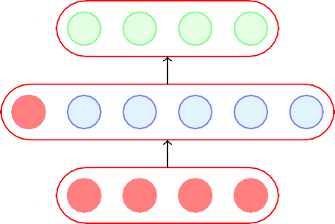
Let us consider the case when dim(h) ≥ dim(x_{i})
In such a case the autoencoder could learn a trivial encoding by simply copying x_{i} into h and then copying h into xˆ_{i}
xˆ_{i}
_{W} ∗
h
W
x_{i}
h = g(W x_{i} + b)
xˆ_{i} = f (W ∗h + c)
5/1
CS7015 (Deep Learning) : Lecture 7

Slide 21
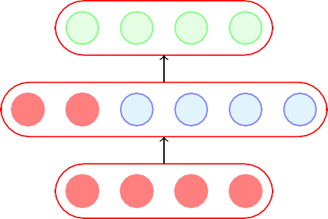
Let us consider the case when dim(h) ≥ dim(x_{i})
In such a case the autoencoder could learn a trivial encoding by simply copying x_{i} into h and then copying h into xˆ_{i}
xˆ_{i}
_{W} ∗
h
W
x_{i}
h = g(W x_{i} + b)
xˆ_{i} = f (W ∗h + c)
5/1
CS7015 (Deep Learning) : Lecture 7

Slide 22
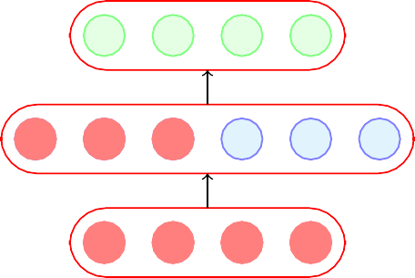
Let us consider the case when dim(h) ≥ dim(x_{i})
In such a case the autoencoder could learn a trivial encoding by simply copying x_{i} into h and then copying h into xˆ_{i}
xˆ_{i}
_{W} ∗
h
W
x_{i}
h = g(W x_{i} + b)
xˆ_{i} = f (W ∗h + c)
5/1
CS7015 (Deep Learning) : Lecture 7

Slide 23
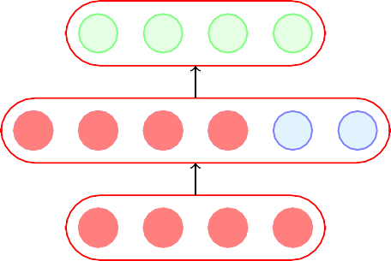
Let us consider the case when dim(h) ≥ dim(x_{i})
In such a case the autoencoder could learn a trivial encoding by simply copying x_{i} into h and then copying h into xˆ_{i}
xˆ_{i}
_{W} ∗
h
W
x_{i}
h = g(W x_{i} + b)
xˆ_{i} = f (W ∗h + c)
5/1
CS7015 (Deep Learning) : Lecture 7

Slide 24
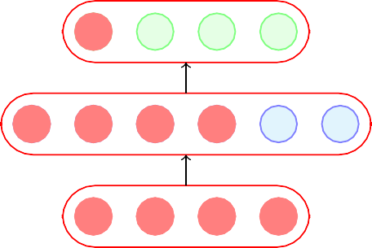
Let us consider the case when dim(h) ≥ dim(x_{i})
In such a case the autoencoder could learn a trivial encoding by simply copying x_{i} into h and then copying h into xˆ_{i}
xˆ_{i}
_{W} ∗
h
W
x_{i}
h = g(W x_{i} + b)
xˆ_{i} = f (W ∗h + c)
5/1
CS7015 (Deep Learning) : Lecture 7

Slide 25
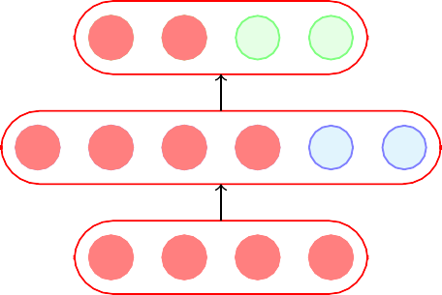
Let us consider the case when dim(h) ≥ dim(x_{i})
In such a case the autoencoder could learn a trivial encoding by simply copying x_{i} into h and then copying h into xˆ_{i}
xˆ_{i}
_{W} ∗
h
W
x_{i}
h = g(W x_{i} + b)
xˆ_{i} = f (W ∗h + c)
5/1
CS7015 (Deep Learning) : Lecture 7

Slide 26
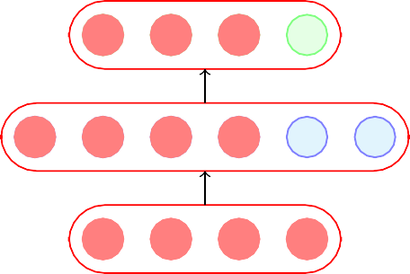
Let us consider the case when dim(h) ≥ dim(x_{i})
In such a case the autoencoder could learn a trivial encoding by simply copying x_{i} into h and then copying h into xˆ_{i}
xˆ_{i}
_{W} ∗
h
W
x_{i}
h = g(W x_{i} + b)
xˆ_{i} = f (W ∗h + c)
5/1
CS7015 (Deep Learning) : Lecture 7

Slide 27
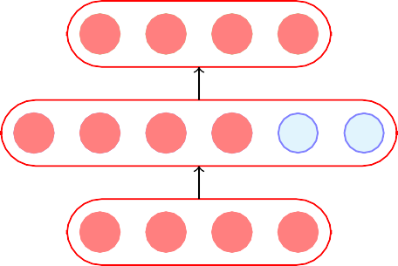
Let us consider the case when dim(h) ≥ dim(x_{i})
In such a case the autoencoder could learn a trivial encoding by simply copying x_{i} into h and then copying h into xˆ_{i}
xˆ_{i}
_{W} ∗
h
W
x_{i}
h = g(W x_{i} + b)
xˆ_{i} = f (W ∗h + c)
5/1
CS7015 (Deep Learning) : Lecture 7

Slide 28
Let us consider the case when dim(h) ≥ dim(x_{i})
In such a case the autoencoder could learn a trivial encoding by simply copying x_{i} into h and then copying h into xˆ_{i}
Such an identity encoding is useless in practice as it does not really tell us anything about the important char- acteristics of the data
xˆ_{i}
_{W} ∗
h
W
x_{i}
h = g(W x_{i} + b)
xˆ_{i} = f (W ∗h + c)
5/1
CS7015 (Deep Learning) : Lecture 7

Slide 29
Let us consider the case when dim(h) ≥ dim(x_{i})
xˆ_{i}
_{W} ∗
In such a case the autoencoder could learn a trivial encoding by simply copying x_{i} into h and then copying h into xˆ_{i}
Such an identity encoding is useless in practice as it does not really tell us anything about the important char- acteristics of the data
h
W
x_{i}
h = g(W x_{i} + b)
xˆ_{i} = f (W ∗h + c)
An autoencoder where dim(h) ≥ dim(x_{i}) is called an over complete autoencoder
5/1
CS7015 (Deep Learning) : Lecture 7

Slide 30
The Road Ahead
6/1
CS7015 (Deep Learning) : Lecture 7

Slide 31
The Road Ahead
Choice of f (x_{i}) and g(x_{i})
6/1
CS7015 (Deep Learning) : Lecture 7

Slide 32
The Road Ahead
Choice of f (x_{i}) and g(x_{i}) Choice of loss function
6/1
CS7015 (Deep Learning) : Lecture 7

Slide 33
The Road Ahead
Choice of f (x_{i}) and g(x_{i}) Choice of loss function
CS7015 (Deep Learning) : Lecture 7

Slide 34
xˆi = f (W ∗h + c)
_{W} ∗
h = g(W xi + b)
W
x_{i}
0
1
1
0
1 (binary inputs)
8/1
CS7015 (Deep Learning) : Lecture 7

Slide 35
Suppose all our inputs are binary
xˆi = f (W ∗h + c)
(each x ∈ {0, 1})
ij
_{W} ∗
h = g(W xi + b)
W
x_{i}
0
1
1
0
1 (binary inputs)
8/1
CS7015 (Deep Learning) : Lecture 7

Slide 36
Suppose all our inputs are binary
xˆi = f (W ∗h + c)
(each x ∈ {0, 1})
ij
_{W} ∗
Which of the following functions would be most apt for the decoder?
h = g(W xi + b)
W
x_{i}
0
1
1
0
1 (binary inputs)
8/1
CS7015 (Deep Learning) : Lecture 7

Slide 37
Suppose all our inputs are binary
xˆi = f (W ∗h + c)
(each x ∈ {0, 1})
ij
_{W} ∗
Which of the following functions would be most apt for the decoder?
h = g(W xi + b)
xˆ_{i} = tanh(W ∗h + c)
W
x_{i}
0
1
1
0
1 (binary inputs)
8/1
CS7015 (Deep Learning) : Lecture 7

Slide 38
Suppose all our inputs are binary
xˆi = f (W ∗h + c)
(each x ∈ {0, 1})
ij
_{W} ∗
Which of the following functions would be most apt for the decoder?
h = g(W xi + b)
xˆ_{i} = tanh(W ∗h + c)
xˆ_{i} = W ∗h + c
W
x_{i}
0
1
1
0
1 (binary inputs)
8/1
CS7015 (Deep Learning) : Lecture 7

Slide 39
Suppose all our inputs are binary
xˆi = f (W ∗h + c)
(each x ∈ {0, 1})
ij
_{W} ∗
Which of the following functions would be most apt for the decoder?
h = g(W xi + b)
xˆ_{i} = tanh(W ∗h + c)
xˆ_{i} = W ∗h + c
xˆ_{i} = logistic(W ∗h + c)
W
x_{i}
0
1
1
0
1 (binary inputs)
8/1
CS7015 (Deep Learning) : Lecture 7

Slide 40
Suppose all our inputs are binary
xˆi = f (W ∗h + c)
(each x ∈ {0, 1})
ij
_{W} ∗
Which of the following functions would be most apt for the decoder?
h = g(W xi + b)
xˆ_{i} = tanh(W ∗h + c)
xˆ_{i} = W ∗h + c
xˆ_{i} = logistic(W ∗h + c)
Logistic as it naturally restricts all outputs to be between 0 and 1
W
x_{i}
0
1
1
0
1 (binary inputs)
8/1
CS7015 (Deep Learning) : Lecture 7

Slide 41
Suppose all our inputs are binary
xˆi = f (W ∗h + c)
(each x ∈ {0, 1})
ij
_{W} ∗
Which of the following functions would be most apt for the decoder?
h = g(W xi + b)
xˆ_{i} = tanh(W ∗h + c)
xˆ_{i} = W ∗h + c
xˆ_{i} = logistic(W ∗h + c)
Logistic as it naturally restricts all outputs to be between 0 and 1
W
x_{i}
0
1
1
0
1 (binary inputs)
g is typically chosen as the sigmoid function
8/1
CS7015 (Deep Learning) : Lecture 7

Slide 42
xˆi = f (W ∗h + c)
_{W} ∗
h = g(W xi + b)
W
x_{i}
0.25 0.5 1.25 3.5 4.5
(real valued inputs)
9/1
CS7015 (Deep Learning) : Lecture 7

Slide 43
Suppose all our inputs are real (each
xˆi = f (W ∗h + c)
x ∈ R)
ij
_{W} ∗
h = g(W xi + b)
W
x_{i}
0.25 0.5 1.25 3.5 4.5
(real valued inputs)
9/1
CS7015 (Deep Learning) : Lecture 7

Slide 44
Suppose all our inputs are real (each
xˆi = f (W ∗h + c)
x ∈ R)
ij
_{W} ∗
Which of the following functions would be most apt for the decoder?
h = g(W xi + b)
W
x_{i}
0.25 0.5 1.25 3.5 4.5
(real valued inputs)
9/1
CS7015 (Deep Learning) : Lecture 7

Slide 45
Suppose all our inputs are real (each
xˆi = f (W ∗h + c)
x ∈ R)
ij
_{W} ∗
Which of the following functions would be most apt for the decoder?
h = g(W xi + b)
xˆ_{i} = tanh(W ∗h + c)
W
x_{i}
0.25 0.5 1.25 3.5 4.5
(real valued inputs)
9/1
CS7015 (Deep Learning) : Lecture 7

Slide 46
Suppose all our inputs are real (each
xˆi = f (W ∗h + c)
x ∈ R)
ij
_{W} ∗
Which of the following functions would be most apt for the decoder?
h = g(W xi + b)
xˆ_{i} = tanh(W ∗h + c)
xˆ_{i} = W ∗h + c
W
x_{i}
0.25 0.5 1.25 3.5 4.5
(real valued inputs)
9/1
CS7015 (Deep Learning) : Lecture 7

Slide 47
Suppose all our inputs are real (each
xˆi = f (W ∗h + c)
x ∈ R)
ij
_{W} ∗
Which of the following functions would be most apt for the decoder?
h = g(W xi + b)
xˆ_{i} = tanh(W ∗h + c)
xˆ_{i} = W ∗h + c
W
x_{i}
xˆ = logistic(W ∗h + c)
i
0.25 0.5 1.25 3.5 4.5
(real valued inputs)
9/1
CS7015 (Deep Learning) : Lecture 7

Slide 48
Suppose all our inputs are real (each
xˆi = f (W ∗h + c)
x ∈ R)
ij
_{W} ∗
Which of the following functions would be most apt for the decoder?
h = g(W xi + b)
xˆ_{i} = tanh(W ∗h + c)
xˆ_{i} = W ∗h + c
W
x_{i}
xˆ = logistic(W ∗h + c)
i
0.25 0.5 1.25 3.5 4.5
(real valued inputs)
What will logistic and tanh do?
9/1
CS7015 (Deep Learning) : Lecture 7

Slide 49
Suppose all our inputs are real (each
xˆi = f (W ∗h + c)
x ∈ R)
ij
_{W} ∗
Which of the following functions would be most apt for the decoder?
h = g(W xi + b)
xˆ_{i} = tanh(W ∗h + c)
xˆ_{i} = W ∗h + c
W
x_{i}
xˆ = logistic(W ∗h + c)
i
0.25 0.5 1.25 3.5 4.5
(real valued inputs)
What will logistic and tanh do?
They will restrict the reconstruc- ted xˆ_{i} to lie between [0,1] or [-1,1] whereas we want xˆ_{i} ∈ R^{n}
9/1
CS7015 (Deep Learning) : Lecture 7

Slide 50
Suppose all our inputs are real (each
xˆi = f (W ∗h + c)
x ∈ R)
ij
_{W} ∗
Which of the following functions would be most apt for the decoder?
xˆ_{i} = tanh(W ∗h + c)
xˆ_{i} = W ∗h + c
xˆ = logistic(W ∗h + c)
What will logistic and tanh do?
They will restrict the reconstruc- ted xˆ_{i} to lie between [0,1] or [-1,1] whereas we want xˆ_{i} ∈ R^{n}
h = g(W xi + b)
W
x_{i}
i
0.25 0.5 1.25 3.5 4.5
(real valued inputs)
Again, g is typically chosen as the sigmoid function
9/1
CS7015 (Deep Learning) : Lecture 7

Slide 51
The Road Ahead
Choice of f (x_{i}) and g(x_{i}) Choice of loss function
CS7015 (Deep Learning) : Lecture 7

Slide 52


xˆi
_{W} ∗
h
W
xi
h = g(W xi + b)
xˆi = f (W ∗h + c)
11/1
CS7015 (Deep Learning) : Lecture 7

Slide 53
Consider the case when the inputs are real valued
xˆi
_{W} ∗
h
W
xi
h = g(W xi + b)
xˆi = f (W ∗h + c)
11/1
CS7015 (Deep Learning) : Lecture 7

Slide 54
Consider the case when the inputs are real valued
The objective of the autoencoder is to recon-
xˆi
_{W} ∗
struct xˆi to be as close to xi as possible
h
W
xi
h = g(W xi + b)
xˆi = f (W ∗h + c)
11/1
CS7015 (Deep Learning) : Lecture 7

Slide 55
Consider the case when the inputs are real valued
xˆi
_{W} ∗
The objective of the autoencoder is to recon-
struct xˆi to be as close to xi as possible
This can be formalized using the following objective function:
h
W
Σ Σ
i=1 j=1
1
m n
min
(xˆ − x )²
x
W,W ∗ ,c,b m
ij ij
i
h = g(W xi + b)
xˆi = f (W ∗h + c)
11/1
CS7015 (Deep Learning) : Lecture 7

Slide 56
Consider the case when the inputs are real valued
xˆi
_{W} ∗
The objective of the autoencoder is to recon-
struct xˆi to be as close to xi as possible
This can be formalized using the following objective function:
h
W
Σ Σ
1
m n
min (xˆ − x )²
x
W,W ∗ ,c,b m
ij ij
i
i=1 j=1 m
1
Σ
i=1
i.e., min
T
h = g(W x + b)
(xˆ − x ) (xˆ − x )
i
W,W ∗ ,c,b m
i i i i
xˆi = f (W ∗h + c)
11/1
CS7015 (Deep Learning) : Lecture 7

Slide 57
Consider the case when the inputs are real valued
xˆi
_{W} ∗
The objective of the autoencoder is to recon-
struct xˆi to be as close to xi as possible
This can be formalized using the following objective function:
h
W
Σ Σ
1
m n
min (xˆ − x )²
x
W,W ∗ ,c,b m
ij ij
i
i=1 j=1 m
1
Σ
i.e., min
T
h = g(W x + b)
(xˆ − x ) (xˆ − x )
i
W,W ∗ ,c,b m
i i i i
xˆi = f (W ∗h + c)
i=1
We can then train the autoencoder just like a regular feedforward network using back- propagation
11/1
CS7015 (Deep Learning) : Lecture 7

Slide 58
Consider the case when the inputs are real valued
xˆi
_{W} ∗
The objective of the autoencoder is to recon-
struct xˆi to be as close to xi as possible
This can be formalized using the following objective function:
h
W
Σ Σ
1
m n
min (xˆ − x )²
x
W,W ∗ ,c,b m
ij ij
i
i=1 j=1 m
1
Σ
i.e., min
T
h = g(W x + b)
(xˆ − x ) (xˆ − x )
i
W,W ∗ ,c,b m
i i i i
xˆi = f (W ∗h + c)
i=1
We can then train the autoencoder just like a regular feedforward network using back- propagation
All we need is a formula for ^{∂L (θ)} and ^{∂L (θ)}
which we will see now
∂W ∗ ∂W
11/1
CS7015 (Deep Learning) : Lecture 7

Slide 59
T
L (θ) = (xˆ_{i} − x_{i}) (xˆ_{i} − x_{i})
h2 = xˆi
a₂
_{W} ∗
h1
a₁
W
h0 = xi
12/1
CS7015 (Deep Learning) : Lecture 7

Slide 60
L (θ) = (xˆ_{i} − x_{i}) (xˆ_{i} − x_{i})
T
h2 = xˆi
a₂
_{W} ∗
h1
a₁
W
h0 = xi
Note that the loss function is shown for only one training example.
12/1
CS7015 (Deep Learning) : Lecture 7

Slide 61
∂L (θ) ₌ ∂L (θ)
∂W ∗ ∂h₂
T
L (θ) = (xˆ_{i} − x_{i}) (xˆ_{i} − x_{i})
∂h₂ ∂a₂
∂a₂ ∂W ∗
h = xˆ
2 i
a₂
_{W} ∗
h1
a₁
W
h0 = xi
Note that the loss function is shown for only one training example.
12/1
CS7015 (Deep Learning) : Lecture 7

Slide 62
∂L (θ) ₌ ∂L (θ)
∂W ∗ ∂h₂
T
L (θ) = (xˆ_{i} − x_{i}) (xˆ_{i} − x_{i})
∂h₂ ∂a₂
∂a₂ ∂W ∗
h = xˆ
2 i
a₂
∂L (θ) ₌ ∂L (θ)
∂W ∂h₂
∂h₂ ∂a₂ ∂h₁ ∂a₁
∂a₂ ∂h₁ ∂a₁ ∂W
_{W} ∗
h1
a₁
W
h0 = xi
Note that the loss function is shown for only one training example.
12/1
CS7015 (Deep Learning) : Lecture 7

Slide 63
∂L (θ) ₌ ∂L (θ)
∂W ∗ ∂h₂
T
L (θ) = (xˆ_{i} − x_{i}) (xˆ_{i} − x_{i})
∂h₂ ∂a₂
∂a₂ ∂W ∗
h = xˆ
2 i
a₂
∂L (θ) ₌ ∂L (θ)
∂W ∂h₂
∂h₂ ∂a₂ ∂h₁ ∂a₁
∂a₂ ∂h₁ ∂a₁ ∂W
_{W} ∗
h1
a₁
We have already seen how to calculate the expres-
sion in the boxes when we learnt backpropagation
W
h0 = xi
Note that the loss function is shown for only one training example.
12/1
CS7015 (Deep Learning) : Lecture 7

Slide 64
∂L (θ) ₌ ∂L (θ)
∂W ∗ ∂h₂
T
L (θ) = (xˆ_{i} − x_{i}) (xˆ_{i} − x_{i})
∂h₂ ∂a₂
∂a₂ ∂W ∗
h = xˆ
2 i
a₂
∂L (θ) ₌ ∂L (θ)
∂W ∂h₂
∂h₂ ∂a₂ ∂h₁ ∂a₁
∂a₂ ∂h₁ ∂a₁ ∂W
_{W} ∗
h1
a₁
We have already seen how to calculate the expres-
sion in the boxes when we learnt backpropagation
W
∂L (θ) ₌ ∂L (θ)
∂h₂ ∂xˆ_{i}
h0 = xi
Note that the loss function is shown for only one training example.
12/1
CS7015 (Deep Learning) : Lecture 7

Slide 65
∂L (θ) ₌ ∂L (θ)
∂W ∗ ∂h₂
T
L (θ) = (xˆ_{i} − x_{i}) (xˆ_{i} − x_{i})
∂h₂ ∂a₂
∂a₂ ∂W ∗
h = xˆ
2 i
a₂
∂L (θ) ₌ ∂L (θ)
∂W ∂h₂
∂h₂ ∂a₂ ∂h₁ ∂a₁
∂a₂ ∂h₁ ∂a₁ ∂W
_{W} ∗
h1
a₁
We have already seen how to calculate the expres-
sion in the boxes when we learnt backpropagation
W
h0 = xi
∂L (θ) ₌ ∂L (θ)
∂h₂
∂xˆ_{i}
T
= ∇_{xˆi} {(xˆ_{i} − x_{i}) (xˆ_{i} − x_{i})}
Note that the loss function is shown for only one training example.
12/1
CS7015 (Deep Learning) : Lecture 7

Slide 66
∂L (θ) ₌ ∂L (θ)
∂W ∗ ∂h₂
T
L (θ) = (xˆ_{i} − x_{i}) (xˆ_{i} − x_{i})
∂h₂ ∂a₂
∂a₂ ∂W ∗
h = xˆ
2 i
a₂
∂L (θ) ₌ ∂L (θ)
∂W ∂h₂
∂h₂ ∂a₂ ∂h₁ ∂a₁
∂a₂ ∂h₁ ∂a₁ ∂W
_{W} ∗
h1
a₁
We have already seen how to calculate the expres-
sion in the boxes when we learnt backpropagation
W
∂L (θ) ₌ ∂L (θ)
∂h₂ ∂xˆ_{i}
h0 = xi
T
= ∇ {(xˆ − x ) (xˆ − x )}
xˆ i i i i
i
Note that the loss function is shown for only one training example.
= 2(xˆ_{i} − x_{i})
12/1
CS7015 (Deep Learning) : Lecture 7

Slide 67
xˆi = f (W ∗h + c)
_{W} ∗
h = g(W xi + b)
W
x_{i}
0
1
1
0 1 (binary inputs)
13/1
CS7015 (Deep Learning) : Lecture 7

Slide 68
Consider the case when the inputs are binary
xˆi = f (W ∗h + c)
_{W} ∗
h = g(W xi + b)
W
x_{i}
0
1
1
0 1 (binary inputs)
13/1
CS7015 (Deep Learning) : Lecture 7

Slide 69
Consider the case when the inputs are binary
xˆi = f (W ∗h + c)
_{W} ∗
We use a sigmoid decoder which will produce outputs between 0 and 1, and can be interpreted as probabilities.
h = g(W xi + b)
W
x_{i}
0
1
1
0 1 (binary inputs)
13/1
CS7015 (Deep Learning) : Lecture 7

Slide 70
Consider the case when the inputs are binary
xˆi = f (W ∗h + c)
_{W} ∗
We use a sigmoid decoder which will produce outputs between 0 and 1, and can be interpreted as probabilities.
For a single n-dimensional i^{th} input we can use the following loss function
n
h = g(W xi + b)
W
x
i
Σ
min{− (x_{ij} log xˆ_{ij} + (1 − x_{ij} ) log(1 − xˆ_{ij} ))}
0
1
1
0 1 (binary inputs)
j=1
13/1
CS7015 (Deep Learning) : Lecture 7

Slide 71
Consider the case when the inputs are binary
xˆi = f (W ∗h + c)
_{W} ∗
We use a sigmoid decoder which will produce outputs between 0 and 1, and can be interpreted as probabilities.
For a single n-dimensional i^{th} input we can use the following loss function
n
h = g(W xi + b)
W
x
i
Σ
min{− (x_{ij} log xˆ_{ij} + (1 − x_{ij} ) log(1 − xˆ_{ij} ))}
0 1 1 0 1 (binary inputs)
What value of xˆ_{ij} will minimize this function?
j=1
13/1
CS7015 (Deep Learning) : Lecture 7

Slide 72
Consider the case when the inputs are binary
xˆi = f (W ∗h + c)
_{W} ∗
We use a sigmoid decoder which will produce outputs between 0 and 1, and can be interpreted as probabilities.
For a single n-dimensional i^{th} input we can use the following loss function
n
h = g(W xi + b)
W
x
i
Σ
min{− (x_{ij} log xˆ_{ij} + (1 − x_{ij} ) log(1 − xˆ_{ij} ))}
0 1 1 0 1 (binary inputs)
What value of xˆ_{ij} will minimize this function?
If x_{ij} = 1 ?
j=1
13/1
CS7015 (Deep Learning) : Lecture 7

Slide 73
Consider the case when the inputs are binary
xˆi = f (W ∗h + c)
_{W} ∗
We use a sigmoid decoder which will produce outputs between 0 and 1, and can be interpreted as probabilities.
For a single n-dimensional i^{th} input we can use the following loss function
n
h = g(W xi + b)
W
x
i
Σ
min{− (x_{ij} log xˆ_{ij} + (1 − x_{ij} ) log(1 − xˆ_{ij} ))}
0 1 1 0 1 (binary inputs)
What value of xˆ_{ij} will minimize this function?
If x_{ij} = 1 ?
If x_{ij} = 0 ?
j=1
13/1
CS7015 (Deep Learning) : Lecture 7

Slide 74
Consider the case when the inputs are binary
xˆi = f (W ∗h + c)
_{W} ∗
We use a sigmoid decoder which will produce outputs between 0 and 1, and can be interpreted as probabilities.
For a single n-dimensional i^{th} input we can use the following loss function
n
h = g(W xi + b)
W
x
i
Σ
min{− (x_{ij} log xˆ_{ij} + (1 − x_{ij} ) log(1 − xˆ_{ij} ))}
0 1 1 0 1 (binary inputs)
j=1
Again we need is a formula for ^{∂L (θ)} and
What value of xˆ will minimize this
∂W ∗
ij
^{∂L (θ)} to use backpropagation
function?
If x_{ij} = 1 ?
If x_{ij} = 0 ?
∂W
13/1
CS7015 (Deep Learning) : Lecture 7

Slide 75
Consider the case when the inputs are binary
xˆi = f (W ∗h + c)
_{W} ∗
We use a sigmoid decoder which will produce outputs between 0 and 1, and can be interpreted as probabilities.
For a single n-dimensional i^{th} input we can use the following loss function
n
h = g(W xi + b)
W
x
i
Σ
min{− (x_{ij} log xˆ_{ij} + (1 − x_{ij} ) log(1 − xˆ_{ij} ))}
0 1 1 0 1 (binary inputs)
j=1
Again we need is a formula for ^{∂L (θ)} and
What value of xˆ will minimize this
∂W ∗
ij
^{∂L (θ)} to use backpropagation
function?
If x_{ij} = 1 ?
If x_{ij} = 0 ?
Indeed the above function will be minimized when xˆ_{ij} = x_{ij} !
∂W
13/1
CS7015 (Deep Learning) : Lecture 7

Slide 76
Σ
n
L (θ) = −
(xij log xˆij + (1 − xij ) log(1 − xˆij ))
j=1
^{h}2 ^{= xˆ} i
a₂
_{W} ∗
h1
a₁
W
^{h}0 ^{= x} i
14/1
CS7015 (Deep Learning) : Lecture 7

Slide 77
∂L (θ) ₌ ∂L (θ) ∂h₂ ∂a₂
∂W ∗
Σ
n
L (θ) = − (xij log xˆij + (1 − xij ) log(1 − xˆij ))
∂W ∗ ∂h ∂a
j=1
2 2
^{h}2 ^{= xˆ} i
a₂
_{W} ∗
h1
a₁
W
^{h}0 ^{= x} i
14/1
CS7015 (Deep Learning) : Lecture 7

Slide 78
∂L (θ) ₌ ∂L (θ) ∂h₂ ∂a₂
∂W ∗
Σ
n
L (θ) = − (xij log xˆij + (1 − xij ) log(1 − xˆij ))
∂W ∗ ∂h ∂a
j=1
2 2
^{h}2 ^{= xˆ} i
∂L (θ) ∂L (θ) ∂h₂
∂W ∂h₂ ∂a₂
a₂
∂a₂ ∂h₁ ∂a₁
∂h₁ ∂a₁ ∂W
=
_{W} ∗
h1
a₁
W
^{h}0 ^{= x} i
14/1
CS7015 (Deep Learning) : Lecture 7

Slide 79
∂L (θ) ₌ ∂L (θ) ∂h₂ ∂a₂
∂W ∗
Σ
n
L (θ) = − (xij log xˆij + (1 − xij ) log(1 − xˆij ))
∂W ∗ ∂h ∂a
j=1
2 2
^{h}2 ^{= xˆ} i
∂L (θ) ∂L (θ) ∂h₂
∂W ∂h₂ ∂a₂
a₂
∂a₂ ∂h₁ ∂a₁
∂h₁ ∂a₁ ∂W
=
_{W} ∗
h
We have already seen how to calculate the expressions in the square boxes when we learnt BP
1
a₁
W
^{h}0 ^{= x} i
14/1
CS7015 (Deep Learning) : Lecture 7

Slide 80
∂L (θ) ₌ ∂L (θ) ∂h₂ ∂a₂
∂W ∗
Σ
n
L (θ) = − (xij log xˆij + (1 − xij ) log(1 − xˆij ))
∂W ∗ ∂h ∂a
j=1
2 2
^{h}2 ^{= xˆ} i
∂L (θ) ∂L (θ) ∂h₂
∂W ∂h₂ ∂a₂
a₂
∂a₂ ∂h₁ ∂a₁
∂h₁ ∂a₁ ∂W
=
_{W} ∗
h
We have already seen how to calculate the expressions in the square boxes when we learnt BP
The first two terms on RHS can be computed as:
1
a₁
W
^{h}0 ^{= x} i
∂L (θ) x 1 − x
∂h_{2j}
= − +
ij ij
xˆ_{ij} 1 − xˆ_{ij}
^{∂h2j} = σ(a )(1 − σ(a ))
∂a_{2j}
2j 2j
14/1
CS7015 (Deep Learning) : Lecture 7

Slide 81
∂L (θ) ₌ ∂L (θ) ∂h₂ ∂a₂
∂W ∗
Σ
n
L (θ) = − (xij log xˆij + (1 − xij ) log(1 − xˆij ))
∂W ∗ ∂h ∂a
j=1
2 2
^{h}2 ^{= xˆ} i
∂L (θ) ∂L (θ) ∂h₂
∂W ∂h₂ ∂a₂
a₂
∂a₂ ∂h₁ ∂a₁
∂h₁ ∂a₁ ∂W
=
_{W} ∗
h
We have already seen how to calculate the expressions in the square boxes when we learnt BP
The first two terms on RHS can be computed as:
1
a₁
W
^{h}0 ^{= x} i
∂L (θ) x 1 − x
 
= − +
ij ij
∂L (θ)
∂h21
∂L (θ)
∂h_{2j} xˆ_{ij} 1 − xˆ_{ij}


^{∂h2j} = σ(a )(1 − σ(a ))
∂L (θ)
∂h
∂a_{2j}
2j 2j
=
∂h₂  . 
22

.
∂L (θ)
∂h2n
14/1
CS7015 (Deep Learning) : Lecture 7

Slide 82
Module 7.2: Link between PCA and Autoencoders
CS7015 (Deep Learning) : Lecture 7

Slide 83
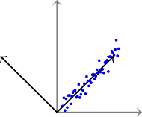
We will now see that the encoder part of an autoencoder is equivalent to PCA if we
xˆ_{i}
PCA
y
h
≡
u₁
u₂
x
x_{i}
P^{T} X^{T} XP = D
16/1
CS7015 (Deep Learning) : Lecture 7

Slide 84
We will now see that the encoder part of an autoencoder is equivalent to PCA if we
use a linear encoder
xˆ_{i}
PCA
y
h
≡
u₁
u₂
x
x_{i}
P^{T} X^{T} XP = D
16/1
CS7015 (Deep Learning) : Lecture 7

Slide 85
We will now see that the encoder part of an autoencoder is equivalent to PCA if we
use a linear encoder use a linear decoder
xˆ_{i}
PCA
y
h
≡
u₁
u₂
x
x_{i}
P^{T} X^{T} XP = D
16/1
CS7015 (Deep Learning) : Lecture 7

Slide 86
We will now see that the encoder part of an autoencoder is equivalent to PCA if we
xˆ_{i}
PCA
y
use a linear encoder use a linear decoder
use squared error loss function
h
≡
u₁
u₂
x
x_{i}
P^{T} X^{T} XP = D
16/1
CS7015 (Deep Learning) : Lecture 7

Slide 87
We will now see that the encoder part of an autoencoder is equivalent to PCA if we
xˆ_{i}
PCA
y
use a linear encoder use a linear decoder
use squared error loss function
h
≡
u₁
u₂
normalize the inputs to
x
!
x_{i}
Σ
P^{T} X^{T} XP = D
1 1
m
xˆ_{ij} = √_{m} x_{ij} − _{m}
xkj
k=1
16/1
CS7015 (Deep Learning) : Lecture 7

Slide 88
First let us consider the implication of normalizing the inputs to
xˆ_{i}
PCA
y
!
m
1 1
Σ
xˆ_{ij} = √_{m} x_{ij} − _{m}
^{x}kj
h
≡
u₁
u₂
k=1
x
x_{i}
P^{T} X^{T} XP = D
17/1
CS7015 (Deep Learning) : Lecture 7

Slide 89
First let us consider the implication of normalizing the inputs to
xˆ_{i}
PCA
y
!
m
1 1
Σ
xˆ_{ij} = √_{m} x_{ij} − _{m}
^{x}kj
h
≡
u₁
u₂
k=1
The operation in the bracket ensures that the data now has 0 mean along each dimension j (we are subtracting the mean)
x
x_{i}
P^{T} X^{T} XP = D
17/1
CS7015 (Deep Learning) : Lecture 7

Slide 90
First let us consider the implication of normalizing the inputs to
xˆ_{i}
PCA
y
!
m
1 1
Σ
xˆ_{ij} = √_{m} x_{ij} − _{m}
^{x}kj
h
≡
u₁
u₂
k=1
The operation in the bracket ensures that the data now has 0 mean along each dimension j (we are subtracting the mean)
′
Let X be this zero mean data mat-
rix then what the above normaliza-
x
x_{i}
P^{T} X^{T} XP = D
1
′
tion gives us is X = X
√
m
17/1
CS7015 (Deep Learning) : Lecture 7

Slide 91
First let us consider the implication of normalizing the inputs to
xˆ_{i}
PCA
y
!
m
1 1
Σ
xˆ_{ij} = √_{m} x_{ij} − _{m}
^{x}kj
h
≡
u₁
u₂
k=1
The operation in the bracket ensures that the data now has 0 mean along each dimension j (we are subtracting the mean)
′
Let X be this zero mean data mat-
rix then what the above normaliza-
x
x_{i}
P^{T} X^{T} XP = D
1
′
tion gives us is X = X
√
m
Now (X)^{T} X = ¹ (X^{r})^{T} X^{r} is the co-
m
variance matrix (recall that covari-
ance matrix plays an important role in PCA)
17/1
CS7015 (Deep Learning) : Lecture 7

Slide 92
xˆ_{i}
PCA
y
h
≡
u₁
u₂
x
x_{i}
P^{T} X^{T} XP = D
18/1
CS7015 (Deep Learning) : Lecture 7

Slide 93
First we will show that if we use lin- ear decoder and a squared error loss function then
xˆ_{i}
PCA
y
h
≡
u₁
u₂
x
x_{i}
P^{T} X^{T} XP = D
18/1
CS7015 (Deep Learning) : Lecture 7

Slide 94
First we will show that if we use lin- ear decoder and a squared error loss function then
The optimal solution to the following objective function
xˆ_{i}
PCA
y
h
≡
u₁
u₂
x
x_{i}
P^{T} X^{T} XP = D
18/1
CS7015 (Deep Learning) : Lecture 7

Slide 95
First we will show that if we use lin- ear decoder and a squared error loss function then
xˆ_{i}
PCA
y
The optimal solution to the following objective function
h
≡
u₁
u₂
m n
x
1
m
Σ Σ
(x − xˆ
₎2
x_{i}
P^{T} X^{T} XP = D
ij
ij
i=1 j=1
18/1
CS7015 (Deep Learning) : Lecture 7

Slide 96
First we will show that if we use lin- ear decoder and a squared error loss function then
xˆ_{i}
PCA
y
The optimal solution to the following objective function
h
≡
u₁
u₂
m n
x
1
m
Σ Σ
(x − xˆ
₎2
x_{i}
P^{T} X^{T} XP = D
ij
ij
i=1 j=1
is obtained when we use a linear en- coder.
18/1
CS7015 (Deep Learning) : Lecture 7

Slide 97
m n
Σ Σ
min
θ
2
(x_{ij} − xˆ_{ij} )
(1)
i=1 j=1
19/1
CS7015 (Deep Learning) : Lecture 7

Slide 98
m n
Σ Σ
min
θ
2
(x_{ij} − xˆ_{ij} )
(1)
i=1 j=1
This is equivalent to
19/1
CS7015 (Deep Learning) : Lecture 7

Slide 99
m n
Σ Σ
min
θ
2
(x_{ij} − xˆ_{ij} )
(1)
i=1 j=1
This is equivalent to
min ( X − HW
∗
)
2
W ∗ H
F
19/1
CS7015 (Deep Learning) : Lecture 7

Slide 100
m n
Σ Σ
min
θ
2
(x_{ij} − xˆ_{ij} )
(1)
i=1 j=1
,
This is equivalent to
u
m n
u
Σ Σ
min ( X − HW
∗
)
2
A =
,
_{a}2
W ∗ H
F
F
ij
i=1 j=1
19/1
CS7015 (Deep Learning) : Lecture 7

Slide 101
m n
Σ Σ
min
θ
2
(x_{ij} − xˆ_{ij} )
(1)
i=1 j=1
,
This is equivalent to
u
m n
u
Σ Σ
min ( X − HW
∗
)
2
A =
,
_{a}2
W ∗ H
F
F
ij
i=1 j=1
(just writing the expression (??) in matrix form and using the definition of ||A||_{F} ) (we are ignoring the biases)
19/1
CS7015 (Deep Learning) : Lecture 7

Slide 102
m n
Σ Σ
min
θ
2
(x_{ij} − xˆ_{ij} )
(1)
i=1 j=1
,
This is equivalent to
u
m n
u
Σ Σ
min ( X − HW
∗
)
2
A =
,
_{a}2
W ∗ H
F
F
ij
i=1 j=1
(just writing the expression (??) in matrix form and using the definition of ||A||_{F} ) (we
are ignoring the biases)
From SVD we know that optimal solution to the above problem is given by
HW ∗ = U.,≤kΣk,kV ^{T}
.,≤k
19/1
CS7015 (Deep Learning) : Lecture 7

Slide 103
m n
Σ Σ
min
θ
2
(x_{ij} − xˆ_{ij} )
(1)
i=1 j=1
,
This is equivalent to
u
m n
u
Σ Σ
min ( X − HW
∗
)
2
A =
,
_{a}2
W ∗ H
F
F
ij
i=1 j=1
(just writing the expression (??) in matrix form and using the definition of ||A||_{F} ) (we
are ignoring the biases)
From SVD we know that optimal solution to the above problem is given by
HW ∗ = U.,≤kΣk,kV ^{T}
.,≤k
By matching variables one possible solution is
H = U.,≤kΣk,k
W ∗ = V ^{T}
.,≤k
19/1
CS7015 (Deep Learning) : Lecture 7

Slide 104
We will now show that H is a linear encoding and find an expression for the encoder weights W
20/1
CS7015 (Deep Learning) : Lecture 7

Slide 105
We will now show that H is a linear encoding and find an expression for the encoder weights W
H = U.,≤kΣk,k
20/1
CS7015 (Deep Learning) : Lecture 7

Slide 106
We will now show that H is a linear encoding and find an expression for the encoder weights W
H = U.,≤kΣk,k
= (XX^{T} )(XX^{T} )⁻¹U_{.,≤K} Σ_{k,k}
(pre-multiplying (XX^{T} )(XX^{T} )⁻¹ = I)
20/1
CS7015 (Deep Learning) : Lecture 7

Slide 107
We will now show that H is a linear encoding and find an expression for the encoder weights W
H = U.,≤kΣk,k
= (XX^{T} )(XX^{T} )⁻¹U_{.,≤K} Σ_{k,k}
= (XV Σ^{T} U^{T} )(U ΣV ^{T} V Σ^{T} U^{T} )⁻¹U_{.,≤k}Σ_{k,k}
(pre-multiplying (XX^{T} )(XX^{T} )⁻¹ = I)
(using X = U ΣV ^{T} )
20/1
CS7015 (Deep Learning) : Lecture 7

Slide 108
We will now show that H is a linear encoding and find an expression for the encoder weights W
H = U.,≤kΣk,k
= (XX^{T} )(XX^{T} )⁻¹U_{.,≤K} Σ_{k,k}
= (XV Σ^{T} U^{T} )(U ΣV ^{T} V Σ^{T} U^{T} )⁻¹U_{.,≤k}Σ_{k,k}
= XV Σ^{T} U^{T} (U ΣΣ^{T} U^{T} )⁻¹U_{.,≤k}Σ_{k,k}
(pre-multiplying (XX^{T} )(XX^{T} )⁻¹ = I)
(using X = U ΣV ^{T} )
(V ^{T} V = I)
20/1
CS7015 (Deep Learning) : Lecture 7

Slide 109
We will now show that H is a linear encoding and find an expression for the encoder weights W
H = U.,≤kΣk,k
= (XX^{T} )(XX^{T} )⁻¹U_{.,≤K} Σ_{k,k}
= (XV Σ^{T} U^{T} )(U ΣV ^{T} V Σ^{T} U^{T} )⁻¹U_{.,≤k}Σ_{k,k}
= XV Σ^{T} U^{T} (U ΣΣ^{T} U^{T} )⁻¹U_{.,≤k}Σ_{k,k}
= XV Σ^{T} U^{T} U (ΣΣ^{T} )⁻¹U^{T} U_{.,≤k}Σ_{k,k}
(pre-multiplying (XX^{T} )(XX^{T} )⁻¹ = I)
(using X = U ΣV ^{T} )
(V ^{T} V = I) ((ABC)⁻¹ = C⁻¹B⁻¹A⁻¹)
20/1
CS7015 (Deep Learning) : Lecture 7

Slide 110
We will now show that H is a linear encoding and find an expression for the encoder weights W
H = U.,≤kΣk,k
= (XX^{T} )(XX^{T} )⁻¹U_{.,≤K} Σ_{k,k}
= (XV Σ^{T} U^{T} )(U ΣV ^{T} V Σ^{T} U^{T} )⁻¹U_{.,≤k}Σ_{k,k}
= XV Σ^{T} U^{T} (U ΣΣ^{T} U^{T} )⁻¹U_{.,≤k}Σ_{k,k}
= XV Σ^{T} U^{T} U (ΣΣ^{T} )⁻¹U^{T} U_{.,≤k}Σ_{k,k}
= XV Σ^{T} (ΣΣ^{T} )⁻¹U^{T} U_{.,≤k}Σ_{k,k}
(pre-multiplying (XX^{T} )(XX^{T} )⁻¹ = I)
(using X = U ΣV ^{T} )
(V ^{T} V = I) ((ABC)⁻¹ = C⁻¹B⁻¹A⁻¹)
(U^{T} U = I)
20/1
CS7015 (Deep Learning) : Lecture 7

Slide 111
We will now show that H is a linear encoding and find an expression for the encoder weights W
H = U.,≤kΣk,k
= (XX^{T} )(XX^{T} )⁻¹U_{.,≤K} Σ_{k,k}
= (XV Σ^{T} U^{T} )(U ΣV ^{T} V Σ^{T} U^{T} )⁻¹U_{.,≤k}Σ_{k,k}
= XV Σ^{T} U^{T} (U ΣΣ^{T} U^{T} )⁻¹U_{.,≤k}Σ_{k,k}
= XV Σ^{T} U^{T} U (ΣΣ^{T} )⁻¹U^{T} U_{.,≤k}Σ_{k,k}
= XV Σ^{T} (ΣΣ^{T} )⁻¹U^{T} U_{.,≤k}Σ_{k,k}
−1
= XV Σ^{T} Σ^{T} Σ⁻¹U^{T} U_{.,≤k}Σ_{k,k}
(pre-multiplying (XX^{T} )(XX^{T} )⁻¹ = I)
(using X = U ΣV ^{T} )
(V ^{T} V = I) ((ABC)⁻¹ = C⁻¹B⁻¹A⁻¹)
(U^{T} U = I) ((AB)⁻¹ = B⁻¹A⁻¹)
20/1
CS7015 (Deep Learning) : Lecture 7

Slide 112
We will now show that H is a linear encoding and find an expression for the encoder weights W
H = U.,≤kΣk,k
= (XX^{T} )(XX^{T} )⁻¹U_{.,≤K} Σ_{k,k}
= (XV Σ^{T} U^{T} )(U ΣV ^{T} V Σ^{T} U^{T} )⁻¹U_{.,≤k}Σ_{k,k}
= XV Σ^{T} U^{T} (U ΣΣ^{T} U^{T} )⁻¹U_{.,≤k}Σ_{k,k}
= XV Σ^{T} U^{T} U (ΣΣ^{T} )⁻¹U^{T} U_{.,≤k}Σ_{k,k}
= XV Σ^{T} (ΣΣ^{T} )⁻¹U^{T} U_{.,≤k}Σ_{k,k}
−1
= XV Σ^{T} Σ^{T} Σ⁻¹U^{T} U_{.,≤k}Σ_{k,k}
= XV Σ⁻¹I.,≤kΣk,k
(pre-multiplying (XX^{T} )(XX^{T} )⁻¹ = I)
(using X = U ΣV ^{T} )
(V ^{T} V = I) ((ABC)⁻¹ = C⁻¹B⁻¹A⁻¹)
(U^{T} U = I)
((AB)⁻¹ = B⁻¹A⁻¹) (U^{T} U.,≤k = I.,≤k)
20/1
CS7015 (Deep Learning) : Lecture 7

Slide 113
We will now show that H is a linear encoding and find an expression for the encoder weights W
H = U.,≤kΣk,k
= (XX^{T} )(XX^{T} )⁻¹U_{.,≤K} Σ_{k,k}
= (XV Σ^{T} U^{T} )(U ΣV ^{T} V Σ^{T} U^{T} )⁻¹U_{.,≤k}Σ_{k,k}
= XV Σ^{T} U^{T} (U ΣΣ^{T} U^{T} )⁻¹U_{.,≤k}Σ_{k,k}
= XV Σ^{T} U^{T} U (ΣΣ^{T} )⁻¹U^{T} U_{.,≤k}Σ_{k,k}
= XV Σ^{T} (ΣΣ^{T} )⁻¹U^{T} U_{.,≤k}Σ_{k,k}
−1
= XV Σ^{T} Σ^{T} Σ⁻¹U^{T} U_{.,≤k}Σ_{k,k}
= XV Σ⁻¹I.,≤kΣk,k
= XV I_{.,≤k}
(pre-multiplying (XX^{T} )(XX^{T} )⁻¹ = I)
(using X = U ΣV ^{T} )
(V ^{T} V = I) ((ABC)⁻¹ = C⁻¹B⁻¹A⁻¹)
(U^{T} U = I)
((AB)⁻¹ = B⁻¹A⁻¹) (U^{T} U.,≤k = I.,≤k)
(Σ⁻¹I_{.,≤k} = Σ⁻¹ )
k,k
20/1
CS7015 (Deep Learning) : Lecture 7

Slide 114
We will now show that H is a linear encoding and find an expression for the encoder weights W
H = U.,≤kΣk,k
= (XX^{T} )(XX^{T} )⁻¹U_{.,≤K} Σ_{k,k}
= (XV Σ^{T} U^{T} )(U ΣV ^{T} V Σ^{T} U^{T} )⁻¹U_{.,≤k}Σ_{k,k}
= XV Σ^{T} U^{T} (U ΣΣ^{T} U^{T} )⁻¹U_{.,≤k}Σ_{k,k}
= XV Σ^{T} U^{T} U (ΣΣ^{T} )⁻¹U^{T} U_{.,≤k}Σ_{k,k}
= XV Σ^{T} (ΣΣ^{T} )⁻¹U^{T} U_{.,≤k}Σ_{k,k}
−1
= XV Σ^{T} Σ^{T} Σ⁻¹U^{T} U_{.,≤k}Σ_{k,k}
= XV Σ⁻¹I.,≤kΣk,k
= XV I_{.,≤k}
H = XV_{.,≤k}
(pre-multiplying (XX^{T} )(XX^{T} )⁻¹ = I)
(using X = U ΣV ^{T} )
(V ^{T} V = I) ((ABC)⁻¹ = C⁻¹B⁻¹A⁻¹)
(U^{T} U = I)
((AB)⁻¹ = B⁻¹A⁻¹) (U^{T} U.,≤k = I.,≤k)
(Σ⁻¹I_{.,≤k} = Σ⁻¹ )
k,k
20/1
CS7015 (Deep Learning) : Lecture 7

Slide 115
We will now show that H is a linear encoding and find an expression for the encoder weights W
H = U.,≤kΣk,k
= (XX^{T} )(XX^{T} )⁻¹U_{.,≤K} Σ_{k,k}
= (XV Σ^{T} U^{T} )(U ΣV ^{T} V Σ^{T} U^{T} )⁻¹U_{.,≤k}Σ_{k,k}
= XV Σ^{T} U^{T} (U ΣΣ^{T} U^{T} )⁻¹U_{.,≤k}Σ_{k,k}
= XV Σ^{T} U^{T} U (ΣΣ^{T} )⁻¹U^{T} U_{.,≤k}Σ_{k,k}
= XV Σ^{T} (ΣΣ^{T} )⁻¹U^{T} U_{.,≤k}Σ_{k,k}
−1
= XV Σ^{T} Σ^{T} Σ⁻¹U^{T} U_{.,≤k}Σ_{k,k}
= XV Σ⁻¹I.,≤kΣk,k
= XV I_{.,≤k}
H = XV_{.,≤k}
(pre-multiplying (XX^{T} )(XX^{T} )⁻¹ = I)
(using X = U ΣV ^{T} )
(V ^{T} V = I) ((ABC)⁻¹ = C⁻¹B⁻¹A⁻¹)
(U^{T} U = I)
((AB)⁻¹ = B⁻¹A⁻¹) (U^{T} U.,≤k = I.,≤k)
(Σ⁻¹I_{.,≤k} = Σ⁻¹ )
k,k
Thus H is a linear transformation of X and W = V_{.,≤k}
20/1
CS7015 (Deep Learning) : Lecture 7

Slide 116
We have encoder W = V_{.,≤k}
21/1
CS7015 (Deep Learning) : Lecture 7

Slide 117
We have encoder W = V_{.,≤k}
From SVD, we know that V is the matrix of eigen vectors of X^{T} X
21/1
CS7015 (Deep Learning) : Lecture 7

Slide 118
We have encoder W = V_{.,≤k}
From SVD, we know that V is the matrix of eigen vectors of X^{T} X
From PCA, we know that P is the matrix of the eigen vectors of the covariance matrix
21/1
CS7015 (Deep Learning) : Lecture 7

Slide 119
We have encoder W = V_{.,≤k}
From SVD, we know that V is the matrix of eigen vectors of X^{T} X
From PCA, we know that P is the matrix of the eigen vectors of the covariance matrix
We saw earlier that, if entries of X are normalized by
21/1
CS7015 (Deep Learning) : Lecture 7

Slide 120
We have encoder W = V_{.,≤k}
From SVD, we know that V is the matrix of eigen vectors of X^{T} X
From PCA, we know that P is the matrix of the eigen vectors of the covariance matrix
We saw earlier that, if entries of X are normalized by
!
m
1 1
Σ
xˆ_{ij} = √_{m} x_{ij} − _{m}
^{x}kj
k=1
21/1
CS7015 (Deep Learning) : Lecture 7

Slide 121
We have encoder W = V_{.,≤k}
From SVD, we know that V is the matrix of eigen vectors of X^{T} X
From PCA, we know that P is the matrix of the eigen vectors of the covariance matrix
We saw earlier that, if entries of X are normalized by
!
m
1 1
Σ
xˆ_{ij} = √_{m} x_{ij} − _{m}
then X^{T} X is indeed the covariance matrix
^{x}kj
k=1
21/1
CS7015 (Deep Learning) : Lecture 7

Slide 122
We have encoder W = V_{.,≤k}
From SVD, we know that V is the matrix of eigen vectors of X^{T} X
From PCA, we know that P is the matrix of the eigen vectors of the covariance matrix
We saw earlier that, if entries of X are normalized by
!
m
1 1
Σ
xˆ_{ij} = √_{m} x_{ij} − _{m}
then X^{T} X is indeed the covariance matrix
^{x}kj
k=1
Thus, the encoder matrix for linear autoencoder(W ) and the projection matrix(P ) for PCA could indeed be the same. Hence proved
21/1
CS7015 (Deep Learning) : Lecture 7

Slide 123
Remember
The encoder of a linear autoencoder is equivalent to PCA if we
22/1
CS7015 (Deep Learning) : Lecture 7

Slide 124
Remember
The encoder of a linear autoencoder is equivalent to PCA if we use a linear encoder
22/1
CS7015 (Deep Learning) : Lecture 7

Slide 125
Remember
The encoder of a linear autoencoder is equivalent to PCA if we use a linear encoder
use a linear decoder
22/1
CS7015 (Deep Learning) : Lecture 7

Slide 126
Remember
The encoder of a linear autoencoder is equivalent to PCA if we use a linear encoder
use a linear decoder
use a squared error loss function
22/1
CS7015 (Deep Learning) : Lecture 7

Slide 127
Remember
The encoder of a linear autoencoder is equivalent to PCA if we use a linear encoder
use a linear decoder
use a squared error loss function and normalize the inputs to
22/1
CS7015 (Deep Learning) : Lecture 7

Slide 128
Remember
The encoder of a linear autoencoder is equivalent to PCA if we use a linear encoder
use a linear decoder
use a squared error loss function and normalize the inputs to
!
m
1 1
Σ
xˆ_{ij} = √_{m} x_{ij} − _{m}
^{x}kj
k=1
22/1
CS7015 (Deep Learning) : Lecture 7

Slide 129
Module 7.3: Regularization in autoencoders (Motivation)
CS7015 (Deep Learning) : Lecture 7

Slide 130
xˆ_{i}
_{W} ∗
h
W
x_{i}
24/1
CS7015 (Deep Learning) : Lecture 7

Slide 131
While poor generalization could hap- pen even in undercomplete autoen- coders it is an even more serious prob- lem for overcomplete auto encoders
xˆ_{i}
_{W} ∗
h
W
x_{i}
24/1
CS7015 (Deep Learning) : Lecture 7

Slide 132
While poor generalization could hap- pen even in undercomplete autoen- coders it is an even more serious prob- lem for overcomplete auto encoders
Here, (as stated earlier) the model can simply learn to copy x_{i} to h and then h to xˆ_{i}
xˆ_{i}
_{W} ∗
h
W
x_{i}
24/1
CS7015 (Deep Learning) : Lecture 7

Slide 133
While poor generalization could hap- pen even in undercomplete autoen- coders it is an even more serious prob- lem for overcomplete auto encoders
Here, (as stated earlier) the model can simply learn to copy x_{i} to h and then h to xˆ_{i}
To avoid poor generalization, we need to introduce regularization
xˆ_{i}
_{W} ∗
h
W
x_{i}
24/1
CS7015 (Deep Learning) : Lecture 7

Slide 134
The simplest solution is to add a L₂- regularization term to the objective function
xˆ_{i}
_{W} ∗
m n
1
Σ Σ
h
min
2 2
(xˆ_{ij} − x_{ij} ) + λ θ
θ,w,w∗,b,c m
i=1 j=1
W
x_{i}
25/1
CS7015 (Deep Learning) : Lecture 7

Slide 135
The simplest solution is to add a L₂- regularization term to the objective function
xˆ_{i}
_{W} ∗
m n
1
Σ Σ
h
min
2 2
(xˆ_{ij} − x_{ij} ) + λ θ
θ,w,w∗,b,c m
i=1 j=1
W
This is very easy to implement and just adds a term λW to the gradient
x_{i}
^{∂L (θ)} (and similarly for other para-
∂W
meters)
25/1
CS7015 (Deep Learning) : Lecture 7

Slide 136
Another trick is to tie the weights of the encoder and decoder
xˆ_{i}
_{W} ∗
h
W
x_{i}
26/1
CS7015 (Deep Learning) : Lecture 7

Slide 137
Another trick is to tie the weights of the encoder and decoder i.e., W ∗ =
_{W}T
xˆ_{i}
_{W} ∗
h
W
x_{i}
26/1
CS7015 (Deep Learning) : Lecture 7

Slide 138
Another trick is to tie the weights of the encoder and decoder i.e., W ∗ =
_{W}T
This effectively reduces the capacity of Autoencoder and acts as a regular- izer
xˆ_{i}
_{W} ∗
h
W
x_{i}
26/1
CS7015 (Deep Learning) : Lecture 7

Slide 139
Module 7.4: Denoising Autoencoders
CS7015 (Deep Learning) : Lecture 7

Slide 140
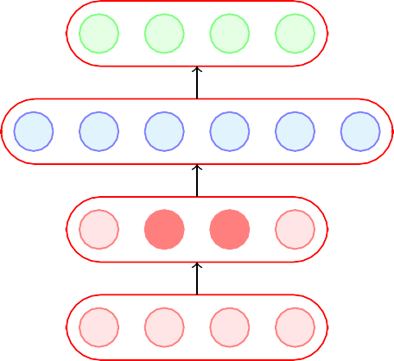
A denoising encoder simply corrupts the input data using a probabilistic
xˆ_{i}
process (P (x˜ |x )) before feeding it
ij ij
to the network
h
x˜_{i}
P (x˜_{ij} |x_{ij} )
x_{i}
28/1
CS7015 (Deep Learning) : Lecture 7

Slide 141
A denoising encoder simply corrupts the input data using a probabilistic
xˆ_{i}
process (P (x˜ |x )) before feeding it
ij ij
to the network
A simple P (x˜ |x ) used in practice
h
ij ij
is the following
x˜_{i}
P (x˜_{ij} |x_{ij} )
x_{i}
28/1
CS7015 (Deep Learning) : Lecture 7

Slide 142
A denoising encoder simply corrupts the input data using a probabilistic
xˆ_{i}
process (P (x˜ |x )) before feeding it
ij ij
to the network
A simple P (x˜ |x ) used in practice
h
ij ij
is the following
P (x˜_{ij} = 0|x_{ij} ) = q
x˜
i
P (x˜_{ij} |x_{ij} )
x_{i}
28/1
CS7015 (Deep Learning) : Lecture 7

Slide 143
A denoising encoder simply corrupts the input data using a probabilistic
xˆ_{i}
process (P (x˜ |x )) before feeding it
ij ij
to the network
A simple P (x˜ |x ) used in practice
h
ij ij
is the following
P (x˜ = 0
|x ) = q
x˜
ij ij
i
P (x˜_{ij} = x_{ij} |x_{ij} ) = 1 − q
P (x˜_{ij} |x_{ij} )
x_{i}
28/1
CS7015 (Deep Learning) : Lecture 7

Slide 144
A denoising encoder simply corrupts the input data using a probabilistic
xˆ_{i}
process (P (x˜ |x )) before feeding it
ij ij
to the network
A simple P (x˜ |x ) used in practice
h
ij ij
is the following
P (x˜ = 0
|x ) = q
x˜
ij ij
i
P (x˜_{ij} = x_{ij} |x_{ij} ) = 1 − q
In other words, with probability q the input is flipped to 0 and with probab- ility (1 − q) it is retained as it is
P (x˜_{ij} |x_{ij} )
x_{i}
28/1
CS7015 (Deep Learning) : Lecture 7

Slide 145
How does this help ?
xˆ_{i}
h
x˜_{i}
P (x˜_{ij} |x_{ij} )
x_{i}
29/1
CS7015 (Deep Learning) : Lecture 7

Slide 146
How does this help ?
xˆ_{i}
This helps because the objective is still to reconstruct the original (un- corrupted) x_{i}
m n
h
1
m
Σ Σ
arg min
θ
(xˆ − x
₎2
ij
ij
i=1 j=1
x˜_{i}
P (x˜_{ij} |x_{ij} )
x_{i}
29/1
CS7015 (Deep Learning) : Lecture 7

Slide 147
How does this help ?
xˆ_{i}
This helps because the objective is still to reconstruct the original (un- corrupted) x_{i}
m n
h
1
m
Σ Σ
arg min
θ
(xˆ − x
₎2
ij
ij
i=1 j=1
x˜_{i}
It no longer makes sense for the model to copy the corrupted x˜ into h(x˜ )
i i
P (x˜_{ij} |x_{ij} )
and then into xˆ_{i} (the objective func-
x_{i}
tion will not be minimized by doing so)
29/1
CS7015 (Deep Learning) : Lecture 7

Slide 148
How does this help ?
xˆ_{i}
This helps because the objective is still to reconstruct the original (un- corrupted) x_{i}
m n
h
1
m
Σ Σ
arg min
θ
(xˆ − x
₎2
ij
ij
i=1 j=1
x˜_{i}
It no longer makes sense for the model to copy the corrupted x˜ into h(x˜ )
i i
P (x˜_{ij} |x_{ij} )
and then into xˆ_{i} (the objective func-
x_{i}
tion will not be minimized by doing so)
Instead the model will now have to capture the characteristics of the data correctly.
29/1
CS7015 (Deep Learning) : Lecture 7

Slide 149
How does this help ?
xˆ_{i}
This helps because the objective is still to reconstruct the original (un- corrupted) x_{i}
m n
h
1
m
Σ Σ
arg min
θ
(xˆ − x
₎2
ij
ij
i=1 j=1
x˜_{i}
It no longer makes sense for the model to copy the corrupted x˜ into h(x˜ )
i i
P (x˜_{ij} |x_{ij} )
and then into xˆ_{i} (the objective func-
x_{i}
tion will not be minimized by doing so)
Instead the model will now have to capture the characteristics of the data correctly.
For example, it will have to learn to reconstruct a corrupted x_{ij} correctly by relying on its interactions with other elements of x_{i}
29/1
CS7015 (Deep Learning) : Lecture 7

Slide 150
We will now see a practical application in which AEs are used and then compare Denoising Autoencoders with regular autoencoders
CS7015 (Deep Learning) : Lecture 7

Slide 151


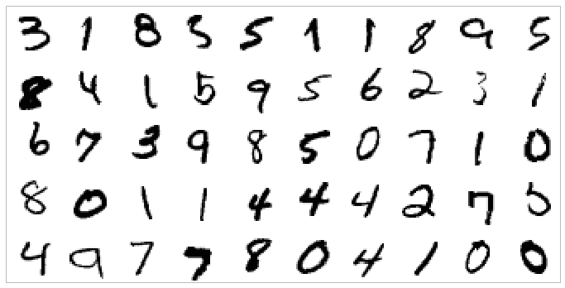

0
1
2
3
9
Task: Hand-written digit recognition
|x_{i}| = 784 = 28 × 28
28*28
Figure: Basic approach(we use raw data as input features)
Figure: MNIST Data
CS7015 (Deep Learning) : Lecture 7

Slide 152
xˆ_{i} ∈ R⁷⁸⁴
Task: Hand-written digit recognition
h ∈ R^{d}
|x_{i}| = 784 = 28 × 28
Figure: MNIST Data
Figure: AE approach (first learn important characteristics of data)
CS7015 (Deep Learning) : Lecture 7

Slide 153

Task: Hand-written digit recognition
0
1
2
3
9
h ∈ R^{d}
|x_{i}| = 784 = 28 × 28
Figure: MNIST Data
Figure: AE approach (and then train a classifier on top of this hidden representation)
CS7015 (Deep Learning) : Lecture 7

Slide 154
We will now see a way of visualizing AEs and use this visualization to compare different AEs
CS7015 (Deep Learning) : Lecture 7

Slide 155

We can think of each neuron as a filter which will fire (or get maximally) activated for a cer- tain input configuration x_{i}
xˆ_{i}
h
x_{i}
35/1
CS7015 (Deep Learning) : Lecture 7

Slide 156
We can think of each neuron as a filter which will fire (or get maximally) activated for a cer- tain input configuration x_{i}
xˆ_{i}
For example,
h
h₁ = σ(W^{T} x_{i}) [ignoring bias b]
1
x_{i}
Where W₁ is the trained vector of weights con- necting the input to the first hidden neuron
35/1
CS7015 (Deep Learning) : Lecture 7

Slide 157
We can think of each neuron as a filter which will fire (or get maximally) activated for a cer- tain input configuration x_{i}
xˆ_{i}
For example,
h
h₁ = σ(W^{T} x_{i}) [ignoring bias b]
1
x_{i}
Where W₁ is the trained vector of weights con- necting the input to the first hidden neuron
What values of x_{i} will cause h₁ to be max- imum (or maximally activated)
35/1
CS7015 (Deep Learning) : Lecture 7

Slide 158
We can think of each neuron as a filter which will fire (or get maximally) activated for a cer- tain input configuration x_{i}
xˆ_{i}
For example,
h
h₁ = σ(W^{T} x_{i}) [ignoring bias b]
1
x_{i}
Where W₁ is the trained vector of weights con- necting the input to the first hidden neuron
What values of x_{i} will cause h₁ to be max- imum (or maximally activated)
Suppose we assume that our inputs are nor- malized so that x_{i} = 1
35/1
CS7015 (Deep Learning) : Lecture 7

Slide 159
We can think of each neuron as a filter which will fire (or get maximally) activated for a cer- tain input configuration x_{i}
xˆ_{i}
For example,
h
h₁ = σ(W^{T} x_{i}) [ignoring bias b]
1
x_{i}
Where W₁ is the trained vector of weights con- necting the input to the first hidden neuron
What values of x_{i} will cause h₁ to be max- imum (or maximally activated)
Suppose we assume that our inputs are nor- malized so that x_{i} = 1
max
x_{i}
{W^{T} xi}
1
s.t. ||xi||² = x^{T} xi = 1
i
35/1
CS7015 (Deep Learning) : Lecture 7

Slide 160
We can think of each neuron as a filter which will fire (or get maximally) activated for a cer- tain input configuration x_{i}
xˆ_{i}
For example,
h
h₁ = σ(W^{T} x_{i}) [ignoring bias b]
1
x_{i}
Where W₁ is the trained vector of weights con- necting the input to the first hidden neuron
What values of x_{i} will cause h₁ to be max- imum (or maximally activated)
Suppose we assume that our inputs are nor- malized so that x_{i} = 1
max
x_{i}
{W^{T} xi}
1
s.t. ||xi||² = x^{T} xi = 1
i
Solution: x = √
W1
i
T
W W
1
1
35/1
CS7015 (Deep Learning) : Lecture 7

Slide 161
Thus the inputs
xˆ_{i}
W₁
W₂
W_{n}
x_{i} = q
, q
, . . . √
T
h
W^{T} W₁ W^{T} W₂
W_{n} W_{n}
1 2
will respectively cause hidden neurons 1 to n
to maximally fire
x_{i}
max
x_{i}
{W^{T} xi}
1
s.t. ||xi||² = x^{T} xi = 1
i
Solution: x = √
W1
i
T
W W
1
1
36/1
CS7015 (Deep Learning) : Lecture 7

Slide 162
Thus the inputs
xˆ_{i}
W₁
W₂
W_{n}
x_{i} = q
, q
, . . . √
T
h
W^{T} W₁ W^{T} W₂
W_{n} W_{n}
1 2
will respectively cause hidden neurons 1 to n
to maximally fire
Let us plot these images (x_{i}’s) which maxim- ally activate the first k neurons of the hidden representations learned by a vanilla autoen- coder and different denoising autoencoders
x_{i}
max
x_{i}
{W^{T} xi}
1
s.t. ||xi||² = x^{T} xi = 1
i
Solution: x = √
W1
i
T
W W
1
1
36/1
CS7015 (Deep Learning) : Lecture 7

Slide 163
Thus the inputs
xˆ_{i}
W₁
W₂
W_{n}
x_{i} = q
, q
, . . . √
T
h
W^{T} W₁ W^{T} W₂
W_{n} W_{n}
1 2
will respectively cause hidden neurons 1 to n
to maximally fire
Let us plot these images (x_{i}’s) which maxim- ally activate the first k neurons of the hidden representations learned by a vanilla autoen- coder and different denoising autoencoders
These x_{i}’s are computed by the above formula using the weights (W₁, W₂ . . . W_{k}) learned by the respective autoencoders
x_{i}
max
x_{i}
{W^{T} xi}
1
s.t. ||xi||² = x^{T} xi = 1
i
Solution: x = √
W1
i
T
W W
1
1
36/1
CS7015 (Deep Learning) : Lecture 7

Slide 164
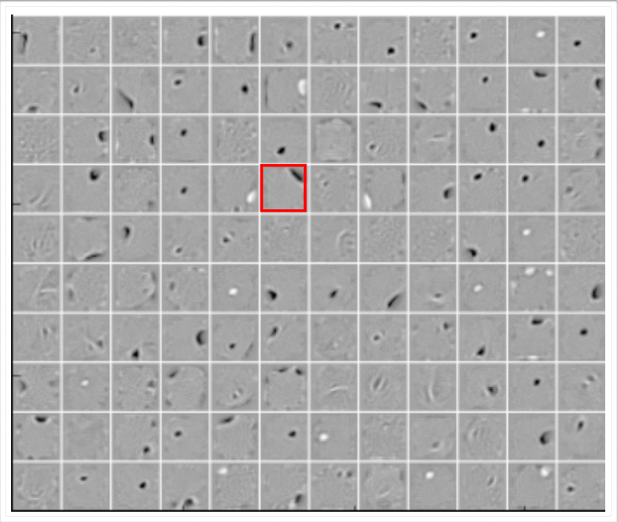
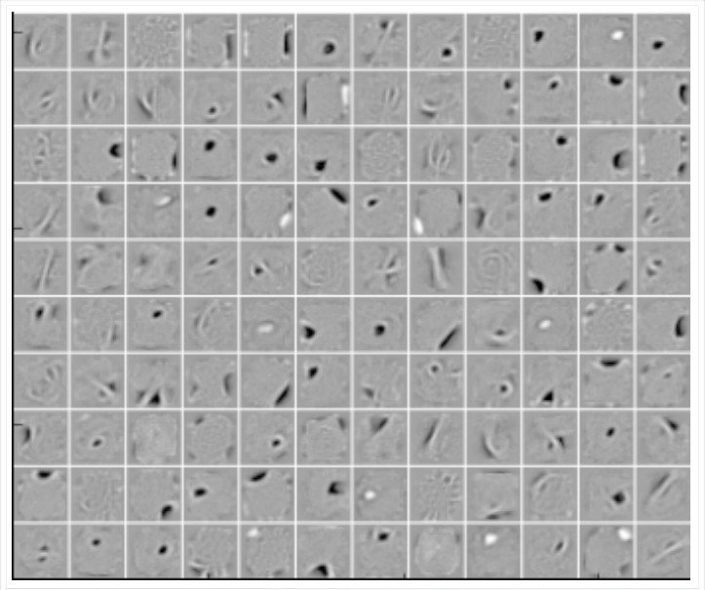
Figure: Vanilla AE (No noise)
Figure: 25% Denoising AE (q=0.25)
Figure: 50% Denoising AE (q=0.5)
The vanilla AE does not learn many meaningful patterns
37/1
CS7015 (Deep Learning) : Lecture 7

Slide 165
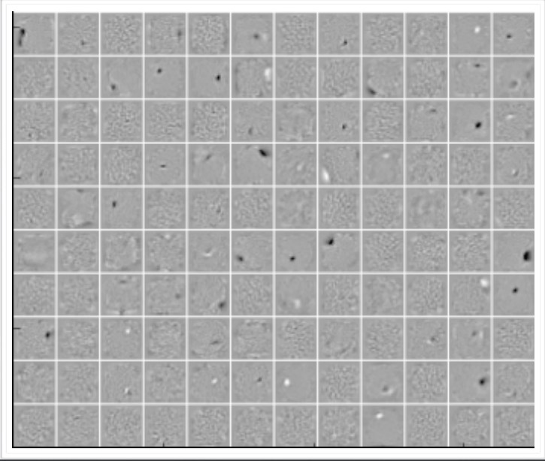
Figure: Vanilla AE (No noise)
Figure: 25% Denoising AE (q=0.25)
Figure: 50% Denoising AE (q=0.5)
The vanilla AE does not learn many meaningful patterns
The hidden neurons of the denoising AEs seem to act like pen-stroke detectors (for example, in the highlighted neuron the black region is a stroke that you would expect in a ’0’ or a ’2’ or a ’3’ or a ’8’ or a ’9’)
37/1
CS7015 (Deep Learning) : Lecture 7

Slide 166
Figure: Vanilla AE (No noise)
Figure: 25% Denoising AE (q=0.25)
Figure: 50% Denoising AE (q=0.5)
The vanilla AE does not learn many meaningful patterns
The hidden neurons of the denoising AEs seem to act like pen-stroke detectors (for example, in the highlighted neuron the black region is a stroke that you would expect in a ’0’ or a ’2’ or a ’3’ or a ’8’ or a ’9’)
As the noise increases the filters become more wide because the neuron has to rely on more adjacent pixels to feel confident about a stroke
37/1
CS7015 (Deep Learning) : Lecture 7

Slide 167

We saw one form of P (x˜ |x ) which flips a
ij ij
xˆ
i
fraction q of the inputs to zero
h
x˜_{i}
P (x˜_{ij} |x_{ij} )
x_{i}
38/1
CS7015 (Deep Learning) : Lecture 7

Slide 168
We saw one form of P (x˜ |x ) which flips a
ij ij
xˆ
i
fraction q of the inputs to zero
Another way of corrupting the inputs is to add a Gaussian noise to the input
h
x˜_{ij} = x_{ij} + N (0, 1)
x˜_{i}
P (x˜_{ij} |x_{ij} )
x_{i}
38/1
CS7015 (Deep Learning) : Lecture 7

Slide 169
We saw one form of P (x˜ |x ) which flips a
ij ij
xˆ
i
fraction q of the inputs to zero
Another way of corrupting the inputs is to add a Gaussian noise to the input
h
x˜ = x + N (0, 1)
ij ij
x˜_{i}
We will now use such a denoising AE on a
P (x˜_{ij} |x_{ij} )
x_{i}
different dataset and see their performance
38/1
CS7015 (Deep Learning) : Lecture 7

Slide 170
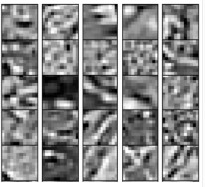
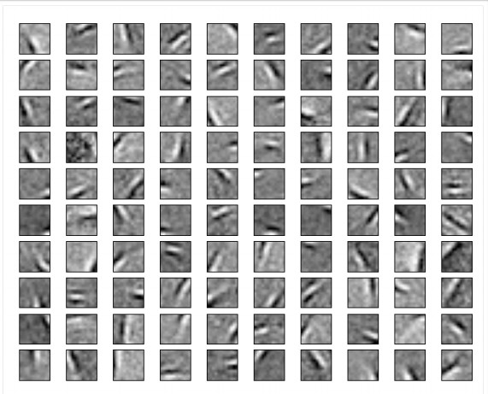
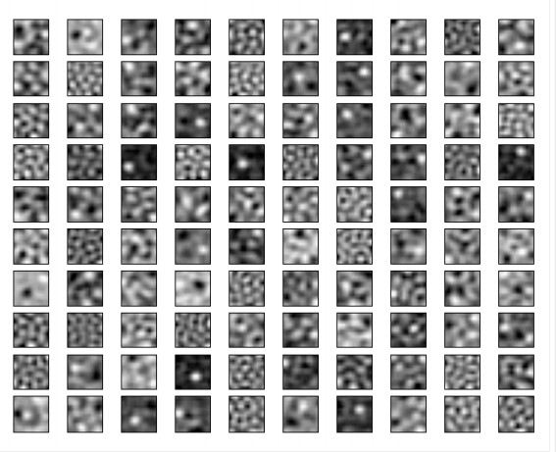
Figure: Weight decay filters
Figure: Data
Figure: AE filters
The hidden neurons essentially behave like edge detectors
39/1
CS7015 (Deep Learning) : Lecture 7

Slide 171
Figure: Weight decay filters
Figure: Data
Figure: AE filters
The hidden neurons essentially behave like edge detectors PCA does not give such edge detectors
39/1
CS7015 (Deep Learning) : Lecture 7

Slide 172
Module 7.5: Sparse Autoencoders
CS7015 (Deep Learning) : Lecture 7

Slide 173
xˆ_{i}
h
x_{i}
41/1
CS7015 (Deep Learning) : Lecture 7

Slide 174
A hidden neuron with sigmoid activation will have values between 0 and 1
xˆ_{i}
h
x_{i}
41/1
CS7015 (Deep Learning) : Lecture 7

Slide 175
A hidden neuron with sigmoid activation will have values between 0 and 1
We say that the neuron is activated when its output is close to 1 and not activated when its output is close to 0.
xˆ_{i}
h
x_{i}
41/1
CS7015 (Deep Learning) : Lecture 7

Slide 176
A hidden neuron with sigmoid activation will have values between 0 and 1
We say that the neuron is activated when its output is close to 1 and not activated when its output is close to 0.
A sparse autoencoder tries to ensure the neuron is inactive most of the times.
xˆ_{i}
h
x_{i}
41/1
CS7015 (Deep Learning) : Lecture 7

Slide 177
If the neuron l is sparse (i.e. mostly inactive) then ρˆ_{l} → 0
xˆ_{i}
h
x_{i}
The average value of the activation of a neuron l is given by
m
1
Σ
ρˆ =
h(x )
l
m
i l
i=1
42/1
CS7015 (Deep Learning) : Lecture 7

Slide 178
If the neuron l is sparse (i.e. mostly inactive) then ρˆ_{l} → 0
xˆ_{i}
A sparse autoencoder uses a sparsity para- meter ρ (typically very close to 0, say, 0.005) and tries to enforce the constraint ρˆ_{l} = ρ
h
x_{i}
The average value of the activation of a neuron l is given by
m
1
Σ
ρˆ =
h(x )
l
m
i l
i=1
42/1
CS7015 (Deep Learning) : Lecture 7

Slide 179
If the neuron l is sparse (i.e. mostly inactive) then ρˆ_{l} → 0
xˆ_{i}
A sparse autoencoder uses a sparsity para- meter ρ (typically very close to 0, say, 0.005) and tries to enforce the constraint ρˆ_{l} = ρ
One way of ensuring this is to add the follow- ing term to the objective function
h
x_{i}
k
The average value of the activation of a neuron l is given by
m
Σ
ρ
1 − ρ
1 − ρˆ_{l}
Ω(θ) = ρ log + (1 − ρ) log
ρˆ_{l}
l=1
1
Σ
ρˆ =
h(x )
l
m
i l
i=1
42/1
CS7015 (Deep Learning) : Lecture 7

Slide 180
If the neuron l is sparse (i.e. mostly inactive) then ρˆ_{l} → 0
xˆ_{i}
A sparse autoencoder uses a sparsity para- meter ρ (typically very close to 0, say, 0.005) and tries to enforce the constraint ρˆ_{l} = ρ
One way of ensuring this is to add the follow- ing term to the objective function
h
x_{i}
k
The average value of the activation of a neuron l is given by
m
Σ
ρ
1 − ρ
1 − ρˆ_{l}
Ω(θ) = ρ log + (1 − ρ) log
ρˆ_{l}
l=1
1
Σ
When will this term reach its minimum value and what is the minimum value? Let us plot it and check.
ρˆ =
h(x )
l
m
i l
i=1
42/1
CS7015 (Deep Learning) : Lecture 7

Slide 181
ρ = 0.2
Ω(θ)
0.2
ρˆ_{l}
43/1
CS7015 (Deep Learning) : Lecture 7

Slide 182
ρ = 0.2
Ω(θ)
0.2
ρˆ_{l}
The function will reach its minimum value(s) when ρˆ_{l} = ρ.
43/1
CS7015 (Deep Learning) : Lecture 7

Slide 183
Now,
L^{ˆ}(θ) = L (θ) + Ω(θ)
44/1
CS7015 (Deep Learning) : Lecture 7

Slide 184
Now,
L^{ˆ}(θ) = L (θ) + Ω(θ)
L (θ) is the squared error loss or cross entropy loss and Ω(θ) is the sparsity constraint.
44/1
CS7015 (Deep Learning) : Lecture 7

Slide 185
Now,
L^{ˆ}(θ) = L (θ) + Ω(θ)
L (θ) is the squared error loss or cross entropy loss and Ω(θ) is the sparsity constraint.
We already know how to calculate
∂L (θ)
∂W
44/1
CS7015 (Deep Learning) : Lecture 7

Slide 186
Now,
L^{ˆ}(θ) = L (θ) + Ω(θ)
L (θ) is the squared error loss or cross entropy loss and Ω(θ) is the sparsity constraint.
We already know how to calculate
∂L (θ)
∂W
Let us see how to calculate ^{∂Ω(θ)} .
∂W
44/1
CS7015 (Deep Learning) : Lecture 7

Slide 187
Now,
k
Σ
l=1
1 − ρ
1 − ρˆl
ρ
Ω(θ) =
ρlog + (1 − ρ)log
ρˆl
L^{ˆ}(θ) = L (θ) + Ω(θ)
L (θ) is the squared error loss or cross entropy loss and Ω(θ) is the sparsity constraint.
We already know how to calculate
∂L (θ)
∂W
Let us see how to calculate ^{∂Ω(θ)} .
∂W
44/1
CS7015 (Deep Learning) : Lecture 7

Slide 188
Now,
k
Σ
1 − ρ
1 − ρˆl
ρ
Ω(θ) =
ρlog + (1 − ρ)log
ρˆl
l=1
L^{ˆ}(θ) = L (θ) + Ω(θ)
Can be re-written as
k
Σ
L (θ) is the squared error loss or cross entropy loss and Ω(θ) is the sparsity constraint.
We already know how to calculate
∂L (θ)
∂W
Ω(θ) = ρlogρ−ρlogρˆl+(1−ρ)log(1−ρ)−(1−ρ)log(1−ρˆl)
l=1
Let us see how to calculate ^{∂Ω(θ)} .
∂W
44/1
CS7015 (Deep Learning) : Lecture 7

Slide 189
Now,
k
Σ
1 − ρ
1 − ρˆl
ρ
Ω(θ) =
ρlog + (1 − ρ)log
ρˆl
l=1
L^{ˆ}(θ) = L (θ) + Ω(θ)
Can be re-written as
k
Σ
L (θ) is the squared error loss or cross entropy loss and Ω(θ) is the sparsity constraint.
We already know how to calculate
∂L (θ)
∂W
Ω(θ) = ρlogρ−ρlogρˆl+(1−ρ)log(1−ρ)−(1−ρ)log(1−ρˆl)
l=1
By Chain rule:
∂Ω(θ)
∂Ω(θ) ∂ρˆ
=
.
∂W
∂ρˆ ∂W
Let us see how to calculate ^{∂Ω(θ)} .
∂W
44/1
CS7015 (Deep Learning) : Lecture 7

Slide 190
Now,
k
Σ
1 − ρ
1 − ρˆl
ρ
Ω(θ) =
ρlog + (1 − ρ)log
ρˆl
l=1
L^{ˆ}(θ) = L (θ) + Ω(θ)
Can be re-written as
k
Σ
L (θ) is the squared error loss or cross entropy loss and Ω(θ) is the sparsity constraint.
We already know how to calculate
∂L (θ)
∂W
Ω(θ) = ρlogρ−ρlogρˆl+(1−ρ)log(1−ρ)−(1−ρ)log(1−ρˆl)
l=1
By Chain rule:
∂Ω(θ)
∂Ω(θ) ∂ρˆ
=
.
∂W
∂ρˆ ∂W
Let us see how to calculate ^{∂Ω(θ)} .
∂Ω(θ)
∂ρˆ
h
i
∂W
∂Ω(θ) ∂Ω(θ)
∂Ω(θ)
∂ρˆ_{k}
T
=
, , . . .
∂ρˆ₁ ∂ρˆ₂
44/1
CS7015 (Deep Learning) : Lecture 7

Slide 191
Now,
k
Σ
1 − ρ
1 − ρˆl
ρ
Ω(θ) =
ρlog + (1 − ρ)log
ρˆl
l=1
L^{ˆ}(θ) = L (θ) + Ω(θ)
Can be re-written as
k
Σ
L (θ) is the squared error loss or cross entropy loss and Ω(θ) is the sparsity constraint.
We already know how to calculate
∂L (θ)
∂W
Ω(θ) = ρlogρ−ρlogρˆl+(1−ρ)log(1−ρ)−(1−ρ)log(1−ρˆl)
l=1
By Chain rule:
∂Ω(θ)
∂Ω(θ) ∂ρˆ
=
.
∂W
∂ρˆ ∂W
Let us see how to calculate ^{∂Ω(θ)} .
∂Ω(θ)
∂ρˆ
h
i
∂W
∂Ω(θ) ∂Ω(θ)
∂Ω(θ)
∂ρˆ_{k}
T
=
, , . . .
∂ρˆ₁ ∂ρˆ₂
For each neuron l ∈ 1 . . . k in hidden layer, we have
44/1
CS7015 (Deep Learning) : Lecture 7

Slide 192
Now,
k
Σ
1 − ρ
1 − ρˆl
ρ
Ω(θ) =
ρlog + (1 − ρ)log
ρˆl
l=1
L^{ˆ}(θ) = L (θ) + Ω(θ)
Can be re-written as
k
Σ
L (θ) is the squared error loss or cross entropy loss and Ω(θ) is the sparsity constraint.
We already know how to calculate
∂L (θ)
∂W
Ω(θ) = ρlogρ−ρlogρˆl+(1−ρ)log(1−ρ)−(1−ρ)log(1−ρˆl)
l=1
By Chain rule:
∂Ω(θ)
∂Ω(θ) ∂ρˆ
=
.
∂W
∂ρˆ ∂W
Let us see how to calculate ^{∂Ω(θ)} .
∂Ω(θ)
∂ρˆ
h
i
∂W
∂Ω(θ) ∂Ω(θ)
∂Ω(θ)
∂ρˆ_{k}
T
=
, , . . .
∂ρˆ₁ ∂ρˆ₂
For each neuron l ∈ 1 . . . k in hidden layer, we have
∂Ω(θ) ₌ ₋ ρ ₊ (1 − ρ)
∂ρˆl ρˆl 1 − ρˆl
44/1
CS7015 (Deep Learning) : Lecture 7

Slide 193
Now,
k
Σ
1 − ρ
1 − ρˆl
ρ
Ω(θ) =
ρlog + (1 − ρ)log
ρˆl
l=1
L^{ˆ}(θ) = L (θ) + Ω(θ)
Can be re-written as
k
Σ
L (θ) is the squared error loss or cross entropy loss and Ω(θ) is the sparsity constraint.
We already know how to calculate
∂L (θ)
∂W
Ω(θ) = ρlogρ−ρlogρˆl+(1−ρ)log(1−ρ)−(1−ρ)log(1−ρˆl)
l=1
By Chain rule:
∂Ω(θ)
∂Ω(θ) ∂ρˆ
=
.
∂W
∂ρˆ ∂W
Let us see how to calculate ^{∂Ω(θ)} .
∂Ω(θ)
∂ρˆ
h
i
∂W
∂Ω(θ) ∂Ω(θ)
∂Ω(θ)
∂ρˆ_{k}
T
=
, , . . .
∂ρˆ₁ ∂ρˆ₂
For each neuron l ∈ 1 . . . k in hidden layer, we have
∂Ω(θ) ₌ ₋ ρ ₊ (1 − ρ)
∂ρˆl ρˆl 1 − ρˆl
∂ρˆ
l ′
T T
and
= x (g (W x + b)) (see next slide)
∂W
i
i
44/1
CS7015 (Deep Learning) : Lecture 7

Slide 194
Now,
k
Σ
1 − ρ
1 − ρˆl
ρ
Ω(θ) =
ρlog + (1 − ρ)log
ρˆl
l=1
L^{ˆ}(θ) = L (θ) + Ω(θ)
Can be re-written as
k
Σ
L (θ) is the squared error loss or cross entropy loss and Ω(θ) is the sparsity constraint.
We already know how to calculate
∂L (θ)
∂W
Ω(θ) = ρlogρ−ρlogρˆl+(1−ρ)log(1−ρ)−(1−ρ)log(1−ρˆl)
l=1
By Chain rule:
∂Ω(θ)
∂Ω(θ) ∂ρˆ
=
.
∂W
∂ρˆ ∂W
Let us see how to calculate ^{∂Ω(θ)} .
∂Ω(θ)
∂ρˆ
h
i
∂W
∂Ω(θ) ∂Ω(θ)
∂Ω(θ)
∂ρˆ_{k}
T
=
, , . . .
Finally,
∂ρˆ₁ ∂ρˆ₂
For each neuron l ∈ 1 . . . k in hidden layer, we have
∂L^{ˆ}(θ)
∂L (θ)
∂Ω(θ)
∂Ω(θ) ρ (1 − ρ)
= +
= − +
ρˆ 1 − ρˆ
∂W ∂W ∂W
∂ρˆ
l
l l
∂ρˆ
(and we know how to calculate both terms on R.H.S)
and
l
′ T T
= x (g (W x + b)) (see next slide)
∂W
i i
44/1
CS7015 (Deep Learning) : Lecture 7

Slide 195
Derivation
∂ρˆ
∂W
=
∂ρˆ
1
∂ρˆ
2
. . .
∂ρˆ
k
∂W ∂W ∂W
For each element in the above equation we can calculate ^{∂ρˆl} (which is the partial
∂W
derivative of a scalar w.r.t. a matrix = matrix). For a single element of a matrix W_{jl}:-
h i
Σ
∂
1
m
T
∂ρˆ_{l}
g W x + b
m i=1
:,l
i l
=
∂W_{jl}
∂W_{jl}
h
i
T
m
∂ g W x
+ b
1
m
1
m
Σ
:,l
i
l
=
∂W_{jl}
i=1
m
Σ
=
′ T
g W x + b x
:,l i
l ij
i=1
So in matrix notation we can write it as :
∂ρˆ
l
′ T T
= x (g (W x + b))
∂W
i i
CS7015 (Deep Learning) : Lecture 7

Slide 196
Module 7.6: Contractive Autoencoders
CS7015 (Deep Learning) : Lecture 7

Slide 197
A contractive autoencoder also tries to prevent an overcomplete autoen- coder from learning the identity func- tion.
xˆ
h
x
47/1
CS7015 (Deep Learning) : Lecture 7

Slide 198
A contractive autoencoder also tries to prevent an overcomplete autoen- coder from learning the identity func- tion.
xˆ
It does so by adding the following reg- ularization term to the loss function
h
Ω(θ) = J_{x}(h) ²
F
x
47/1
CS7015 (Deep Learning) : Lecture 7

Slide 199
A contractive autoencoder also tries to prevent an overcomplete autoen- coder from learning the identity func- tion.
xˆ
It does so by adding the following reg- ularization term to the loss function
h
Ω(θ) = J_{x}(h) ²
F
x
where J_{x}(h) is the Jacobian of the en- coder.
47/1
CS7015 (Deep Learning) : Lecture 7

Slide 200
A contractive autoencoder also tries to prevent an overcomplete autoen- coder from learning the identity func- tion.
xˆ
It does so by adding the following reg- ularization term to the loss function
h
Ω(θ) = J_{x}(h) ²
F
x
where J_{x}(h) is the Jacobian of the en- coder.
Let us see what it looks like.
47/1
CS7015 (Deep Learning) : Lecture 7

Slide 201
If the input has n dimensions and the hidden layer has k dimensions then
48/1
CS7015 (Deep Learning) : Lecture 7

Slide 202
If the input has n dimensions and the hidden layer has k dimensions then


∂h
1
. . . . . . . . .
. . . . . . . . .
. . .
. . . . . . . . .
∂h
1
∂x1
∂xn

∂h
2
∂h
2

J (h) =
∂x1
∂xn
x

.
.


.
∂h_{k}
∂x1
.
∂h_{k}
∂xn
48/1
CS7015 (Deep Learning) : Lecture 7

Slide 203
If the input has n dimensions and the hidden layer has k dimensions then


∂h
1
. . . . . . . . .
. . . . . . . . .
. . .
. . . . . . . . .
∂h
1
∂x1
∂xn
In other words, the (l, j) entry of the Jacobian captures the variation in the output of the l^{th} neuron with a small variation in the j input.

∂h
2
∂h
2

J (h) =
∂x1
∂xn
x

.
.


.
∂h_{k}
∂x1
.
∂h_{k}
∂xn
th
48/1
CS7015 (Deep Learning) : Lecture 7

Slide 204
If the input has n dimensions and the hidden layer has k dimensions then


∂h
1
. . . . . . . . .
. . . . . . . . .
. . .
. . . . . . . . .
∂h
1
∂x1
∂xn
In other words, the (l, j) entry of the Jacobian captures the variation in the output of the l^{th} neuron with a small variation in the j input.

∂h
2
∂h
2

J (h) =
∂x1
∂xn
x

.
.


.
∂h_{k}
∂x1
.
∂h_{k}
∂xn
th
n k
Σ Σ
∂h
2
2
l
J_{x}(h) _{F} =
∂x
j
j=1 l=1
48/1
CS7015 (Deep Learning) : Lecture 7

Slide 205

What is the intuition behind this ?
n k
Σ Σ
∂h
2
2
l
J (h) =
x
F
∂x_{j}
j=1 l=1
xˆ
h
x
49/1
CS7015 (Deep Learning) : Lecture 7

Slide 206
What is the intuition behind this ?
n k
Σ Σ
∂h
2
2
l
∂h
J_{x}(h) _{F} =
Consider , what does it mean if
1
∂x
∂x
1
j
∂h
1
= 0
j=1 l=1
∂x
1
xˆ
h
x
49/1
CS7015 (Deep Learning) : Lecture 7

Slide 207
What is the intuition behind this ?
n k
Σ Σ
∂h
2
2
l
∂h
J_{x}(h) _{F} =
Consider , what does it mean if
1
∂x
∂x
1
j
∂h
1
= 0
j=1 l=1
∂x
1
It means that this neuron is not very sensitive to variations in the input x₁.
xˆ
h
x
49/1
CS7015 (Deep Learning) : Lecture 7

Slide 208
What is the intuition behind this ?
n k
Σ Σ
∂h
2
2
l
∂h
J_{x}(h) _{F} =
Consider , what does it mean if
1
∂x
∂x
1
j
∂h
1
= 0
j=1 l=1
∂x
1
It means that this neuron is not very sensitive to variations in the input x₁.
But doesn’t this contradict our other
xˆ
goal of minimizing L(θ) which re-
quires h to capture variations in the input.
h
x
49/1
CS7015 (Deep Learning) : Lecture 7

Slide 209
Indeed it does and that’s the idea
n k
Σ Σ
∂h
2
2
l
J (h) =
x
F
∂x_{j}
j=1 l=1
xˆ
h
x
50/1
CS7015 (Deep Learning) : Lecture 7

Slide 210
Indeed it does and that’s the idea
n k
Σ Σ
∂h
2
J (h)
2
F
=
l
By putting these two contradicting objectives against each other we en- sure that h is sensitive to only very important variations as observed in the training data.
x
∂x_{j}
j=1 l=1
xˆ
h
x
50/1
CS7015 (Deep Learning) : Lecture 7

Slide 211
Indeed it does and that’s the idea
n k
Σ Σ
∂h
2
J (h)
2
F
=
l
By putting these two contradicting objectives against each other we en- sure that h is sensitive to only very important variations as observed in the training data.
x
∂x_{j}
j=1 l=1
xˆ
L(θ) - capture important variations in data
h
x
50/1
CS7015 (Deep Learning) : Lecture 7

Slide 212
Indeed it does and that’s the idea
n k
Σ Σ
∂h
2
J (h)
2
F
=
l
By putting these two contradicting objectives against each other we en- sure that h is sensitive to only very important variations as observed in the training data.
x
∂x_{j}
j=1 l=1
xˆ
L(θ) - capture important variations
in data
Ω(θ) - do not capture variations in data
h
x
50/1
CS7015 (Deep Learning) : Lecture 7

Slide 213
Indeed it does and that’s the idea
n k
Σ Σ
∂h
2
J (h)
2
F
=
l
By putting these two contradicting objectives against each other we en- sure that h is sensitive to only very important variations as observed in the training data.
x
∂x_{j}
j=1 l=1
xˆ
L(θ) - capture important variations
in data
Ω(θ) - do not capture variations in data
Tradeoff - capture only very import- ant variations in the data
h
x
50/1
CS7015 (Deep Learning) : Lecture 7

Slide 214
Let us try to understand this with the help of an illustration.
CS7015 (Deep Learning) : Lecture 7

Slide 215
y
u₁
u₂
x
52/1
CS7015 (Deep Learning) : Lecture 7

Slide 216
y
Consider the variations in the data along directions u₁ and u₂
u₁
u₂
x
52/1
CS7015 (Deep Learning) : Lecture 7

Slide 217
y
Consider the variations in the data along directions u₁ and u₂
It makes sense to maximize a neuron to be sensitive to variations along u₁
u₁
u₂
x
52/1
CS7015 (Deep Learning) : Lecture 7

Slide 218
y
Consider the variations in the data along directions u₁ and u₂
It makes sense to maximize a neuron to be sensitive to variations along u₁
At the same time it makes sense to inhibit a neuron from being sensitive to variations along u₂ (as there seems to be small noise and unimportant for reconstruction)
u₁
u₂
x
52/1
CS7015 (Deep Learning) : Lecture 7

Slide 219
y
Consider the variations in the data along directions u₁ and u₂
It makes sense to maximize a neuron to be sensitive to variations along u₁
At the same time it makes sense to inhibit a neuron from being sensitive to variations along u₂ (as there seems to be small noise and unimportant for reconstruction)
By doing so we can balance between the contradicting goals of good recon- struction and low sensitivity.
u₁
u₂
x
52/1
CS7015 (Deep Learning) : Lecture 7

Slide 220
y
Consider the variations in the data along directions u₁ and u₂
It makes sense to maximize a neuron to be sensitive to variations along u₁
At the same time it makes sense to inhibit a neuron from being sensitive to variations along u₂ (as there seems to be small noise and unimportant for reconstruction)
By doing so we can balance between the contradicting goals of good recon- struction and low sensitivity.
What does this remind you of ?
u₁
u₂
x
52/1
CS7015 (Deep Learning) : Lecture 7

Slide 221
Module 7.7 : Summary
CS7015 (Deep Learning) : Lecture 7

Slide 222
xˆ
y
PCA
h
≡
u₁
u₂
x
x
P^{T} X^{T} XP = D
54/1
CS7015 (Deep Learning) : Lecture 7

Slide 223
xˆ
y
PCA
h
≡
u₁
u₂
x
x
P^{T} X^{T} XP = D
min X − HW ∗
2
F
` ˛¸ x
θ
U ΣV ^{T}
(SVD)
54/1
CS7015 (Deep Learning) : Lecture 7

Slide 224
xˆ_{i}
h
x˜_{i}
P (x˜_{ij} |x_{ij} )
x_{i}
55/1
CS7015 (Deep Learning) : Lecture 7

Slide 225
xˆ_{i}
Regularization
h
x˜_{i}
P (x˜_{ij} |x_{ij} )
x_{i}
55/1
CS7015 (Deep Learning) : Lecture 7

Slide 226
xˆ_{i}
Regularization
h
Ω(θ) = λ θ ²
Weight decaying
x˜_{i}
P (x˜_{ij} |x_{ij} )
x_{i}
55/1
CS7015 (Deep Learning) : Lecture 7

Slide 227
Regularization
xˆ_{i}
h
Ω(θ) = λ θ ²
Weight decaying
Σ
k
ρ 1 − ρ
Ω(θ) = ρ log + (1 − ρ) log
Sparse
ρˆl 1 − ρˆl
x˜_{i}
P (x˜_{ij} |x_{ij} )
x_{i}
l=1
55/1
CS7015 (Deep Learning) : Lecture 7

Slide 228
Regularization
xˆ_{i}
h
Ω(θ) = λ θ ²
Weight decaying
Σ
k
ρ 1 − ρ
Ω(θ) = ρ log + (1 − ρ) log
Sparse
ρˆl 1 − ρˆl
x˜_{i}
l=1
Σ Σ
n k
∂h
2
Ω(θ) =
l
Contractive
P (x˜_{ij} |x_{ij} )
∂xj
j=1 l=1
x_{i}
55/1
CS7015 (Deep Learning) : Lecture 7

