Slide 1

VaCCINE RISK Analysis of VAERS Reports for Vaccine Safety Assessment
DATA 606 Capstone in Data Science
Under the guidance: Unal Sakoglu
Github Link: https://github.com/sri-nadella/Team_H_606_Project_VAERS
TEAM-H
Sri Spoorthy Nadella
Sarath Chandra Vundavalli
Sree Sai Sankalp Jagadam

Slide 2

TABLE OF CONTENTS
Overview
Background
Data Description
Exploratory Data Analysis and Data engineering
Project Scope

Slide 3

OVERVIEW
Our study uses data from the Vaccine Adverse Event Reporting System
(VAERS) to assess and forecast Adverse Events (AEs) related to vaccines
in an era of increased focus on public health and vaccine safety.
Our main objectives are to build a tool to assist users in evaluating the
safety of vaccines and a model that forecasts the risk of adverse events.
Adverse Events (AEs): What Are They? Any negative or unexpected result
that follows medical treatment, including vaccination, is referred to as an
adverse event.
AEs can be as minor as injection site pain or as serious as anaphylaxis.

Slide 4
Project Rationale
Public health depends on vaccines, but none are completely risk-free.
01
To reduce risk and enhance patient safety, it is essential to know which vaccines produce more severe reactions for specific people. Given the heightened awareness of vaccination safety during the COVID-19 epidemic, this initiative is well-timed.
02
Given the COVID-19 pandemics increased emphasis on vaccination safety and the continued need for efficient, secure immunization protocols, this research is especially pertinent.
03

Slide 5
Research Question and Hypothesis
Based on patient demographics, medical history, and symptoms, is it possible to anticipate if a vaccine would result in a serious adverse event.
Machine learning algorithms can be used to forecast which vaccines are more likely to cause major adverse responses in people with particular features.

Slide 6

Motivation Behind the study
There have been over a million COVID-19 vaccine-related injuries reported, underscoring the necessity of determining the causes of unfavorable results.
Even though they are uncommon, serious adverse events (AEs) might result in life-threatening complications, severe allergic responses, and seizures.
Higher instances of fainting were found during a CDC assessment into the Janssen vaccine, highlighting the significance of keeping an eye on vaccine users.

Slide 7
Overview of similar approaches
State of Art:
A lot of study has been done on the safety of vaccines, with a particular emphasis on adverse events that have been recorded in the VAERS database. Most studies concentrate on a single vaccine or short-term adverse effects, but others have utilized machine learning to predict serious versus non-serious results. VAERS Monitoring Tools: To identify safety signals, the FDA and CDC now employ data mining techniques; however, these models are generic and not customized to the unique characteristics of each patient.
2. What’s Missing?
Personalized Prediction: Based on a person's demographics and medical history, the majority of current methods do not customize forecasts for them. Predicting future dangers for people who are thinking about getting vaccinated is also not given enough attention.

Slide 8
introduction to Dataset
Data source: VAERS data link
Dataset characteristics:
It consists of 3 CSV files per year (1990-2025):
1.VAERSDATA.CSV: Contains demographic and AE information
2. VAERSVAX.CSV: Vaccine-specific data
3. VAERSSYMPTOMS.CSV: Detailed symptom information
Data volume:
The total size of the zip file is 505.96 MB.
VAERSDATA – 1418326 rows and 35 columns, VAERSSYMPTOM – 1844343 rows and 11 columns and VAERSVAX – 16008874 rows and 8 columns
Data quality considerations:
Self-reported data may include biases and inconsistencies, and not all AEs are reported to VAERS

Slide 9
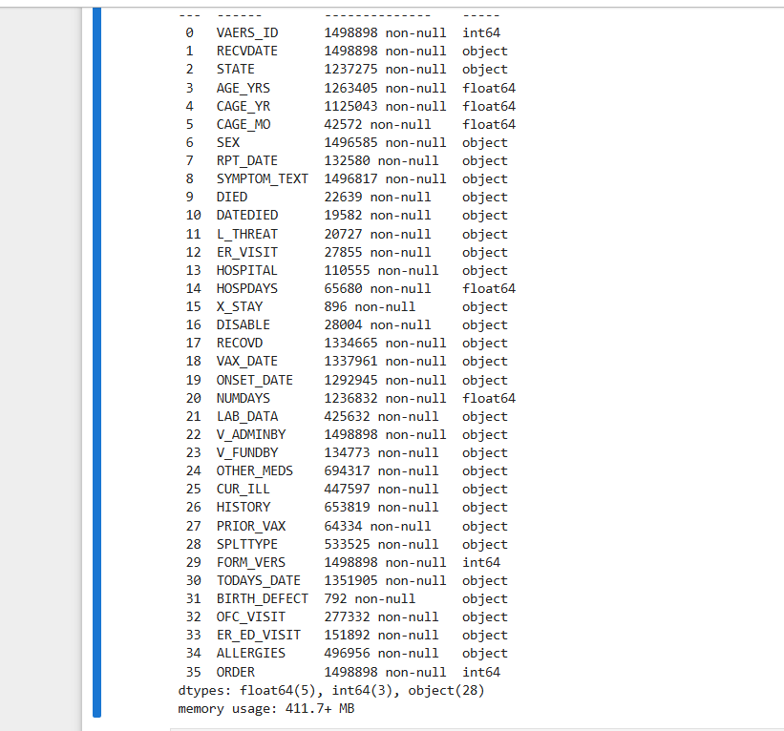
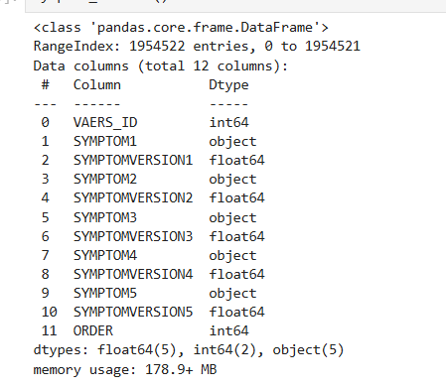
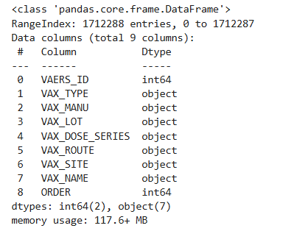
Data description

Slide 10
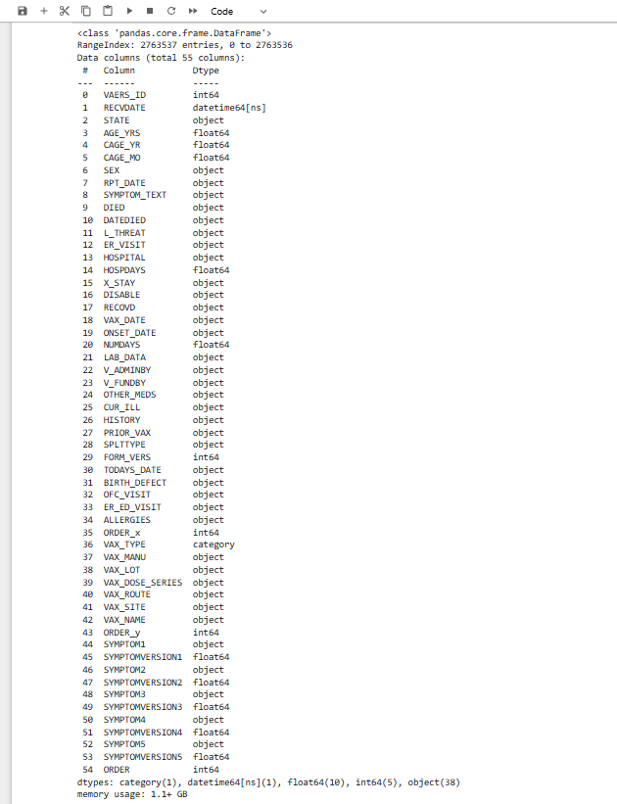
Merging Dataframes
After Merging all the dataframes from the year 2015 to 2025
total size of data is 1.1+ GB
It consists of total 2763537
and 55 columns

Slide 11
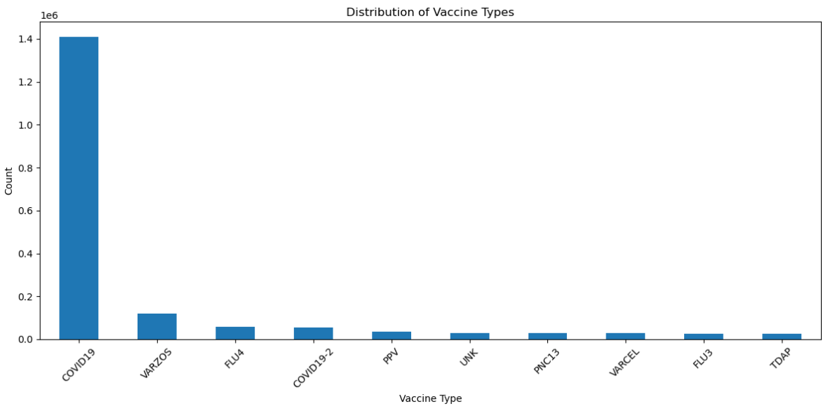
Exploratory Data Analysis
1. Understanding Vaccine type
With approximately 1.4 million side effects, COVID-19 immunizations out number all other vaccines, according to the chart. Vaccines like FLU3, TDAP, and VARCEL have modest counts, and VARZOS comes in second with significantly lower numbers, underscoring the dominant emphasis on COVID-19 immunizations.

Slide 12
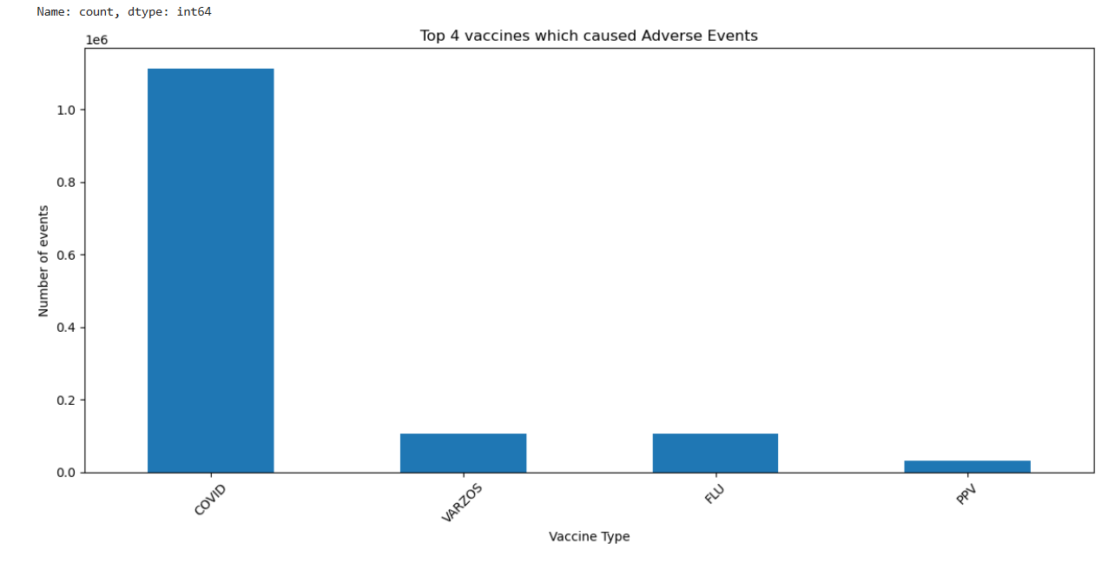
1. Understanding Vaccine type
After classifying vaccination types into more general categories such as "COVID" and "FLU," the graphic displays the top 4 vaccines with adverse events (AEs) that have been reported. Since they are responsible for the majority of serious adverse events, these vaccines—COVID, VARZOS, FLU, and PPV—will be the subject of additional investigation

Slide 13
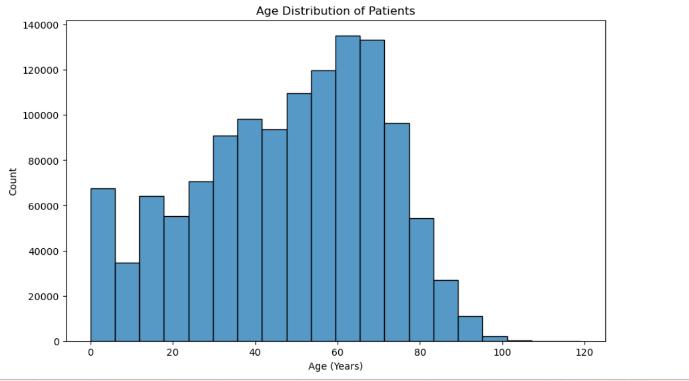
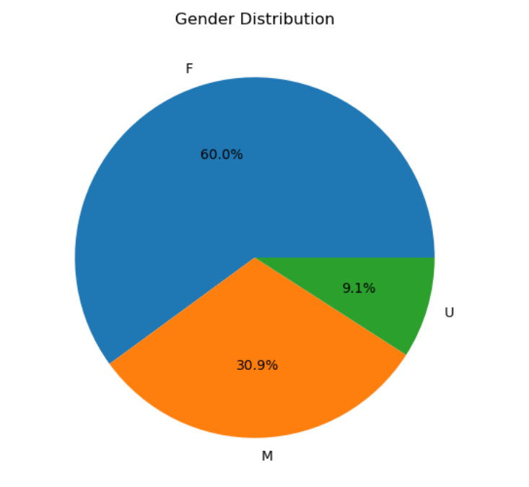
2. Understanding the demographics: Age and Gender
The frequency of the age distribution with VAERS patient entries is displayed in the histogram. It indicates that older adults have a big influence, peaking at 50–60.
According to the pie chart, the majority of patients—61.0%—are female (F). Male (M): 31.9% of the total. Unspecified (U): 7.1% of the total.

Slide 14
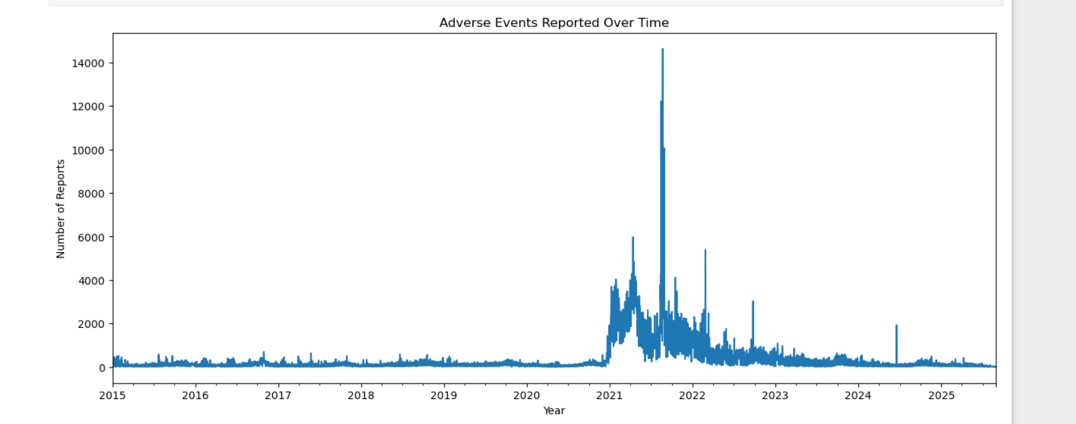
3. Understanding Adverse events over the time
The start of the COVID-19 pandemic in late 2020 is accompanied by a notable increase in reports. In 2021, this tendency reaches a sharp climax. There is a slow drop following the peak in 2021, but through 2024, there are still more reports than there were before the epidemic.

Slide 15
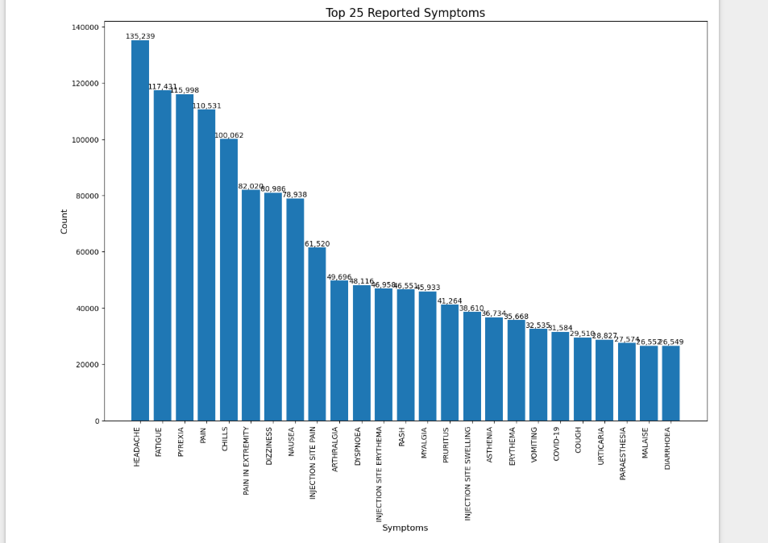
4. What are the top 25 symptoms?
This bar graph shows that headache and fatigue were the most commonly reported symptoms. These are typical adverse responses, as evidenced by the close follow-up of pyxeria, discomfort, and chills. Top 25 symptoms are displayed on the graph.

Slide 16
Vaccine Considered
The COVID vaccination prevents acute respiratory diseases in people that can produce severe symptoms and are brought on by a coronavirus.
The vaccine known as VARICELLA-ZOSTER (VARZOS): vaccine that lowers the risk of herpes zoster, popularly known as shingles, a condition brought on by the varicella-zoster virus (VZV), which also causes chickenpox.
The influenza vaccine guards against the virus and its potentially dangerous side effects.
Particularly in elderly people and those with compromised immune systems, the PPV vaccine guards against diseases like pneumonia and meningitis brought on by the Streptococcus pneumoniae bacteria.

Slide 17

Data engineering
Steps in Data Preprocessing
Combining each year's three CSV files (VAERSDATA, VAERSVAX,
and VAERSSYMPTOMS)
Managing inconsistent data and missing values
Categorical variables (such as vaccination types and symptoms) are encoded.
Engineering features: To better capture the underlying patterns,
raw data is transformed and new variables (features) are created
based on the data that already exists. Create a target variable.

Slide 18
Project Scope
The following vaccines were taken into consideration: COVID-19, influenza (FLU), varicella-zoster (VARZOS), and pneumococcal vaccine polyvalent (PPV).
The challenge is estimating the likelihood of severe adverse events (AEs) from patient demographics, symptoms, and medical history. gaining knowledge to determine which vaccinations are safest for various patient types.

Slide 19

Thank you

