Slide 1



KONGU ENGINEERING COLLEGE
PERUNDURAI ERODE-638060
DEPARTMENT OF COMPUTER APPLICATION
TITLE : GLOSSMART WEBSITE FOR
DEPARTMENT STORE
TEAM MENTOR : Mr. KARTIKEYAN S B
(Assistant Professor)
TEAM MEMBERS : SIVAKUMAR P(24MCR102)
SIVAKUMARAN L(24MCR103)
SRIRAGHAVARDHINI(24MCR107)
TEAM NO : 42

Slide 2
PROJECT OVERVIEW
The “GLOSSMART WEBSITE FOR DEPARTMENT STORE” full-stack web application built using the MERN (MongoDB, Express, React, Node.js) stack, designed to offer a comprehensive online shopping experience for departmental goods.
The Gloss Mart web-based application is designed to revolutionize the online shopping experience, making it simple, efficient, and enjoyable for users .
This application prioritizes scalability, performance, and security, Node.js and Express, handles business logic and API services.
MongoDB serves as the database backbone, offering flexibility to manage product inventories, user accounts, and order histories efficiently.
1

Slide 3
EXISTING SYSTEM
A user interface has been developed for both the admin and user modules.
The admin module allows administrators to add new products and manage existing products and orders.
In the user module, customers can view all available products along with their prices and descriptions.
When customers wish to purchase a product, they can add it to their shopping cart and they can track the order. All data is stored in a MongoDB database.
2

Slide 4
DRAWBACKS OF EXISTING SYSTEM
The disadvantages of the existing system are:
Manual Data Entry
Time-Consuming Processes
Inventory Tracking Issues
Difficulty in Monitoring Deliveries
Lack of Transaction Grouping
3

Slide 5
PROPOSED SYSTEM
The proposed system for Glossmart Department Store is designed to enhance business performance, improve customer satisfaction, and boost competitive advantage.
Customers will be able to browse and search for products across various categories, making it easy for them to find exactly what they need.
The system is equipped with robust features to ensure accurate billing and timely processing of orders. It tracks the billing details, including product prices, taxes, and discounts, to ensure accurate invoicing.
The proposed system also includes strong security measures to protect customer data, ensuring secure transactions and safe online shopping.
4

Slide 6
ADVANTAGE OF PROPOSED SYSTEM
Convenience for Customers
Wide Product Range
Improved Efficiency
Accurate Billing
Real-Time Order Tracking
Secure Transactions
Improved Customer Experience
Reduced Human Errors
Faster Order Processing
Cost-Effective
5

Slide 7
TECHNOLOGIES USED
FRONT-END
BACK-END
DATABASE
REACT JS
HTML
CSS
JAVASCRIPT
EXPRESS
NODE.JS
MONGO DB
6

Slide 8
MODULE DESCRIPTION
The project contains the following modules such as:
Home page
Product
Add to cart
Orders
Profile
7

Slide 9
Administrator Module
The Administrator is provided with the username and password with which he/she can access the system. The Administrator has the right to maintain and modify the data in the database such as details, user details, etc..
User Module
A user module is provided for the customer to access the system. The entire access will be provided for the user such as login, register, add to cart, payment, etc..
8

Slide 10
Home Page Module
The home page serves as the main entry point of the application, showcasing featured products, categories, and promotions. It provides users with easy navigation to explore items, view their cart, and access various sections of the site.
Order Page Module
The order page displays a summary of the user's purchase, including product details, quantities, prices, and the total amount. It also shows the order status, delivery address, and tracking information, allowing users to monitor the progress of their order.
9

Slide 11
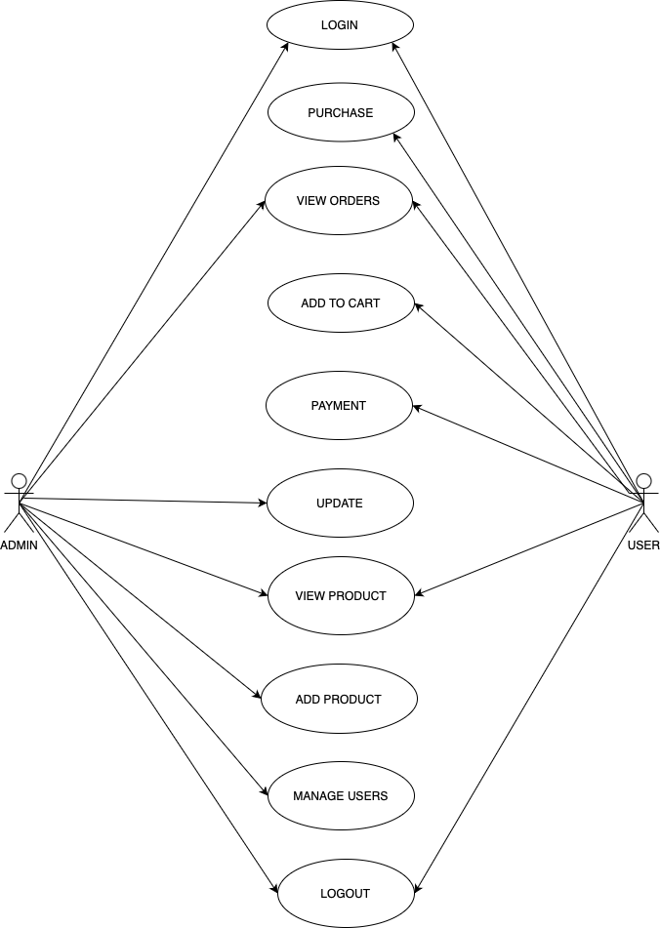
USE CASE DIAGRAM
10

Slide 12
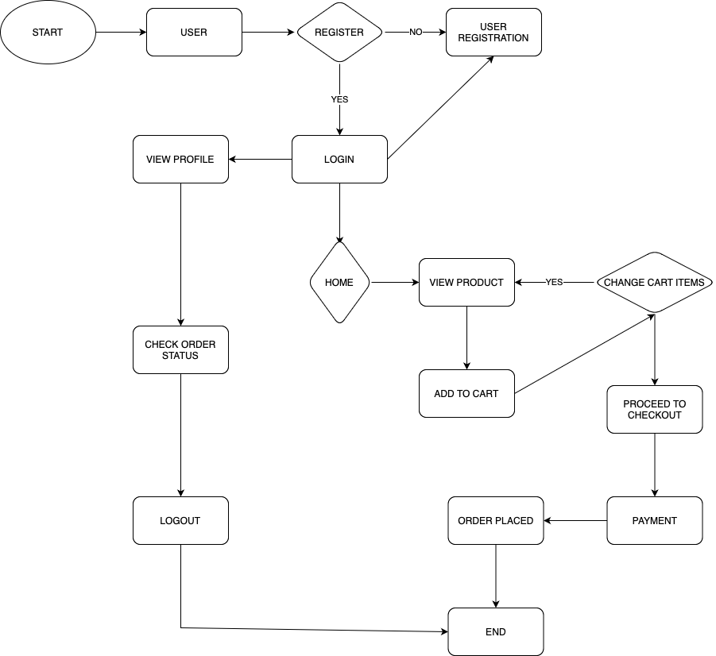




USER SYSTEM FLOW DIAGRAM
11

Slide 13
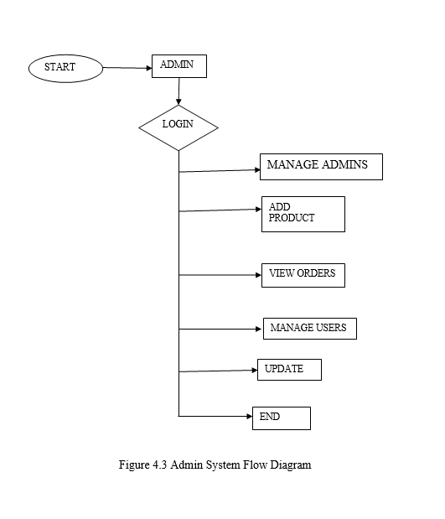
ADMIN SYSTEM FLOW DIAGRAM
12

Slide 14
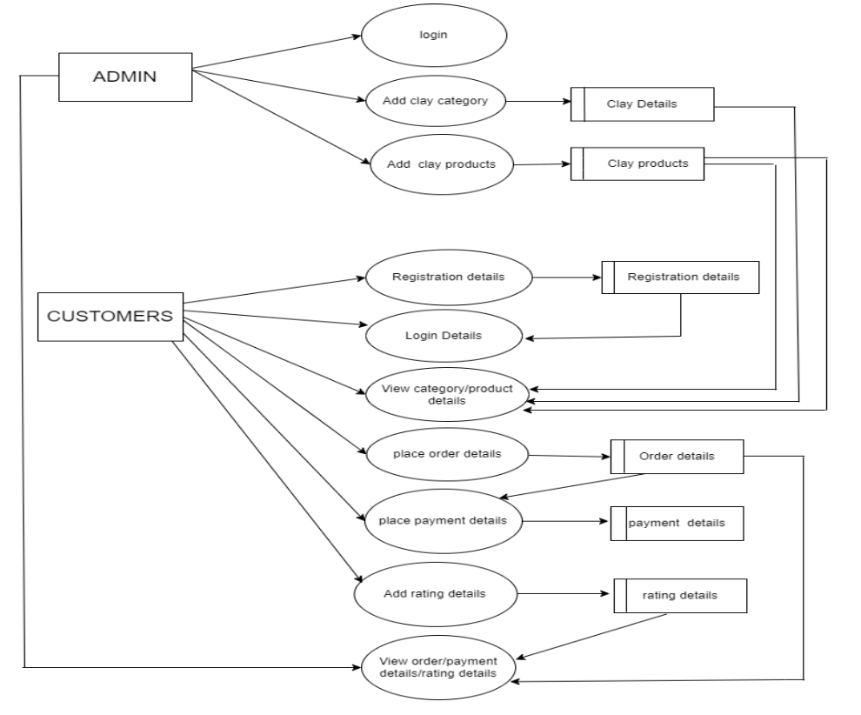
DATA FLOW DIAGRAM
13

Slide 15
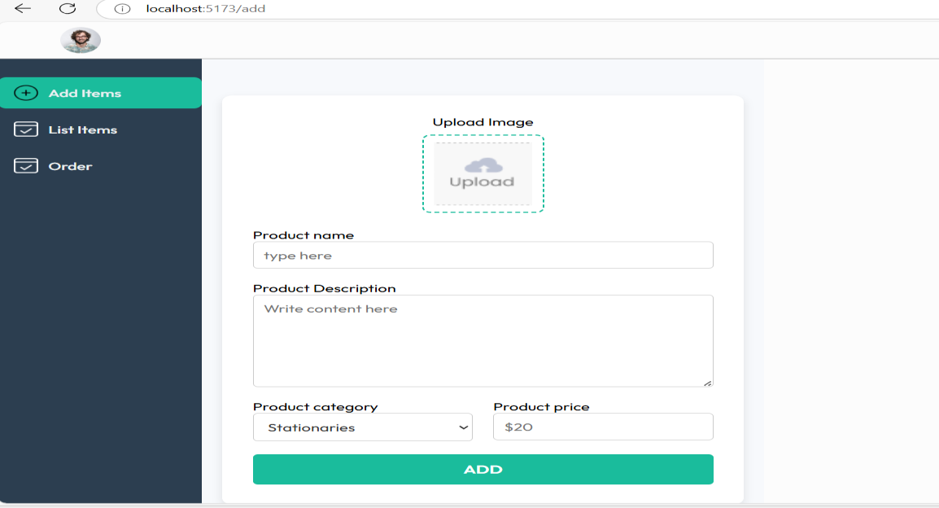
ADMIN DASHBOARD
Admin dashboard for adding the cart items to the database.
Admin Add Items
14

Slide 16
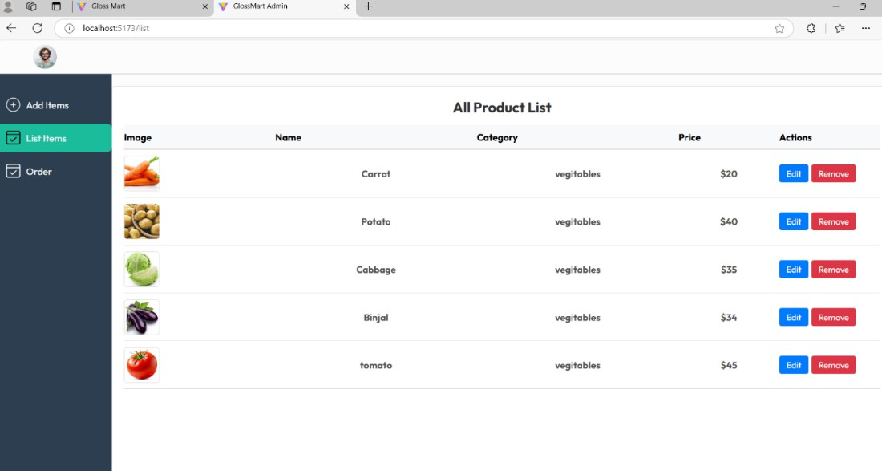
Admin dashboard for listing the cart items to the user on the daily basis we can update the products.
Admin List Items
15

Slide 17
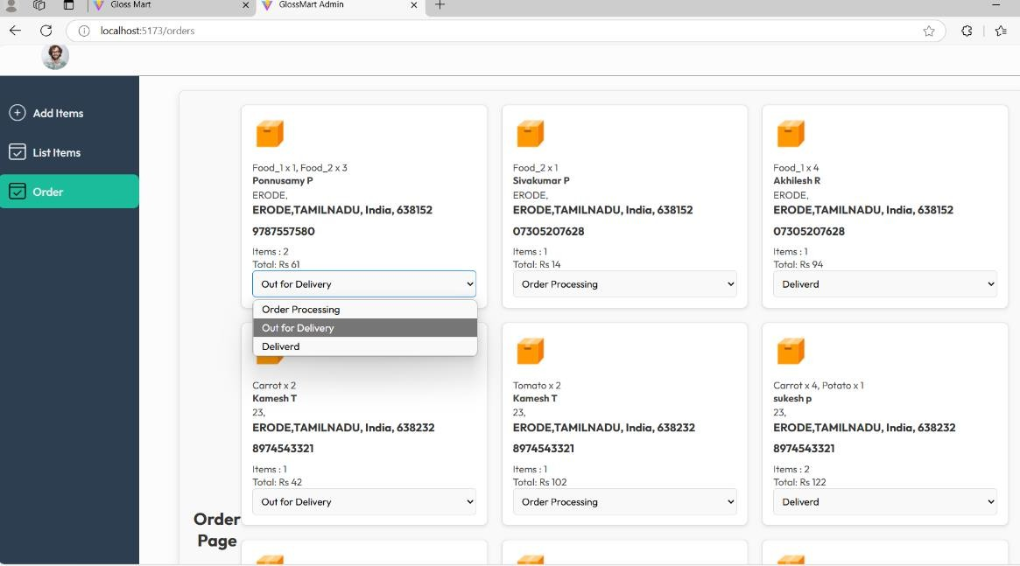
About page , displays details of a user's order, including the items purchased, their quantities, prices, and the total cost. It might also show order status, such as "processing" "out for delivery" or "delivered," and could include tracking information. This visual summary helps users quickly understand their order details and track its progress.
Admin Manage Orders
16

Slide 18
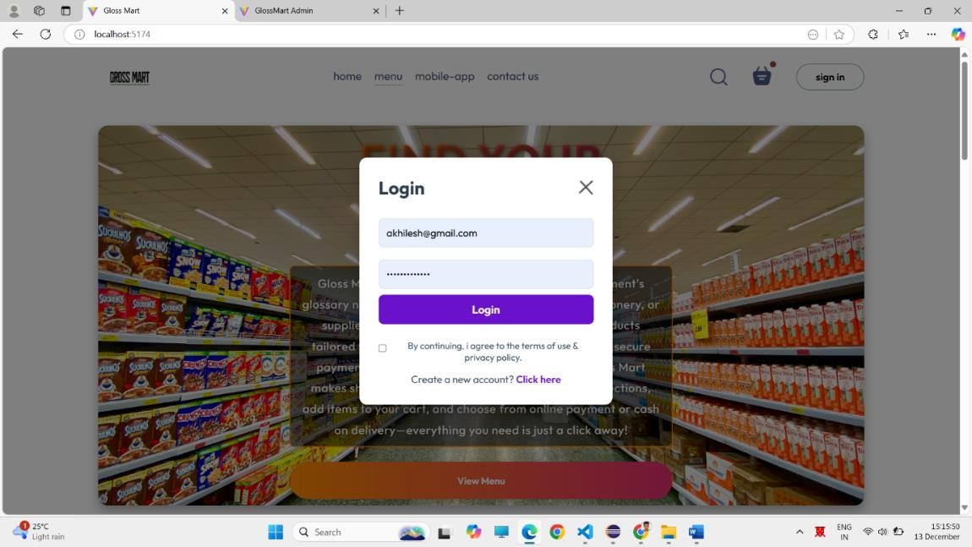
USER
The user login allows customers to securely access their account by entering their registered email and password. The sign-up process enables new users to create an account by providing essential details like name, email, and password for future login access.
User Login Page
17

Slide 19
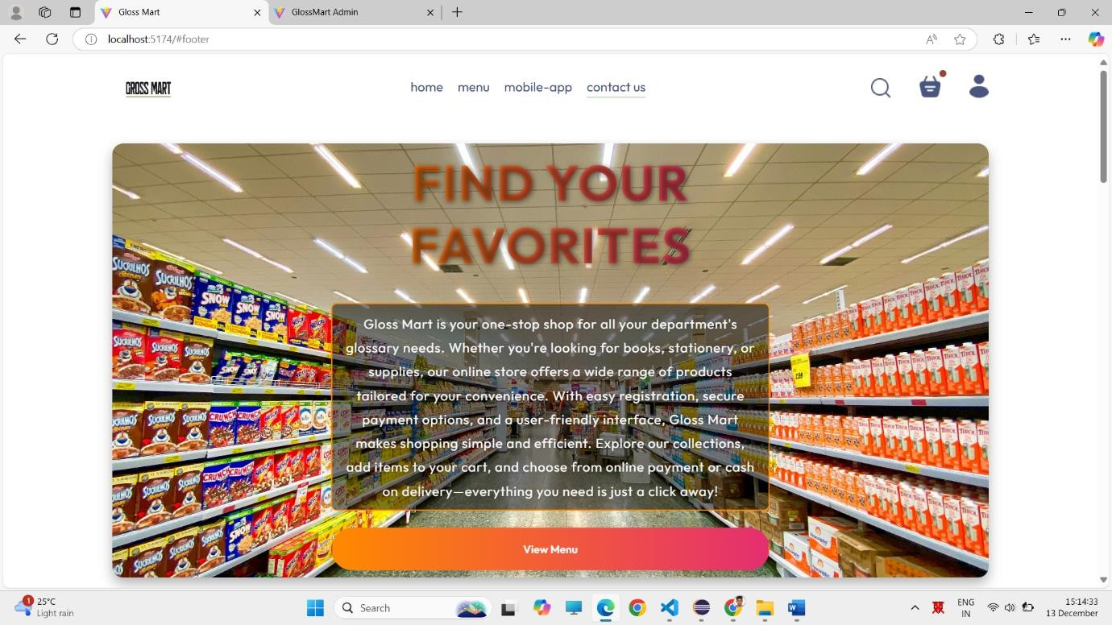
The home page serves as the main entry point of the application, showcasing featured products, categories, and promotions. It provides users with easy navigation to explore items, view their cart, and access various sections of the site.
User Home Page
18

Slide 20
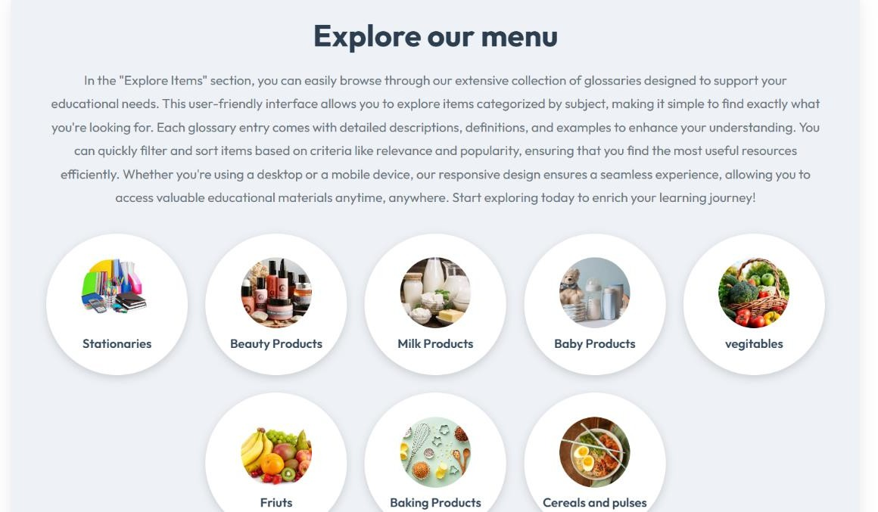
The "Explore Products" section allows users to browse through various product categories, view detailed descriptions, and filter items based on preferences like price, ratings, and brand. It provides an interactive and seamless shopping experience to help users discover products easily.
Explore Product Page
19

Slide 21
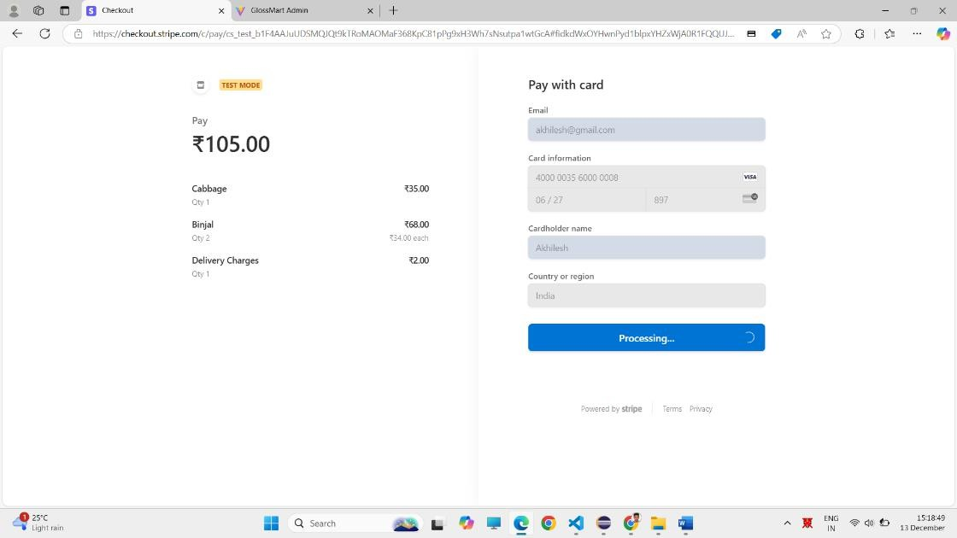
The payment page using Stripe allows users to securely enter their payment information, such as credit card details, to complete their purchase. It provides a seamless checkout experience, including options for billing address entry and payment confirmation, ensuring secure transactions with Stripe's encryption and fraud protection features.
Payment Page
20

Slide 22
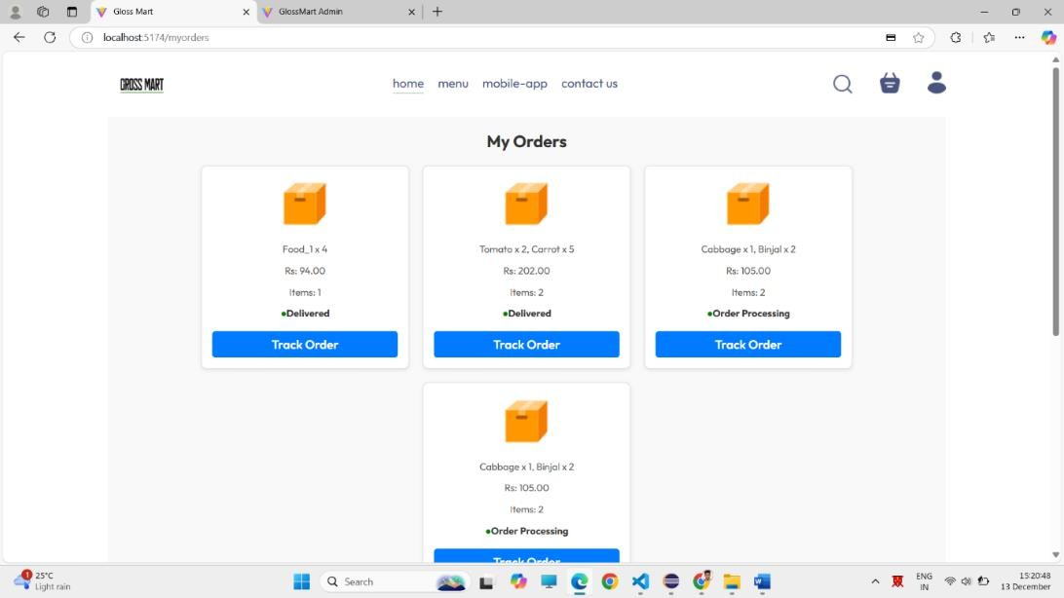
The order page displays a summary of the user's purchase, including product details, quantities, prices, and the total amount. It also shows the order status, delivery address, and tracking information, allowing users to monitor the progress of their order.
Order Page
21

Slide 23
Conclusion
In conclusion, the Gloss Mart Website offers a contemporary, effective, and trustworthy alternative to the difficulties encountered by conventional manual systems in department stores.
By optimizing processes, minimizing mistakes, and improving user satisfaction, it guarantees a secure and seamless shopping experience for customers, while equipping administrators with powerful management resources.
This platform not only enhances operational efficiency but also fosters strategic development, rendering it an essential resource for businesses seeking to attain sustained success in the competitive retail environment.
22

Slide 24
THANK YOU

