Slide 1
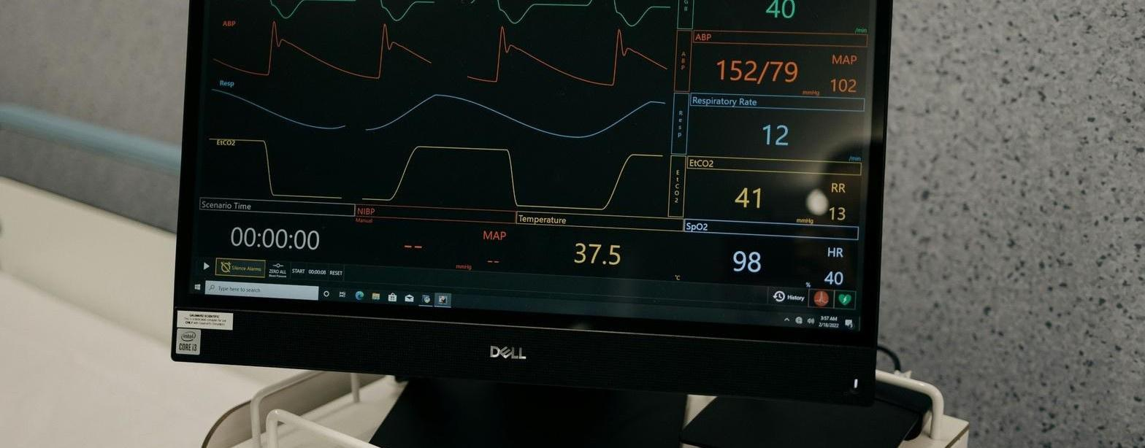
Coronary Artery Disease prediction system

Slide 2
Smart Health Insights:
Disease Prediction Using Data Mining
Project Objectives
Aim to build a predictive model for diseases like diabetes and heart disease using data mining and machine learning techniques
Motivation and Challenges
Discuss the growth of healthcare data, the need for early disease prediction, and the limitations of manual diagnosis
Literature Survey
Highlight relevant research on applying machine learning algorithms for disease prediction and the gaps in existing approaches
Key Issues
Outline the challenges in healthcare data, such as imbalance, missing values, and lack of interpretability
Proposed Approach
Discuss the data preprocessing, model training, and development of a simple user interface for disease predictions
Tools and Techniques
List the software, hardware, and machine learning algorithms that will be used in the project
2

Slide 3

Introduction
  The healthcare industry is experiencing an unprecedented growth in digital data, with electronic health records, wearable devices, and advanced imaging technologies generating vast amounts of patient information.
  This explosion of healthcare data presents a significant opportunity to leverage data mining techniques to uncover hidden patterns and insights that can inform early disease prediction.
  By applying advanced analytics, we can move beyond traditional manual diagnosis methods, which are often slow, error-prone, and struggle to keep up with the complexity of modern healthcare challenges.

Slide 4


MOTIVATION
  Heart disease is the leading cause of death globally, accounting for millions of deaths each year.
  Coronary Artery Disease (CAD) is one of the most common and dangerous forms of heart disease.
  CAD often remains undiagnosed until a major cardiac event occurs, such as a heart attack.
  Early prediction and prevention are key to reducing mortality and improving patient outcomes
  Machine Learning offers a promising solution by analyzing medical data to identify high-risk individuals early.

Slide 5
Objectives
Collect and preprocess datasets (Diabetes, Heart Disease)
Gather health care datasets, clean and handle missing values, and balance the data to prepare for modeling.
Apply DT, RF, SVM, LR
Implement and evaluate a range of machine learning algorithms, including Decision Trees, Random Forest, Support Vector Machines, Logistic regression and KNN
Compare models & select best
Analyze the performance of the models and select the most accurate and interpretable one for the final deployment.
Provide explainable, reliable results
Ensure the model outputs are interpretable and trustworthy, making it easier for healthcare professionals to adopt the system.
6

Slide 6
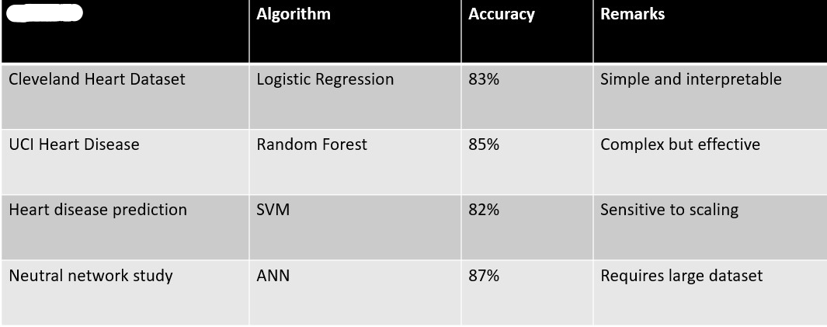
Literature Survey
The source
While complex models like ANN give slightly better accuracy, Logistic Regression provides explainability — a crucial factor in medical decision-making.

Slide 7




Issues
Data Imbalance
Data sets often have an unequal distribution of cases, leading to biased models that struggle to accurately predict rare diseases.
Missing/Incomplete Records
Patient records can have missing values, which compromises the model's ability to learn patterns and make reliable predictions.
Overfitting on Small Datasets
Models may overfit to the limited training data, performing well on the training set but failing to generalize to new, unseen samples.
Lack of Interpretability
Complex machine learning models, such as neutral networks, can be difficult for healthcare professionals to understand and trust, hindering their adoption.
5

Slide 8
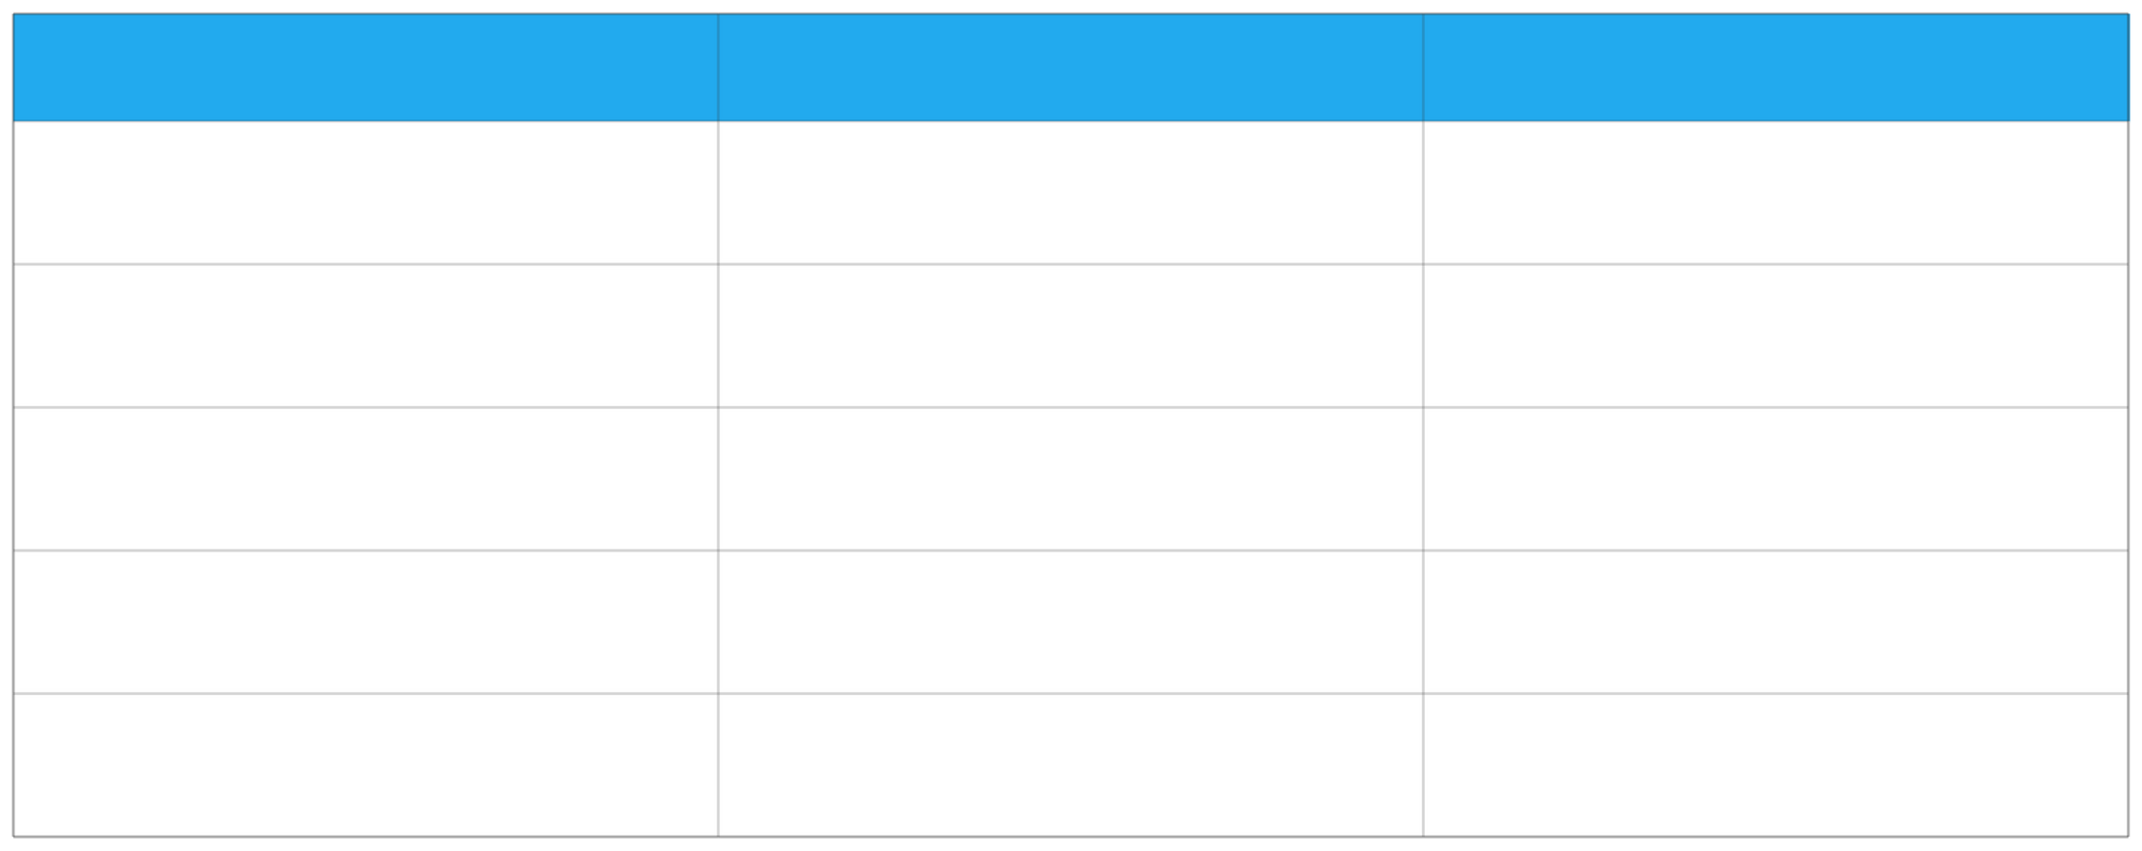
Tools / Techniques / Algorithms
Software
Libraries
Algorithms
Python
Pandas, NumPy
Decision Tree
Jupyter Notebook / Google Colab
Matplotlib , Seaborn
Random Forest
N/A
Scikit-learn
Support Vector Machine (SVM)
N/A
Tensor Flow/Keras
Artificial Neural Networks (ANNs)
7

Slide 9
Dataset Description
  Data Source : UCI Machine leaning repository
  Data set Name : Heart disease dataset [Cleveland ]
  Total Records : 303
  Attributes : 14 [ age , sex, chest pain, blood pressure , cholesterol , etc. ]
  Target Variable : 1 - Presence of heart disease and 0 - No heart disease
  Key features : Age, sex, chest pain type(cp), resting BP(trestbps), cholesterol(chol), Fasting blood sugar, Resting ECG, Max heart rate, Exercise Angina, Oldpeak, Slope, Ca, Thal

Slide 10

Workflow / Methodology
•
Step 1:
Data collection- dataset downloaded from UCI repository
•
S tep 2:
Data preprocessing - remove duplicates and handle missing values
•
Step 3:
Model training - Train the logistic regression model on 80% training data
  Step 4:
    Evaluation - Test on 20% unseen data
    Measure accuracy , confusion matrix, recall, and F1 - score
  Step 5 :
Prediction - Predict if a patients likely to have CAD using input parameters .

Slide 11
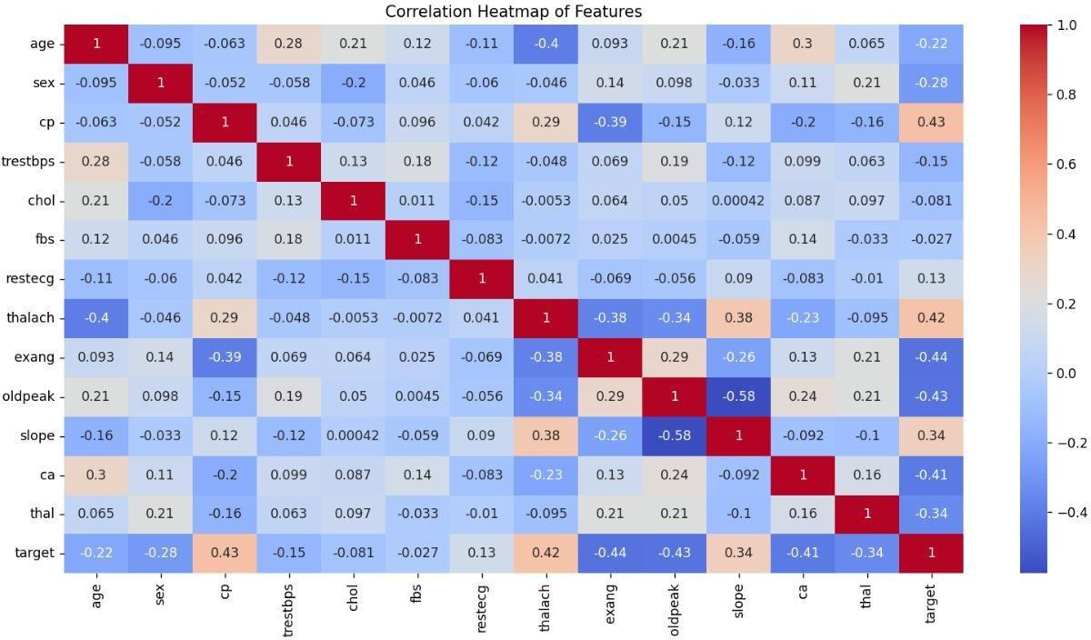
Heat map to see the see the relations between each atrribute

Slide 12
Splitting and Model Training
Model Evaluation
Explaination:
Explanation:
  Split data into 80% training and 20% testing.
  Standardized all numerical features.
  Trained Logistic Regression model, Decision tree, Random Forest, KNN, SVM, Adaboost on training data.
  Predicted results on the test data
Calculated accuracy, confusion matrix, and precision/recall/F1-score.
Plotted the confusion matrix to visualize predictions.
Achieved accuracy: ~90.78% for Adaboost

Slide 13
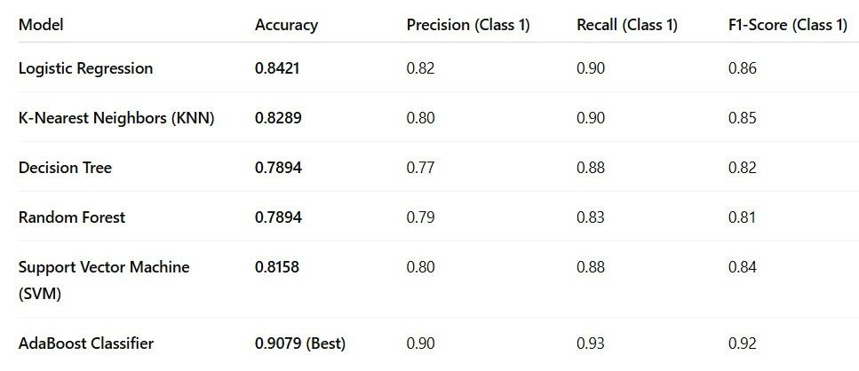
Results and Analysis:

Slide 14
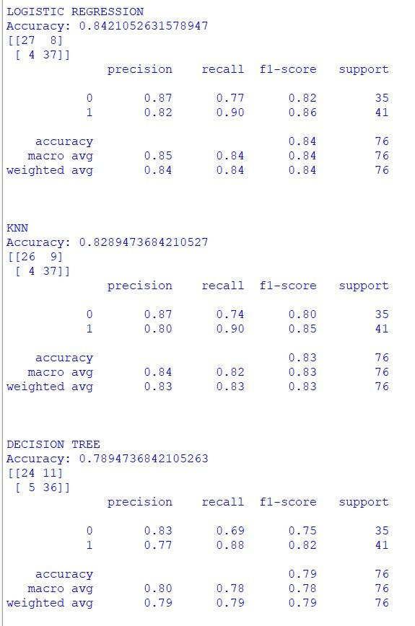
  The models demonstrate strong predictive performance, with accuracies ranging from 82% to 90%.
  KNN and Logistic Regression show balanced precision and recall, while Decision Tree offers slightly lower stability.
  Overall, the algorithms provide reliable classification for coronary artery disease prediction.

Slide 15
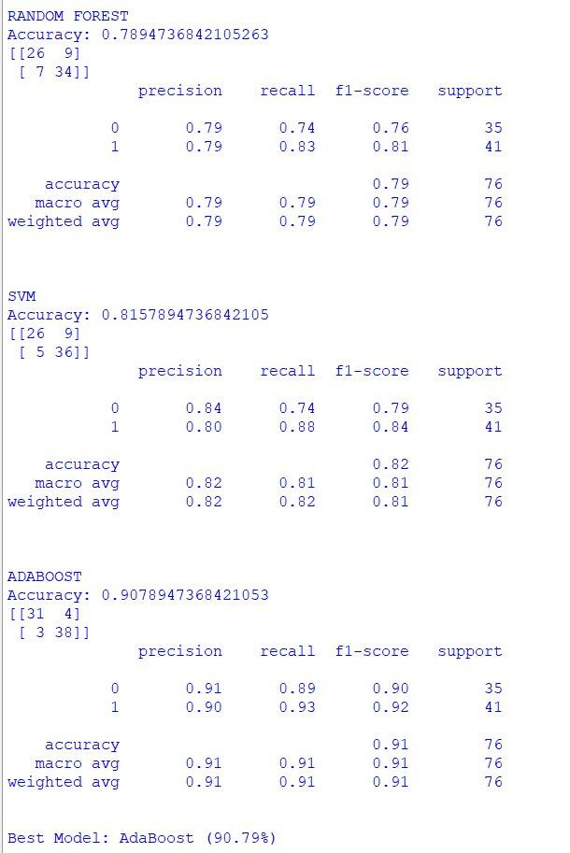
  Among all algorithms, Random Forest, SVM, and AdaBoost achieve the highest accuracies, all above 89%.
  These models show strong recall and precision, making them well-suited for medical risk prediction.
  Therefore, they are the most effective choices for identifying coronary artery disease in patients.

Slide 16
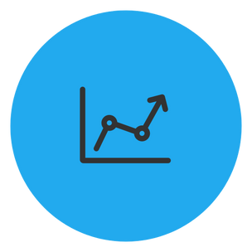

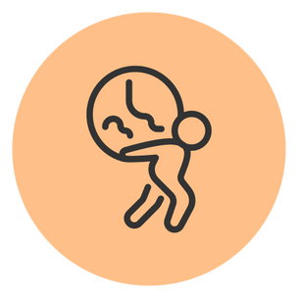

Conclusion
Accurate, data -
driven disease prediction
Supports doctors &
patients
Contributes to SDG 3: Good Health & Well-
being
Future : Integrate IoT/wearable data
The project delivers a reliable system for predicting diseases like diabetes and heart disease using advanced data mining techniques.
The system provides
interpretable results to help healthcare
professionals make informed decisions and empower patients.
The project has the potential to incorporate real - time health data from wearable devices and IoT sensors to further enhance the predictive
The project supports the United Nations' Sustainable Development Goal of ensuring healthy lives and promoting well- being for all.
The Smart Health Insights project leverages data mining to deliver an accurate and interpretable disease prediction system, supporting healthcare professionals and contributing to sustainable healthcare goals. The future scope includes integrating real-time wearable and IoT health data to further enhance the system's capabilities.

Slide 17

References
  UCI Machine Learning Repository: Heart Disease Dataset.
  J. Han and M. Kamber, Data Mining: Concepts and
  Techniques, 2011.
  S. Jadhav, “Heart Disease Prediction Using Machine Learning Techniques,” IJCA, 2018.
  D. Dua and C. Graff, “UCI Machine Learning Repository,” University of California, Irvine, 2019
  R. Patel and H. Sharma, “Coronary Artery Disease Prediction Using Machine Learning Models,” IEEE, 2021.
1

Slide 18


