Slide 1
Stenography
CAPSTONE PROJECT
Presented By : SAIBA SRI MAHALAKSHMI
Student Name : SAIBA SRI MAHALAKSHMI
College Name : GEETHANJALI INSTUTION OF PG STUDIES
Department : MASTER OF COMPUTER APPLICATION

Slide 2
OUTLINE
Problem Statement
Technology used
Wow factor
End users
Result
Conclusion
Git-hub Link
Future scope

Slide 3
Problem Statement
With the increasing need for secure communication and data protection, traditional encryption methods may attract unwanted attention. Stenography, the practice of concealing information within digital media, offers a covert way to transmit sensitive data without raising suspicion. The challenge is to develop a stenography-based system that can efficiently hide and extract text within images, audio, or video files while maintaining the original quality and ensuring minimal detectability. The system should be user-friendly, support various file formats, and provide a robust mechanism for data security and retrieval.

Slide 4
Technology used
Programming Language : Python Development Environment: Python IDLE Libraries & Modules : PIL (Pillow) – For image processing (hiding and extracting data in images)
OpenCV – If working with advanced image processing
NumPy – For handling image data in arrays
Wave (built-in Python module) – If implementing audio stenography
Cryptography – For encrypting the hidden message

Slide 5
Wow factors
1.Invisible Data Hiding
The message is hidden inside an image or audio without changing its appearance or quality, making it undetectable.
2. Encryption for Extra Security
Uses encryption (e.g., AES or simple XOR cipher) to add an extra layer of protection before hiding the message.
3. Multiple File Format Support
Can work with JPEG, PNG, BMP for images or WAV for audio files.
4. Easy Message Extraction
With a simple Python script, the hidden message can be extracted instantly.
5. Minimal Image Distortion
The algorithm ensures that image quality remains unchanged, preventing detection by the human eye.
6. Lightweight & Fast Processing
The program runs quickly and efficiently, even on low-end systems.
7. User-Friendly & Customizable
Simple GUI (if implemented using Tkinter or PyQt) makes it easy to use, or a CLI for power users.

Slide 6
End users
1. Cybersecurity Professionals
To securely transmit sensitive data without attracting attention.
2. Journalists & Whistleblowers
To communicate confidential information without detection.
3. Government & Defense Organizations
For covert communication and data protection.
4. Digital Forensics Experts
To uncover hidden messages in digital evidence.
5. Ethical Hackers & Penetration Testers
To test security measures against hidden data transmission.
6. Individuals Concerned About Privacy
For personal data security in images or audio files.
7. Software Developers & Researchers
To explore data hiding techniques and improve security algorithms.

Slide 7
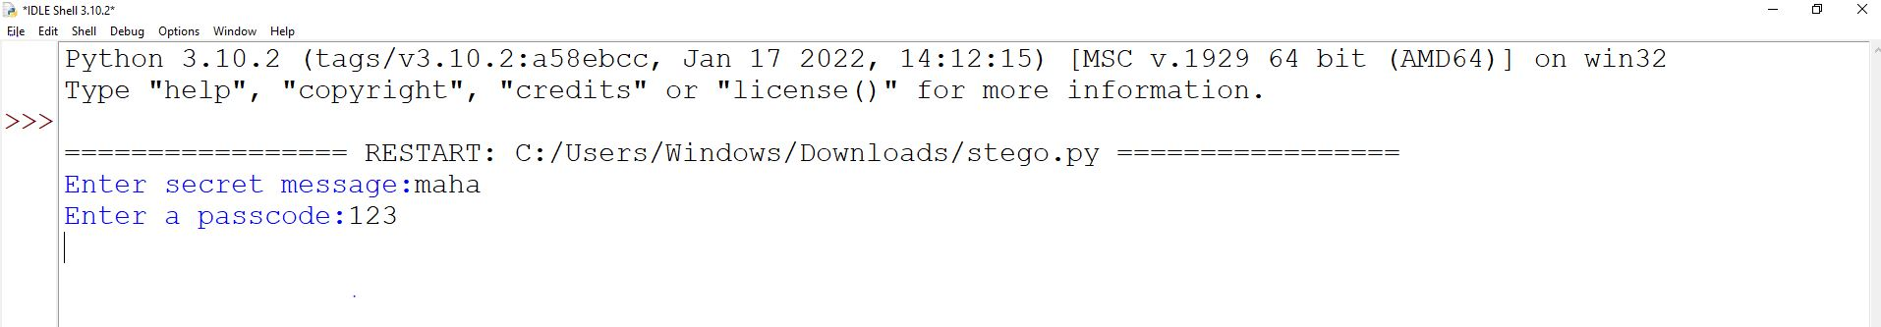
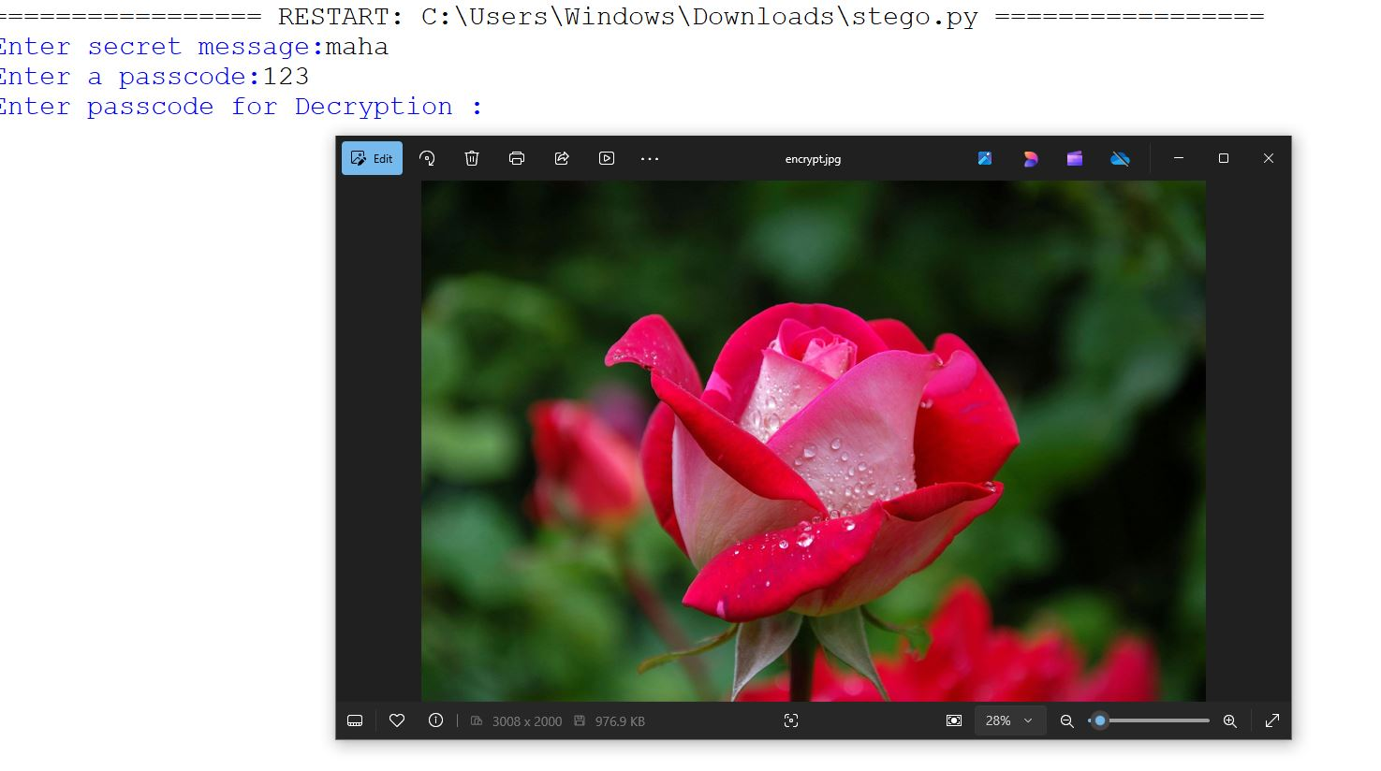
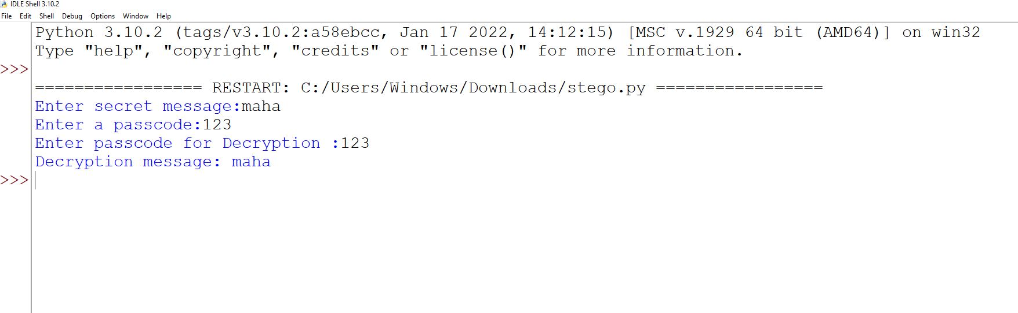
Results

Slide 8
Conclusion
Stenography is a powerful technique for hiding sensitive information within digital media, ensuring covert communication without raising suspicion. This project successfully implements image-based stenography using Python IDLE, allowing users to embed and extract hidden messages while preserving the original quality.
With features like encryption, multiple file format support, and minimal image distortion, the project enhances data security and privacy. It has practical applications in cybersecurity, journalism, digital forensics, and personal data protection.
Future improvements could include audio and video stenography, a user-friendly GUI, and advanced encryption techniques for enhanced security. This project demonstrates the potential of steganography in modern cybersecurity while maintaining simplicity and efficiency.

Slide 9
GitHub Link
https://github.com/sri0099/steno.git

Slide 10
Future scope(optional)
1.Support for Audio & Video Stenography
Extend the project to hide messages in audio (WAV, MP3) and video (MP4, AVI) files for enhanced versatility.
2.Improved Encryption Techniques
Integrate AES, RSA, or SHA encryption to make hidden messages even more secure.
3.AI-Based Steganalysis Resistance
Implement machine learning techniques to make hidden data harder to detect by AI-based forensic tools.
4.Lossless Data Compression
Use compression algorithms (e.g., Huffman coding, LZW) to reduce message size while maintaining quality.
5.Cloud Integration
Enable secure cloud storage and retrieval of steganographic images/audio for remote access.

Slide 11
THANK YOU

