Slide 1
BRAHMAASTRA
MINISTRY/ORGANIZATION : DIRECTORATE OF IT & CYBER SECURITY, DRDO
PROBLEM STATEMENT : CLUSTERING OF AIR OBJECTS BASED ON TRAJECTORY
SRIRAM G
C P VIKRAM ADITHYA
NACHIAPPAN S K
PARITHIMALAN A
KARTHIK UDUPA
MANASA KASHYAP

Slide 2
Data Curation
Collected the flight data from internet sources (including flightradar24.com) for a 6865 flights and helicopters.
Found an API to download a single trajectory in github which took an integer trip id to download the data file
Used sophisticated data mining techniques (such as shell scripting, brute forcing the trip Id) to download a huge collection of trajectories.
Created feature vectors for few other objects for clustering
Further the data (trajectory) synthesisation for other air objects is currently in progress

Slide 3
Data Curation
Collected the flight data from internet sources (including flightradar24.com) for a 6865 flights and helicopters.
Found an API to download a single trajectory in github which took an integer trip id to download the data file
Used sophisticated data mining techniques (such as shell scripting, brute forcing the trip Id) to download a huge collection of trajectories.
Created feature vectors for few other objects for clustering
Further the data (trajectory) synthesisation for other air objects is currently in progress

Slide 4
Feature Extraction
What is feature extraction?
Why did we choose feature extraction?
Following are the most relevant and differentiating features extracted from the trajectories
Maximum Altitude
Vertical Accelerations (Up and Down)
Horizontal Speed
Distance
Radar Cross Section
Other features were also extracted to help in classification
Synthetic Feature Vectors

Slide 5
Clustering
K-means:
It is a centroid based algo for which you must input the k (number of clusters we expect)
Why K-means?
Our clustering method predicts dropped bomb and missiles very well, however, higher order clustering is required to differentiate the finer features
Pick a cluster and further cluster it to get better results.
Example: Fighter jets usually are in squadron so we can apply density based clustering algorithm on the location to find a group of fighter jets. Also we can detect maneuvers.
Deviation from specified flight routes.
After clustering, we reduce dimensions (TSNE) and plot it on our UI to visualize

Slide 6
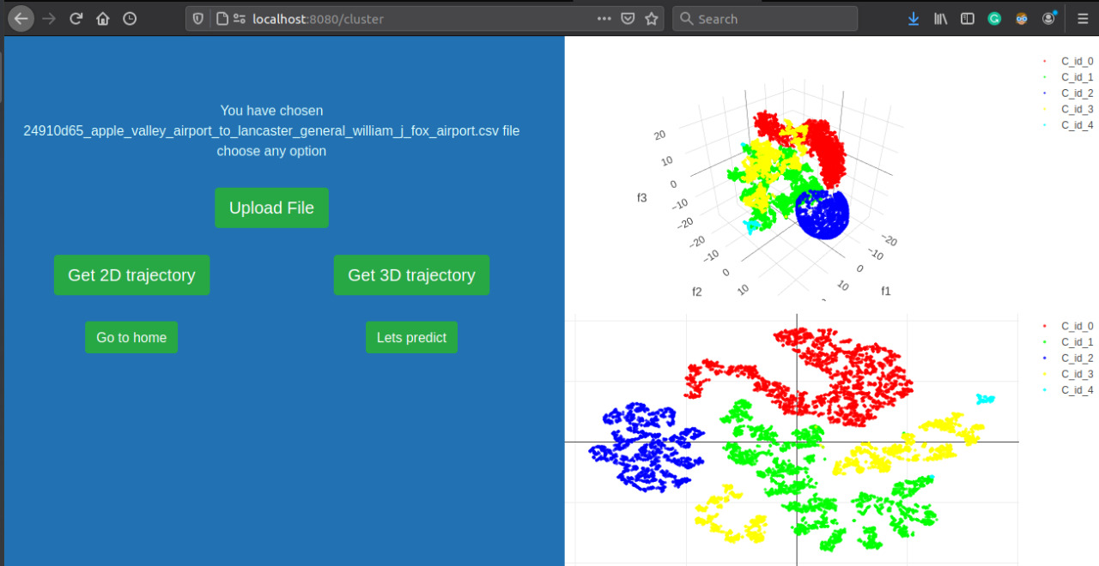

Slide 7
Trajectory Prediction
Static approach
Dynamic approach
Long term predictor, short term predictor - > 2 LSTMs
Layered LSTMs

Slide 8
Trajectory Prediction
Why LSTM?
Remembers even the earlier parts
implementing changes
making additions to the existing code
Future possible enhancements
Features & Region of Interests
Bi-directional
Reduce noise by applying filters

Slide 9
Missile Guidance
Using the prediction from previous part, we will try to guide the missile to intercept a hostile air object using the following algorithm,
For every time step,
At this time step, we know the state of the missile and the target.
Using the LSTM we predict the trajectory for next 20-30 seconds.
Based on this we find the optimum location in space where the target could be intercepted possible and we will guide the missile in that direction.

Slide 10
UI
Our UI consists of two Main pages one for “Clustering” and another for “Prediction”.
clustering page:
We can visualize the clusters formed in a 2-D and 3-D scatter plot.
We can also view which data file it is by clicking on test points in 3-D cluster
prediction page:
Allows us to visualize the actual and predicted trajectories in 3-D and also in 2-D over a map.
The above feature can also be done on the clustering page
Our UI is made to:
ease the understanding of the large amounts of processed data
provide a quick visualization of the various types of data.
For the UI’s backend, we have made use of used Node js and Express framework and also applied python for interconnecting the data in the backend.
For the frontend, we have used HTML,CSS and Javascript and have made use of some additional packages such as Folium(python), Plotly graphing package(Javascript) and Bootstrap(CSS).

Slide 11
Result
Created synthetic datasets for 50 trajectories (10 for each cluster, namely flight, helicopter, dropped bomb, missile and fighter jet)
Clustering:
We took 9 files of each type and used them for training. We then computed the centroids for k means clustering and the files were clustered out perfectly
While testing with 5 new files there was one misprediction.
Trajectory Prediction:
Obtained good results but loss can be further improved if given more data and training
Missile guidance:
Missile comes within 500 meter range of the air object

