Slide 1
STRUCTURE OF “C” (PSC)
Patalay Amrith
22B81A0406
I B.Tech. I. Sem. ECE-A
2022-23
CVR College Of Engineering

Slide 2
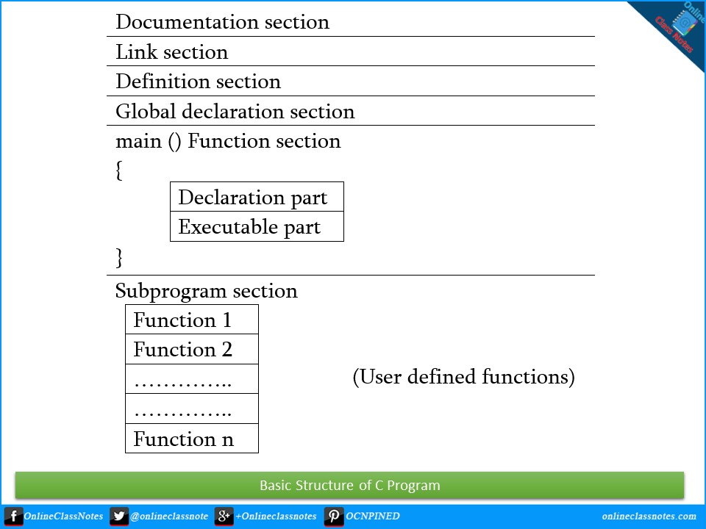

Slide 3
Documentation Section
This section of the program consists of a set of comment lines such as File name, Author name, Date of execution, etc.
It gives us the overview of the program.
It is also known as commenting section.
The Documentation section contains:-
1. File name.
2. Author name.
3. Date of execution.
4. Description.
/** * file: age.c * author: you * description: program to find our age. */

Slide 4
Link Section
This section of the program provides instructions to the compiler to link functions from the system library.
This section is used to declare all the header files to be used in the program.
Some of the header files used in “C” programming are
1. #include<stdio.h>
2. #include<math.h>
3. #include<conio.h>
4. #include<stdlib.h>
#include<stdio.h>

Slide 5
Definition Section
This section of the program is to define different constants which we are going to be used in the program.
The keyword used is:- #define
#define BORN 2000

Slide 6
Global Declaration Section
This section of the program is to declare all the global variables to be used in the program.
The declaration of global variables occurs only outside the blocks.
This section also declares all the user-defined functions.
int age(int current);

Slide 7
main() function Section
It is the body of C-program.
It consists of two parts:-
1. Declaration part:- All the variables will be declared in this part.
2. Executable part:- All the operations will be made in this part.
Both these parts should be written in between curly brackets i.e; {}.
int main(void) { int current = 2021; printf("Age: %d", age(current)); return 0; }

Slide 8
Sub program Section
This section of the program contains all the user-defined functions that are called in the main() function.
User-defined functions are generally placed immediately after the main() function, although they may appear in any order.
int age(int current) { return current - BORN; }

Slide 9
/** //Documentation * file: age.c * author: you * description: program to find our age. */ #include <stdio.h> //Link #define BORN 2000 //Definition int age(int current); //Global Declaration int main(void) //Main() Function { int current = 2021; printf("Age: %d", age(current)); return 0; } int age(int current) { //Subprograms return current - BORN; }

Slide 10
Thank you

