Slide 1

Data Warehousing with IBM Cloud Db2 Warehouse
INDRODUCTION:
The project is aimed at transforming the initial data warehousing design into an innovative solution that not only consolidates data but also leverages advanced technologies and strategies to drive data-driven decisionmaking.
By Srikanth KIT

Slide 2
Device Integeration
Identify Data Sources:List all the devices and sensors from which you intend to collect data. This could include temperature sensors, GPS devices, industrial machinery, or any other IoT devices.
Data Collection:Determine how data is collected from these devices. Some devices may transmit data through APIs, while others might use standard communication protocols like MQTT, CoAP, or HTTP.
Data Ingestion:Choose an appropriate method to ingest data from devices into your data warehouse. This could involve setting up data ingestion platforms or tools that can handle various data formats.

Slide 3

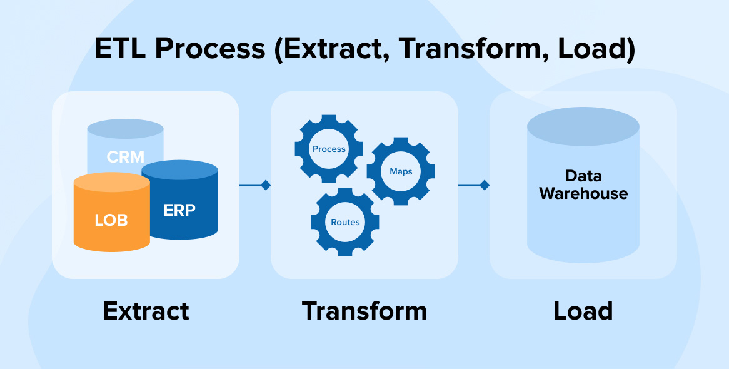
Real-time Data Processing:If real-time data is critical for your project, consider using real-time data processing technologies such as Apache Kafka, Apache Flink, or AWS Kinesis to handle streaming data from devices.
ETL Processes:Integrate the device data into your ETL (Extract, Transform, Load) processes, which may involve using ETL tools and frameworks. These processes will ensure that device data is structured and integrated with other data sources.
Data Governance and Security:Implement data governance and security measures to protect device data. This includes encryption, access control, and auditing.
Data Catalog and Metadata Management:Include device data in your data catalog and metadata management system. This will help users discover and understand the available device data assets.

Slide 4



Monitoring and Alerts:Set up monitoring for device data to detect anomalies or issues in real-time. Configure alerts that notify your team if there are data transmission failures or irregularities.
Backup and Recovery:Ensure you have backup and recovery strategies in place for device data. Data loss can be costly, so having a reliable backup system is essential.
Device Management:Implement device management capabilities to monitor and control the status and health of connected devices. This can include remote device management and firmware updates.
Data Retention Policy:Define a data retention policy that outlines how long device data will be stored in the data warehouse. This policy should consider legal requirements and data usage.
Data Analytics and Visualization:After integrating device data, make it available for analytics and visualization tools. This could include creating dashboards and reports that provide insights from device data.

Slide 5

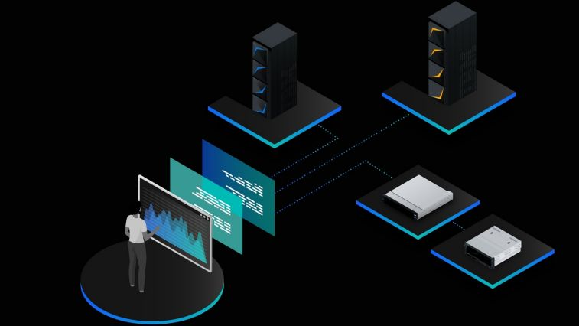
Compliance and Regulations:Ensure that your device data integration complies with relevant industry regulations and data privacy standards, especially if the data contains sensitive information.
Documentation:Document the entire device integration process, including configurations, data sources, ETL processes, and data governance practices.
Code :
CREATE TABLE Sales (
OrderID INT,
ProductID INT,
OrderDate DATE,
Quantity INT,
Price DECIMAL(10, 2),
CustomerID INT,
PRIMARY KEY (OrderID));

Slide 6
conclusion
In the building and maintaining a data warehouse is a comprehensive and dynamic project that requires careful planning, ongoing attention, and a commitment to data quality and security. When executed effectively, a data warehouse can serve as a valuable asset, supporting informed decision-making and data analysis across an organization.

