Slide 1
Predicting Human Preferences for LLM responses
Team Members:
SRIHARI INUKURTHI (srihari.inukurthi@ucdenver.edu)
YEAMON SULTANA (yeamon.sultana@ucdenver.edu)
Video Link: Presentation

Slide 2
Problem Statement
Language models, like those powering chatbots and content generators, are designed to understand and produce human-like text. They’ve shown impressive abilities, from answering questions to creating creative content.
However, these models don’t always get it right. This misalignment can cause real-world issues, like frustrating users in customer support or producing content that feels uninspired or out of touch.
To address this, we need better ways to align LLM outputs with what people truly value, making their responses more engaging, relevant, and human-centered.

Slide 3
Motivation
The central focus of this project is to address the gap between LLM-generated outputs and human preferences by leveraging advanced fine-tuning techniques like Low-Rank Adaptation (LoRA).
Through this approach, we aim to analyze and align LLM responses with human expectations, making AI interactions more intuitive and satisfying.
By the end of this project, we hope to contribute to the creation of user-friendly AI systems that prioritize human-centric design and meaningful engagement.

Slide 4

Metrics used
Cross-Entropy Loss:
Cross-Entropy Loss (also called Multi-class Cross-Entropy Loss or Log Loss in multi-class classification) is a loss function used for classification problems where each sample belongs to one of multiple classes.
The loss function computes the negative logarithm of the predicted probability for the true class, penalizing the model more when the predicted probability for the correct class is low.
If the model predicts a high probability for the correct class, the loss will be smaller. If the model assigns a low probability to the correct class, the loss increases.
It works well because it uses the predicted probabilities and compares them to the actual distribution (which is typically a one-hot encoded vector). This allows for models that output probabilities to be directly optimized.

Slide 5
Why Cross-Entropy Loss
For our problem of language model (LLM) outputs with what people truly value, using log loss instead of traditional classification metrics is important because it helps optimize probability calibration.
Language models, especially in tasks like generating creative content or customer support, benefit from log loss by being penalized more for confidently incorrect or off-target responses, encouraging better alignment with user intent.
This leads to outputs that are more relevant, human-centered, and engaging, rather than merely correct in a binary sense.

Slide 6
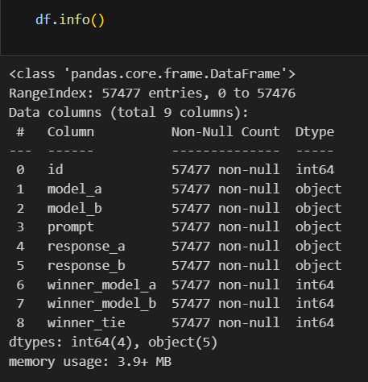
Dataset Collection
For the purpose of this project, we used dataset from the Kaggle dataset repository and the Hugging face dataset repository.
https://drive.google.com/file/d/1VKlPDHf_WAaqEs3eNtjY2ZfWy5zmQjhs/view
The training dataset includes over 55,000 real-world user and LLM conversations across more than 70 state-of-the-art LLMs (e.g., GPT-4, Claude 2, Llama 2, Gemini, Mistral).

Slide 7
Tools and Libraries
Pandas
Pandas are a fast , powerful, flexible, and easy to use open - source data analysis and manipulation tool.
Offers data structures and operations for manipulating numerical tables and time series.
NumPy
Numerical Python, is one of the most valuable libraries in Python, with numerous built-in functions. It can be used to perform various mathematical operations on arrays.
PyTorch
Open-source deep learning framework known for its flexibility and high-performance capabilities.
Used for building and deploying deep learning models, especially large models like transformers.
Supports parallel processing with multi-GPU setups, automatic mixed precision, and robust memory management.

Slide 8
Tools and Libraries
Gemma 2
A large-scale transformer model used for natural language processing (NLP) tasks.
capable of handling complex linguistic patterns and can be fine-tuned for specific tasks, such as sequence classification.
LoRA (Low-Rank Adaptation)
A method used to adapt large pre-trained models efficiently. Instead of retraining all the model’s parameters, LoRA modifies a small subset of parameters in a low-rank manner.
Hugging Face Transformers Library
Provides a vast selection of pre-trained models, including transformers like Gemma2.
Offers tools for fine-tuning these models on specific tasks.
PeFT (Parameter-Efficient Fine-Tuning)
PeFT is a technique designed to fine-tune large pre-trained models efficiently by reducing the number of parameters that need to be updated during the fine-tuning process.

Slide 9
Exploratory Data Analysis
The EDA phase helped us explore the dataset's structure and identify key trends, such as the frequency of model usage.
By comparing win rates, we identified which models were most frequently preferred by humans, highlighting performance disparities.
The findings from EDA point to the need for further analysis, like sentiment and text analysis, to better understand what drives human preferences in LLM responses.

Slide 10
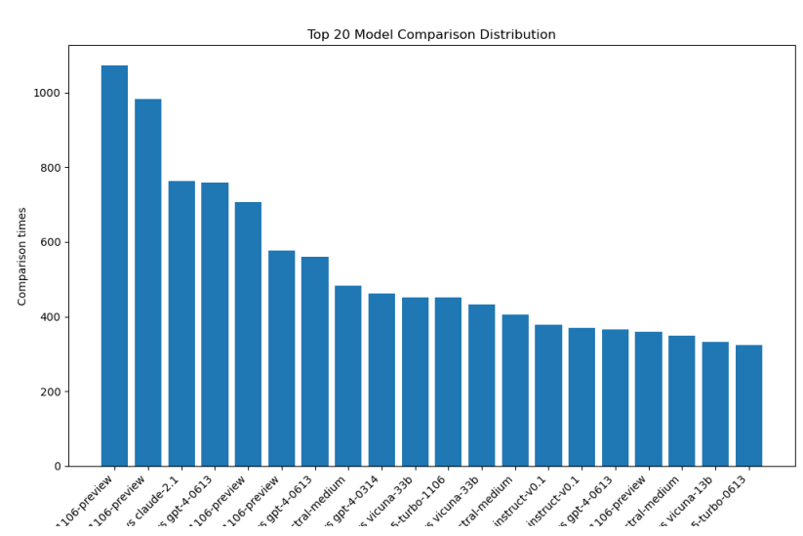
Exploratory Data Analysis

Slide 11
Fine-Tuning with RoBERTa Model
We used a pre-trained RoBERTa model to predict human preferences by adapting its initial weights for the task of distinguishing between preferred and less preferred LLM responses.
The roberta-base model from Hugging Face is configured for multi-class regression, using AutoModelForSequenceClassification to output continuous preference scores for multiple response categories.
A custom BERTDataset Class tokenizes input text, adding [CLS] and [SEP] tokens, while ensuring consistent input dimensions through truncation and padding.
We use the AdamW optimizer with dynamic learning rate adjustments and Mean Squared Error (MSE) as the loss function, running on Pytorch with GPU support via CUDA.
Implementing 5-fold cross-validation ensures better model generalization and reduces overfitting by evaluating the model on different validation sets.

Slide 12
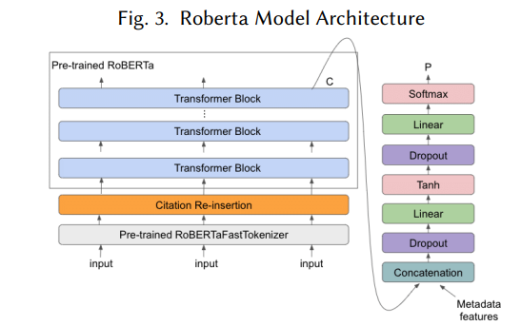
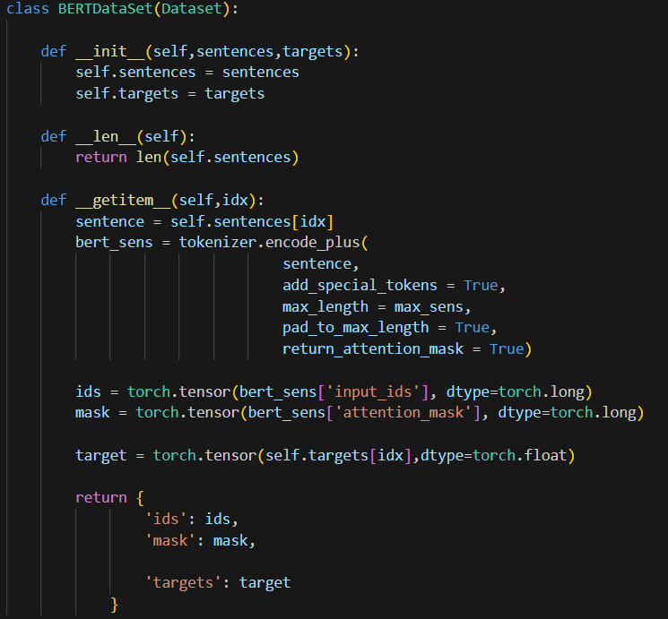
Fine-Tuning with RoBERTa Model

Slide 13
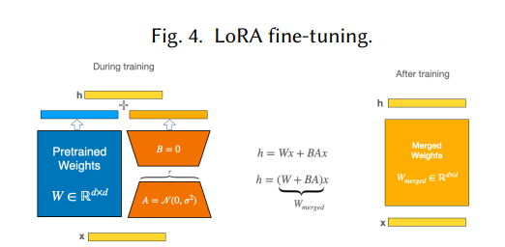
Fine-Tuning with LoRA and PEFT
LoRA fine-tunes large pre-trained models by freezing the original model weights and introducing trainable low-rank matrices (A and B) to approximate weight updates.
This reduces the number of trainable parameters and computational load, improving efficiency by up to 10,000x.
PEFT optimizes fine-tuning by freezing most of the pre-trained model layers and only updating the essential ones (e.g., output layers), saving both computational resources and time.
We use the Llama 2 8b model fine-tuned with LoRA for human preference prediction.
Distributed Inference is applied by splitting input data across two GPUs and processing them concurrently for faster inference.

Slide 14
Enhanced Efficiency with Gemma2 and Key Differentiators
The Gemma2 model builds on Llama 2 with optimized configurations like adjusting tokenizers and LoRA checkpoints, using the spread_max_length feature for better token distribution.
The model’s configuration includes rank 16 and max length 2048 to handle more data efficiently compared to Llama’s batch size of 1024.
Demonstration

Slide 15

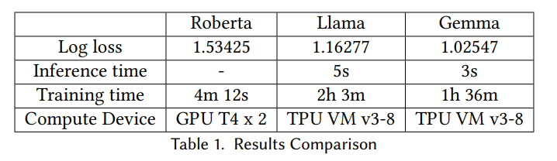
Results
RoBERTa, Llama, and Gemma were evaluated for predicting human preferences.
Models were tested on unseen samples using Kaggle’s evaluation system.
we used sed Cross-Entropy Loss (Log Loss) to measure accuracy.

Slide 16
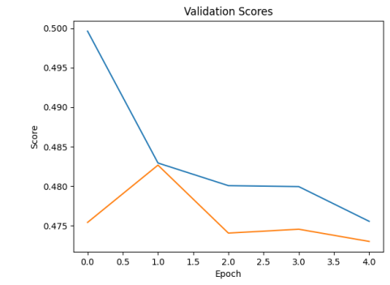
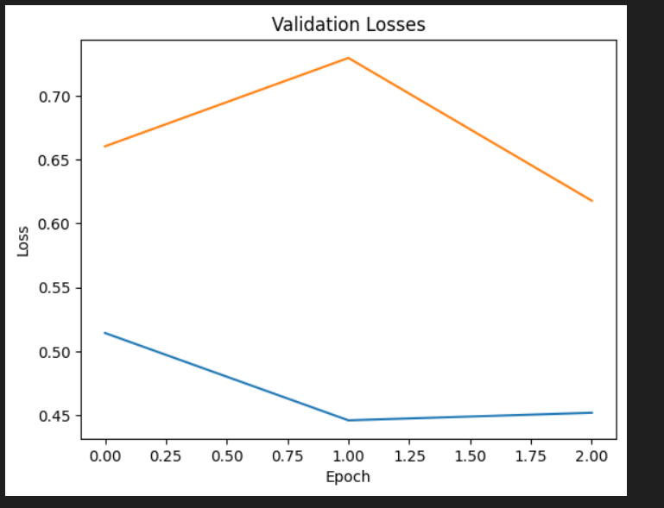
Results

Slide 17
Results
Model Observations:
Gemma :
Delivered best accuracy with faster inference and training times.
Required fewer epochs to converge, saving time and resources.
Llama :
LoRA-based tuning balanced accuracy and computational efficiency.
RoBERTa :
Achieved reasonable results but lagged behind the larger models.

Slide 18
Enhancements and Learnings
Model Improvements:
Fine-tuned hyperparameters like learning rate, batch size, and LoRA rank for better performance.
Applied data augmentation techniques (e.g., paraphrasing, concatenation) to enhance accuracy slightly.
Inference Optimizations:
Introduced Test-Time Augmentation (TTA) to improve robustness by averaging predictions across input transformations.

Slide 19
Lesson Learned
By fine-tuning Gemma2 with LoRA, we demonstrated how powerful models combined with efficient techniques can handle complex linguistic tasks and large datasets effectively, which would have been challenging with smaller tools.
The use of multi-GPU parallelization and dynamic memory allocation helped overcome computational limitations, emphasizing the importance of scalable processing in handling heavy computational workloads.
The application of Test-Time Augmentation (TTA) showcased how thoughtful augmentation strategies can improve model robustness and mitigate biases, a critical learning in building fair and accurate AI models.
Preprocessing techniques like token sorting and dynamic padding revealed the benefits of maximizing GPU utilization and minimizing overhead, critical for efficient handling of large-scale data.

Slide 20
Challenges/Future Plans
We faced challenges with the dataset’s lack of diversity in language, cultural context, and conversational tone, which affected the models' ability to generalize to real-world interactions. To Address This: We plan to enhance the dataset by curating additional samples from varied sources and incorporating automated tools and human reviewers to ensure better quality and reduced bias.
Working with large models like Gemma and LLaMA often led to storage and memory bottlenecks, limiting the number of experiments we could run within the project’s timeline. To Overcome This: We aim to use methods like LoRA fine-tuning, 8-bit quantization, and multi-GPU setups to optimize memory usage and improve computational efficiency.
Human-generated labels occasionally introduced biases, making the model sensitive to subjective preferences. To Mitigate This: We will explore approaches like multi-annotator consensus and fairness-aware training to reduce the impact of biased labels on the model’s predictions.

