Slide 1
PBL REVIEW – 4
TEAM – GROUP 10
AI-Based Disaster Relief Management System
Srianish Saravan
2510030417
Vinay Goud
2510030339
G. Akshith
PBL Review – 4
2510030365
Results & Analysis • Implementation • Working Demonstration
Numairuddin
2510030353
Mohit
Faculty Mentor: Dr. Md. Rafeeq
K L University, Hyderabad • Group 10
2510030336
Notes:
Title slide: AI-Based Disaster Relief Management System, PBL Review 4, Group 10.

Slide 2




Project Objectives
Turning the Review 3 design into a demonstrable operational workflow.
01
02
03
04
Centralize Relief Data
Support Faster Prioritization
Control Allocation
Keep Actions Traceable
Keep incidents, victims/needs, shelters and resources in a shared relational record.
Use severity, affected people, urgency, access conditions and capacity as priority inputs.
Reserve and issue resources without exceeding available stock.
Record approvals, changes, dispatch updates and delivery details with time and actor.

Slide 3
Project Development Approach
Data preparation → application implementation → testing → deployment readiness.
1
2
3
4
5
6
Requirement Analysis
Data & Database Setup
Frontend Implementation
Backend & API Implementation
Testing & Debugging
Deployment, Backup & Maintenance
DATA PIPELINE
Source
Collect
Clean
Organize
Check
Store
PROJECT DATA SOURCES
NCS
NDMA SACHET
OGD / IMD
Census of India

Slide 4


Project Implementation
Technology stack and the parts implemented for the demonstration.
Frontend
Backend
Database
HTML5 • CSS3 • JavaScript
Python
MySQL 8 / InnoDB
Forms, dashboards and role-based UI
API layer, validation and business rules
Relational storage and transactions (target architecture)
APIs
Portable Demo Database: SQLite
Login API
Dashboard API
Incident API
The demonstration runs on SQLite for zero-setup execution.
Target architecture: MySQL 8 / InnoDB.
SQLite is used only for the portable demo, not as the production database.
Resource API
Allocation API
Audit API
Development Environment: VS Code • Python runtime • Local development server

Slide 5
System Architecture
Request flow: User → Frontend → API / Backend → Database → Response.
USER
FRONTEND
API / BACKEND
DATABASE
RESPONSE
Login / submit / monitor
HTML / CSS / JavaScript
Python • Validation • Business Rules • Allocation Logic
MySQL / InnoDB (target)
Dashboard / Status / Reports
USERS / ACTORS
Admin / Agency
Field Team
Shelter / NGO
Actors interact through the web frontend; modules are served by the API layer and share one relational record.
OPERATIONAL MODULES
Incident
Inventory
Allocation
Delivery
Audit

Slide 6
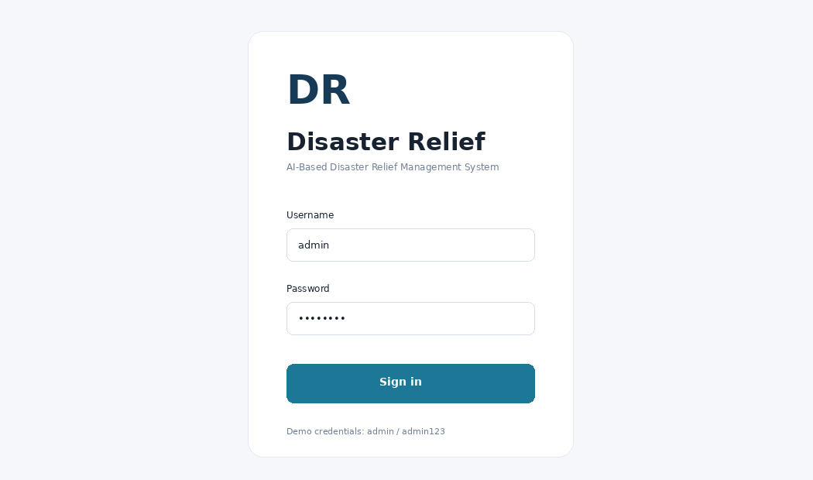
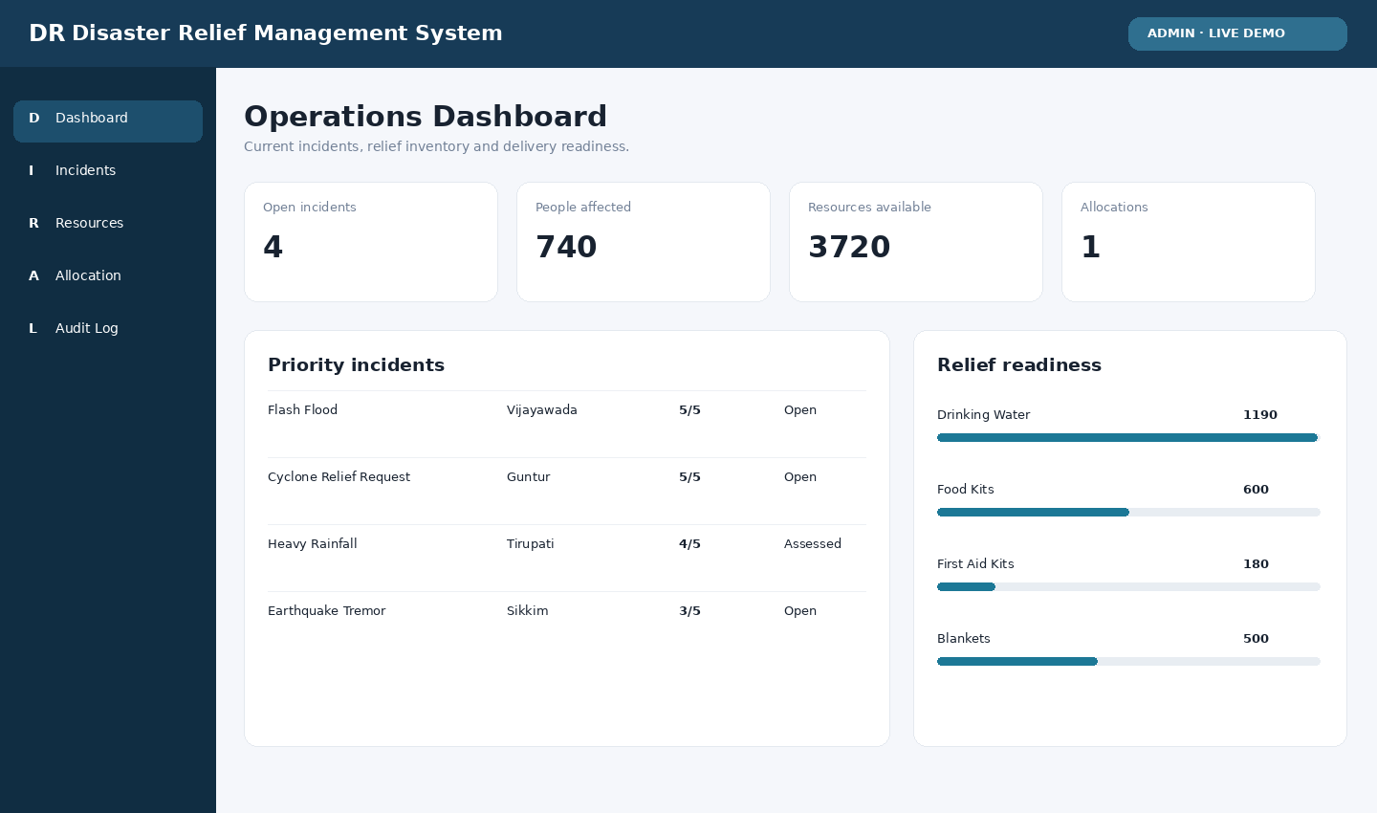
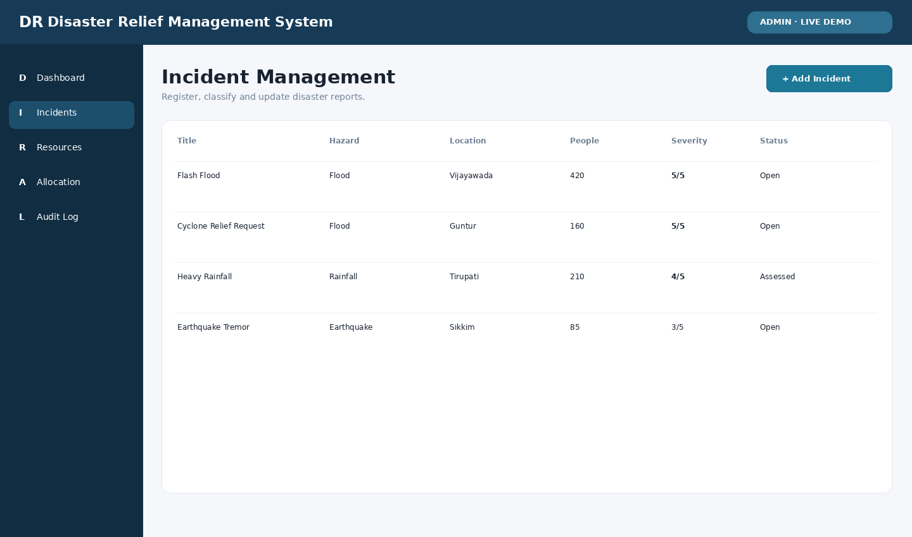
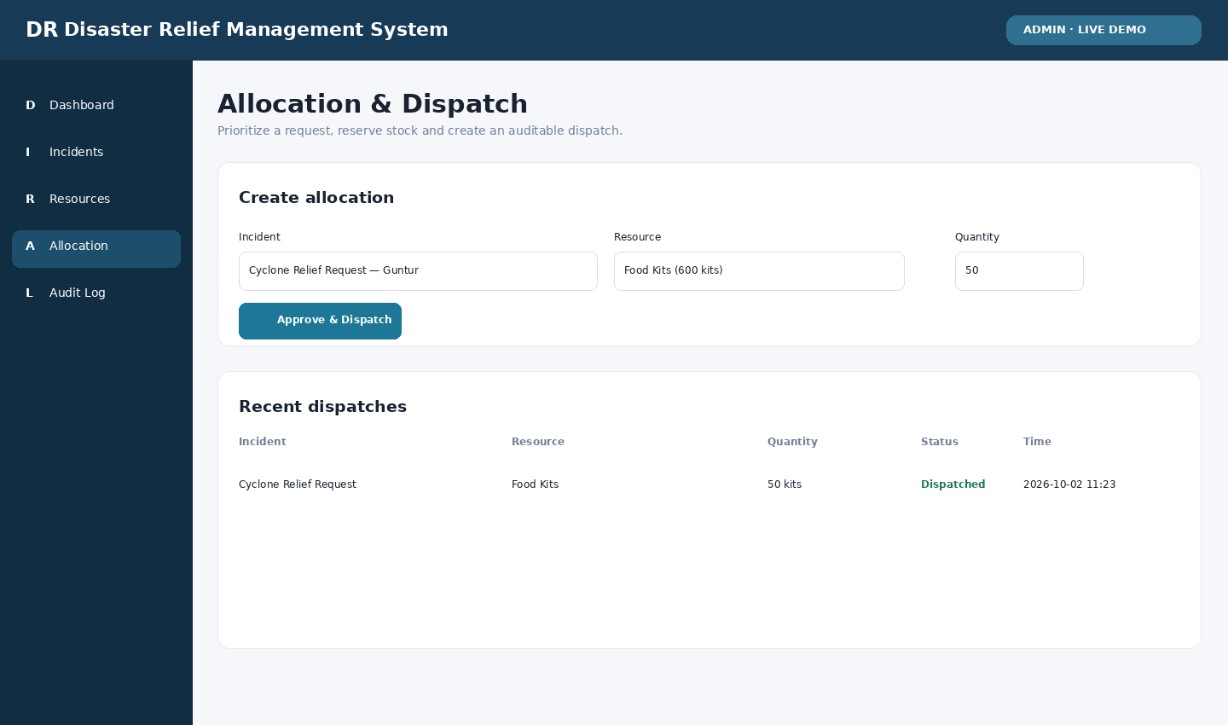
Screens / Working Demonstration
RUN THE DEMO
Run
python server.py
Login Page
Operations Dashboard
Open
http://127.0.0.1:8000
Demo Login
admin / admin123
Screenshots captured from the running local application.
Incident Management
Allocation / Dispatch

Slide 7





Functional Results
What the implemented system can actually do in the demonstration.
Authentication
Incident Management
Search / Records
Admin login is validated before operational access.
Create incidents and update incident status.
Incident, resource and audit records are stored and queryable.
Inventory
Allocation / Dispatch
Audit Trail
View resource quantities and locations.
Select an incident, resource and quantity and perform allocation.
Important actions are recorded with time and actor.

Slide 8
Testing Results
Functional smoke test executed against the running demonstration.
Test Case | Expected Result | Actual Result | Status
Login | Successful login | Successful login | PASS
Add Record | Record added | Incident created | PASS
Update Record | Record updated | Status = Assessed | PASS
API Request | Correct response | HTTP 200 | PASS
Allocation | Stock updated | Dispatch recorded | PASS
5 / 5
Functional Checks Passed
Insufficient-stock allocation is rejected
Successful actions generate audit records

Slide 9
Performance Analysis
Measurable results from the local demonstration environment.
50
1.78 ms
1.70 ms
2.90 ms
0%
Dashboard API requests
Average response time
Median response time
Maximum response time
Smoke-test error rate
Measured on the local demonstration environment; these are not production-scale benchmarks.
SMOKE-TEST WORKFLOW
Login
Incident Create
Status Update
Allocation
Audit
Production deployment should be benchmarked again on the target MySQL / server environment.

Slide 10



Results & Analysis
What Was Achieved
What the Evidence Shows
Interpretation
End-to-end operational workflow is demonstrable
Incident status changes are persisted
Resource quantity decreases after dispatch
Audit trail captures important actions
Dashboard reflects operational data
5/5 smoke tests passed
HTTP 200 responses for tested APIs
50-request dashboard benchmark completed
Insufficient-stock allocation is rejected
Records remain queryable after updates
Core data-to-action loop is working
Current prioritization is rule-based
AI demand prediction is future scope
GPS / SMS enhancements are future scope

Slide 11
Conclusion & Future Scope
Conclusion
Future Scope
Project objectives have been translated into a runnable operational prototype.
Demonstration covers login, incident management, inventory, allocation and audit.
Workflow keeps actions traceable and stock updates consistent.
GPS tracking and route-aware dispatch
Mobile application
SMS / Email alerts
AI-based demand prediction
Cloud deployment with MySQL / InnoDB
Larger performance and reliability evaluation
Thank You

