Slide 1
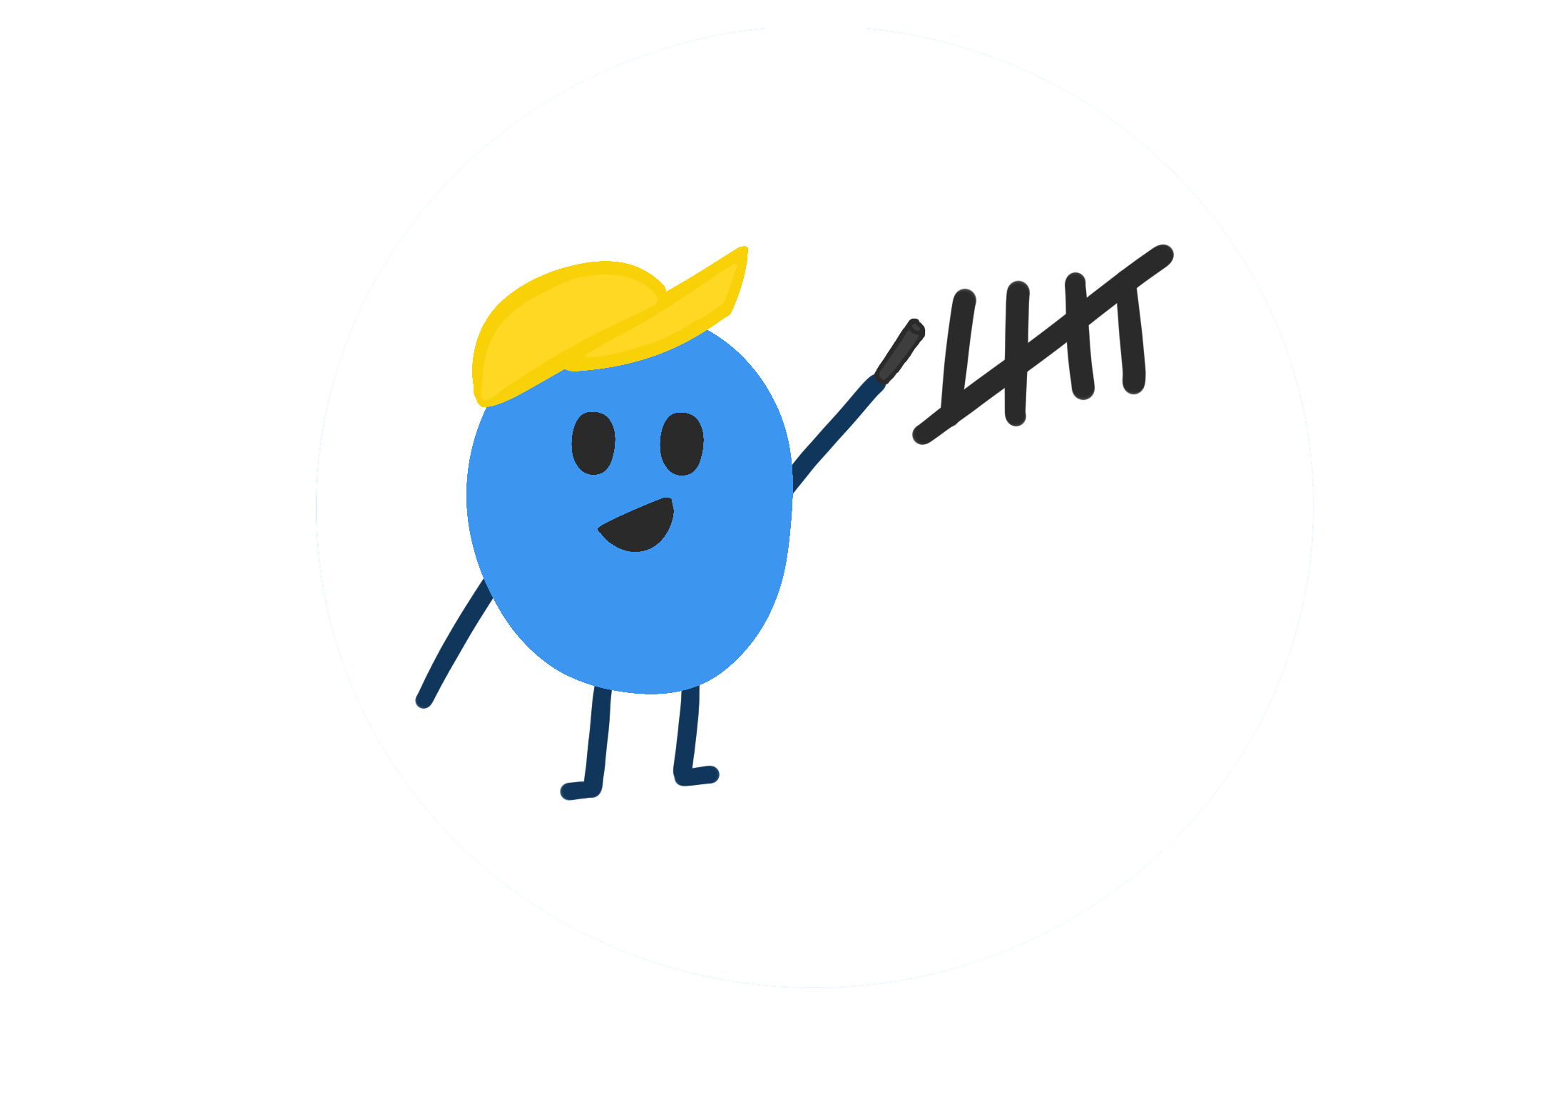
TallyTracker
TallyTracker
Inventory
4
5
Groseries
5
2
Fruits
52%
30
150
50
+56%

Slide 2
Who we are ?
TallyTracker
We are a team of innovators and problem solvers united by a simple mission: to make inventory management effortless for everyone. Whether you're managing school supplies, groceries, or large business inventories, TallyTracker is here to help you take control and stay organized.

Slide 3

How was Tallytracker founded
Fast forward to a few years later, during a team brainstorming session, with the other founders Veronica and Sridevi, the teams minds wandered back to that chaotic closet. The frustration of trying to categorize an endless amount of items and how it felt like a lost cause. That memory sparked an ‘aha’ moment. What if there was a way to make inventory management simpler for anyone facing a similar challenge? That's when the idea for TallyTracker was born
TallyTracker

Slide 4

How was Tallytracker founded
TallyTracker
Fast forward to a few years later, during a team brainstorming session, Scarlett’s mind wandered back to that chaotic closet. She remembered the frustration of trying to categorize an endless amount of items and how it felt like a lost cause. That memory sparked an ‘aha’ moment. What if there was a way to make inventory management simpler for anyone facing a similar challenge? That's when the idea for TallyTracker was born

Slide 5
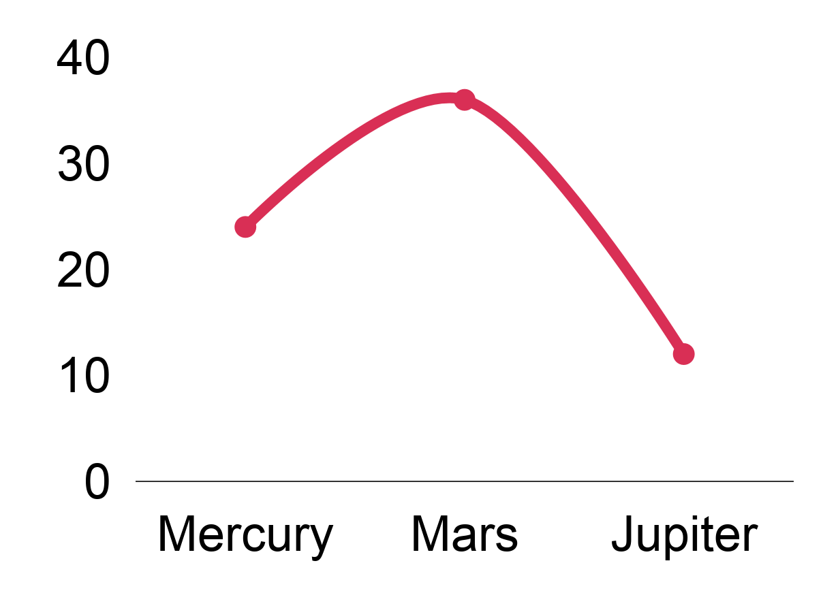
We can help you organize your life!
TallyTracker
Groceries
Income
School supplies
Pencils
2
52%
Crayons
4
Erracers
5
Your consumption of sweets has gone down since last month by 30%
5
Apples
Savings
Others
1
Sugar
Ammount
150$
2
Pears
Goal
45%
24%
30%

Slide 6
We can help you organize your life!
TallyTracker
Groceries
TallyTracker: Your Smart Shopping Assistant
School supplies
Income
Pencils
2
52%
Crayons
4
Take control of your grocery shopping with TallyTracker!
Track your grocery list, avoid waste, and stay on budget with real-time updates.
Save money while keeping your pantry stocked.
Erracers
5
Your consumption of sweets has gone down since last month by 30%
5
Apples
Savings
Others
1
Sugar
Ammount
150$
Goal
2
Pears
45%
24%
30%
Notes:
S: TallyTracker helps you keep an accurate grocery list, so you always know exactly what you need—no more overbuying or waste. Our app tracks your items in real time, helping you stay on budget while keeping your pantry stocked. With TallyTracker, you can manage your groceries smarter and save both money and time

Slide 7
We can help you organize your life!
TallyTracker
Groceries
Income
School supplies
Manage Multiple Inventory Lists with Ease
Pencils
2
52%
Crayons
4
TallyTracker lets you create and manage multiple inventory lists for different categories, like groceries, school supplies, and more. Organize and track everything from one app, ensuring you stay in control of all your lists, budgets, and needs
Erracers
5
Your consumption of sweets has gone down since last month by 30%
5
Apples
Savings
Others
1
Sugar
Ammount
150$
Goal
2
Pears
45%
24%
30%
Notes:
TallyTracker lets you create and manage multiple inventory lists for different categories, like groceries, school supplies, and more. Organize and track everything from one app, ensuring you stay in control of all your lists, budgets, and needs

Slide 8
We can help you organize your life!
TallyTracker
Groceries
Income
School supplies
Boost Your Savings with Personalized Goals
Pencils
2
52%
Crayons
4
TallyTracker helps you set specific savings goals and tracks your progress, so you can see how much you're saving and where you can improve. Set goals for weekly, monthly, or yearly savings and stay motivated as you watch your money grow.
Erracers
5
Your consumption of sweets has gone down since last month by 30%
5
Apples
Savings
Others
1
Sugar
Ammount
150$
2
Pears
Goal
45%
24%
30%
Notes:
With TallyTracker, you can set personalized savings goals based on your financial needs, whether it's for a short-term goal like a new gadget or long-term savings like a vacation. The app tracks your progress in real-time, showing you how much you've saved and how close you are to reaching your target. It’s a simple way to stay motivated and improve your financial habits.

Slide 9
Set Personalized Reminders for Smarter Inventory Management
TallyTracker
M
Tu
W
Th
F
Sa
Su
1
2
3
4
5
6
7
TallyTracker allows you to set customized reminders for your inventory items, so you never miss restocking essentials or checking your supplies. Receive alerts for items when it’s time to reorder or when stock levels fall below your set threshold.
8
9
10
11
12
13
14
15
16
17
18
19
20
21
22
23
24
25
26
27
28
Saturn
29
30
31
11
12
13
14
Jupiter
W
T
F
S
17
You need to buy one gallon of milk
Weekly reminders
Notes:
Remember to say that this is not implemented yet is more for the future
With TallyTracker, you can set personalized reminders for any item in your inventory. Whether it's a reminder to restock groceries or a low-stock alert for school supplies, you’ll always stay on top of your needs. The app makes it simple to ensure that you're never caught off guard, helping you keep everything from groceries to school supplies perfectly balanced and organized.

Slide 10

TallyTracker
TallyTracker helps reduce food waste and fight food insecurity by tracking inventory in real time, making sure important items are always available and avoiding too many wasted donations. This system can be used in various food pantries, helping them stay organized, waste less food, and ensure people get the items they truly need.
Notes:
Remember to say that this is not implemented yet is more for the future

Slide 11

Our Vision
TallyTracker
Bringing TallyTracker to the Mason Food Pantry
The Mason Food Pantry may face challenges in managing its inventory, from tracking donations to organizing stock. Relying manual lists and Amazon Wish List but keeping track of high-demand items like personal care products and canned goods can be difficult. Essential supplies may run out before anyone notices, while other item donations pile up, unused.
Notes:
Remember to say that this is not implemented yet is more for the future

Slide 12

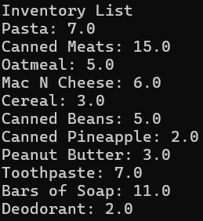
Bringing TallyTracker to the Mason Food Pantry
TallyTracker
We need 7 boxes of Pasta
Pasta
Canned Meats
Oatmeal
Mac N Cheese
Cereal
Canned Beans
Canned Pineapple
Peanut Butter
Toothpaste
Bars of Soap
Deodorant
TallyTracker ensures that food pantries always know how much of each item they have and what they will need in the future. This helps them stay organized, plan better, and make sure they don’t run out of essential items.
Notes:
Remember to say that this is not implemented yet is more for the future
With TallyTracker, you can set personalized reminders for any item in your inventory. Whether it's a reminder to restock groceries or a low-stock alert for school supplies, you’ll always stay on top of your needs. The app makes it simple to ensure that you're never caught off guard, helping you keep everything from groceries to school supplies perfectly balanced and organized.

Slide 13
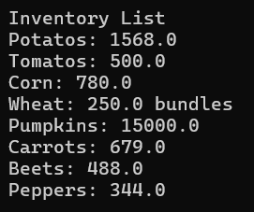
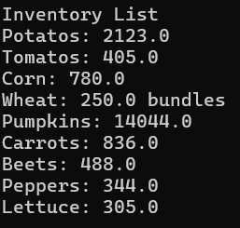

Check out our prototype
Click here

Slide 14
Thank You
Questions ?

