Slide 1
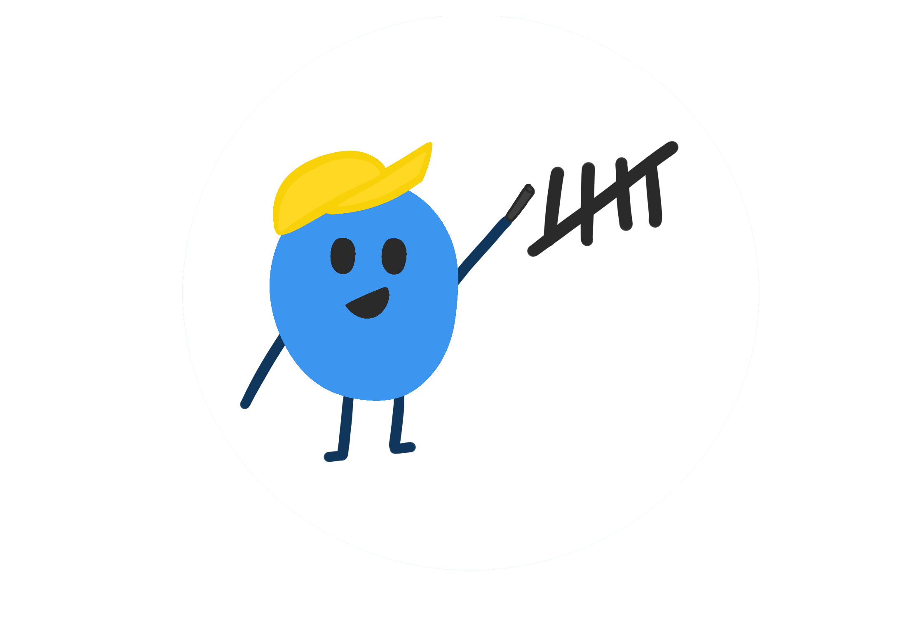
TallyTracker
TallyTracker
Inventory
4
5
Groseries
5
2
Fruits
52%
30
150
50
+56%

Slide 2
Who we are ?
TallyTracker
We are a team of innovators and problem solvers united by a simple mission: to make inventory management effortless for everyone. Whether you're managing school supplies, groceries, or large business inventories, TallyTracker is here to help you take control and stay organized.

Slide 3

How was Tallytracker founded
Back in high school, one of TallyTracker’s founders, Scarlett, found herself staring at a massive problem—an enormous dance closet overflowing with 50 years of dance costumes. She had a vision to organize everything by size, type, and color, making it easier to distribute costumes and sizes. But the sheer size of the closet and the overwhelming number of items made the task feel impossible. No matter how hard she tried, nothing was ever truly organized.
TallyTracker

Slide 4

How was Tallytracker founded
TallyTracker
Fast forward to a few years later, during a team brainstorming session, Scarlett’s mind wandered back to that chaotic closet. She remembered the frustration of trying to categorize an endless amount of items and how it felt like a lost cause. That memory sparked an ‘aha’ moment. What if there was a way to make inventory management simpler for anyone facing a similar challenge? That's when the idea for TallyTracker was born

Slide 5
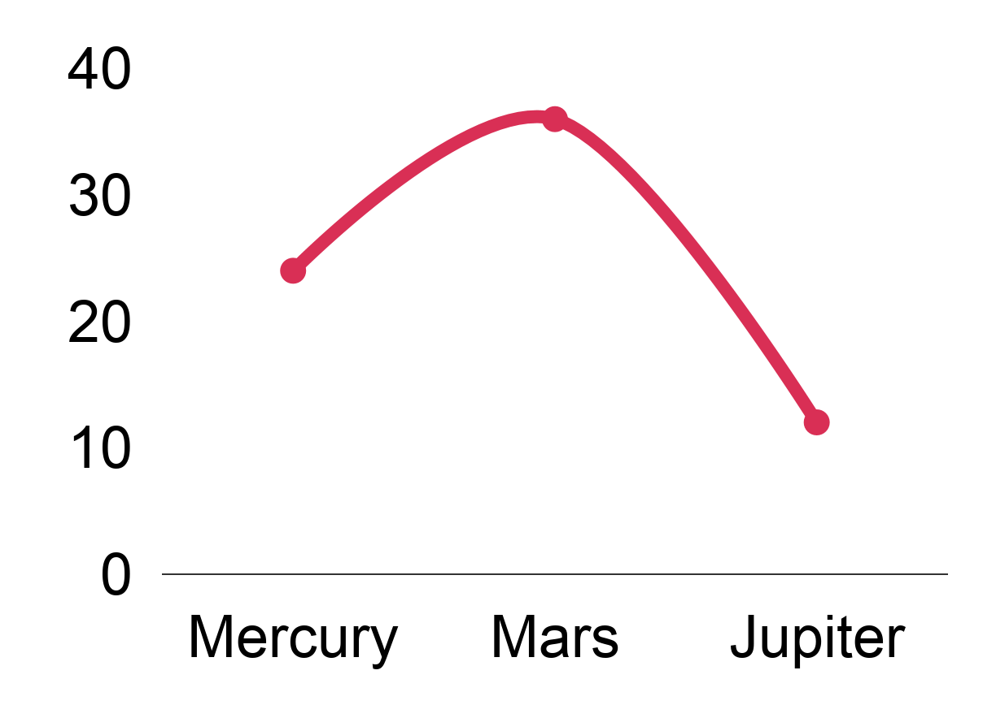
We can help you organize your life!
TallyTracker
Groceries
Income
School supplies
Pencils
2
52%
Crayons
4
Erracers
5
Your consumption of sweets has gone down since last month by 30%
5
Apples
Savings
Others
1
Sugar
Ammount
150$
2
Pears
Goal
45%
24%
30%

Slide 6
We can help you organize your life!
TallyTracker
Groceries
TallyTracker: Your Smart Shopping Assistant
School supplies
Income
Pencils
2
52%
Crayons
4
Take control of your grocery shopping with TallyTracker!
Track your grocery list, avoid waste, and stay on budget with real-time updates.
Save money while keeping your pantry stocked.
Erracers
5
Your consumption of sweets has gone down since last month by 30%
5
Apples
Savings
Others
1
Sugar
Ammount
150$
Goal
2
Pears
45%
24%
30%
Notes:
S: TallyTracker helps you keep an accurate grocery list, so you always know exactly what you need—no more overbuying or waste. Our app tracks your items in real time, helping you stay on budget while keeping your pantry stocked. With TallyTracker, you can manage your groceries smarter and save both money and time

Slide 7
We can help you organize your life!
TallyTracker
Groceries
Income
School supplies
Manage Multiple Inventory Lists with Ease
Pencils
2
52%
Crayons
4
TallyTracker lets you create and manage multiple inventory lists for different categories, like groceries, school supplies, and more. Organize and track everything from one app, ensuring you stay in control of all your lists, budgets, and needs
Erracers
5
Your consumption of sweets has gone down since last month by 30%
5
Apples
Savings
Others
1
Sugar
Ammount
150$
Goal
2
Pears
45%
24%
30%
Notes:
TallyTracker lets you create and manage multiple inventory lists for different categories, like groceries, school supplies, and more. Organize and track everything from one app, ensuring you stay in control of all your lists, budgets, and needs

Slide 8
We can help you organize your life!
TallyTracker
Groceries
Income
School supplies
Boost Your Savings with Personalized Goals
Pencils
2
52%
Crayons
4
TallyTracker helps you set specific savings goals and tracks your progress, so you can see how much you're saving and where you can improve. Set goals for weekly, monthly, or yearly savings and stay motivated as you watch your money grow.
Erracers
5
Your consumption of sweets has gone down since last month by 30%
5
Apples
Savings
Others
1
Sugar
Ammount
150$
2
Pears
Goal
45%
24%
30%
Notes:
With TallyTracker, you can set personalized savings goals based on your financial needs, whether it's for a short-term goal like a new gadget or long-term savings like a vacation. The app tracks your progress in real-time, showing you how much you've saved and how close you are to reaching your target. It’s a simple way to stay motivated and improve your financial habits.

Slide 9
Set Personalized Reminders for Smarter Inventory Management
TallyTracker
M
Tu
W
Th
F
Sa
Su
1
2
3
4
5
6
7
TallyTracker allows you to set customized reminders for your inventory items, so you never miss restocking essentials or checking your supplies. Receive alerts for items when it’s time to reorder or when stock levels fall below your set threshold.
8
9
10
11
12
13
14
15
16
17
18
19
20
21
22
23
24
25
26
27
28
Saturn
29
30
31
11
12
13
14
Jupiter
W
T
F
S
17
You need to buy one gallon of milk
Weekly reminders
Notes:
With TallyTracker, you can set personalized reminders for any item in your inventory. Whether it's a reminder to restock groceries or a low-stock alert for school supplies, you’ll always stay on top of your needs. The app makes it simple to ensure that you're never caught off guard, helping you keep everything from groceries to school supplies perfectly balanced and organized.

Slide 10
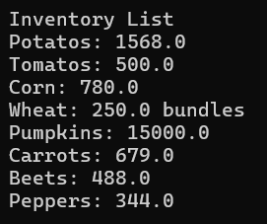
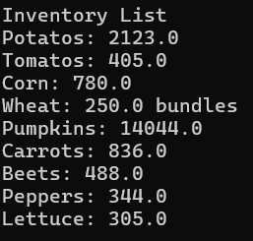

Check out our prototype
Click here

