Slide 1
TUN challenge
Christopher Purdin, Brijesh Suthar, Sanyah Riaz, & Mina Nagy

Slide 2
Introduction
Help non profit determine what their donors look like
By determining common attributes, can help assist in future donation campaigns
Saves resources
More effective donation campaigns

Slide 3
Plan
Rip apart data sets to determine if any demographic information can be used to either
Use predictive models to perform an analysis
Determine most common characteristics shared between donors

Slide 4
Data Cleaning
Null null null
Why are there so many Nulls
Delete delete delete
Our team made the decision to not guess any null data fields, we deleted every entry that did not have a gender associated with it, and then worked with the rest of the null fields
A more complete data set would’ve made our methods a lot more fruitful

Slide 5
Excel Work
Combination of several fields into one field
3-4 different donation fields, needed to be captured by only one

Slide 6
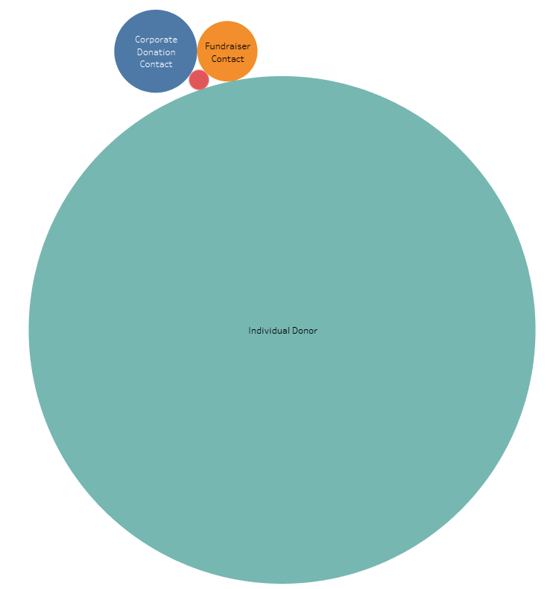
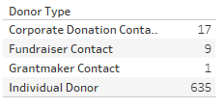
Visualizations

Slide 7
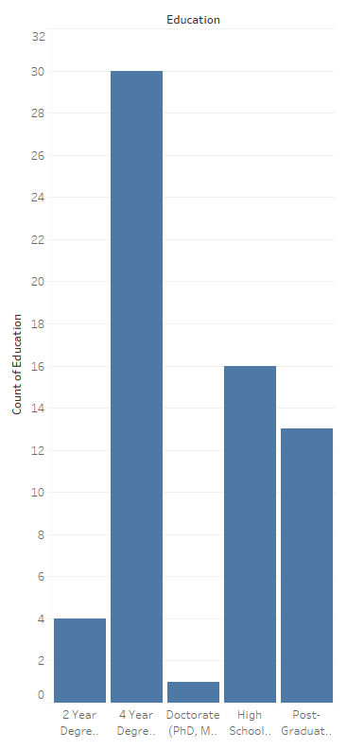

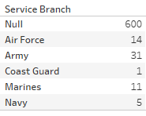
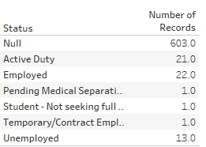
Visualizations

Slide 8
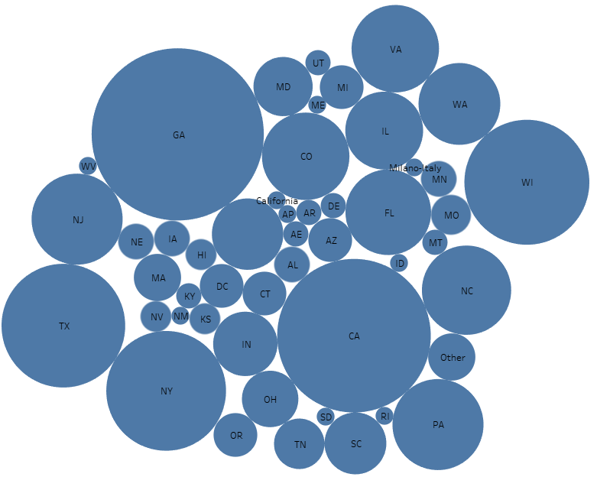
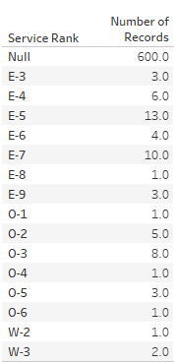
Visualizations

Slide 9
Conclusion
Target Donors
Avoid
4 year degree or higher
E-4 or higher
Employed/Active Duty
Primarily Army
Gender(Somewhat negligible)
Below 4 year degree
E-3 or lower
Students
Coast Guard

