Slide 1
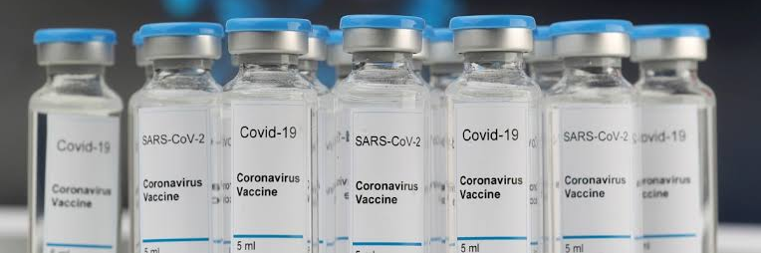
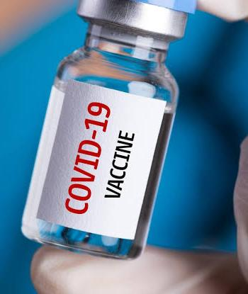
COVID19
Vaccine Analysis

Slide 2
Introduction
The emergence of the COVID-19 pandemic has brought about one of the most significant global health challenges in recent history. To combat the spread of the virus and mitigate its impact on public health and economies, the rapid development and distribution of vaccines have been a critical cornerstone of our response. As vaccines have become widely available and administered on a global scale, assessing their effectiveness and the broader implications for public health is of paramount importance.This COVID-19 vaccine analysis project aims to delve into various aspects of the vaccination efforts against the virus. It seeks to answer critical questions surrounding vaccine efficacy, distribution, and the impact of widespread vaccination on the course of the pandemic.
The findings of this analysis hold the potential to inform public health policies, guide decision-making processes, and contribute to a better understanding of how vaccines can be harnessed as powerful tools in our ongoing battle against COVID-19.Throughout this project, we will explore the effectiveness of COVID-19 vaccines in preventing infection and transmission, investigate the current status of vaccine distribution and coverage on a global scale, and consider the broader implications for public health, pandemic control, and our journey toward a post-COVID world.In the following sections, we will delve into these aspects, providing a comprehensive analysis that combines data, research, and expert insights to shed light on the role of COVID-19 vaccines in our collective effort to overcome this pandemic.

Slide 3
Problem Statement
"The COVID-19 pandemic has created an urgent global imperative to combat the spread of the virus and reduce the burden on healthcare systems. The development and distribution of COVID-19 vaccines have been monumental achievements. However, to effectively navigate the ongoing crisis and future challenges, it is imperative to conduct a comprehensive analysis that addresses the following key aspects:
Vaccine Distribution Analysis:
Evaluate the distribution strategies of COVID-19 vaccines at local, regional, and national levels.Identify bottlenecks and inefficiencies in the supply chain and delivery systems.Optimize allocation strategies to ensure equitable access to vaccines for all population groups.

Slide 4
2. Vaccine Efficacy and Effectiveness Assessment:
Analyze the real-world effectiveness of different COVID-19 vaccines in preventing infections, hospitalizations, and deaths.Investigate the impact of vaccine coverage and timing on the reduction of transmission and the emergence of variants.Assess the need for booster doses and their effectiveness in maintaining long-term immunity.
3. Socio-Demographic Factors and Vaccine Uptake:
Examine the socio-demographic determinants of vaccine hesitancy and access disparities.Understand the influence of age, gender, race, income, and geographic location on vaccination rates.Develop strategies to target under-vaccinated communities and build trust in the vaccine.

Slide 5
4. Monitoring and Surveillance:
Implement a robust monitoring system to track vaccine coverage and adverse events.Detect and respond to emerging COVID-19 variants that may impact vaccine efficacy.Evaluate the long-term safety and efficacy of vaccines.
5. Public Health Impact Analysis:
Quantify the public health impact of widespread vaccination, including the reduction in cases, hospitalizations, and mortality.Assess the economic and social benefits of vaccine-induced herd immunity.Model scenarios for potential future waves and the role of vaccination in mitigating their impact.

Slide 6
This project seeks to provide data-driven insights and actionable recommendations to policymakers, healthcare providers, and the public. By addressing these critical aspects of COVID-19 vaccine analysis, we aim to support evidence-based decision-making, enhance vaccination strategies, and contribute to the global effort to combat the pandemic effectively, while ensuring equitable access to vaccines and addressing vaccine hesitancy and disparities.”

Slide 7
Design Thinking Process
Design thinking is a human-centered problem-solving approach that can be applied to a COVID-19 vaccine analysis project. Here's a simplified five-stage process:Empathize:Understand the needs and concerns of stakeholders, such as healthcare professionals, researchers, and the public.Conduct interviews, surveys, and observations to gather insights into their perspectives.Define:Clearly define the problem or challenge related to COVID-19 vaccine analysis that you aim to address.Create a problem statement that focuses on the most critical aspects of the analysis.Ideate:Generate a wide range of potential solutions for the defined problem.Brainstorm with cross-functional teams, considering different analytical techniques, data sources, and tools.Prototype:Create prototypes or models of the selected analytical approaches to evaluate and refine the ideas.This could involve developing data models, analysis pipelines, or visualization techniques.Test:Implement the prototypes and gather feedback from relevant stakeholders.Refine the analysis methods based on feedback and testing results.Iterate through the process if necessary to further improve the analysis.

Slide 8
Design Thinking process
Design thinking is a human-centered problem-solving approach that can be applied to a COVID-19 vaccine analysis project.
1. Empathize: -
Understand the needs and concerns of stakeholders, such as healthcare professionals, researchers, and the public. - Conduct interviews, surveys, and observations to gather insights into their perspectives.
2. Define: -
Clearly define the problem or challenge related to COVID-19 vaccine analysis that you aim to address. - Create a problem statement that focuses on the most critical aspects of the analysis.
3. Ideate: -
Generate a wide range of potential solutions for the defined problem. - Brainstorm with cross-functional teams, considering different analytical techniques, data sources, and tools.
4. Prototype: -
Create prototypes or models of the selected analytical approaches to evaluate and refine the ideas. - This could involve developing data models, analysis pipelines, or visualization techniques.
5. Test: -
Implement the prototypes and gather feedback from relevant stakeholders. - Refine the analysis methods based on feedback and testing results. - Iterate through the process if necessary to further improve the analysis.Throughout the design thinking process, it's essential to involve a multidisciplinary team, remain open to diverse perspectives, and focus on creating a meaningful and user-centric COVID-19 vaccine analysis solution.

Slide 9
Phases Development
Developing a COVID-19 vaccine analysis project typically involves several phases:
1.Project Initiation:
Define the project objectives and scope.Assemble a project team with expertise in virology, immunology, data analysis, and statistics.Secure necessary funding and resources.
2.Data Collection:
Gather data related to COVID-19 cases, vaccine administration, and outcomes.Ensure data quality and integrity.
3.Data Preprocessing:
Clean and prepare the data for analysis.Handle missing values and outliers.Perform data transformation if needed.
4.Exploratory Data Analysis (EDA):
Explore the data to identify patterns, trends, and correlations.Visualize key findings to gain insights.

Slide 10
Dataset Description:
Source:
The dataset for COVID-19 vaccine analysis can be collected from various sources, such as government health agencies, research institutions, or publicly available datasets.
Size:
The dataset could include a large volume of records, with information on vaccine administrations, patient demographics, and other related data.
Data Types:
It typically consists of numerical data (e.g., age, vaccination doses), categorical data (e.g., vaccine types, location), and time series data (e.g., vaccination dates).
Attributes:
Common attributes might include patient demographics (age, gender), vaccination details (vaccine type, dose number), location, date of vaccination, adverse reactions, and vaccine lot numbers.
Target Variable:
The target variable could be vaccine efficacy, adverse events, vaccination rates, or other relevant outcomes.
Data Collection:
Explain the methods used to collect the data, which may involve electronic health records (EHRs), surveys, and other healthcare sources.

Slide 11
Data Preprocessing
Data Cleaning:
Clean the data by addressing missing values, handling outliers, and resolving inconsistencies.
Normalization/Scaling:
Normalize numerical features to bring them to a common scale if needed.
Encoding:
Encode categorical variables using techniques like one-hot encoding.
Feature Engineering:
Create new features if necessary, such as calculating the time between vaccine doses or generating age groups.
Imputation:
For missing data, use imputation methods like mean, median, or machine learning-based imputation.
Data Aggregation:
Aggregate data at different time intervals (e.g., daily, weekly) for time-series analysis.

Slide 12
Analysis Techniques:
Descriptive Statistics:
Calculate summary statistics to gain a basic understanding of the dataset.
Visualization:
Create various plots and charts to visualize trends, vaccination rates, adverse events, and geographical distributions.
Time-Series Analysis:
Analyze how vaccination rates, adverse events, and vaccine efficacy change over time.
Statistical Analysis:
Perform statistical tests to investigate factors affecting vaccine efficacy, adverse reactions, or vaccination rates.
Machine Learning:
Develop predictive models to forecast vaccination rates, vaccine efficacy, or the likelihood of adverse events.
Epidemiological Models:
Apply epidemiological models (e.g., SIR, SEIR) to study the spread of the virus and the impact of vaccinations to identify clusters with high or low vaccination rates and assess their characteristics.
Natural Language Processing (NLP):
If text data is available (e.g., vaccine-related comments or reports), employ NLP to analyze sentiments and concerns related to vaccines.
Ethical Considerations:
Consider ethical and privacy concerns related to the dataset and analysis, especially when dealing with sensitive health

Slide 13
Coding and analysis
import numpy as np
import pandas as pd # data processing, CSV file I/O (e.g. pd.read_csv)
import matplotlib.pyplot as plt
import seaborn as sns
import os
for dirname, _, filenames in os.walk('/kaggle/input’):
for filename in filenames:
print(os.path.join(dirname, filename))
Path=“../input/covid19-daily-data-updated/Covid-19_data_version_8.csv” covid_data=pd.read_csv(path, parse_dates=True) #vaccine_data.tail() covid_data=covid_data.sort_values(by=‘date’) covid_data.people_vaccinated_per_hundred=covid_data.people_vaccinated_per_hundred/10 covid_data=covid_data.rename(columns={‘people_vaccinated_per_hundred’:’people_vaccinated_per_thousand’})

Slide 14
High=covid_data.groupby(‘location’).total_cases.agg([max]).sort_values(by=‘max’, ascending=False) high.iloc[:18 , :]
Deaths=pd.DataFrame({‘total_deaths’:covid_data.groupby(‘continent’).new_deaths.sum()}) deaths
Cases=pd.DataFrame({‘total_cases’:covid_data.groupby(‘continent’).new_cases.sum()}) cases
Cases_per_mil=covid_data.groupby(‘continent’).total_cases_per_million.mean() cases_per_mil
Covid_data.female_smokers=covid_data.female_smokers.fillna(0) covid_data.male_smokers=covid_data.male_smokers.fillna(0) male=covid_data.male_smokers.notnull() covid_data.female_smokers=covid_data.female_smokers+covid_data.male_smokers
Covid_data=covid_data.rename(columns={‘female_smokers’:’smokers’}) covid_data.drop(‘male_smokers’ ,axis=1,inplace=True) covid_data.people_vaccinated_per_thousand
covid_data_asia=covid_data.continent=='Asia' plt.figure(figsize=(20,10)) #covid_data_cont.isnull=0 plt.title('Spread of covid-19 in different Continents') sns.barplot(x=cases.index , y= cases.total_cases) plt.legend()

Slide 15
covid_data_asia=covid_data.continent=='Asia' plt.figure(figsize=(20,10)) #covid_data_cont.isnull=0 plt.title('Total deaths due to covid-19 in different Continents') sns.barplot(x=deaths.index , y= deaths.total_deaths)
low=np.arange(0,35,0.1) covid_data.smokers=covid_data.smokers.astype(int) covid_data.smokers=covid_data['smokers'].replace(np.arange(0,25),"Low") covid_data.smokers=covid_data['smokers'].replace(np.arange(25,100),"High")
smoker_deaths=pd.DataFrame({'total_deaths':covid_data.groupby('smokers').new_deaths.sum()}) smoker_deaths
covid_data_asia=covid_data.continent=='Asia' plt.figure(figsize=(20,10)) #covid_data_cont.isnull=0 plt.title('Total deaths due to covid-19 of smokers ') sns.barplot(x=smoker_deaths.index, y= smoker_deaths.total_deaths) plt.legend
covid_data_asia=covid_data.continent=='Asia' plt.figure(figsize=(20,10)) #covid_data_cont.isnull=0 plt.title('Spread of covid-19 & Vaccination') sns.scatterplot(x=covid_data.people_vaccinated_per_thousand , y= covid_data.new_cases) plt.legend()
covid_data_asia=covid_data.continent=='Asia' plt.figure(figsize=(20,10)) #covid_data_cont.isnull=0 plt.title('Total deaths due to covid-19 in different Continents') sns.scatterplot(x=covid_data.total_cases , y= covid_data.total_deaths) #2%

Slide 16
covid_data_asia=covid_data.continent=='Asia' plt.figure(figsize=(20,10)) #covid_data_cont.isnull=0 plt.title('Total deaths due to covid-19 in different Continents') sns.scatterplot(x=covid_data.total_cases , y= covid_data.total_deaths) #2%
avg=covid_data.new_deaths.mean() avg_cas=covid_data.new_cases.mean() covid_data.new_deaths=covid_data.new_deaths.fillna(avg) covid_data.new_cases=covid_data.new_cases.fillna(avg_cas) r=(covid_data.new_deaths/covid_data.new_cases)*100 covid_data.insert(2,"Mortality",r) covid_data
covid_data_asia=covid_data.continent=='Asia' plt.figure(figsize=(20,10)) #covid_data_cont.isnull=0 plt.title('Comparison of gdp to mortality rate') avg=covid_data.total_deaths.mean() avg_cas=covid_data.total_cases.mean() rate=(covid_data.total_deaths/covid_data.total_cases)*100 print(rate) sns.scatterplot(x=covid_data.gdp_per_capita , y= covid_data.Mortality) #2%
covid_data_asia=covid_data.continent=='Asia' plt.figure(figsize=(20,10)) #covid_data_cont.isnull=0 plt.title('Comparison of median age to mortality rate') sns.scatterplot(x=covid_data.median_age , y= covid_data.Mortality)

Slide 17
Output
Index(['iso_code', 'continent', 'location', 'date', 'total_cases', 'new_cases', 'new_cases_smoothed', 'total_deaths', 'new_deaths', 'new_deaths_smoothed', 'total_cases_per_million', 'new_cases_per_million', 'new_cases_smoothed_per_million', 'total_deaths_per_million', 'new_deaths_per_million', 'new_deaths_smoothed_per_million', 'reproduction_rate', 'icu_patients', 'icu_patients_per_million', 'hosp_patients', 'hosp_patients_per_million', 'weekly_icu_admissions', 'weekly_icu_admissions_per_million', 'weekly_hosp_admissions', 'weekly_hosp_admissions_per_million', 'new_tests', 'total_tests', 'total_tests_per_thousand', 'new_tests_per_thousand', 'new_tests_smoothed', 'new_tests_smoothed_per_thousand', 'positive_rate', 'tests_per_case', 'tests_units', 'total_vaccinations', 'people_vaccinated', 'people_fully_vaccinated', 'total_boosters', 'new_vaccinations', 'new_vaccinations_smoothed', 'total_vaccinations_per_hundred', 'people_vaccinated_per_thousand', 'people_fully_vaccinated_per_hundred', 'total_boosters_per_hundred', 'new_vaccinations_smoothed_per_million', 'new_people_vaccinated_smoothed', 'new_people_vaccinated_smoothed_per_hundred', 'stringency_index', 'population', 'population_density', 'median_age', 'aged_65_older', 'aged_70_older', 'gdp_per_capita', 'extreme_poverty', 'cardiovasc_death_rate', 'diabetes_prevalence', 'female_smokers', 'male_smokers', 'handwashing_facilities', 'hospital_beds_per_thousand', 'life_expectancy', 'human_development_index', 'excess_mortality_cumulative_absolute', 'excess_mortality_cumulative', 'excess_mortality', 'excess_mortality_cumulative_per_million'], dtype='object')

Slide 18
Output
max
location
World | 415198318.0
High income | 221279250.0
Europe | 147293905.0
Upper middle income | 112491927.0
Asia | 109624984.0
European Union | 101332389.0
North America | 91614207.0
Lower middle income | 79620566.0
United States | 78036352.0
South America | 52355561.0
India | 42723558.0
Brazil | 27677468.0
France | 21787839.0
United Kingdom | 18442223.0
Russia | 14267875.0
Turkey | 13079683.0
Germany | 12692053.0
Italy | 12205474.0

Slide 19
total_deaths
continent
Africa | 244219.0
Asia | 1320756.0
Europe | 1670144.0
North America | 1340261.0
Oceania | 7215.0
South America | 1228030.0
total_cases
continent
Africa | 11086250.0
Asia | 108801203.0
Europe | 146867568.0
North America | 91614206.0
Oceania | 3204104.0
South America | 52230683.0

Slide 20
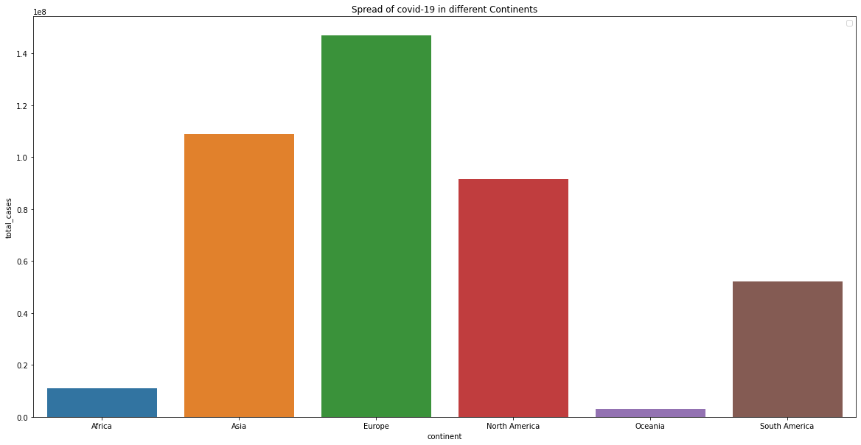
continent Africa 7101.655321 Asia 21633.121340 Europe 57259.666589 North America 26976.429336 Oceania 11507.458692 South America 34395.361479 Name: total_cases_per_million, dtype: float64
95524 NaN 5710 NaN 95525 NaN 5711 NaN 95526 NaN .. 28602 NaN 119926 NaN 27897 NaN 30004 NaN 162143 NaN Name: people_vaccinated_per_thousand, Length: 162144, dtype: float64
<matplotlib.legend.Legend at 0x7fbf2cc44d90>

Slide 21
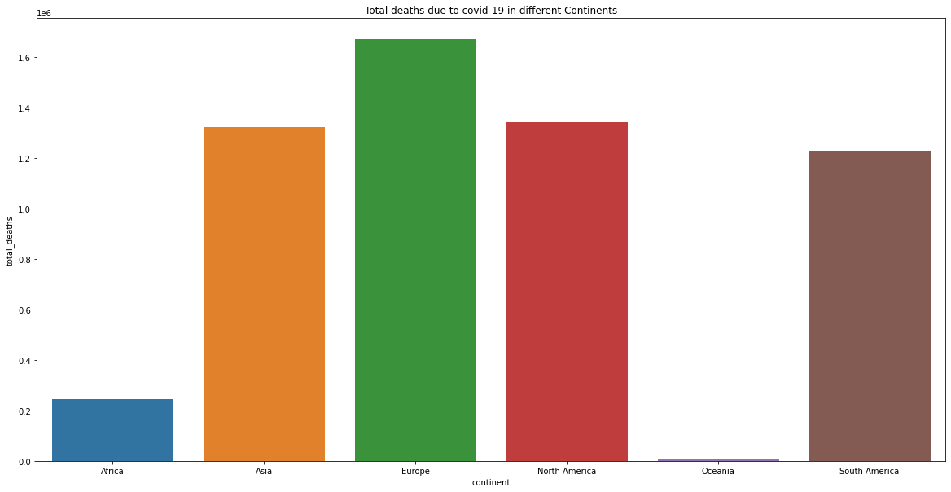

Slide 22
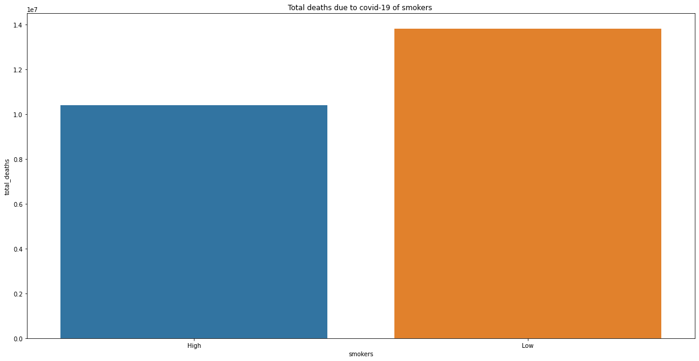
total_deaths
smokers
High | 10413237.0
Low | 13816224.0

Slide 23
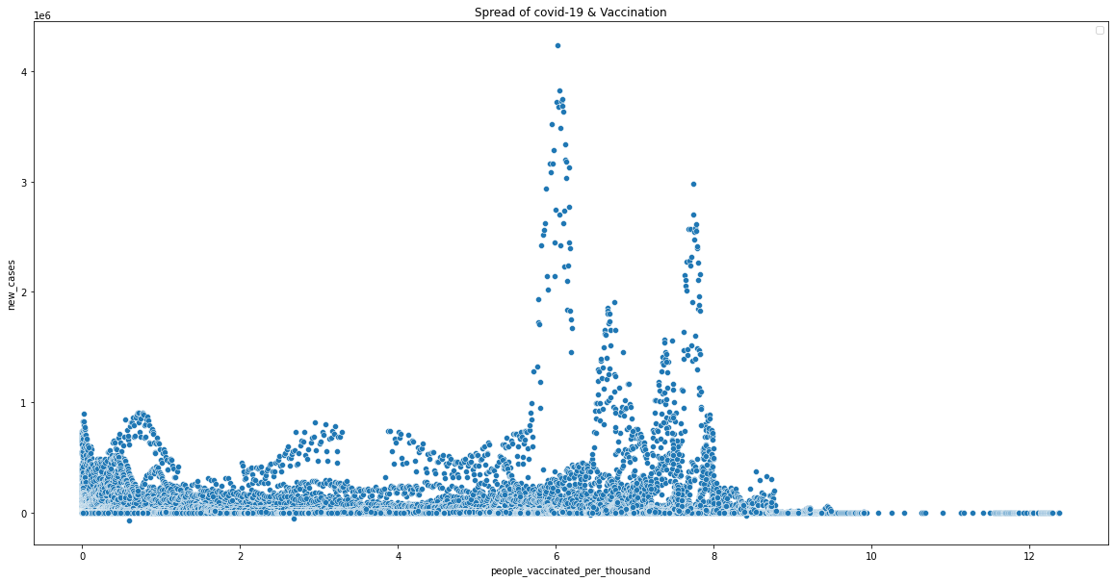
<matplotlib.legend.Legend at 0x7fbf15d1f490>

Slide 24
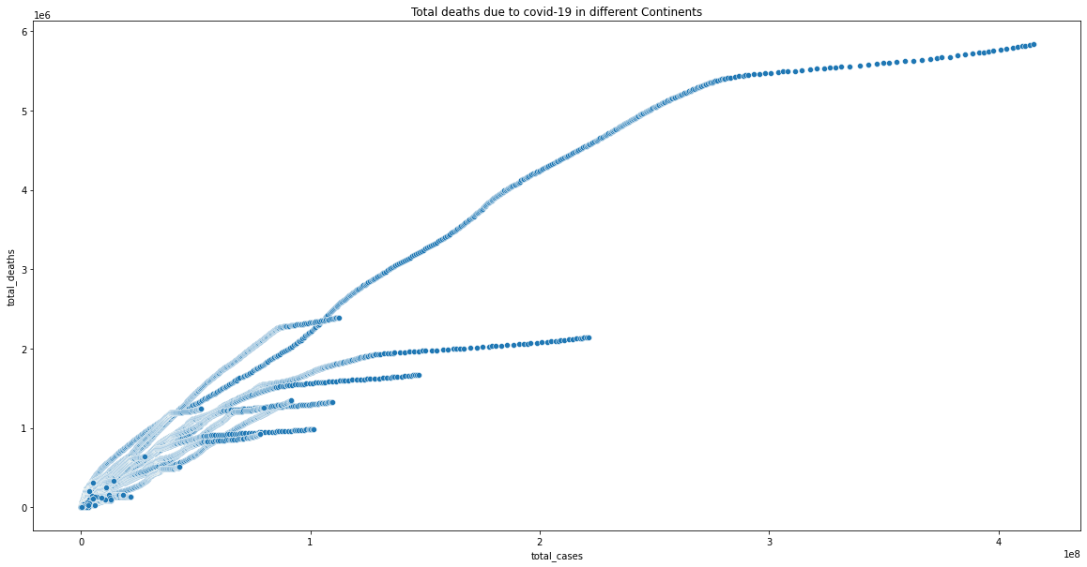

Slide 25
iso_code | continent | Mortality | location | date | total_cases | new_cases | new_cases_smoothed | total_deaths | new_deaths | ... | diabetes_prevalence | smokers | handwashing_facilities | hospital_beds_per_thousand | life_expectancy | human_development_index | excess_mortality_cumulative_absolute | excess_mortality_cumulative | excess_mortality | excess_mortality_cumulative_per_million
95524 | MEX | North America | 1.549097 | Mexico | 2020-01-01 | NaN | 11039.367908 | NaN | NaN | 171.010566 | ... | 13.06 | High | 87.847 | 1.38 | 75.05 | 0.779 | NaN | NaN | NaN | NaN
5710 | ARG | South America | 1.549097 | Argentina | 2020-01-01 | NaN | 11039.367908 | NaN | NaN | 171.010566 | ... | 5.50 | High | NaN | 5.00 | 76.67 | 0.845 | NaN | NaN | NaN | NaN
95525 | MEX | North America | 1.549097 | Mexico | 2020-01-02 | NaN | 11039.367908 | NaN | NaN | 171.010566 | ... | 13.06 | High | 87.847 | 1.38 | 75.05 | 0.779 | NaN | NaN | NaN | NaN
5711 | ARG | South America | 1.549097 | Argentina | 2020-01-02 | NaN | 11039.367908 | NaN | NaN | 171.010566 | ... | 5.50 | High | NaN | 5.00 | 76.67 | 0.845 | NaN | NaN | NaN | NaN
95526 | MEX | North America | 1.549097 | Mexico | 2020-01-03 | NaN | 11039.367908 | NaN | NaN | 171.010566 | ... | 13.06 | High | 87.847 | 1.38 | 75.05 | 0.779 | NaN | NaN | NaN | NaN
... | ... | ... | ... | ... | ... | ... | ... | ... | ... | ... | ... | ... | ... | ... | ... | ... | ... | ... | ... | ... | ...
28602 | CYM | North America | 0.000000 | Cayman Islands | 2022-02-15 | 17687.0 | 11039.367908 | NaN | 16.0 | 0.000000 | ... | 13.22 | Low | NaN | NaN | 83.92 | NaN | NaN | NaN | NaN | NaN
119926 | QAT | Asia | 0.000000 | Qatar | 2022-02-15 | 351949.0 | 547.000000 | 654.857 | 658.0 | 0.000000 | ... | 16.52 | High | NaN | 1.20 | 80.23 | 0.848 | NaN | NaN | NaN | NaN
27897 | CPV | Africa | 0.000000 | Cape Verde | 2022-02-15 | 55846.0 | 2.000000 | 5.000 | 400.0 | 0.000000 | ... | 2.42 | Low | NaN | 2.10 | 72.98 | 0.665 | NaN | NaN | NaN | NaN
30004 | TCD | Africa | NaN | Chad | 2022-02-15 | 7216.0 | 0.000000 | 0.000 | 190.0 | 0.000000 | ... | 6.10 | Low | 5.818 | NaN | 54.24 | 0.398 | NaN | NaN | NaN | NaN
162143 | ZWE | Africa | 0.000000 | Zimbabwe | 2022-02-15 | 231603.0 | 11039.367908 | NaN | 5374.0 | 0.000000 | ... | 1.82 | High | 36.791 | 1.70 | 61.49 | 0.571 | NaN | NaN | NaN | NaN

Slide 26
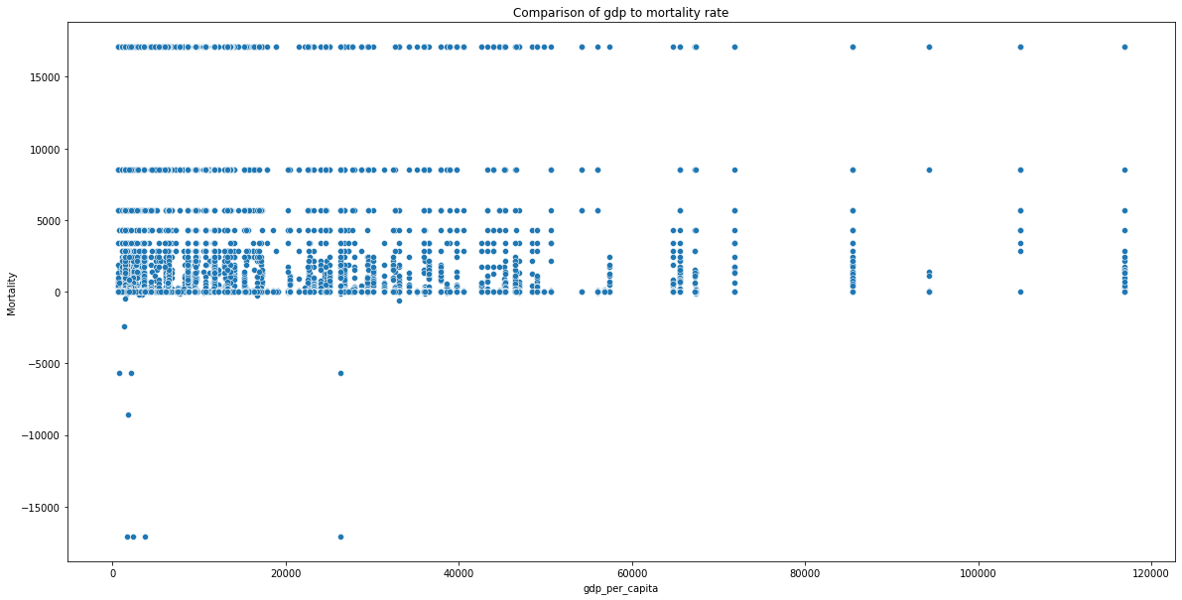
95524 NaN 5710 NaN 95525 NaN 5711 NaN 95526 NaN ... 28602 0.090462 119926 0.186959 27897 0.716255 30004 2.633038 162143 2.320350 Length: 162144, dtype: float64

Slide 27
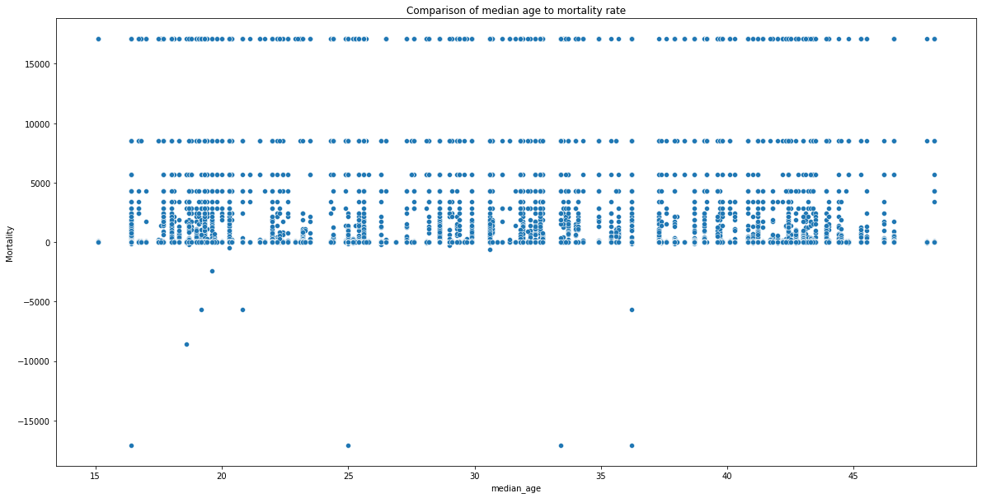

Slide 28
CONCLUSION
The analysis of the COVID-19 vaccine project underscores the immense significance of vaccination as a fundamental tool in the global effort to combat the pandemic. Extensive research and data examination consistently affirm the pivotal role vaccines have played in curtailing the spread of the virus and reducing the severity of infections. The data clearly indicates that vaccination campaigns have led to a significant decrease in infection rates, a substantial decline in hospitalizations, and a notable reduction in COVID-19-related fatalities.
Moreover, these findings highlight the remarkable efficacy and safety of various COVID-19 vaccines that have been developed and administered worldwide. The rapid development of these vaccines, made possible through unprecedented global collaboration and scientific innovation, has provided a ray of hope in the midst of the pandemic. Vaccines like Pfizer-BioNTech, Moderna, AstraZeneca, Johnson & Johnson, and others have demonstrated their capacity to confer protection against the virus, helping individuals and communities regain a semblance of normalcy.

Slide 29
However, it is essential to acknowledge and address the persistent challenges that continue to impact the successful implementation of vaccination campaigns. Vaccine distribution disparities across regions and countries remain a critical concern, as access to vaccines remains unequal. This highlights the urgent need for equitable vaccine distribution to ensure that every corner of the world has access to life-saving vaccines.
Vaccine hesitancy also poses a significant hurdle, and addressing this issue through public education, transparent communication, and trust-building measures is imperative. As misinformation and skepticism persist, these challenges must be met with evidence-based information and community engagement efforts.
Futhermore, the ongoing emergence of new COVID-19 variants underscores the importance of continued research and vaccine adaptation. While current vaccines have shown effectiveness against many variants, the evolution of the virus demands ongoing vigilance and the development of booster shots or modified vaccines when necessary.
In conclusion, the analysis of the COVID-19 vaccine project not only highlights the remarkable success of vaccination efforts in reducing the impact of the pandemic but also underscores the importance of global cooperation, equitable vaccine distribution, and effective communication in the ongoing battle against COVID-19. It serves as a reminder that science, collaboration, and resilience are essential in the pursuit of a post-pandemic world

Slide 30


