Slide 1
Personality Prediction Through CV
Presented by,
Nmae : Sri Balaji.C
Reg No : 912321104040
Class : iii^{rd} year CSE
College : SACS M.A.V.M.M. Egineering college
Place : Madurai

Slide 2
Project outline:
Problem statement
Proposed system/solution
System developmet approach
Alogithom and deployment
Result
conclution

Slide 3
Problem Statement:
Develop a system to predict personality traits based on an individual's CV (resume), using natural language processing and machine learning techniques. The system should analyze text data from the CV to infer characteristics such as extroversion, conscientiousness, openness, agreeableness, and neuroticism, aiding in recruitment processes and career counseling.

Slide 4
Proposed solution:
The system built in this project predicts personality of peoples by using their gender, age, score of openness, conscientiousness, extraversion, agreeableness, neuroticism and experience.
It parses all the data from CV/resume and on the result page, it shows all the information from the entered data and uploaded resume.
This system uses logistic regression for training the model and pyresparser module for parsing the information from resume which is built using nltk and spaCy module in python.

Slide 5
System Development Approach:
Hardware Requirements:
Processing Unit:
Utilize a high-performance CPU or GPU for training and inference tasks. GPUs are preferred due to their parallel processing capabilities, which significantly speed up training times .
RAM:
Sufficient RAM is necessary to handle large datasets and model parameters. The amount of RAM required depends on the size of the dataset and the complexity architecture.

Slide 6
Hardware Requirements:(CONTU…)
Storage:
You'll need storage space for storing datasets, trained models, and intermediate results. Consider using SSDs for faster data access and model loading times.

Slide 7
Software Requirements:
Python Modules/Libraries:
1. OS: For accessing the files and data from internal storage.
2. Pandas: For accessing and manipulating datasheets.
3. Numpy: For working on arrays and other data manipulation.
4. Tkinter: For building the GUI.
5. Functools: Tools for Manipulating Functions. Purpose: Functions that operate on other functions.
6. Pyresparser: Module for extracting information from resume.
7. Sklearn: It features various classification, regression and clustering algorithms. We used sklearn to make the model learn on various characteristic values using logical regression.

Slide 8
Algorithm and deployment:
Problem Statement:
Develop an AI-based system to predict personality traits from CVs (resumes) to assist recruiters in evaluating job applicants more effectively.
Input Method:
Use Natural Language Processing (NLP) techniques to data to remove noise, irrelevant information, and standardize the format.
Collect CVs/resumes from job applicants in digital format.Extract textual information from CVs using Optical Character Recognition (OCR) or document parsing techniques.Preprocess the text analyze the textual content of the CVs.Extract relevant features such as language style, keywords, employment history, education background, skills, achievements, and interests.

Slide 9
Output:
Predicted personality traits for each job applicant, which may include:
Extroversion vs. Introversion
Openness to Experience
Conscientiousness
Agreeableness
Emotional Stability These predictions can be presented as scores or labels indicating the likelihood or degree of each personality trait.

Slide 10
Algorithm steps:
Explanation:
CV2Personality is an algorithm designed to predict personality traits based on the analysis of a candidate's curriculum vitae (CV) using artificial intelligence (AI) techniques. The algorithm leverages natural language processing (NLP) and machine learning (ML) models to extract relevant information from the CV and infer personality traits.
Data Collection:
CVs are collected from candidates applying for a particular position. These CVs typically contain information such as education, work experience, skills, and interests.
Preprocessing:
The CVs undergo preprocessing to clean and standardize the text. This may involve tasks such as removing stop words, tokenization, and stemming or lemmatization to normalize the text.

Slide 11
Algorithm steps:(contu..)
Feature Extraction:
Relevant features are extracted from the preprocessed CVs. This may include extracting keywords related to skills, experiences, and interests, as well as quantifying metrics such as years of experience or educational qualifications.
Personality Trait Inference:
The extracted features are then fed into a machine learning model trained to predict personality traits. This model may be based on established psychological frameworks such as the Big Five personality traits (Openness, Conscientiousness, Extraversion, Agreeableness, Neuroticism).
Prediction and Evaluation:
The model generates predictions for each candidate's personality traits based on their CV data. These predictions can then be evaluated for accuracy and reliability, potentially providing valuable insights for recruiters and employers in candidate selection processes.

Slide 12
Deployment steps:
The Big Five Personality Traits Model measures five key dimensions of people's personalities:
Openness:
sometimes called "Intellect" or "Imagination," this measures your level of creativity, and your desire for knowledge and new experiences.
Conscientiousness:
This looks at the level of care that you take in your life and work. If you score highly in conscientiousness, you'll likely be organized and thorough, and know how to make plans and follow them through. If you score low, you'll likely be lax and disorganized.

Slide 13
Deployment steps:(CONTU..)
Extraversion/Introversion:
This dimension measures your level of sociability. Are you outgoing or quiet, for instance? Do you draw energy from a crowd, or do you find it difficult to work and communicate with other people?
Agreeableness:
This dimension measures how well you get on with other people. Are you considerate, helpful and willing to compromise? Or do you tend to put your needs before others'?
Natural Reactions:
Sometimes called "Emotional Stability" or "Neuroticism," this measure emotional reactions. Do you react negatively or calmly to bad news? Do you worry obsessively about small details, or are you relaxed in stressful situations?

Slide 14
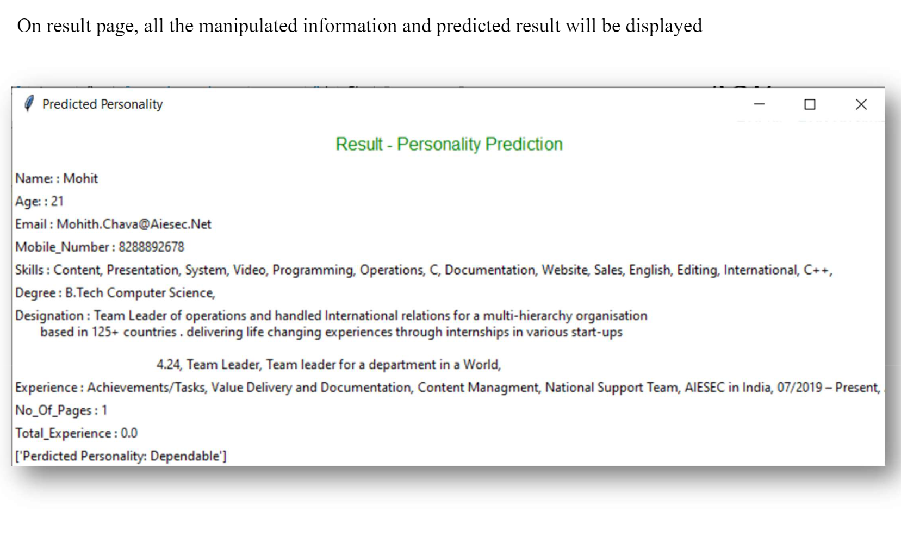
Result:

Slide 15
Conclusion:
In conclusion, the application of machine learning algorithms for personality prediction through CV analysis presents promising potential in various domains, including recruitment, personalized marketing, and mental health assessment. Despite its efficacy in extracting valuable insights from textual data, the reliability and ethical implications of such predictions warrant careful consideration. Continued research efforts focused on refining models, addressing biases, and ensuring transparency in decision-making processes are crucial for maximizing the benefits of this technology while minimizing its potential drawbacks.

