Slide 1
INHERITANCE

Slide 2
What is INHERITANCE?
Inheritance is the concept of extending the existing thing.
Inheritance can be defined as the process where one class acquires the properties (methods and fields) of another.
Defining an object with help of existing object.

Slide 3
Iphone-6S(EXISTING SYSTEM)
(extends)
Iphone-7S(PROPOSED SYSTEM)

Slide 4
EXTENDS
extends is the keyword used to inherit the properties of a class.
Syntax:
class Super {
.....
.....
}
class Sub extends Super {
.....
.....
}

Slide 5
Program and OUTPUT for INHERITANCE:
Output
The sum of the given numbers:30
The difference between the given numbers:10
The product of the given numbers:200

Slide 6
Types of Inheritance in java
1)Single inheritance
2) Multilevel inheritance
3)Hierarchical inheritance
4)Multiple inheritance
(NOT SUPPORTED IN JAVA)
This means that a class cannot extend more than one class.
5)Hybrid inheritance

Slide 7
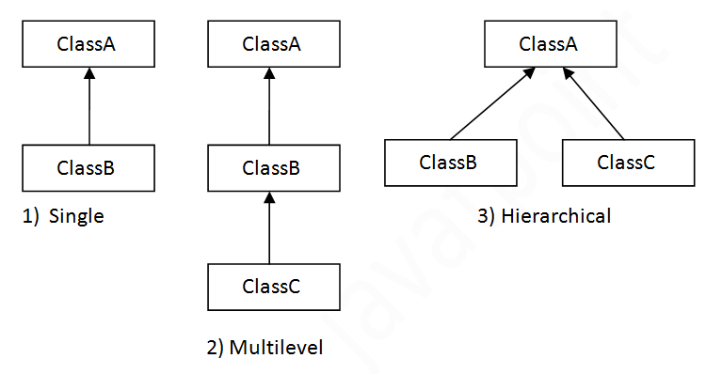
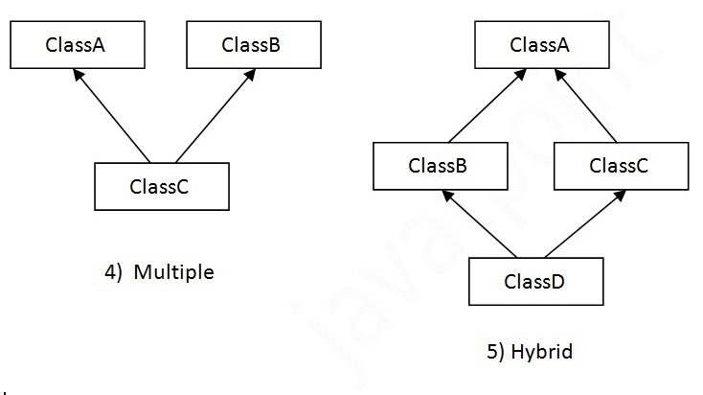

Slide 8
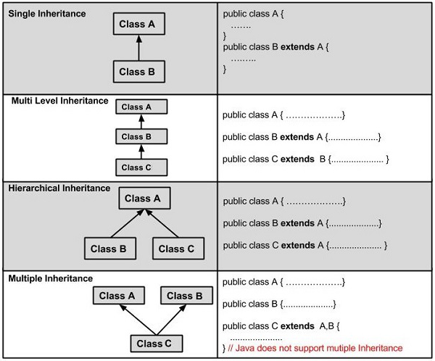

Slide 9
SINGLE INHERITANCE
Single inheritance enables a derived class to inherit properties and behavior from a single parent class.
It allows a derived class to inherit the properties and behavior of a base class.
Enabling code reusability as well as adding new features to the existing code.

Slide 10
Single Inheritance Example Program
class SingleInheritance{
static int num1=10;
static int num2=5;
}
class MainInheritance extends SingleInheritance{
public static void main(String[] args){
int num3=2;
int result=num1+num2+num3;
System.out.println("Result of child class is "+result);
}
}
Sample Output
Output is:
Result of child class is 17

Slide 11
MULTILEVEL INHERITANCE
Inheritance is when an object or class is based on another object or class, using the same implementation specifying implementation to maintain the same behavior.
In multilevel inheritance a subclass is inherited from another subclass.
The class A serves as a base class for the derived class B, which in turn serves as a base class for the derived class C.
The class B is known as intermediate base class since it provides a link for the inheritance between A and C.

Slide 12
MULTILEVEL INHERITANCE EXAMPLE PROGRAM
class Multilevel Inheritance{
protected String str;
Multilevel Inheritance() {
str = "This ";}}
class ChildClass1 extends Multilevel Inheritance {
ChildClass1() {
str = str.concat("is ");}}
class ChildClass2 extends ChildClass1 {
ChildClass2() {
str = str.concat("Multilevel Inheritance ");}}
class ChildClass3 extends ChildClass2 {
ChildClass3() {
str = str.concat("Example.");}
void display() {
System.out.println(str);}}
class MultilevelInheritanceMain {
public static void main(String args[]) {
ChildClass3 obj = new ChildClass3();
obj.display();}}
Sample Output
Output is:
This is Multilevel Inheritance Example.

Slide 13
Hierarchical Inheritance
Inheritance is when an object or class is based on another object or class, using the same implementation specifying implementation to maintain the same behavior.
In hierarchical inheritance a single class serves as a superclass (base class) for more than one sub class.

Slide 14
HIERARCHICAL INHERITANCE PROGRAM
class HierarchicalInheritance {
void DisplayA() {
System.out.println("This is a content of parent class");} }
class A extends HierarchicalInheritance {
void DisplayB() {
System.out.println("This is a content of child class 1"); } }
class B extends HierarchicalInheritance {
void DisplayC() {
System.out.println("This is a content ofchild class 2");} }
class HierarchicalInheritanceMain {
public static void main(String args[]) {
System.out.println("Calling for child clasC");
B b = new B();
b.DisplayA();
b.DisplayC();
System.out.println("Calling for child clasB");
A a = new A();
a.DisplayA();
a.DisplayB();} }
Output:
Calling for child class C
This is a content of parent class
This is a content of child class 2
Calling for child class B
This is a content of parent class
This is a content of child class 1

Slide 15
MULTIPLE INHERITANCE
Multiple Inheritance is a feature of object oriented concept, where a class can inherit properties of more than one parent class.
The problem occurs when there exist methods with same signature in both the super classes and subclass.
On calling the method, the compiler cannot determine which class method to be called and even on calling which class method gets the priority.

Slide 16
MULTIPLE INHERITANCE EXAMPLE PROGRAM
// First Parent class
class Parent1
{
void fun()
{
System.out.println("Parent1");}}
// Second Parent Class
class Parent2
{
void fun()
{
System.out.println("Parent2");}}
// Error : Test is inheriting from multiple
// classes
class Test extends Parent1, Parent2
{
public static void main(String args[])
{
Test t = new Test();
t.fun();}
}
Output :
Compiler Error

Slide 17
Why multiple inheritance is not supported in java?
To reduce the complexity and simplify the language, multiple inheritance is not supported in java.

Slide 18
class A{
void msg(){System.out.println("Hello");}
}
class B{
void msg(){System.out.println("Welcome");}
}
class C extends A,B{//suppose if it were
Public Static void main(String args[]){
C obj=new C();
obj.msg();//Now which msg() method would be invoked?
}
}
Consider a scenario where A, B and C are three classes.
The C class inherits A and B classes.
If A and B classes have same method and you call it from child class object, there will be ambiguity to call method of A or B class.
OUTPUT:
Compile Time Error

Slide 19
THANK YOU

