Slide 1


Slide 2


Slide 3
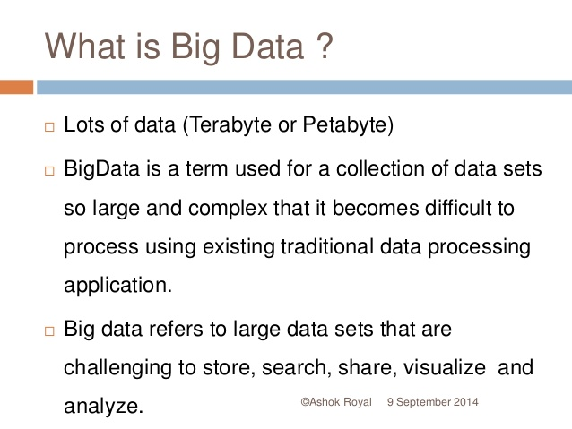

Slide 4
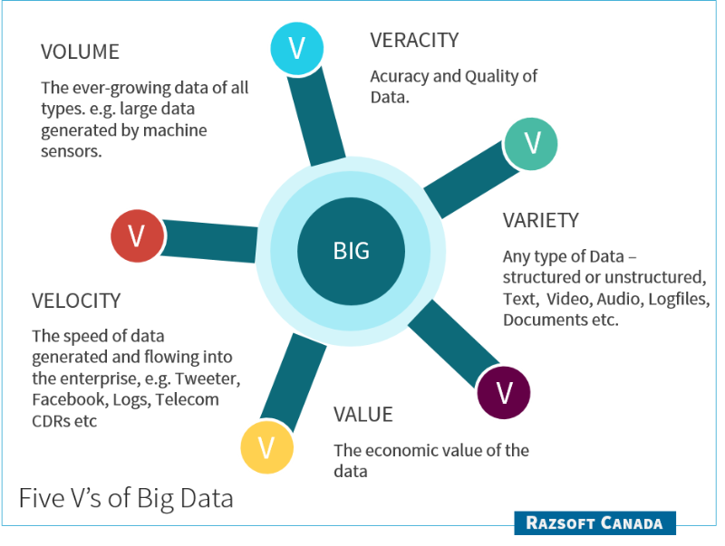

Slide 5
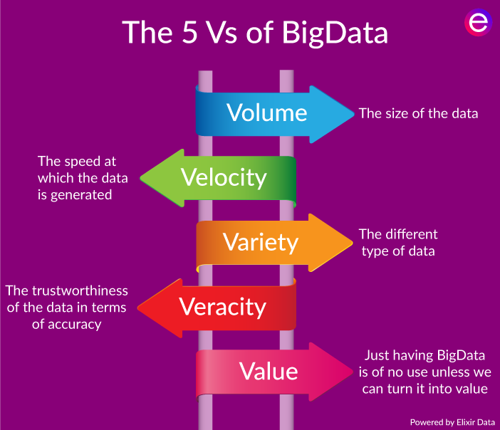

Slide 6

BENEFITS OF BIG-DATA

Slide 7
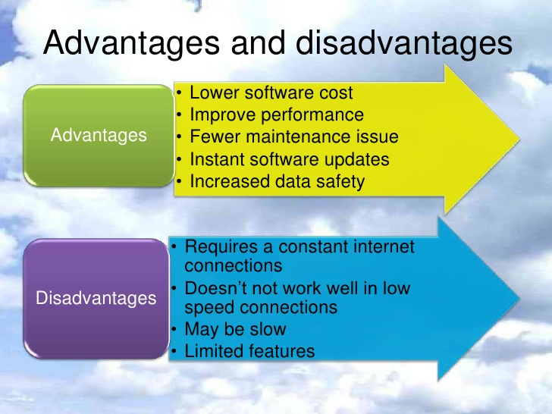

Slide 8
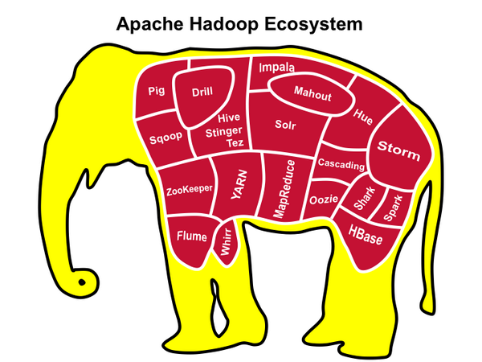

Slide 9

HADOOP

Slide 10
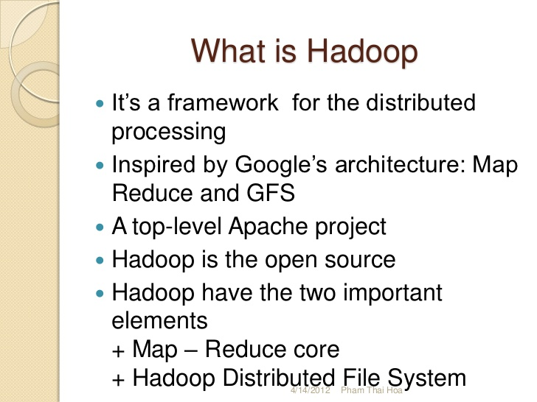

Slide 11
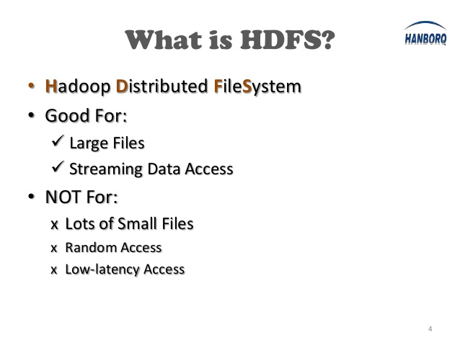

Slide 12
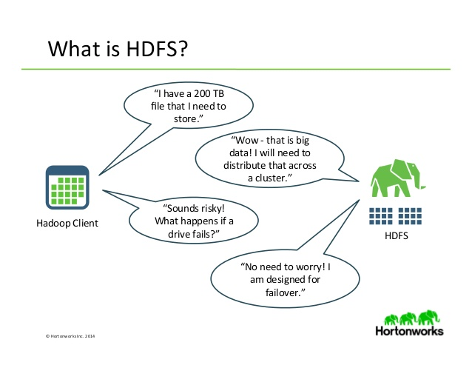

Slide 13
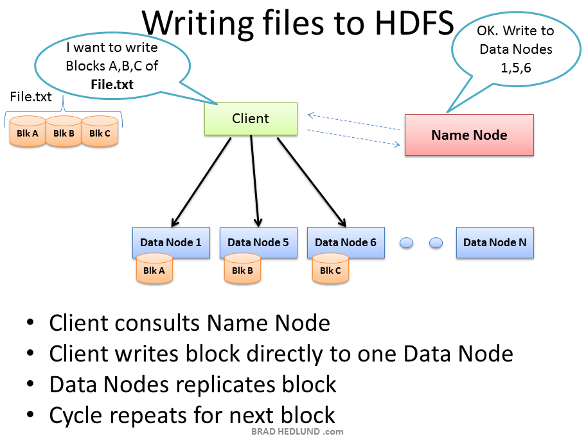

Slide 14
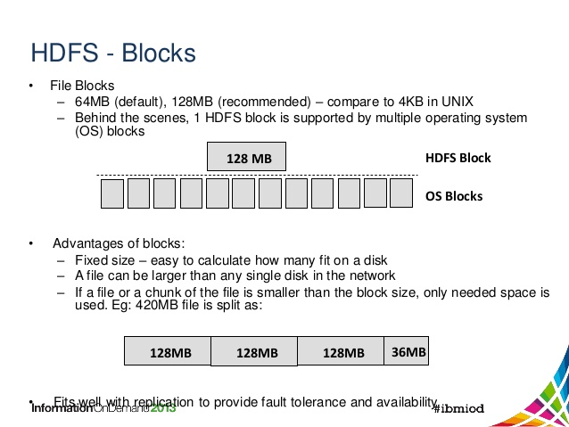
BLOCKS

Slide 15
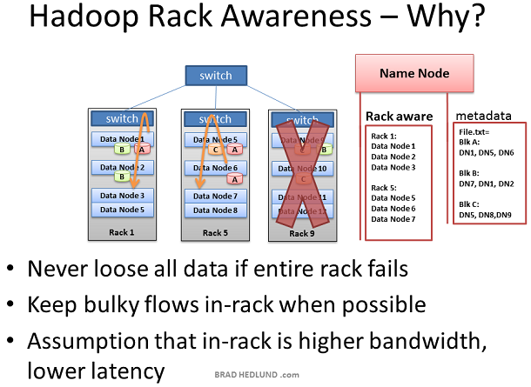

Slide 16
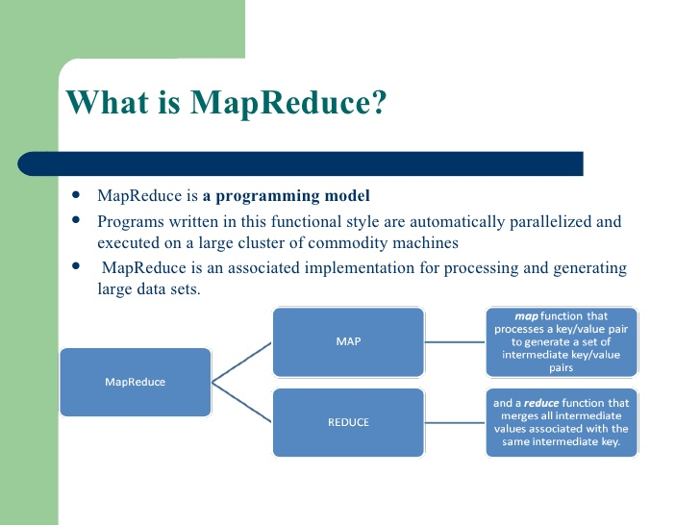

Slide 17
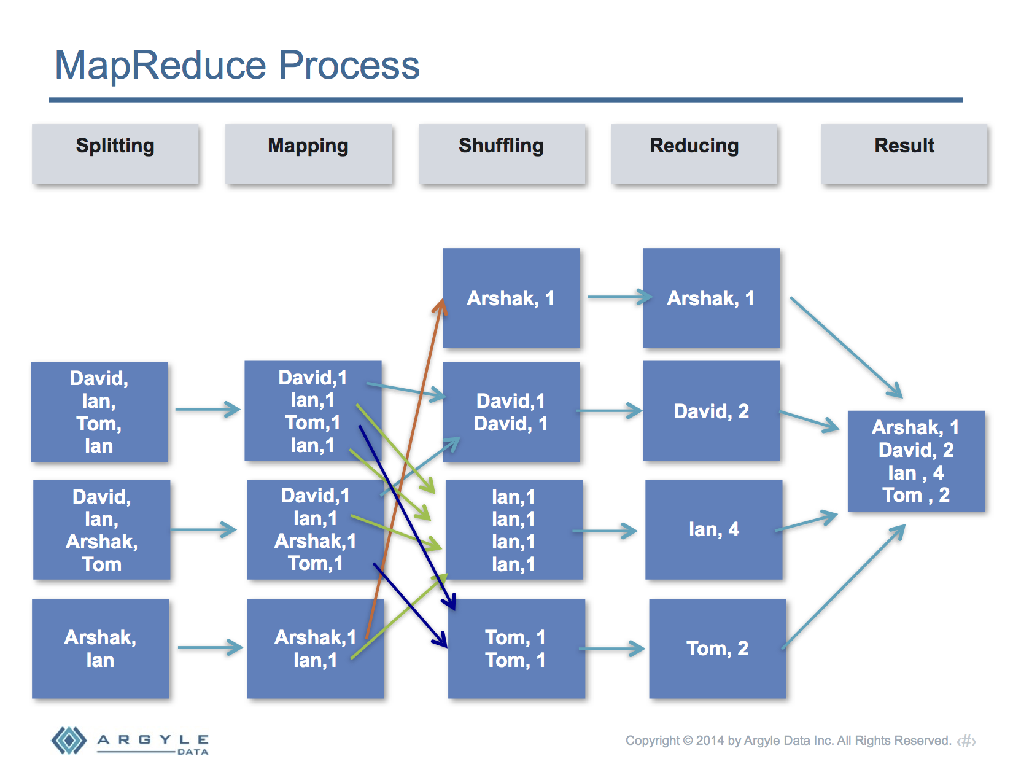

Slide 18
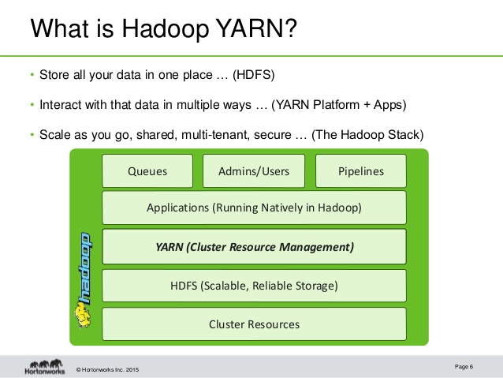

Slide 19
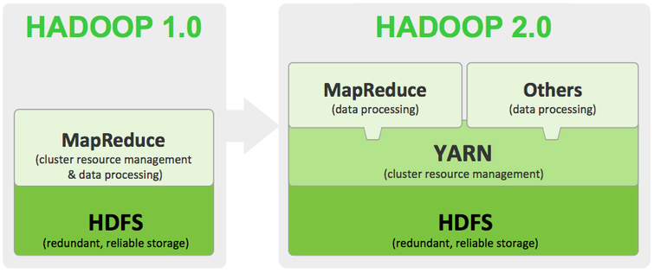

Slide 20
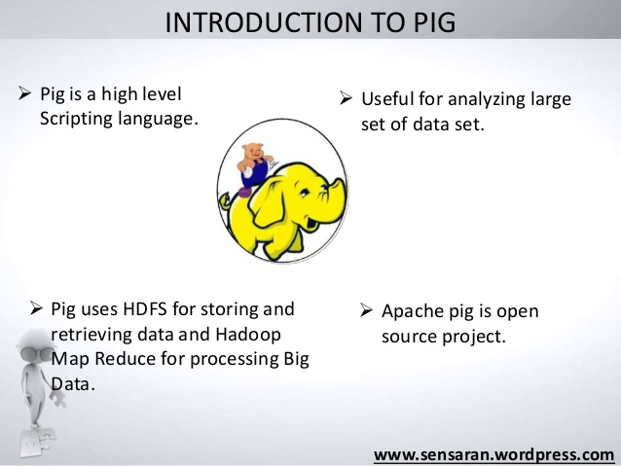

Slide 21
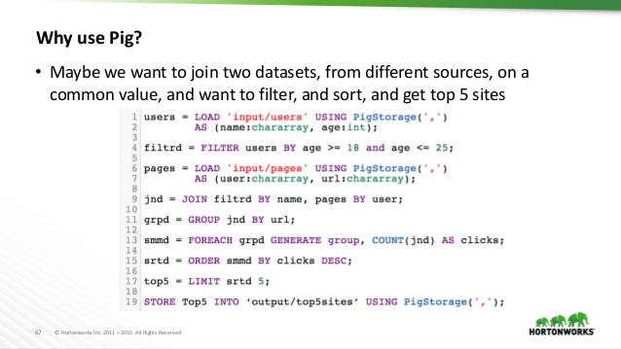

Slide 22
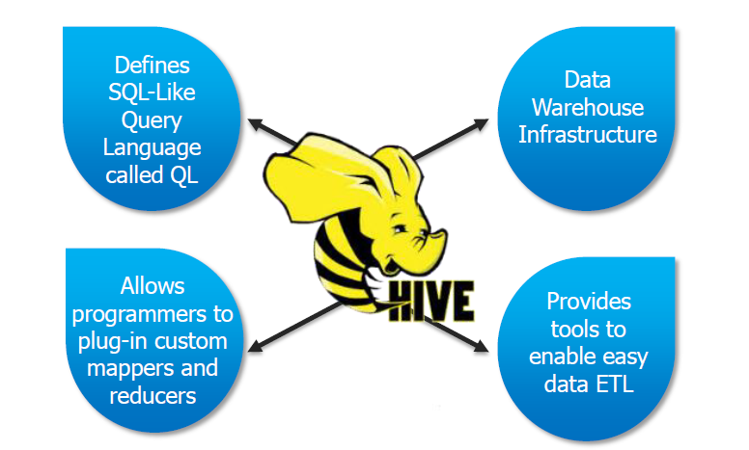

Slide 23
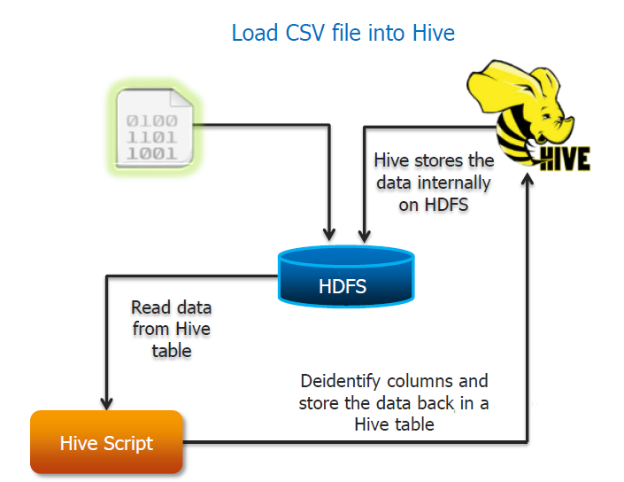

Slide 24
Pig | Hive
Procedural Data Flow Language | Declarative SQLish Language
For Programming | For creating reports
Mainly used by Researchers and Programmers | Mainly used by Data Analysts

Slide 25


Slide 26
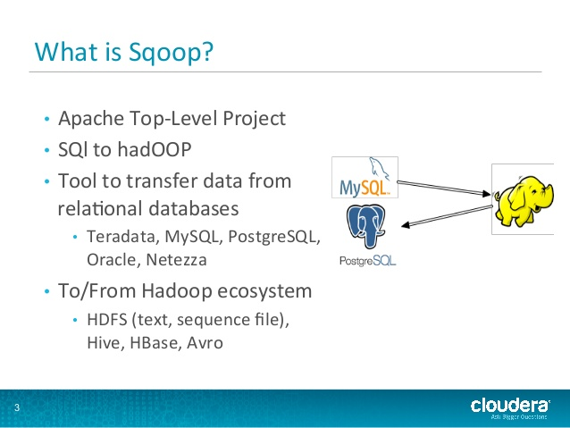

Slide 27
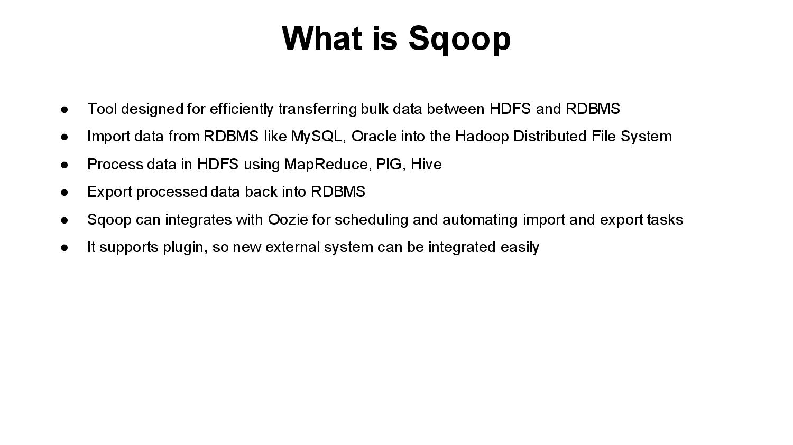

Slide 28
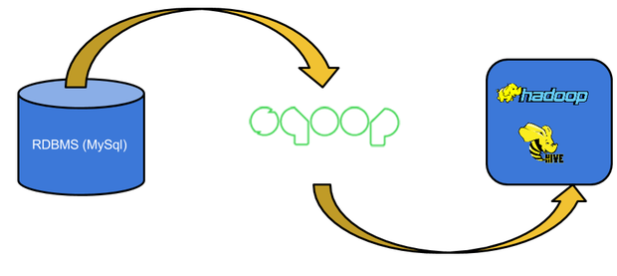

Slide 29
PROJECT H1B CASE STUDY
The H1B is an employment-based, non-immigrant visa category for temporary foreign workers in the United States. For a foreign national to apply for H1B visa, an US employer must offer a job and petition for H1B visa with the US immigration department. This is the most common visa status applied for and held by international students once they complete college/ higher education (Masters, Ph.D.) and work in a full-time position. The data set has nearly 3 million records.
"4","CERTIFIED-WITHDRAWN","GATES CORPORATION, A WHOLLY-OWNED SUBSIDIARY OF TOMKINS PLC","CHIEF EXECUTIVES","REGIONAL PRESIDEN, AMERICAS","Y",220314,2016,"DENVER, COLORADO",-104.990251,39.7392358
"5","WITHDRAWN","PEABODY INVESTMENTS CORP.","CHIEF EXECUTIVES","PRESIDENT MONGOLIA AND INDIA","Y",157518.4,2016,"ST. LOUIS, MISSOURI",-90.1994042,38.6270025
(s_no:int,case_status:chararray,employer_name:chararray,soc_name:chararray,job_title:chararray,full_time_position:chararray,prevailing_wage:int,year:chararray,worksite:chararray,longitute:double,latitute:double);

Slide 30


