Slide 1



Ad_Hoc Insights
CONSUMER GOODS

Slide 2
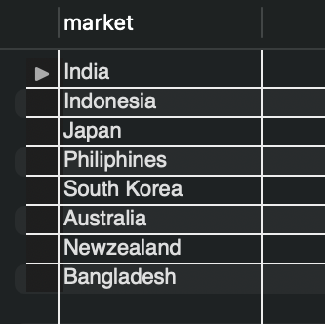
1. Markets in which customer "Atliq Exclusive" operates its business in the APAC region
Atliq Exclusive has its presence in 8 countries spread across Asia Pacific (APAC) region.

Slide 3
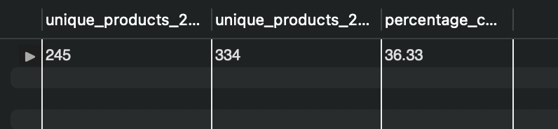
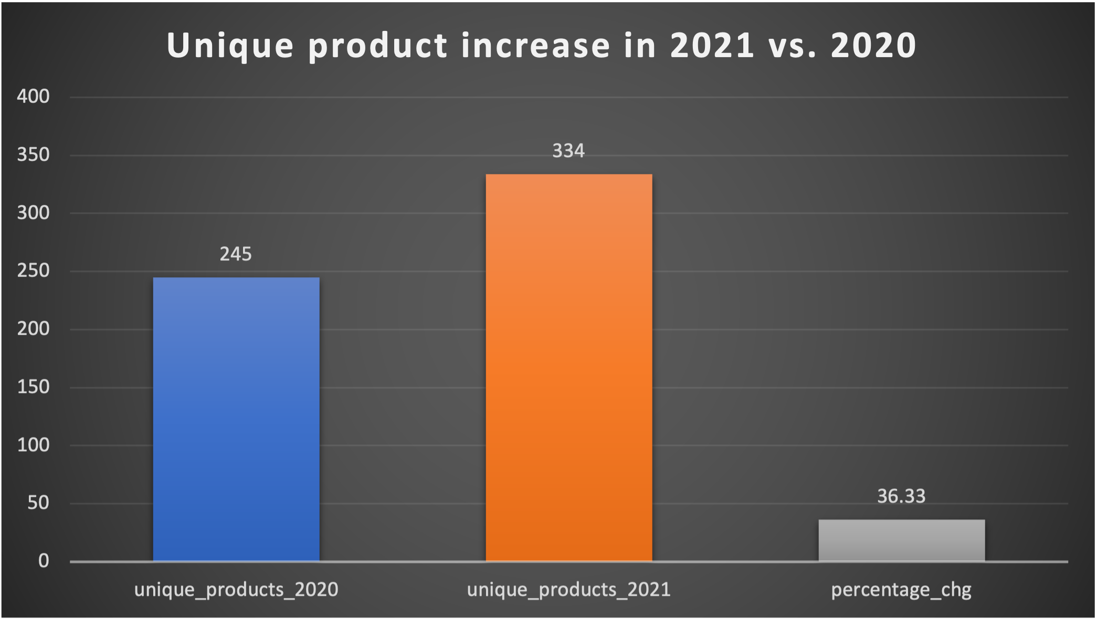
2. Unique product increase in 2021 vs 2020
Atliq Hardware has produced 36.3% more products from 2020 to 2021.
Sales from 2020 has allowed Atliq Hardware to expand its product range in 2021 showing a growth of consumption in the market.

Slide 4
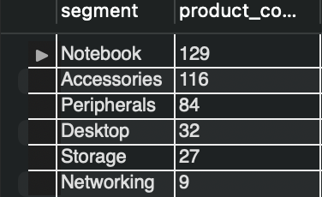
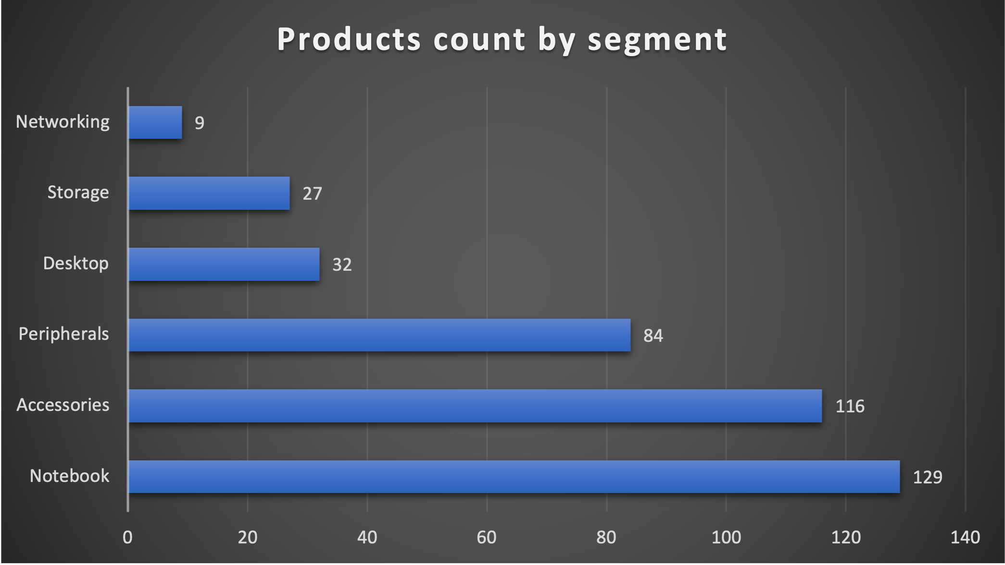
3. Unique products for each segment
It can be observed that Networking segment has least number of products while Notebook segment has the highest number of products.
Using this, Atliq Hardware can prioritize the segment where it’d focus to increase the customer acquisition and thereby revenue.

Slide 5
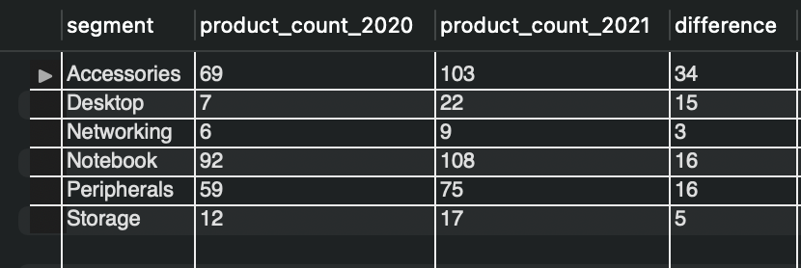
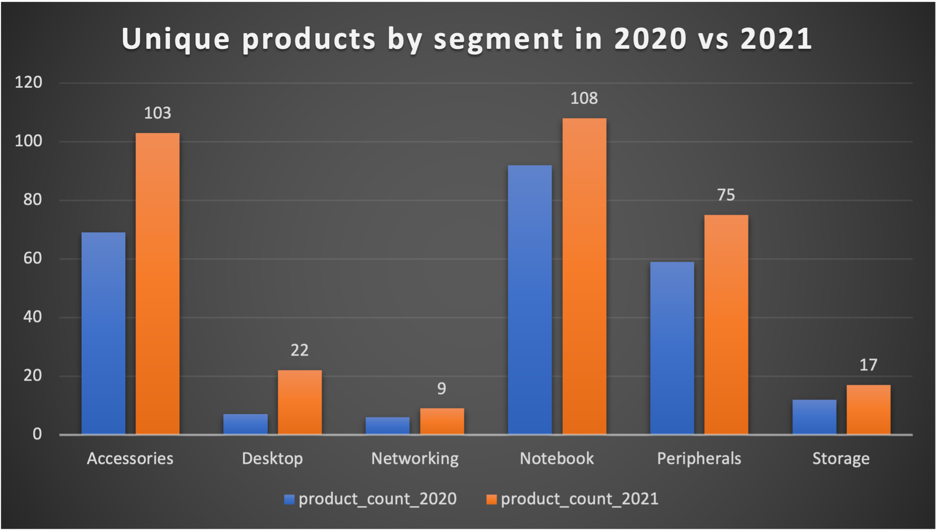
4. Increase in products in 2020 vs 2021 by Segment
The analysis shows that Atliq Hardware has increase the number of products in every segment.
Atliq Hardware has majorly focused on Accessories and Desktop segments in 2021 with an increase of 34 and 15 respectively.

Slide 6
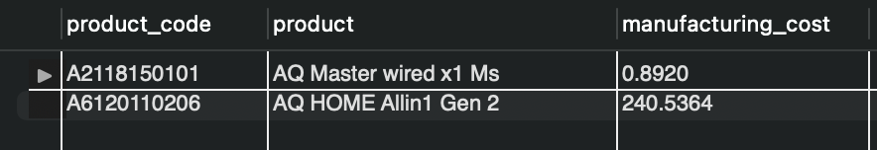
5. Products with highest and lowest manufacturing cost.
AQ Master wired x1 Ms is the product with lowest manufacturing cost and AQ Home Allin1 Gen 2 has the highest manufacturing cost.
Atliq Hardware can investigate into the production process of “AQ Home Allin1 Gen 2” and make possible improvements in the process to lower the manufacturing costs to become more profitable.

Slide 7
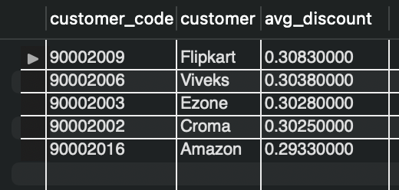
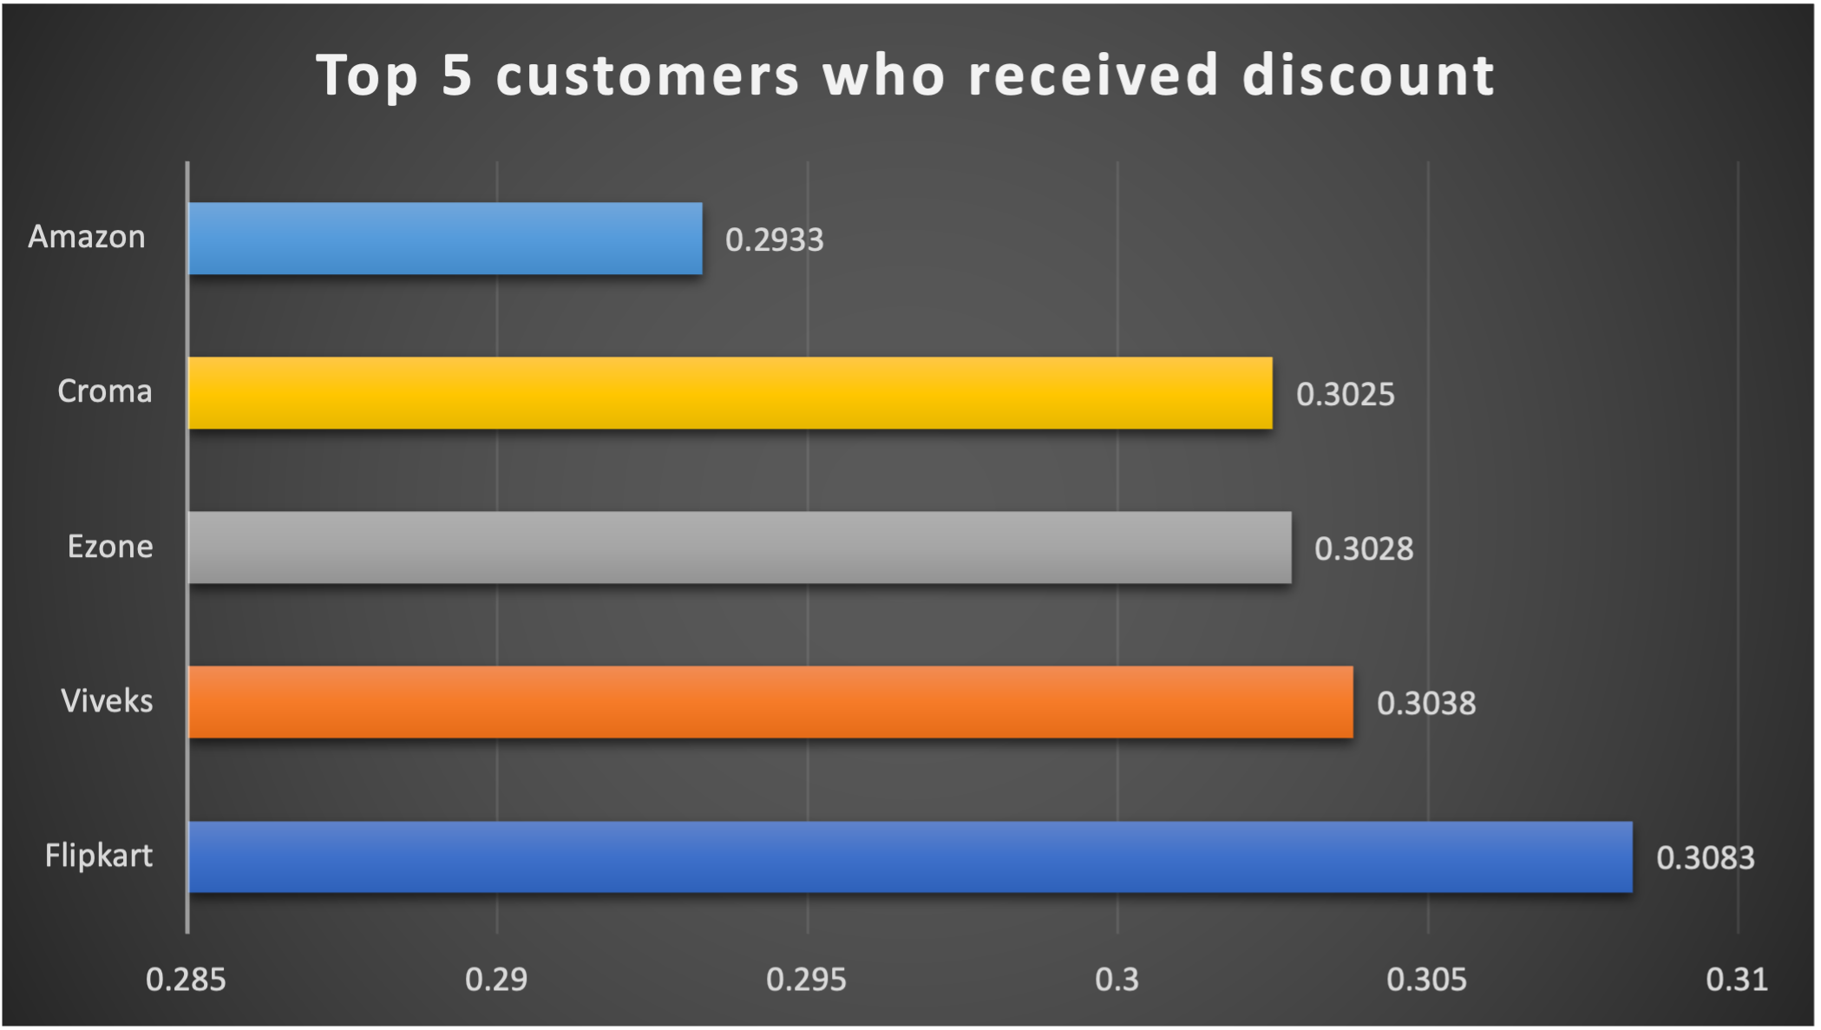
6. Top 5 customers who received average discount
Atliq Hardware provides an average discount of 0.301% to its top 5 customers.
“Flipkart” and “Viveks” received maximum discount, hence are considered more valuable customers to Atliq Hardware.

Slide 8
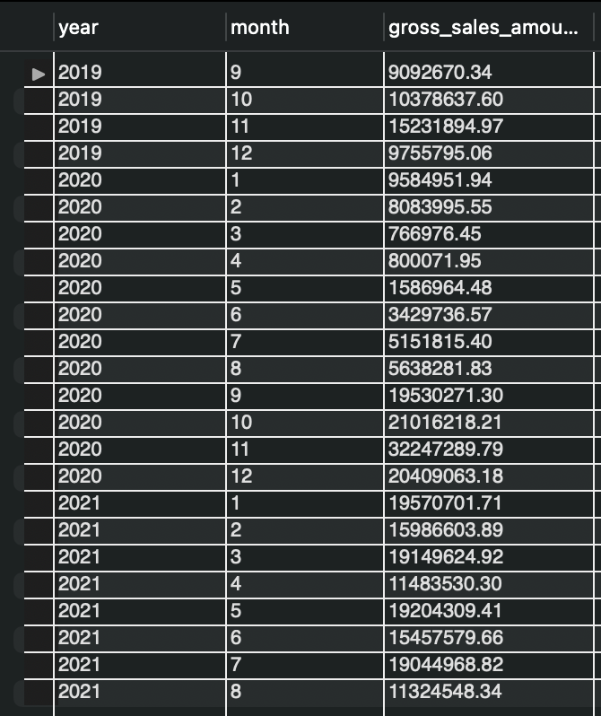
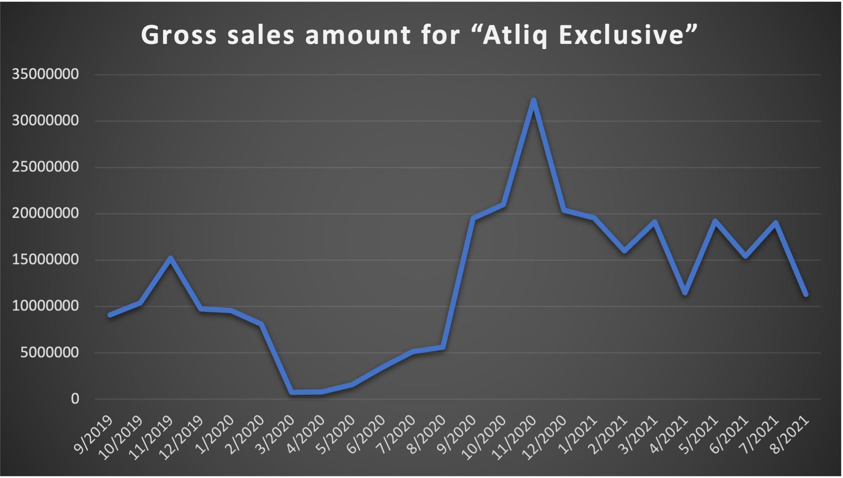
7. Gross Sales for “Atliq Exclusive” by month
Atliq Exclusive has a trend of continuous increase in sales from April 2020 to Nov 2020 and then a trend of decrease is observed post Nov 2020.
Atliq Exclusive has maximum sales in Nov 2020.

Slide 9
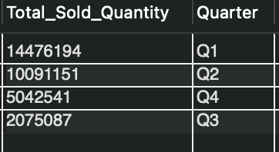
8. Maximum sold quantity by Quarter
Atliq Hardware has maximum sales in Q1 2020 in the beginning of fiscal year from September to November 2020.

Slide 10
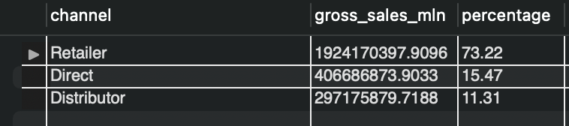
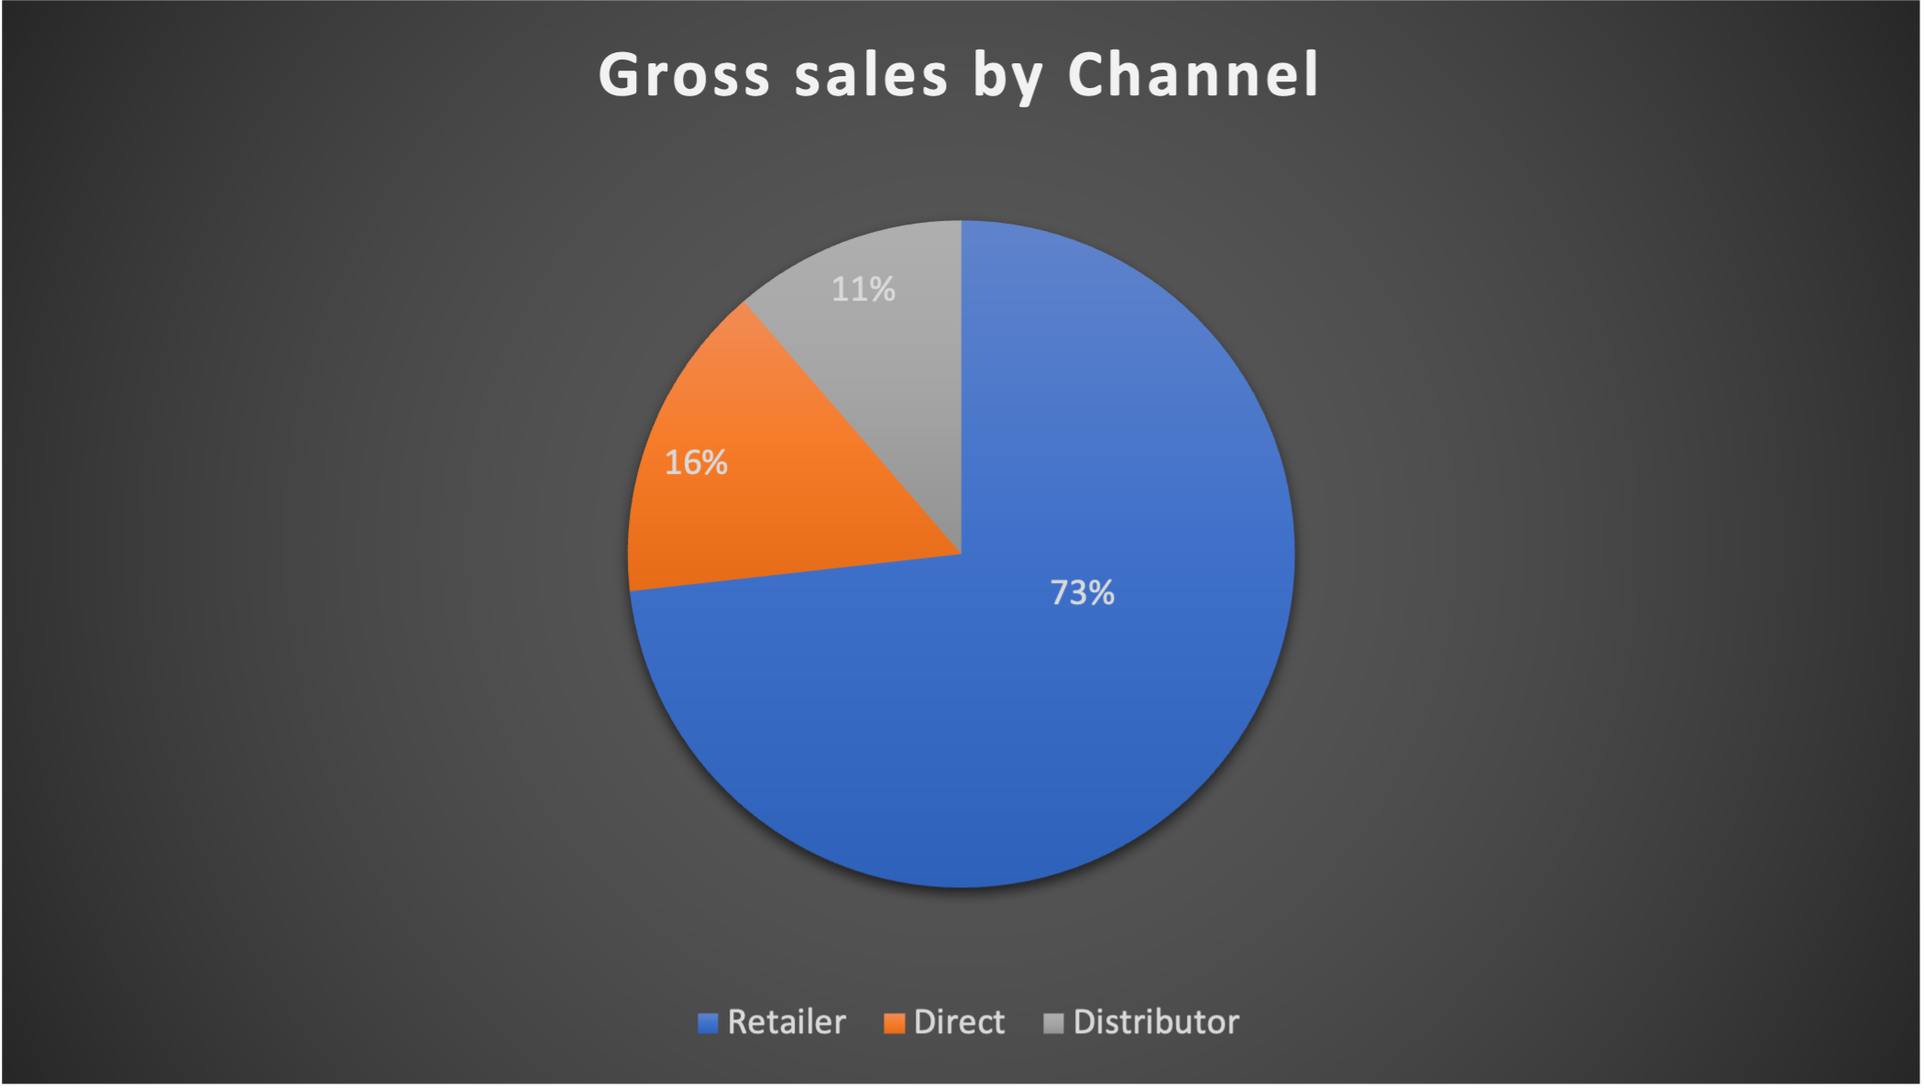
9. Gross sales by channel in FY 2021
Atliq Hardware makes maximum sales via “Retailer Channel”.
It contributes upto 73.22% of entire sales.

Slide 11
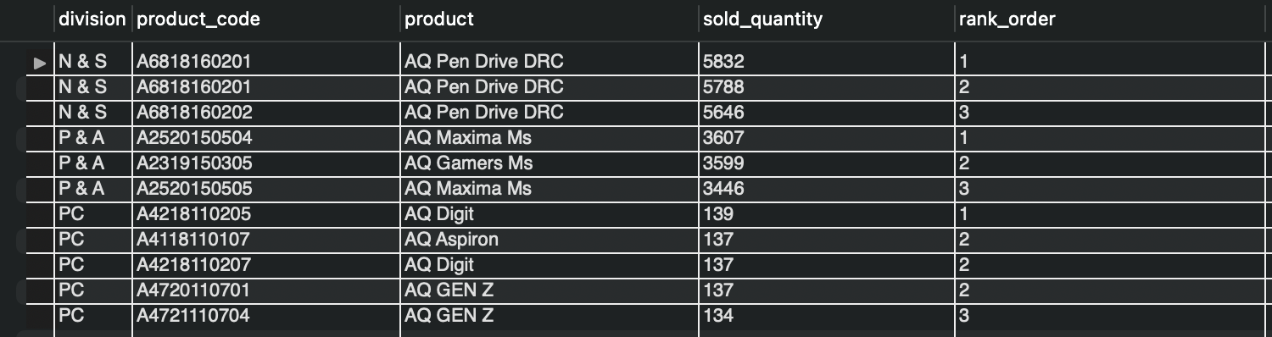
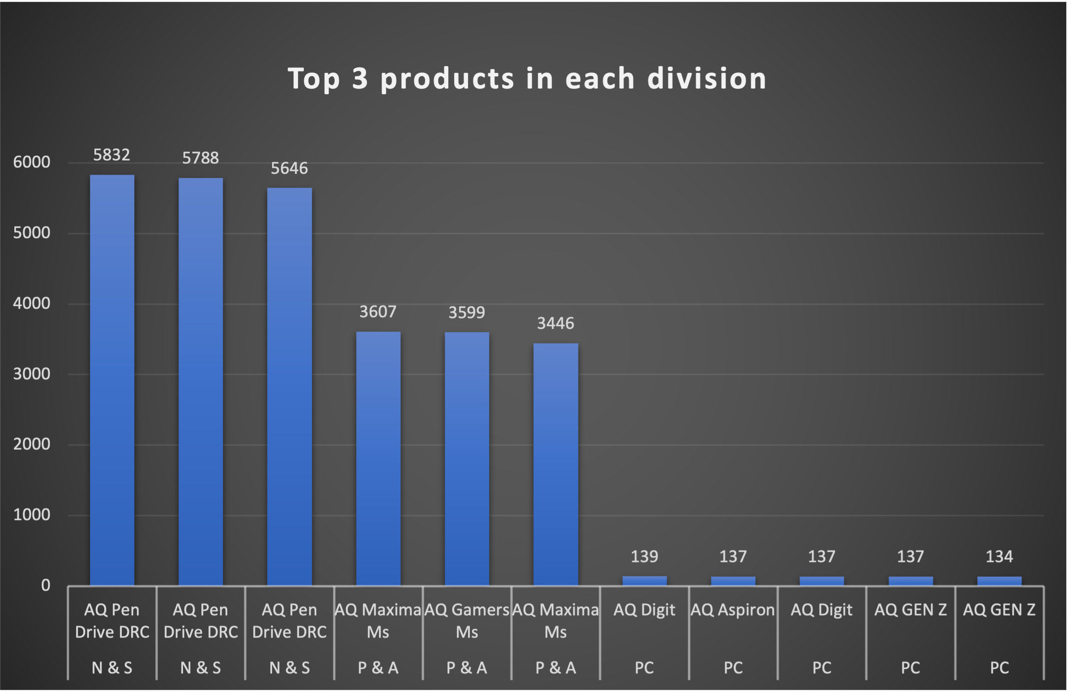
10. Top 3 products in each division in FY 2021
Atliq Hardware has sold maximum products in “N & S division”, with “P & A” division with next maximum and “PC” division with least number of products sold.
It can be seen that N & S Division is top performing division for Atliq Hardware.

Slide 12

Thank You

