Slide 1

IMAGE STEGNOGRAPHY

Slide 2
Student Details
Name: Sri Bhaskar Yendluri
SkillsBuild Email ID: bhaskaryendluri7@gmail.com
Collage Name: SRM University AP
Collage State: Andhra Pradesh
Internship Domain: Cybersecurity with Kali Linux
Internship start date: 03/07/2024
Internship end date: 10/07/2024

Slide 3
INTRODUCTION
Concept and Purpose: Image steganography involves hiding secret data within an image file, ensuring that the presence of the hidden information is undetectable to the naked eye. This technique is used to achieve secure and covert communication.
Techniques: Common methods include Least Significant Bit (LSB) modification, which subtly alters the pixel values of an image to encode data, and more complex algorithms that use frequency domain transformations to embed information.
Applications: It is widely used in digital watermarking, protecting intellectual property, and secure transmission of confidential information. Image steganography offers an additional layer of security in combination with encryption techniques.

Slide 4
PROJECT TOPIC
Problem Statement:
To develop a robust and efficient image steganography system that securely embeds and retrieves hidden data within digital images without compromising the visual quality or raising suspicion.
Objective:
Data Embedding: Implement a method for embedding secret data into digital images using least significant bit (LSB) modification and advanced steganographic techniques to ensure minimal perceptible changes.
Data Retrieval: Create an algorithm to accurately extract the embedded data from the steganographic image, ensuring the integrity and completeness of the retrieved information.
Security and Evaluation: Assess the robustness of the steganographic system against various steganalysis attacks and evaluate its performance in terms of embedding capacity, imperceptibility, and computational efficiency.

Slide 5
AGENDA
Problem Statement and Objectives
Background and Literature Review
Methodology
Implementation
Evaluation and Results
Applications and Use Cases
Future Work
Conclusion

Slide 6
Project Overview
Purpose: The primary purpose of the image steganography project is to develop a system capable of securely embedding and retrieving hidden information within digital images. This system aims to ensure the concealed data remains undetectable to unauthorized parties while maintaining the original image quality. Image steganography can be used for secure communication, digital watermarking, and protecting intellectual property.
Scope
Data Embedding and Retrieval:
Implementing techniques to embed secret data within images.
Developing algorithms to accurately extract the hidden data from the images.
Security:
Ensuring the embedded data is secure and resilient against common steganalysis attacks.
Evaluating the robustness of the steganographic methods used.

Slide 7
Objectives
Data Embedding:
Implement a reliable method for embedding secret data within digital images using least significant bit (LSB) modification and advanced steganographic techniques.
Ensure the embedding process causes minimal perceptible changes to the original image.
Data Retrieval:
Create an algorithm to accurately extract the embedded data from steganographic images.
Maintain the integrity and completeness of the retrieved information.
Security and Evaluation:
Assess the robustness of the steganographic system against various steganalysis attacks.
Evaluate the system's performance in terms of embedding capacity, imperceptibility, and computational efficiency.

Slide 8
Methodology
The methodology involves embedding secret data in images using techniques like LSB modification, DCT, and Wavelet Transform. Data retrieval algorithms ensure accuracy and integrity, with added encryption for security. Performance is evaluated by embedding capacity, visual quality (PSNR, SSIM), and computational efficiency, ensuring robust, imperceptible, and secure steganographic systems.
Implementation
Implementation involves embedding secret data into images using LSB, DCT, or Wavelet Transform techniques. Algorithms are developed for accurate data retrieval and integrity checks. Security is enhanced with encryption and steganalysis resistance. Performance is evaluated by embedding capacity, visual quality (PSNR, SSIM), and computational efficiency, ensuring robustness and imperceptibility.

Slide 9
Evaluation
The Image Steganography GUI code effectively demonstrates the basic principles of steganography using the Least Significant Bit (LSB) technique. The code is well-structured and leverages the Tkinter library for the GUI, making it user-friendly and accessible even for those with minimal technical background.
Strengths:
Functionality and Simplicity: The code effectively embeds and extracts messages using LSB steganography and is easy to understand, making it suitable for educational purposes.
User-Friendly Interface: The Tkinter GUI offers an intuitive interface, allowing users to easily select images and manage the embedding and extraction processes.

Slide 10
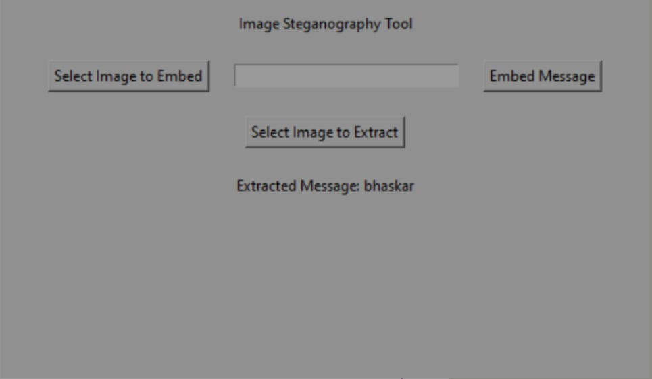

2. Areas For Improvement
Enhanced Security: Implement more complex encoding methods and encryption to increase the security of the embedded messages.
Extended Features: Add support for different image formats, larger message sizes, and batch processing to enhance usability and functionality.
Results:

Slide 11
Application and Use cases
Secure Communication: Image steganography can be used to embed confidential messages within images, providing a covert channel for secure communication.
Digital Watermarking: It can be employed to embed copyright information or digital watermarks within images to protect intellectual property.
Data Integrity: Used for embedding checksums or metadata within images, ensuring data integrity and authenticity without altering the visual appearance.
Military and Intelligence: Utilized for covert operations and intelligence sharing, where maintaining secrecy is crucial.
Steganographic File Systems: Incorporating steganography into file systems to hide data within ordinary files, adding an extra layer of security against unauthorized access.

Slide 12
End Users of the Image Steganography Project
Security Professionals: Individuals working in cybersecurity who need to embed and extract confidential information securely.
Digital Forensics Experts: Professionals who require tools to hide or uncover hidden data within digital images during investigations.
Intellectual Property Owners: Artists, photographers, and content creators looking to embed digital watermarks to protect their works.
Military and Intelligence Agencies: Organizations needing secure methods for covert communication and data exchange.
Educational Institutions: Students and educators using steganography projects for learning purposes in computer science and cybersecurity courses.
Privacy Advocates: Individuals interested in protecting their privacy by hiding sensitive information within innocuous-looking images.

Slide 13
THE END

