Slide 1
Project #2 Final Demo: [$1 + Protractor], [Unistoke and Custom Datasets] [Sri Chaitanya Nulu]
[CIS4930/CIS6930] Human-Centered Input Recognition Algorithms Instructor: Dr. Lisa Anthony
April 14, 2022

Slide 2
Project #2 Overview
Project #2:
Algorithm: Protractor ($1)
Language: Python
Existing dataset: $1 Unistroke gestures [10 people]
New dataset: $1 Unistroke gestures [Collected from 6 people]
Analysis: user-dependent recog. accuracy, visualizing major steps and several confusion matrices for gesture mismatches.

Slide 3
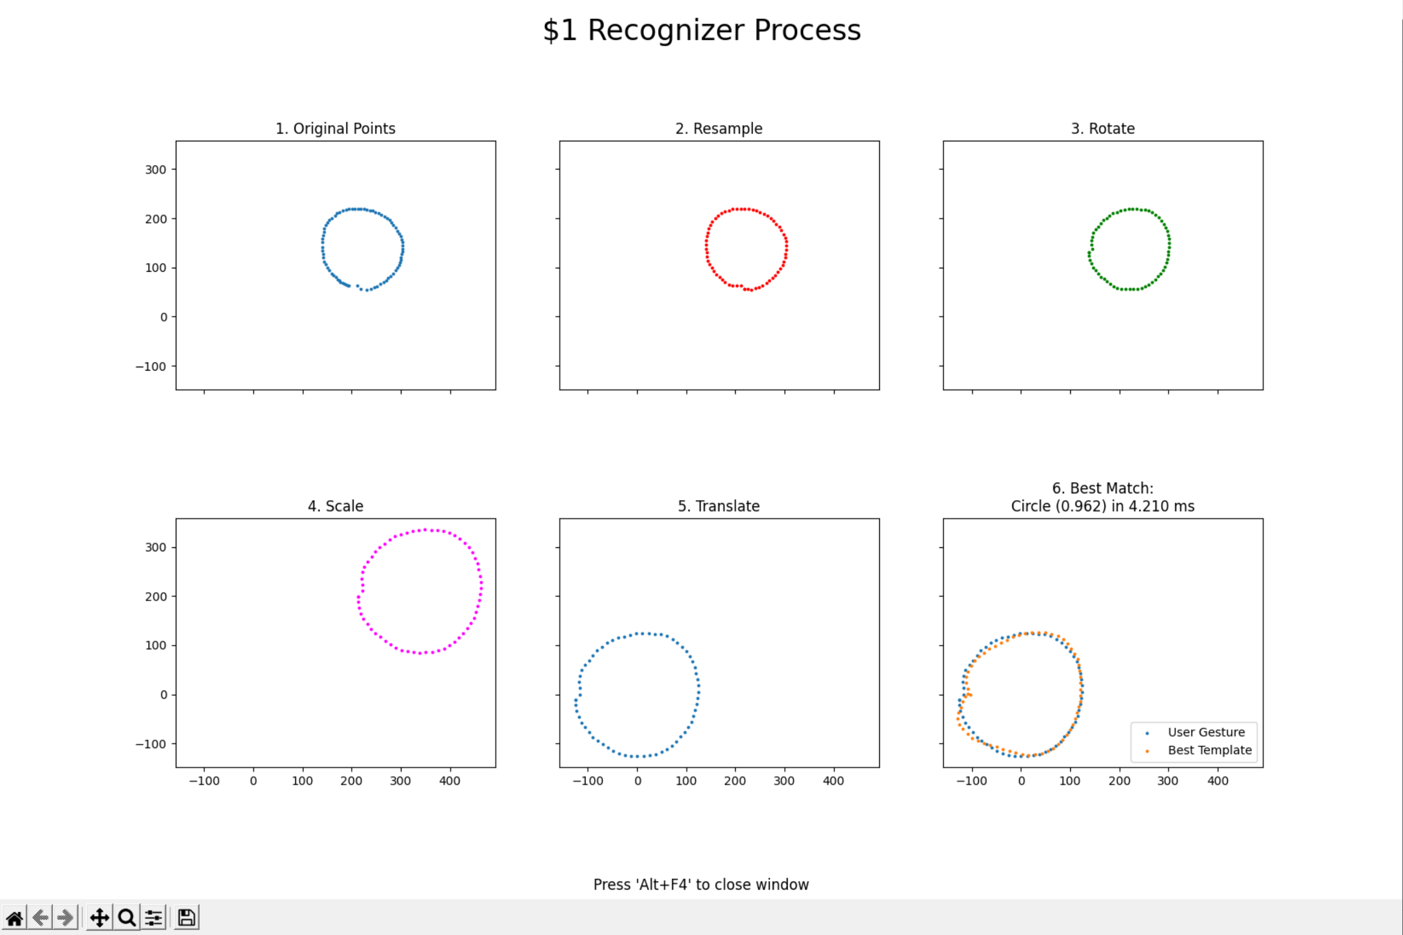
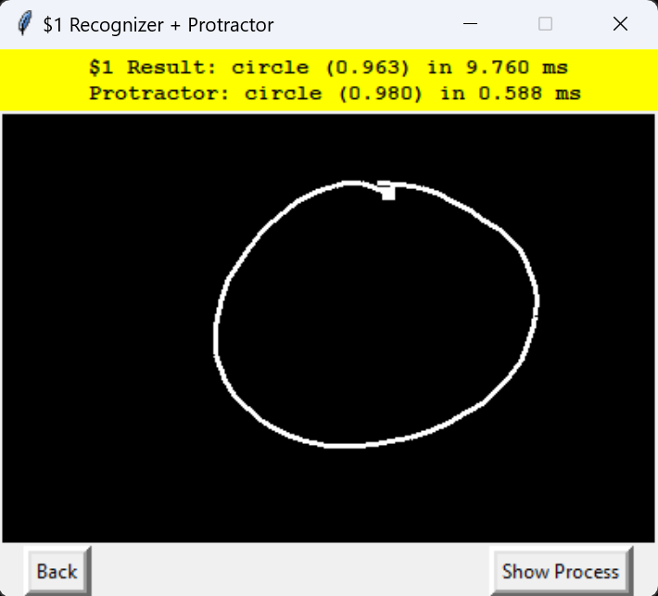
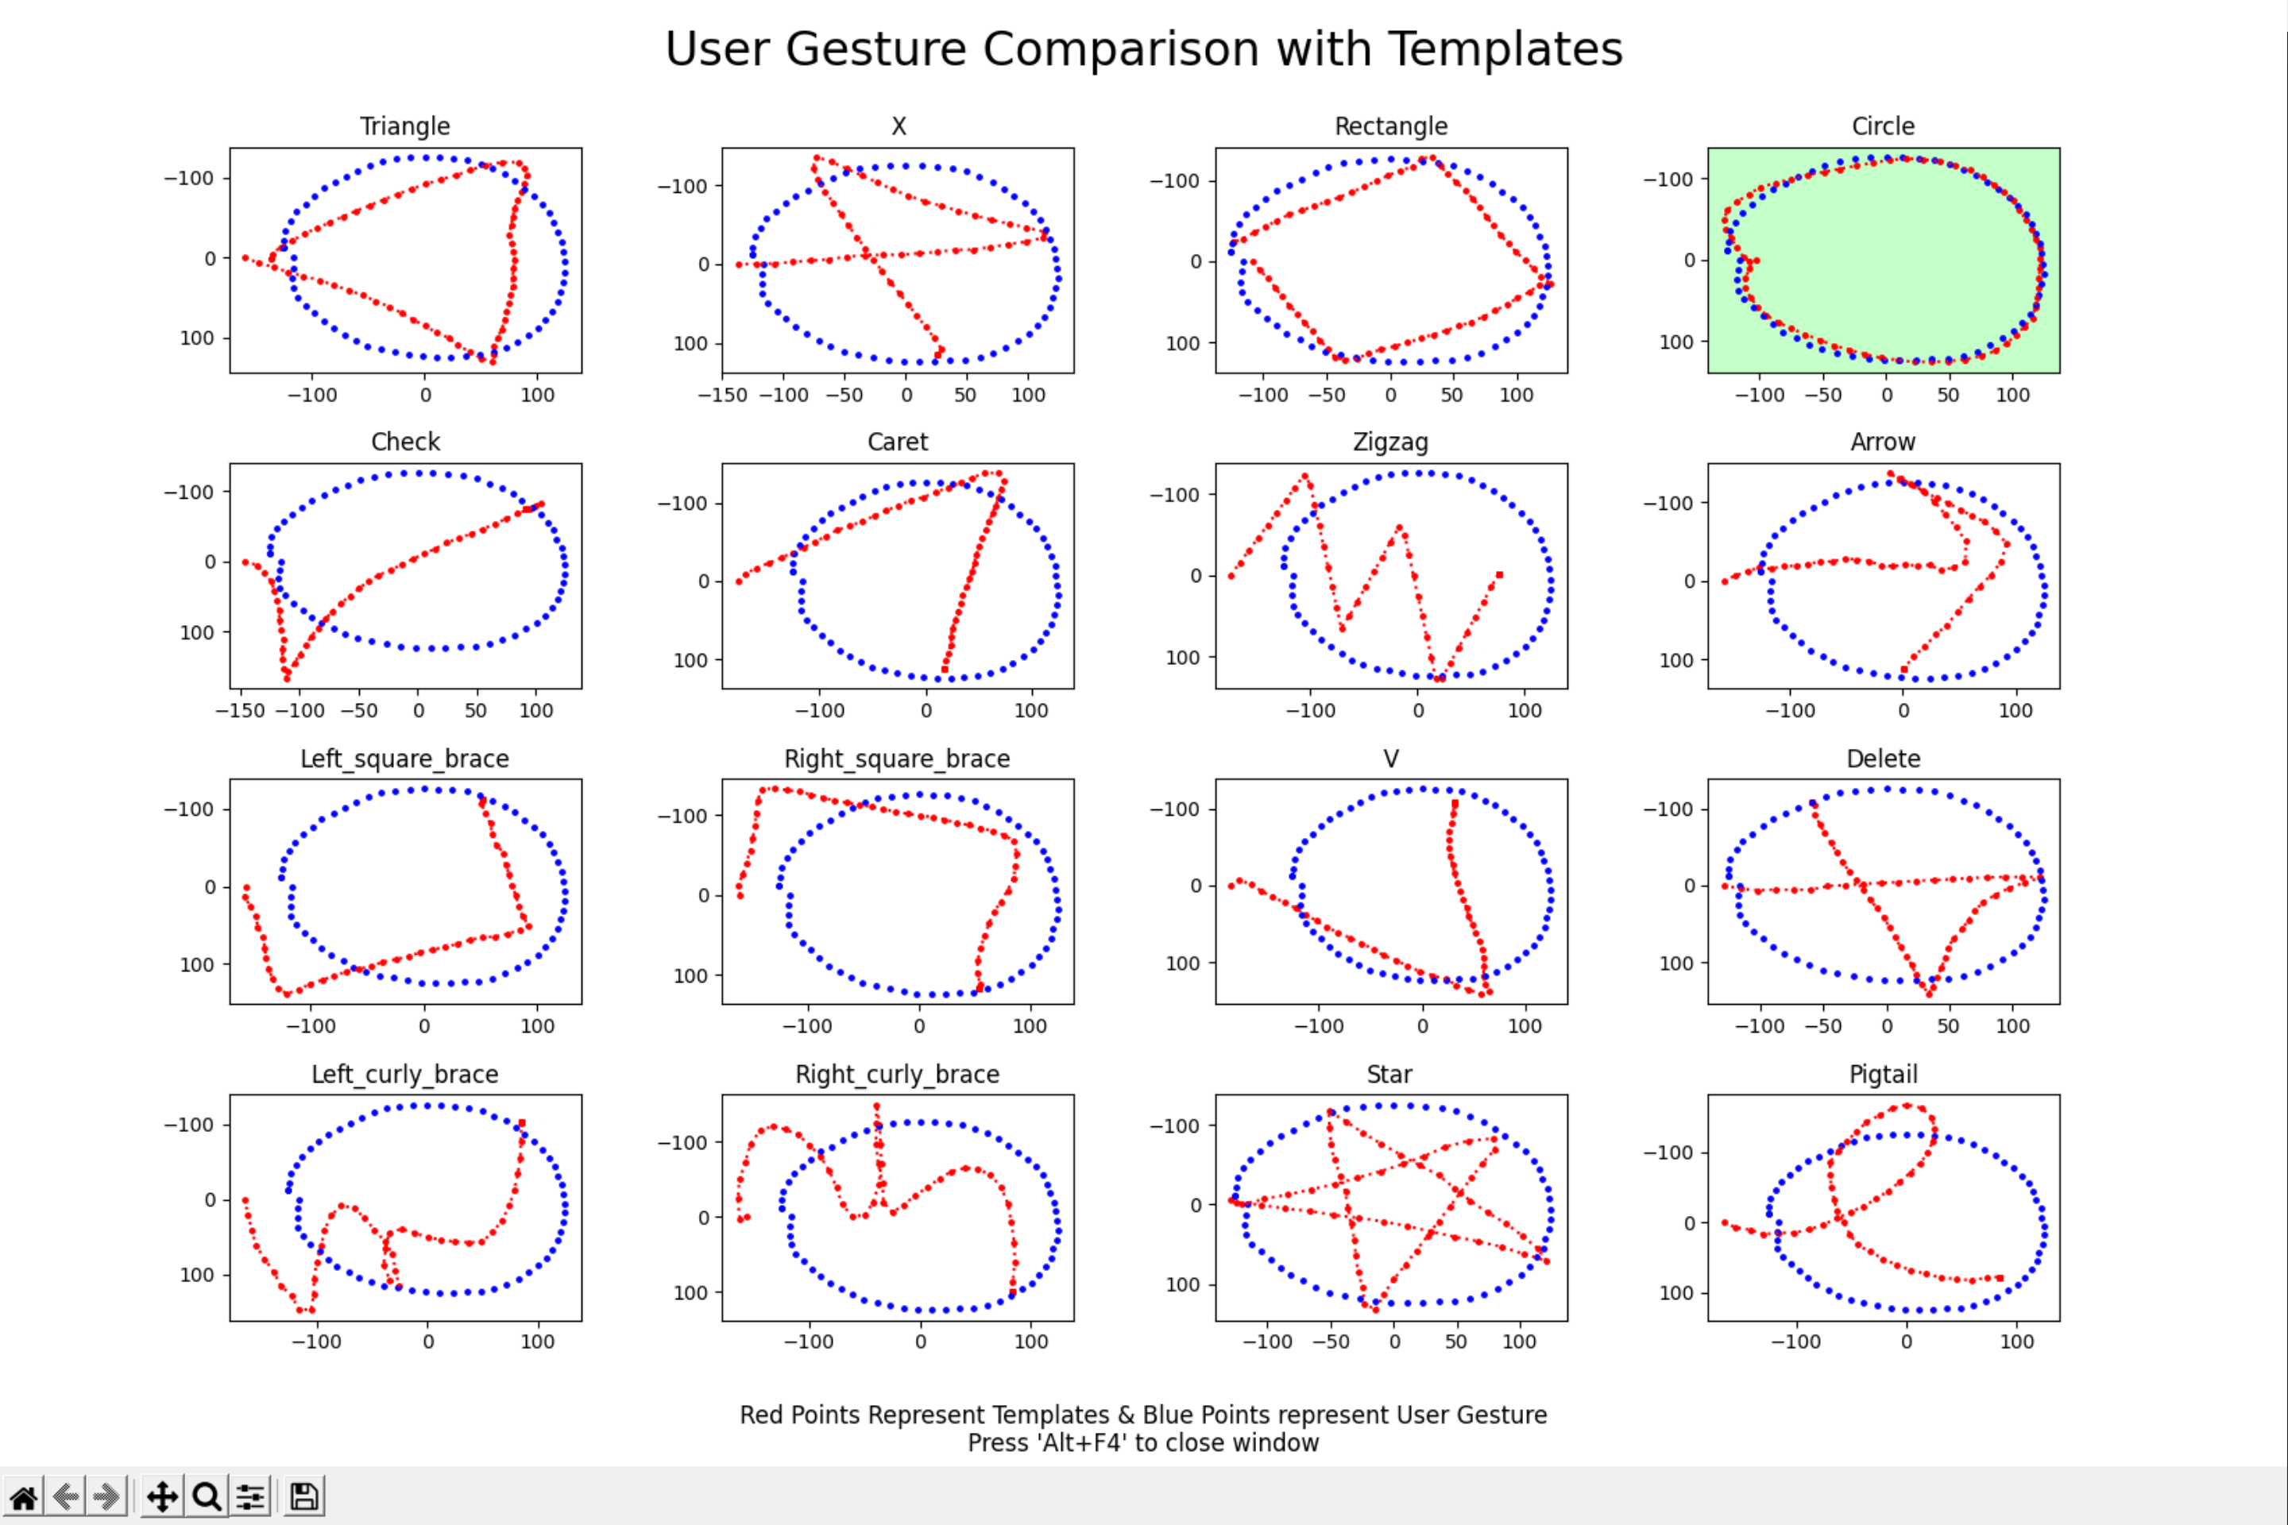
Online / Live Demo
Figure 2: $1 Algorithm Steps Visualized)
Figure 1: $1 and $1+protractor algorithms outputs)
Figure 3: Template Comparison with Candidate for $1

Slide 4
Collecting Data
Not Applicable

Slide 5
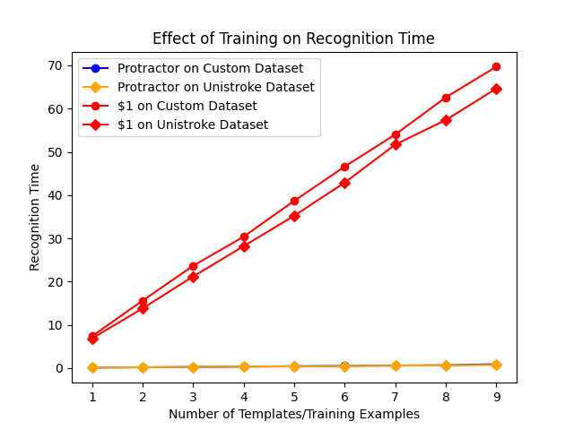
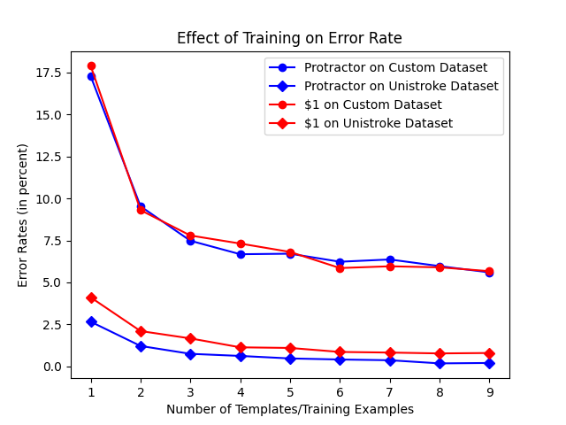
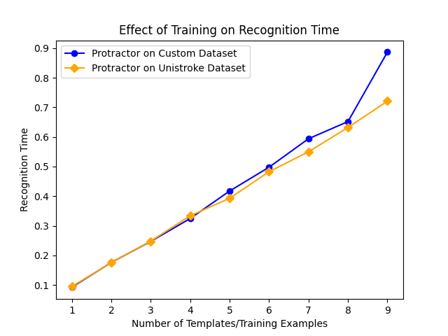
Offline Recognition Tests
Figure 4: The time (ms) needed for recognizing a
gesture grows as the number of training samples increases.
Protractor runs significantly faster than the $1 recognizer.
Figure 5: The error rates of both the $1 recognizer and Protractor decrease
as more training samples are used.

Slide 6
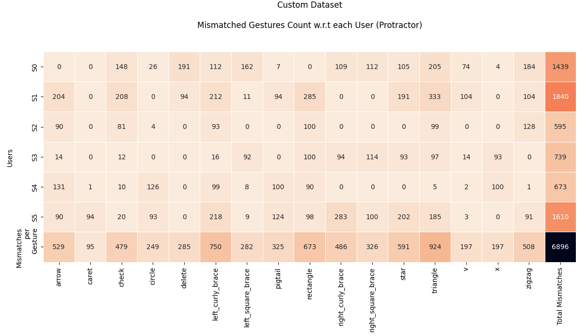
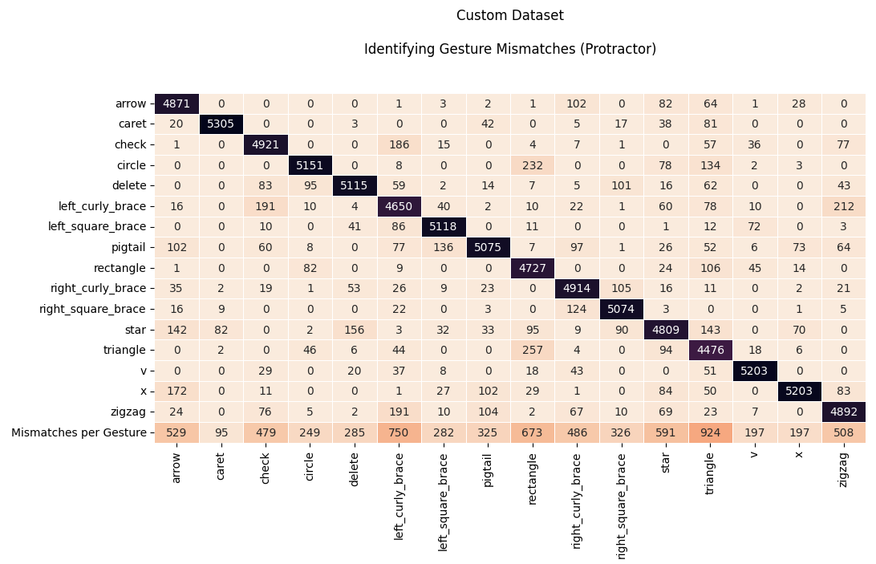
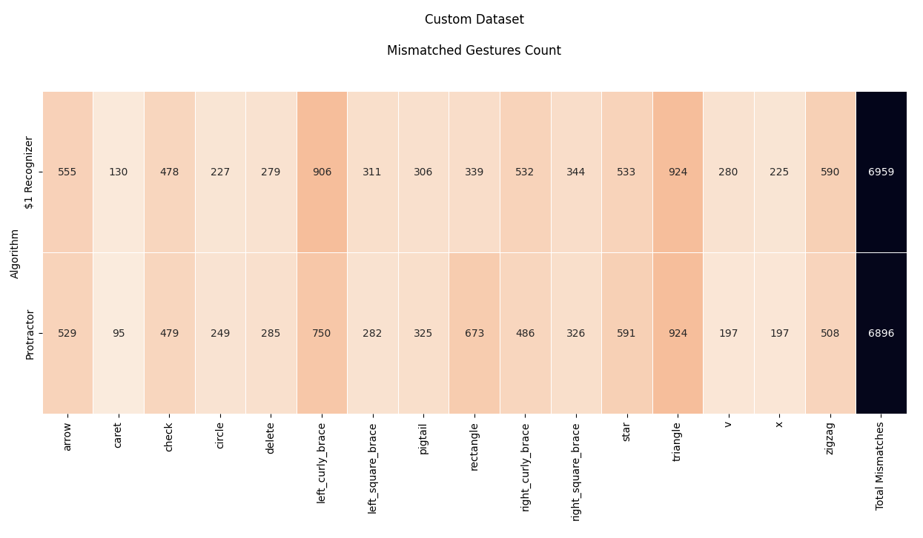
Analyses
Figure 7: All gesture mismatches per user for Custom Dataset
(each column represents the number of mismatches per gesture.)
Figure 6: All gesture mismatches per gesture for Custom Dataset
(each column represents the number of mismatches per gesture.)
Figure 8: All gesture mismatches per gesture for $1 and protractor for Custom Dataset
(each column represents the number of mismatches per gesture.)

Slide 7
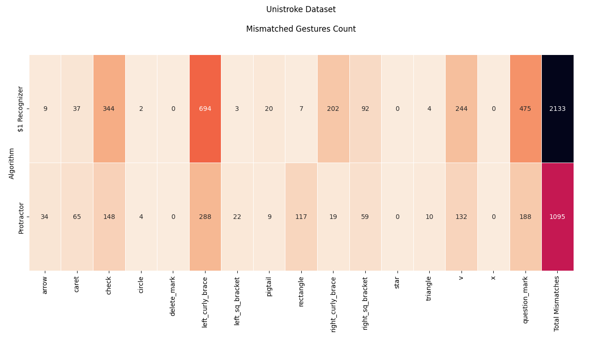
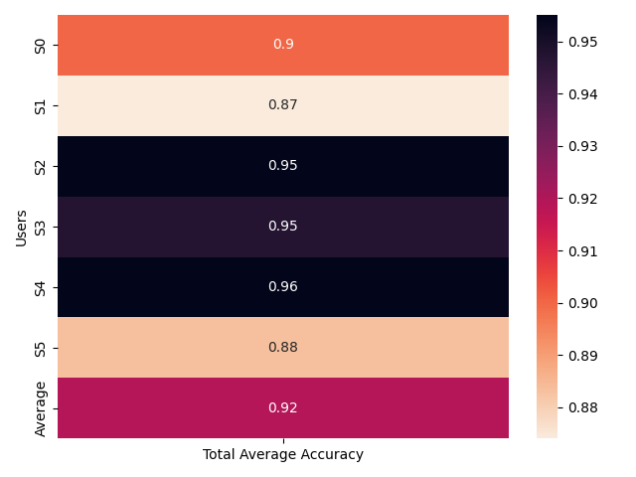
Implementation and Challenges
Figure 9: Total Average Accuracy per User according to protractor
for Custom Dataset.
Figure 10: All gesture mismatches per gesture for $1 and protractor for Unistroke Dataset
(each column represents the number of mismatches per gesture.)
Integrating protractor into existing code.
Visualization of the steps and process.
Understanding why the custom dataset has lower accuracy than the Unistroke dataset.
Understanding why certain gestures have high mismatch count than others.

Slide 8
Predicted and Actual Outcome
Statistics:
The Total average accuracy for $1 Recognizer for Unistroke data is 0.985 and 0.919 for Unistroke and Custom Datasets respectively.
Similarly, the Total average accuracy for $1+Protractor for Unistroke data is 0.992 and 0.92 for Unistroke and Custom Datasets respectively.
The Total average recognition time for $1+Protractor for Unistroke data is 0.403 ms and 0.432 for Unistroke and Custom Datasets respectively.
As a comparison, it is 35.759 ms and 38.727 ms for $1 Recognizer for Unistroke and Custom Datasets respectively.
Gesture Predictions and Outcomes:
For Project 1, a heatmap was generated using GHOST. The results from that heatmap and the gesture mismatches are similar in many cases. For example, triangle, rectangle, star, arrow, zig-zag, left curly brace, etc. have a high deviation in the heatmap. That reflected in the gesture mismatches matrix(fig.6).
Even though protractor performs slightly better, there are some gestures, where it creates more mismatches for certain gestures (fig. 8).
Individidual user accuracies have direct impact on total average accuracy, so some data must be removed for better performance (fig. 9).
Note: Unistroke dataset showed better comparison between $1 and $1 + Protractor. This is because all the users were instructed to draw the gestures in a certain way (speed for example). This certainly has an impact on the analysis. Look at fig. 10.

Slide 9
Questions?

