Slide 1

Artificial Intelligence Teaching Assistant

Slide 2


Slide 3


Slide 4

ARTIFICIAL INTELLIGENCE TEACHING ASSISTANT

Slide 5

ARTIFICIAL INTELLIGENCE TEACHING ASSISTANT

Slide 6

Hack-a-Roo
Team
Roolers
Raju Nekadi
Vivek Pottam
Srichakradhar

Slide 7
Student TA Ratio
University | Students | TAs | Ratio
University of Missouri-Kansas City | 16,019 (2012) | 255 | 1.6%
University of Missouri (Columbia) | 29,866 (2018) | 955 | 3.2%
University of Kansas | 28,447 (2018) | 1,179 | 4.1%
University of Florida | 52,367 (2017) | 1,291 | 2.5%
Florida State University | 32,812 (2017) | 1,746 | 5.3%
University of Central Florida (Orlando) | 66,183 (2017) | 1,300 | 1.9%
University of South Florida (Tampa) | 49,591 (2016) | 1,431 | 2.9%
Eastern Michigan University | 21,105 (2017) | 167 | 0.8%

Slide 8

ARTIFICIAL INTELLIGENCE TEACHING ASSISTANT

Slide 9
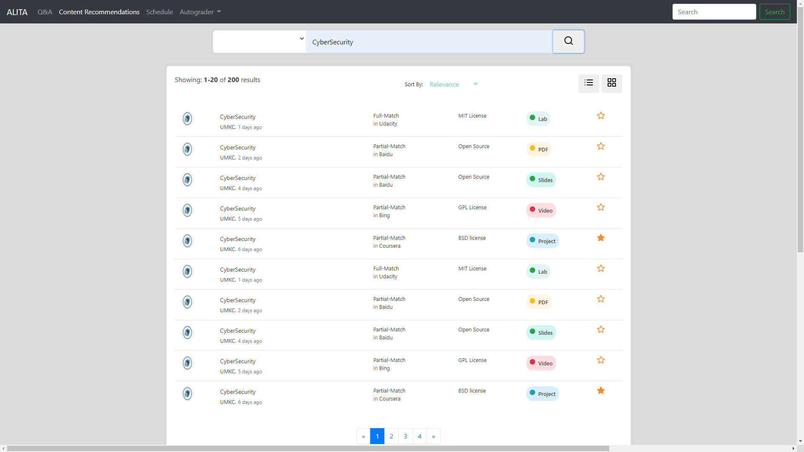

Slide 10
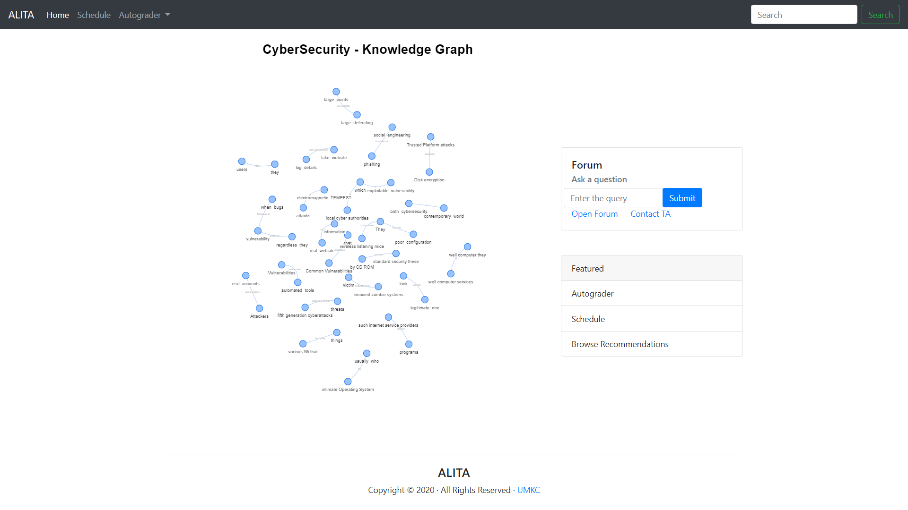

Slide 11
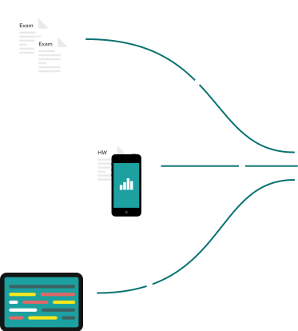


Autograder
View student solutions and leave comments on how to improve their style. You can put the pen & paper away and digitize feedback.

Slide 12
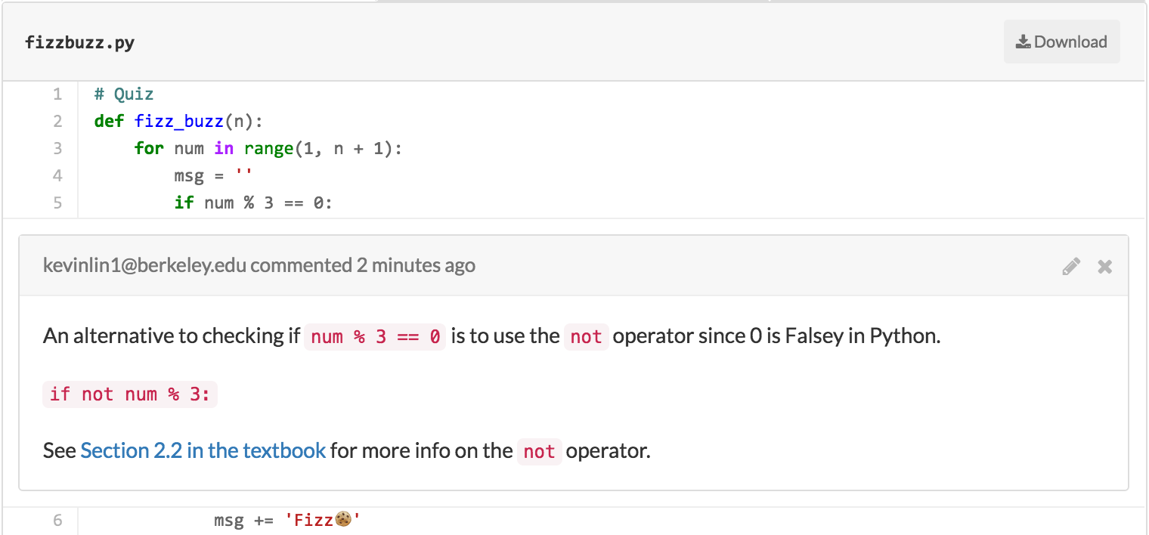
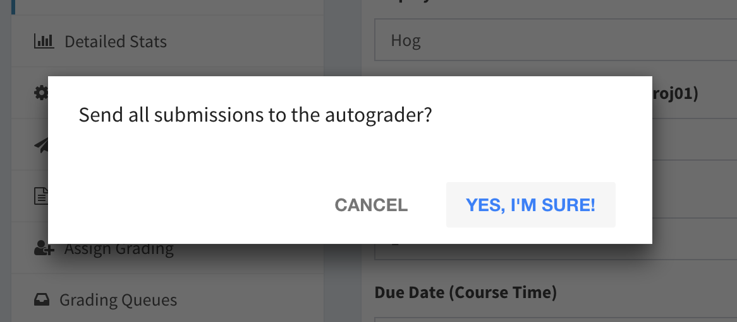
The autograder provides optional email notification and a cooldown period for autograder results.

Slide 13
Realtime assignment statistics
Find out what questions, students are working on, how many students are done, and which students have not started with detailed statistics.

Slide 14
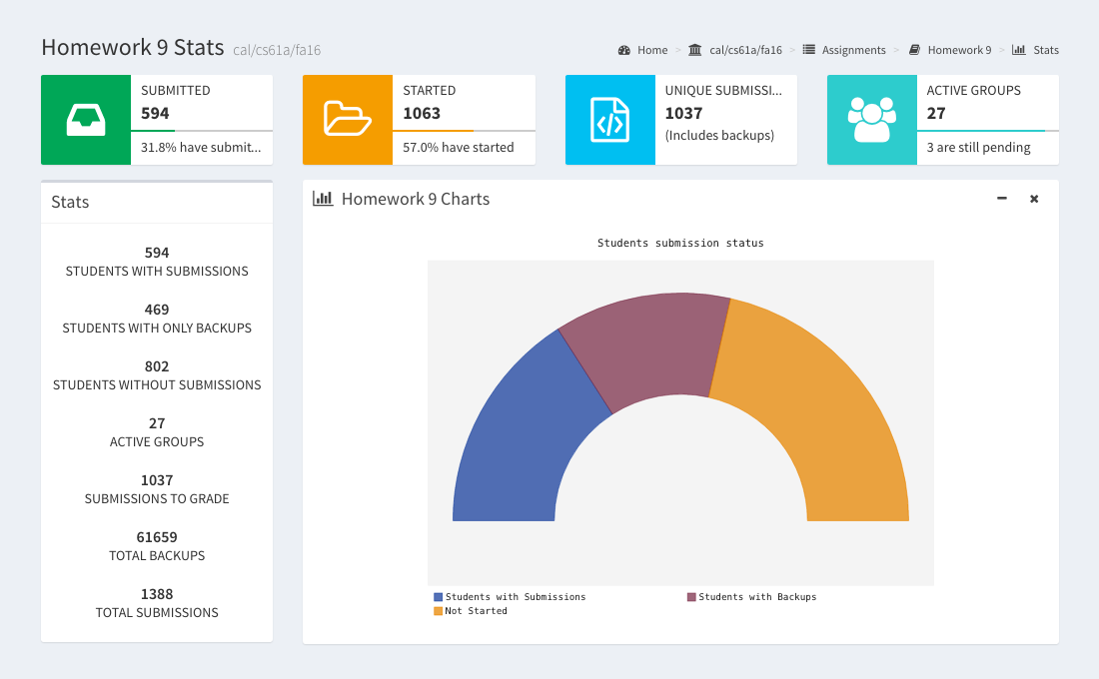

Slide 15




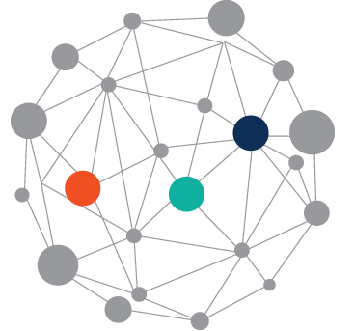



Assignment Submissions
Auto Grader
Question
Feedback
Forum
Answer | Delegate
E-Mail
Course Scheduling
K-BERT
Question Answering
Sources
NLP Pipeline
Parsing
Sentence Tokenization
Tagging
Entities & Relations
Content Recommendation
Knowledge Graph
neo4j

Slide 16
Thank
You

Slide 17



















