Slide 1


Keras
Keras for Deep Learning Research

Slide 2
Feedback is greatly appreciated!

Slide 3

Overview
Difference between Feedforward Neural Network (FNN) and Recurrent Neural Network (RNN)
The importance of context
RNN
LSTM
Use case

Slide 4
Why Recurrent Neural Network
Humans don’t start their thinking from scratch every second. As you read this essay, you understand each word based on your understanding of previous words.
You don’t throw everything away and start thinking from scratch again. Your thoughts have persistence.

Slide 5
Why Recurrent Neural Network
Traditional neural networks can’t do this, and it seems like a major shortcoming.
For example, imagine you want to classify what kind of event is happening at every point in a movie.
It’s unclear how a traditional neural network could use its reasoning about previous events in the film to inform later ones.
Recurrent neural networks address this issue.
They are networks with loops in them, allowing information to persist.

Slide 6
The importance of context
Recall the 5th digit of your phone number
Sing your favorite song beginning at third sentence
Recall 10th character of the alphabet
Probably you went straight from the beginning of the stream in each case…
because in sequences, order matters!
Idea: retain the information preserving the importance of order

Slide 7
Recurrent Neural Network (RNN)

Slide 8
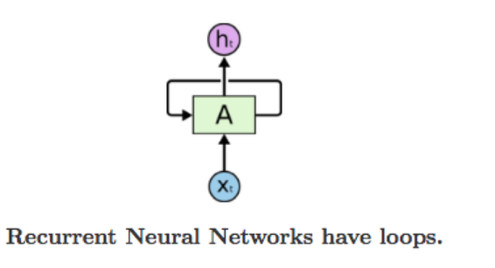
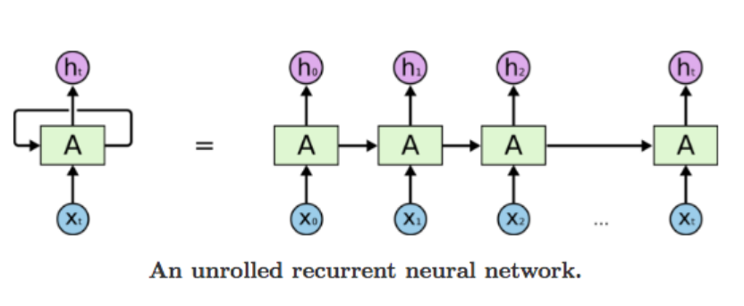
Recurrent Neural Network
A recurrent neural network can be thought of as multiple copies of the same network, each passing a message to a successor.

Slide 9
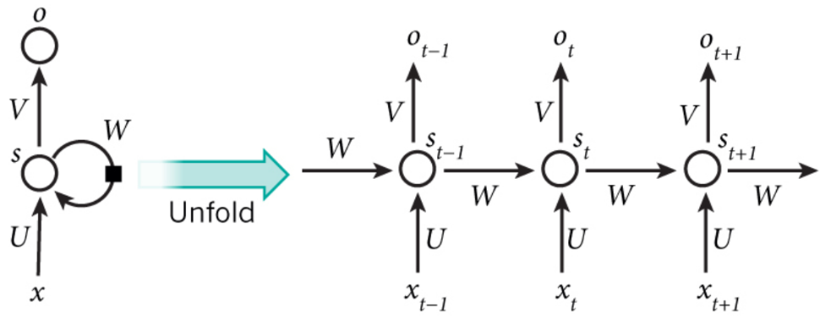
RNN
Xt: input at the time step t. for example, a word in a sentence
St: hidden state at time step t. It’s the memory of network. St = f(Uxt + Wst-1)
Ot: output at step t. for example, if we wanted to predict the next word in a sentence it would be a vector of probabilities across the vocabulary

Slide 10
Example
“The concert was boring for the first 15 minutes while the band warmed up but then was terribly exciting.”
A machine learning model that considers the words in isolation such as a bag of words model would probably conclude this sentence is negative.
An RNN by contrast should be able to see the words “but” and “terribly exciting” and realize that the sentence turns from negative to positive because it has looked at the entire sequence.
Reading a whole sequence gives us a context for processing its meaning, a concept encoded in recurrent neural networks.

Slide 11
Recurrent Neural Network (RNN)
Good for Sequential data, or ordered data
Internal memory: remember important things about input
Produces output, copies and output, loop it back into input

Slide 12
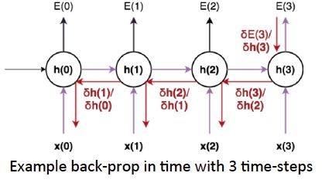
Recurrent Neural Network (RNN)
Back Propagation Through Time (BPTT):
The training method has to take into account the time operations → a cost function E is defined to train our RNN, and in this case the total error at the output of the network is the sum of the errors at each time-step

Slide 13
Recurrent Neural Network (RNN)
Main problems:
Sometimes, we only need to look at recent information to perform the present task - "the clouds are in the sky"
But there are also cases where we need more context - "I grew up in France … I speak fluent French."
Source: http://colah.github.io/posts/2015-08-Understanding-LSTMs/

Slide 14
Recurrent Neural Network (RNN)
Main problems:
Exploding Gradients: weights assigns high importance: unstable network.
Vanishing Gradients: values of gradients are too small: model stops learning

Slide 15
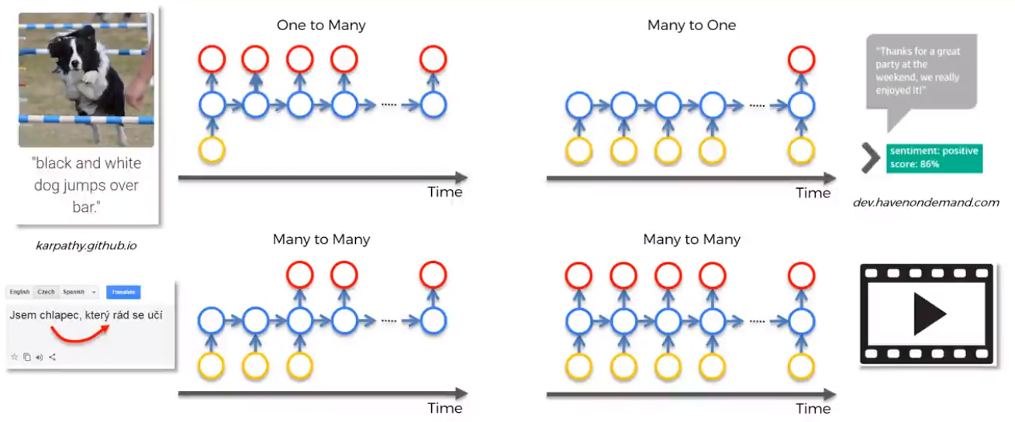
Different kind of RNN

Slide 16
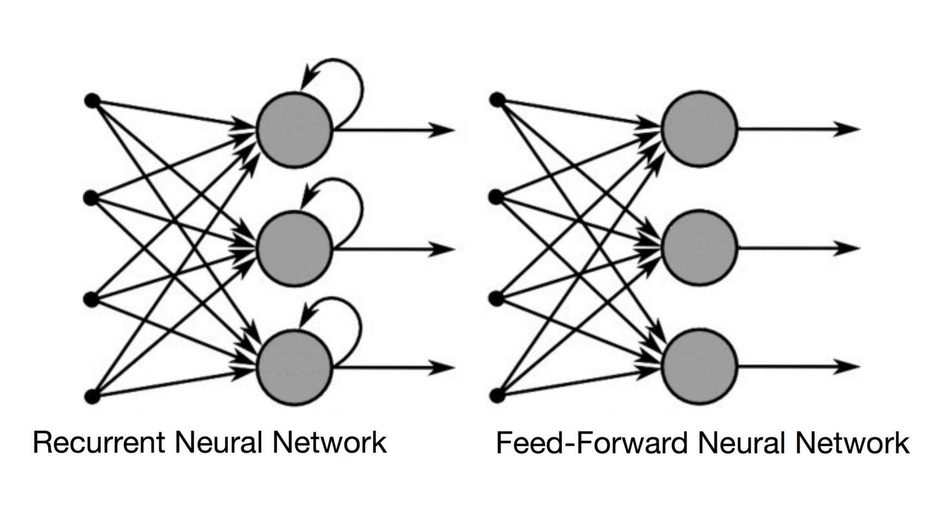
Difference between RNN and feed forward
Source: https://towardsdatascience.com/recurrent-neural-networks-and-lstm-4b601dd822a5
Notes:
In a Feed-Forward NN, the information only moves in one direction, from the input layer, through the hidden layers, to the output layer. The information moves straight through the network. Because of that, the information never touches a node twice.
In a RNN, the information cycles through a loop. When it makes a decision, it takes into consideration the current input and also what it has learned from the inputs it received previously.

Slide 17
Long Short Term Memory (LSTM)

Slide 18
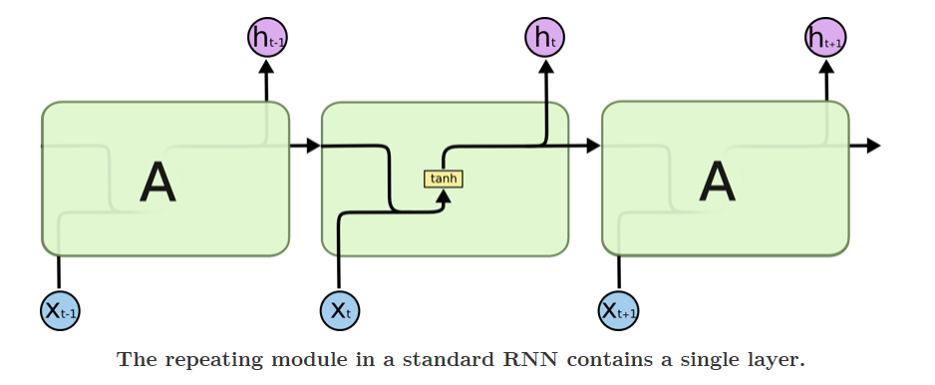
RNN vs LSTM
Source: http://colah.github.io/posts/2015-08-Understanding-LSTMs/

Slide 19
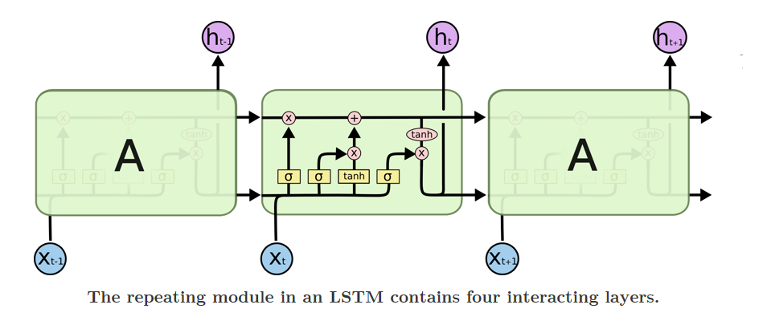
RNN vs LSTM
Source: http://colah.github.io/posts/2015-08-Understanding-LSTMs/

Slide 20
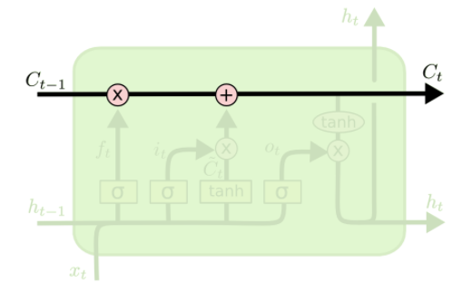
Core idea behind LSTM
The key to LSTMs is the cell state, the horizontal line running through the top of the diagram.
The LSTM does have the ability to remove or add information to the cell state, carefully regulated by structures called gates.
Source: http://colah.github.io/posts/2015-08-Understanding-LSTMs/

Slide 21
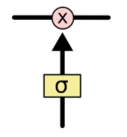
Gate
Gates are a way to optionally let information through.
They are composed out of a sigmoid neural net layer and a pointwise multiplication operation
The sigmoid layer outputs numbers between zero and one, describing how much of each component should be let through.
A value of zero means "let nothing through," while a value of one means "let everything through!"
An LSTM has three of these gates, to protect and control the cell state.
Source: http://colah.github.io/posts/2015-08-Understanding-LSTMs/

Slide 22
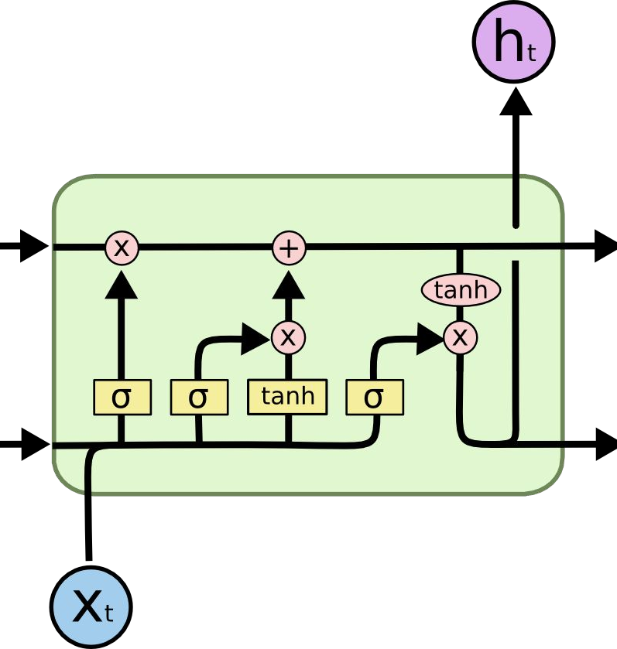
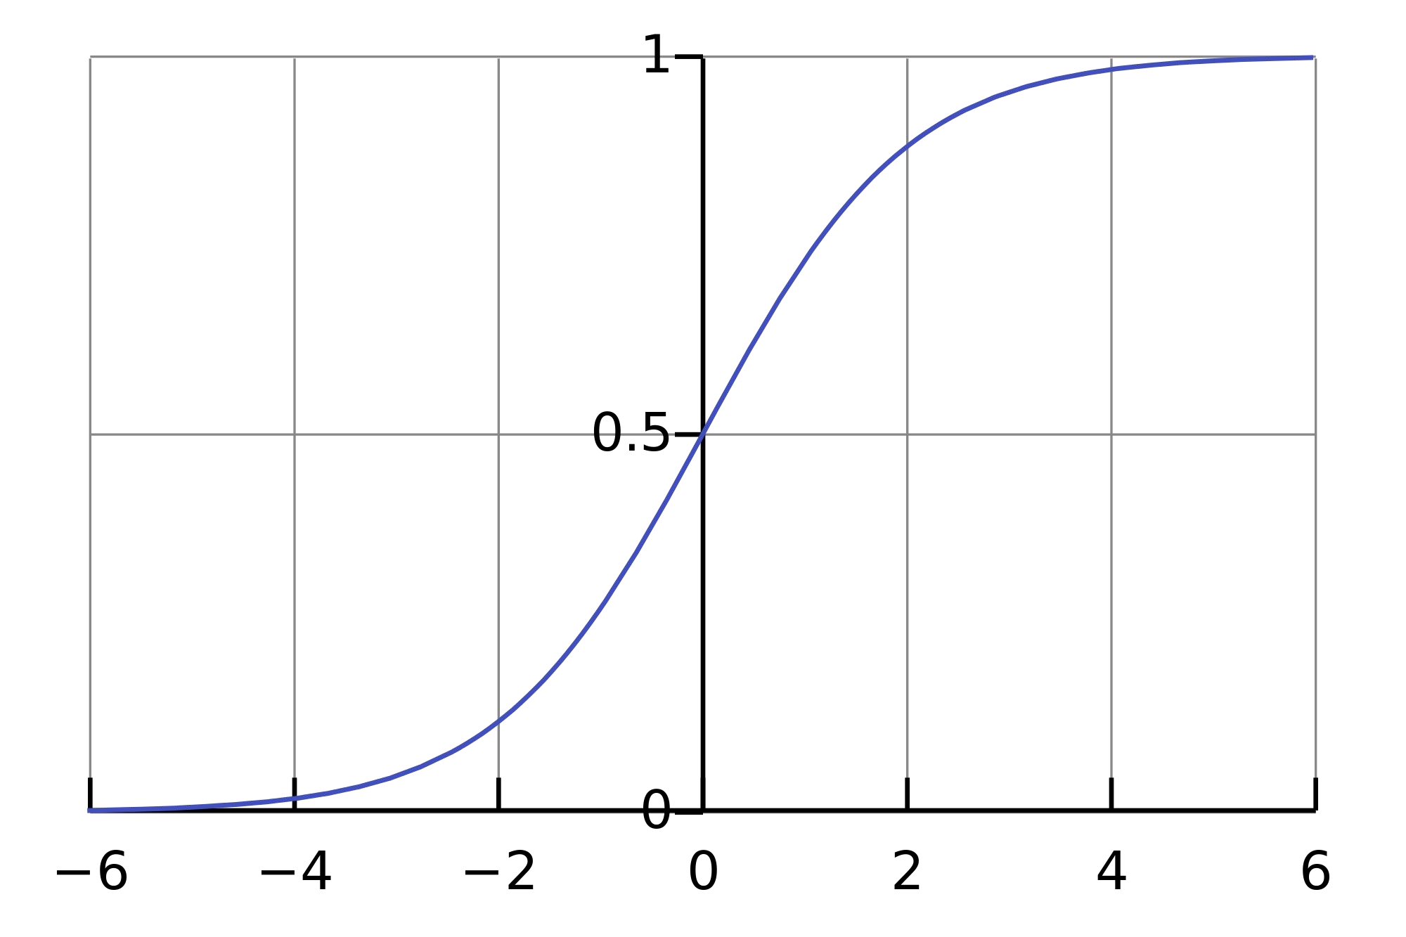
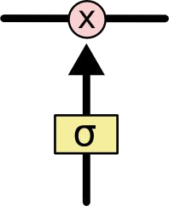
Long Short Term Memory (LSTM)
Source: http://colah.github.io/posts/2015-08-Understanding-LSTMs/

Slide 23
Meaning Of the Symbols
+ : Adding information
σ : Sigmoid layer
tanh: tanh layer
h(t-1) : Output of last LSTM unit
c(t-1) : Memory from last LSTM unit
X(t) : Current input
c(t) : New updated memory
h(t) : Current output

Slide 24
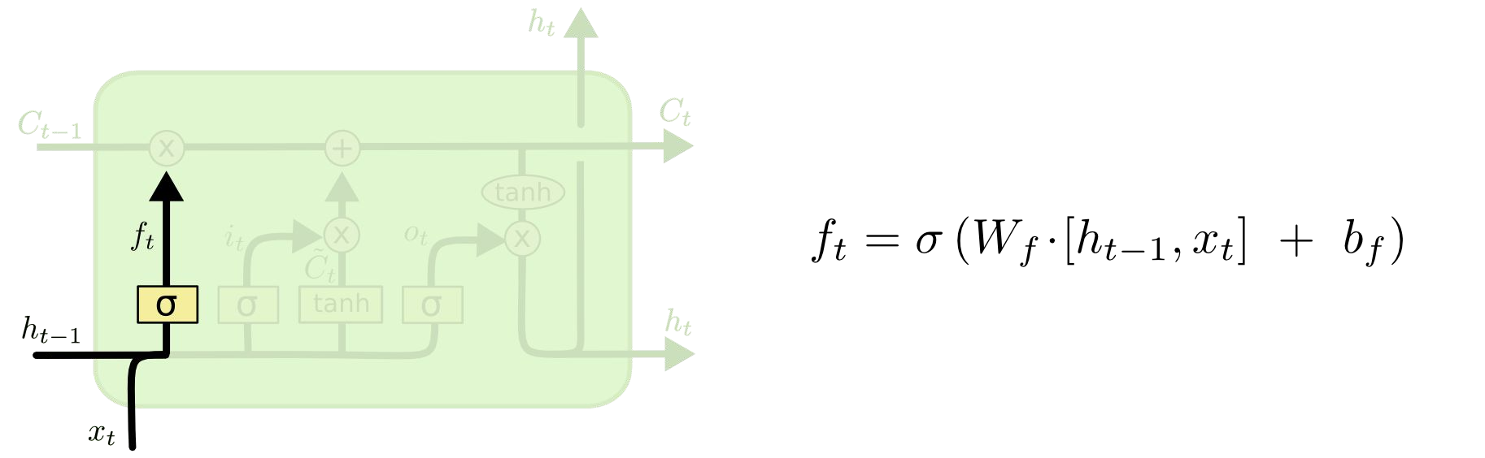
Long Short Term Memory (LSTM)
Forget Gate Layer
Source: http://colah.github.io/posts/2015-08-Understanding-LSTMs/
Notes:
The first step in our LSTM is to decide what information we’re going to throw away from the cell state.

Slide 25
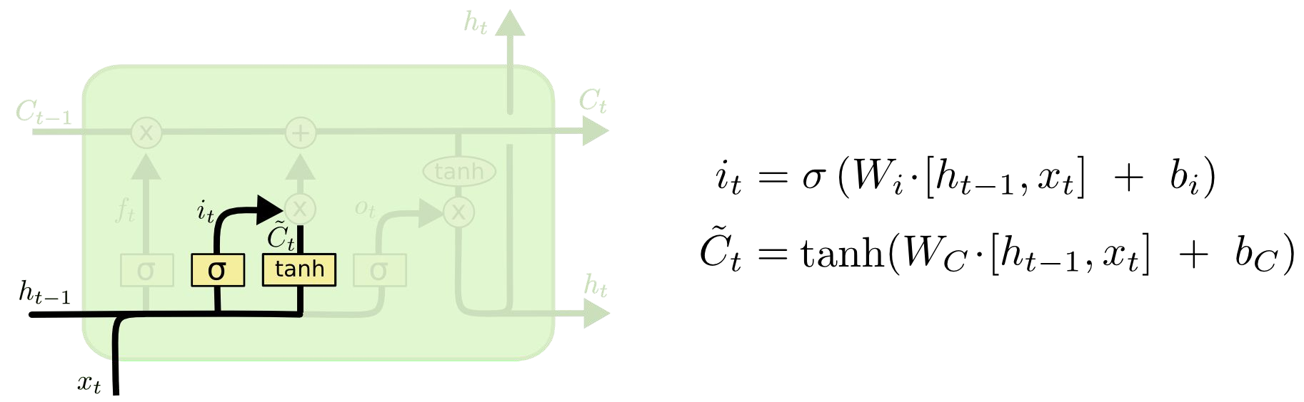
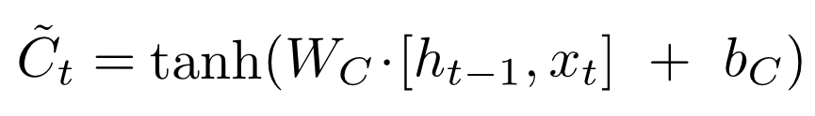
Long Short Term Memory (LSTM)
Input Gate Layer
New contribution to cell state
Source: http://colah.github.io/posts/2015-08-Understanding-LSTMs/
Notes:
The next step is to decide what new information we’re going to store in the cell state.

Slide 26
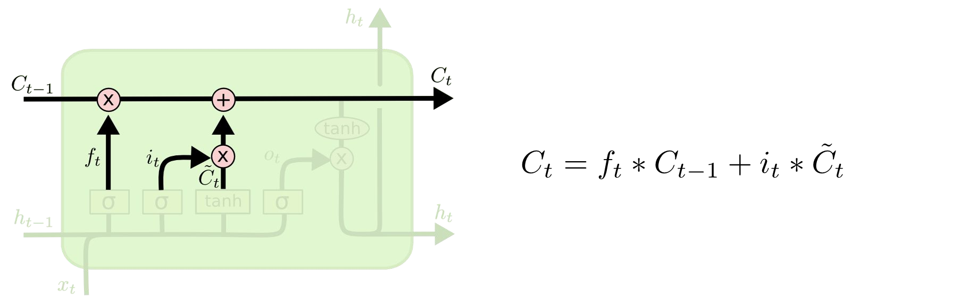
Long Short Term Memory (LSTM)
Update Cell State (memory)
Source: http://colah.github.io/posts/2015-08-Understanding-LSTMs/
Notes:
It's now time to update the old cell state Ct−1, into the new cell state Ct. The previous steps already decided what to do, we just need to actually do it.

Slide 27
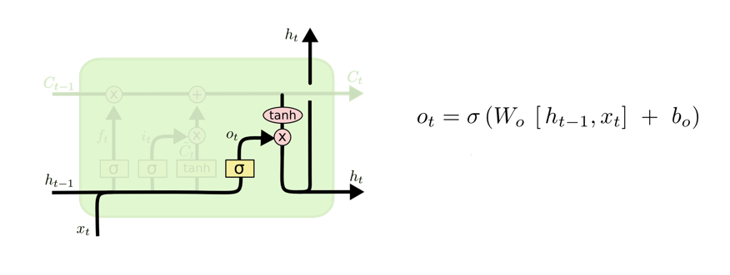

Long Short Term Memory (LSTM)
Output Gate Layer
Output to next layer
Source: http://colah.github.io/posts/2015-08-Understanding-LSTMs/
Notes:
Finally, we need to decide what we're going to output. This output will be based on our cell state, but will be a filtered version.

Slide 28

Long Short Term Memory (LSTM)
Source: http://colah.github.io/posts/2015-08-Understanding-LSTMs/

Slide 29
Overfitting
Overfitting occurs when you achieve a good fit of your model on the training data, while it does not generalize well on new, unseen data.
In other words, the model learned patterns specific to the training data, which are irrelevant in other data

Slide 30
Different ways to avoid overfitting
Get more data
Reduce the network’s capacity
Apply regularization
Use Dropout layers

Slide 31
Regularization techniques
Regularization: adding an extra element to the loss function, which punishes our model for being too complex or, for using too high values in the weight matrix
L1: Least Absolute Deviations (Lasso)
L2: Least Square Errors (Ridge)

Slide 32
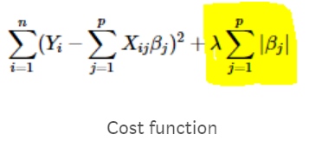
L1: Least Absolute Deviations (Lasso)
Lasso shrinks the less important feature’s coefficient to zero
Removing some feature altogether.
This works well for feature selection in case we have a huge number of features.

Slide 33
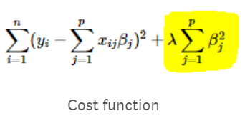
L2:Least Square Errors (Ridge)
Adds “squared magnitude” of coefficient as penalty term to the loss function

Slide 34
Hyperparameter Optimization
Grid Search
Random Search
Hand-tuning
Gaussian Process with Expected Improvement
Tree-structured Parzen Estimators (TPE)

Slide 35
Hyperparameter Optimization
Grid search capability from the scikit-learn python machine learning library
Grid search is a model hyperparameter optimization technique
It tune the hyperparameters of deep learning models

Slide 36
How to Use Keras Models in scikit-learn
Keras models can be used in scikit-learn by wrapping them with the KerasClassifier or KerasRegressor class.

Slide 37
How to Tune Batch Size and Number of Epochs
model = KerasClassifier(build_fn=model,verbose=0) batch_size = [10, 20, 40] epochs = [1, 2, 3] param_grid = dict(batch_size=batch_size, epochs=epochs) from sklearn.model_selection import GridSearchCV grid = GridSearchCV(estimator=model, param_grid=param_grid) grid_result = grid.fit(X_train, Y_train) # summarize results print("Best: %f using %s" % (grid_result.best_score_, grid_result.best_params_))

Slide 38
Results
Best: 0.846411 using {'batch_size’: 40, 'epochs’: 3}

Slide 39
List of hyperparameters to be tuned
Optimization Algorithm
optimizer = ['SGD', 'RMSprop', 'Adagrad', 'Adadelta', 'Adam', 'Adamax', 'Nadam’]
Network Weight Initialization
init_mode = ['uniform', 'lecun_uniform', 'normal', 'zero', 'glorot_normal', 'glorot_uniform', 'he_normal', 'he_uniform’]
Neuron Activation Function
activation = ['softmax', 'softplus', 'softsign', 'relu', 'tanh', 'sigmoid', 'hard_sigmoid', 'linear’]
Dropout Regularization
dropout_rate = [0.0, 0.1, 0.2, 0.3, 0.4, 0.5, 0.6, 0.7, 0.8, 0.9]

Slide 40
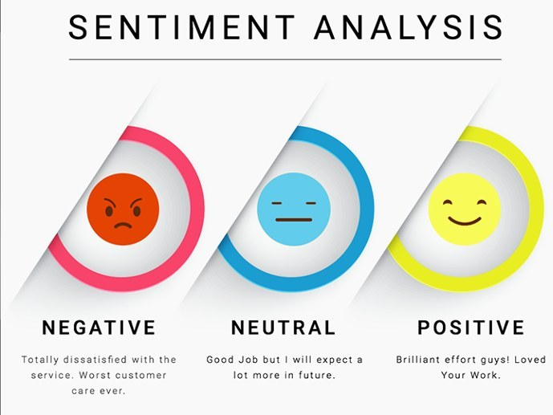
Use case: Sentiment Analysis using LSTM

Slide 41
Sentiment Classification
The process of computationally identifying and categorizing opinions expressed in a piece of text
In order to determine whether the writer's attitude towards a particular topic, product, etc. is positive, negative, or neutral.

Slide 42
First GOP Debate Twitter Sentiment
Analyze tweets on the first 2016 GOP Presidential Debate

Slide 43
keeping the necessary columns
Only keeping the necessary columns.
data = pd.read_csv('../input/Sentiment.csv’)
# Keeping only the neccessary columns
data = data[['text','sentiment']]

Slide 44
Filtering the tweets, using Tokenizer to vectorize, convert text into Sequences
data['text'] = data['text'].apply(lambda x: x.lower())
data['text'] = data['text'].apply((lambda x: re.sub('[^a-zA-z0-9\s]','',x)))
for idx, row in data.iterrows():
row[0] = row[0].replace('rt',' ‘)
max_features = 2000
tokenizer = Tokenizer(num_words=max_fatures, split=' ‘)
tokenizer.fit_on_texts(data['text'].values)
X = tokenizer.texts_to_sequences(data['text'].values)
X = pad_sequences(X)

Slide 45
composing the LSTM Network
embed_dim = 128
lstm_out = 196
model = Sequential()
model.add(Embedding(max_fatures, embed_dim,input_length = X.shape[1]))
model.add(LSTM(unit, dropout=0.2, recurrent_dropout=0.2))
model.add(Dense(3,activation='softmax’))
model.compile(loss = 'categorical_crossentropy', optimizer='adam',metrics = ['accuracy'])
(model.summary())

Slide 46
Defining training and test data
labelencoder = LabelEncoder() integer_encoded = labelencoder.fit_transform(data['sentiment’]) Y = to_categorical(integer_encoded)
X_train, X_test, Y_train, Y_test = train_test_split(X,Y, test_size = 0.33, random_state = 42)
(X_train.shape,Y_train.shape)
(X_test.shape,Y_test.shape)
batch_size = 32
model.fit(X_train, Y_train, epochs = 7, batch_size=batch_size, verbose = 2)

Slide 47
Evaluating the model
score, acc = model.evaluate(X_test, Y_test, verbose = 2, batch_size = batch_size)
("score: %.2f" % (score))
("acc: %.2f" % (acc))

Slide 48
Use Case 2: Word prediction
# source text
data = """ Jack and Jill went up the hill\n
To fetch a pail of water\n
Jack fell down and broke his crown\n
And Jill came tumbling after\n """

Slide 49
Preparing the data
X y
_, _, _, _, _, Jack, and
_, _, _, _, Jack, and Jill
_, _, _, Jack, and, Jill, went
_, _, Jack, and, Jill, went, up
_, Jack, and, Jill, went, up, the
Jack, and, Jill, went, up, the, hill

Slide 50
tokenizer = Tokenizer() tokenizer.fit_on_texts([data]) # determine the vocabulary size vocab_size = len(tokenizer.word_index) + 1 print('Vocabulary Size: %d' % vocab_size) # create line-based sequences sequences = list() for line in data.split('\n'): encoded = tokenizer.texts_to_sequences([line])[0] for i in range(1, len(encoded)): sequence = encoded[:i+1] sequences.append(sequence) print(sequence)

Slide 51
max_length = max([len(seq) for seq in sequences]) sequences = pad_sequences(sequences, maxlen=max_length, padding='pre') print('Max Sequence Length: %d' % max_length) # split into input and output elements sequences = array(sequences) X, y = sequences[:,:-1],sequences[:,-1] y = to_categorical(y, num_classes=vocab_size)

Slide 52
model = Sequential() model.add(Embedding(vocab_size, 10, input_length=max_length-1)) model.add(LSTM(50)) model.add(Dense(vocab_size, activation='softmax')) print(model.summary()) # compile network model.compile(loss='categorical_crossentropy', optimizer='adam', metrics=['accuracy']) # fit network model.fit(X, y, epochs=500, verbose=2)

Slide 53
References
https://stats.stackexchange.com/questions/181/how-to-choose-the-number-of-hidden-layers-and-nodes-in-a-feedforward-neural-netw
https://stackoverflow.com/questions/47788799/grid-search-the-number-of-hidden-layers-with-keras
https://medium.com/@erikhallstrm/hello-world-rnn-83cd7105b767
https://towardsdatascience.com/exploring-activation-functions-for-neural-networks-73498da59b02
https://medium.com/lingvo-masino/introduction-to-recurrent-neural-network-d77a3fe2c56c
http://colah.github.io/posts/2015-08-Understanding-LSTMs/
https://www.slideshare.net/ashraybhandare/deep-learning-cnn-and-rnn?qid=0f39b4da-a290-4e9e-9d31-ed21816598e3&v=&b=&from_search=27
https://machinelearningmastery.com/truncated-backpropagation-through-time-in-keras/
https://medium.com/explore-artificial-intelligence/an-introduction-to-recurrent-neural-networks-72c97bf0912
https://medium.com/datadriveninvestor/how-do-lstm-networks-solve-the-problem-of-vanishing-gradients-a6784971a577

Slide 54
Cheat Code
Code for saving the model: model.save(‘model.h5’)
Code for loading the model:
from keras.models import load_model
model = load_model(‘model.h5’)
Code for predicting on new data:
model.predict([‘’new text’]

