Slide 1

Python Programming
Natural language processing in Python using NLTK

Slide 2
Feedback is greatly appreciated!

Slide 3

Objective
NLP (Natural language processing)
NLTK (Natural Language Toolkit)

Slide 4
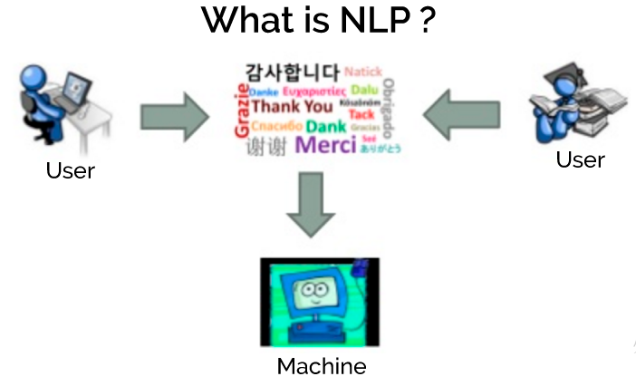
Natural Language Processing
Computer aided text analysis of human language
The goal is to enable machines to understand human language and extract meaning from text
The “Natural Language Toolkit” is a python module that provides a variety of functionality that will aid us in processing text
https://www.upwork.com/hiring/for-clients/artificial-intelligence-and-natural-language-processing-in-big-data/

Slide 5
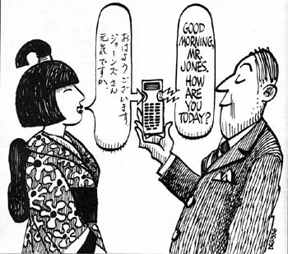
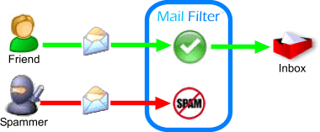
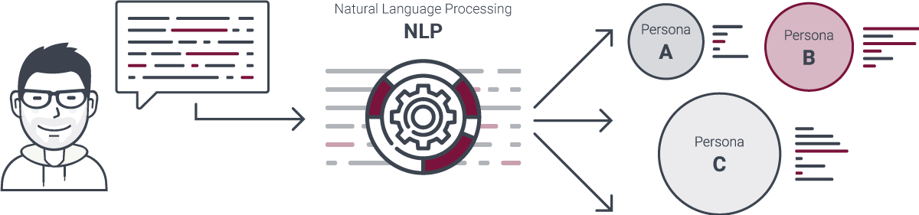

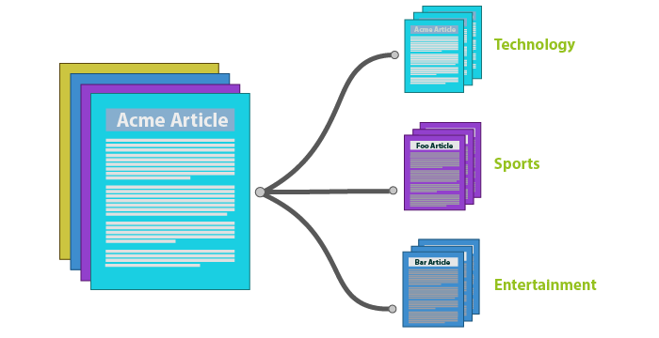
NLP Applications
Consumer behavior Analysis
Site recommendation
Spam filtering
Detecting fake news
Automatic Summarization (to generate summary of given text) and Machine Translation (translation of one language into another)

Slide 6
NLP Libraries
NLTK (Natural Language Toolkit)
SpaCy
Stanford NLP
Apache OpenNLP
https://opensource.com/business/15/7/five-open-source-nlp-tools

Slide 7
NLTK (Natural Language Toolkit)
An open source library which simplifies the implementation of Natural Language Processing(NLP) in Python.
https://www.nltk.org/

Slide 8
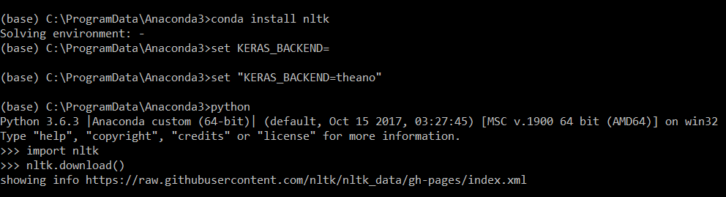
Download and Installation
For Anaconda and Python3.6
Run the Python interpreter and type the commands:
> conda install nltk
>python
>>> import nltk
>>>nltk.download()
https://www.nltk.org/

Slide 9
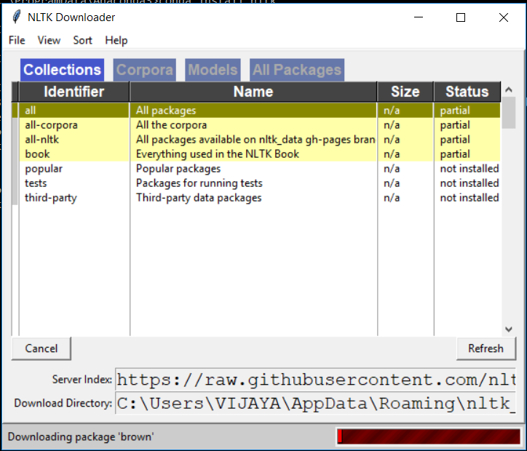
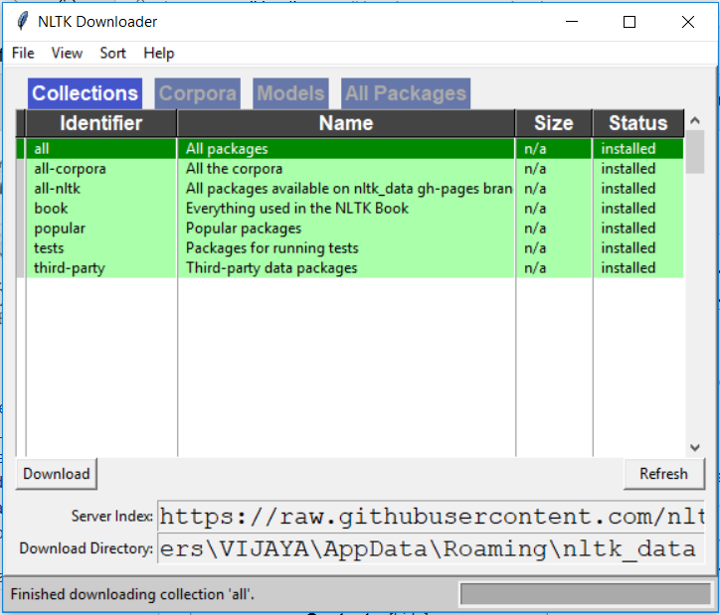
Download and Installation
https://www.nltk.org/

Slide 10

Download and Installation
For pip or other
Installation instructions at: http://www.nltk.org/
Run the Python interpreter and type the commands:
Opens the NLTK downloader, you can choose what to download.
https://www.nltk.org/

Slide 11
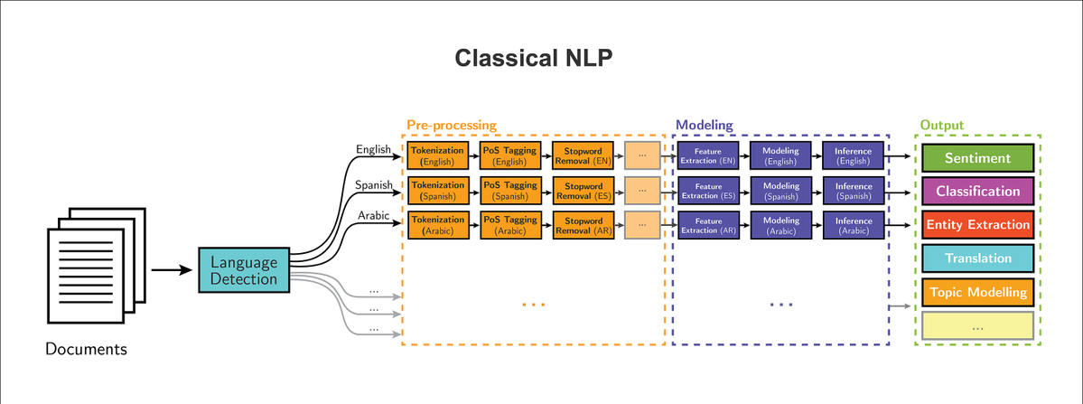
Basic NLP pipeline
https://www.nltk.org/

Slide 12
Text corpora
Corpus
Large collection of text
Raw or categorized
Concentrate on a topic or open domain
The plural form of corpus is corpora
Examples
Brown Corpus - first, largest corpus, categorized by genre such as news, editorial, and so on
Web and Chat Text - discussion forum, reviews, etc.
Reuters Corpus - news, 90 topics
Universal Declaration of Human Rights (UDHR) corpus – multilingual (372)
https://www.nltk.org/book/ch02.html

Slide 13
Working with brown corpus example
import nltk nltk.download("brown") from nltk.corpus import brown print(brown.categories()) print(brown.words(categories ='news'))
['adventure', 'belles_lettres', 'editorial', 'fiction', 'government', 'hobbies', 'humor', 'learned', 'lore', 'mystery', 'news', 'religion', 'reviews', 'romance', 'science_fiction']
['The', 'Fulton', 'County', 'Grand', 'Jury', 'said', ...]

Slide 14
WordNet
WordNet is a lexical database for the English language
It groups English words into sets of synonyms called synsets
WordNet is freely and publicly available for download
WordNet's structure makes it a useful tool for natural language processing
The main relation among words in WordNet is synonymy, as between the words car and automobile
https://en.wikipedia.org/wiki/WordNet

Slide 15
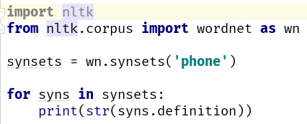

WordNet: Example
'electronic equipment that converts sound into electrical signals that can be transmitted over distances and then converts received signals back into sounds‘
'(phonetics) an individual sound unit of speech without concern as to whether or not it is a phoneme of some language‘
'electro-acoustic transducer for converting electric signals into sounds; it is held over or inserted into the ear‘
'get or try to get into communication (with someone) by telephone'
https://wordnet.princeton.edu/

Slide 16
Steps for natural language processing

Slide 17
Tokenization
Tokenization is the process of breaking a stream of text up into words, phrases, symbols, or other meaningful elements called tokens.
The tokens may be the sentences, words, numbers or punctuation marks.
Example:
I/P: Mango, banana, pineapple and apple all are fruits.
O/P: Mango | Banana | Pineapple | and | Apple | all | are | Fruits
https://www.tutorialspoint.com/artificial_intelligence_with_python/artificial_intelligence_with_python_nltk_package.htm

Slide 18
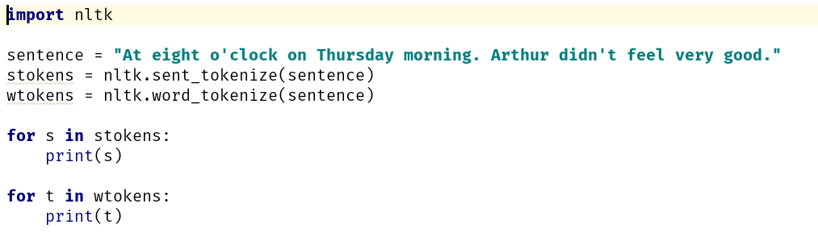
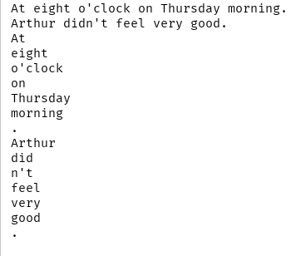
Tokenization: Example
Input
Output

Slide 19
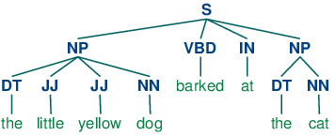
Part of Speech tagging
The process of classifying the words in a text(corpus) into their parts of speech and labeling them accordingly is known as part-of-speech tagging, POS-tagging, or simply tagging
Parts of speech are also known as word classes or lexical categories
The collection of tags used for a particular task is known as a tagset
In English the main parts of speech are noun, pronoun, adjective, determiner, verb, adverb, preposition, conjunction, and interjection

Slide 20
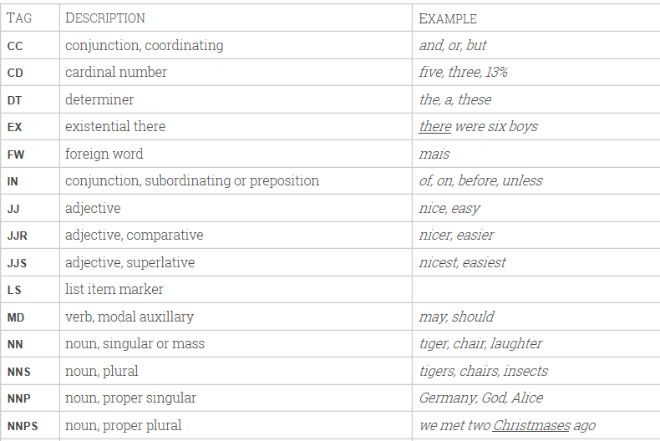
Penn Treebank Part-of-Speech Tags
https://www.clips.uantwerpen.be/pages/mbsp-tags
https://www.ling.upenn.edu/courses/Fall_2003/ling001/penn_treebank_pos.html

Slide 21
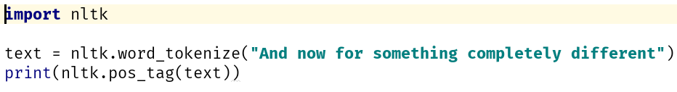
Part of Speech tagging: Example
https://www.nltk.org/book/ch05.html

Slide 22
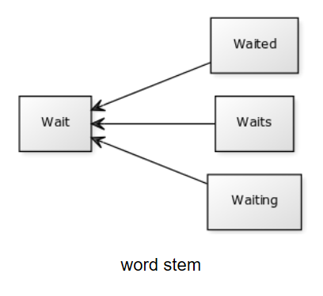
Stemming
For grammatical reasons, documents are going to use different forms of a word, such as organize, organizes, and organizing
Stemming is the process for reducing injected words to their stem, base root form
ies -> Y Applies -> Apply
Ing-> reading -> read
https://pythonspot.com/nltk-stemming/

Slide 23
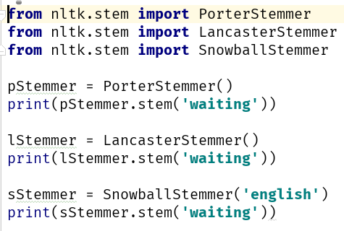
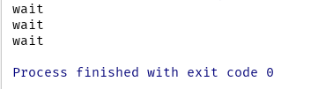
Stemming: Example
Input
Output
http://text-processing.com/demo/stem/

Slide 24
Lemmatization
Lemmatization process involves first determining the part of speech of a word and applying different normalization rules for each part of speech
The WordNet Lemmatizer uses the WordNet Database to lookup lemmas
Lemmatization and stemming are related, but different. The difference is that a stemmer operates on a single word without knowledge of the context, and therefore cannot discriminate between words which have different meaning depending on part of speech.
https://pythonprogramming.net/lemmatizing-nltk-tutorial/

Slide 25
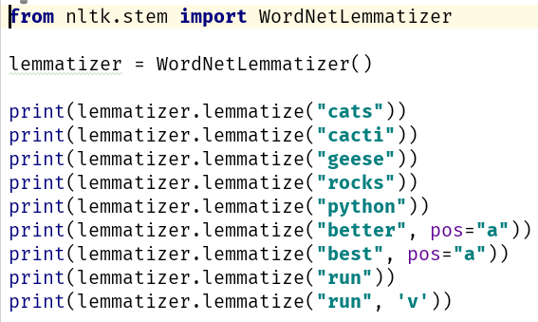
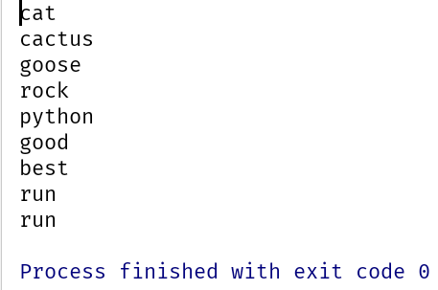
Lemmatization: Example
Input
Output
https://pythonprogramming.net/lemmatizing-nltk-tutorial/

Slide 26
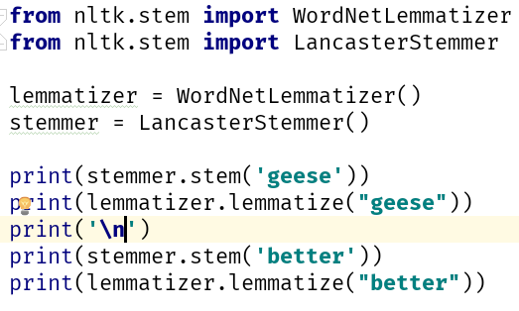
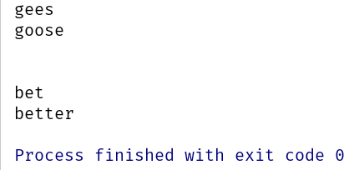
Stemming vs Lemmatization
Input
Output
https://pythonprogramming.net/lemmatizing-nltk-tutorial/

Slide 27
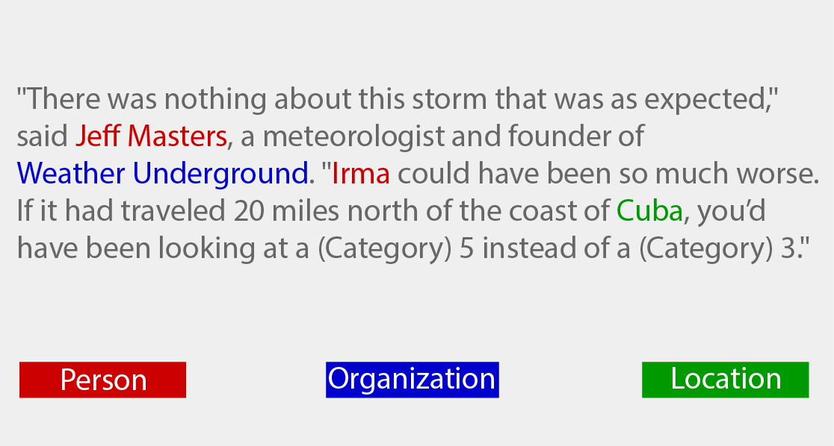
Named Entity Recognition (NER)
Named entity recognition is the subtask of information extraction that seeks to locate and classify elements in text into pre-defined categories such as the names of the person, organizations, locations, expressions of times, quantities, etc.
https://www.nltk.org/book/ch07.html
Notes:
Why do you need this information? You might want to map it against a knowledge base to understand what the sentence is about, or you might want to extract relationships between different named entities (like who works where, when the event takes place etc.)

Slide 28
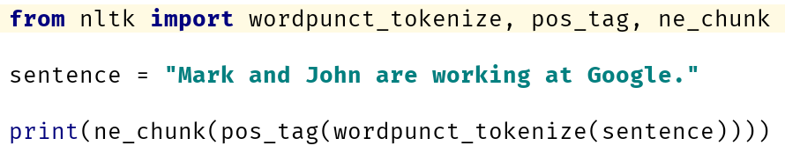
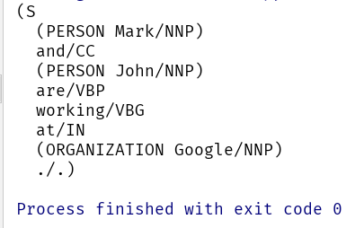
Named Entity Recognition (NER): Example
Input
Output
https://www.nltk.org/book/ch07.html

Slide 29
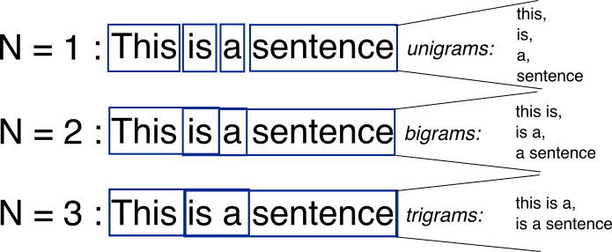
N-gram
An n-gram is a contiguous sequence of n items from a given sample of text or speech.

Slide 30
Trigram: Example
The sentence "the quick red fox jumps over the lazy brown dog" has the following word level trigrams:
the quick red
quick red fox
red fox jumps
fox jumps over
jumps over the
over the lazy
the lazy brown
lazy brown dog

Slide 31
NLTK modules and functionality
NLTK modules | Functionality
nltk.corpus | Corpus
nltk.tokenize, nltk.stem | Tokenizers, Stemmer
nltk.collacations | T-test, chi-squared, mutual-info
nltk.tag | N-gram
nltk.cluster, nltk.classify | Decision tree, Naïve Bayes, K means
nltk.chunk | Regex, n-gram, named-entity
nltk.parsing | parsing
nltk.metrics | Evaluation metrics
nltk.probability | Probability and estimation
nltk.app, nltk.chat | Applications

Slide 32
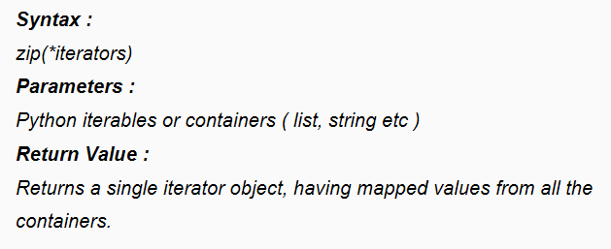
zip() in Python
The purpose of zip() is to map the similar index of multiple containers so that they can be used just as single entity

Slide 33
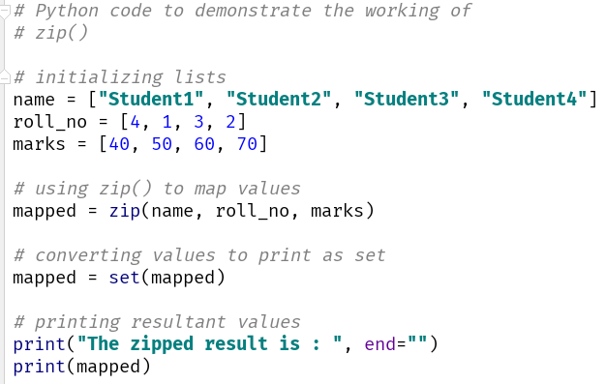
zip(): Example
Input
Output

Slide 34
We are here to think about
Determining the topic of an article or a book
Deciding if an email is spam or not
Determining who wrote a text
Determining the meaning of a word in a particular context
Creating a new poem out of a text

Slide 35
Text Classification
Text classification is the process of assigning tags or categories to text according to its content
Unstructured data in the form of text is everywhere: emails, chats, web pages, social media, support tickets, survey responses, and more.
Text can be an extremely rich source of information, but extracting insights from it can be hard and time-consuming due to its unstructured nature.

Slide 36
Example: Every word is a feature
Feature vector
Feature space
Feature dimensions | Document 1: Class A | Document 2: Class A | Document 3: Class B | Document 4: Class B
1: arrived | 0 | 1 | 4 | 5
2: received | 1 | 2 | 3 | 5
3: gold | 4 | 4 | 4 | 1
4: a | 1 | 0 | 1 | 2
5: energy | 5 | 5 | 5 | 3

Slide 37
Text = sparse
Feature dimensions | Document 1: Class A | Document 2: Class A | Document 3: Class A | Document 4: Class A | Document 5: Class ?
1: acquired | 0 | 0 | 1 | 0 | 0
2: received | 0 | 2 | 0 | 0 | 0
3: collected | 1 | 0 | 0 | 0 | 0
4: a | 0 | 0 | 0 | 2 | 0
5: energy | 0 | 0 | 0 | 0 | 1

Slide 38
Classification score - pipeline
Documents = text + category
20%
words+categories
training
verification
80%
Trained model
score

Slide 39
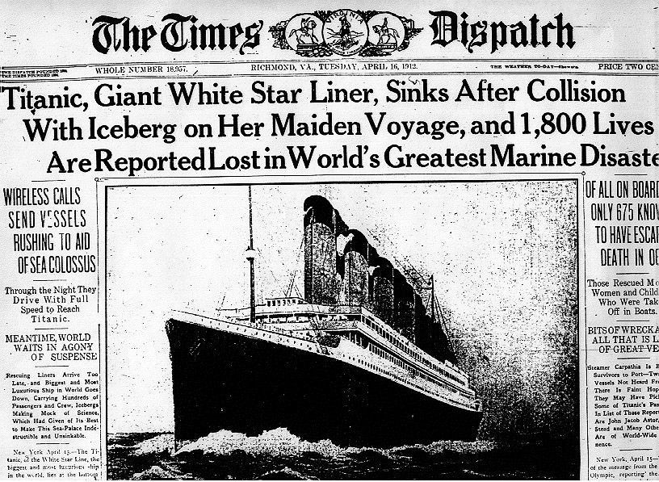
Example: News article classification
What is the category of this news article?

Slide 40
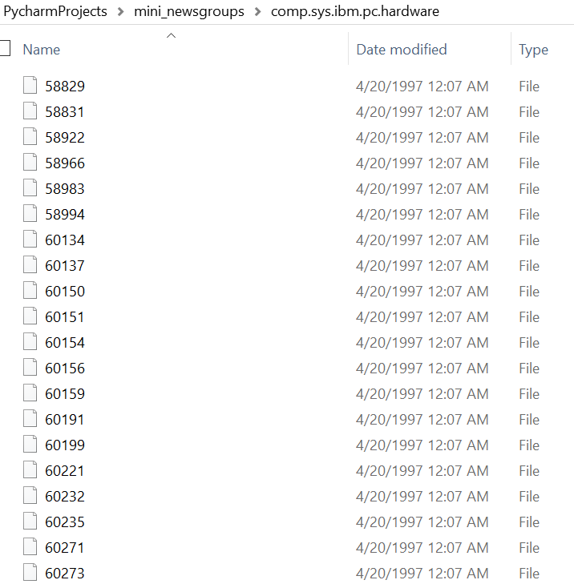
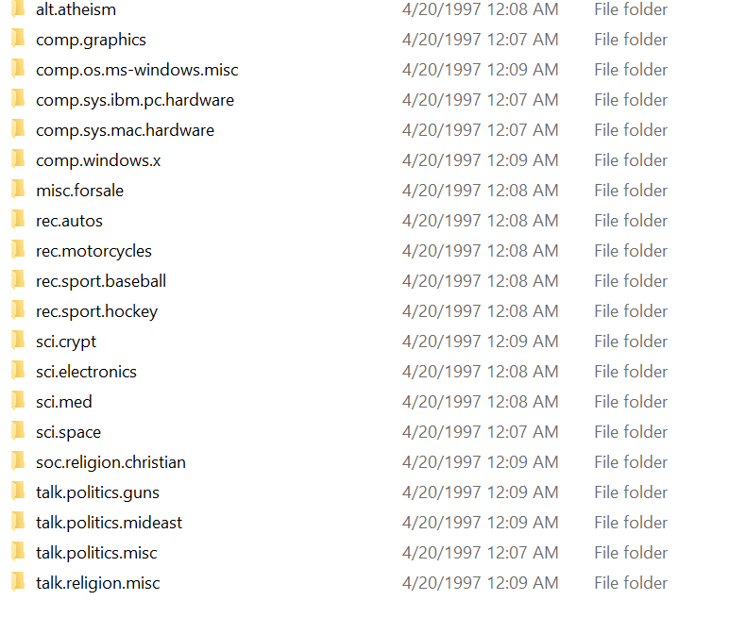
Use Case: Text Classification on 20 newsgroup

Slide 41
Step1:Dataset preparation
Reading the data
twenty_train = fetch_20newsgroups(subset='train', shuffle=True)

Slide 42
2. Feature Engineering
The next step is the feature engineering step.
In this step, raw text data will be transformed into feature vectors
new features will be created using the existing dataset.

Slide 43
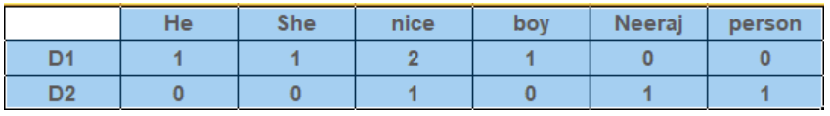
2.1 Count Vectors as features
Count Vector is a matrix notation of the dataset in which every row represents a document from the corpus,
every column represents a term from the corpus, and
every cell represents the frequency count of a particular term in a particular document.
count_vect = CountVectorizer() X_train_counts = count_vect.fit_transform(twenty_train.data)

Slide 44
2.2 TF-IDF Vectors as features
TF-IDF score represents the relative importance of a term in the document and the entire corpus. TF-IDF score is composed by two terms:
TF(t) = (Number of times term t appears in a document) / (Total number of terms in the document) IDF(t) = log_e(Total number of documents / Number of documents with term t in it)
tfidf_Vect = TfidfVectorizer() X_train_tfidf = tfidf_Vect.fit_transform(twenty_train.data)

Slide 45
3. Model Building
The final step in the text classification framework is to train a classifier using the features created in the previous step.
clf = MultinomialNB() clf.fit(X_train_tfidf, twenty_train.target)

Slide 46
Evaluation
twenty_test = fetch_20newsgroups(subset='test', shuffle=True) X_test_tfidf = tfidf_Vect.transform(twenty_test.data) predicted = clf.predict(X_test_tfidf) score = metrics.accuracy_score(twenty_test.target, predicted) print(score)

Slide 47
References
https://github.com/wade12/WikiScraper/blob/master/
http://www.w3resource.com/python-exercises/
https://www.learnpython.org/

