Slide 1
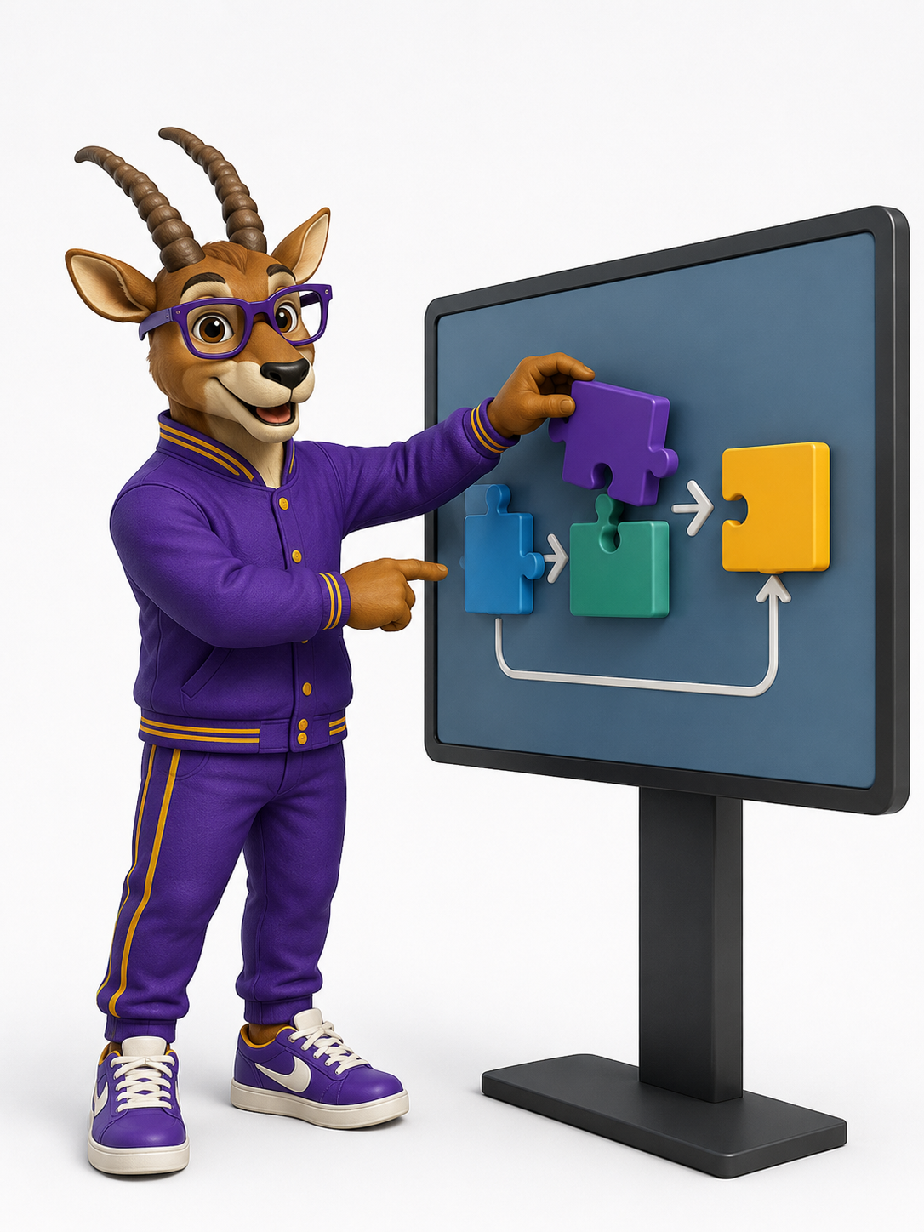

DEPARTMENT OF ARTIFICIAL INTELLIGENCE AND DATA SCIENCE
INTELLIGENT NARRATIVE GENERATION USING CONTEXT-AWARE RETRIEVAL AND ADAPTED LARGE LANGUAGE MODELS
SECOND REVIEW
SUPERVISOR
STUDENT(S)
<Supervisor Name with Designation>
SHAMVRUHT K
SANJEY RAM KUMAR
SRI CHARAN N
Notes:
Introduce the team, the project title and that this is the Second Review. Supervisor name to be filled in before presenting.

Slide 2
Problem Statement
1
Why conventional narrative systems fall short
What is needed
1
Static authoring Predefined dialogue, fixed story branches, scripted events and manually authored responses.
A modular system that combines:
Structured game / input state
2
Poor scalability Manual authoring becomes difficult to scale as the number of possible interactions grows.
Contextual retrieval (RAG)
3
Limited adaptivity Static narratives cannot adapt dynamically to changing game state and context.
Adapted language model (LoRA)
4
Ungrounded LLM output Direct LLM generation is fluent but may ignore game state, previous events, characters or world information.
Controlled narrative generation
PROBLEM STATEMENT
Develop a context-aware intelligent narrative-generation pipeline that can use interaction state and retrieved contextual information to generate dynamic narrative content.
Second Review
Department of Artificial Intelligence and Data Science
Notes:
Traditional game narratives are authored by hand and do not scale or adapt. Plain LLM generation is fluent but not grounded in the current game state. Our goal: a modular, context-aware narrative pipeline.

Slide 3
Proposed System
2
Game / User Input
Input & State Processing
Context Construction
RAG Retrieval
LLM Integration Layer
Adapted LLM + LoRA
Narrative Output
Application layer
Context layer
Model layer
Output
KEY DESIGN PRINCIPLE
Separate application state, retrieval, model interaction and narrative generation into modular components.
N = G( P(q,S), R(P(q,S),K), M )
q: input · S: state · K: knowledge · M: adapted model
1
2
3
4
Input is converted into structured interaction information.
Relevant context is retrieved from the knowledge source.
Retrieved context and interaction information are combined.
The adapted LLM generates the narrative, returned to the game / application.
Second Review
Department of Artificial Intelligence and Data Science
Notes:
Walk through the pipeline left to right. Emphasise that each stage is a separate module so it can be tested and replaced independently. Formula from the paper: N = G(P(q,S), R(P(q,S),K), M).

Slide 4
List of Modules
3
1
game/gamestate/
2
game/…/interaction
3
rag/
4
llm/
GameState / Application State Management
Input & State Processing
Context Retrieval / RAG
LLM Integration Layer
Authoritative state: location, characters, objects, inventory, history.
Converts player input into a structured Interaction and context snapshot.
Indexes world knowledge and returns the top-k relevant context.
Prompt builder and generator; isolates all model-specific calls.
5
models/
6
game/pipeline/
7
tests/ · experiments/
Adapted LLM / LoRA
Narrative Generation Pipeline
Testing & Validation
SmolLM2-1.7B-Instruct base model with a trained LoRA adapter.
Input → context → generate → validate → state update → output.
Automated module tests and model-level CUDA execution tests.
Second Review
Department of Artificial Intelligence and Data Science
Notes:
Seven modules, each mapped to a folder in the repository.

Slide 5
GameState and Input Processing
4
S
GameState
I
Input Processing
Maintains the authoritative state used by the narrative system.
Holds information that influences the generated narrative.
Supports state and inventory updates, verified in testing.
Updates are atomic and applied only after the response passes validation.
Receives interaction information (speech or action).
Converts it into a structured Interaction representation.
Controlled interface between application logic and the narrative pipeline.
The LLM does not need to understand application implementation details.
location
characters
objects
inventory
input
input_type
input_character
relationships
events
history
turn
responder_character
Interaction
player speech / action
Structured Input
Interaction model
Narrative Pipeline
context · generate · validate
State Update
committed after validation
Second Review
Department of Artificial Intelligence and Data Science
Notes:
GameStateManager returns deep copies; only the StateUpdater modifies state, and only after the generated response is validated. State changes are explicit and never inferred from generated text.

Slide 6
Context Retrieval / RAG
5
Retrieval-Augmented Generation supplies project-specific knowledge to the LLM at generation time.
Maintained as a separate module, independent of model inference.
Knowledge covers world lore, characters, locations, items and world rules.
Retrieved context is combined with the processed interaction before generation.
Structured Input → RAGQuery
query text · input type · location · characters · entities
Indexing & Relevance Scoring
weighted inverted index · IDF scaling · entity / location boosts
Top-K Relevant Context
minimum-score threshold · empty result when nothing is relevant
RAG PROVIDES
Stable world knowledge: lore, personas, locations, items, rules
GAMESTATE OWNS
Dynamic facts: location, inventory, object states, history
Prompt / Context Construction
ContextBuilder assembles the NarrativeContext for the LLM
RAG never overrides dynamic GameState.
Retrieval precision, recall and ranking quality have not yet been quantitatively benchmarked.
Second Review
Department of Artificial Intelligence and Data Science
Notes:
Knowledge is indexed with a weighted inverted index (title, entity, content and metadata fields, IDF scaling, entity/location boosts). Results below a minimum score are filtered out; top-k are returned. No retrieval metrics are claimed yet.

Slide 7
LLM Integration and Narrative Generation
6
Input + Retrieved Context
Prompt Construction
LLM Integration
LoRA-Adapted Model
Generated Narrative
Response Validation
LLM Integration Layer
Adapted Model Configuration
Model interaction is isolated in an integration / abstraction layer.
Loads the base model and LoRA adapter through this layer.
Prompt combines task, setting, characters, world state, history, retrieved knowledge and current input.
Generates responder-character speech or narrator descriptions.
Model can be replaced or reconfigured without restructuring the application.
Base model
SmolLM2-1.7B-Instruct
Adaptation
LoRA (PEFT) · r = 16, α = 32
Target modules
q, k, v, o projections
CUDA loading
4-bit NF4 quantisation
Decoding
≤128 new tokens · T 0.7 · top-p 0.9
LoRA artifacts:
adapter_config.json
adapter_model.safetensors
tokenizer.json
tokenizer_config.json
chat_template.jinja
training_args.bin
Second Review
Department of Artificial Intelligence and Data Science
Notes:
NarrativeGenerator loads SmolLM2-1.7B-Instruct with the LoRA adapter (4-bit on CUDA, CPU fallback). NarrativePromptBuilder turns NarrativeContext into a chat prompt. ResponseValidator rejects empty output, prompt leakage, input echo, speaker prefixes and over-long responses before any state update.

Slide 8
Implementation Progress – Module Wise
7
Module | Status | Evidence / Notes
GameState | Implemented | State models, manager, updater and validator with unit tests
Input / State Processing | Implemented | InputInteractionProcessor and ContextBuilder with tests
RAG / Retrieval | Implemented / Integration Stage | Knowledge loader, inverted index and retriever with tests
LLM Integration Layer | Implemented | NarrativeGenerator and NarrativePromptBuilder with prompt tests
LoRA Adapted Model | Available & Loaded | SmolLM2-1.7B + LoRA adapter loaded on CUDA
Narrative Generation | Functionally Verified | Pipeline with response validation; preliminary end-to-end runs
Testing Infrastructure | Implemented | 210 tests passed, 1 skipped; 2048-token model execution test
Game / Interactive Input Integration | Remaining Refinement | Interactive user input and gameplay integration
Narrative Quality Evaluation | Pending | Coherence, relevance, consistency, baseline comparison
Performance Benchmarking | Pending | Latency, memory and throughput under representative load
Implemented / Verified
Integration stage / Refinement
Pending
Second Review
Department of Artificial Intelligence and Data Science
Notes:
Status labels are qualitative. No per-module percentages are claimed.

Slide 9
Outputs / Results
8
1
Model Loading
2
Automated Testing
3
Model Execution
[ Screenshot: model + adapter load log (CUDA) ]
[ Screenshot: pytest summary line ]
Input tensor: 1 × 2048
Active tokens: 560
Masked tokens: 2041
Target tokens: 7
Forward: Successful
Backward: Successful
Loss*: 8.100089
Peak VRAM: 10.335786 GB
SmolLM2 + LoRA adapter successfully loaded on CUDA
210 tests passed, 1 skipped
2048-token forward and backward pass executed
4
RAG Retrieval
5
State / Inventory
6
Narrative Generation
[ Screenshot: retrieved knowledge for a query ]
[ Screenshot: GameState before / after an action ]
[ Screenshot: player input and generated response ]
Relevant contextual information retrieved for generation
GameState and inventory updates verified
Context-aware narrative output generated
*Loss is an execution observation from a single test configuration, not a narrative-quality score. Live demonstration follows this slide.
Second Review
Department of Artificial Intelligence and Data Science
Notes:
Replace each dashed placeholder with the actual screenshot from your runs before the review. Then run the live demo: python scripts/run_prototype.py (use --fake for the deterministic mode, or without it to load the fine-tuned adapter).

Slide 10
Overall Project Progress
9
✓
Core technical pipeline
Substantially implemented and functionally verified
GameState · input processing · RAG · LLM integration · LoRA model · pipeline · tests
~80%
implementation
~20%
Remaining work
Final system evaluation and complete interactive integration: ongoing
Interactive user-input integration
Final gameplay / application integration
Larger end-to-end validation
Narrative-quality evaluation
Baseline comparison
Retrieval-quality evaluation
Overall implementation progress:
approximately 80%
An implementation-progress estimate — not an experimental performance score.
Latency / performance benchmarking
Robustness and user evaluation
Second Review
Department of Artificial Intelligence and Data Science
Notes:
~80% refers to implementation progress of the planned system components. It is not an accuracy or quality metric. The remaining work is mostly integration and systematic evaluation.

Slide 11

THANK YOU
Second Review
Department of Artificial Intelligence and Data Science
Questions & Discussion
Notes:
Invite questions.

