Slide 1
TALENTFLOW
Next-Generation AI Recruitment & RAG Sourcing Suite

Slide 2
VISION
Executive Summary: Redefining Talent Acquisition
01
Smart Sourcing
Automatically reads incoming resume attachments from email and extracts text from low-contrast scans using Python OCR.
02
Semantic Matching
Scores and ranks candidates against natural-language Job Descriptions using vector search embeddings.
03
Audited Reliability
Eliminates AI hallucinations mathematically using a programmatic experience safety filter.

Slide 3
WHY WE BUILT TALENTFLOW
The Problem Statement
Recruiters are drowning in administrative tasks, missing out on top talent.
1. Extreme Pre-Screening Volume: Recruiters spend hours manually filtering hundreds of unqualified resumes. 2. Legacy ATS Keyword Traps: Traditional systems miss highly qualified candidates simply because they use synonyms instead of exact keywords. 3. AI Deficits & Hallucinations: Standard LLMs fail at basic date math (e.g. evaluating 'Present' roles) leading to critical false-negative matching.

Slide 4
THE KEYWORD GAP
The Keyword Trap: Legacy ATS Limitations
LEGACY KEYWORD FILTERS
Rigid and Non-Intuitive
• Syntactic Matching: Rejects candidates who use synonyms instead of exact keywords. • Keyword Stuffing: Unqualified candidates game the system by pasting hidden keywords in their CV text.
TALENTFLOW SEMANTIC RAG
Conceptual Intelligence
• Vector Embeddings: Understands core concepts, related technical packages, and equivalent roles natively. • Intent-Based Queries: Search matches are returned based on what recruiters *mean*, not just specific words.

Slide 5
RELIABILITY RISKS
The AI Deficit: LLM Hallucinations
Raw LLMs are not enough for secure, accurate enterprise recruitment.
• Static Context: LLMs don't know 'today's date' natively. They miscalculate durations for roles ending in 'Present'. • Syntactic Math Failures: AI models fail to compute sum timelines properly, flagging a candidate with 8 years of experience as missing a '5+ years' requirement. • Structural Failures: Raw completions truncate output or fail to return valid JSON parser schemas.

Slide 6
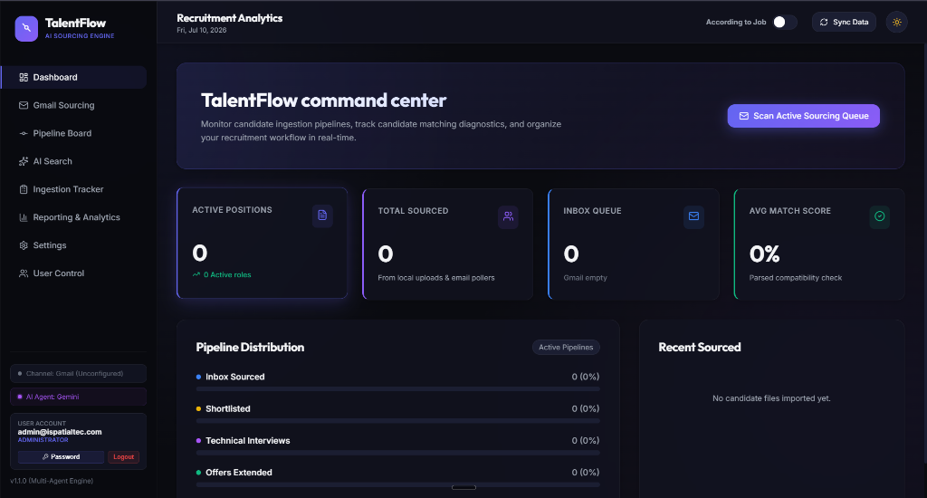
HOW WE SOLVE IT
The Solution: Resilient Intelligence
The TalentFlow Command Center
• Automated Pipeline: Sourcing, reading, and parsing directly from emails. • Semantic RAG Matching: Discovers intent and actual skills rather than raw keywords. • Programmatic Guardrails: Math-backed safety filters correct AI timeline hallucinations.

Slide 7
INGESTION CHANNEL
Feature Spotlight: Hybrid Ingestion & OCR
✔
Manual Portal Upload
Recruiters upload standard PDF resumes directly. Node-Multer manages secure disk upload storage paths.
✔
Scheduled Email Sourcing
Cron scheduler loops (Gmail/Outlook) pull CV attachments automatically, categorizing them using AI classifiers.
✔
Python OCR Fallback
Scanned or low-contrast PDFs trigger Python routines (OpenCV preprocessing, PyMuPDF, and Tesseract-OCR) to capture text.

Slide 8
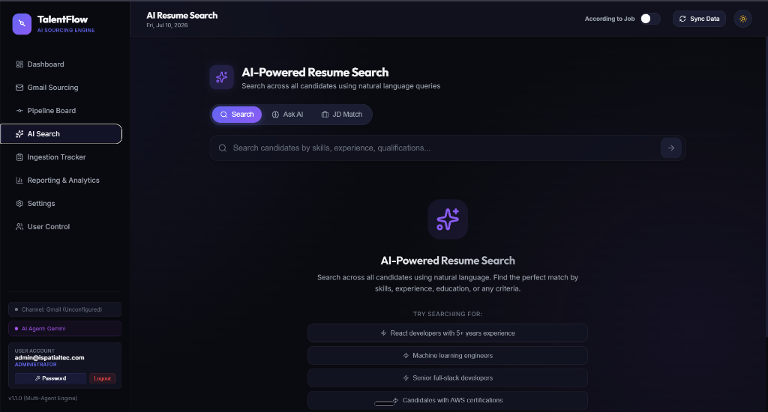
AI SEARCH
Feature Spotlight: Semantic RAG Search
VECTOR REPRESENTATIONS
Embedding & Indexing
• Semantic Vector Indexing: Translates parsed resume descriptions into high-dimensional vector representations. • Contextual Matching: Identifies candidates based on experience definitions, not just literal keyword spelling.

Slide 9
SAFETY INTERCEPTOR
Feature Spotlight: Algorithmic Safety Filters
Curing LLM Hallucinations
• Safety Layer Interception: Overrides LLM outputs using local Javascript date-math functions on candidate history arrays. • Dynamic Experience Alignment: Mathematically confirms timeline values (e.g. if timeline equals 8 years, auto-moves '5+ years' requirement to 'Matches'). • Recruiter Validation: Ensures zero false negatives, preventing valid candidates from being hidden from recruiter pipelines.

Slide 10
PIPELINE VISUALS
Feature Spotlight: Pipeline Board
Inbox
New applications gathered from email and portals.
Shortlist
Candidates matching key credentials.
Interview
Scheduled and mapped in recruiter lists.
Offered
Pre-screened and approved profiles.
Rejected
Archived files with clear reasons.

Slide 11
PRE-SCREEN ASSISTANT
Feature Spotlight: Double Question Banks
HR PRE-SCREENING ASSISTANT
14 Standardized HR Questions
• First 7: Standardized screening questions automatically prepended. • Last 7: Dynamic, AI-generated questions tailored to the candidate's specific background details.
TECHNICAL KNOWLEDGE AUDIT
Custom Tech Q&A Panel
• Experience-Specific: Focuses on frameworks, databases, and architectures listed in their candidate profile. • On-Demand Refresh: A single click triggers backend regeneration, refreshing questions directly.

Slide 12
DATA SANITY
Feature Spotlight: Duplicate Candidate Resolution
1. Update Details
Overwrites existing database values and files.
2. Delete & Re-Import
Deletes existing candidate profile, runs fresh parse.
3. Delete Only
Deletes existing candidate profile and halts upload.
4. Cancel Sourcing
Discards temp uploaded file, keeping DB intact.

Slide 13
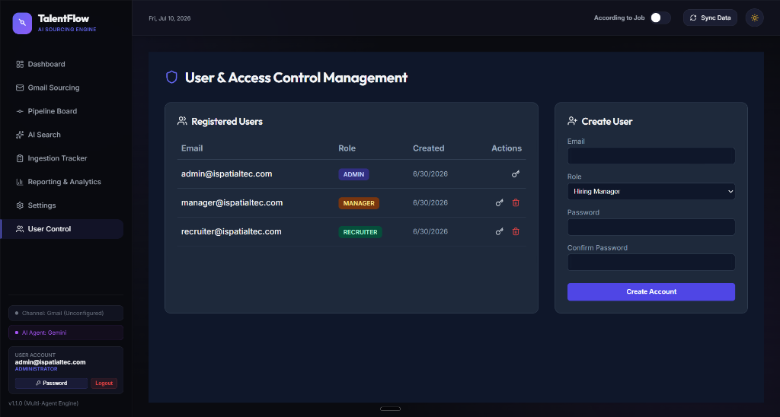
SECURITY
Security & Governance: Role-Based Access Control

Slide 14
SYSTEM DESIGN
Architecture & Cloud Infrastructure
FRONTEND
React.js, Vite, Vanilla CSS (HUD glassmorphic layout), Lucide icons, DOM state retention.
BACKEND & DATABASE
Node.js, Express.js REST API, MongoDB Atlas, Node-Scheduler, Multer file upload.
AI ENGINES & OCR
google/gemini-2.5-flash, local Ollama integrations, Python OCR Subsystem (OpenCV, PyMuPDF, Tesseract-OCR).

Slide 15
ROI METRICS
The Business Value: ROI & Metric Projections
-90%
Screening Overhead
Eliminates administrative burden, moving candidates from upload to first contact in seconds.
+80%
Matching Accuracy
Semantic vector queries prevent qualified candidates from being rejected by legacy keyword systems.
100%
Reliability Guarantee
Algorithmic safety filters eliminate date-math mistakes and LLM hallucinations.

Slide 16
Thank You
Empowering Recruitment Teams with Accurate AI

