Slide 1
TALENTFLOW
AI-Powered Recruitment Automation Platform
Streamlining the entire hiring lifecycle — from resume sourcing to candidate evaluation
Generative AI • Semantic Search • Email Automation • Smart Match & Interview Generation

Slide 2
THE RECRUITING CHALLENGE
The Problem Statement: Recruitment Bottlenecks
OPERATIONAL INEFFICIENCY
Manual Screening & Fragmentation
• Time-Intensive Screening: Recruiters spend an average of 23 hours reviewing resumes per hire, creating major delays.
• Inbox Overload: Resumes arrive scattered across multiple email servers (Gmail, Outlook). Downloading and sorting attachments manually is slow.
• Poor Pipeline Tracking: Managing candidate progress in spreadsheets leads to missed dates, lost CVs, and slow communication.
TECHNOLOGICAL LIMITS
Keyword Matchers & Biased Prep
• Keyword-Only Search: Traditional ATS systems miss candidates due to exact word queries (e.g. 'Node.js Developer' ignoring 'Express.js Engineer').
• Inconsistent Evaluation: No objective scoring exists. Candidates are interviewed on subjective standards without structured checklists.
• Unprepared Interview Panels: Hiring managers ask mismatched or generic questions, failing to test candidate skills effectively.

Slide 3
TALENTFLOW ADVANTAGE
The Solution: Resilient Recruitment Intelligence
AUTOMATED CHANNELS
Sourcing, Parsing & OCR
• Dynamic Email Pollers: Continual background sync scans Gmail (IMAP) & Outlook (Graph API) to capture resumes automatically.
• AI Parsing & OCR Ingest: Parses raw PDF/Docx text into database structures, falling back to Python Tesseract OCR for scanned files.
• Duplicate Resolution Flow: Prevents candidate database clutter via a 4-option duplicate candidate management flow.
INTELLIGENT RECRUITING
RAG, JD Score & Interview Prep
• Semantic Search (RAG): Maps queries to vectors for conceptual match, allowing searches like 'Node.js' to find 'Express.js' profiles.
• Objective JD Match: Ranks candidates (0-100%) against JDs with detailed missing/matching skill metrics and AI reasoning.
• Custom Question Banks: Auto-generates HR & technical question guides with correct answers, sorted by criticality (Must Ask, optional).

Slide 4
INPUT METHODS
Candidate Sourcing: Automated Input Channels
METHOD 01
Direct Upload
Allows recruiters to drag and drop single or bulk resume files. Accepts PDF & DOCX formats. Immediately runs text parsing and database indexing.
METHOD 02
Gmail IMAP Sync
Background sync loop polls Gmail folders every 30s using app password connection. Downloads PDF attachments and logs processed UIDs to avoid double imports.
METHOD 03
Outlook API Connection
Secured Microsoft Graph OAuth 2.0 flow. Fetches unread emails, parses attachments, and enables direct platform email replies.
METHOD 04
Auto Poller Loop
A unified background poller checks settings to run the correct email pipeline, categorizing spam out and auto-importing applicants.

Slide 5
DATA CONFLICT RESOLUTION
Ingestion Control & Duplicate Candidate Flow
INTELLIGENT DEDUPLICATION
How Conflicts are Spotted
• Email Verification: Matches incoming candidates against database records using case-insensitive email regex checking.
• Name Matching: Employs case-insensitive name matching to catch candidates applying with alternative email accounts.
• Atomic Upserts: Prevents simultaneous ingestion write conflicts via MongoDB atomic checks.
CONFLICT DECISION FLOW
Four Resolution Options Offered to User
1. Update (Overwrite Existing Info & CV)
Retains current Candidate ID, updates experience, education, skills, and replaces PDF resume file with new upload. Triggers scoring re-runs.
2. Delete Existing & Import New
Wipes the previous profile (including history and indices) and imports the new resume fresh, assigning a new Candidate ID.
3. Delete Existing Only (Halt Import)
Deletes the existing candidate from the database entirely, while discarding the newly uploaded file without importing it.
4. Cancel (Discard Uploaded File)
Keeps the existing candidate database profile untouched, immediately deleting the new temporary file from the server.

Slide 6
PROFILE INGESTION
Smart Resume Ingestion: AI & OCR Parser
DOCUMENT EXTRACTION PIPELINE
Resume Parsing Mechanics
• Multi-Format Parser: Extracts textual details from PDF, DOCX, TXT, RTF, and MD files.
• PDF.js Core: Extracts text segments directly using web-standard client libraries for high speed.
• Tesseract OCR Fallback: Runs a Python subprocess utilizing Tesseract to extract content if the PDF is scanned or image-based.
• JSON Repair Engine: Employs regex filters and structural bracket matching to repair malformed LLM outputs and avoid crashes.
Extracted Candidate Schema Model:
{ "name": "John Doe", "email": "john@example.com", "skills": ["React", "Node.js", "AWS"], "experience": [ { "role": "Backend Engineer", "company": "TechCorp", "duration": "3 years 4 months" } ], "seniorityLevel": "Senior", "tags": [{"value": "Backend", "category": "Domain"}] }

Slide 7
AI SERVICE CONFIGURATION
Multi-Provider AI & Model Settings
PLUG-AND-PLAY AI LAYERS
Supported Models & APIs
• Google Gemini: Connects directly to gemini-2.0-flash using standard developer API keys.
• OpenAI: Dispatches to GPT-4o for parsing and evaluations.
• Anthropic Claude: Integrated with Claude 3.5 Sonnet.
• OpenRouter: Allows routing requests to 100+ cloud LLMs via a single sk-or-* prefixed API key.
• Ollama (Local LLM): Connects to local endpoints (e.g. LLaMA3) for offline usage and data confidentiality.
ROBUSTNESS & OPTIMIZATION
AI Operations & Stability
• Connection Checks: Settings UI offers test-connection endpoints for Ollama, Gmail, and Outlook to verify integrations before saving.
• Ollama Context Optimization: Dynamically shrinks local prompt schemas to avoid high pre-processing latency.
• High Output Limits: Enforces at least 8000 max_tokens for candidate analysis & question generators to prevent JSON truncation.
• Stateless Fallbacks: If AI APIs fail, fallback routines preserve database status without losing uploaded resume files.

Slide 8
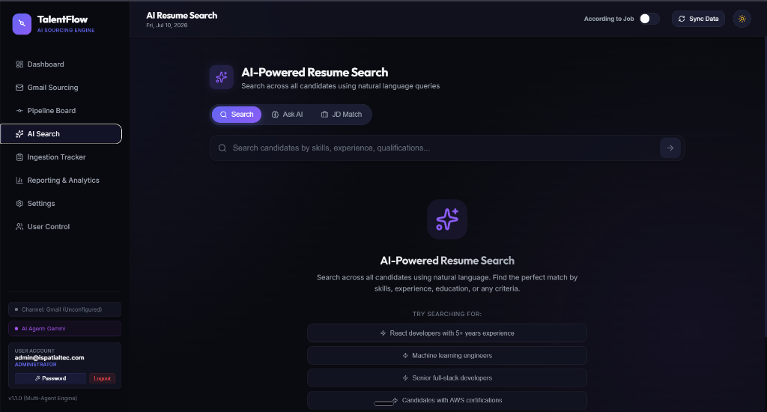
AI SEARCH SYSTEM
Advanced Semantic Search (RAG Engine)
CONCEPTUAL SEARCH RETRIEVAL
RAG & Vector Embeddings
• Chunk-Level Indexing: Splits resumes into sections (contact, skills, experience, projects) to store embeddings in MongoDB.
• Semantic Vector Search: Translates natural language queries into embeddings to locate contextually relevant candidate chunks.
• AI Q&A Chatbot: An interactive 'Ask AI' chat panel answers recruiter questions using relevant candidates as context.
• Keyword Fallback: Seamless token matching checks for exact keyword matches if the vector API goes offline.

Slide 9
SEARCH METHODOLOGIES
High-Speed Tag & Keyword Search
METHOD 01
Trie Autocomplete
Indexes candidate tags and skills for instantaneous keystroke suggestions.
METHOD 02
Trigram Fuzzy Match
Splits words into three-character tokens to match queries despite spelling mistakes.
METHOD 03
Interactive Tag Cloud
Visualized tag list for rapid exploration of pool skills and counts.

Slide 10
CANDIDATE RANKING
Job Description (JD) Matcher & Reranking
INTELLIGENT RANKING ALGORITHM
JD Scoring & Analysis
• Upload Job Description: Enter title, location, requirements, and description.
• Scoring Scale (0-100%): Ranks profiles objectively using AI models.
• Dual Scoring Modes: JD Match ranks candidates for a selected job, while Own-Category Score ranks them within their parsed specialization.
• Retrieve-and-Rerank: Uses vector search to pre-filter top candidates, scoring only matches via LLM to optimize speed and API costs.
JD Matching Logic Flow:
1. Parse Job Description requirements 2. Query RAG vector database for top candidates 3. Perform programmatical experience duration validation 4. Dispatch selected profiles to LLM for precise match score 5. Extract matching skills, missing gaps, and reasoning

Slide 11
PIPELINE MANAGEMENT
Interactive Kanban Pipeline Board
Inbox
New email & upload profiles.
• Sourced email CVs
• Manual file uploads
• Duplicate prevention
• OCR text fallback
History & Audit Logs
Shortlist
Selected fit profiles.
• Experience math validation
• Skill checks
• Initial candidate review
• Custom tags display
History & Audit Logs
Interview
Scheduled panels & tests.
• Custom technical Q&As
• Custom HR Q&As
• Regenerable question bank
• Checklists for interviewers
History & Audit Logs
Offered
Fit profiles for hiring.
• Profile score matching
• Fit recommendations
• Final review pipeline
• Offer letter template
History & Audit Logs
Rejected
Archived applicant files.
• Archive with reason
• Searchable pool retention
• Re-engagement rules
• Timeline logs
History & Audit Logs

Slide 12
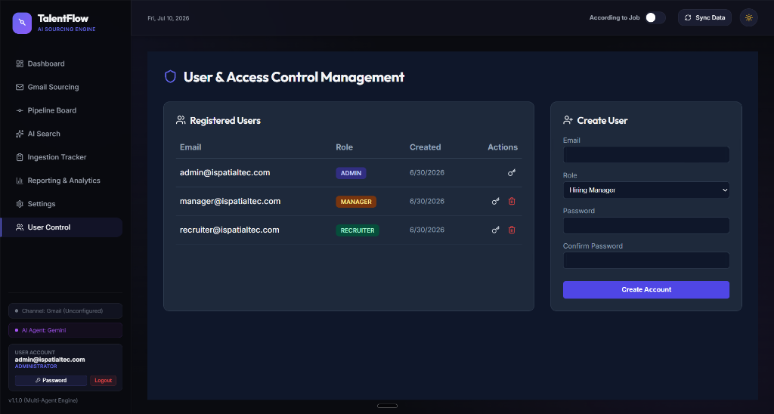
RECRUITER WORKSPACE
Slide-Out Details Drawer & PDF Preview
CONTEXT RETAINED INTERFACE
360° Candidate Profile View
• Employment Gap Detection: Automatically calculates total experience and logs detailed employment gap timelines.
• Interactive Side-by-Side: View candidate's original PDF/Docx alongside AI-structured data.
• Tabbed Detail Panels: Organizes structured data into Experience, Education, Projects, and customized Question-Answers.
• Audit Log Trail: Lists detailed profile history entries (Ingested, Stage Changed, Emailed).

Slide 13
PRE-SCREENING PREPARATION
Tailored Interview Question Generator
CANDIDATE-SPECIFIC CHECKS
HR & Technical Q&A Generation
• Culture & Behavioral Questions: Generates custom HR screening questions aligned with candidate seniority.
• Domain-Specific Questions: Inspects candidate skills to build custom technical evaluation questions.
• Expected Answer Guide: Supplies the correct expected answers for each question so any interviewer can grade responses.
• Regenerate on Demand: A simple button in the details panel lets users re-run AI generation to fresh sets.
COMPETENCY HIGHLIGHTING
Importance Ratings & Badging
🔴 Must Ask / Very Important
Critical questions targeting core skill gaps or mismatch points.
🟠 Important
Highlights crucial job description requirements.
🟡 Good to Ask
Helpful to confirm details, but not project blockers.
🔵 Screening
Rapid qualification checks (e.g. visa status, notice period).
🟢 Optional
Nice-to-have topics if interview time permits.

Slide 14
RECRUITER WORKFLOW
Inbox Management & Real-Time Ingestion Logs
COMMUNICATION HUB
Unified Sourcing Inbox
• Email Previews: Displays sender, subject, date, body snippet, and attachments directly in the app.
• AI Email Categorization: Labels emails into Resume, HR, Spam, Client, Interview, Notification, or Other.
• Email Send Modal: Compose and send messages to candidates with templates (Interview, Offer, Rejection) using mail servers.
• Auto-Process Toggle: Automatically ingests emails categorized as 'Resume' without human intervention.
INGESTION TRACKER
Real-Time Processing Logs
• Status Monitoring: Real-time poller tracks uploads through states: Processing, Success, Failed, Duplicate, Cancelled.
• Error Diagnostics: Log details display the exact failure reasons (e.g. failed OCR, missing API keys) for debugging.
• Candidate Link: Clickable success links instantly open the parsed candidate details drawer.
• Channel Source: Traces manual upload vs Gmail vs Outlook sourcing pathways.

Slide 15
DATA MANAGEMENT
Data Export Features & Formats
FORMAT 01
Pipeline CSV Export
Allows exporting filtered candidates based on stages and date ranges. Generates UTF-8 BOM CSV files with parsed work experience, education, scores, and skills.
FORMAT 02
Tag Search CSV Export
Directly exports candidate search matches filtered by tag queries and seniority sliders to spreadsheets.
FORMAT 03
Ingestion Log CSV
Exports tracker audits including filename, timestamp, sourcing channel, status, and failure logs for compliance audits.

Slide 16
SECURITY & RBAC
Authentication & Role-Based Access Control
JWT AUTHENTICATION
Session & Cryptography
• JSON Web Tokens (JWT): Secures communications via token verification in headers or query params, set to expire in 24 hours.
• BCrypt Hashing: Encrypts passwords before storage in MongoDB to protect accounts.
• Candidate Sharing: Recruiters and admins can share specific candidate profiles with hiring managers via email assignment.
RBAC PERMISSIONS MATRIX
User Roles & Permissions
1. Administrator (Admin)
Complete workspace authority. Configures system settings, toggles email syncs, adds users, and manages databases.
2. Recruiter
Functional sourcing role. Can import profiles, trigger JD matches, update pipelines, compose emails, and run searches.
3. Hiring Manager
Restricted reviewer. Access is limited to candidate profiles explicitly assigned to them. Cannot edit, upload, or delete data.

Slide 17
METRICS & KPI MONITOR
Reporting & Recruitment Analytics
Conversion Funnel
Visualizes conversion ratios from Sourced → Shortlisted → Interviewed → Offered.
Match Score Distribution
Segments the database into Excellent (90-100), Good (70-89), Average, and Poor bands.
Sourcing Channels
Analyzes the intake volume of manual uploads vs Gmail vs Outlook integrations.
Talent Seniority Segments
Graphs candidate pools across Junior, Mid, Senior, Lead, and Executive levels.

Slide 18
THE END-TO-END SUITE
Platform Summary
Automated Sourcing
Monitors mailboxes dynamically for applicant resume attachments.
Structured Parsing
Hybrid PDF parser & OCR extractor structure documents cleanly.
Intelligent Search
Semantic RAG & high-speed keyword systems optimize discovery.
Pipeline Management
Job Description matching, custom Q&A arrays, and visual Kanban flow.

Slide 19
Thank You
Transform Recruitment with Intelligent Automation
Simplify Sourcing, Evaluation, and Pipeline Management. Explore the platform capabilities today.

