Slide 1
TALENTFLOW
AI-Powered Recruitment & RAG Sourcing Suite
Sourcing, Parsing, Matching, Question Generation, and Pipeline Management in One Platform

Slide 2
VISION & VALUE PROP
Executive Summary: Redefining Talent Acquisition
01
Smart Sourcing
Automatically reads incoming resume attachments from email and extracts text from low-contrast scans using Python OCR.
02
Semantic Matching
Scores and ranks candidates against natural-language Job Descriptions using vector search embeddings.
03
Audited Reliability
Eliminates AI hallucinations mathematically using a programmatic experience safety filter.

Slide 3
THE CHALLENGE
The Problem Statement: The Recruiter's Overhead
Recruiters are drowning in administrative tasks, missing out on top talent.
• Extreme Pre-Screening Volume: Recruiters spend hours manually filtering hundreds of unqualified resumes. • Legacy ATS Keyword Traps: Traditional systems miss highly qualified candidates simply because they use synonyms instead of exact keywords. • Sourcing channels are fragmented: Emails, portals, direct uploads, etc. lead to lost candidate profiles. • Time-to-Hire stretches over weeks: Top talent accepts competing offers before interviews can be scheduled.

Slide 4
THE KEYWORD GAP
The Keyword Trap: Legacy ATS Limitations
LEGACY KEYWORD FILTERS
Rigid and Non-Intuitive
• Syntactic Matching: Rejects candidates who use synonyms instead of exact keywords (e.g. searching 'NodeJS' misses 'Express Developer'). • Keyword Stuffing: Unqualified candidates game the system by pasting hidden keywords in their CV text.
TALENTFLOW SEMANTIC RAG
Conceptual Intelligence
• Vector Embeddings: Understands core concepts, related technical packages, and equivalent roles natively. • Senses Experience Depth: Prioritizes skills based on time duration and impact descriptions in previous roles. • Intent-Based Queries: Search matches are returned based on what recruiters *mean*, not just specific words.

Slide 5
RELIABILITY RISKS
The AI Deficit: LLM Hallucinations & Dynamic Safeguards
RAW LLM HALLUCINATIONS & DATE BUGS
The AI Deficit
• Static Context: LLMs don't know 'today's date' natively. They miscalculate durations for roles ending in 'Present'. • Syntactic Math Failures: AI models fail to compute sum timelines properly, flagging a candidate with 8 years of experience as missing a '5+ years' requirement.
TALENTFLOW ENGINEERING SAFEGUARDS
Structured Validation Layers
• Dynamic Date Injection: Injecting context date on every API call allows the parser to compute relative dates reliably. • Programmatic Safety Filters: Post-processing code intercepts and validates LLM findings against mathematical candidate histories. • Hardened Token Configurations: Limits outputs and applies robust bracket repair algorithms.

Slide 6
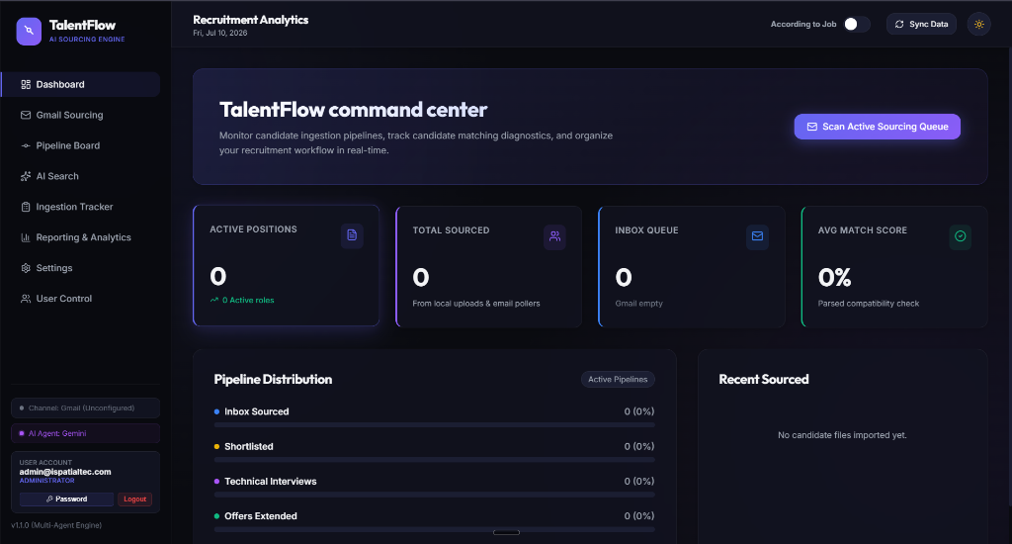
HOW WE SOLVE IT
The Solution: Resilient Intelligence
The TalentFlow Command Center
• Automated Pipeline: Sourcing, reading, and parsing directly from emails. • Semantic RAG Matching: Discovers intent and actual skills rather than raw keywords. • Programmatic Guardrails: Math-backed safety filters correct AI timeline hallucinations.

Slide 7
INGESTION CHANNEL
Feature spotlight: Hybrid Ingestion & OCR
✔
Manual Portal Upload
Recruiters upload standard PDF resumes directly. Node-Multer manages secure disk upload storage paths.
✔
Scheduled Email Sourcing
Cron scheduler loops (Gmail/Outlook) pull CV attachments automatically, categorizing them using AI classifiers.
✔
Python OCR Fallback
Scanned or low-contrast PDFs trigger Python routines (OpenCV preprocessing, PyMuPDF, and Tesseract-OCR) to capture text.

Slide 8
LLM CORE
Feature 1: Multi-Provider AI Engine
Complete control over your artificial intelligence backend.
• Model Versatility: Switch backend APIs seamlessly between Grok 4.5, OpenAI GPT-4o, Google Gemini, Anthropic Claude, and open-source models. • Local Offline Execution: Connects to local Ollama endpoints (supporting Llama 3, Qwen, etc.) for absolute data privacy and offline pre-screening. • Intelligent Prompt Optimization: Compresses prompts dynamically to decrease latency on local models and prevent context bottlenecks. • Settings Dashboard: Recruiter HUD panel to configure, test, and save provider API keys securely in real-time.

Slide 9
EMAIL PIPELINE
Feature 2: Automated Email Polling Queue
Connecting directly to standard sourcing mailboxes.
• Gmail & Outlook Office 365: Out-of-the-box integration with Google Gmail and Microsoft Graph APIs. • Scheduled Cron Polling: Runs an automated cron poller background task to fetch incoming recruitment emails. • Auto-Classification: Uses LLM classifiers to read email body, filter spam, and detect attached PDF resumes automatically. • UI Ingestion Queue: Renders active email queues inside the dashboard, letting recruiters manually trigger parses or dismiss emails in bulk.

Slide 10
INGESTION TRACKER
Feature 3: Resume Ingestion Tracker & Logs
Live monitoring of upload queues and extraction progress.
• Parallel Batch Uploads: Supports drag-and-drop parsing of multiple PDF resume files in parallel. • Live Status HUD: Shows real-time progress bars for each file (uploading ➔ text extraction ➔ AI parsing ➔ scoring ➔ saved). • Comprehensive Auditing: Standardized logs capturing successful ingestions and detailed error stacks. • Error Recovery: Proactively monitors and logs API limit failures (e.g., OpenRouter credit issues, model timeouts).

Slide 11
COMPATIBILITY
Feature 4: Dynamic Match Scoring & Ranking
Objective, multi-dimensional candidate evaluation.
• Real-Time JD Matching: Pasting a natural language Job Description instantly calculates a compatibility score (0-100%). • Dual Evaluation Modes: Switch between 'Match According to Job Description' and 'General Own Category Score' for flexible ranking. • Direct Skill Mapping: Visualizes 'Matching Skills' and 'Missing Skills' side-by-side using red/green badges. • Auto-sorting: Automatically orders the recruiter pipeline by the highest compatibility rank to highlight top profiles.

Slide 12
PIPELINE VISUALS
Feature Spotlight: Pipeline Board
Inbox
New applications gathered from email and portals.
• Drag Guard • Log Guard • Excel Export
Shortlist
Candidates matching key credentials.
• Drag Guard • Log Guard • Excel Export
Interview
Scheduled and mapped in recruiter lists.
• Drag Guard • Log Guard • Excel Export
Offered
Pre-screened and approved profiles.
• Drag Guard • Log Guard • Excel Export
Rejected
Archived files with clear reasons.
• Drag Guard • Log Guard • Excel Export

Slide 13
PRE-SCREEN ASSISTANT
Feature Spotlight: Double Question Banks
HR PRE-SCREENING ASSISTANT
14 Standardized HR Questions
• First 7: Standardized screening questions automatically prepended. • Last 7: Dynamic, AI-generated questions tailored to the candidate's specific background details.
TECHNICAL KNOWLEDGE AUDIT
Custom Tech Q&A Panel
• Experience-Specific: Focuses on frameworks, databases, and architectures listed in their candidate profile. • On-Demand Refresh: A single click triggers backend regeneration, refreshing questions directly.

Slide 14
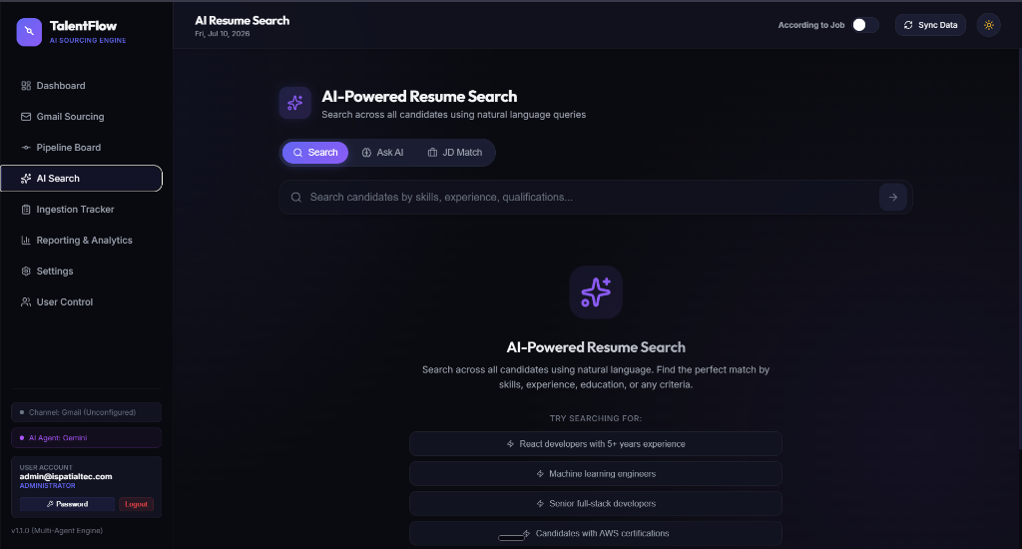
AI SEARCH
Feature Spotlight: Semantic RAG Search Engine
VECTOR REPRESENTATIONS
Embedding & Indexing
• Semantic Vector Indexing: Translates parsed resume descriptions into high-dimensional vector representations. • In-Memory Fast Retrieval: Executes similarity vector searches across candidate profiles instantly in the backend. • Contextual Matching: Identifies candidates based on experience definitions, not just literal keyword spelling.

Slide 15
CANDIDATE OUTREACH
Feature 9: Integrated Communication Center
Send custom technical outreach letters directly from the dashboard.
• Direct Email Client: Trigger email outreach modals directly from the Candidate Details panel. • AI Email Drafter: Instantly generates personalized invitation/offer emails tailored to candidate's skills. • Outbox Logger: Logs history of emails sent (timestamps and contents) on the candidate's activity timeline. • SMTP Integration: Connects seamlessly with standard SMTP services or custom mail APIs configured in server environments.

Slide 16
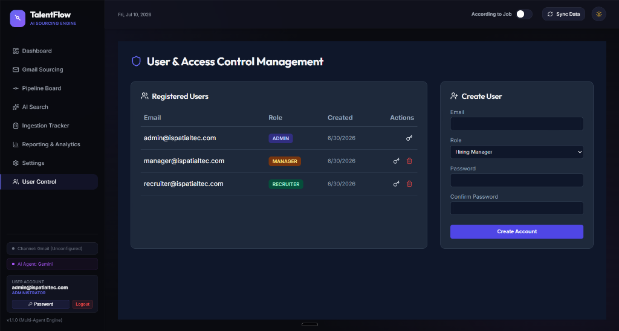
SECURITY
Security & Governance: Role-Based Access Control

Slide 17
ROI METRICS
The Business Value: ROI & Metric Projections
-90%
Screening Overhead
Eliminates administrative burden, moving candidates from upload to first contact in seconds.
+80%
Matching Accuracy
Semantic vector queries prevent qualified candidates from being rejected by legacy keyword systems.
100%
Reliability Guarantee
Algorithmic safety filters eliminate date-math mistakes and LLM hallucinations.

Slide 18
Thank You
Empowering Recruitment Teams with Accurate AI
Questions & Answers

