Slide 1
Bus Reservation System Mobile App
Anudeep Kakumanu
Sri Charan Eluri

Slide 2
The Problem
Buses are the most frequently available and most used vehicle for going from small distance trip to very long trip. They’re a no. of types of buses available in the market according to the private or public. What the problem here arises about the ticket is everyone has to take a card and want seats. But it’s not possible. The buses which will register on our system will have the option to give their customers an option to select the seats of the bus according to their wish as many places depending on the availability.
Making the system more useful unique tickets will be generated as its seats confirmed. Here we are with a system which can facilitate the users to which they can get their seats prior.By Creating a Mobile application to this system, everyone can book the tickets from their mobile itself without logging into their customers. And now a days, everyone is having a smart phone and it is very convenient for the customers to book a ticket for their travel.

Slide 3
Users and stakeholders
Bus reservation system mobile application is made of the combination of modules which work with collaboration with each other and make it beneficial to accomplish the main aim of the scheme.
The main users of this application will be customers as it will enable them to book a seat in a bus by choosing the route, travel date and the available seats.

Slide 4
Scope
Below is the list of features that will be available on the application
User Registration
User Login.
Ticket Booking
Retrieve ticket
Cancel ticket

Slide 5
Technologies used
OS – Windows 10, Android OS
Platform – Java 1.8, XML
Database – SQLite
IDE – Android Studio
Minimum API 23(Marshmellow)

Slide 6
Project flow

Slide 7

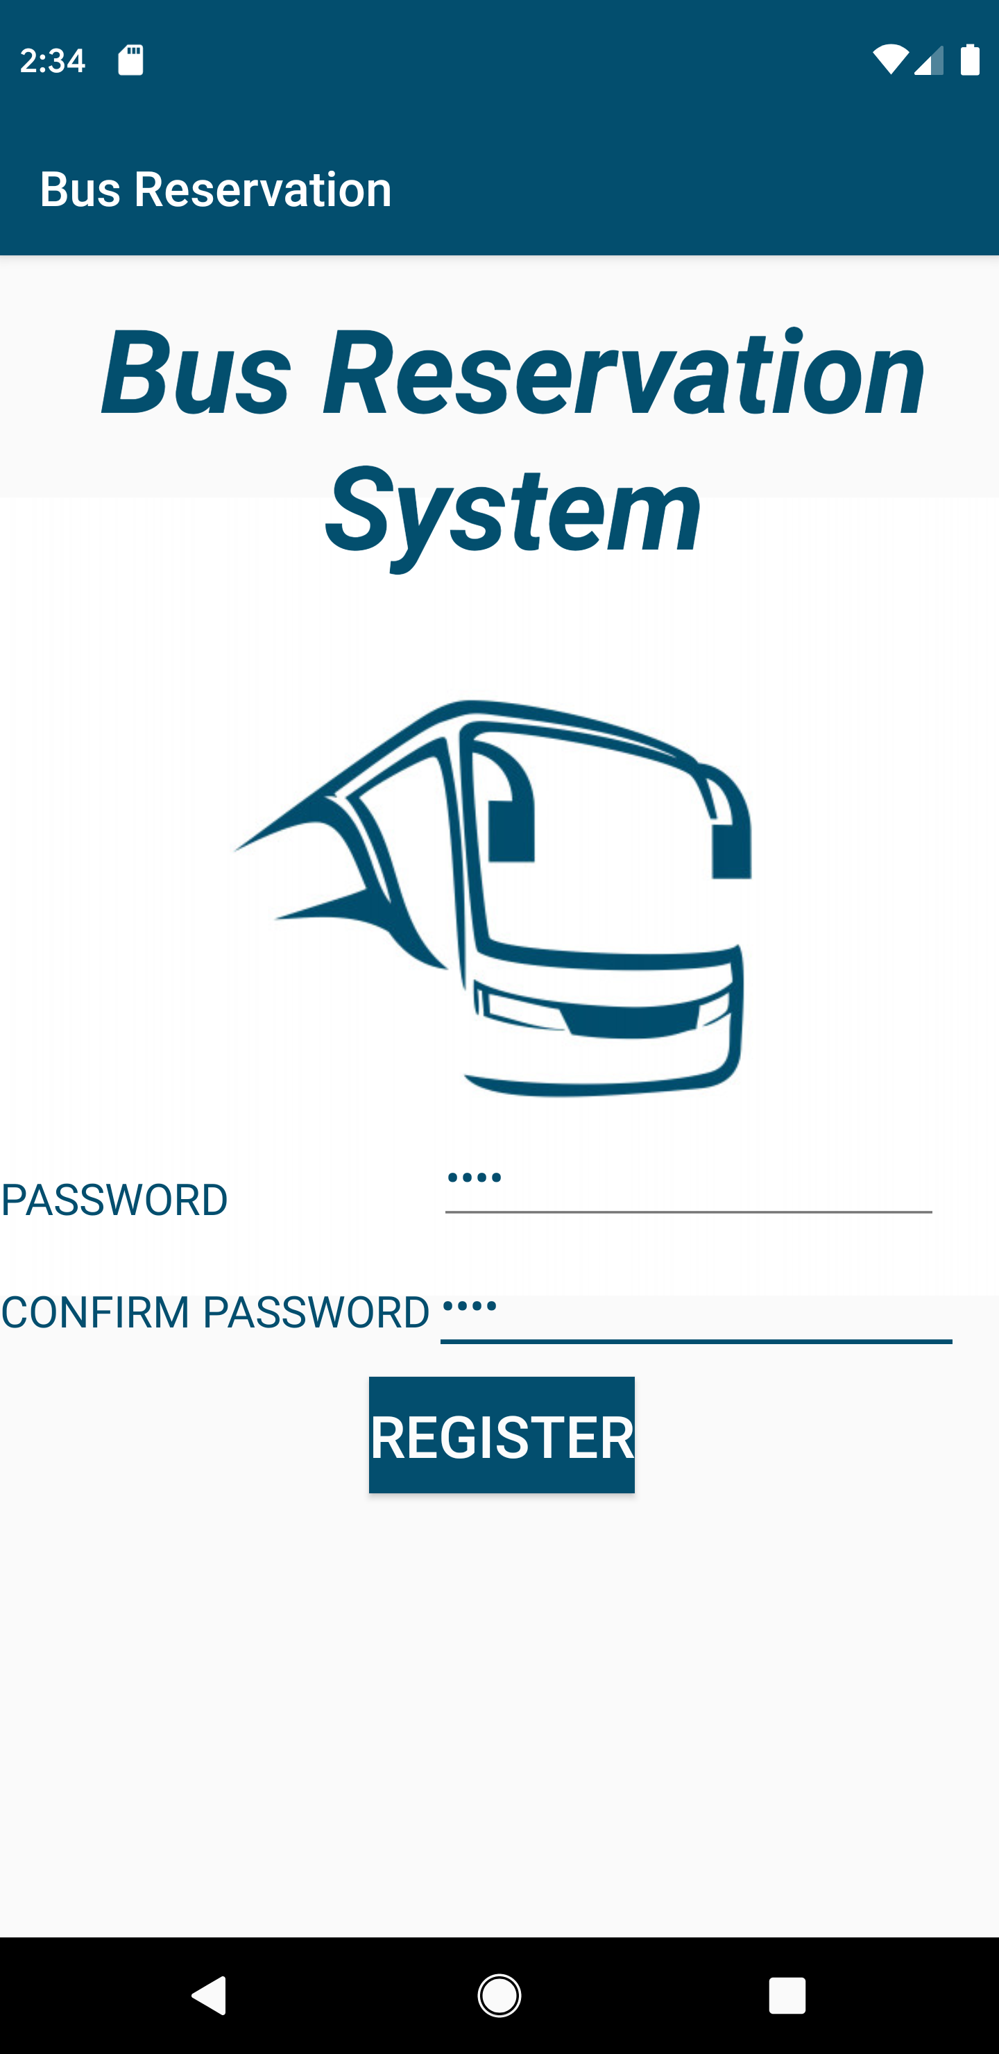
User Registration
The first-time users of the app should register first.
Application ask the user to enter the password and to re-enter the password.
Once the password is entered, user clicks on register button.

Slide 8
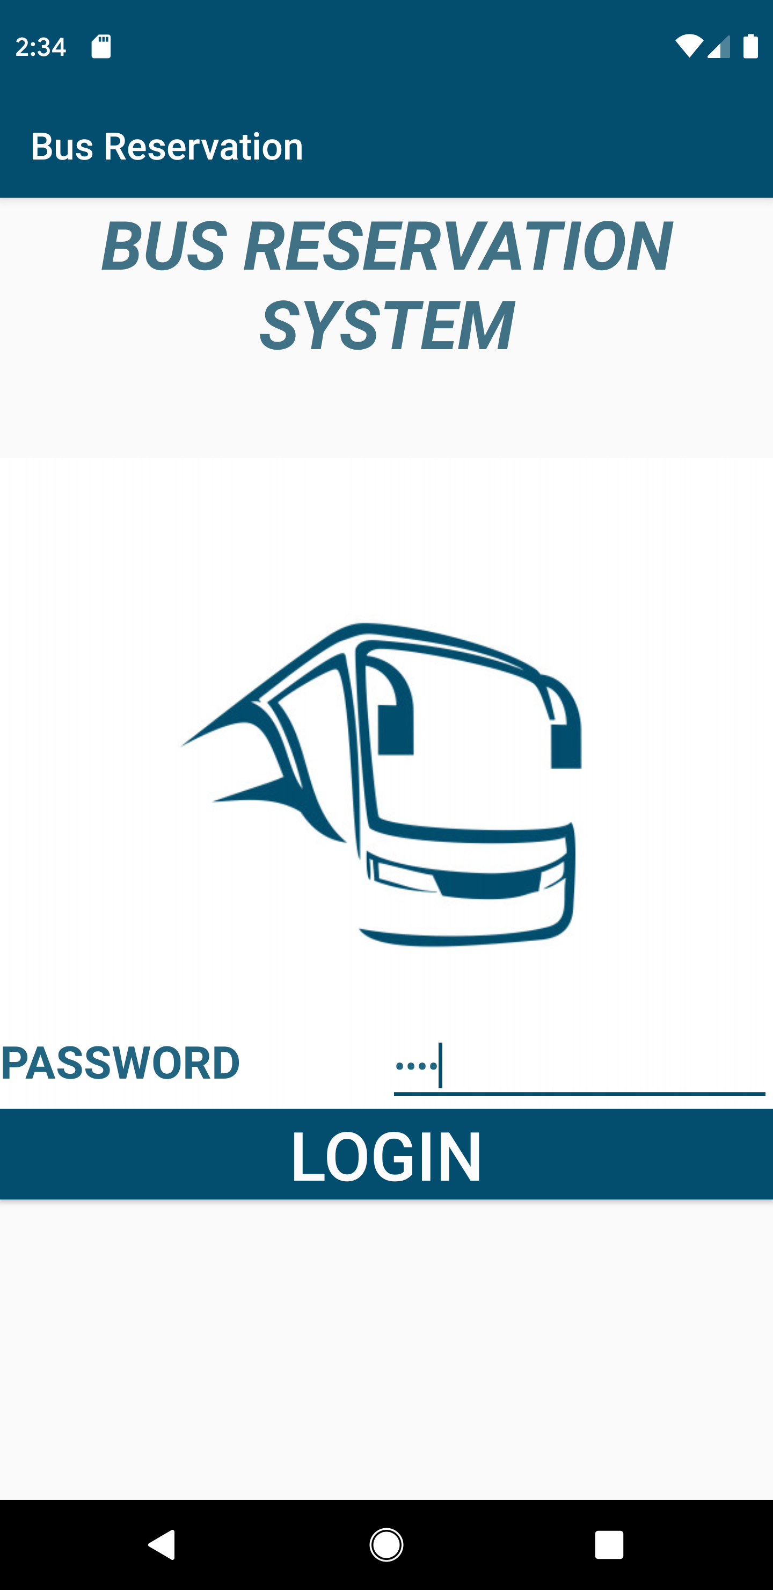
User Login
Every time when the user wants to use the app, user needs to enter the password which was set by the user while registering.
Once the password is entered Click on the login button to use the app.

Slide 9
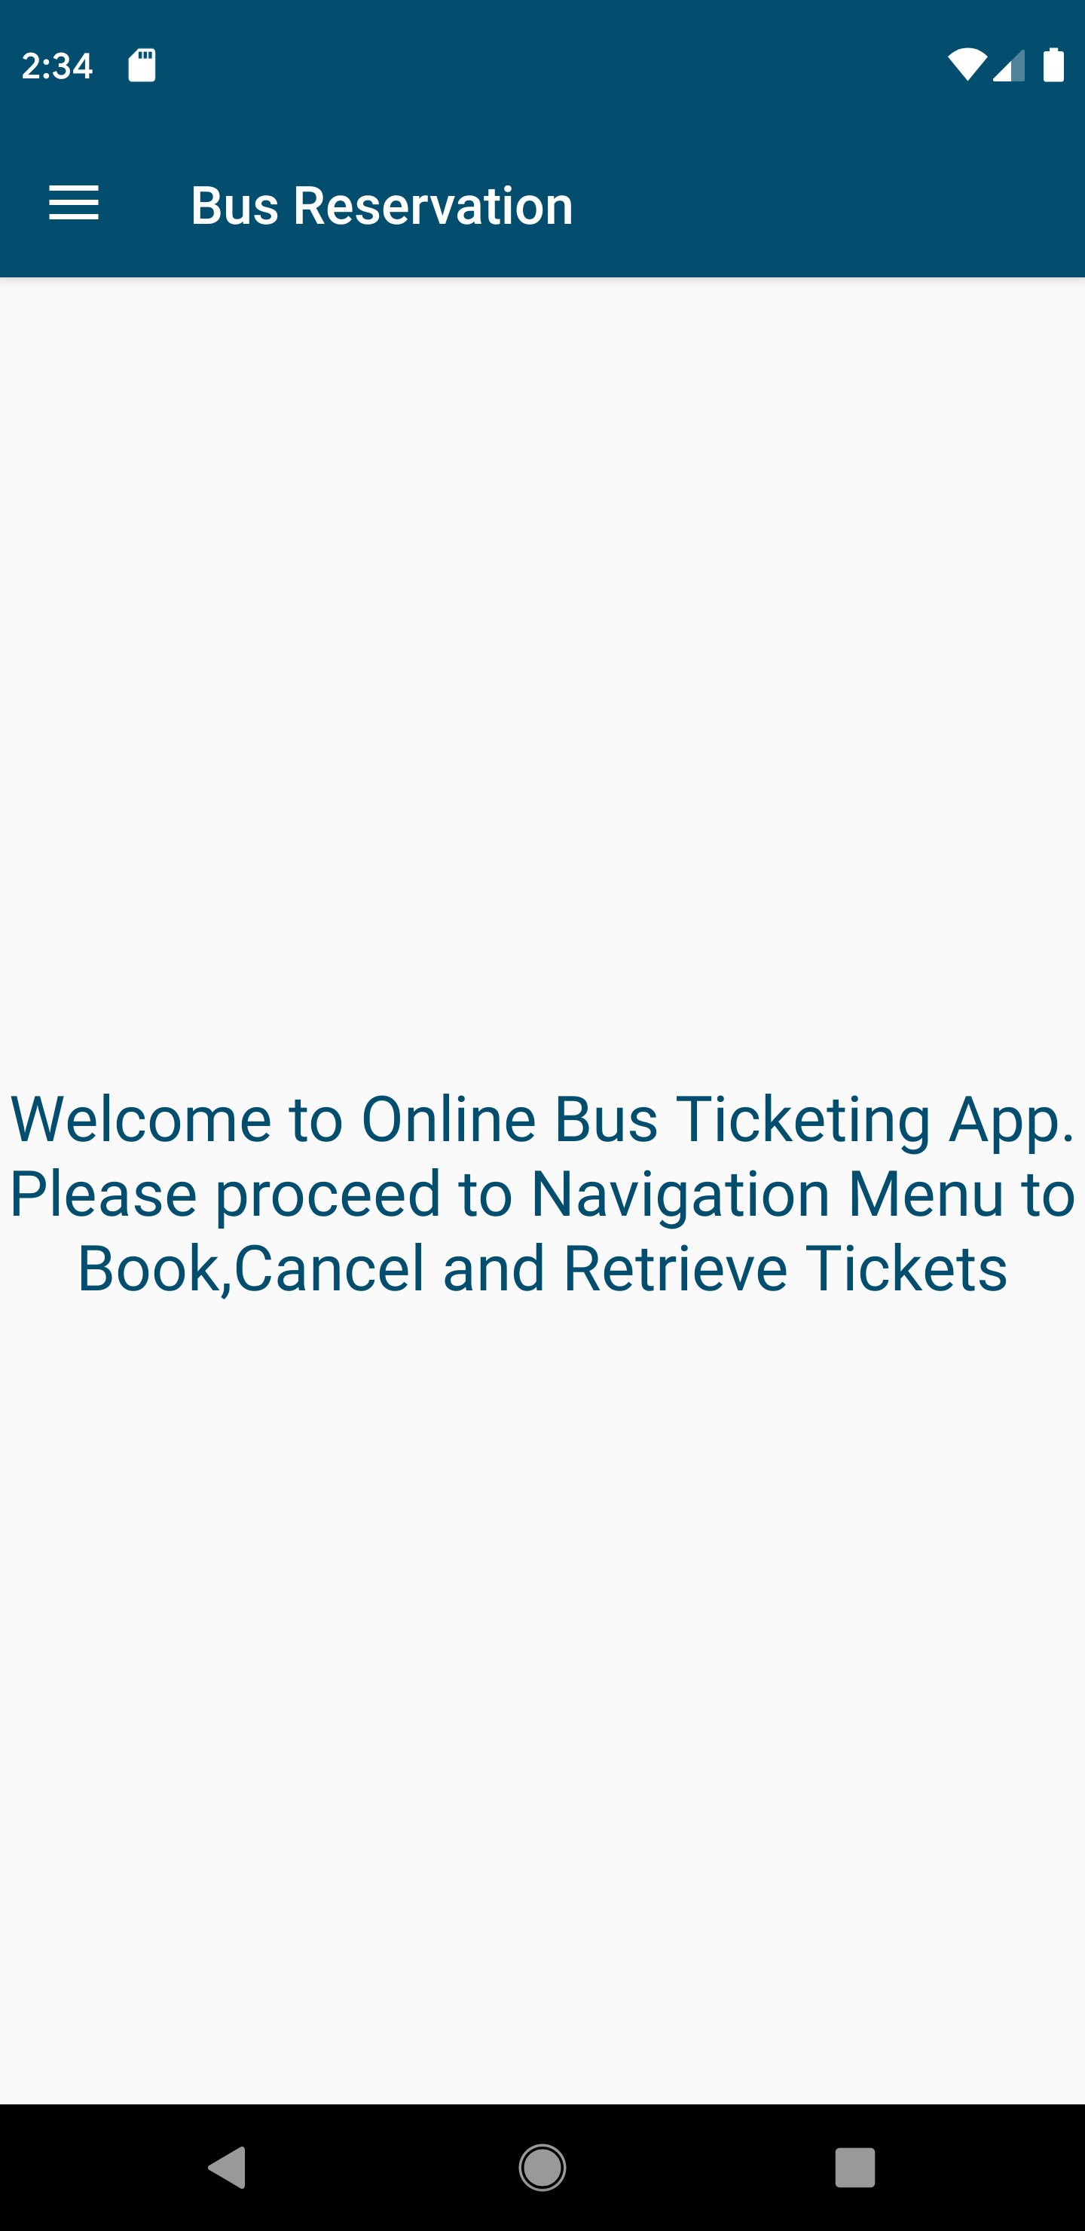
Home Page
After the successful login to the app user first enters into the Home page.

Slide 10
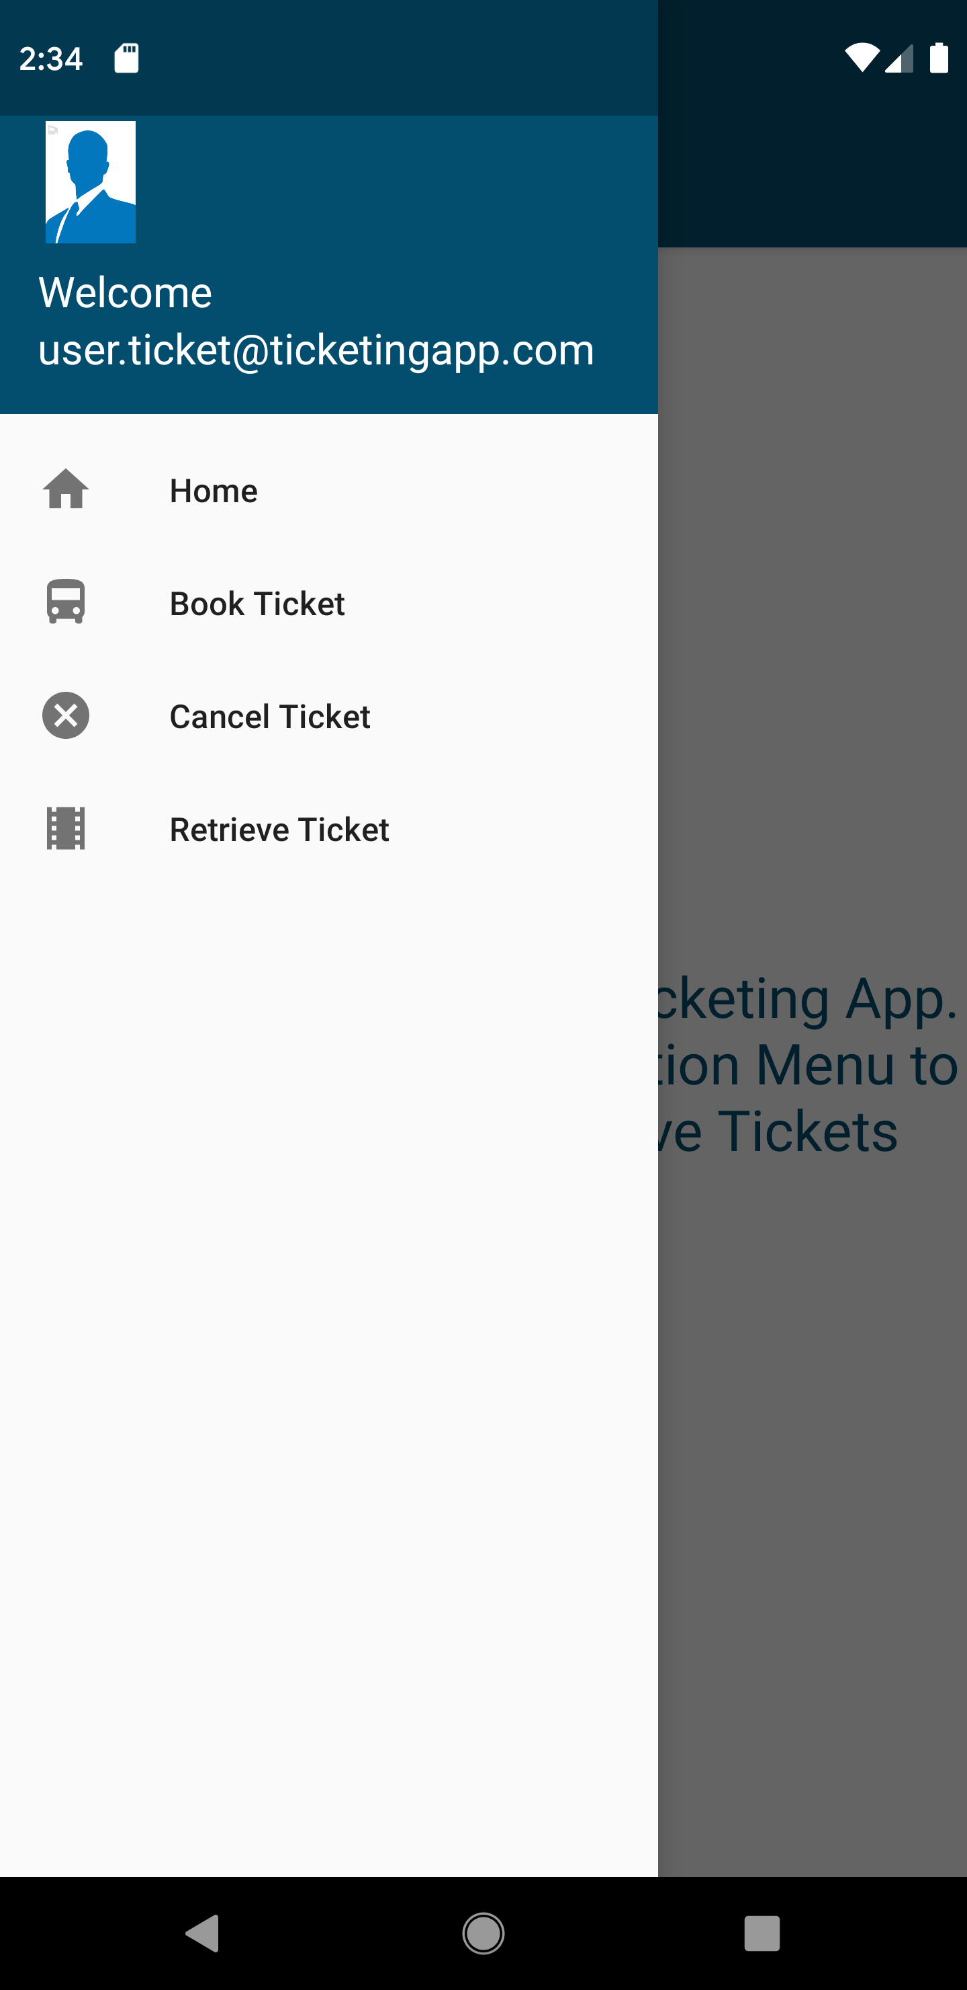
Navigation controls
User can navigate to the required page using the navigation drawer.
User can navigate to Home page, Book Ticket page, Retrieve Ticket page, Cancel Ticket page from any point while using the application

Slide 11
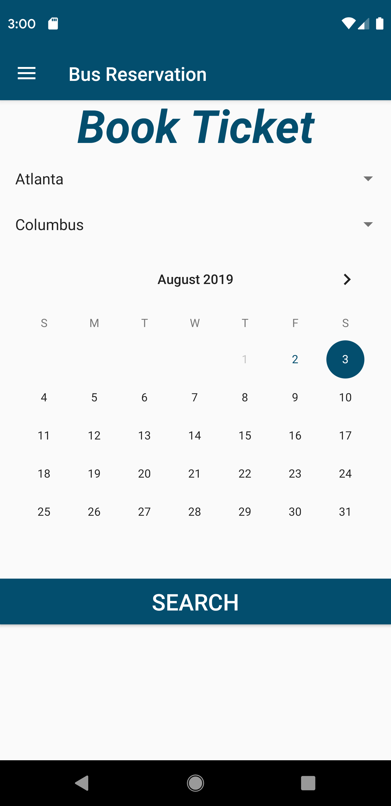
Book Ticket
User can book the ticket by providing the source, destination and date of journey.
Once the required information is provided, user needs to click on the search button to view the available buses on the route.

Slide 12
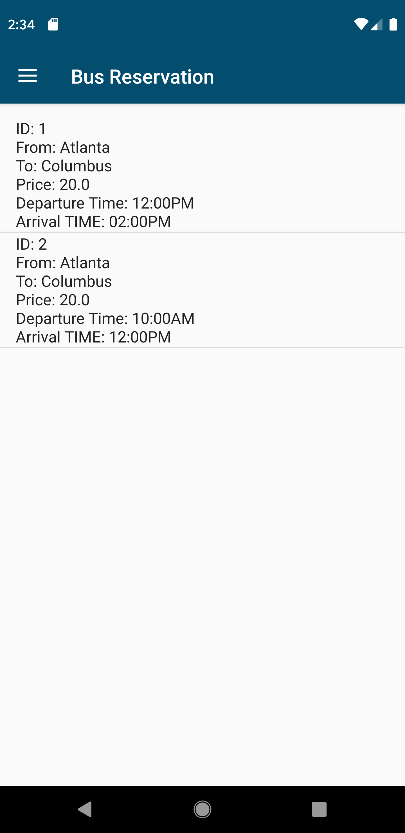
Available routes page
Once the user clicks the search button on the book ticket page, it will show the buses available for that routes with the details like from, to, departure time and arrival time.
User can select the bus from the list view depending on the price/departure time/arrival time

Slide 13
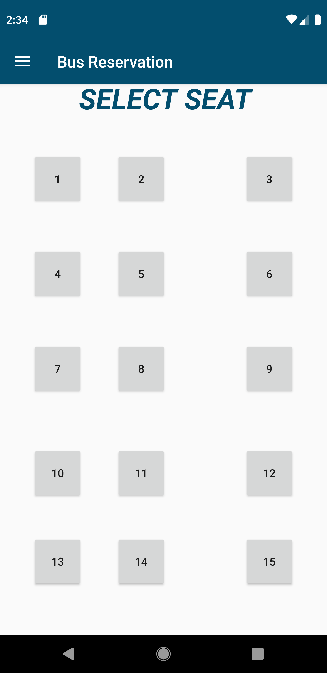
Seat layout
User has selected the required bus now the user needs to select the seat on the bus.
User can select bus and the seat will be greyed out and will not be available for the same bus and the same date.

Slide 14
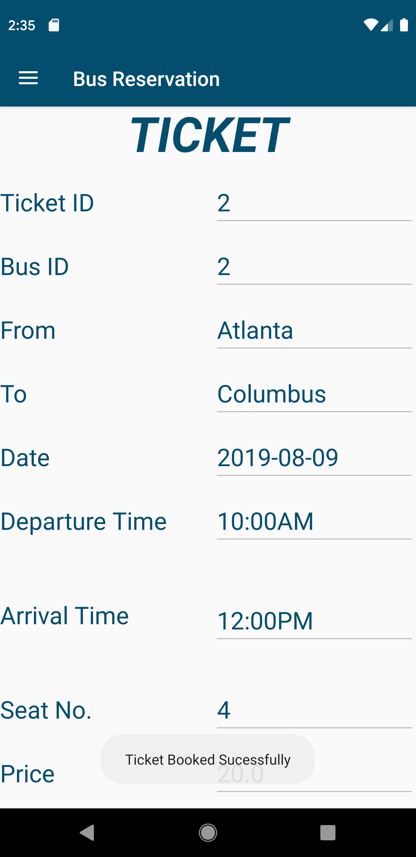
Ticket page
Once the seat has been choosen the ticket is successfully booked and it will navigate to the ticket page.
On the ticket page it will have information like ticket id, from, to, date, time, seat no and price.

Slide 15
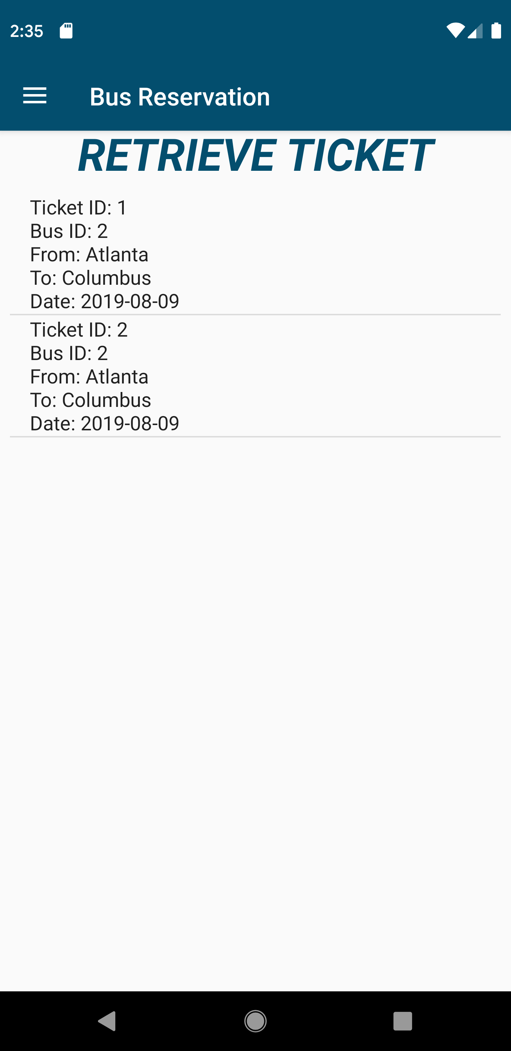
Retrieve Ticket
User can retrieve all the tickets which were booked by the user.
To go the ticket page to see the details user needs to select the required ticket so that it will show the details corresponding to that ticket

Slide 16
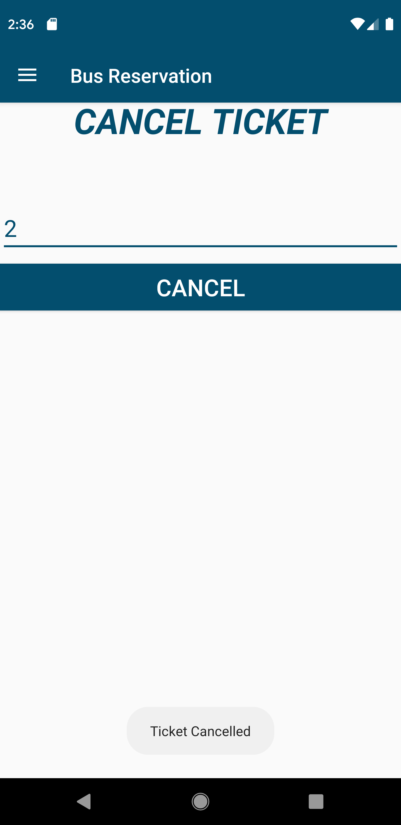
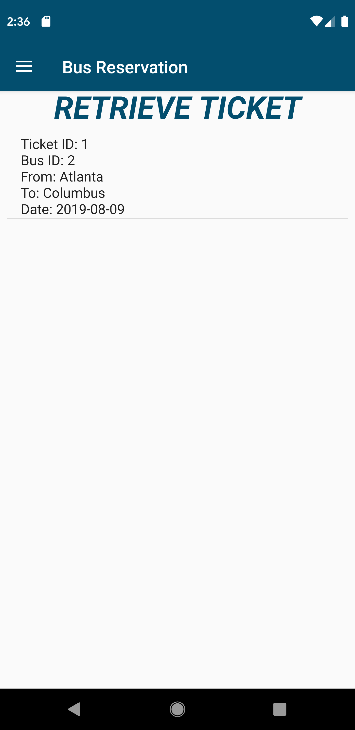
Cancel Ticket
User can cancel the ticket by providing the ticket id.
User needs to click on the cancel button to cancel the ticket successfully.

Slide 17
Thank you

