Slide 1


M.Tech/MCA Program
Advanced Industry Integrated Programs
Jointly offered by University and LTIMindTree
Review III
Claim Sense
RAG-Based Insurance Claims Adjudication & Policy Knowledge Assistant
S.K. Sricharan
T-SERIES ID: T9984
Knowledge partner | Implementation partner

Slide 2
Claim Sense: RAG-Based Insurance Claims Adjudication & Policy Knowledge Assistant
Introduction
Why claims adjudication needs help
Settling an insurance claim means reading the claim packet, finding the policy wording in force on the incident date, applying limits, waiting periods and exclusions, and working out the payable amount.
Done by hand this is slow and inconsistent, and a wrong rejection must be defended clause by clause.
What Claim Sense does
AI agents read the documents and retrieve the exact policy clauses (Retrieval-Augmented Generation).
A deterministic rules engine calculates the payable amount in exact decimal arithmetic.
Every recommendation goes to a human reviewer, with the evidence and an audit trail.
6
lines: health, motor, home, travel, personal accident, life
8
specialised agents in one supervised pipeline
72
synthetic claims analysed end to end
Live
deployed at claim-sense.onrender.com

Slide 3
Claim Sense: RAG-Based Insurance Claims Adjudication & Policy Knowledge Assistant
Objective
1
Understand claim documents
2
Ground decisions in policy text
3
Calculate exactly
Classify each uploaded document and extract facts with the file, line and confidence they came from.
Retrieve the clause from the wording in force on the incident date, and cite it in every finding.
Compute payable amounts with a Decimal rules engine; an LLM never does financial arithmetic.
4
Flag risk transparently
5
Keep people in control
6
Prove it works
Score fraud and risk with explainable rules: duplicates, early claims, amount mismatches, missing documents.
Route every claim to a review queue; approval limits, reviewer notes and a complete audit trail.
Hand-worked golden evaluation, automated tests in CI, and checks against the live deployment.

Slide 4
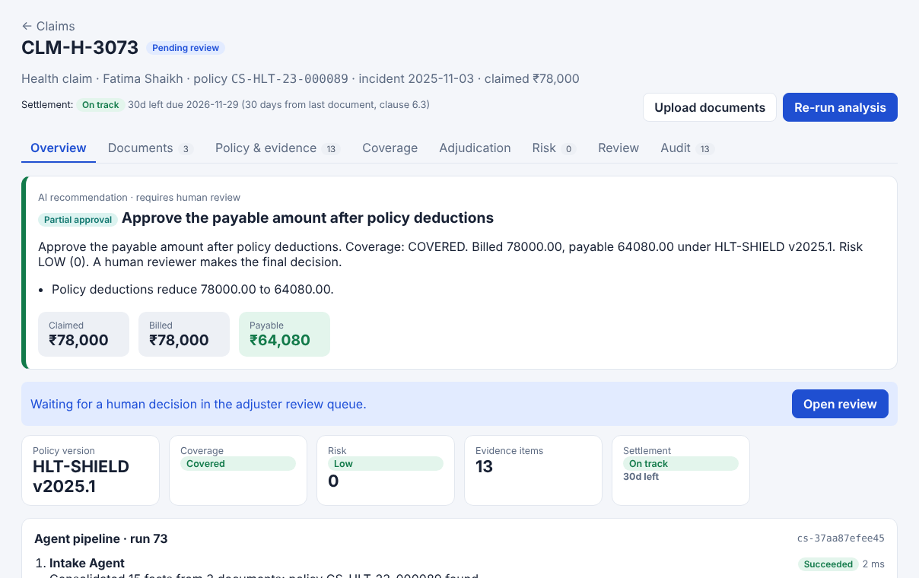
Claim Sense: RAG-Based Insurance Claims Adjudication & Policy Knowledge Assistant
Module 1 - Document Intelligence & Intake
From an uploaded claim packet to one consolidated claim view
Upload claim forms, bills, estimates and reports as text or PDF (page-preserving extraction with pypdf).
Each document is classified (14 types: discharge summary, repair estimate, loss assessment, death certificate ...).
Facts are extracted with their source file, line and confidence; itemised charges are categorised per line of business.
Text addressed to an AI inside a document is flagged for the reviewer and never followed.
A reviewer can correct a fact with a reason; the next analysis uses it and the change is audited.
Claim analysis screen: recommendation, amounts and evidence

Slide 5
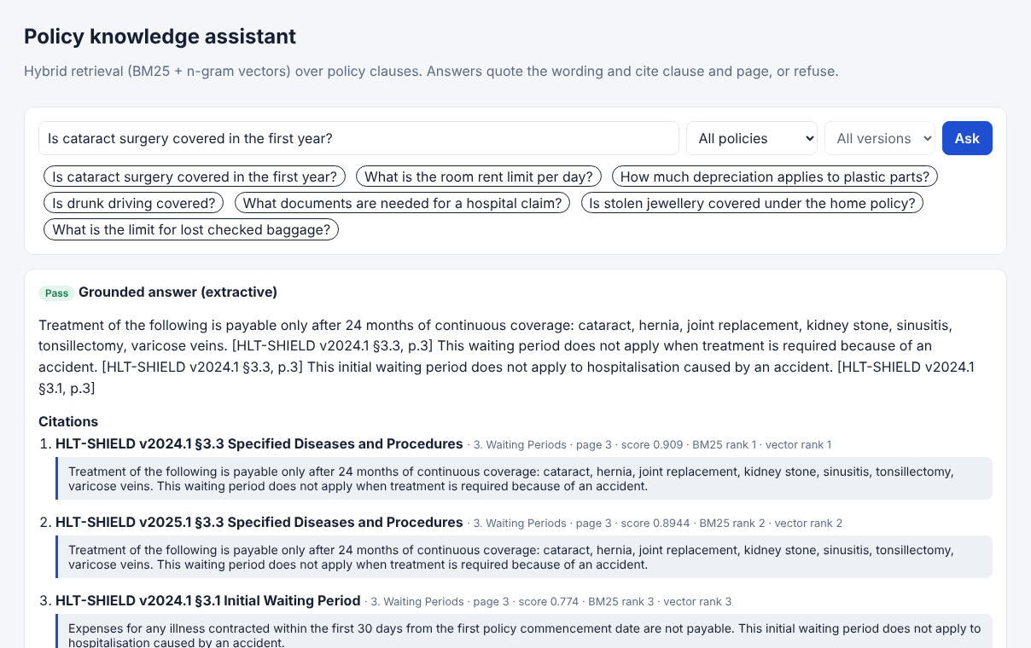
Claim Sense: RAG-Based Insurance Claims Adjudication & Policy Knowledge Assistant
Module 2 - Policy RAG & Knowledge Assistant
Find the right clause in the right version, or refuse
Policy wordings (Markdown or PDF) are parsed into clause-level chunks keeping page, section and clause number.
The wording version in force on the incident date is matched first (e.g. HLT-SHIELD 2024.1 vs 2025.1).
Hybrid retrieval: BM25 on stemmed words + TF-IDF on character n-grams, fused by reciprocal rank, with an insurance synonym map.
The assistant answers only from retrieved clauses with citations, and refuses when evidence is too weak.
PDF ingestion pipeline: validation, SHA-256 duplicate check, extraction, clause parsing, indexing.
Policy assistant: cited answer from the matched wording

Slide 6
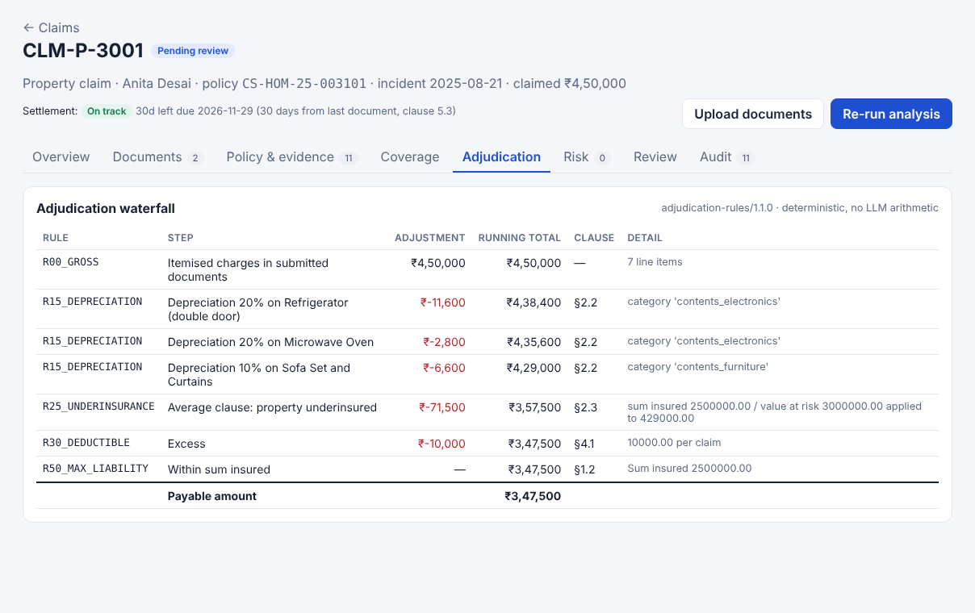
Claim Sense: RAG-Based Insurance Claims Adjudication & Policy Knowledge Assistant
Module 3 - Deterministic Adjudication Engine
A cited, step-by-step payment waterfall in exact decimal arithmetic
Health: room and ICU per-day limits, non-payable consumables, deductible, co-payment, sum insured cap.
Motor: depreciation by part type and vehicle age, deductible by engine size, cap at the insured declared value.
Home: depreciation and the average clause for underinsurance; travel: per-item and per-benefit limits.
Personal accident and life: a benefit schedule (% of the capital sum insured) and the sum assured.
Every step (R10-R99) names the policy clause it applies; terms citing a missing clause are rejected at ingestion.
Home claim waterfall with the average clause

Slide 7
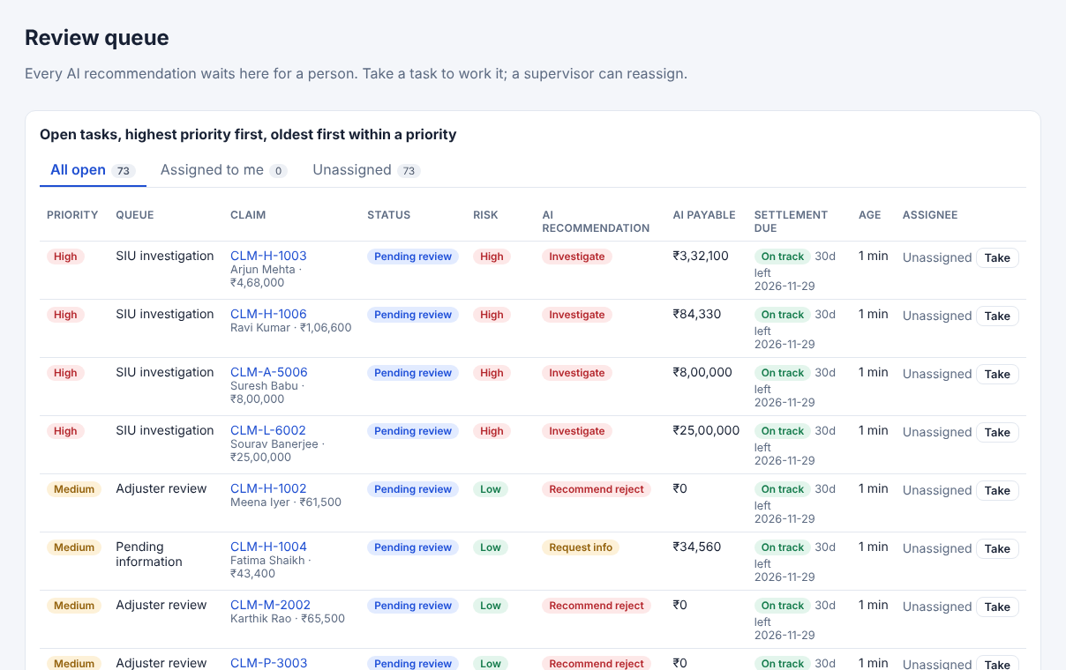
Claim Sense: RAG-Based Insurance Claims Adjudication & Policy Knowledge Assistant
Module 4 - Risk, Review & Audit
Explainable risk signals and a human decision on every claim
Rule-based risk score: duplicate, early claim, high amount ratio, amount or name mismatch, missing documents, life contestable period.
Recommendation: reject (cite clause), request information, investigate, partial approval or approve.
Routed to adjuster, supervisor, SIU investigation or pending-information queues with settlement-clock tracking.
Role-based access: approval limits, supervisor escalation, read-only auditors; adverse decisions need notes.
Settlement and repudiation letters, CSV export, dashboard and a full audit trail.
Review queue with risk, age and assignee

Slide 8
Claim Sense: RAG-Based Insurance Claims Adjudication & Policy Knowledge Assistant
Problem Statement
Build a claims decision-support system that reads a claim packet, finds the applicable clause in the policy version in force, calculates the payable amount exactly, flags risk, and hands a cited, auditable recommendation to a human who makes the decision.
Today's pain points
Four gaps the project closes
!
Manual and slow
!
Inconsistent outcomes
Handlers cross-check documents against long wordings with versions, sub-limits, waiting periods and exclusions.
The same claim can be settled differently by different handlers; rejections are hard to defend.
!
LLMs alone are unsafe
!
Fraud slips through
Generic chatbots invent clauses and do arithmetic unreliably: not acceptable for money or for regulators.
Duplicates, early claims and mismatched amounts need systematic, explainable signals.

Slide 9
Claim Sense: RAG-Based Insurance Claims Adjudication & Policy Knowledge Assistant
Methodology - System Architecture
Users
Adjuster
Supervisor
Auditor
Optional LLM
Writes the explanation narrative only. Off by default: answers are extractive. Never decides or calculates.
Presentation
React + TypeScript single-page app (Vite)
Dashboard · Claims · New claim · Review queue · Policy library · Assistant · Audit · Evaluation
API
FastAPI REST API /api/v1 · sign-in tokens and roles · security headers
Agent Supervisor
8 agents, tool calls logged, fails safely
Hybrid RAG
BM25 + char n-gram, version match
Rules Engine
Decimal waterfall with clause refs
Review & Letters
queues, SLA, letters, analytics
Delivery
One Docker image (UI built into the API). GitHub Actions CI. Live on Render; a verify-deployment workflow snapshots the live claims and runs the smoke test.
Services
Data
PostgreSQL / SQLite
claims, facts, runs, decisions, tasks, audit
Policy corpus
7 wordings + structured terms, PDF ingestion
Document storage
uploaded claim files
Source registry
SHA-256 provenance, RAG manifest

Slide 10
Claim Sense: RAG-Based Insurance Claims Adjudication & Policy Knowledge Assistant
Methodology - Claim Workflow
Upload
claim packet
0 Document
classify, extract
1 Intake
consolidate facts
2 Policy
version + RAG
3 Coverage
waiting, exclusions
8 Audit
record event
7 Review
route to queue
6 Evidence
recommendation
5 Risk
fraud signals
4 Adjudicate
Decimal waterfall
Human decision
approve, reject, ask, investigate
Letter + audit
settlement or repudiation
Recommendation rules (checked in order)
1. Not covered -> recommend reject, citing the failing clause
2. Missing documents -> request information
3. High risk score -> investigate (SIU queue)
4. Payable below claimed -> partial approval; otherwise approve
Any agent error stops the run safely and marks the claim for attention.

Slide 11
Claim Sense: RAG-Based Insurance Claims Adjudication & Policy Knowledge Assistant
Approach / Algorithms / Tools
Algorithms
Tools & Stack
Data & Evaluation
Hybrid retrieval: BM25 (weight 1.5) + TF-IDF over character 3-5 grams (weight 1.0), fused by weighted reciprocal rank
Policy version matching by incident date
Rules waterfall in Python Decimal, rounded to paise
Weighted risk rules: score 0-100, Low / Medium (25+) / High (50+)
Refusal below a minimum retrieval score
Python 3, FastAPI, SQLAlchemy, Pydantic
PostgreSQL (Docker Compose) and SQLite
pypdf for PDF text extraction
React, TypeScript, Vite
Docker, Render, GitHub Actions
pytest, Playwright, ruff
Synthetic only: 7 policy wordings across 6 lines
72 claim packets; 10,000-claim synthetic portfolio
Golden set: 72 claim cases + 30 questions, worked by hand
SHA-256 source registry; CAS Schedule P industry benchmark (not used in decisions)
CI fails on any failed check

Slide 12
Claim Sense: RAG-Based Insurance Claims Adjudication & Policy Knowledge Assistant
Findings and Results - Claims
72
₹2.22 Cr
₹1.62 Cr
986/986
claims across 6 lines
billed
recommended payable (72.9%)
golden checks passed
Recommendations
Partial approval: 33
Reject with cited clause: 25
Request information: 6
Investigate: 4 · Approve: 4
Every claim went to a human review queue; the system decided none. Every exclusion, waiting period and limit in the wordings is exercised by at least one claim.
Live site, 30 Oct 2026
The figures above are the live snapshot. They match the repository's prediction to the rupee, and the smoke test then filed and assessed one new claim on each line.

Slide 13
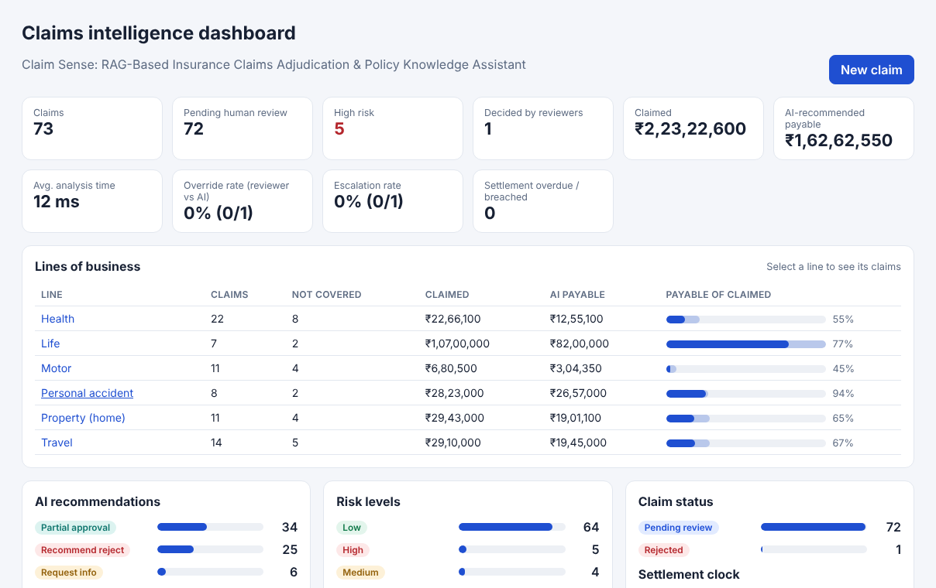
Claim Sense: RAG-Based Insurance Claims Adjudication & Policy Knowledge Assistant
Findings and Results - Quality and Deployment
Golden evaluation dimension | Checks passed
Retrieval correctness | 130/130
Citation correctness | 80/80
Groundedness | 156/156
Coverage state | 143/143
Adjudication amount | 182/182
Risk classification | 79/79
Workflow outcome | 216/216
Retrieval hit@1 100% · MRR 1.00
Refusals correct 100%
Risk rules on 10,000 synthetic claims: precision 90.1%, recall 78.3% (injected patterns only)
Claims dashboard: every tile, line and bar opens the matching claims
158 backend tests · 12 browser tests · live site checks passed (30 Oct 2026)

Slide 14
Claim Sense: RAG-Based Insurance Claims Adjudication & Policy Knowledge Assistant
Conclusion
What was achieved
Project complete: every item in the definition of done is met and verified on the live site.
A working, deployed claims decision-support system for health, motor, home, travel, personal accident and life insurance.
Retrieval-augmented, cited reasoning over versioned policy wordings, with refusal when evidence is weak.
Exact, explainable payable amounts: 986/986 hand-worked checks pass, and every step cites its clause.
People stay in charge: review queues, approval limits, reviewer notes, letters and a complete audit trail.
Limitations
Synthetic data only; the LLM narrative is not yet scored; no OCR for scanned images.
The free hosting tier restarts with the 72 seeded claims, so claims filed on the live site are not kept.
Future work
Ingest real IRDAI circulars after a licence review
Embedding retriever alongside BM25
OCR for scanned claim documents
Score LLM-written explanations sentence by sentence against cited clauses
Azure Container Apps deployment, single sign-on and an ML fraud model
Persistent database on a paid hosting tier

Slide 15
Claim Sense: RAG-Based Insurance Claims Adjudication & Policy Knowledge Assistant
Acknowledgement
I sincerely thank the University and LTIMindtree for the M.Tech Advanced Industry Integrated Program, and L&T EduTech for its support as implementation partner.
I am grateful to my project guide and mentors for their guidance, reviews and encouragement throughout this project, and to my family and friends for their constant support.
S.K. Sricharan · T-SERIES ID: T9984

Slide 16
Claim Sense: RAG-Based Insurance Claims Adjudication & Policy Knowledge Assistant
References
[1] P. Lewis et al., "Retrieval-Augmented Generation for Knowledge-Intensive NLP Tasks," Advances in Neural Information Processing Systems (NeurIPS), 2020.
[2] S. Robertson and H. Zaragoza, "The Probabilistic Relevance Framework: BM25 and Beyond," Foundations and Trends in Information Retrieval, vol. 3, no. 4, 2009.
[3] G. V. Cormack, C. L. A. Clarke and S. Buettcher, "Reciprocal Rank Fusion Outperforms Condorcet and Individual Rank Learning Methods," Proc. ACM SIGIR, 2009.
[4] Insurance Regulatory and Development Authority of India (IRDAI), Master Circulars on Health Insurance Business and on Protection of Policyholders' Interests, 2024. https://irdai.gov.in
[5] Casualty Actuarial Society, Loss Reserving Data Pulled From NAIC Schedule P (accident years 1998-2007), compiled for the CAS by S&P Global Market Intelligence. https://www.casact.org
[6] FastAPI documentation, https://fastapi.tiangolo.com · React documentation, https://react.dev · SQLAlchemy documentation, https://www.sqlalchemy.org
[7] Project source code: https://github.com/sricharansk/CLAIM-SENSE · Live application: https://claim-sense.onrender.com

