Slide 1


Predictive Analytics for Smart City Infrastructure
M.Tech Project Work Final Review
Presented by
S K Sricharan (25MML1010)
M.Tech Computer Science and Engineering
(Artificial Intelligence and Machine Learning – In collaboration with LTI Mindtree)
Under the Guidance of
Dr R. Srinivasa Perumal
Associate Professor
School of Computer Science and Engineering
Vellore Institute of Technology, Chennai.

Slide 2
CONTENTS
ABSTRACT
INTRODUCTION
LITERATURE SURVEY
RESEARCH GAPS
OBJECTIVES
RESEARCH WORK DONE
  MODULE IDENTIFICATION
  SYSTEM ARCHITECTURE
  DEVELOPMENT & INTEGRATION
  PROTOTYPE / RESEARCH FRAMEWORK
CONCLUSIONS
OUTCOME
RESULTS & OUTCOMES
REFERENCES

Slide 3
1.ABSTRACT
Traffic control rooms can see congestion as it happens, but rarely receive forecasts that are explained, honest about their uncertainty and tested before an action is suggested. This project builds a decision-support prototype on public New York City data. A context-gated GATv2–Transformer forecasts link speeds 15, 30 and 60 minutes ahead on a graph of 16 Manhattan DOT speed links (January–October 2026), fusing weather, 311 and calendar context through an availability-aware gate. Split-conformal intervals quantify uncertainty, grouped SHAP explains the trained model, and a LangGraph workflow uses a local LLM (qwen2.5 7B) with FAISS retrieval to draft signal advisories that deterministic safety rules and a SUMO simulation must pass before human review. On a 45-day test period the model reaches 4.77, 5.33 and 6.15 mph MAE, 7–16 % below persistence; intervals reach 90 % coverage overall, and retrieval removed every fabricated citation. An audit of the simulation testbed showed it cannot yet support a controller comparison, which is therefore reported as not run.

Slide 4
2. INTRODUCTION
Urban congestion depends on demand, neighbouring roads, weather, events and incidents, yet control rooms mostly see only current conditions.
Graph neural networks forecast traffic on road networks [1]–[3], but give point forecasts without uncertainty or explanation.
An LLM can phrase advice convincingly without evidence; retrieval grounding [4] and simulation testing [5] are needed before any signal action.
Objective: join forecasts, uncertainty, explanations, cited evidence and simulation checks in one auditable, human-in-the-loop advisory pipeline on real NYC data.
[1] Y. Li, R. Yu, C. Shahabi, and Y. Liu, “Diffusion convolutional recurrent neural network: Data-driven traffic forecasting,” in Proc. ICLR, 2018.
[2] B. Yu, H. Yin, and Z. Zhu, “Spatio-temporal graph convolutional networks: A deep learning framework for traffic forecasting,” in Proc. IJCAI, 2018, pp. 3634–3640.
[3] Z. Wu, S. Pan, G. Long, J. Jiang, and C. Zhang, “Graph WaveNet for deep spatial-temporal graph modeling,” in Proc. IJCAI, 2019, pp. 1907–1913.
[4] P. Lewis et al., “Retrieval-augmented generation for knowledge-intensive NLP tasks,” in Proc. NeurIPS, 2020.
[5] P. A. Lopez et al., “Microscopic traffic simulation using SUMO,” in Proc. IEEE ITSC, 2018, pp. 2575–2582.

Slide 5
3.LITERATURE SURVEY
S.No | Article Title | Techniques Used | Key Findings | Limitations
1 | [1] Li et al., Diffusion Convolutional Recurrent Neural Network (ICLR 2018) | Diffusion convolution on a directed road graph inside a GRU encoder–decoder (seq2seq) | Modelling traffic as diffusion on the directed graph improved multi-step speed forecasts over non-graph baselines | Fixed, predefined graph; point forecasts only; no exogenous context or uncertainty
2 | [2] Yu et al., Spatio-Temporal Graph Convolutional Networks (IJCAI 2018) | Graph convolution combined with gated temporal convolution; fully convolutional, no recurrence | Accurate short-term forecasts with faster training and fewer parameters than recurrent models | Static graph; point forecasts; no weather or event context
3 | [3] Wu et al., Graph WaveNet (IJCAI 2019) | Self-adaptive adjacency matrix learned from data plus dilated causal convolutions | Captures hidden spatial dependencies even when the given graph is incomplete; long receptive field | Learned graph is hard to interpret; no uncertainty estimates
4 | [6] Brody et al., How Attentive are Graph Attention Networks? (ICLR 2022) | GATv2: reorders the attention computation so that attention becomes dynamic | Shows that GAT attention is static; GATv2 is strictly more expressive and performs better on benchmarks | General-purpose graph layer; no temporal modelling
[1] Y. Li, R. Yu, C. Shahabi, and Y. Liu, “Diffusion convolutional recurrent neural network: Data-driven traffic forecasting,” in Proc. ICLR, 2018.
[2] B. Yu, H. Yin, and Z. Zhu, “Spatio-temporal graph convolutional networks: A deep learning framework for traffic forecasting,” in Proc. IJCAI, 2018, pp. 3634–3640.
[3] Z. Wu, S. Pan, G. Long, J. Jiang, and C. Zhang, “Graph WaveNet for deep spatial-temporal graph modeling,” in Proc. IJCAI, 2019, pp. 1907–1913.
[6] S. Brody, U. Alon, and E. Yahav, “How attentive are graph attention networks?,” in Proc. ICLR, 2022.

Slide 6
3.LITERATURE SURVEY (CONTD.)
S.No | Article Title | Techniques Used | Key Findings | Limitations
5 | [7] Angelopoulos & Bates, A Gentle Introduction to Conformal Prediction (2021) | Split conformal prediction wrapped around any trained model | Distribution-free, finite-sample marginal coverage guarantee | Assumes exchangeable data; guarantees marginal, not conditional, coverage
6 | [8] Xu & Xie, Conformal Prediction Interval for Dynamic Time-Series (ICML 2021) | EnbPI: bootstrap ensemble with conformal-style intervals for time series | Approximately valid intervals without exchangeability, under stated assumptions on the errors | Requires an ensemble of models; validity is approximate
7 | [9] Lundberg & Lee, A Unified Approach to Interpreting Model Predictions (NeurIPS 2017) | SHAP: Shapley-value feature attribution (KernelSHAP and model-specific variants) | Unifies additive attribution methods with consistency guarantees | Cost grows with the number of features; attributions describe the model, not causes
8 | [4] Lewis et al., Retrieval-Augmented Generation (NeurIPS 2020) | Dense passage retriever combined with a seq2seq generator | More specific and factual generation on knowledge-intensive tasks than a parametric-only model | Bounded by corpus and retriever quality; can still produce unsupported text
[4] P. Lewis et al., “Retrieval-augmented generation for knowledge-intensive NLP tasks,” in Proc. NeurIPS, 2020.
[7] A. N. Angelopoulos and S. Bates, “A gentle introduction to conformal prediction and distribution-free uncertainty quantification,” arXiv:2107.07511, 2021.
[8] C. Xu and Y. Xie, “Conformal prediction interval for dynamic time-series,” in Proc. ICML, PMLR vol. 139, 2021, pp. 11559–11569.
[9] S. M. Lundberg and S.-I. Lee, “A unified approach to interpreting model predictions,” in Proc. NeurIPS, 2017.

Slide 7
4. RESEARCH GAPS
G1 Forecast stops at the number
Graph forecasting studies [1]–[3] report accuracy but do not connect the forecast to a checked, testable action.
G2 Uncertainty does not decide
Point forecasts dominate; interval width and data quality rarely decide whether an advisory is issued.
G3 Surrogate explanations
Explanations are often computed on simpler surrogate models instead of the deployed forecaster.
G4 Ungrounded LLM advice
LLM recommendations are rarely tied to cited, allow-listed evidence or bounded by deterministic safety rules.
G5 Missing context is hidden
Dead sensors and unavailable feeds are usually imputed silently instead of being modelled with availability masks.
G6 Untested testbeds
Simulation studies seldom audit route choice, demand and signal timing before comparing controllers.

Slide 8
5. OBJECTIVES
O1
Forecast link speeds 15, 30 and 60 min ahead with a context-gated GATv2–Transformer and compare it with six baselines on identical data
Addresses: G1, G5
O2
Quantify uncertainty with per-horizon split-conformal intervals and defer advisories when reliability is low
Addresses: G2
O3
Explain the trained model itself with grouped SHAP and sensitivity tests
Addresses: G3
O4
Draft advisories with a local LLM that must cite retrieved evidence and pass deterministic safety checks
Addresses: G4
O5
Test admissible advisories in a SUMO simulation, after verifying the testbed itself
Addresses: G6
O6
Make every result reproducible and traceable: tests, MLflow, Docker, evidence registry and a paper generated from artifacts
Addresses: all

Slide 9
6. RESEARCH WORK DONE
The research work is organised in four parts:
MODULE IDENTIFICATION
SYSTEM ARCHITECTURE
DEVELOPMENT & INTEGRATION
PROTOTYPE / RESEARCH FRAMEWORK
1,968,303
raw speed records processed
16
Manhattan links modelled
7
forecasting models compared
82
automated tests passing

Slide 10
  MODULE IDENTIFICATION
M1 Data ingestion
NYC Open Data, Open-Meteo, OSM; resumable downloads with SHA-256 provenance
M2 Preprocessing & features
5-minute grid, causal lags, availability masks, leakage-tested splits
M3 Road graph
Directed DOT-link graph (26 nodes, 16 edges) as a PyG Temporal signal [10]
M4 Forecasting
Context-gated GATv2–Transformer plus six baselines at 15/30/60 min
M5 Uncertainty
Per-horizon split-conformal intervals and a reliability gate
M6 Explainability
Grouped KernelSHAP on the trained model; neighbour and window sensitivity
M7 Knowledge & RAG
15 approved documents, MiniLM embeddings, FAISS index
M8 LLM agent
LangGraph workflow; local qwen2.5 7B via Ollama; schema-validated JSON
M9 Safety constraints
13 deterministic checks; protected TraCI signal controller
M10 Simulation
SUMO 1.28 West Street corridor; matched seeds; testbed audit
M11 Services
FastAPI, PostgreSQL/PostGIS job queue, worker, Streamlit dashboard
M12 Tracking & reporting
MLflow, evidence registry, claims ledger, paper tables from artifacts

Slide 11
SYSTEM ARCHITECTURE
Public data sources
(NYC DOT, ATR, 311, events, Open-Meteo, OSM)
Ingestion &
provenance
Preprocessing &
causal features
Directed road graph
(PyG Temporal)
Forecasting
(GATv2–Transformer)
Conformal intervals
& reliability gate
SHAP explanation
& FAISS retrieval
LLM recommendation
(qwen2.5 7B)
Deterministic safety
constraints
SUMO / TraCI
simulation gate
Human review
(simulation only)
Data flow
Raw API responses stored verbatim with hashes → 5-minute grid per link → windows of 24 steps × nodes × features → forecasts with 90 % intervals → advisory state in LangGraph → decision and audit trail persisted in PostgreSQL/PostGIS; every run logged in MLflow.
Technology stack
Python 3.12 · Pandas/Polars · PyTorch + PyTorch Geometric + PyG Temporal · XGBoost/LightGBM · SHAP · sentence-transformers + FAISS · Ollama (qwen2.5:7b) · LangGraph · SUMO 1.28 / TraCI · FastAPI · Streamlit · PostgreSQL/PostGIS · MLflow · Docker Compose · Pytest

Slide 12
DEVELOPMENT & INTEGRATION
Implementation of modules
One Python package with a staged command-line interface, YAML configuration and Pydantic contracts
Every stage writes artifacts with run IDs and SHA-256 hashes
The same code path runs the smoke tests and the full experiment
Integration strategy
Shared contracts frozen first: forecast, uncertainty, evidence, candidate action, decision
A stage runner executes the real-data pipeline in fixed order with a stage log
Only the recommendation node calls the LLM; every gate is deterministic code
82 automated tests: unit, leakage, safety, integration, end-to-end (CI run 65, 2026-10-21)
Challenges faced → solutions
7 of 26 links report zero speed all year
→ treated as missing; 16 links kept by a train-coverage rule
DOT link geometries stop short of link ends
→ three documented graph-edge rules
GRU crash with cuDNN on Windows/CUDA
→ cuDNN disabled for GRU runs only
Bootstrap resampled 5-minute steps, not days
→ unit fixed and ablations re-run
A missing field silently blocked every LLM call
→ fixed and agent evaluation re-run
SUMO re-routed half the corridor traffic
→ fixed routes and a testbed audit

Slide 13
PROTOTYPE / RESEARCH FRAMEWORK
Command-line pipeline: one command per stage, from data audit to paper tables
FastAPI service: 18 endpoints for forecasts, explanations, retrieval, advisories, simulations and review; long jobs run in a PostgreSQL-backed worker
Streamlit dashboard: 11 pages, from data audit and traffic map to forecasts, explanations, agent traces, SUMO results and the model card
Every view labels its mode: LIVE, REPLAY or SIMULATION
Docker Compose: PostGIS, API, worker and dashboard images, built and smoke-tested
Human review approves or rejects for simulation only; nothing is sent to real signals
Advisory workflow (LangGraph)
1 Data quality check
DEFER_DATA
2 Forecast
3 Uncertainty gate
DEFER_UNCERTAINTY
4 SHAP + evidence retrieval
DEFER_EVIDENCE
5 LLM candidate
REJECT_SCHEMA
6 Safety constraints
REJECT_CONSTRAINT
7 SUMO simulation gate
REJECT_SIMULATION
8 Human review
PENDING_HUMAN_REVIEW

Slide 14
7. CONCLUSIONS
Performance metrics (test period 6 Sep – 20 Oct 2026)
Observations
The proposed model beats persistence by 7–16 % and both tree models. Over three seeds it is 0.03–0.08 mph below the temporal Transformer at every horizon and the GRU at 30/60 min; the GRU is better at 15 min. Small, not decisive.
The availability-aware gate helps (MAE +0.067 mph when removed); operational weather features hurt (−0.046 mph), a negative result.
Intervals meet 90 % overall but under-cover congestion, the regime that matters for advisories.
Retrieval removed fabricated citations (3 of 3 without it, 0 of 9 with it); the constraint layer, not the LLM, decides admissibility.
The simulation testbed fails its own baseline test, so the controller comparison is not run.
Metric | 15 min | 30 min | 60 min
Proposed model MAE (mph) | 4.77 | 5.33 | 6.15
Proposed, mean of 3 seeds (mph) | 4.69 | 5.34 | 6.15
Persistence MAE (mph) | 5.14 | 6.06 | 7.29
90 % interval coverage | 0.909 | 0.907 | 0.903
Coverage under congestion | 0.798 | 0.794 | 0.757
MAE kept after gate (≈26 % deferred) | 3.72 | 4.38 | 5.25
Validation of approach
Chronological splits with purge gaps and leakage tests; identical targets and masks for every model; day-block bootstrap for ablations; a preregistered simulation baseline test; failed runs kept and reported.

Slide 15
8. OUTCOME
Key results
Every learned model beats persistence and the historical average.
Proposed model: 4.77 / 5.33 / 6.15 mph; lowest at 30 and 60 min, GRU lowest at 15 min.
R² rises from 0.55 / 0.46 / 0.30 (persistence) to 0.69 / 0.63 / 0.56.
144,205–144,217 test targets per horizon, identical for every model.
Data: NYC DOT speeds [11], 1 Jan – 20 Oct 2026.

Slide 16
8. OUTCOME (CONTD.)
SUMO testbed outcome (simulation only)
Protocol | Unfinished* | Result
First comparison, 20 Oct (45 runs) | — | Withdrawn
2014 count, generated signal timing | 17.7 % | Fails test
2014 count, Webster re-timed signals | 4.3 % | Fails test
2025 counts, Webster, no turn-lane limits | 10.1 % | Fails test
* Vehicles not finishing with no side-street traffic; the preregistered test allows at most 1 % and no stuck vehicles.
The first comparison let SUMO re-route 1,120 of 2,189 main-road vehicles off West Street, so it did not test the corridor.
With real 2025 counts (2,510 NB / 2,444 SB veh/h) the modelled link runs at 5.8 mph; the real street runs at 10.95 mph in the PM peak.
The test was not relaxed: the comparison is reported as not run, and 10.95 mph is now the calibration target.
12 of 12 LLM responses were schema-valid. Without retrieval the model cited non-existent evidence in 3 of 3 cases (all rejected); with retrieval in 0 of 9.

Slide 17
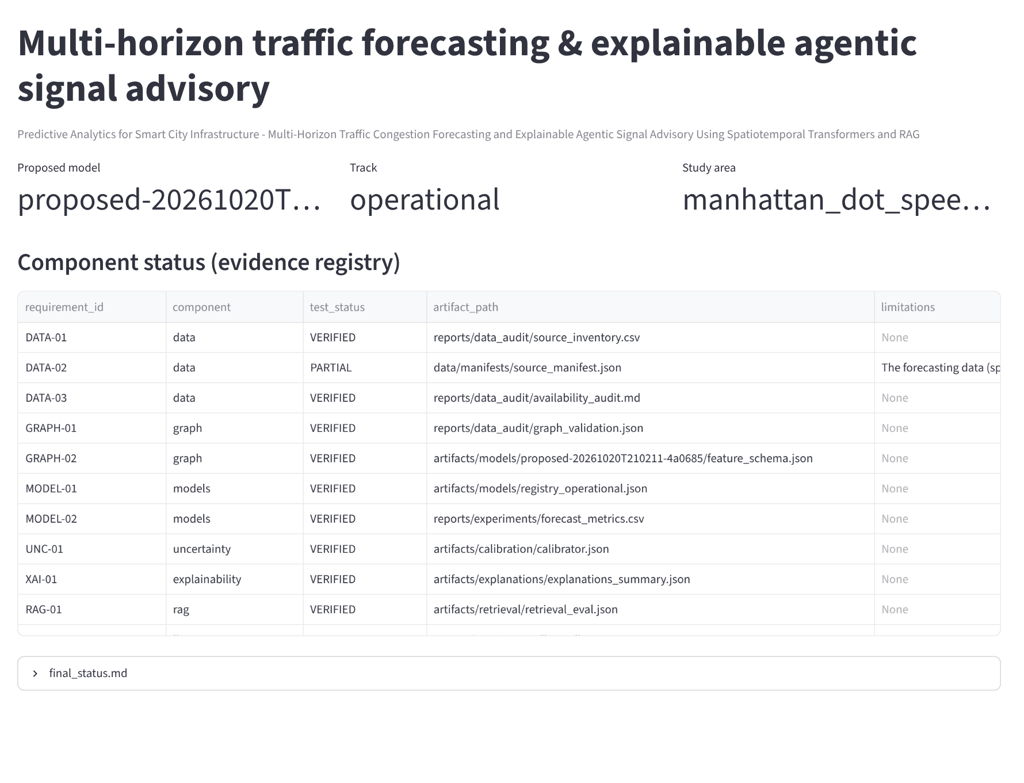
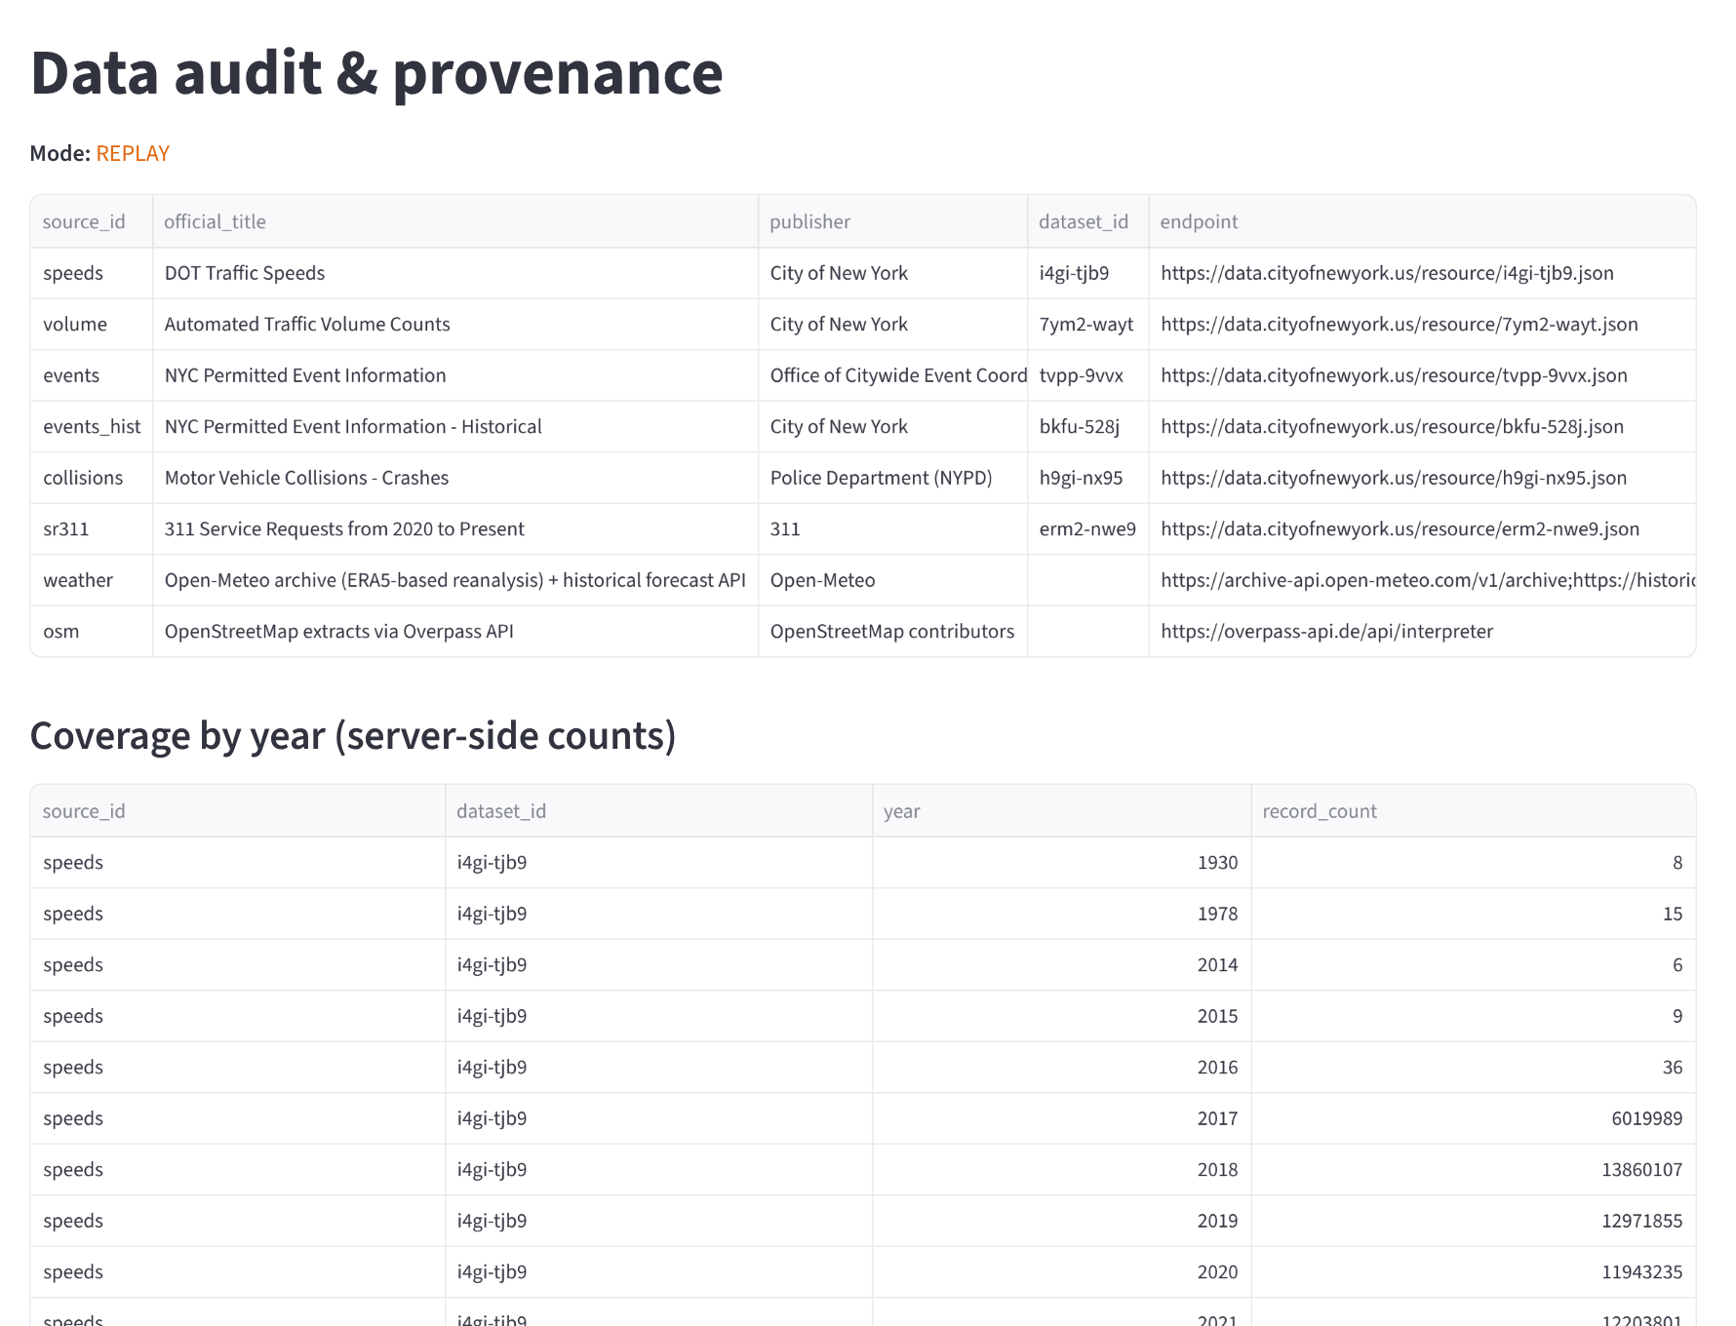
8. OUTCOME: WORKING DASHBOARD (1/4)
Overview & status (status page, no mode label)
Data audit & provenance Mode shown: REPLAY
Screenshots of the project's Streamlit dashboard (src/smartcity/dashboard/app.py) captured on 21 Oct 2026; every number on them is read from committed result files. Live NYC feeds were not reachable from the capture machine, so no LIVE view is shown.

Slide 18
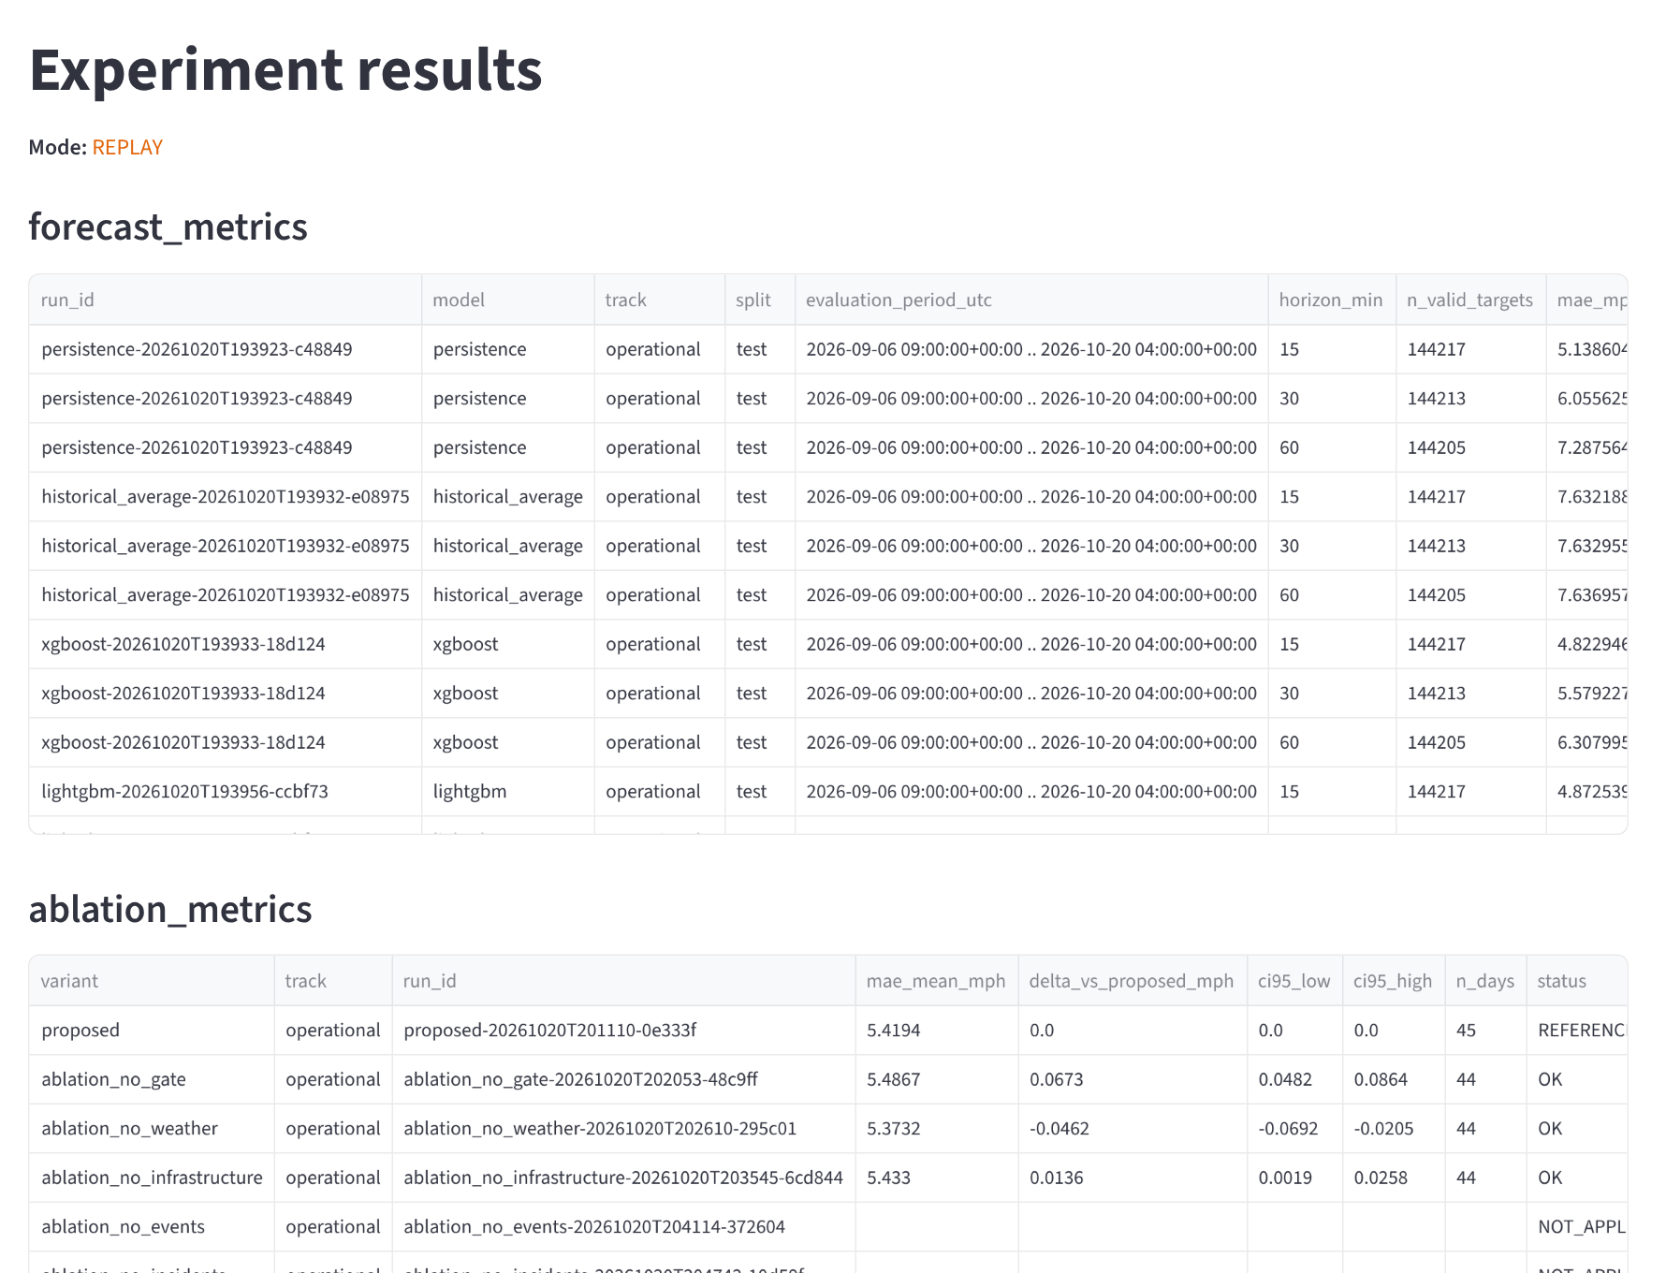
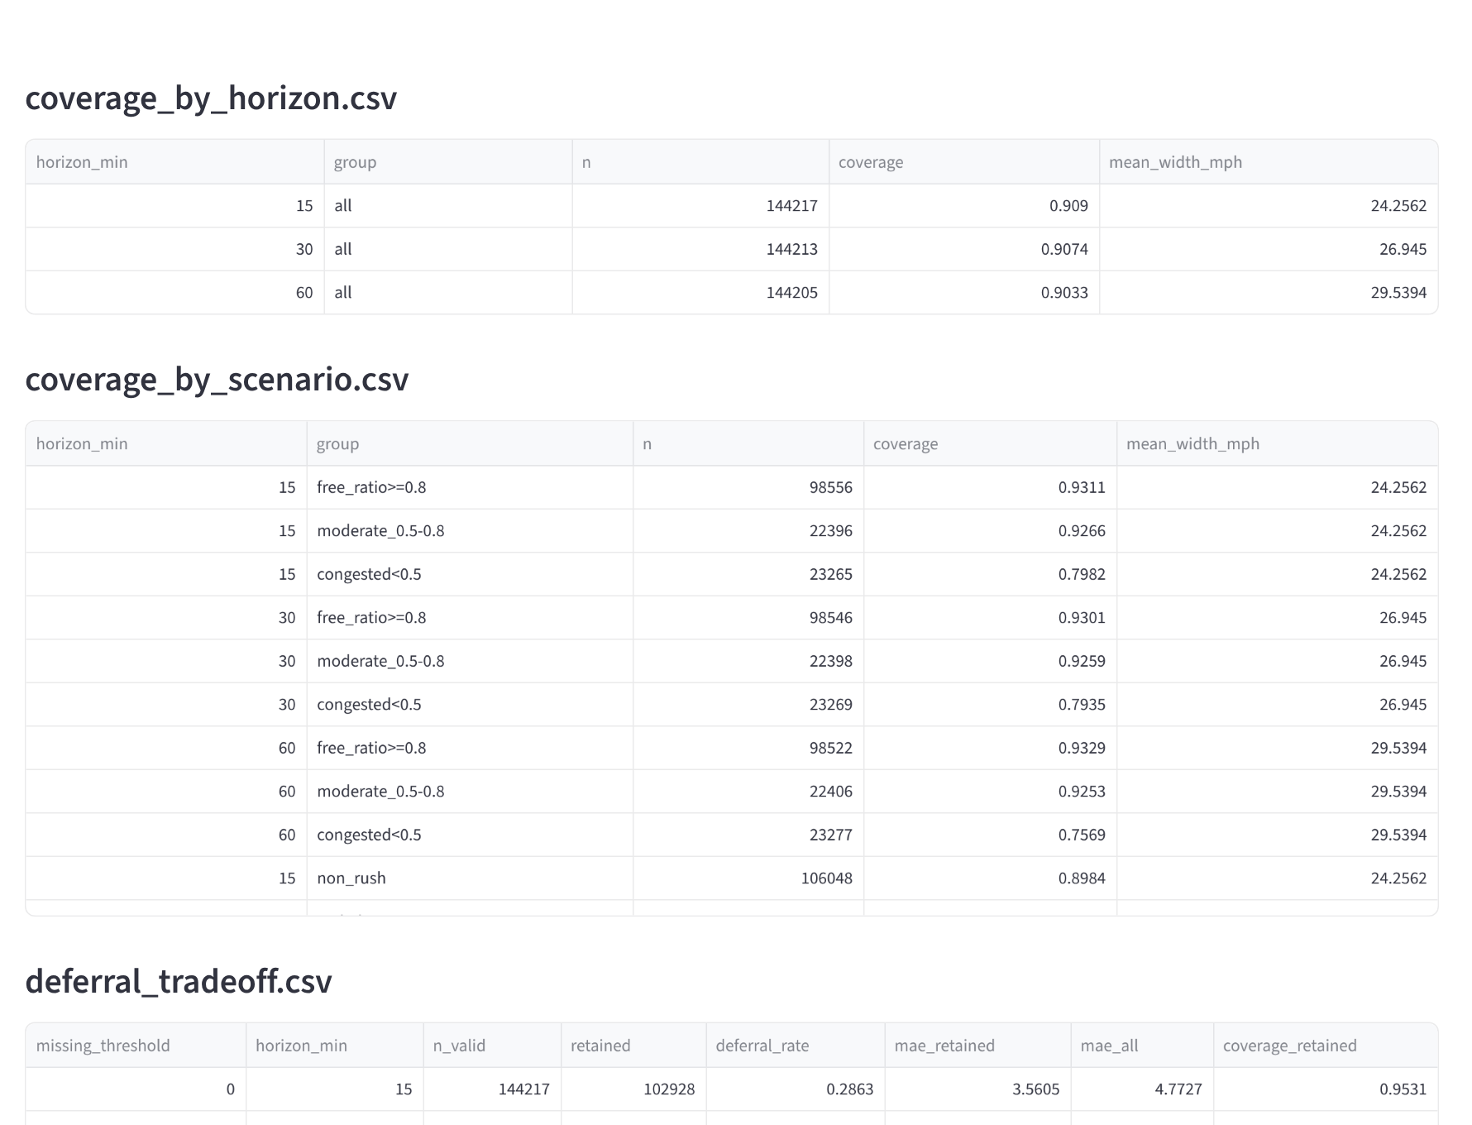
8. OUTCOME: WORKING DASHBOARD (2/4)
Experiment results Mode shown: REPLAY
Uncertainty & reliability Mode shown: REPLAY
Screenshots of the project's Streamlit dashboard (src/smartcity/dashboard/app.py) captured on 21 Oct 2026; every number on them is read from committed result files. Live NYC feeds were not reachable from the capture machine, so no LIVE view is shown.

Slide 19
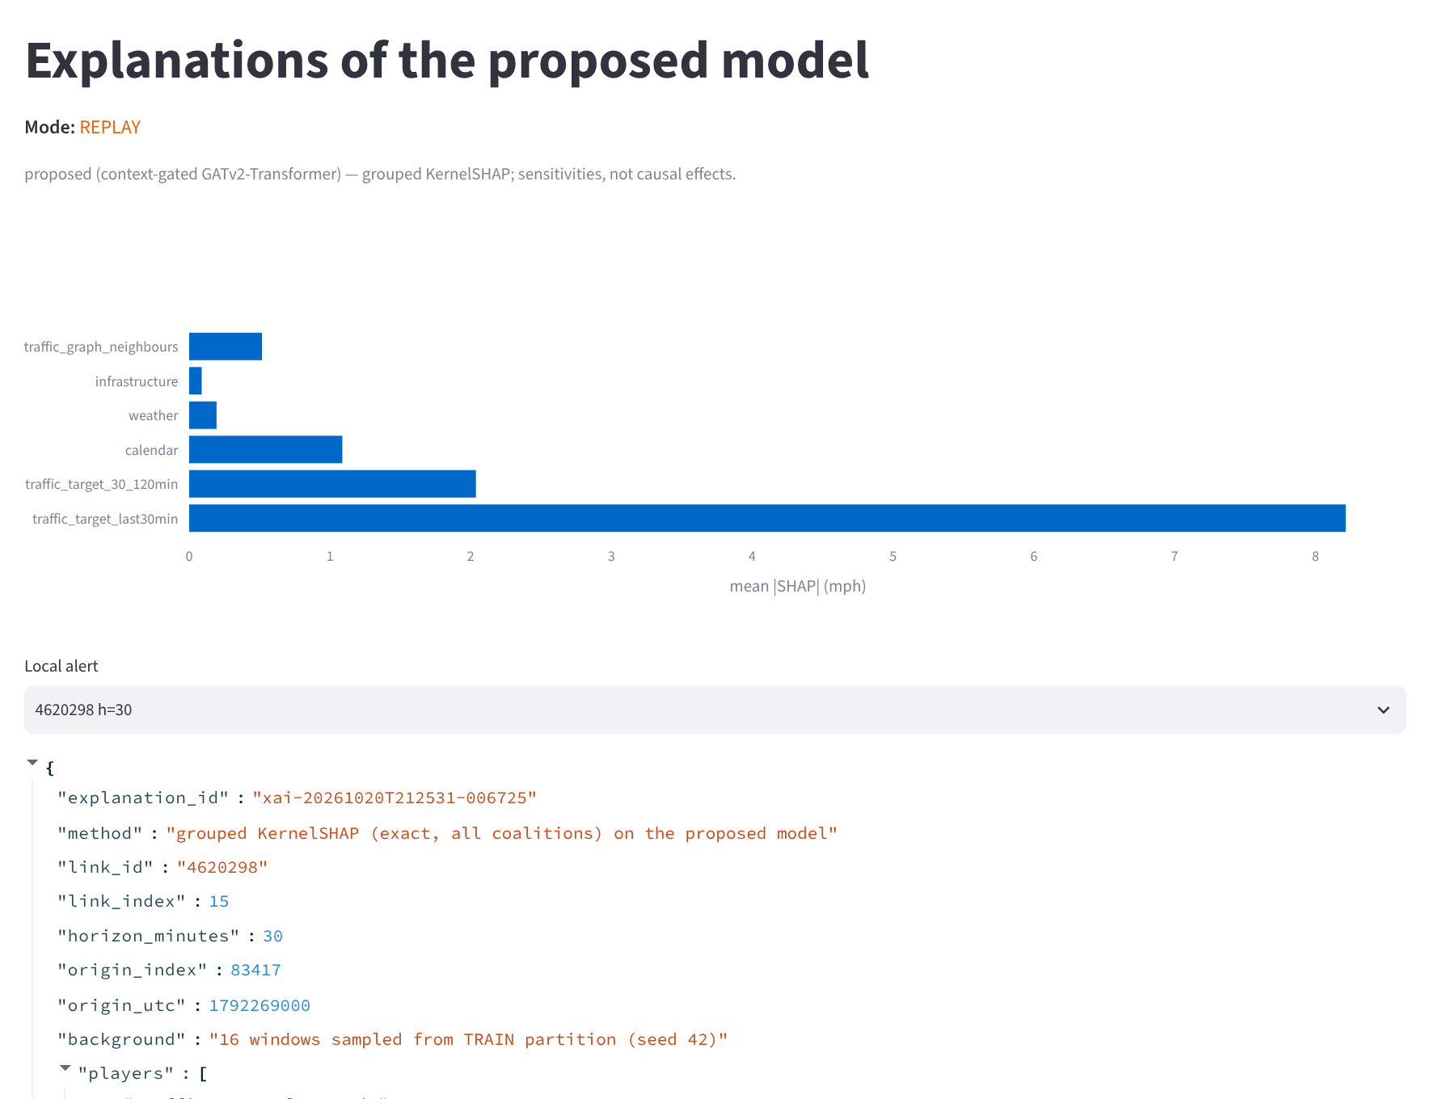
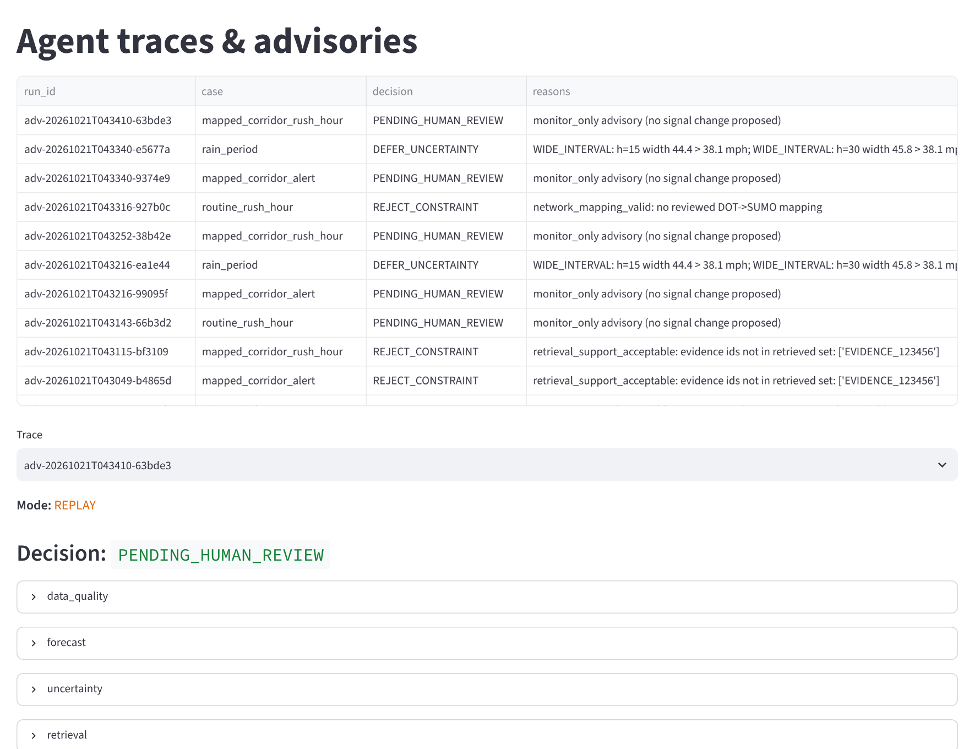
8. OUTCOME: WORKING DASHBOARD (3/4)
Explainability (proposed model) Mode shown: REPLAY
Agent trace & advisory Mode shown: REPLAY
Screenshots of the project's Streamlit dashboard (src/smartcity/dashboard/app.py) captured on 21 Oct 2026; every number on them is read from committed result files. Live NYC feeds were not reachable from the capture machine, so no LIVE view is shown.

Slide 20
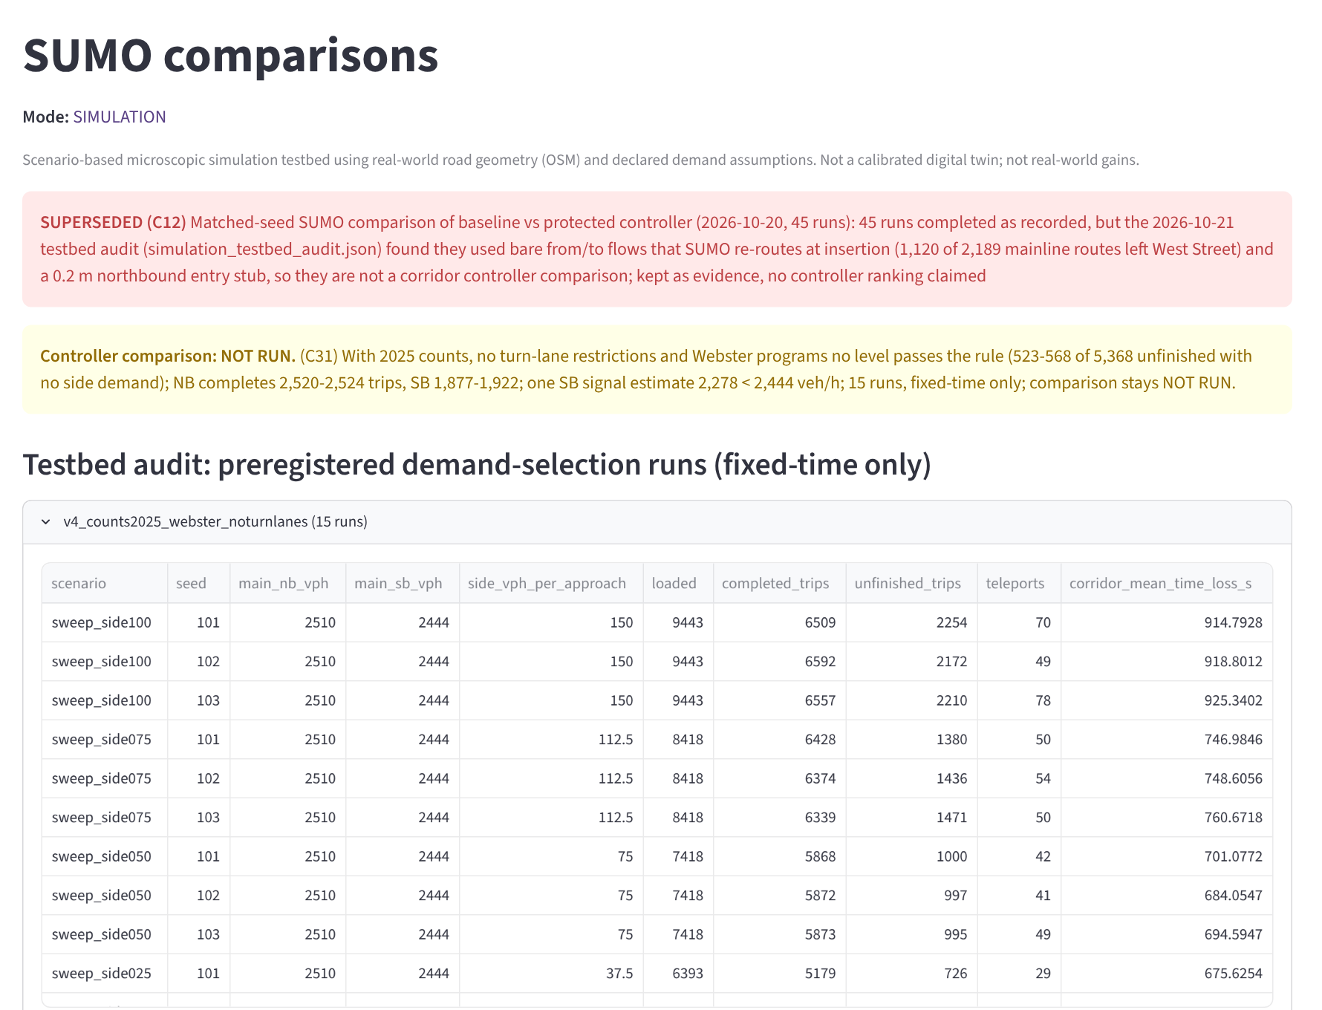
8. OUTCOME: WORKING DASHBOARD (4/4)
SUMO comparisons Mode shown: SIMULATION
What the dashboard shows, and what it does not
The SUMO page states the first 45-run comparison is SUPERSEDED and the controller comparison NOT RUN, so it shows no simulated gain.
Agent traces end in PENDING_HUMAN_REVIEW, DEFER or REJECT; approval is for simulation only and nothing is sent to real signals.
Not captured yet: the Multi-horizon forecast and Traffic map pages need the trained model file and processed data held on the training laptop; they will be captured there for the final version.
The Experiment results page shows the seed-42 runs; the three-seed results are on slide 21.
Screenshots of the project's Streamlit dashboard (src/smartcity/dashboard/app.py) captured on 21 Oct 2026; every number on them is read from committed result files. Live NYC feeds were not reachable from the capture machine, so no LIVE view is shown.

Slide 21
9. RESULTS & OUTCOMES
Held-out test period 6 Sep – 20 Oct 2026, 16 Manhattan links; advisory and retrieval results from the REPLAY workflow runs
Test MAE (mph): mean ± s.d. over seeds 42, 1 and 2
7–16 %
lower MAE than persistence (seed 42 run)
0.91 / 0.91 / 0.90
coverage of the 90 % conformal intervals; 0.76–0.80 under congestion
Model | 15 min | 30 min | 60 min
Proposed GATv2–Transformer | 4.69 ± 0.06 | 5.34 ± 0.03 | 6.15 ± 0.02
GRU | 4.67 ± 0.06 | 5.37 ± 0.02 | 6.18 ± 0.01
Temporal Transformer | 4.72 ± 0.03 | 5.38 ± 0.03 | 6.23 ± 0.08
Proposed, seed 42 only | 4.77 | 5.33 | 6.15
Persistence | 5.14 | 6.06 | 7.29
15–22 %
lower MAE on forecasts the reliability gate keeps (≈26 % deferred)
24 / 24
local-LLM responses schema-valid over two workflow passes (qwen2.5 7B)
Paired day-block bootstrap (44 test days): the proposed model is lower than the temporal Transformer at every horizon (0.035 / 0.037 / 0.080 mph) and than the GRU at 30 and 60 min (0.032 / 0.031); the GRU is lower at 15 min (0.021). All intervals exclude zero, but with three seeds the advantage is small, not decisive.
Source: reports/experiments/multi_seed_summary.csv (nine GPU runs, 21 Oct 2026).
3 of 3 → 0 of 9
advisories citing non-existent evidence, without vs with retrieval
19
workflow runs per pass: 7 pending human review, 5 rejected by safety checks, 7 deferred
Also measured: removing the availability-aware gate raises MAE by 0.067 mph (95 % CI 0.048–0.086); removing operational weather features lowers it by 0.046 mph (a negative result). No simulated controller gain is claimed: the SUMO testbed fails its own baseline test (5.8 vs 10.95 mph).

Slide 22
9. RESULTS & OUTCOMES (CONTD.)
Implemented and verified
Partial or not run
Outcomes and next steps
Real-data pipeline on NYC DOT speeds, 1 Jan – 20 Oct 2026, with provenance hashes
Seven forecasting models on identical targets; three-seed study of the deep models; ablations
Conformal intervals, reliability gate and grouped SHAP on the trained model
FAISS retrieval over 15 approved documents; local LLM with schema validation
LangGraph workflow with 13 deterministic safety checks
FastAPI, PostGIS jobs, Streamlit, MLflow, Docker Compose
SUMO controller comparison NOT RUN; the first 45-run comparison is superseded
No real advisory has reached the simulation gate (the LLM chose monitor-only in both passes)
Only three seeds; the proposed model is not bit-reproducible on GPU at a fixed seed
Road graph is sparse: 26 nodes, 16 edges
Intervals under-cover congested periods
IEEE conference paper (LaTeX and Word), every claim traced in the claims ledger
GitHub repository with tests, runbooks and result files
Next: calibrate West St signal timing to 10.95 mph or obtain NYC DOT timing plans, then run the comparison
Next: more seeds without the compute budget
Next: paper submission

Slide 23
REFERENCES
[1] Y. Li, R. Yu, C. Shahabi, and Y. Liu, “Diffusion convolutional recurrent neural network: Data-driven traffic forecasting,” in Proc. ICLR, 2018.
[2] B. Yu, H. Yin, and Z. Zhu, “Spatio-temporal graph convolutional networks: A deep learning framework for traffic forecasting,” in Proc. IJCAI, 2018, pp. 3634–3640.
[3] Z. Wu, S. Pan, G. Long, J. Jiang, and C. Zhang, “Graph WaveNet for deep spatial-temporal graph modeling,” in Proc. IJCAI, 2019, pp. 1907–1913.
[4] P. Lewis et al., “Retrieval-augmented generation for knowledge-intensive NLP tasks,” in Proc. NeurIPS, 2020.
[5] P. A. Lopez et al., “Microscopic traffic simulation using SUMO,” in Proc. IEEE ITSC, 2018, pp. 2575–2582.
[6] S. Brody, U. Alon, and E. Yahav, “How attentive are graph attention networks?,” in Proc. ICLR, 2022.
[7] A. N. Angelopoulos and S. Bates, “A gentle introduction to conformal prediction and distribution-free uncertainty quantification,” arXiv:2107.07511, 2021.
[8] C. Xu and Y. Xie, “Conformal prediction interval for dynamic time-series,” in Proc. ICML, PMLR vol. 139, 2021, pp. 11559–11569.
[9] S. M. Lundberg and S.-I. Lee, “A unified approach to interpreting model predictions,” in Proc. NeurIPS, 2017.
[10] B. Rozemberczki et al., “PyTorch Geometric Temporal: Spatiotemporal signal processing with neural machine learning models,” in Proc. ACM CIKM, 2021, pp. 4564–4573.
[11] NYC Department of Transportation, “DOT Traffic Speeds NBE,” NYC Open Data, dataset i4gi-tjb9, accessed Oct. 2026.
[12] NYC Department of Transportation, “Automated Traffic Volume Counts,” NYC Open Data, dataset 7ym2-wayt, accessed Oct. 2026.

Slide 24
Thank You

