Slide 1


M.Tech/MCA Program
Advanced Industry Integrated Programs
Jointly offered by University and LTIMindTree
Review III
Site Guard AI: Multi-Agent Construction Safety
& Quality Incident Resolution System
Team Member
S.K. Sricharan
T-Series ID: T9984
Knowledge partner | Implementation partner
Notes:
Review III: Site Guard AI, a multi-agent system that takes a construction safety or quality incident from report to verified closure with AI decision support and human approval. Presented by S.K. Sricharan (T9984).

Slide 2
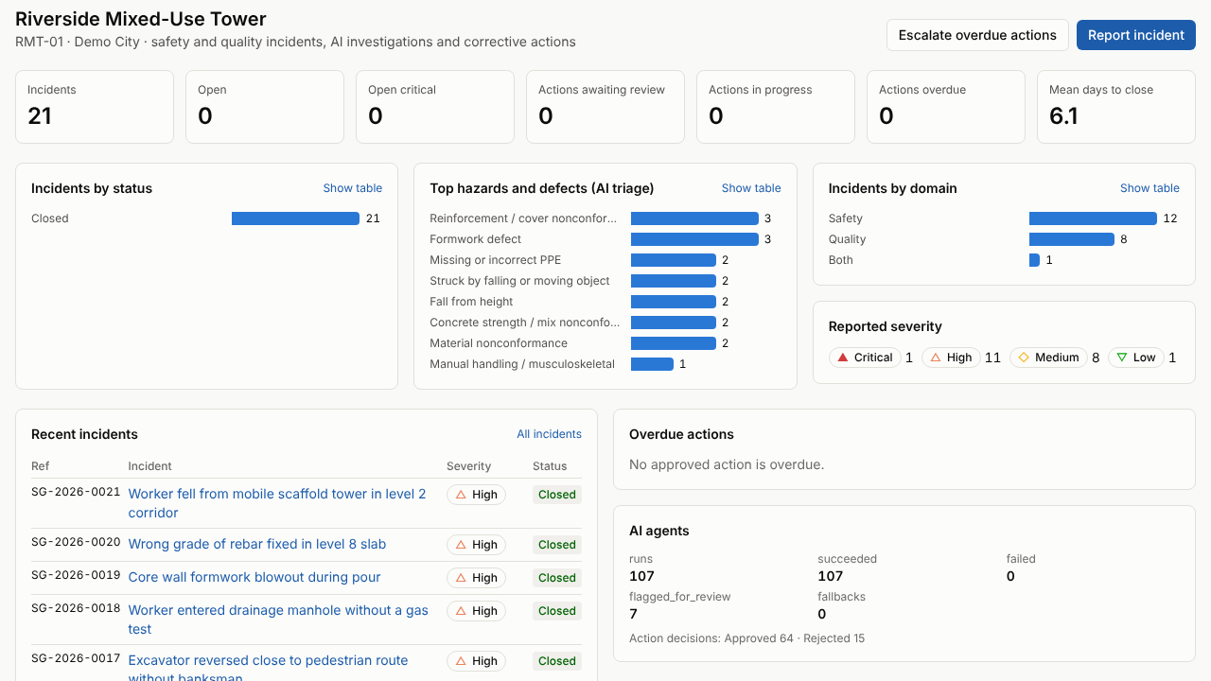
Site Guard AI: Multi-Agent Construction Safety & Quality Incident Resolution System
Introduction
Construction sites report two kinds of events that must be investigated and closed: safety incidents (falls, struck-by, excavation collapse, electrical, lifting, plant) and quality defects (cracking, honeycombing, low cover, tolerance, water ingress).
Site Guard AI is an agentic decision-support and workflow platform:
Six bounded AI agents triage and investigate each incident, find root causes, map it to company procedures and propose corrective and preventive actions (CAPA)
Every finding cites the procedure it came from; risk is scored by a deterministic 5×5 matrix
Qualified people approve, verify and close; the AI never approves, closes or certifies compliance
Live Site Guard AI dashboard after resolving every incident (synthetic demo project)
20
hazard & defect classes
6 + 1
AI agents + risk engine
9
user roles (RBAC)
Notes:
Context, what the system is, and the live product.

Slide 3
Site Guard AI: Multi-Agent Construction Safety & Quality Incident Resolution System
Objectives
1
Unified incident capture
2
AI-assisted investigation
3
Grounded in procedures
Report safety and quality incidents with photos and documents, scoped by organisation and project, with a full lifecycle and audit trail.
Triage, safety / quality investigation, 5-Whys root cause and compliance mapping by bounded agents with validated, structured outputs.
Every requirement and answer cites the retrieved company procedure; unsupported claims are removed and injected instructions are flagged.
4
Deterministic risk
5
Human-in-the-loop CAPA
6
Measured & deployable
A 5×5 likelihood × consequence matrix computes the risk band; the AI may only suggest the inputs.
AI proposes actions; authorised people approve, verify and close. No safety-critical incident is ever closed automatically.
≥ 85% class and ≥ 90% domain accuracy on a held-out set; secure API, CI on every change, Docker image and Azure templates.
Notes:
Six objectives; each is delivered and measured later in the deck.

Slide 4
Site Guard AI: Multi-Agent Construction Safety & Quality Incident Resolution System
Modules – System Overview
Incident & Evidence
Multi-Agent Investigation
Knowledge & Retrieval
Risk & Compliance
Reporting, lifecycle state machine, evidence files with SHA-256 integrity
Orchestrator with six agents, checkpoints, pause / resume, conflict records
PDF / DOCX upload, chunking, embeddings, hybrid search, grounded answers
5×5 risk matrix, requirement mapping marked “possible gap, needs review”
CAPA Workflow
Vision Evidence
Knowledge Graph
Reports, Alerts & Audit
Approval by role, overdue escalation, independent verification, closure rules
Photo checks for PPE / hazards / defects in an isolated process; engineer review
Optional Neo4j projection of incidents, causes and actions with provenance
Markdown / Word / PDF reports, email outbox, dashboard, full audit trail
Notes:
Eight modules built and integrated in the product.

Slide 5
Site Guard AI: Multi-Agent Construction Safety & Quality Incident Resolution System
Module – Multi-Agent Investigation
Subtopic: six bounded agents and a deterministic engine
Guardrails
Explicit tool allowlist and call budget per agent
Outputs validated against Pydantic schemas; invalid output falls back to rules
Cites only evidence retrieved in the same run; unknown citations removed
Documents and uploads treated as untrusted data; injection attempts flagged
Disagreements stored as conflicts for a person to decide
Agents never approve, verify or close
Providers: deterministic rules (offline, default) or Claude (optional)
Triage
Class (20-class taxonomy), domain SAFETY / QUALITY / BOTH, severity, priority, missing info
Safety investigation
Unsafe acts, unsafe conditions, failed or missing controls
Quality investigation
Defect, nonconformance and the inspection / test points that missed it
Risk engine (no AI)
Likelihood × consequence on a 5×5 matrix → band; uses the higher of the two views
Root cause (RCA)
5-Whys across people, process, equipment, materials, environment, management
Compliance
Maps facts to retrieved procedure clauses: likely not met / unclear – never certifies
CAPA
Corrective and preventive actions with owner, due date and verification criterion
Notes:
The core module: what each agent does and the guardrails around it.

Slide 6
Site Guard AI: Multi-Agent Construction Safety & Quality Incident Resolution System
Problem Statement
Problem
Construction organisations lack a single, trustworthy system that turns a reported safety or quality incident into an evidence-backed investigation, proportionate corrective actions and verified closure – quickly, consistently and with a complete audit trail.
1
Fragmented evidence
Reports, photos, procedures, NCRs and action logs live in different tools and inboxes.
2
Slow, inconsistent investigations
Root causes and actions depend on who investigates; procedures are not cited.
3
Weak follow-through
Overdue actions and unverified closures go unnoticed until the next incident.
4
Unsafe automation
Generic AI can hallucinate, follow injected instructions or “close” an incident – unacceptable for safety.
Notes:
Why this system is needed.

Slide 7
Site Guard AI: Multi-Agent Construction Safety & Quality Incident Resolution System
Methodology – System Architecture
Users
HSE manager · Safety & QA/QC engineers · Site engineer · Project manager · Auditor
Platform
One Docker image: API + web app
Alembic migrations on start
GitHub Actions: 7 CI jobs
Azure Bicep: Container Apps, PostgreSQL, Key Vault, Files
Security headers, CSP, login throttle, upload checks
Structured logs with correlation IDs
Access
Web app
Next.js · TypeScript · Tailwind
FastAPI REST API
JWT · RBAC · tenant scoping · rate limits
Services
Incidents
lifecycle
Evidence
files · vision
CAPA
escalation
Reports
MD · Word · PDF
Audit
notifications
AI layer
Orchestrator
checkpoints · pause / resume
Triage
Safety
Quality
Risk engine
5×5 matrix (no AI)
Human gate
approve · verify · close
RCA
Compliance
CAPA
Data
PostgreSQL 16
system of record
pgvector + BM25
hybrid RAG
Neo4j
knowledge graph
Evidence store
SHA-256
LLM provider
rules / Claude
Request path: user → web app → API (authorisation enforced server-side) → services → agents → data. The browser never decides access.
Notes:
Layered architecture, from users to data. Arrows show the request path. Everything runs in one Docker image; PostgreSQL is the system of record.

Slide 8
Site Guard AI: Multi-Agent Construction Safety & Quality Incident Resolution System
Methodology – Incident Resolution Workflow
Report incident
+ photos, documents
Triage agent
class · domain · severity
Safety / Quality agents
acts · conditions · controls
Risk matrix
5×5 → band
RCA agent
5-Whys
Compliance agent
cited clauses
Checkpointed after every stage: pause, resume or cancel; crashed runs resume without repeating work.
Closure
authorised role
Verification
independent person
Action work
owners · due dates · escalation
Human review
approve / modify / reject
CAPA agent
corrective & preventive
Incident status (enforced by the API)
Reported
Under investigation
Pending approval
Action in progress
Pending verification
Closed
Critical actions need the HSE manager; an assignee cannot verify their own action; an incident closes only from Pending verification and only when every AI conflict has a recorded human decision.
Notes:
Read the top row left to right, then the bottom row right to left. Blue = AI agent, teal = deterministic, green = a person decides.

Slide 9
Site Guard AI: Multi-Agent Construction Safety & Quality Incident Resolution System
Methodology – Development & Evaluation
Staged delivery, every change through CI
Honest evaluation protocol
READ → INSPECT → PLAN → IMPLEMENT → TEST → REVIEW → DOCUMENT → COMMIT
1
Freeze
A separate author writes 46 held-out cases; committed before any tuning
A
Hardening, Azure IaC, staging, backup / restore, smoke test
B
Document parsing, embeddings, hybrid retrieval, grounded answers
2
Tune on dev only
Rules and procedures improved using 120 dev cases; held-out never opened
C
Word / PDF investigation reports, email outbox
D
Vision analysis, knowledge graph, resumable workflows, conflicts
3
Measure once
Held-out scored once on the frozen rules and published as is
E
Web screens for every feature, browser tests
+
Accuracy round, load testing, concurrency fix
4
Gate in CI
Floors just under the results, 0 CRITICAL under-rated, 10/10 red-team
Notes:
How the system was built and how accuracy was measured without fooling ourselves.

Slide 10
Site Guard AI: Multi-Agent Construction Safety & Quality Incident Resolution System
Approach, Algorithms & Tools
1
Weighted keyword triage
Tools & technologies
20-class taxonomy; title words ×2, ambiguous words ×0.5; falling-object, fall and struck-by patterns
Python 3.12
FastAPI
Pydantic
2
Hybrid retrieval (RAG)
SQLAlchemy
Alembic
PostgreSQL 16
BM25 + vector search fused by Reciprocal Rank Fusion, then a deterministic rerank on coverage, headings and phrases
pgvector
Neo4j 5
Next.js
3
Deterministic risk scoring
TypeScript
Tailwind CSS
Docker
Likelihood (1–5) × consequence (1–5) → LOW / MEDIUM / HIGH / CRITICAL; the AI only suggests inputs
GitHub Actions
Azure Bicep
pytest
4
Root cause & grounding
Playwright
ruff · mypy
Claude (optional)
5-Whys over six cause categories; answers keep only claims supported by cited chunks
Notes:
Key algorithms on the left, technology stack on the right.

Slide 11
Site Guard AI: Multi-Agent Construction Safety & Quality Incident Resolution System
Findings – AI Accuracy on Held-out Data
0
CRITICAL incidents rated LOW or MEDIUM
10 / 10
red-team attacks contained
100%
workflow invariants held
166
labelled cases: 120 dev + 46 held-out
All four accuracy targets met; class +21.7 points and retrieval +26.1 points after tuning.
Notes:
One measurement before and one after tuning, on 46 held-out cases that were never used for tuning. Scores are for the offline rules provider on synthetic cases.

Slide 12
Site Guard AI: Multi-Agent Construction Safety & Quality Incident Resolution System
Findings – End-to-End Incident Resolution
Metric | Before | After
Incidents | 20 | 21
Open incidents | 13 | 0
Actions awaiting review | 15 | 0
Actions overdue | 4 | 0
Mean days to close* | 11 | 6.1
107
agent runs, 0 failures
79
human decisions: 64 approved, 15 rejected
21 / 21
incidents closed after verification
Dashboard after the run: 21 incidents closed, 0 open, 0 overdue. *Scripted reviewers act within minutes, so days-to-close is a workflow check, not a performance figure.
Notes:
resolve_all.py drove the running product over HTTP on PostgreSQL: the agents investigated, scripted reviewers decided, and every incident closed.

Slide 13
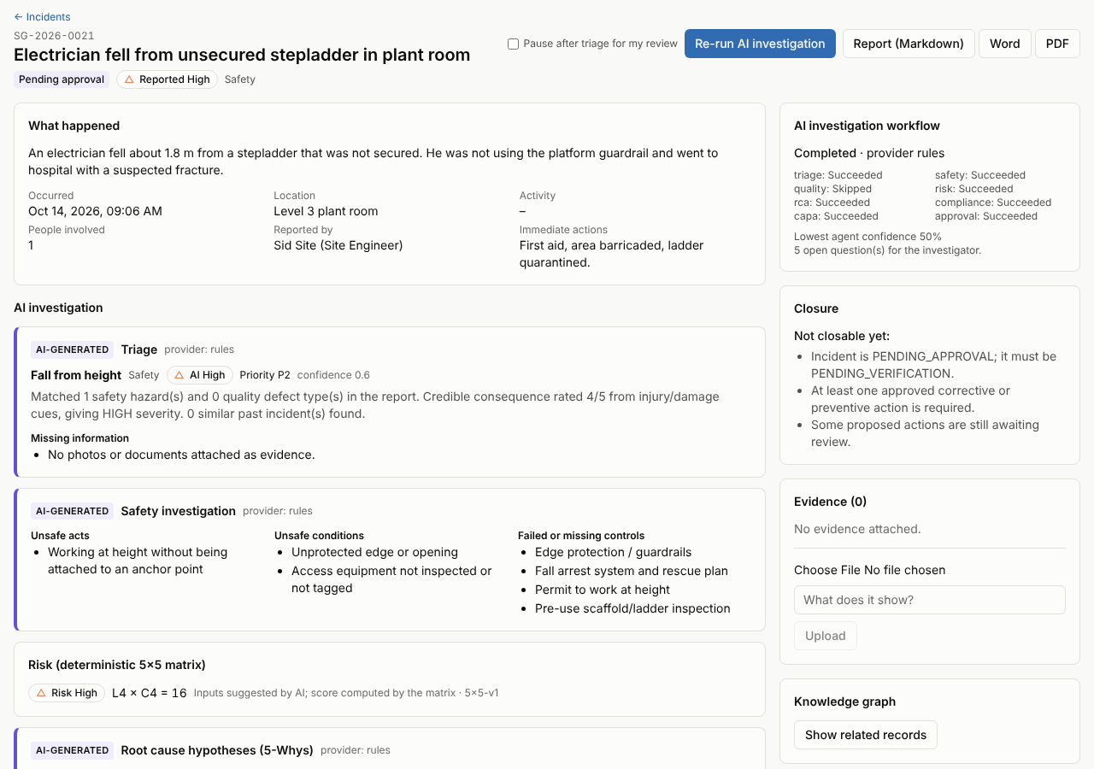
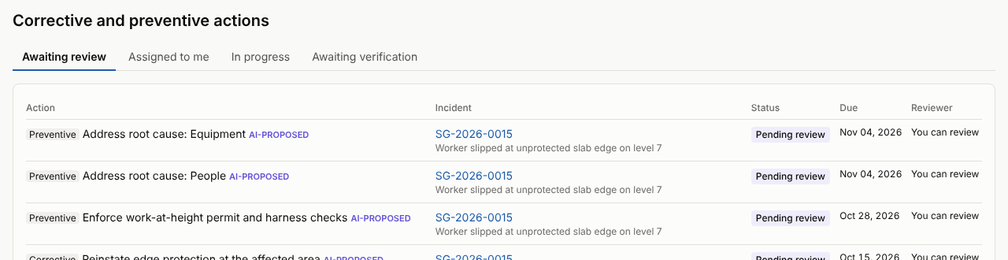
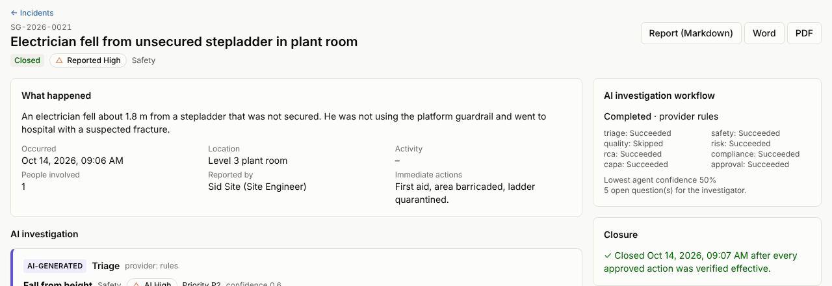
Site Guard AI: Multi-Agent Construction Safety & Quality Incident Resolution System
Findings – The Product: Investigation to Closure
Action queue: every AI-proposed action waits for a person; critical ones only for the HSE manager
AI investigation of a new report: triage, safety findings, 5×5 risk, root causes, all marked AI-generated
The same incident closed, only after each approved action was verified effective
Notes:
Screens from the running product (browser end-to-end run on main). AI output is labelled; actions wait for the HSE manager; closure needs verified actions.

Slide 14
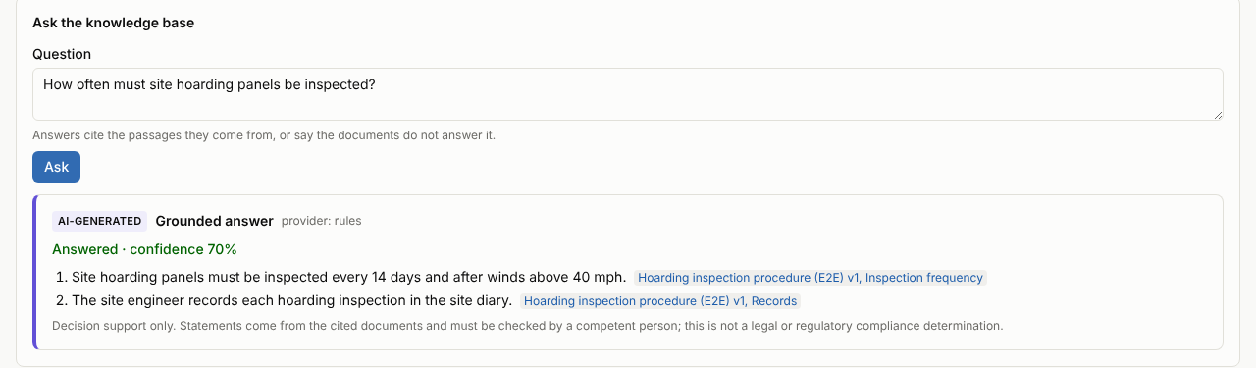
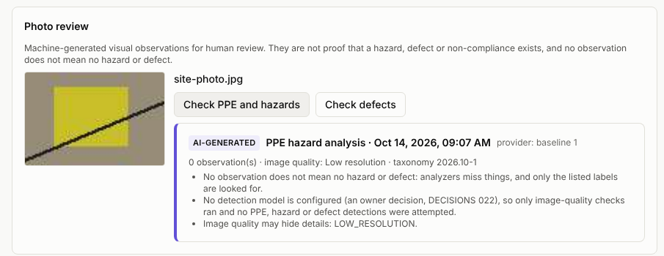
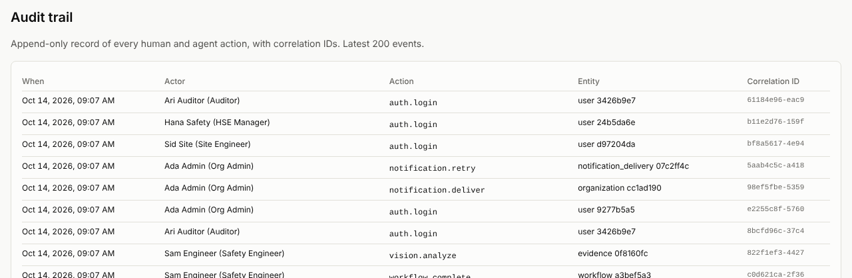
Site Guard AI: Multi-Agent Construction Safety & Quality Incident Resolution System
Findings – The Product: Knowledge, Photos & Audit
Grounded answer: each statement cites its source passage, or says the documents do not answer
Photo review: image checks for an engineer to confirm; never proof on their own
What the screens show
AI output is always labelled and never approves, verifies or closes
Answers and requirements cite retrieved passages only
Role checks happen in the API; the browser only renders what it is allowed
Audit trail: every human and agent action with a correlation ID
Notes:
Grounded answers cite the procedure passage they come from; photo findings are suggestions for an engineer; every action is in the audit trail.

Slide 15
Site Guard AI: Multi-Agent Construction Safety & Quality Incident Resolution System
Findings – Performance & Engineering Quality
Load test run | Users | Req/s | Errors | Read p95
Single user | 1 | 53 | 0% | 28 ms
Saturation | 25 | 56 | 0% | 745 ms
Realistic mix (2 s think time) | 100 + 2 | 39 | 0% | 802 ms
8 concurrent reporters | 1 + 8 | 11 | 0% | 718 ms
275
backend tests (unit, API, migrations, evaluation, red-team)
6
browser end-to-end tests
7
CI jobs green on every pull request
Bug found and fixed by the load test
Two reports submitted at the same moment received the same reference and one failed (HTTP 500). Fixed with a PostgreSQL advisory lock plus a retry; 113 simultaneous reports later, no collision.
0
open dependency-audit findings (Python + npm)
One process serves ≈ 55 req/s – enough for a pilot with tens of active users; the dashboard is the first thing to optimise before scaling.
Notes:
Load test of the production image on PostgreSQL 16 (one API process, 4 vCPU host) and the quality gates that run on every change.

Slide 16
Site Guard AI: Multi-Agent Construction Safety & Quality Incident Resolution System
Conclusion
Achieved
Limitations & future work
End-to-end platform: report → AI investigation → human approval → verified closure, with a full audit trail
Real data: Expert-labelled pilot reports; real OSHA Severe Injury Reports scoring (pipeline ready)
✓
Six bounded agents plus a deterministic risk engine; outputs validated, cited and never self-approving
Claude provider: Score the LLM provider on the same held-out protocol with an API key
✓
Accuracy targets met on held-out data: class 89%, domain 93%, retrieval 93%, 0 critical under-rated
Scale: SQL aggregates and pagination for the dashboard; shared login throttle before scaling out
✓
Production engineering: secure API, 7-job CI, Docker image, Azure templates, load-tested
Deploy & extend: Azure staging; licensed vision model; graph-aware retrieval; OIDC sign-in
✓
Site Guard AI is decision support: people stay accountable for every safety decision, and the system never certifies legal compliance.
Notes:
What was achieved, what is honestly still open, and the next steps.

Slide 17
Site Guard AI: Multi-Agent Construction Safety & Quality Incident Resolution System
Acknowledgement
I sincerely thank the University and LTIMindtree for the Advanced Industry Integrated M.Tech / MCA Program, and L&T EduTech as implementation partner, for the opportunity and guidance to carry out this project.
I am grateful to my project guide, mentors and reviewers for their valuable feedback across the reviews, and to my family and peers for their constant support.
– S.K. Sricharan (T9984)

Slide 18
Site Guard AI: Multi-Agent Construction Safety & Quality Incident Resolution System
References
[1] U.S. OSHA, 29 CFR Part 1926 – Safety and Health Regulations for Construction (Subparts E, K, L, M, P, CC).
[2] U.S. OSHA, Severe Injury Reports dataset, https://www.osha.gov/severeinjury
[3] UK: The Work at Height Regulations 2005; CDM Regulations 2015; LOLER 1998; RIDDOR 2013.
[4] India: Building and Other Construction Workers Act 1996; OSH and Working Conditions Code 2020.
[5] ISO 45001:2018, Occupational health and safety management systems – Requirements.
[6] S. Robertson and H. Zaragoza, “The Probabilistic Relevance Framework: BM25 and Beyond,” Foundations and Trends in Information Retrieval, 2009.
[7] G. V. Cormack, C. L. A. Clarke and S. Büttcher, “Reciprocal Rank Fusion outperforms Condorcet and individual rank learning methods,” SIGIR 2009.
[8] P. Lewis et al., “Retrieval-Augmented Generation for Knowledge-Intensive NLP Tasks,” NeurIPS 2020.
[9] OWASP, Top 10 for Large Language Model Applications (prompt injection, insecure output handling).
[10] Documentation: FastAPI, SQLAlchemy, PostgreSQL / pgvector, Neo4j, Next.js, Playwright, Anthropic Claude API.
[11] Project repository: github.com/sricharansk/SITEGUARD-AI (docs/EVALUATION.md, docs/LOAD_TEST.md, docs/RESULTS.md).

