Slide 1


Motion and Strain Imaging using Displacement-Encoded MRI

Slide 2
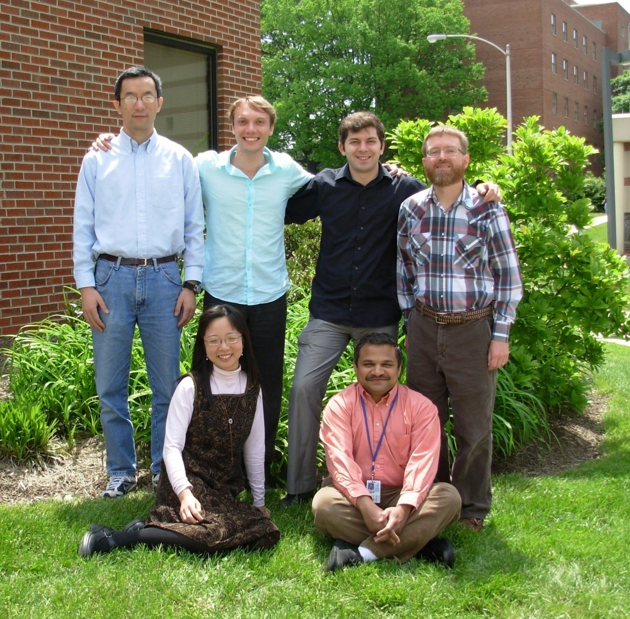
Some of the contributors
Han Wen
Stan Rapacchi
Rael Kopace
Eric Bennett
Yuan Le
Vinay Pai

Slide 3
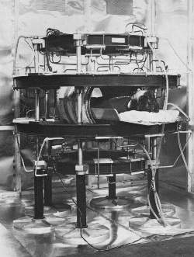
Magnetic Resonance Imaging
B₀
B₁
Hutchison, Edelstein, early 70s

Slide 4
What is Strain?
w₀
w
h₀
h
Longitudinal strain = (h – h₀)/ h₀
Transverse strain = (w – w₀)/ w₀

Slide 5
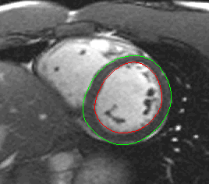
Which strain is important in cardiac function?
Circumferential strain is closely related to the active contraction of myofibers. It is the driving force of ventricular ejection.

Slide 6
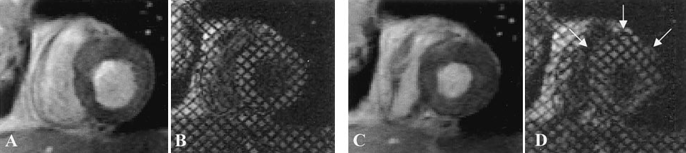
Wall thickening or radial strain may not always be reliable
In a dobutamine stress CMR study (n = 194), myocardial tagging visualized more new wall motion abnormalities compared with cine (D. Kuijpers et al., Circulation. 2003;107:1592-1597).
End-diastole End-systole

Slide 7
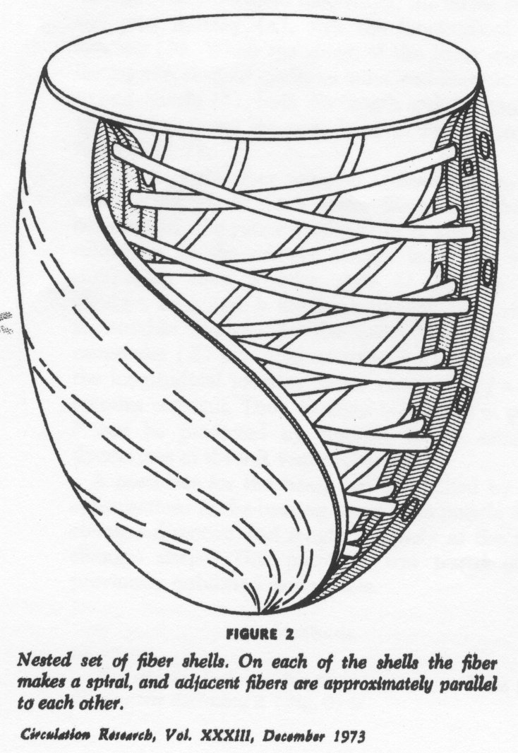
Myofibers arrangement dictates the direction of active strain

Slide 8
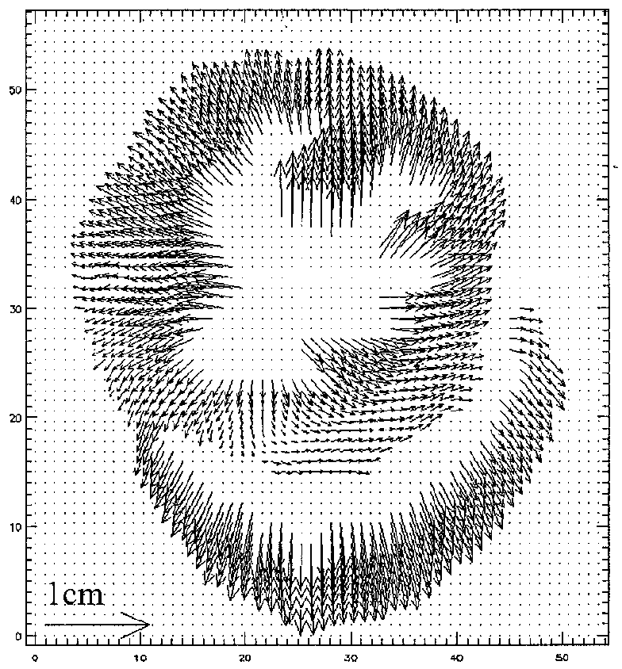
Myocardial displacement-encoding with stimulated echoes (DENSE)
Aletras AH, Ding SJ, Balaban R, and Wen H. Proc. ISMRM April 1998; p.281.
Canine model.

Slide 9
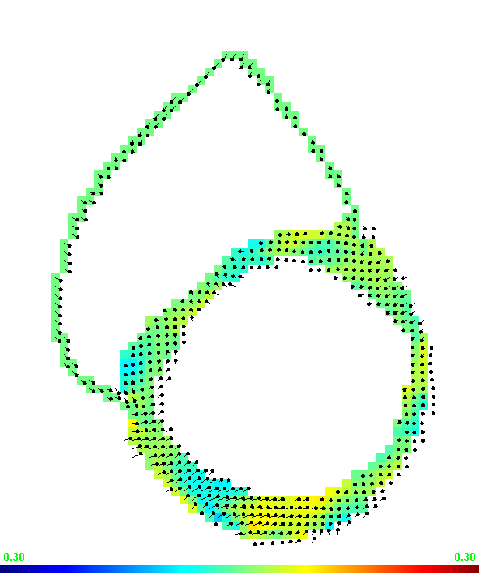
CINE motion and strain maps
Displacement vectors overlayed on color circumferential strain (normal volunteer)
30%
-30%

Slide 10
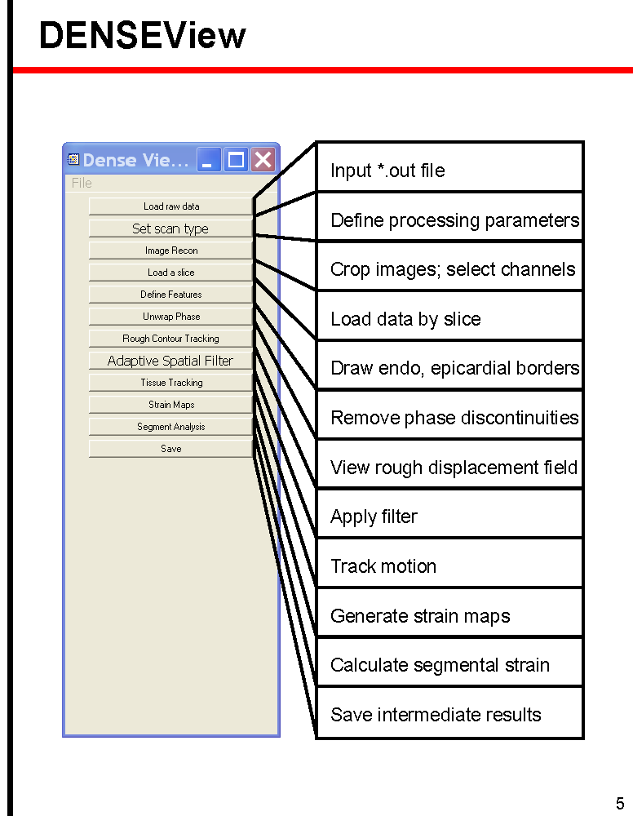
DENSE Image Processing

Slide 11
Patient Study
Study included 12 normal volunteers and 16 patients (6 HF, 9 AMI, 2 diabetic).
The aim is automatic detection of segmental wall motion abnormality based on a strain threshold.
2D echo was the gold standard.
Wen H et al., Radiology 2008; 246:229-240.

Slide 12
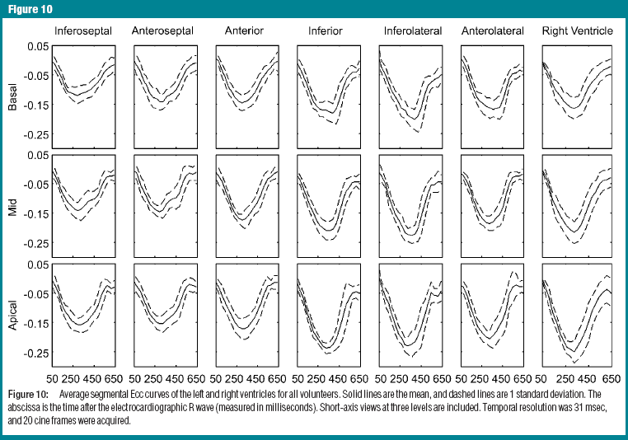
Strain traces in normal volunteers

Slide 13
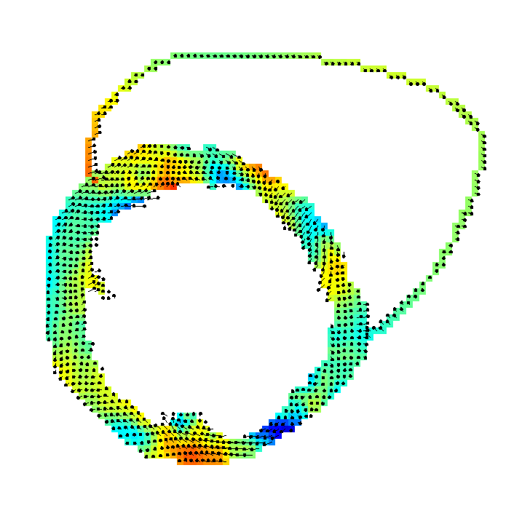
Heart failure patient
57 yr old male
HR = 91 bpm at rest
EF = 20%
Free-breathing scan
0.3
-0.3

Slide 14
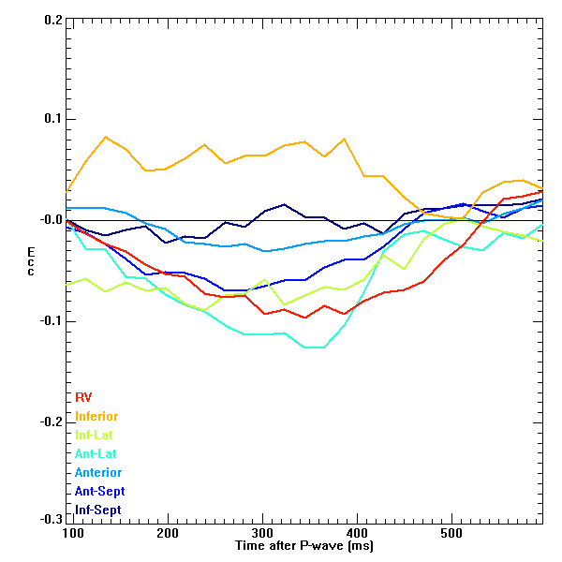

Slide 15
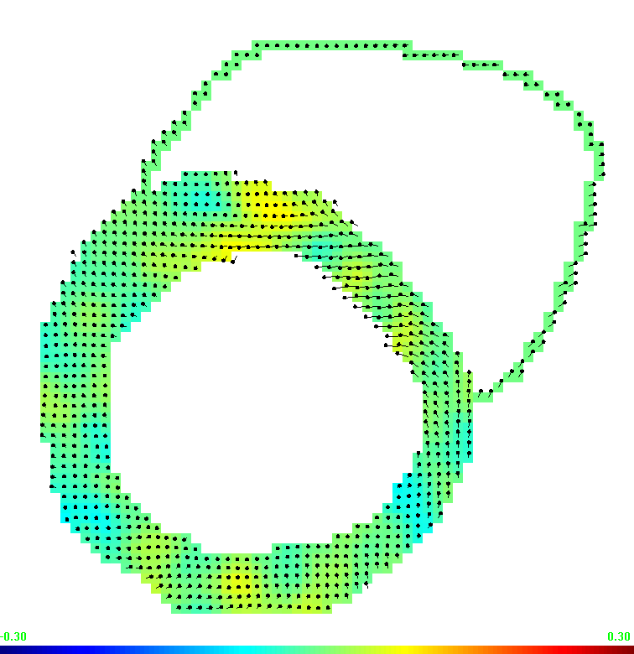
Patient with left bundle branch block
69 yr old male hypertensive, LBBB, frequent ectopic beats, EF > 30%.

Slide 16
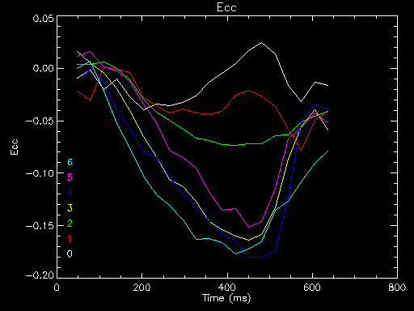
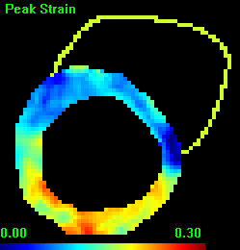
6
1
2
0
3
5
Inferior
4
Early Septal shortening with rebounce.

Slide 17
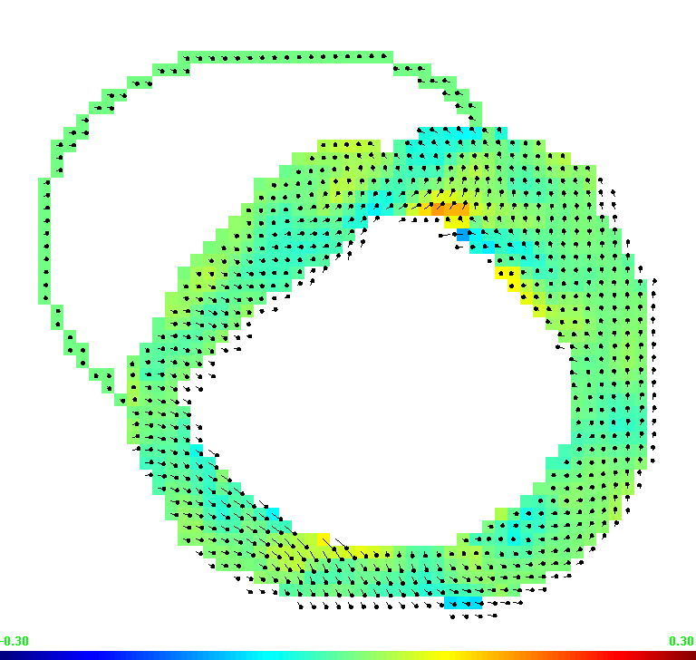
Septal bounce without LBBB
60 yr female hypertensive. EF > 30%.

Slide 18
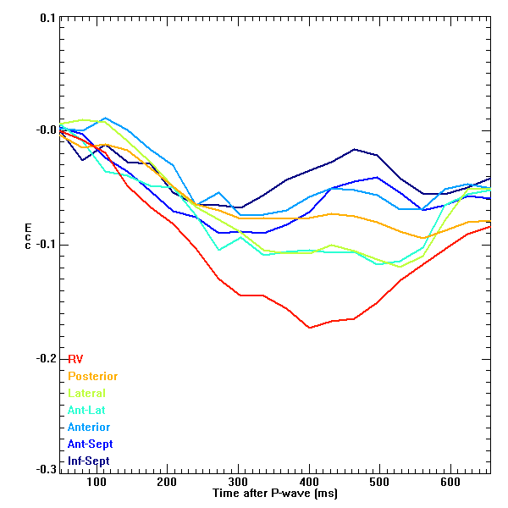
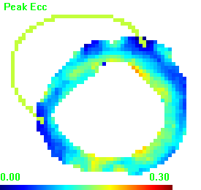
Inferior
Early Septal shortening

Slide 19
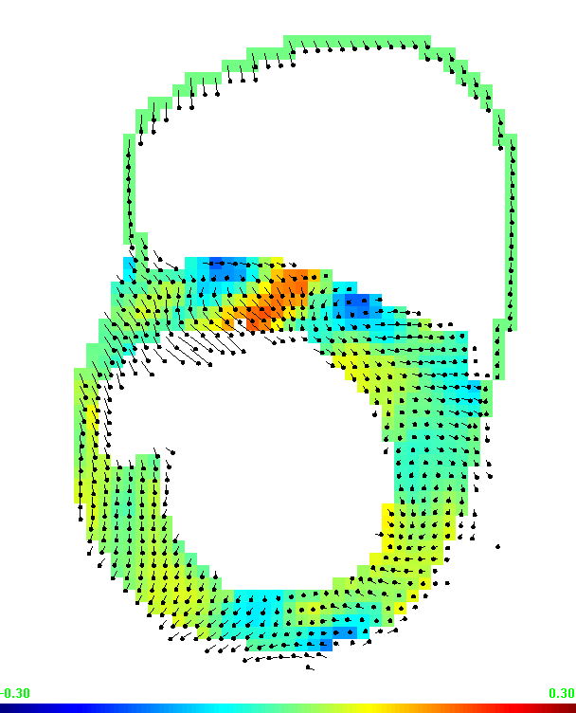
Partially recovered septal strain in AMI patient post laser revascularization
Coutesy of Pierre Croisille

Slide 20
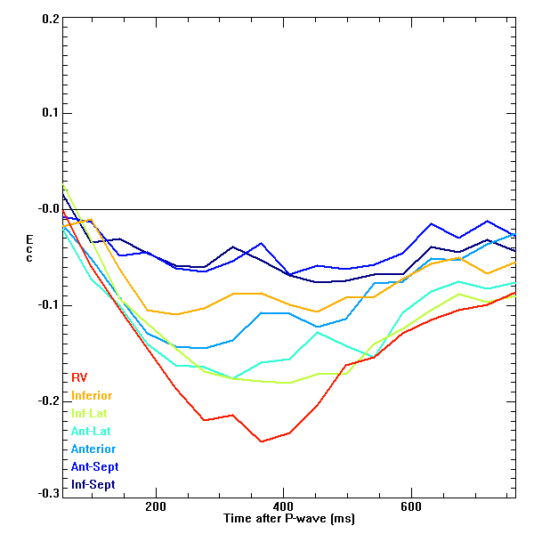
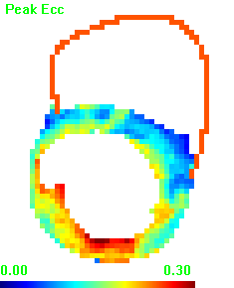
Inferior

Slide 21

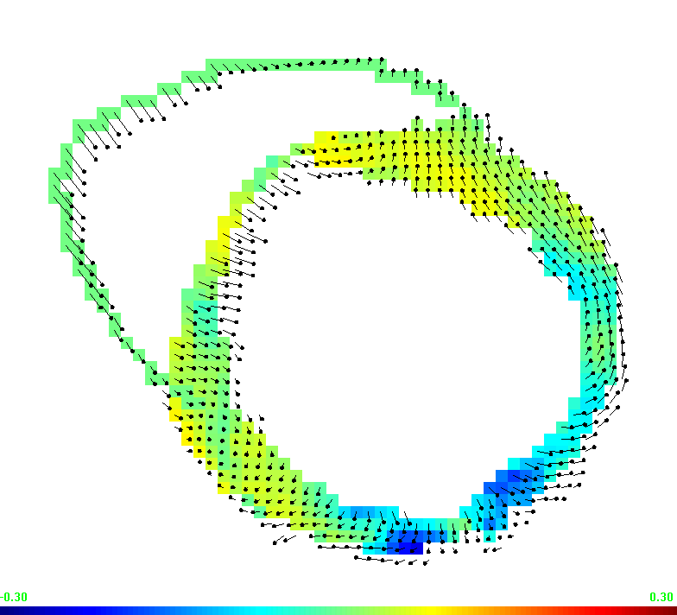
Heart failure patient
55 female with hypertension and tachycardia (125 bpm at rest). Scanned in free-breathing mode.

Slide 22
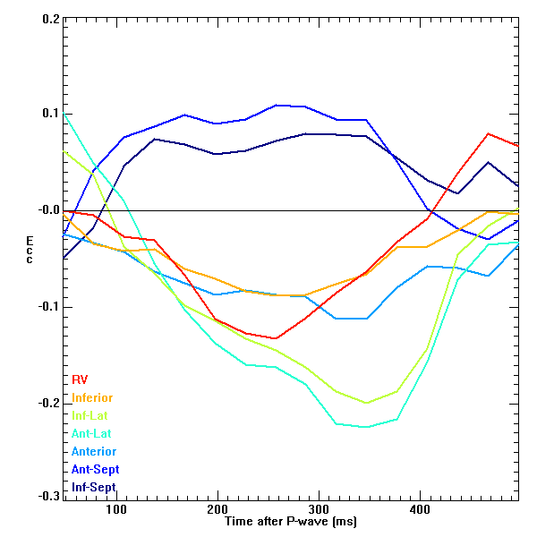
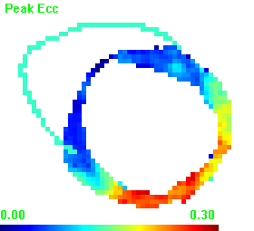
Inferior

Slide 23
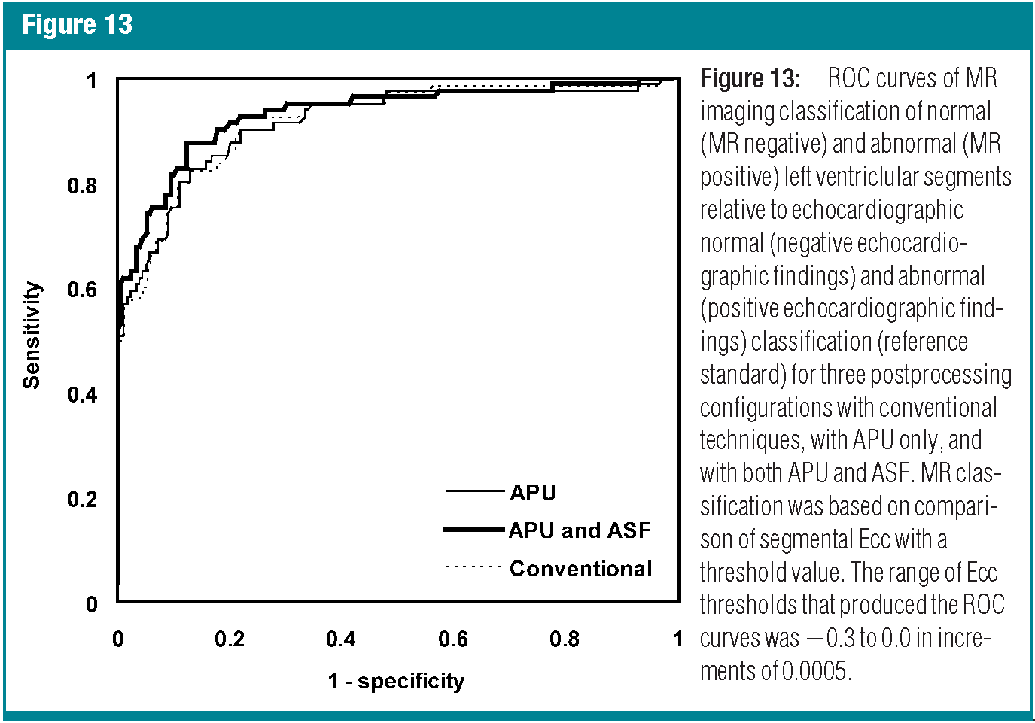
ROC analysis of peak-strain based detection of abnormal segments
abnormal segment = “Ecc < 0.122”. specificity = 88% and sensitivity = 88%. Gold standard is 2D echo reading.

Slide 24
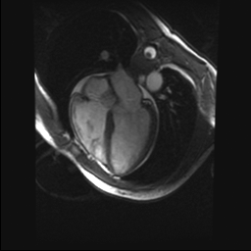
Multi-slice single-shot DENSE imaging during bolus injection of Gd-DTPA
Acquire 3 – 4 slices in a heart beat, and repeat once every two seconds.
30 repetitions × 3 Enc. dir. = 90 images are acquired in 3 to 4 minutes covering the contrast infusion.
Gd-DTPA (Gadopentetate) dose of 0.1 mM/kg.
AIF slice
DENSE slices

Slide 25
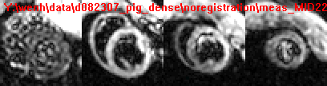
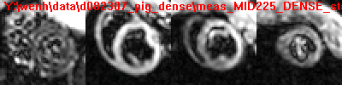
Contrast enhancement in single-shot DENSE images
AIF DENSE base mid apex

Slide 26
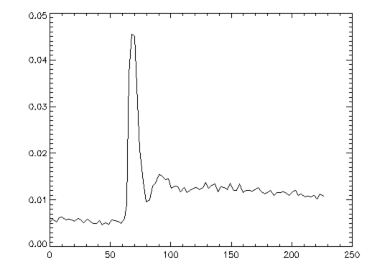
Arterial Input Function slice blood signal
The contrast concentration in the arterial blood is derived from the AIF blood signal.
AIF blood signal
Time (seconds)

Slide 27
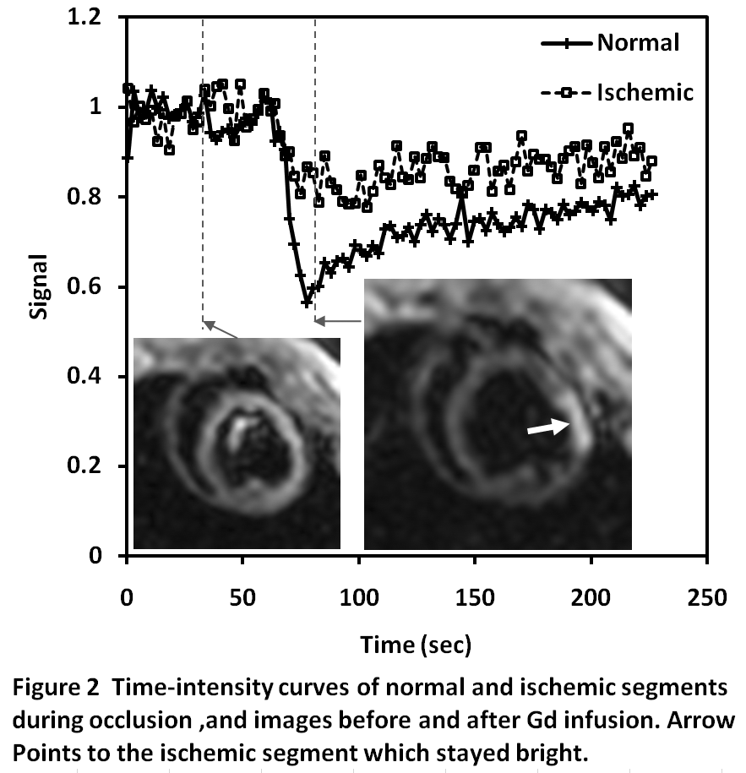
Under-perfused segment remains bright in DENSE images

Slide 28
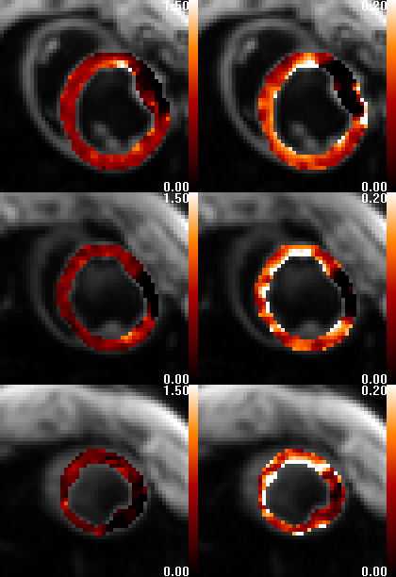
Strain and perfusion images in Pig AMI Study
Perfusion Strain
Basal
Mid
Apical

Slide 29
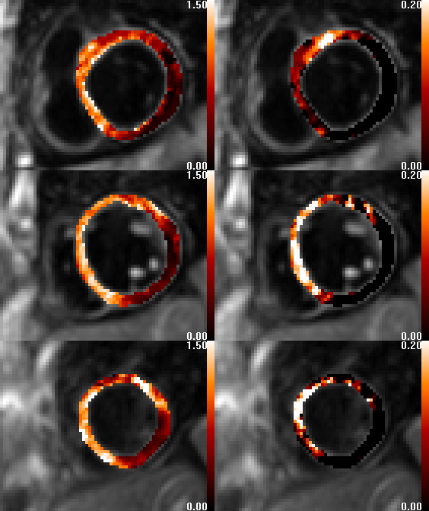
Strain and perfusion in AMI Patient
Perfusion Strain
Basal
Mid
Apical
Courtesy of
Pierre Croisille

Slide 30
Technical limitations of the simultaneous perfusion-strain scan
Number of slices reduced to 2 for HR > 100, to 1 for HR > 150.
Through-slice motion renders the apical slice inaccurate in many cases.

Slide 31
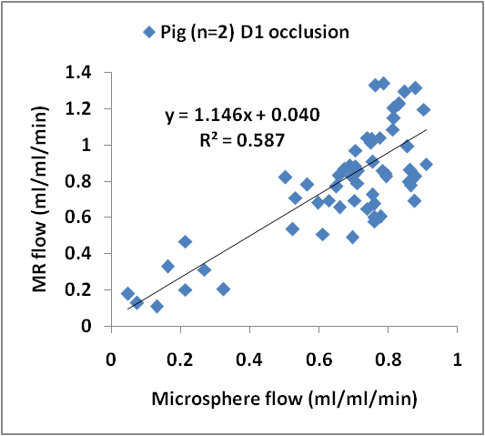
Validation of MR perfusion with microsphere results (n = 2, LCX occlusion)
12 segments per slice.

Slide 32
Put it in perspective
 | Cine | Tagging | DENSE
Global function EF | Gold standard | Not applicable | Not applicable
Regional Function | Wall thickening less reliable than strain | Good sensitivity and specificity; lower spatial resolution | good sensitivity and specificity; Good spatial resolution
Scan speed | Real time | Single shot | single shot

