Slide 1
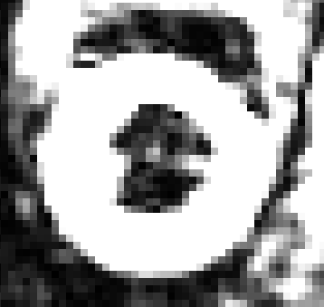
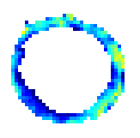

Anatomic image
DENSEView Strain
Plot of DENSE material tracking points
The SA wall sketched by the DENSE data points is much thinner than that shown in the anatomic image. This is the reason that I wish DENSEview also outputs the contour points of epi/endocardial surfaces.

Slide 2
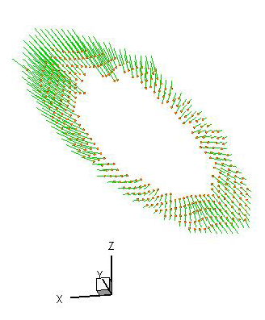
Out-of-plan displacement vector is missing. You can confirm this
by reading the file ?????_vector.txt

