Slide 1
AJAX AND JQUERY

Slide 2
WHAT IS AJAX
Ajax is short for Asynchronous Javascript and XML, which refers to a set of web development techniques rather than an actual programming language. Ajaxhowever, is widely used in client-side programming (e.g. Javascript) to allow for data to be sent and received to and from a database / server.

Slide 3
USE OF AJAX
AJAX is a technique for creating fast and dynamic web pages. AJAX allows web pages to be updated asynchronously by exchanging small amounts of data with the server behind the scenes. This means that it is possible to update parts of a web page, without reloading the whole page.

Slide 4
DIFFERENCE BETWEEN AJAX AND JQUERY
The main difference among the three is that JavaScript is client-side, i.e. in the browser scripting language, whereas jQuery is a library (or framework) built with JavaScript. Meanwhile, AJAX is a method to immediately update parts of the UI without reloading the web pages.

Slide 5
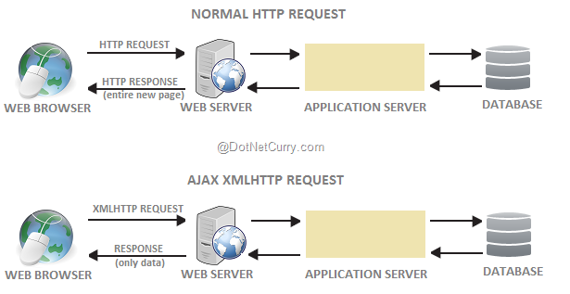
HTTP REQUEST

Slide 6
How to add jquery
Download the jQuery library from jQuery.com
OR Include jQuery from a CDN, like Google,Microsoft
<head> <script src="jquery-3.3.1.min.js"></script> </head>

Slide 7
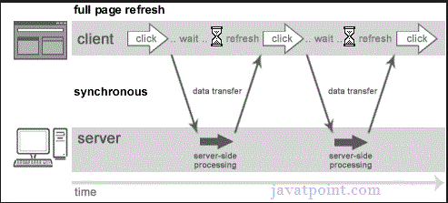
Synchronous response

Slide 8
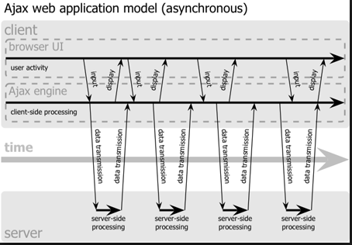
Asynchronous

Slide 9
Getting Started with jquery
<script src="//ajax.googleapis.com/ajax/libs/jquery/1.10.2/jquery.min.js"></script>
<script>
console.log('works');
</script>

Slide 10
Test by var
1…<script>
var name='alex‘;
</script>
Check the output on console
Put name and enter
2….<script> jQuery.ajax();</script>
//check the library is working or not
Or
$.ajax(); //simply use $ instead of jquery object

Slide 11
Testing the http request
$.ajax({
url: 'file.txt',
success: function(data){ console.log('data');},
error:function(){ console.log('something went wrong'); }
});

Slide 12
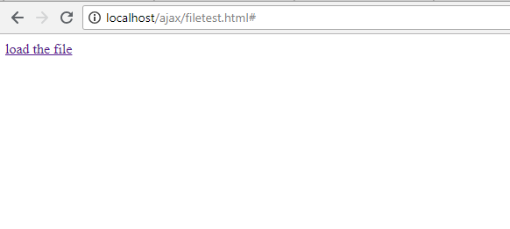
Uploading file
<body>
<a href="#" id="load">load the file</a>
<div id="contents"></div>

Slide 13
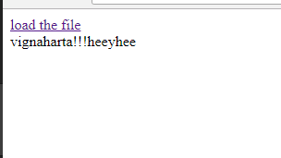
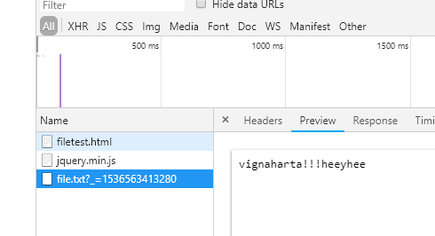

Slide 14
Cont..
$('#load').on('click',function(){
var contents=$('#contents');
$.ajax({
url: 'file.txt',
cache:false, //explain cache
success: function(data)
{
contents.text(data);
},
error:function()
{
console.log('something went wrong');
}
});
});

Slide 15
File test by interval
var contents=$('#contents');
setInterval(function(){
$.ajax({
url: 'file.txt',
cache:false,
success: function(data)
{
contents.text(data);
},
error:function()
{
console.log('something went wrong');
}
});
},1000);

Slide 16
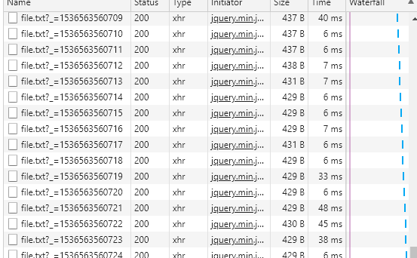

Slide 17
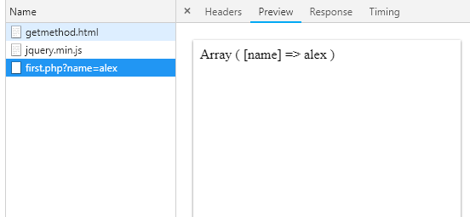
Get and post method
$.ajax({
url: 'first.php',
type:'GET',//if using GET method its passing the data to $_GET in first.php
data:{name:'alex'},
success: function(data)
{
console.log('data');
}
});

Slide 18
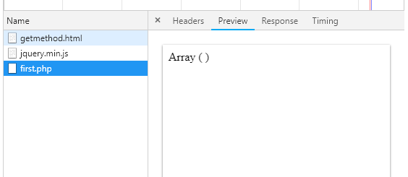
POST

Slide 19
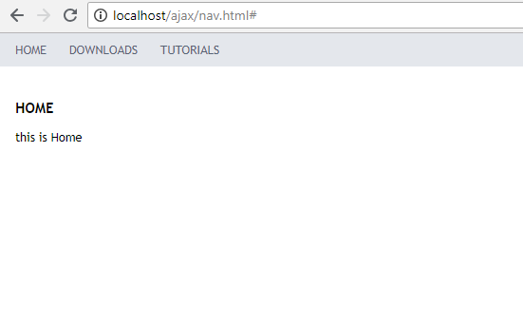
Designing Navigational Bar

