Slide 1

Drug Discovery for Lung Cancer using Data Mining Techniques
Group Member:
Athulya Anand | Diksha Adke | Atharva Karnik | Sricharraan Ramaswamy
Notes:
1. Good afternoon, everyone. Today we are here to present our project, ‘Drug Discovery for Lung Cancer using Data Mining Techniques’, done by Athulya Anand, Diksha Adke, Myself, and Sricharraan Ramaswamy.

Slide 2
INTRODUCTION
Lung cancer, particularly small cell lung cancer (SCLC), is a leading cause of cancer deaths globally.
Abnormal activation of Epidermal Growth Factor Receptor (EGFR) plays a significant role in the development and progression of lung cancer.
Inhibiting EGFR's multiplication is a target of various drugs being tested for efficacy.
IC50 is a measure of the amount of drug needed to inhibit a biological process by 50%.
The ChEMBL dataset provides molecular formulas for drugs used in our study.
Later, Molecular formulas were converted to molecular fingerprints using PubChem database.
Our study compares the performance of Support Vector, Principal Component, Random Forest, KNN and XGBoost regressor models in predicting drug efficacy.
Notes:
2. Lung Cancer is a leading cause of deaths globally. Abnormal growth of EGFR, i.e., Epidermal Growth Factor Receptor plays a significant role in development and progression of lung cancer. Naturally, inhibiting EGFR is the main focus on tackling lung cancer. For this project, we have used ChEMBL and PubChem datasets to predict the drug efficacy against cancer cells.

Slide 3
OBJECTIVE
Our project aims to improve patient outcomes and reduce the burden of lung cancer.
Our medication development endeavor offers opportunities for significant advancements in lung cancer biology.
We aim to provide better treatment choices, higher survival rates, and improved patient quality of life.
Notes:
While conventional treatment modalities such as chemotherapy, radiation therapy, and surgery have demonstrated efficacy, their associated adverse effects have prompted the exploration of alternative lung cancer therapies, including novel drugs. Our objective is to evaluate the performance of various regression algorithms, namely SVM Regressor, KNN Regressor, Random Forest Regressor, XGboost Regressor, and PCA Regressor, in predicting the efficacy of a drug in inhibiting the proliferation of cancer cells harboring EGFR protein defects.

Slide 4
MOTIVATION
EGFR-positive lung cancer is a rare and aggressive tumor, accounting for 10-15% of cases in the US.
Initially, there was insufficient data for prediction, but thanks to the efforts of scientists, we can now predict the efficacy of compounds in lung cancer treatment.
Our methods allow us to accurately predict the efficacy of a compound, making it easier to test potential treatments.
Notes:
4. EGFR-positive lung cancer is a rare and aggressive tumor, accounting for 10-15% of cases in the US. Initially, there was insufficient data for prediction, but thanks to the efforts of scientists, we can now predict the efficacy of compounds in lung cancer treatment. Our methods allow us to accurately predict the efficacy of a compound, making it easier to test potential treatments.

Slide 5


METHODOLOGY
Data Collection
- CHEMBL Dataset
- PUBChem Dataset
Data Preprocessing
Exploratory Data Analysis
Molecular Fingerprint Calculation
Feature Engineering
Model Building
SVM Regressor
PCA Regressor
Random Forest Regressor
KNN Regressor
XGBoost Regressor
Comparison of Models and its results
Deployment and Maintenance
Notes:
ChEMBL webresource client . This is the only official Python client library developed and supported by ChEMBL group. The library helps accessing ChEMBL data and cheminformatics tools from Python. Then we are preprocessing data where we are focusing more on IC 50 column. Then we are heading ahead with EDA, molecular fingerprinting calculation, feature engineering and modeling.

Slide 6
Data Collection & Pre-processing
Chembl_websource_client
Chembl Database
Bioactivity Data
Data Preprocessing
Drop missing values
Drop duplicate values
Classify and label compounds on basis of bioactivity threshold value
Final Curated Bioactivity Data for EDA
Target Protein Search
Targeted search for 'EGFR' molecules in ChEMBL database
Focused on 'Single Protein' target types, extracted human-specific molecular id
Mined dataset for samples with standard type of 'IC50’
Data pre-processing conducted to remove missing values and duplicates
Compounds classified and labeled based on appropriate bioactivity thresholds
Compounds classified into bioactivity classes - active, intermediate, inactive
Resulting data with bioactivity curation used for further processes.
Notes:
Our main focus is EGFR, which is a protein and is a significant factor in the development and progression of lung cancer. For this project we are mainly considering EGFR for homo sepeins and single protein type as dataset contains information for animals also. Now, IC50 Is our standard value for consideration. So, after standard data preprocessing, we are selecting 3 main columns namely, molecular ID, smile and standard value columns and then we are introducing new column as bioactivity class and classifying every single SMILE value based on IC50 value.

Slide 7
Exploratory Data Analysis
Clean SMILES Notation
Calculate Lipinski Descriptors
Perform EDA
Remove small organic compounds
Remove salts
The dataset consists of molecular ID, canonical formula in the form of 'SMILE', and IC50 value indicating bioactivity data.
Lipinski's rule of five is applied to determine if a chemical compound is an active drug in humans.
The negative logarithmic scale of IC50 is computed and recorded as 'pIC50’.
A function is created to test the molecule using Lipinski descriptors: MW, LogP, NumH-Donors, and NumHAcceptors.
Exploratory data analysis is carried out on the dataset using pIC50 as the selection criteria and Lipinski descriptors.
pIC50 is the primary measure used to distinguish active, intermediate, and inactive compounds.
Notes:
The dataset consists of the molecular id, its corresponding canonical formula in the form of ’SMILE’, and the ’IC 50’ value indicating the bioactivity data. Lipinski descriptors are widely used in drug discover to evaluate the drug likeliness of a molecule and how well a drug is absorbed by human cells. Lipinski’s rule of five is applied to the canonical formula to determine if the chemical compound is an active drug in humans. The rule states the following:
a The partition coefficient or ’log p’ value should not exceed 5
b There should be no more than 5 hydrogen bond donors
c There should be no more than 10 hydrogen bond accep- tors
c The molecular mass should not exceed 500 daltons
To conform to the above-mentioned criteria, the logarithm of the ‘IC 50’ value is computed to the negative logarith- mic scale which is essentially -log10(IC50) and recorded as
‘pIC50’. A function is then created to test the molecule with the given Lipinski descriptors using its canonical formula. The Lipinski descriptors in our case are [’MW’, ’LogP’, ’NumH- Donors’, ’NumHAcceptors’]. Subsequently, exploratory data analysis is carried out on the dataset, utilizing ‘pIC50’ as the selection criteria and the Lipinksi descriptors. The results in- dicate that ‘pIC50’ is the primary measure used to distinguish active, intermediate and inactive compounds.

Slide 8
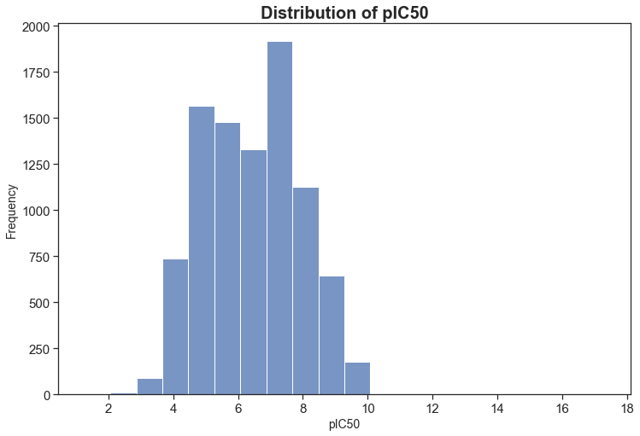
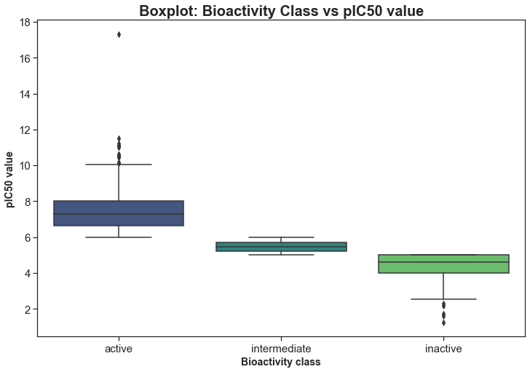
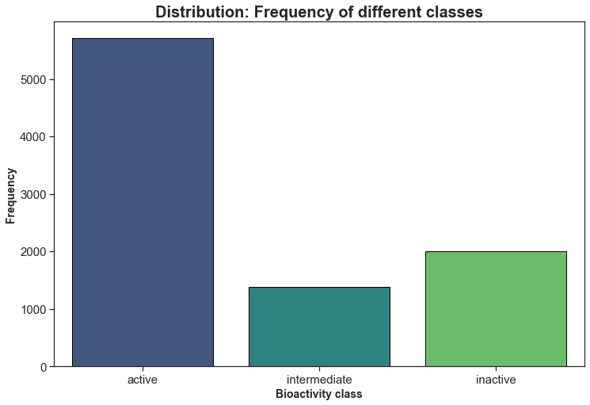
Exploratory Data Analysis

Slide 9
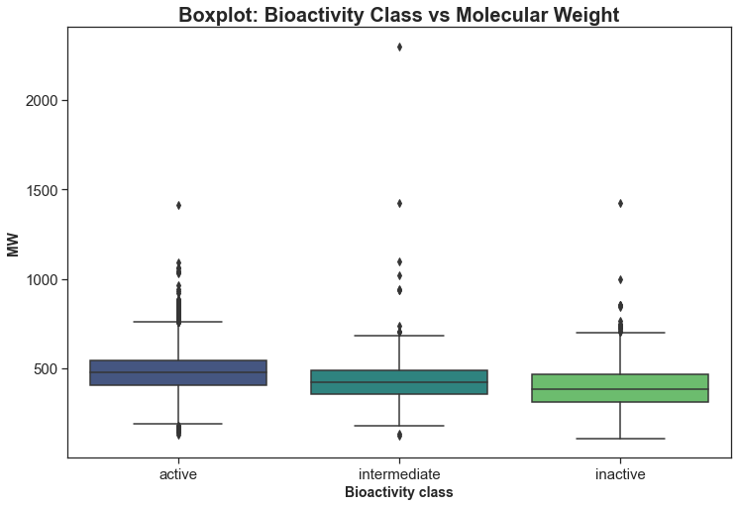
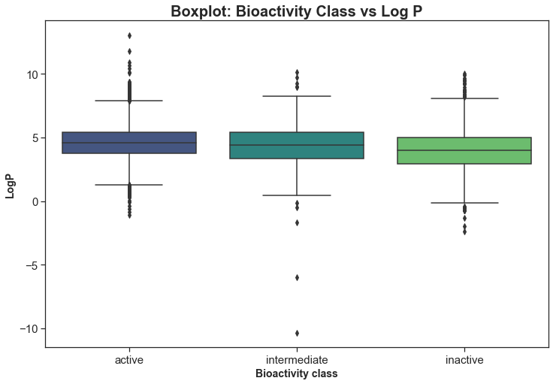
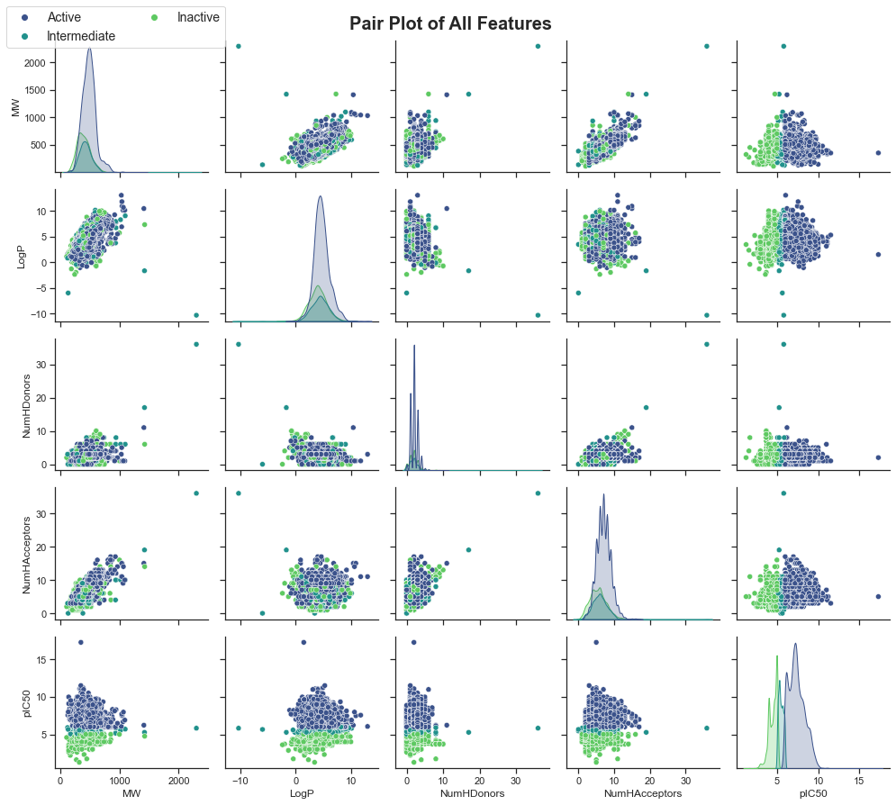
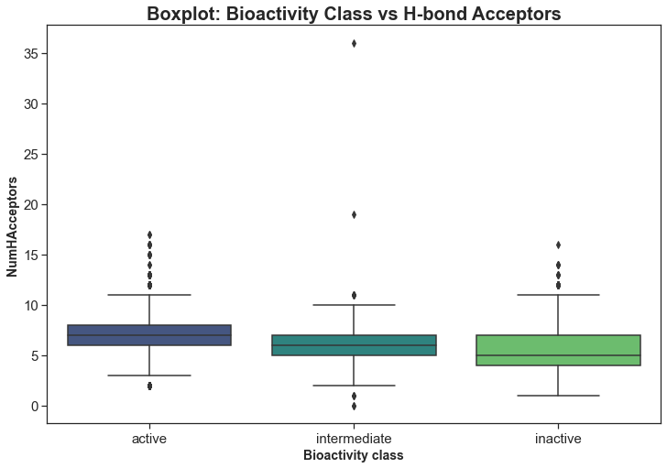
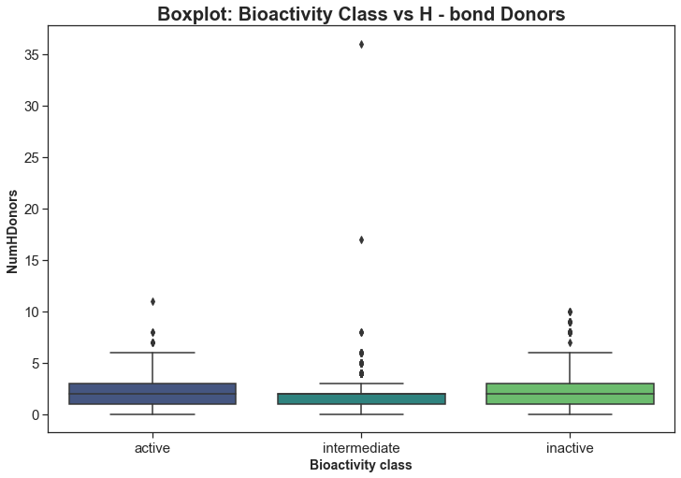
Exploratory Data Analysis

Slide 10

Molecular Fingerprint Computation
Load and read the Data
Prepare input file for PADEL descriptor
Compute fingerprints using PADEL descriptor
Set Variance Threshold value = 0.8 and split the data into training and testing data
PaDEL-Descriptor software calculates molecular fingerprints and descriptors from the canonical formula.
The resulting molecular fingerprint has 0 or 1 values in 881 columns, corresponding to a PubchemFPx value.
PaDEL-Descriptor standardizes data and removes unnecessary salt or irrelevant organic compounds.
'padel.zip' and 'padel.sh' files were downloaded from the Chembl dataset
The final dataset contains molecular ID, molecular fingerprint of 881 columns, and pIC50 value.
Notes:
The next phase involves the conversion of the canonical formula into its corresponding molecular fingerprint with the help of the other descriptors. This is done with the aid of ‘PaDEL-Descriptor’, a software that is specifically designed to calculate molecular fingerprints and descriptors. The software removes any unnecessary salt or irrelevant organic compounds from the molecule and standardizes the data, before providing molecular fingerprints that comprise a 0 or 1 value in each column. Each column corresponds to a ‘PubchemFPx’ value, wherein PubchemFP distinguishes different molecules and x ranges from 0 to 880. The files required ‘padel.zip’ and ‘padel.sh’ were downloaded from the original ‘Chembl’ dataset and uploaded to Google Collaboratory for usage. The final dataset to be operated upon contains the molecular id, the molecular fingerprint of 881 columns and the ‘pIC50’ value.

Slide 11
Model Building
Read CSV file as a dataframe
Eliminate features with low variance
Split Data into Train and Test
Build Regressor Models
SVM Regressor
PCA Regressor
Random Forest Regressor
KNN Regressor
XGBoost Regressor
The data is continuous hence implemented regressor models.
Built Regressor several regression models on the data and chose the best of the lot namaly:
Support Vector Regressor Model
Principal Component Regressor Model
Random Forest Regressor Model
K-nearest neighbor Regressor Model
XGBoost Regressor Model
Evaluated RSE and MAE values for each model
Plotted the Regression line for each model
Compared results of each model to find the best performing model.
Notes:
Thank you Athulya, Now the pIC50 value is continuous and because of which we are using Regressor model. The training model is distributed to 80% training data and 20% test data. We tried 8 different regressor models out of which the top 5 models has been selected and model validity techniques were used. The model validity techniques we used to compare different models are Root Mean Square Error and Mean Absolute Error.

Slide 12
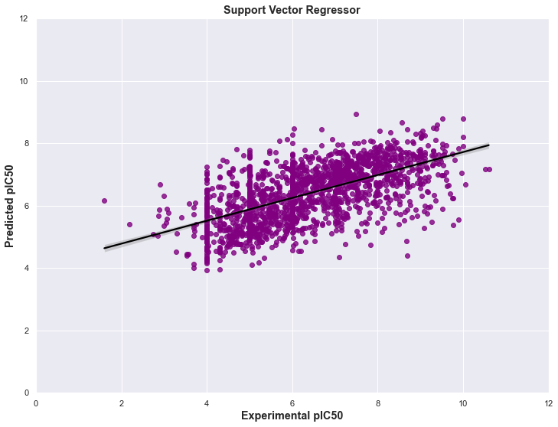
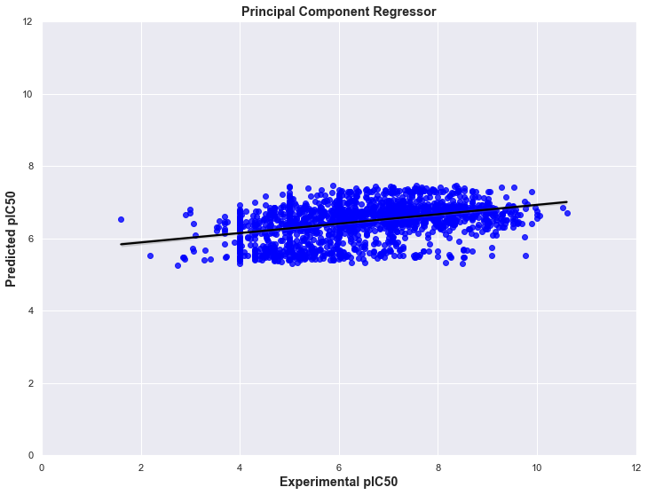
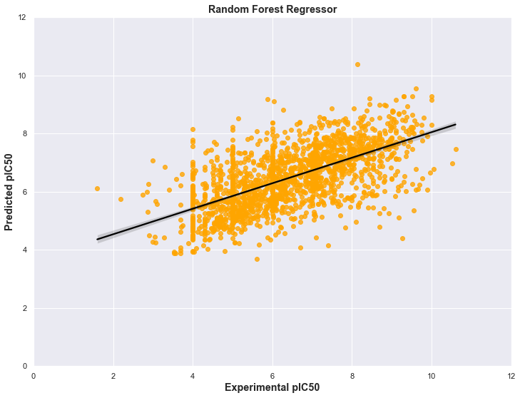
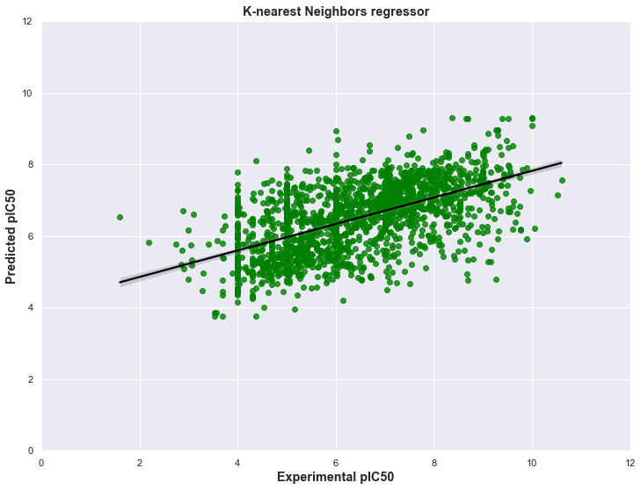
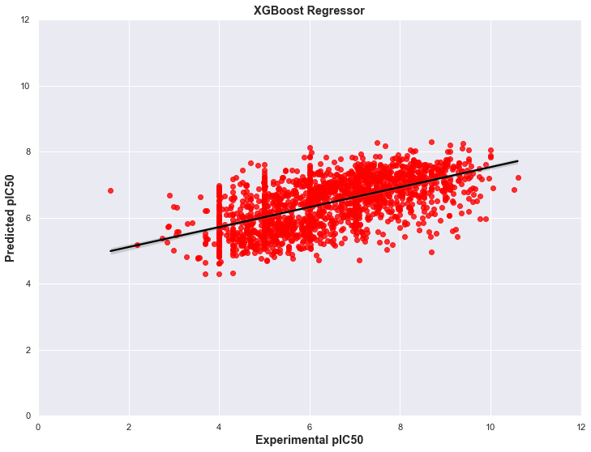
Intermediate Results
Notes:
The following are the plots of experimental pIC50 vs predicted pIC50 for each of the 5 models. The regressor line is considered best when the slope is 1 and intercept 0. In all the models above, we can see that the closet to the origin is the random forest model followed by SVM model and the worst performing model is principal component regressor

Slide 13
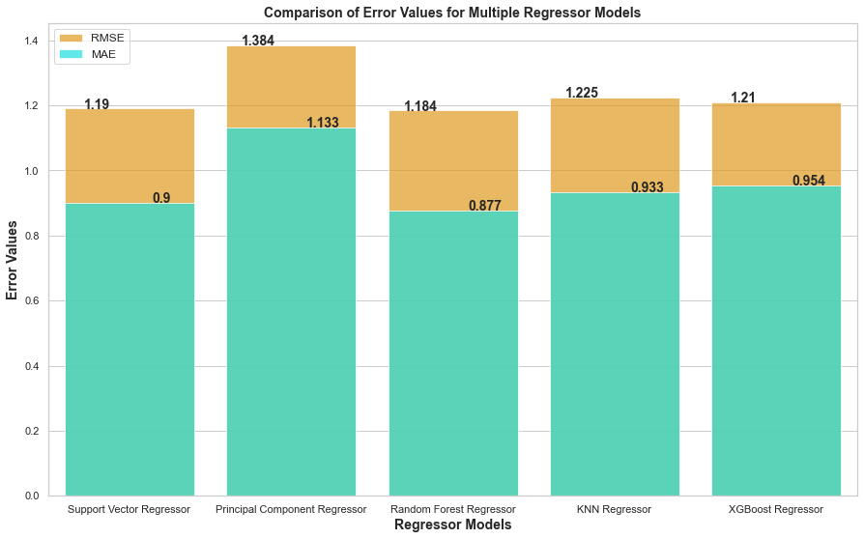
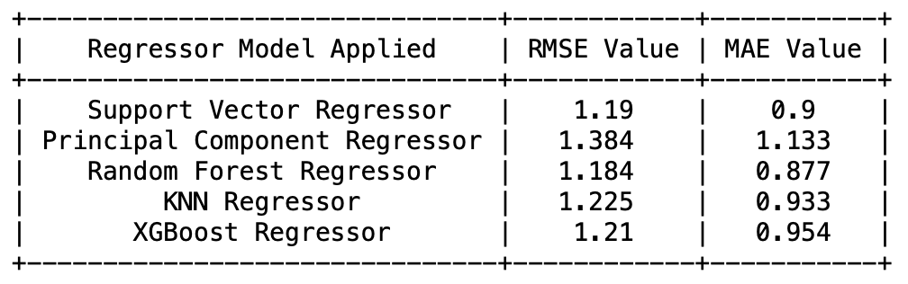
Comparison of Results
The RMSE values for SVM Regressor is 1.19 and Random Forest Regressor is 1.184.
Both are having similar values, however Random Forest regressor with lower RMSE turns out to be the best performing model.
Notes:
As discussed in the pervious slide we saw that random forest performed best according to the plot and since it performed the best the RMSE and MAE values is the lowest for random forest. The image above shows the comparison of RMSE and MAE score of each model where the RSME score depicted in yellow and MAE score in blue. Upon seeing random forest with the lowest rmse value, we tried to increase n_estimators from 200 to 250 and 500 and the max_depth value to see if the rmse value decreses although it was similar to the existing one. Hence we concluded random forest to be the best performing model following svm regressor.

Slide 14
CONCLUSION
Random Forest regressor is the best performing model based on comparing RMSE and MAE values.
RMSE and MAE values of 1.184 and 0.877, respectively, are acceptable since the target variable ranges from 0-10.
SVM regressor is the second-best model.
Regression lines for both models are closer to the origin than other models.
PCA regressor has the farthest regression line from the origin with the highest RMSE value.
Using the Random Forest Regressor model, pIC50 values were predicted very close to the experimental values.
Therefore, we can conclude that the Random Forest Regressor model is effective for predicting pIC50 values and in predicting the drug efficacy.
Project Deployment and Maintanence
Notes:
In conclusion, Random forest is the best performing algorithm and PC regressor is the worst on comparing with RSME and MAE model validity techniques. The pIC50 values were predicted very close to the experimental values when random forest regressor model is used. Lastly, we have deployed the project on Google Cloud.

