Slide 1

ENGR-E 516: Engineering Cloud Computing Financial Portfolio Management
Sricharraan Ramaswamy
Atharva Pandit
Athulya Anand

Slide 2
INTRODUCTION
Everyone’s busy schedule, can be difficult to keep up with regular updates.
One important factor could include managing and getting timely updates on financial affairs, specifically because investment products are unlikely to remain the same over a timeline.
Meaningful financial advice can sometimes not serve the purpose, becoming invaluable.
A customized financial portfolio holding stocks can exclusively cater to the investment needs of individuals. considering their financial interest, financial goals, requirement, willingness, and ability to deal with risk.
Additionally, in most cases, investment portfolios must be designed in such a way where it can minimize an individual’s tax burden.
Objective: Focus on building a customized financial portfolio to hold best performing stocks for investors and individuals who are interested in keeping up with financial affairs given their need and interests.

Slide 3
RELATED WORK
Goyal and Welch (2008) thoroughly assess the performance of variables that have been recommended by the academic literature as being effective predictors of the equity premium and come to conflicting conclusions.
Johannes et al. (2014) provides compelling evidence that, if investors include estimation risk and time-varying volatility in their optimum portfolio issues, they can leverage predictability to enhance out-of-sample performance.
Gu et al. (2020)2 demonstrated the advantage of applying machine learning for empirical asset pricing and linked the improved predictive performance to the acceptance of non-linear predictor interactions. The most accurate methods for predicting returns were trees and neural networks.

Slide 4








WORK-FLOW
Data Collection
ML Model Implementation using LSTM
Developing a User-Interface
Merging ML model and User-Interface in AWS using S3 buckets and Lambda
Validating the calculated results

Slide 5
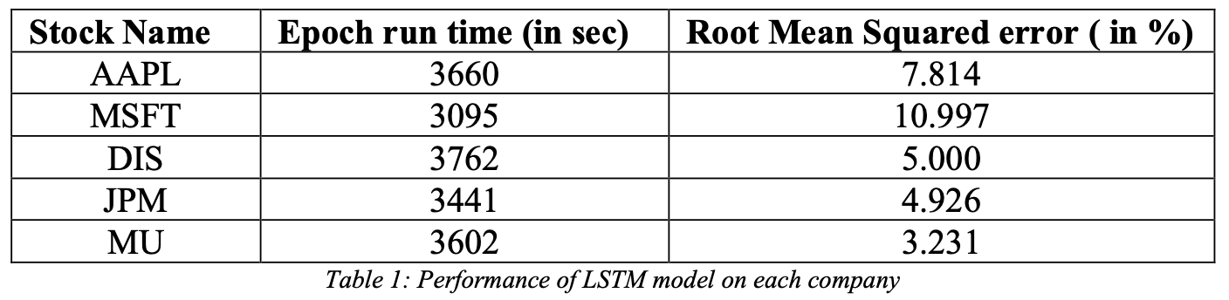
METHODOLOGY
Data Collection
Live data was collected from yahoo finance.
Comprises of opening rate and closing rate per day for the period January 1st, 2012 till today.
Contains the highest rate and lowest rate of a stock per day along with the adjacent closing rate and volume of each stock.
ML Model testing:
We have implemented Long Short-Term Memory (LSTM) ML model for this project.
Predicted the daily closing stock price for the year 2022 and compared it with the current value.
Computed the root mean squared error value as 5%.
Worked on 5 companies namely, Apple (AAPL), Microsoft (MSFT), Disney (DIS), JP Morgan (JPM) and Micron Technology (MU).

Slide 6
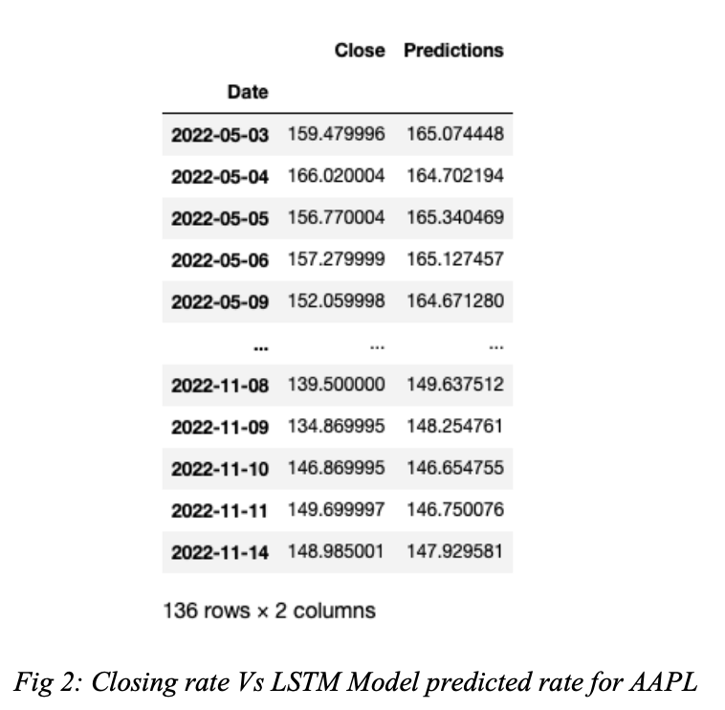
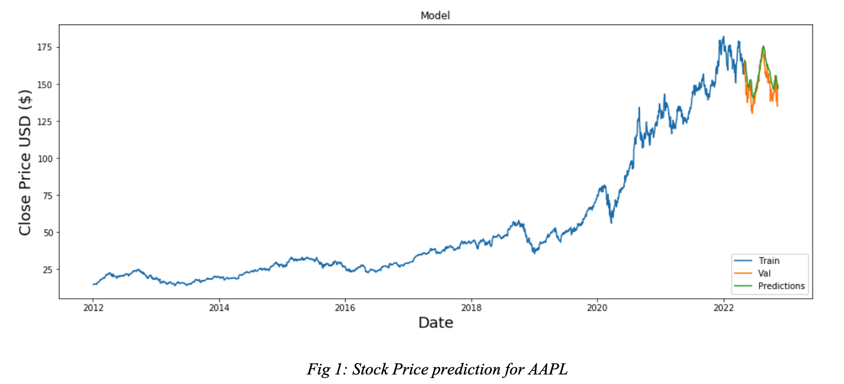
METHODOLOGY

Slide 7
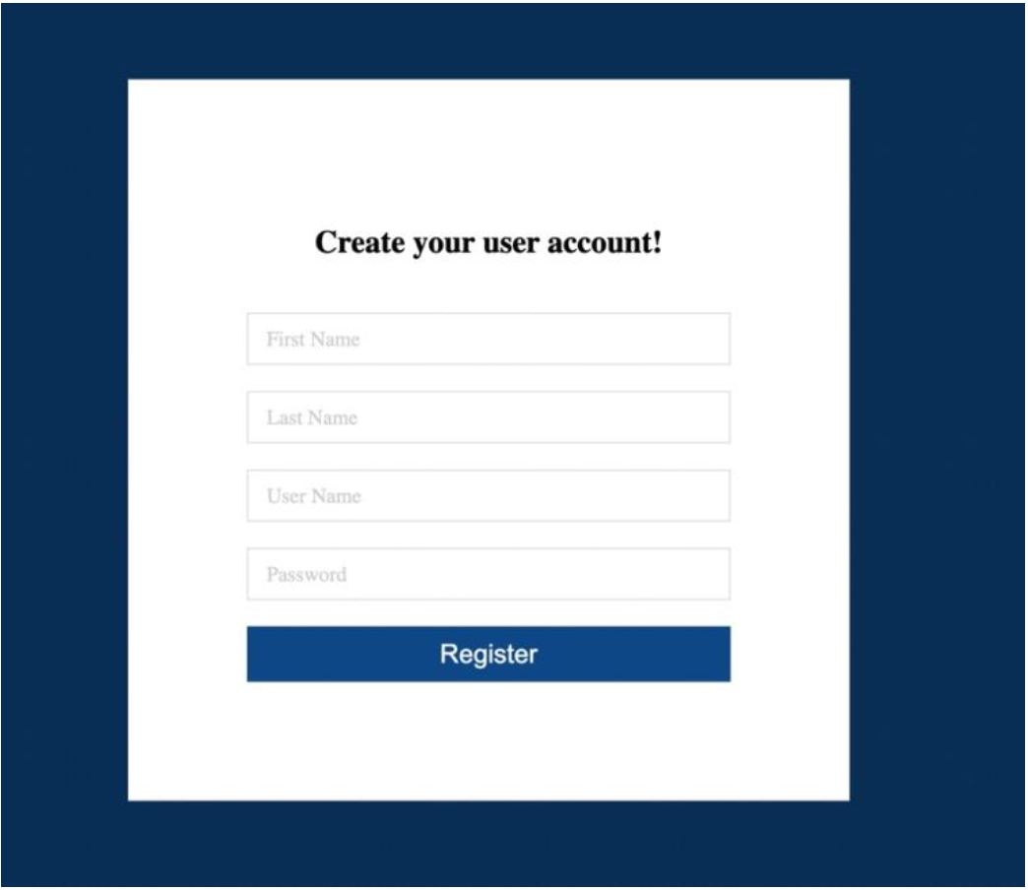
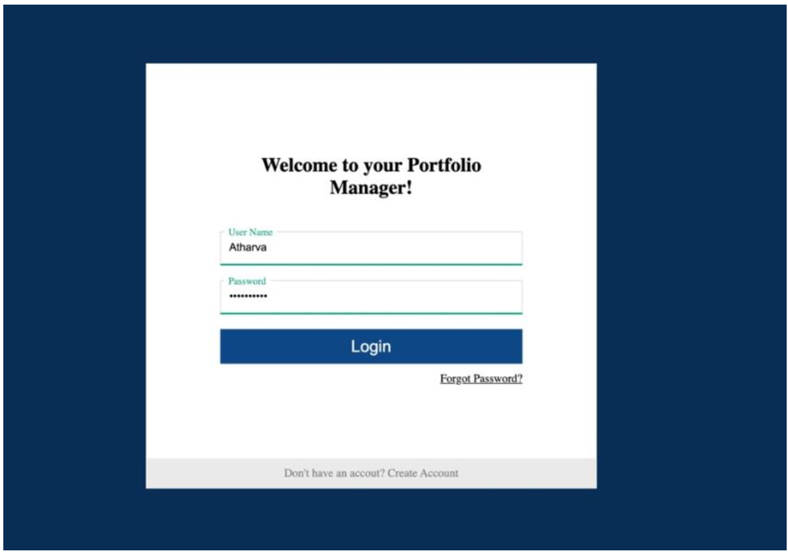
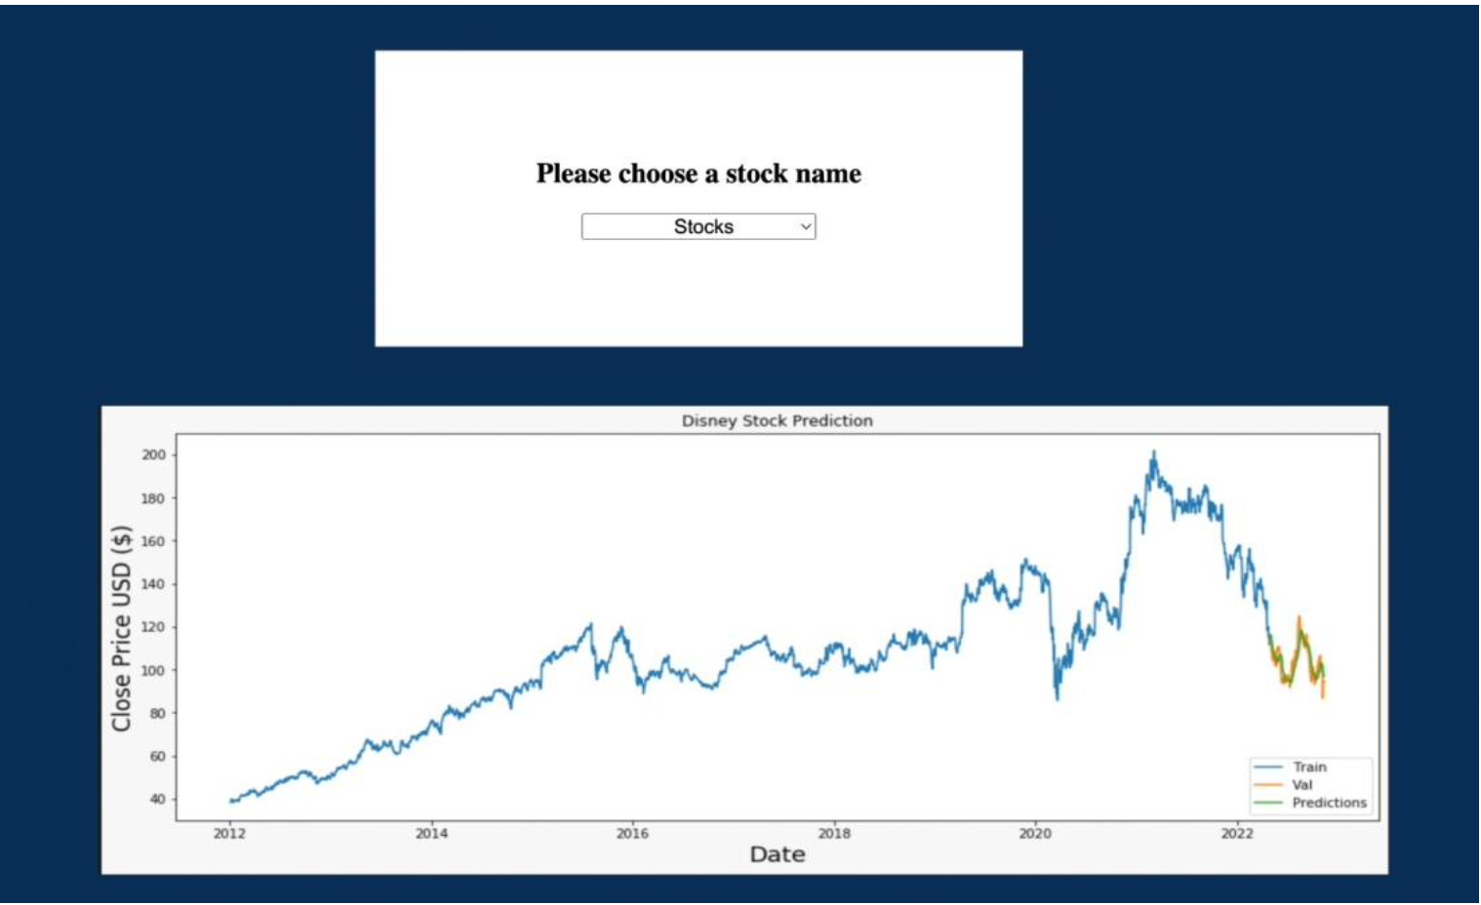
METHODOLOGY
User Interface:
Created a web page for users to access and manage their financial portfolio.
Allows existing users to login with their credentials and new users to create a new account and login in a secure manner.
Upon Signing in, the user can select the company for which they want to view the stock performance and predictions.

Slide 8
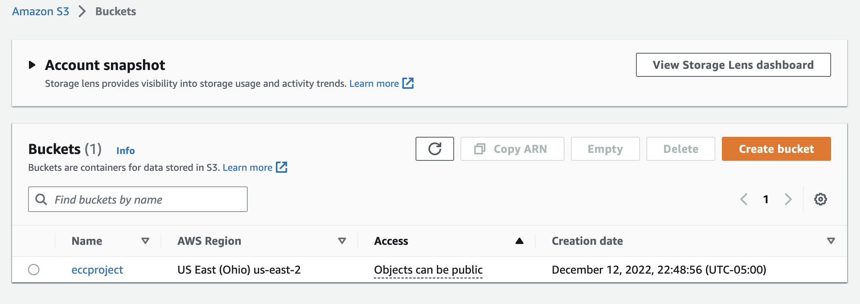
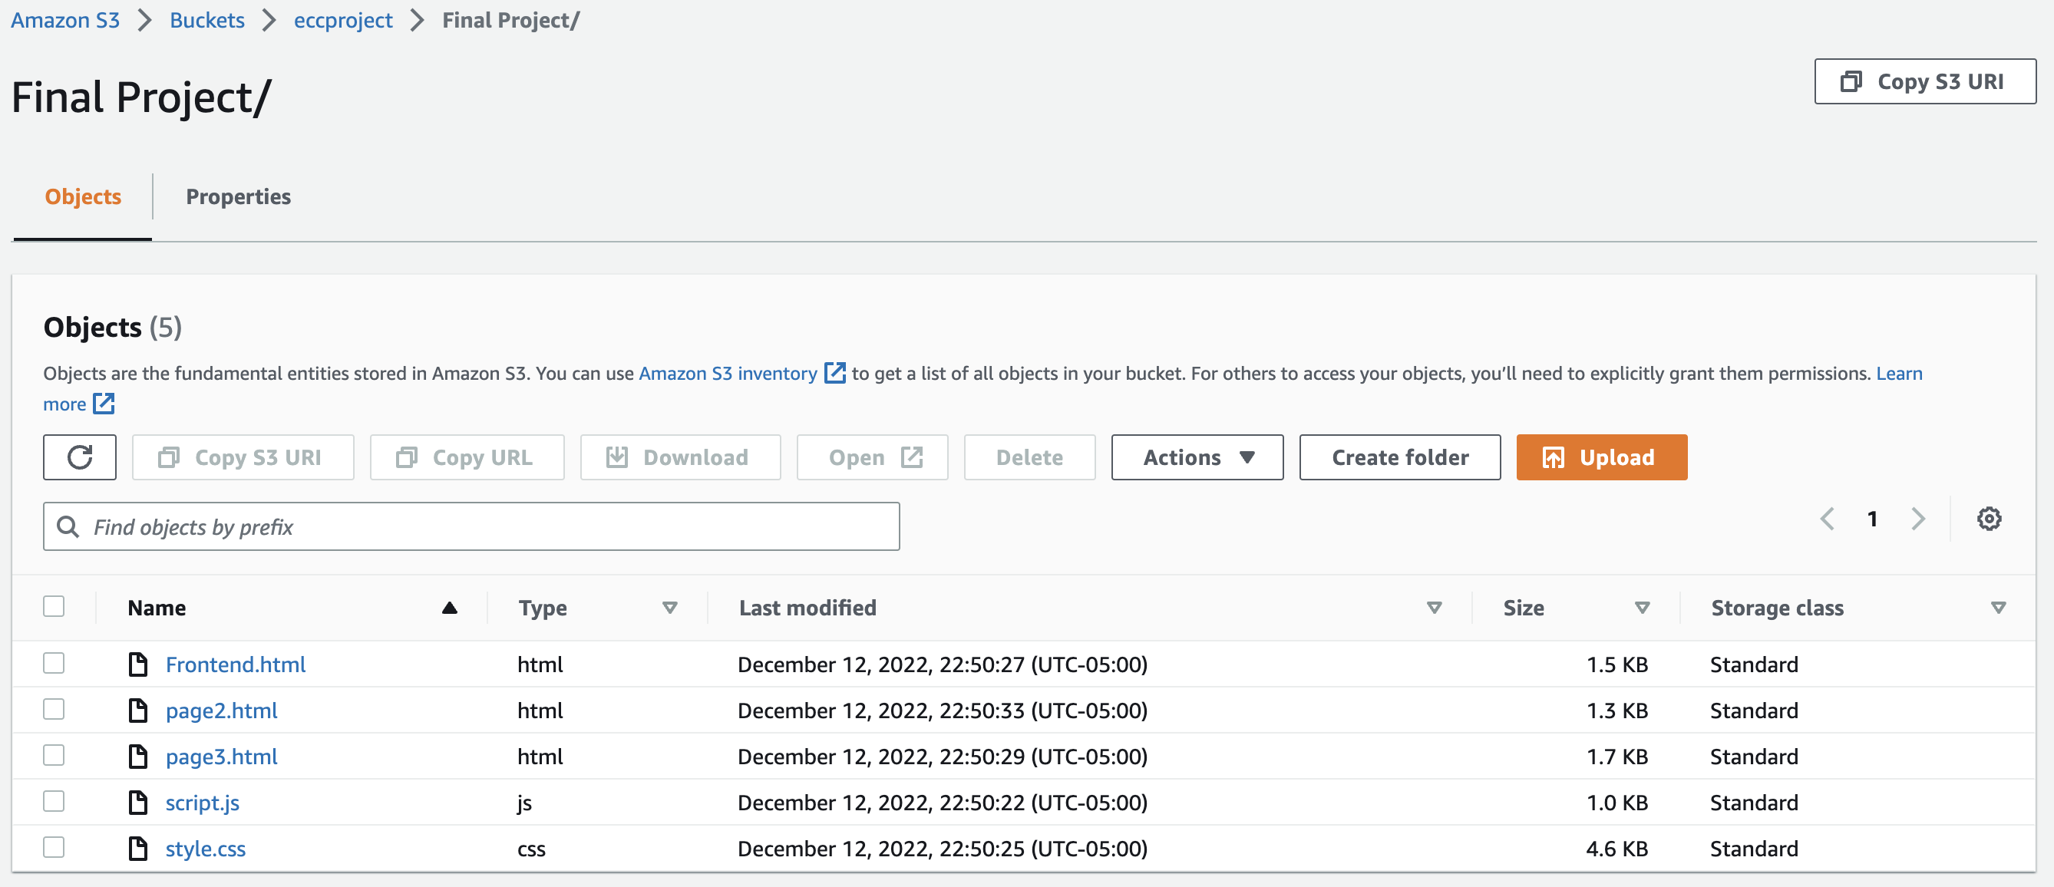
METHODOLOGY
Deploying the Front-end
User-Interface into AWS S3 bucket

Slide 9
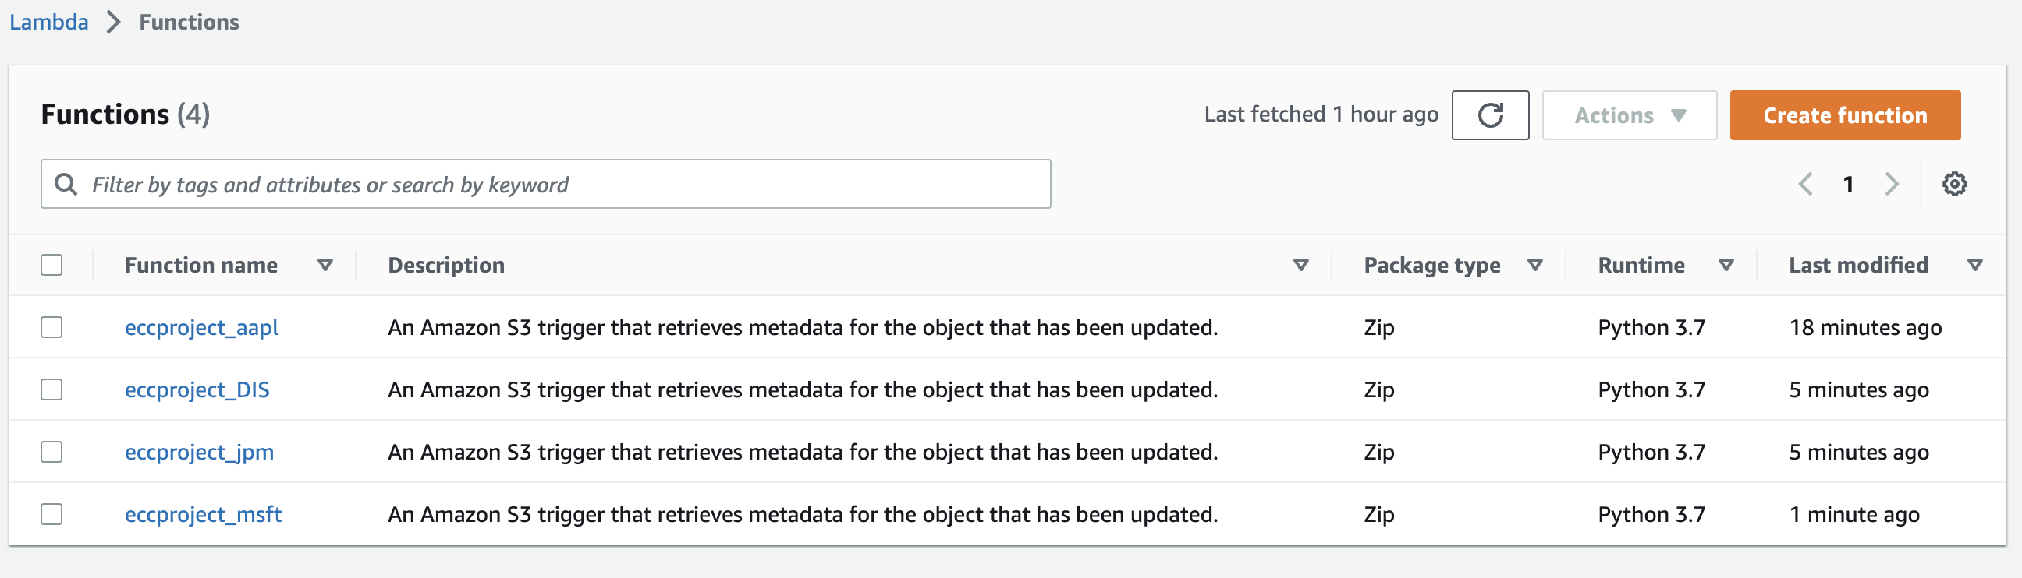
METHODOLOGY
Lambda functions for individual stock

Slide 10
LIMITATIONS & CHALLENGES FACED
Prediction of future stock price is possible, but validation is difficult, thus have used the past dataset to predict future values.
Storing the model is difficult due to varied dataset.

Slide 11
FUTURE SCOPE
Implementing this project on multiple stocks in place of just 5 stocks
Enhancing the UI experience

Slide 12
THANK YOU!

