Slide 1
Scalable & Secure 3-Tier Continuous Delivery
Architecture
-Sridath Jeelugula

Slide 2
Problem Statement & Goals
Design a real-life production-ready 3-tier architecture
Ensure high availability, fault tolerance,and secure tire isolation
Enable fully automated, zero-downtime deployments
Provide centralized logs and historical metrics for observability and troubleshooting

Slide 3
High-Level Architecture
Users access the system via Azure Front Door (CDN)
Web tier hosted on Azure App Service
API tier hosted on Azure App Service
PostgreSQL Flexible Server used as the database
Database is not exposed to the Internet
ACR used as container registry
Log monitoring

Slide 4
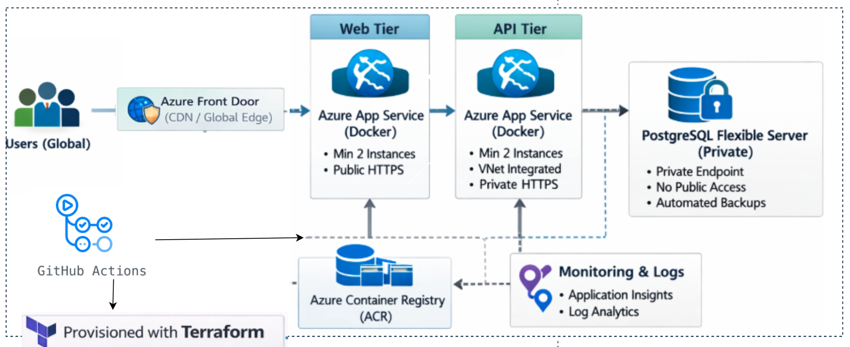
Architecture

Slide 5
Infra as Code
All resources provisioned using Terraform
Infrastructure is version-controlled and reproducible
Supports fast recovery and consistent environments
Avoids configuration drift
State file stored backend

Slide 6
CI/CD & Zero Downtime
GitHub Actions used for CI/CD pipelines
Docker images built and pushed to Azure Container Registry
Deployments go to staging slots first
Slot swap promotes changes to production with zero downtime

Slide 7
High Availability & Autoscaling
App Service Plan configured with minimum 2 instances
Autoscaling enabled to handle load and failures
Instance failures are handled automatically by Azure
Verified using az webapp list-instances

Slide 8
Observability & Historical Metrics
Application and platform logs sent to Log Analytics
Application Insights used for metrics and traces
Historical data available for debugging bottlenecks
No logs stored directly on application hosts

Slide 9
Security Model
Database has no public endpoint
Only API tier can access the database
Web tier communicates with API over HTTPS
Secrets managed via App Service configuration

Slide 10
CDN & Global Performance
Azure Front Door used as a CDN
Routes users based on geographic location
Improves latency and availability
Acts as global entry point for the system

Slide 11
Failure Scenarios & Recovery
Instance failure handled by autoscale and multiple workers
Deployment failures isolated using deployment slots
Database backups allow recovery from failures

Slide 12
Requirement Implementation
CDN by client location → Azure Front Door
High availability & instance failure → App Service autoscale (min 2 instances)
Zero downtime deployments → Deployment slots & swap
Centralized logs & metrics → Application Insights & Log Analytics
Secure DB access → Private networking, API-only access
Backups → PostgreSQL automated backups
IaC → Terraform

Slide 13
Conclusion
Designed a production-ready 3-tier architecture using Azure
Implemented high availability, autoscaling, and zero-downtime deployments
Ensured secure tier isolation with a private database
Enabled centralized observability and historical metrics
Infrastructure and deployments are fully automated via Terraform and CI/CD

Slide 14
Future Improvements
Add automated tests to CI pipelines
Configure alerting on latency and error rates
Implement canary deployments
Enable geo-redundant database backups

