Slide 1
Factors Influencing Housing Prices
Guided by
Prof. Sumona Mondal
Data Mining (IA650)
Presented by
Sri Deepthi Vootla
Jayakishan Minnekanti

Slide 2

Introduction
Understanding the key factors.
Empowering real estate professionals, buyers & sellers.
Uncover the underlying patterns and relationships.

Slide 3
Dataset
Dataset comes from Kaggle.
https://www.kaggle.com/datasets/yasserh/housing-prices-dataset
There are 546 number of observations and 13 columns.
One-hot encoding (0-No, 1-Yes)(1-furnished, 2-semi furnished, 3-unfurnished).
Price(USD) | Area(sq.ft) | bedrooms | bathrooms | stories | mainroad | guestroom | basement | Hotwater heating | Air conditioning | parking | prefarea | Furnishing status
13300000 | 7420 | 4 | 2 | 3 | yes | no | no | no | yes | 2 | yes | furnished
12250000 | 8960 | 4 | 4 | 4 | yes | no | no | no | yes | 3 | no | furnished
12250000 | 9960 | 3 | 2 | 2 | yes | no | yes | no | no | 2 | yes | semi-furnished
12215000 | 7500 | 4 | 2 | 2 | yes | no | yes | no | yes | 3 | yes | furnished
11410000 | 7420 | 4 | 1 | 2 | yes | yes | yes | no | yes | 2 | no | furnished

Slide 4
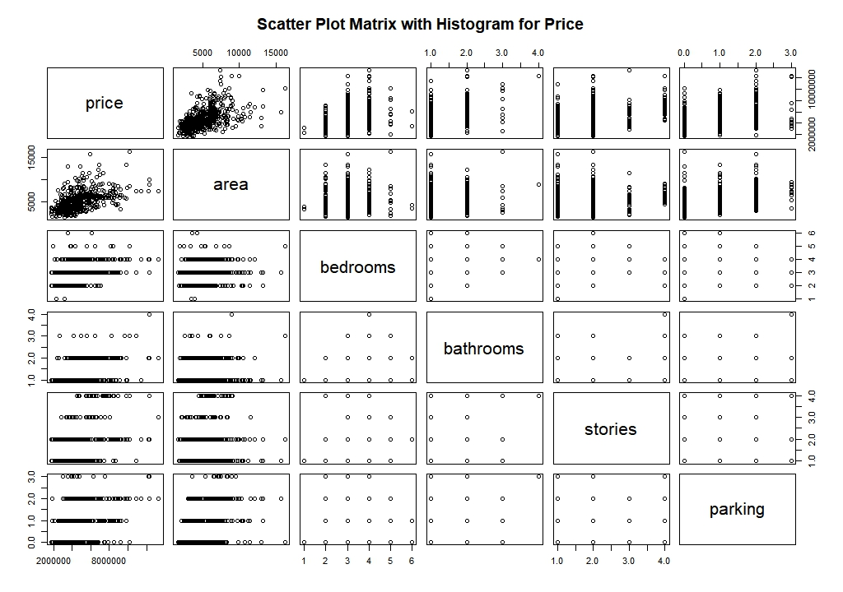
Exploratory Data Analysis - Visualization
Data Exploration:
Data distribution and potential correlations among numerical variables.

Slide 5
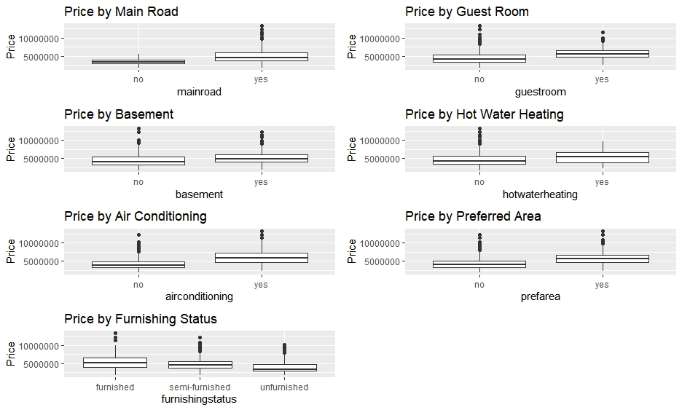
Box plots:
Relationship between categorical features and their impact on prices.
Distribution of the data.

Slide 6
Data Mining Techniques
 | price | area | bedrooms | bathrooms | stories | mainroad | guestroom | basement | hotwaterheating | airconditioning | parking | prefarea | furnishingstatus
area | 1.325208 | 2.629082 | 3.109877 | 2.668208 | 2.861619 | 3.074705 | 3.09598 | 3.065098 | 3.038403 | 2.79905 | 2.997282 | 2.952565 | 3.059937
bedrooms | 1.367503 | 1.371815 | 1.5725 | 1.567982 | 1.523369 | 1.54771 | 1.573126 | 1.549265 | 1.566677 | 1.575002 | 1.538369 | 1.57154 | 1.575336
bathrooms | 1.286559 | 1.499931 | 1.459111 | 1.330648 | 1.238214 | 1.35121 | 1.373235 | 1.35212 | 1.374372 | 1.372812 | 1.370298 | 1.374439 | 1.37353
stories | 1.478029 | 1.560977 | 1.454394 | 1.606262 | 1.499531 | 1.49491 | 1.507121 | 1.505793 | 1.506886 | 1.496926 | 1.507131 | 1.488451 | 1.506957
mainroad | 1.172661 | 1.171058 | 1.171944 | 1.182426 | 1.180734 | 1.599022 | 1.613174 | 1.46492 | 1.613861 | 1.58938 | 1.587164 | 1.611952 | 1.614151
guestroom | 1.212687 | 1.222459 | 1.223237 | 1.224302 | 1.223378 | 1.223997 | 1.191787 | 1.192079 | 1.191015 | 1.188751 | 1.182431 | 1.18184 | 1.186269
basement | 1.320749 | 1.324408 | 1.324971 | 1.345647 | 1.222134 | 1.346828 | 1.202612 | 1.093201 | 1.223981 | 1.222747 | 1.218833 | 1.223985 | 1.223332
hotwaterheating | 1.039293 | 1.063144 | 1.069084 | 1.068964 | 1.068779 | 1.068172 | 1.06885 | 1.069057 | 1.346742 | 1.346707 | 1.346319 | 1.317261 | 1.34437
airconditioning | 1.207262 | 1.347697 | 1.346534 | 1.339002 | 1.327234 | 1.344352 | 1.346408 | 1.347994 | 1.295785 | 1.027626 | 1.067456 | 1.060065 | 1.069077
parking | 1.211959 | 1.234073 | 1.260057 | 1.263867 | 1.242541 | 1.253624 | 1.258213 | 1.263375 | 1.261878 | 1.263647 | 1.347896 | 1.345114 | 1.347528
prefarea | 1.148598 | 1.212869 | 1.215931 | 1.200861 | 1.214086 | 1.205475 | 1.215609 | 1.189226 | 1.205614 | 1.213212 | 1.211409 | 1.259165 | 1.258986
furnishingstatus | 1.095641 | 1.119049 | 1.118431 | 1.119043 | 1.118997 | 1.113705 | 1.118277 | 1.117117 | 1.119108 | 1.118672 | 1.11485 | 1.119109 | 1.215864
Multi-collinearity
Correlation between the predictor variables.
Variance Inflation Factor(VIF).

Slide 7
Multiple linear regression
Significant value is 0.05.
Area, bathrooms and air conditioning – high impact.
 | Estimate | Std. Error | t value | Pr(>|t|)
(Intercept) | 4094376.99 | 425322.52 | 9.627 | 0.0000000000000002 | ***
area | 231.3 | 25.12 | 9.209 | 0.0000000000000002 | ***
bedrooms | 71621.13 | 75201.1 | 0.952 | 0.341441
bathrooms | 1005655.58 | 107673.54 | 9.34 | 0.0000000000000002 | ***
stories | 505742.09 | 67257.79 | 7.519 | 0.000000000000332 | ***
mainroad | -426407.58 | 146954.95 | -2.902 | 0.003906 | **
guestroom | -339978.69 | 133732.49 | -2.542 | 0.011370 | *
basement | -378372.21 | 113757.1 | -3.326 | 0.000957 | ***
hotwaterheating | -1123711.5 | 226338.24 | -4.965 | 0.000000999495553 | ***
airconditioning | -870808.7 | 114261.61 | -7.621 | 0.000000000000167 | ***
parking | 297226.54 | 61017.17 | 4.871 | 0.000001570445956 | ***
prefarea | -606230.07 | 121623.94 | -4.984 | 0.000000907870375 | ***
furnishingstatus | -208295.77 | 66200.66 | -3.146 | 0.001770 | **
R-Squared
0.7162

Slide 8
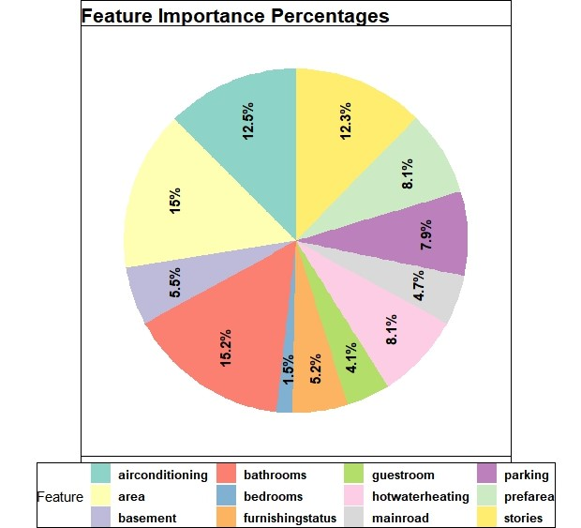
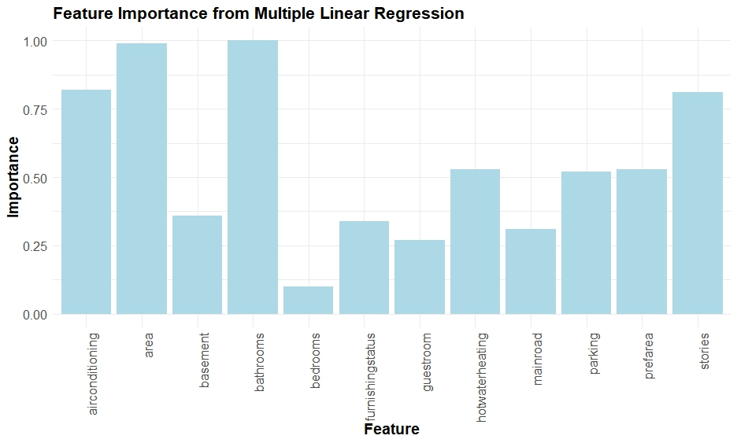
Factors Influencing

Slide 9
Conclusion and Future Research
Conclusions
Based on this study:
Area, no.of bathrooms, stories and air conditioning have more effect on prices.
Main road, guest rooms, basements, and hot water heating have positive impact.
Furnishing status of a property played a role.
Limitations
Data quality and size.
Assumptions of linear regression.
Omitted variables.
Future Research
focus on gathering larger and more diverse datasets.
considering additional relevant variables.
exploring advanced modeling techniques.

Slide 10

Thank you
Guided By : Prof. Sumona Mondal

