Slide 1
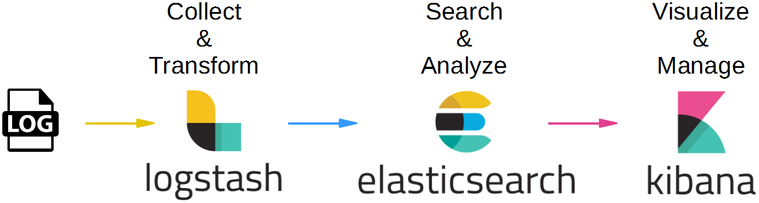
Elasticsearch is widely used for application performance, monitoring and observability-related tasks including security information and event management for cyber threat hunting for many industries.

Slide 2
ELK Stack
The ELK stack is a collection of three Open source products - Elasticsearch, LogStash and kibana. they are developed, managed and maintained by the company called Elastic.
E - Open source full-text search and analytics engine.
L - Used for server-side data processing pipeline for Elasticsearch.
K - Open source browser based visualization tool, mainly used to analyze large volume log files.
W

Slide 3
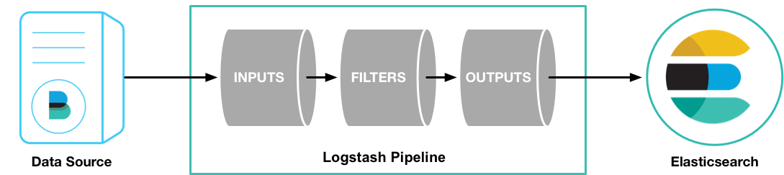
Logstash
Input : Passing logs to process them into machine understandable format.
Filters: It is a set of conditions to perform a particular action or event
Output: Decision maker for processed event or log

Slide 4
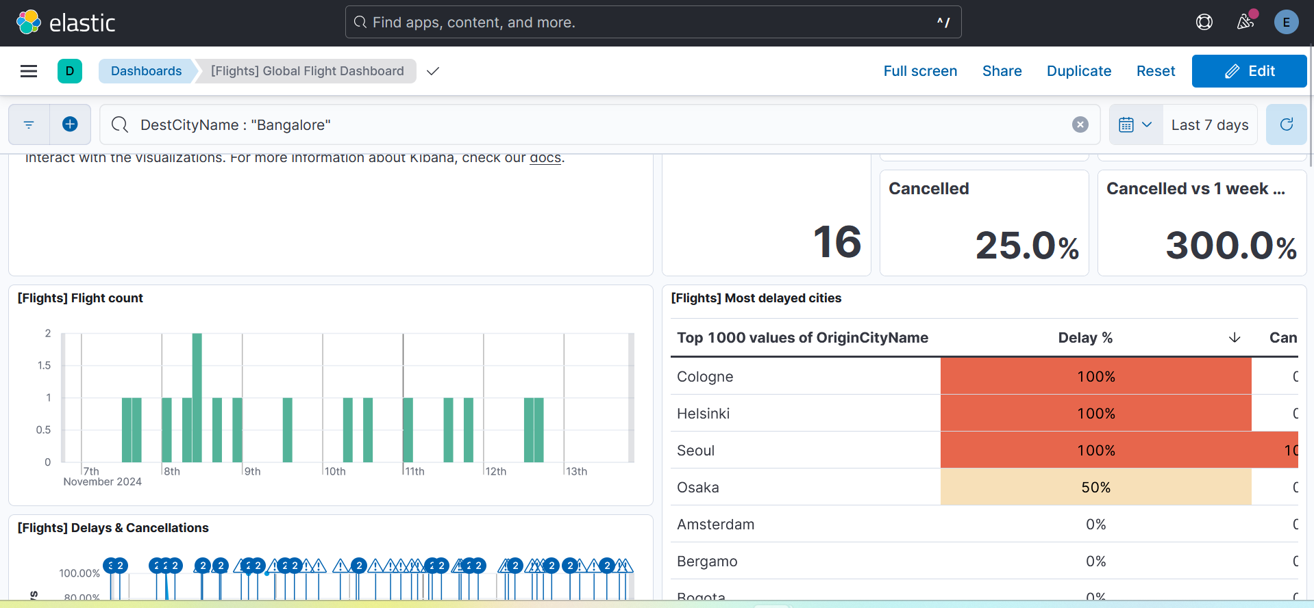
Dashboards

Slide 5
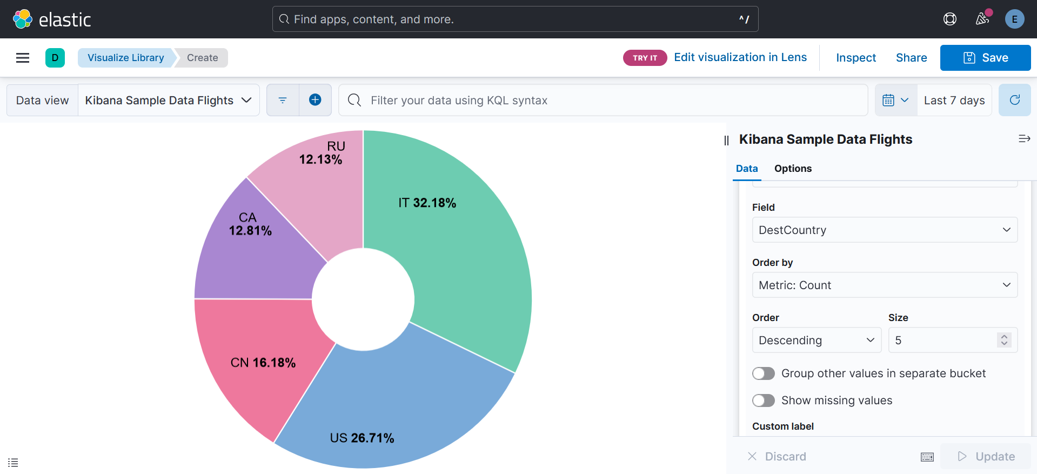
Pie Chart Visualization

Slide 6
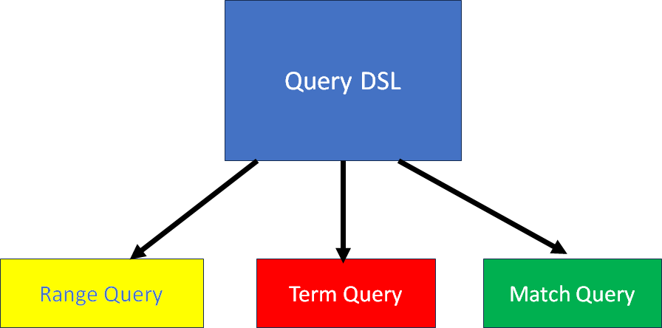
Querying in DSL
W
Range Queries: Useful to filter data from a specific period.
Term Queries: Useful for an exact match.
Match Queries: More flexible and useful for broader and targeted result.

Slide 7
Boolean Queries
Elasticsearch provides a powerful querying known as query DSL(domain specific language).
The must clause specifies conditions that must be met for a document to be considered a match.
The must_not clause excludes documents that match specific criteria,
The should clause specifies additional conditions that are desirable, but not required for a document to be considered a match. if the document matches, it will contribute to the scoring
The filter clause applies conditions that must be met but does not affect the relevant score of the documents.

Slide 8
Visualization in Kibana
Elasticsearch provides a powerful querying known as query DSL(domain specific language).
The must clause specifies conditions that must be met for a document to be considered a match.
The must_not clause excludes documents that match specific criteria,
The should clause specifies additional conditions that are desirable, but not required for a document to be considered a match. if the document matches, it will contribute to the scoring
The filter clause applies conditions that must be met but does not affect the relevant score of the documents.

Slide 9
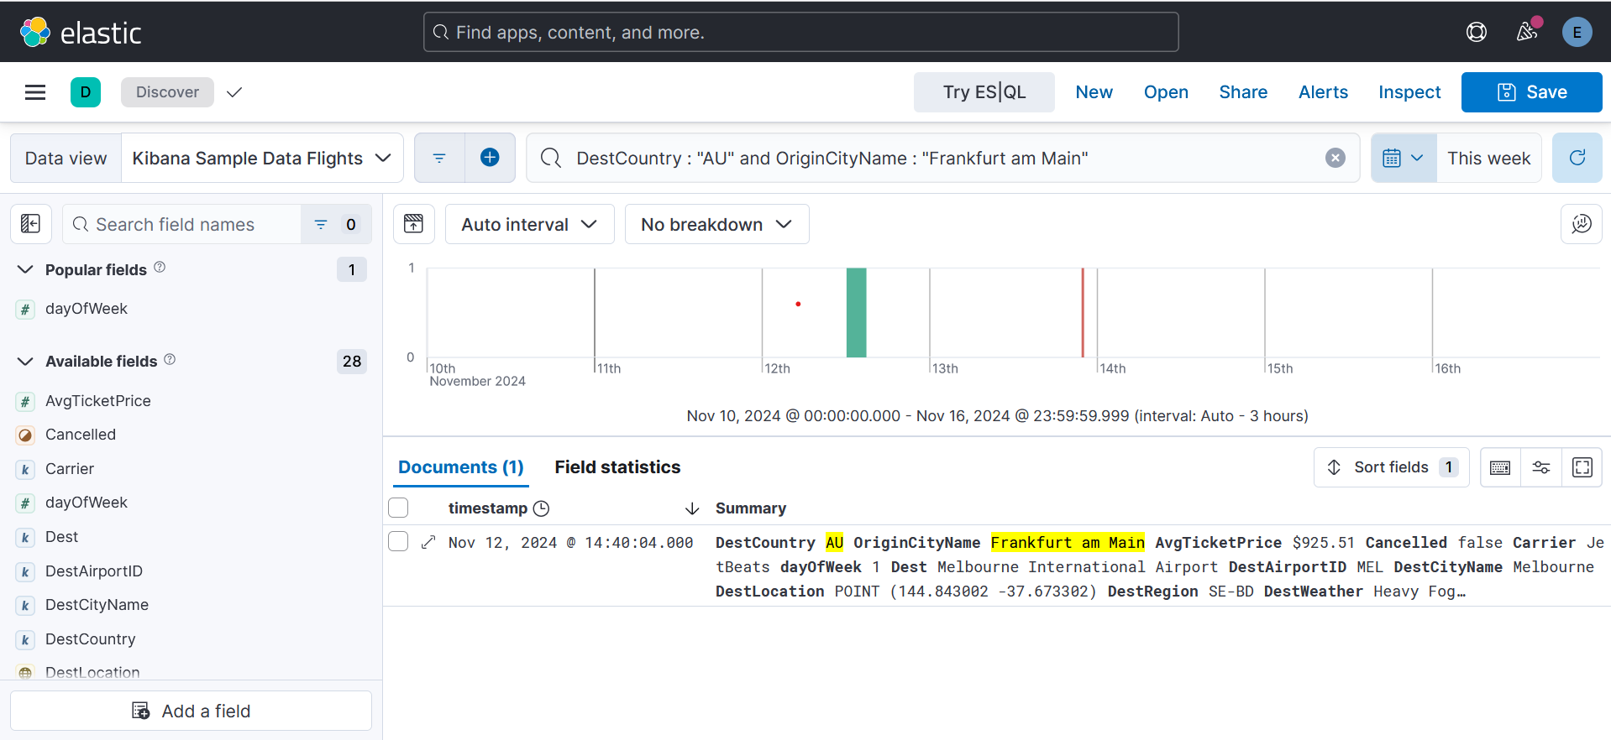
Visualize data using KQL

Slide 10
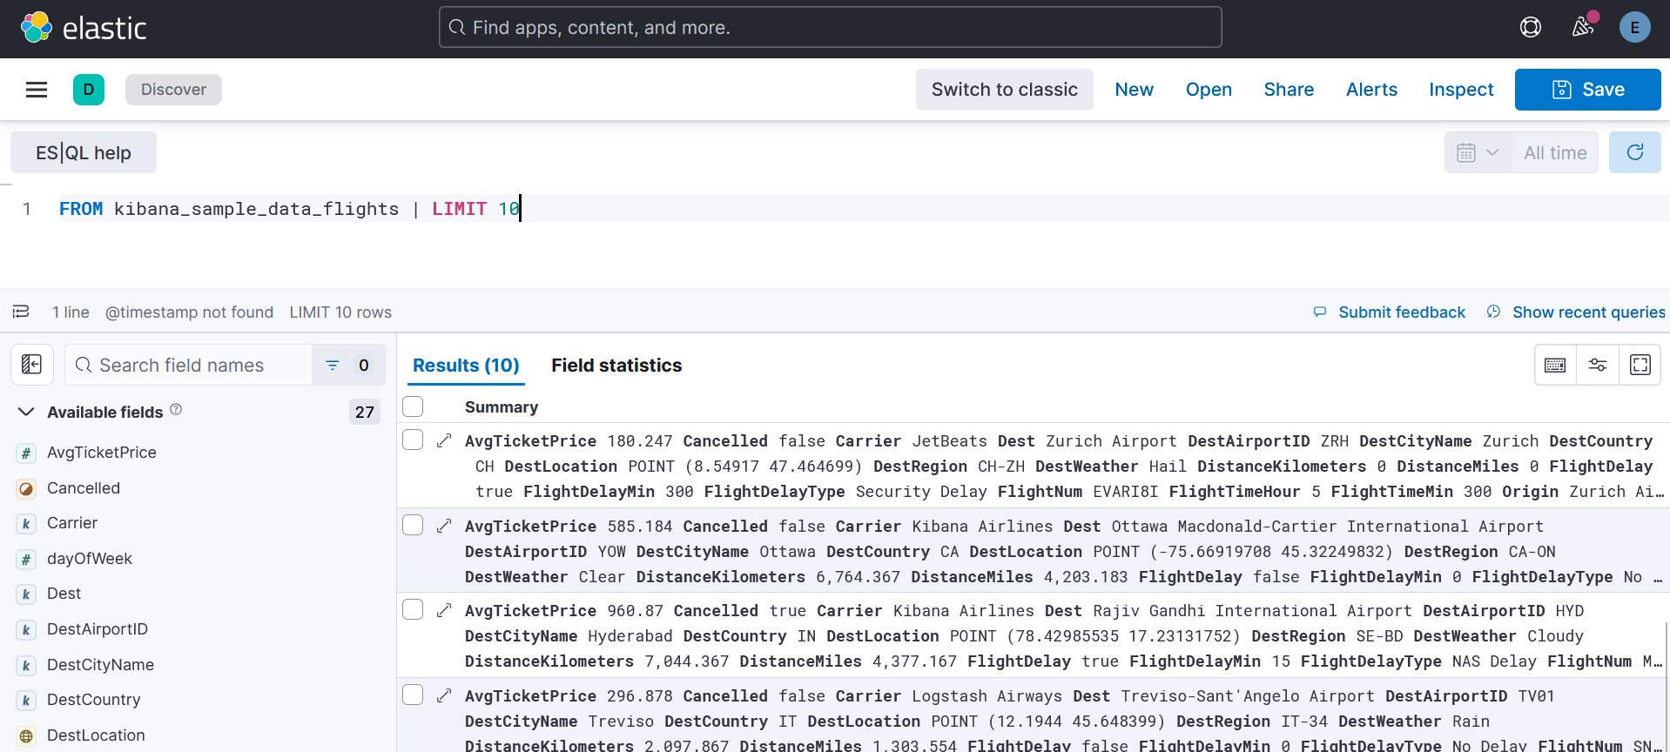
Visualize data using ES|QL

