Slide 1
Data Science Bootcamp Week 1 Movie Project
Team Orange
Friday, July 1, 2016
Notes:
Template version: 7/29/2013, for PowerPoint 2010

Slide 2
Outline
Data Quality
Visualization
Model Building

Slide 3
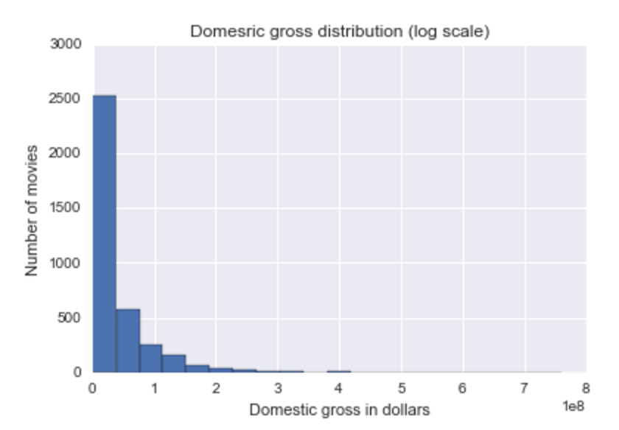
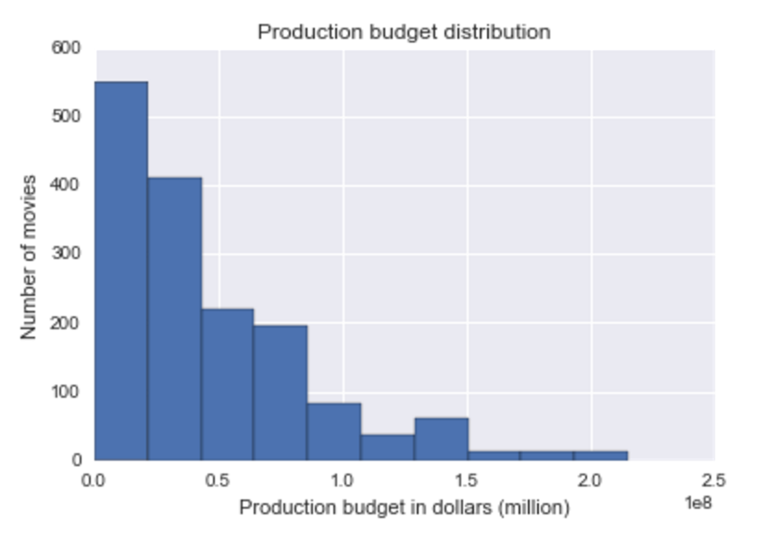
Data exploration provided insights on data structure and quality. Fields with high missing % were processed before entering the model
Raw Data Fields | % Missing
release_date_limited | 92.1%
production_budget | 57.3%
director | 41.7%
worldwide_gross | 24.3%
num_user_ratings | 14.0%
metascore | 12.3%
runtime_minutes | 11.6%
studio | 10.7%
complete | 10.2%
genre | 10.2%
metacritic_page | 10.2%
num_critic_reviews | 10.2%
num_user_reviews | 10.2%
rating | 10.2%
release_date | 10.2%
user_score | 10.2%
opening_per_theater | 4.8%
opening_weekend_take | 4.8%
widest_release | 4.1%
domestic_gross | 2.0%
release_date_wide | 0.3%
year | 0.2%
alt_title | 0.0%
mojo_slug | 0.0%
title | 0.0%
Number of records after merging: 3728

Slide 4
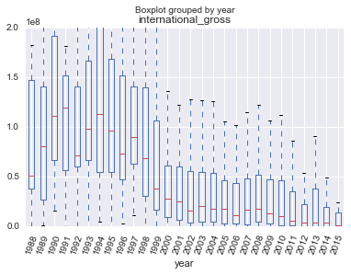
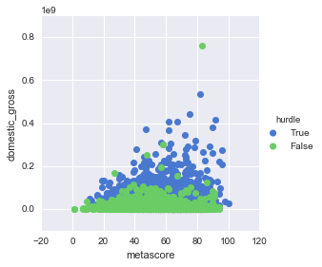
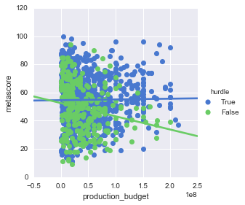
International markets won’t save your poorly rated big budget movie
Graph
Take away
International grosses have declined substantially, post-2000 is a ‘new normal’
Cannot relay on international blockbusters as in the past
All data include only post 2000 movies from here on out, and focus on domestic gross
1
Profitable movies do not require a good metascore, but high grossing ones do
2
High reviews are a misleading target and cannot be ‘bought’
Ensure big budget movies will score 40+, at all costs

Slide 5
Investment strategy depends on the extra budget and many other factors
 | Production Budget | Run time (min) | Famous movie directors | Release in summer break | Release in holiday season | Created by Big Studio
Coefficients | $0.73 | $280,900 | $21,450,000 | $9,168,000 | $6,580,000 | $24,290,000
Cost | $1 dollar | $250,000 per min (Hollywood) | $20,000,000 (Woody Allen) | $6,000,000 | $5,000,000 | $40,000,000

Slide 6
Questions?

