Slide 1
FACE IMAGE RESTORATION WITH GFP(Generative Face Prior) - GAN
NAME : SRIDEVI T
REGISTER NUMBER: 711721243311
NMID : au711721243311
DEPARTMENT: ARTIFICIAL INTELLIGENCE AND DATASCIENCE

Slide 2
PROJECT TITLE
FACE IMAGE RESTORATION WITH GFP(Generative Face Prior) - GAN

Slide 3


AGENDA
1.Problem Statement
2.Project Overview
3.End Users
4.Our Solution and Proposition
5.Key Features
6.Modelling Approach
7.Results and Evaluation
8.Conclusion
3/21/2024 Annual Review

Slide 4

PROBLEM STATEMENT
Facial images often suffer from degradation, including low resolution, noise, and damage, posing challenges for identification and analysis.
Traditional methods for restoring degraded facial images are inadequate due to their limited ability to handle complex degradation patterns and preserve important facial features.
To Utilize advanced deep learning techniques, such as Generative Adversarial Networks (GANs), to automatically restore degraded facial images.

Slide 5

PROJECT OVERVIEW
Our project aims to leverage GFPGAN (Generative Face Prior GAN), a state-of-the-art deep learning model, for face image restoration.
To enhance the visual quality of degraded facial images while preserving important facial features , This involves fine-tuning the pre-trained GFPGAN model on a dataset of degraded facial images paired with high-quality counterparts.
Through this process, the model learns to effectively restore facial images by incorporating generative facial priors.

Slide 6

WHO ARE THE END USERS?
Law Enforcement Agencies: Police departments, investigative agencies, and forensic teams
Medical Professionals: Dermatologists, plastic surgeons, and medical imaging specialists
Biometric Technology Providers: identity verification.
Historical Preservation Organizations: Museums, archives, and historical preservation societies

Slide 7

YOUR SOLUTION AND ITS VALUE PROPOSITION
Leveraging Generative Adversarial Networks (GANs) to produce high-quality facial images with enhanced details and reduced artifacts.
Ability to handle diverse degradation patterns like noise, blur, and damage, surpassing traditional methods.
Incorporating perceptual loss to maintain crucial facial features, ensuring accurate identification and analysis.
Automated process reduces the need for manual intervention, making restoration faster and scalable, promising advancements in facial recognition, forensic analysis, and medical imaging.

Slide 8

THE WOW IN YOUR SOLUTION
GANs deliver unmatched clarity, breathing life into degraded facial images with remarkable fidelity.
GANs effortlessly handle complex degradation patterns, ensuring flawless restoration beyond traditional methods.
Facial features are faithfully preserved, marking a paradigm shift in accuracy and detail restoration.
Automation streamlines the process, expediting results and scaling applications in facial recognition, forensics, and medical imaging.
3/21/2024 Annual Review
8

Slide 9
MODELLING
Facial Image Restoration with GANs:
Training Process:
1.Data Collection: Gathering datasets consisting of pairs of degraded facial images and their corresponding high-quality counterparts. These pairs serve as training examples for the GAN.
2. Preprocessing: Normalizing the images and perform necessary preprocessing steps such as resizing or cropping to ensure uniformity in the dataset.
3.Training Setup: GAN is trained in an adversarial manner, where the generator network learns to generate realistic high-quality facial images from degraded inputs, while the discriminator network learns to distinguish between real high-quality images and those generated by the generator.
4.Optimization: optimization algorithms such as stochastic gradient descent (SGD) or Adam to minimize the adversarial loss between the generator and discriminator networks.
2.Generator Architecture:
1.Input: The generator takes degraded facial images as input, typically represented as low-resolution images or images with noise, blur, or other forms of degradation.
2.Architecture: The generator maps the input degraded images to their corresponding high-quality counterparts by learning the complex relationships between the two domains.
9

Slide 10
3.Layers: The generator typically consists of multiple layers of convolutional, upsampling, and activation functions, gradually transforming the input images to higher-resolution outputs with enhanced visual quality.
4.Loss Function: Train the generator to minimize a combination of pixel-wise reconstruction loss and adversarial loss, ensuring that the generated images are both visually similar to the ground truth high-quality images and realistic enough to fool the discriminator.
3.Discriminator Role:
1.Function: The discriminator network plays a critical role in the adversarial training process by learning to distinguish between real high-quality facial images and those generated by the generator.
2.Architecture: The discriminator network architecture, typically consisting of convolutional layers followed by fully connected layers and activation functions.
3.Training Objective: the discriminator is trained to maximize its ability to differentiate between real and generated images by minimizing its classification loss.
4.Adversarial Training: The discriminator provides feedback to the generator by assessing the realism of the generated images. As the generator learns to produce more realistic images, the discriminator's ability to distinguish between real and generated images improves, leading to better quality output from the generator over time.

Slide 11
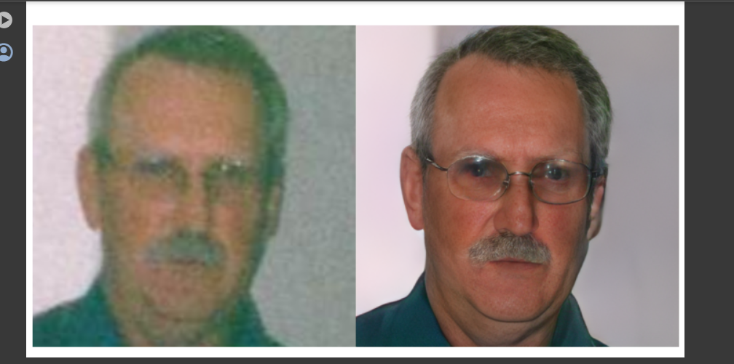
RESULTS
11

