Slide 1
19CSE204 Object Oriented Paradigm
Lecture 1
Overview of different programming paradigms
Notes:
19CSE204 Object oriented paradigm

Slide 2
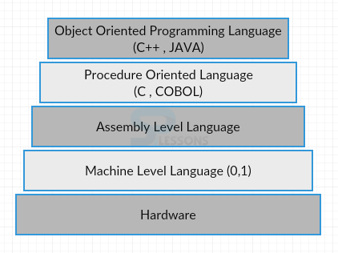
Evolution of Programming Languages
A computer language is a set of predefined words that are combined into a program according to predefined rules (syntax).
Over the years, computer languages have evolved from machine language to high-level languages.
July2020
Notes:
19CSE204 Object oriented paradigm

Slide 3
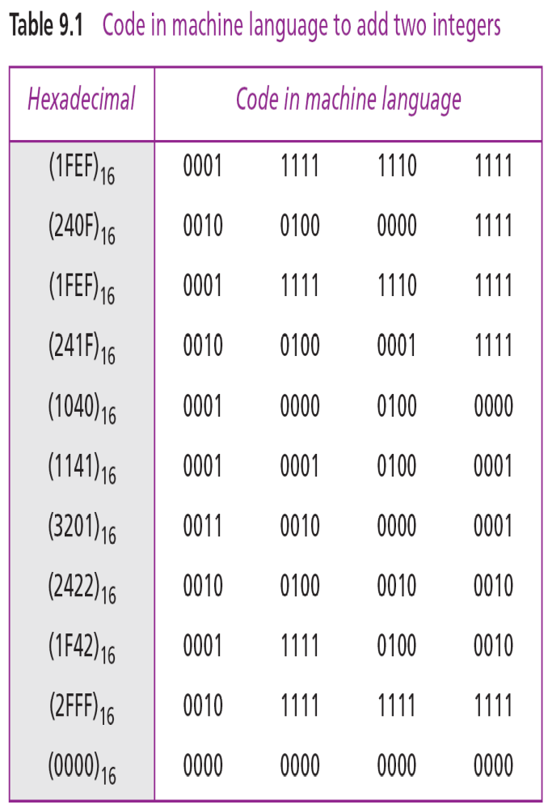
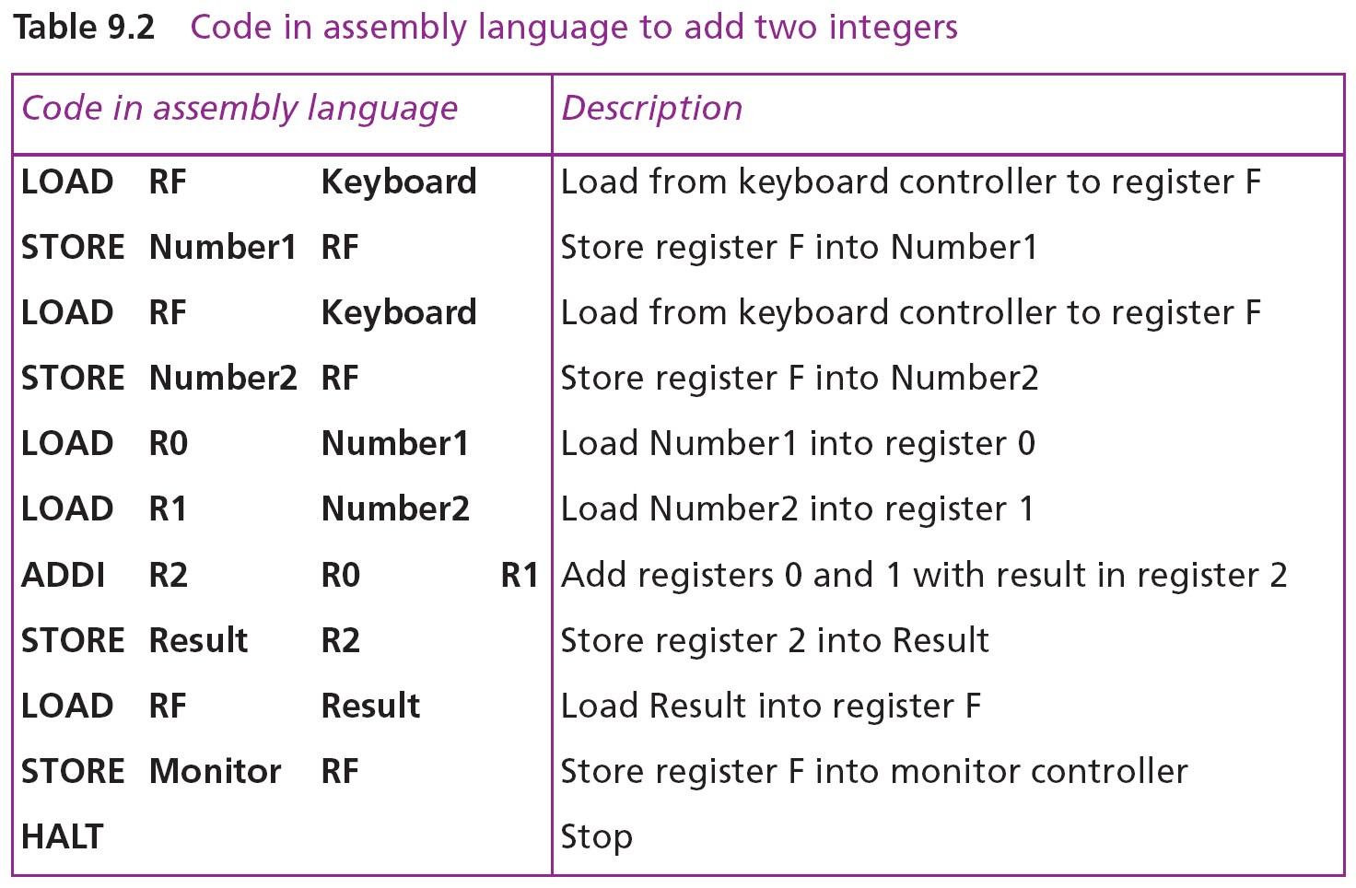
July2020
Notes:
19CSE204 Object oriented paradigm

Slide 4
Evolution of Programming Languages - Paradigm
Today, computer languages are categorized according to the approach they use to solve a problem.
A paradigm, therefore, is a way in which a computer language looks at the problem to be solved.
July2020
Notes:
19CSE204 Object oriented paradigm

Slide 5
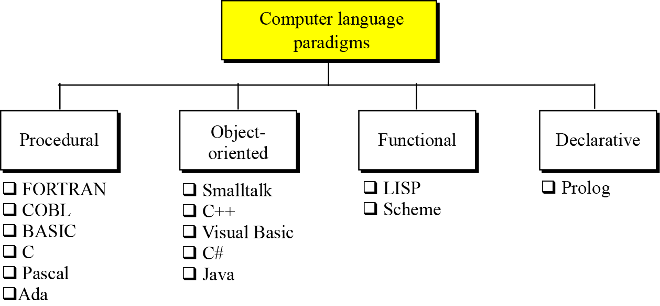
Evolution of Programming Languages -contd
We divide computer languages into four paradigms: procedural, object-oriented, functional and declarative.
July2020
Notes:
19CSE204 Object oriented paradigm

Slide 6
Picture courtesy
CONCEPTS OF OBJECT ORIENTED PROGRAMMING
By Grady Booch
By Ravi P Reddy
July2020

Slide 7
Sample C program
#include <stdlib.h>
#include <time.h>
#define SIZE 5
struct bot { int xpos; int ypos; };
struct bot initialize(struct bot b);
int main()
{
  struct bot robots[SIZE];
  int x;
  srandom((unsigned)time(NULL));
  for(x=0;x<SIZE;x++)
  {
    robots[x] = initialize(robots[x]);
    printf("Robot %d: Coordinates: %d,%dn", x+1,robots[x].
    xpos,robots[x].ypos);
  }
  return(0);
}
struct bot initialize(struct bot b)
{
  int x,y;
  x = random();
  y = random();
  x%=20;
  y%=20;
  b.xpos = x;
  b.ypos = y;
  return(b); }
July2020
Notes:
19CSE204 Object oriented paradigm

Slide 8
Problems with Procedural Languages
Data does not have an owner.
Difficult to maintain data integrity.
Functions are the building blocks.
Many functions can modify a given block of data.
Difficult to pinpoint bug sources when data corrupted.
July2020

Slide 9
Problems with Procedural Languages
Function 1
Function 3
DATA
Function 2
July2020

Slide 10
Problems with Procedural Languages
Uninitialized variables.
int k ;
printf(“%d”,k) ;
July2020

Slide 11
Problems with Procedural Languages
Resource Deallocation Problems
Examples: Memory leaks, open files, open database connections, open network connections.
int* kp;
kp = (int*) malloc(1000);
kp = (int*) malloc(1000);
kp = (int*) malloc(1000);
July2020

Slide 12
Problems with Procedural Languages
Insufficient support for abstraction
ADT = data + functions
data: modelled as structures
functions: global, not related to structure
July2020

Slide 13
Next Session will be
OO Concepts
July2020
Notes:
19CSE204 Object oriented paradigm

