Slide 1
Diabetes Readmission Prediction
Team 11
Anish Sridhar
Anuja Thawali
Nikhil Prabhu Shankar
Sai Swaroop Reddy Pothireddy

Slide 2
Agenda
2
Abstract
Introduction
Problem Statement
Data Description
Methodology
Discussions and Results
Conclusions

Slide 3
Abstract
3
Background: Alarmingly high risk of readmissions in the US
Goal: Determine factors to determine hospital readmission
Algorithms: Logistic Regression, KNN, Bernoulli Naives Bayes, Decision Tree
Results: Predicting readmission based on medical factors
Conclusions: Effective predictions of treatments to reduce hospital readmissions.

Slide 4
Introduction
4
What Is Readmission Rate
A hospitalization that occurs within 30 days after a discharge
Why Is Readmission Important
Reduce cost of care and medical disputes
Improve patients’ safety and health

Slide 5
Problem Statement
5
Identify the major factors that contribute to hospital readmissions
Compare accuracy of each model
Predicting effective treatments for diabetes in turn reducing the readmission into the hospital

Slide 6
Data Description
6.1
The data is from the Center for Clinical and Translational Research, Virginia Commonwealth University
The dataset represents 10 years (1999 - 2008) of clinical care at 130 US hospitals and integrated delivery networks. It includes 101,766 instances and 50 features representing patient and hospital outcomes.
The dataset has many missing values for several columns

Slide 7
Data Description
6.2
Attribute | Description
Admission type | Patient's admission type: emergency, urgent, elective, new-born, not available, etc.
Time in hospital | Integer number of days between admission and discharge
Number of lab procedures | Number of lab tests performed during the encounter
Number of outpatient visits | Number of outpatient visits of the patient in the year preceding the encounter
Number of emergency visits | Number of emergency visits of the patient in the year preceding the encounter
Number of inpatient visits | Number of inpatient visits of the patient in the year preceding the encounter
Number of diagnoses | Number of diagnoses entered to the system
A1c test result | The range of the result or if the test was not taken
Diabetes medications | Whether there was any diabetic medication prescribed or not
Readmitted | Days to inpatient readmission

Slide 8
Methodology
7
Data Processing
Business Outlook
Variable Selection
Problem Statement
Data
Pre-mining
Predictive Analysis
Evaluation
Accuracy Comparison
Model Building
Applying models
Conclusion

Slide 9
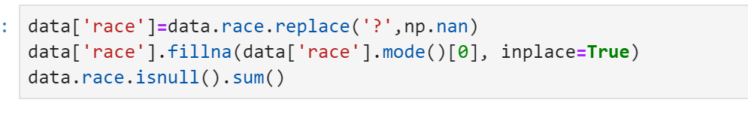
Data Cleaning
8.1
We modified the dataset to drop columns ‘medical_speciality’, ‘payer_code’,’weight’ as they seemed irrelevant to calculate readmission of a diabetic patient.
Column ‘Race’ had some missing numbers which were filled with a question mark. We replaced it with a nan representation.

Slide 10
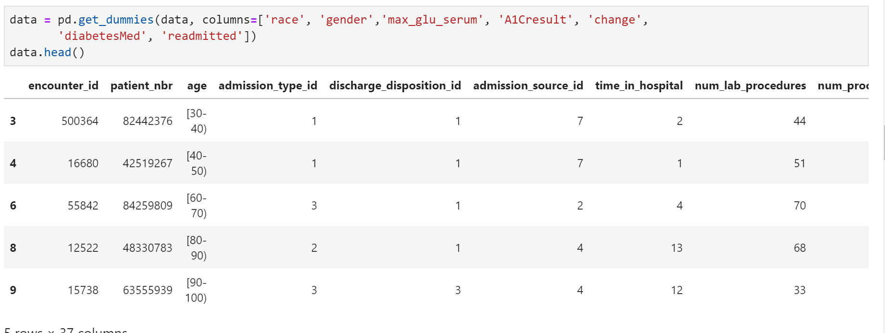
Data Cleaning
8.2
Used dummy variables feature to split some columns in various columns to get a detailed insight. To convert our categorical features to numbers, we will use a technique called one-hot encoding.

Slide 11
Data Pre-mining
9
We separated the patients who took diabetic medications and then we separated the patients who are not readmitted.
We observed that payer code, medical speciality and weight have more than 50% of missing data, hence we dropped those features.
We observed there were missing values in the race features, and filled in using MODE feature(Most repetitive race).
We used dummy variables extensively.
We separated the drugs depending upon if they were helping diabetic patients or not.

Slide 12
Performance Analysis
10
Total sample size: 26,820
Partition: 70% for Training & 30% for Testing
Build models from: 1. Logistic Regression
2. KNN
3. Bernoulli Naives Bayesian
4. Decision Tree
5. Random Forests

Slide 13
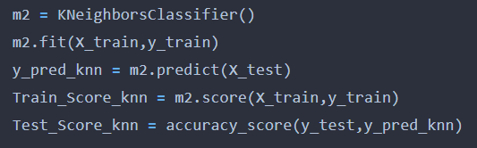
KNN
11
Robust to noisy training data
Effective if training data is large
Given it’s an instance-based learning the classifier immediately adapts as we collect new training data it allows the algorithm to respond quickly to changes in the input during real-time use
Testing Accuracy: 0.6713895103156848

Slide 14
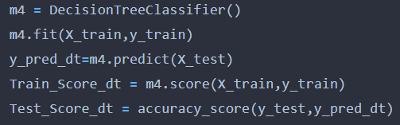
Decision Trees
12
Compared to other algorithms decision trees requires less effort for data preparation during pre-processing
A decision tree does not require scaling of data as well
Missing values in the data also does NOT affect the process of building decision tree to any considerable extent
Decision trees model is very intuitive and easy to explain to technical teams as well as stakeholders.
Testing Accuracy :
0.6976137211036539

Slide 15
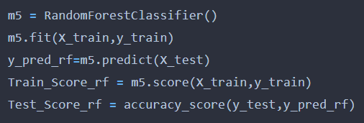
Random Forest
13
No feature scaling required
Random Forest can be used to solve both classification as well as regression problems.
Random Forest algorithm is very stable.
Testing Accuracy : 0.7300521998508576

Slide 16
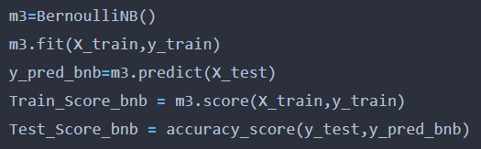
Bernoulli Naive Bayesian
14
Fast and easy to implement
It requires less training data and is highly scalable
It can make probabilistic predictions
Best suited for text classification problems
Works better with binary features
Testing Accuracy : 0.7555306984837186

Slide 17
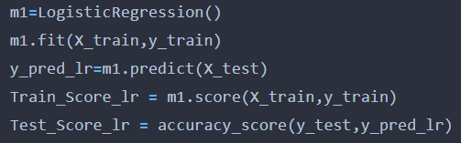
Logistic Regression
15
Very efficient and does not require too many computational resources
Highly interpretable
Doesn’t require input features to be scaled
Doesn’t require any tuning and easy to regularize,
Outputs well-calibrated predicted probabilities
Testing Accuracy: 0.7668406661695252

Slide 18
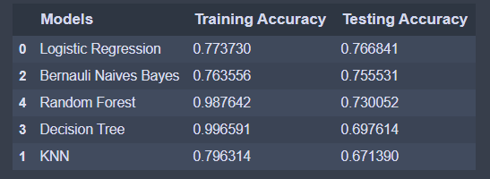
Model Evaluation
16
We can see that Logistic Regression Model performs the best, but other models are not far off. The reason might be because Logistic Regression model has well calibrated predicted probabilities.

Slide 19
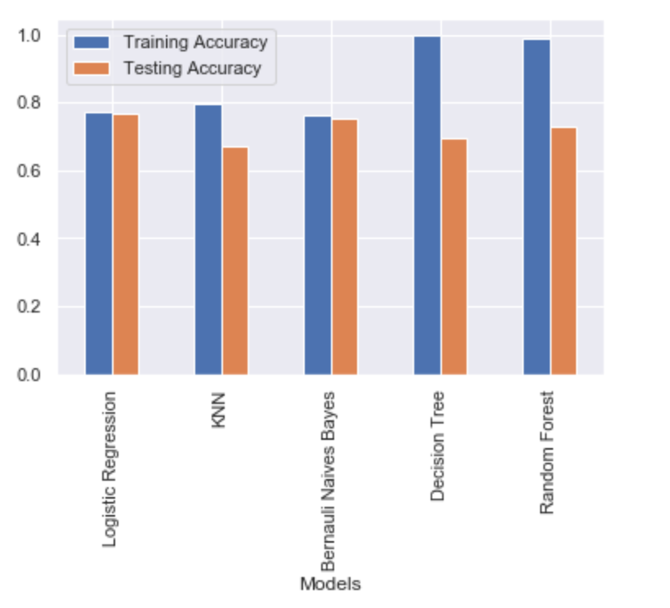
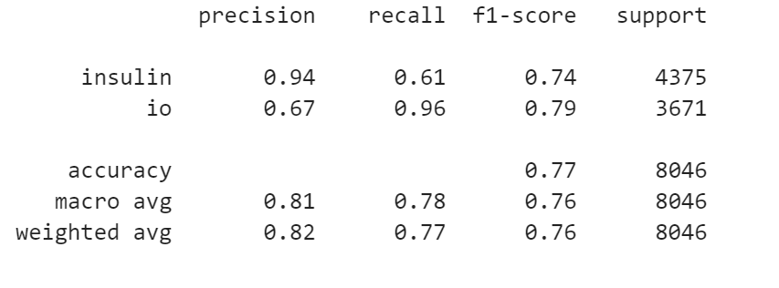
Result
17
27
We were able to get an accuracy of nearly 76 % with the help of Logistic Regression, which is very good in real time analysis to verify our accuracy. Below is classification report for Logistic regression to show the precisions, recalls and f1-score for more details:

Slide 20
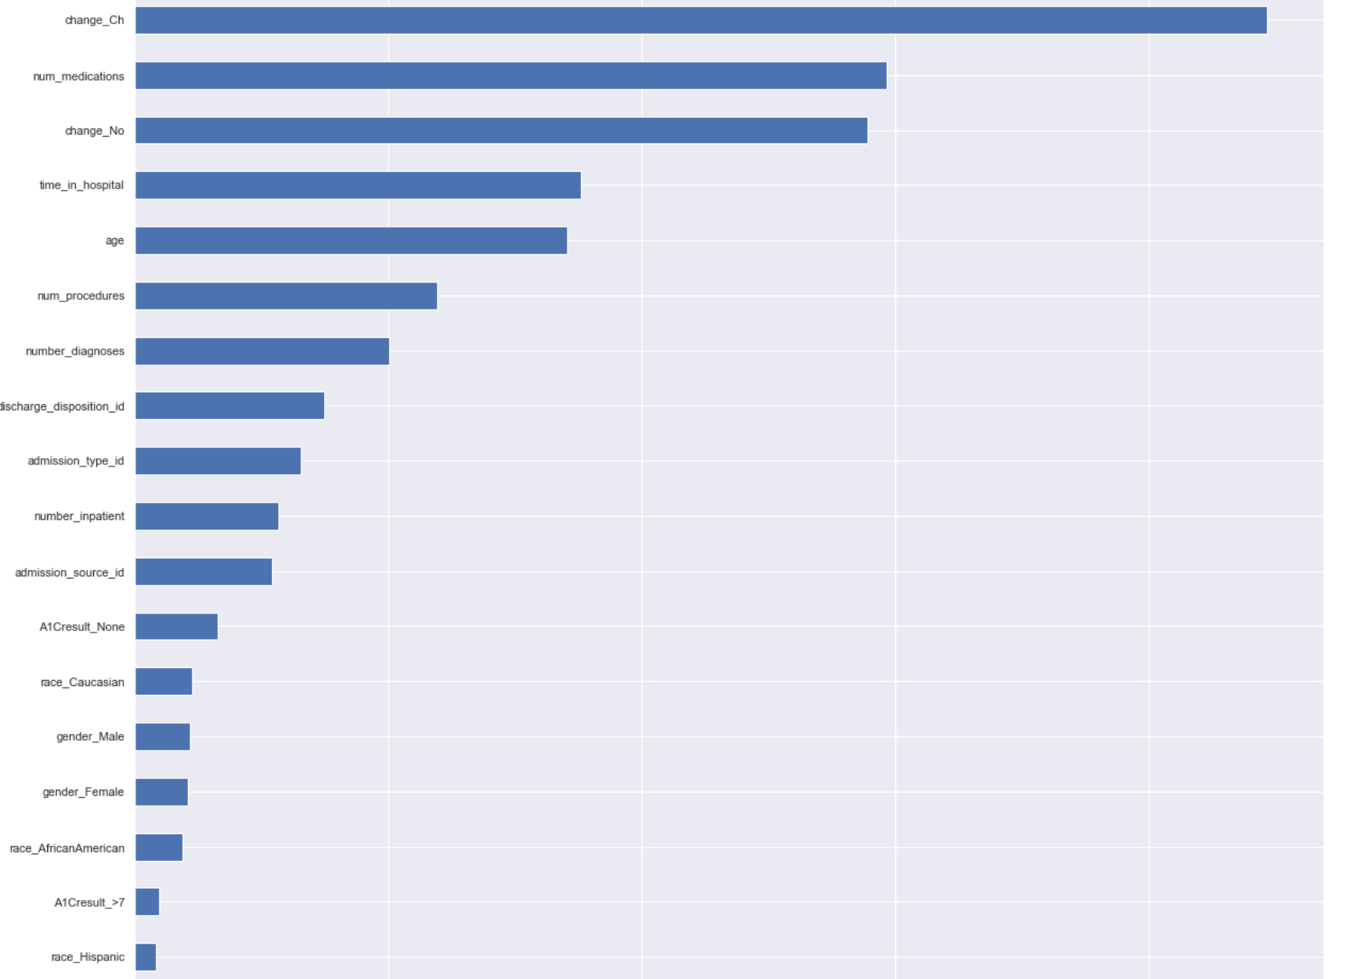
Result
18
27
This chart shows us which features are most relevant in predicting readmission of patients

Slide 21
Conclusion
19
27
Through this project, we created a machine learning model that is able to predict the patients with diabetes with highest risk of being readmitted within 30 days.
The best model was Logistic regression classifier. The model was able to predict 76% of the treatments and helped to reduce readmission of patients.
We have also found that Age, number of medications, change in medication and time in the hospital are major factors that cause readmission.

Slide 22

Thank You!

