Slide 1

Three ways of deploying ML models on Azure
Azure Container Instances (ACI): For lightweight, single-container deployments
Azure App Service: For scalable web app or API hosting
Azure Kubernetes Service (AKS): For large-scale, production-grade deployments requiring orchestration and scaling

Slide 2
Comparison of the approaches
ACI deployment | App Service deployment | AKS deployment
Quick, lightweight deployments, testing, demos Manual scaling, CI/CD For persistence, use external services like Azure blob storage or SQL database No container orchestration | Production-ready apps, APIs, web apps Autoscaling, built-in CI/CD with GitHub, Azure DevOps, Bitbucket etc. Built-in persistent storage No container orchestration | Enterprise-grade apps, distributed systems, or highly available services Autoscaling of pods and clusters for performance optimization, built-in CI/CD with GitHub, Jenkins, Azure DevOps etc. Persistence via external services like Azure Disks, Files Container orchestration – load-balancing, restart failed containers, scheduling

Slide 3
Lab 1: Deploy a FastAPI app on Azure Container Instance

Slide 4
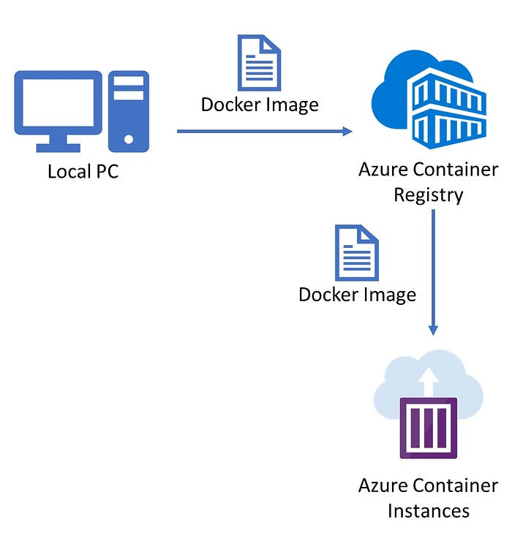
Lab workflow: Deploy FastAPI app to Azure Container Instances
Develop FastAPI app

Slide 5
Developing FastAPI Apps
What is FastAPI?
A modern, fast (high-performance), web framework for building APIs with Python
Supports automatic generation of OpenAPI documentation
Suited for machine learning model deployment due to its simplicity and speed
Defining routes (GET, POST)
FastAPI apps use GET is HTTP methods for data retrieval and POST is for submitting data
These allow creation of endpoints that interact with the ML models
Calls to each endpoint are routed to a function through decorator
Endpoint refers to a specific URL path that is used to interact with a web server or API
Pydantic
Used for request/response validation
Helps ensure incoming request data follows a defined scheme
Running a FastAPI app (uvicorn)
uvicorn is an ASGI server used to run FastAPI app
(Asynchronous Server Gateway Interface) web server implementation tailored for Python
If the script to run is main.py then syntax is: uvicorn main:app --reload

Slide 6
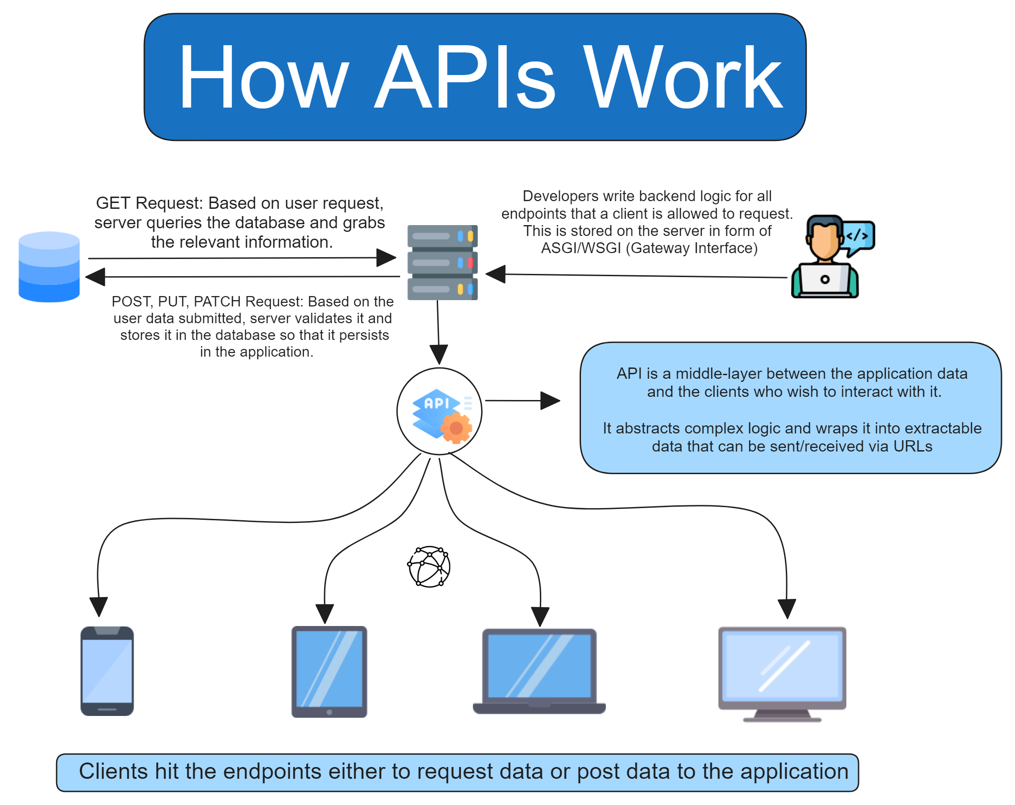
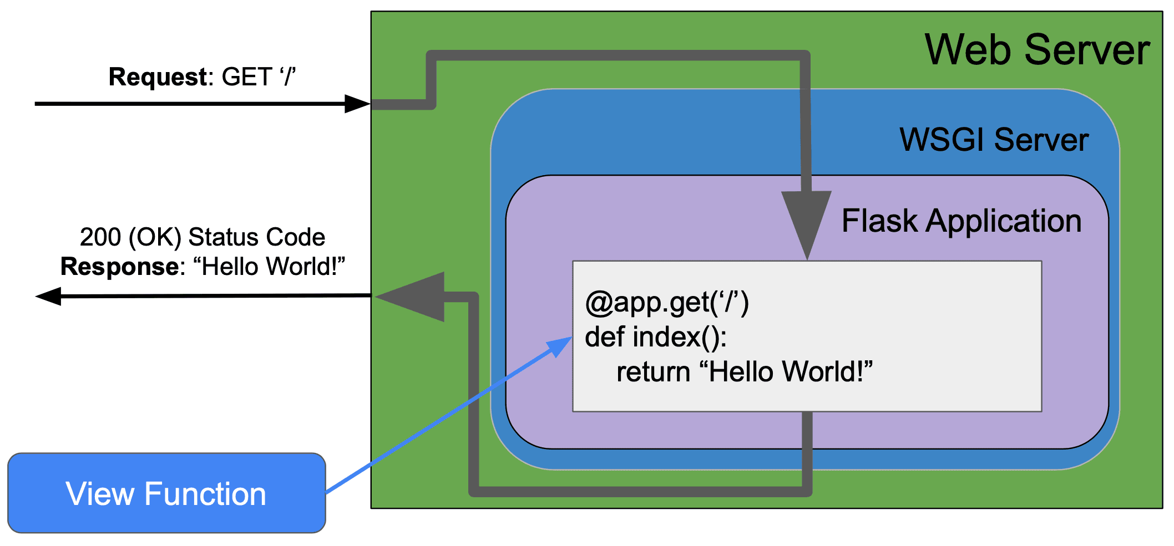
Source: https://www.freecodecamp.org/news/fastapi-quickstart/
Source: https://testdriven.io/blog/how-are-requests-processed-in-flask/

Slide 7
Testing FastAPI Apps
FastAPI creates a Swagger UI at /docs using which the API can be tested
An alternative ReDoc documentation at /redoc can be used to understand the API structure (does not allow interaction)
CLI commands of cURL can also be used to test the APIs

Slide 8
Docker
Docker is a platform that allows developers to automate the deployment of applications inside lightweight, portable containers.
Docker ecosystem includes: Docker Hub, Docker engine, Docker Desktop app
A Docker image is a lightweight, standalone, executable package that includes everything needed to run a piece of software, such as the code, runtime, libraries, and dependencies. It's essentially a snapshot of a file system.
A Docker Container is a running instance of an image. While images are static, containers are dynamic and represent a live, executing application. Containers share the host OS kernel but run in isolated environments.
A Dockerfile is a script that contains instructions on how to build a Docker image. It defines the base image, dependencies, environment settings, and commands to run when the container starts.
In summary: Build Docker image, Run Docker containers, Access applications inside containers

Slide 9
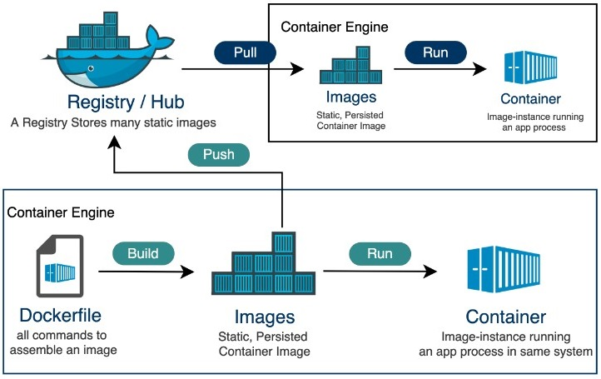
Important Docker commands
build image: docker build – Builds an image from a Dockerfile
push image: docker push – Pushes an image to a remote repository (e.g., Docker Hub, ACR)
run container: docker run – Runs a container from a specified image
stop container: docker stop – Stops a running container
remove container: docker rm – Removes a stopped container
remove image: docker rmi – Removes a Docker image
These can be executed in Docker Desktop or in Docker CLI

Slide 10
Docker vs VM
Lightweight: Docker containers share the host OS, while VMs include a full OS for each instance, making Docker faster and less resource-intensive.
Faster Startup: Containers start in seconds, unlike VMs which take minutes to boot.
Portability: Docker ensures consistent environments across development, testing, and production, whereas VMs may have compatibility issues.
Efficiency: Docker uses fewer resources, enabling more containers to run on the same hardware compared to VMs.

Slide 11
Azure Components used in this lab
Azure Subscription
A logical container used to manage and organize your Azure resources. It represents a billing unit for the resources that are used
Azure CLI
A command-line tool used to manage Azure resources. It allows you to interact with Azure services, including creating and managing resources like ACR, ACI, and more, directly from your terminal.
Azure Portal
A web-based interface that allows you to interact with and manage Azure resources visually
Azure Resource Group
A logical entity that holds related resources in an Azure project
Azure Container Registry
A private registry for storing and managing Docker images
Azure Container Instances
A service that can run containers in Azure and can expose public IP

Slide 12
Topics for further exploration
Docker deep dive
Persistent storage
Multi-container apps using docker-compose
Containerize app with GPU support
Multi-stage docker builds for optimized images
Docker alternatives: Containerd, CRI-O
Azure
Deploy FastAPI app on App Service with CI/CD using GitHub actions
Deploy FastAPI app on App Service with CI/CD using Azure DevOps
Deploy FastAPI app on Azure Kubernetes Service

