Slide 1

Three ways of deploying ML models on Azure
Azure Container Instances (ACI): For lightweight, single-container deployments
Azure App Service: For scalable web app or API hosting
Azure Kubernetes Service (AKS): For large-scale, production-grade deployments requiring orchestration and scaling

Slide 2
Comparison of the approaches
ACI deployment | App Service deployment | AKS deployment
Quick, lightweight deployments, testing, demos Manual scaling, CI/CD For persistence, use external services like Azure blob storage or SQL database No container orchestration | Production-ready apps, APIs, web apps Autoscaling, built-in CI/CD with GitHub, Azure DevOps, Bitbucket etc. Built-in persistent storage No container orchestration | Enterprise-grade apps, distributed systems, or highly available services Autoscaling of pods and clusters for performance optimization, built-in CI/CD with GitHub, Jenkins, Azure DevOps etc. Persistence via external services like Azure Disks, Files Container orchestration – load-balancing, restart failed containers, scheduling

Slide 3
Lab 2: Deploy a FastAPI App on Azure App Service with CI/CD using GitHub Actions

Slide 4
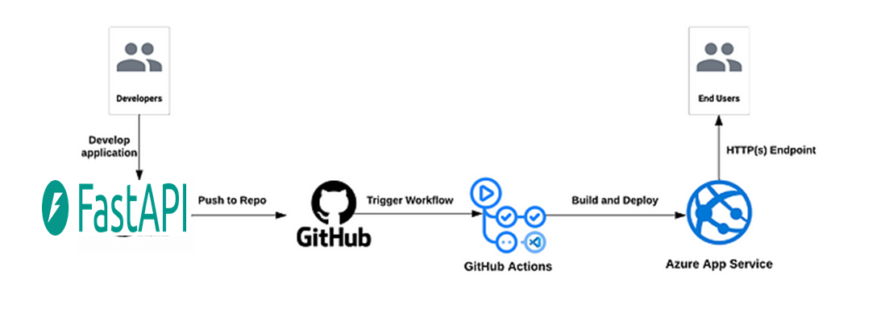
Lab workflow: Deploy a FastAPI App to Azure App Service using CI/CD with GitHub Actions

Slide 5
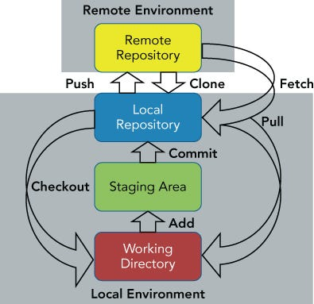
Git workflow
Initialize git using:
git init
add the working dir to git’s safe list
git config --global --add safe.directory "D:/working/dir/full/ path”
Add all files to the staging area
git add .
Commit to the local git repo
git commit -m "Initial commit for FastAPI CI/CD lab"
Create repo in GitHub.com called fastapi-azure-lab2
Add the remote repo to Git
git remote add origin https://github.com/<your-username>/fastapi-azure-lab2.git
Rename branch to main
git branch -M main
Push your local changes to github
git push -u origin main

Slide 6
Key GitHub Actions Concepts for CI/CD
GitHub Remote Repository:
The location where the code is stored online on GitHub, often referred to as the "origin." This is where the code is pushed and pulled from.
GitHub Secrets:
Secure environment variables used in GitHub Actions to store sensitive information (e.g., credentials, keys) safely. They are added in the GitHub repository’s settings under Secrets.
CI/CD Trigger:
An event that initiates the CI/CD process. For example, pushing changes to the GitHub repository (e.g., `git push` to the main branch).
GitHub Actions:
GitHub’s built-in CI/CD tool that automates workflows such as building, testing, and deploying applications. It is triggered by events like pushes to a repository.
GitHub Actions Workflow:
A set of instructions written in YAML format that defines the automation process in GitHub Actions, such as building and deploying a project. Example: `.github/workflows/ci-cd.yml`.

Slide 7
Structure and syntax of the ci-cd.yml file
Ref to ci-cd with comments.yml

Slide 8
Azure Components used in this lab
Azure Subscription
A logical container used to manage and organize your Azure resources. It represents a billing unit for the resources that are used
Azure CLI
A command-line tool used to manage Azure resources. It allows you to interact with Azure services, including creating and managing resources like ACR, ACI, and more, directly from your terminal.
Azure Portal
A web-based interface that allows you to interact with and manage Azure resources visually
Azure Resource Group
A logical entity that holds related resources in an Azure project
Azure Container Registry
A private registry for storing and managing Docker images
Azure App Service Plan
Azure App Service (AAS)
Azure Active Directory (AD)
Azure Service Principal
Defines the region and resource allocation for hosting the web app
Platform-as-a-Service (PaaS) for hosting web apps
Used for creating and managing the Service Principal for GitHub Actions authentication
An identity used by GitHub Actions for deploying the FastAPI app securely

Slide 9
Topics for further exploration
Explore GitHub Actions
Marketplace
Runners
Running a python script on push
Automate tests for ML models
Orchestration using Azure DevOps / Kubernetes / Jenkins / Docker Compose / Docker Swarm
This allows multi-container apps, multi-environment deployment
CI/CD using
GitHub Actions for multi-Environment Deployment
Azure DevOps
Azure Pipelines
Deploy on Azure Functions

