Slide 1
SQL Quick lookup
sridhar

Slide 2
SQL String data types:
Data type | Description | Max size | Storage
char(n) | Fixed width character string | 8,000 characters | Defined width
varchar(n) | Variable width character string | 8,000 characters | 2 bytes + number of chars
varchar(max) | Variable width character string | 1,073,741,824 characters | 2 bytes + number of chars
text | Variable width character string | 2GB of text data | 4 bytes + number of chars
nchar | Fixed width Unicode string | 4,000 characters | Defined width x 2
nvarchar | Variable width Unicode string | 4,000 characters
nvarchar(max) | Variable width Unicode string | 536,870,912 characters
ntext | Variable width Unicode string | 2GB of text data
binary(n) | Fixed width binary string | 8,000 bytes
varbinary | Variable width binary string | 8,000 bytes
varbinary(max) | Variable width binary string | 2GB
image | Variable width binary string | 2GB

Slide 3
SQL Numeric Data Type:
Data type | Description | Storage
bit | Integer that can be 0, 1, or NULL
tinyint | Allows whole numbers from 0 to 255 | 1 byte
smallint | Allows whole numbers between -32,768 and 32,767 | 2 bytes
int | Allows whole numbers between -2,147,483,648 and 2,147,483,647 | 4 bytes
bigint | Allows whole numbers between -9,223,372,036,854,775,808 and 9,223,372,036,854,775,807 | 8 bytes
decimal(p,s) | Fixed precision and scale numbers.Allows numbers from -10^38 +1 to 10^38 –1. The p parameter indicates the maximum total number of digits that can be stored (both to the left and to the right of the decimal point). p must be a value from 1 to 38. Default is 18. The s parameter indicates the maximum number of digits stored to the right of the decimal point. s must be a value from 0 to p. Default value is 0 | 5-17 bytes
numeric(p,s) | Fixed precision and scale numbers.Allows numbers from -10^38 +1 to 10^38 –1. The p parameter indicates the maximum total number of digits that can be stored (both to the left and to the right of the decimal point). p must be a value from 1 to 38. Default is 18. The s parameter indicates the maximum number of digits stored to the right of the decimal point. s must be a value from 0 to p. Default value is 0 | 5-17 bytes
smallmoney | Monetary data from -214,748.3648 to 214,748.3647 | 4 bytes
money | Monetary data from -922,337,203,685,477.5808 to 922,337,203,685,477.5807 | 8 bytes
float(n) | Floating precision number data from -1.79E + 308 to 1.79E + 308.The n parameter indicates whether the field should hold 4 or 8 bytes. float(24) holds a 4-byte field and float(53) holds an 8-byte field. Default value of n is 53. | 4 or 8 bytes
real | Floating precision number data from -3.40E + 38 to 3.40E + 38 | 4 bytes

Slide 4
SQL Date & Time Data Types
Data type | Description | Storage
datetime | From January 1, 1753 to December 31, 9999 with an accuracy of 3.33 milliseconds | 8 bytes
datetime2 | From January 1, 0001 to December 31, 9999 with an accuracy of 100 nanoseconds | 6-8 bytes
smalldatetime | From January 1, 1900 to June 6, 2079 with an accuracy of 1 minute | 4 bytes
date | Store a date only. From January 1, 0001 to December 31, 9999 | 3 bytes
time | Store a time only to an accuracy of 100 nanoseconds | 3-5 bytes
datetimeoffset | The same as datetime2 with the addition of a time zone offset | 8-10 bytes
timestamp | Stores a unique number that gets updated every time a row gets created or modified. The timestamp value is based upon an internal clock and does not correspond to real time. Each table may have only one timestamp variable

Slide 5
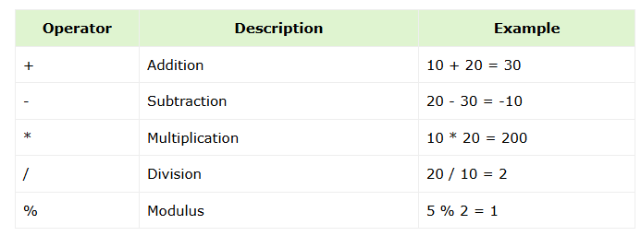
SQL Operators:
SQL Arithmetic Operators

Slide 6
SQL Operators:
SQL Comparison Operators
Operator | Description | Example
= | Equal to | 5 = 5 returns TRUE
!= | Not equal | 5 != 6 returns TRUE
<> | Not equal | 5 <> 4 returns TRUE
> | Greater than | 4 > 5 returns FALSE
< | Less than | 4 < 5 returns TRUE
>= | Greater than or equal to | 4 >= 5 returns FALSE
<= | Less than or equal to | 4 <= 5 returns TRUE
!< | Not less than | 4 !< 5 returns FALSE
!> | Not greater than | 4 !> 5 returns TRUE

Slide 7
SQL Operators:
SQL Comparison Operators
Operator | Description
ALL | TRUE if all of a set of comparisons are TRUE.
AND | TRUE if all the conditions separated by AND are TRUE.
ANY | TRUE if any one of a set of comparisons are TRUE.
BETWEEN | TRUE if the operand lies within the range of comparisons.
EXISTS | TRUE if the subquery returns one or more records
IN | TRUE if the operand is equal to one of a list of expressions.
LIKE | TRUE if the operand matches a pattern specially with wildcard.
NOT | Reverses the value of any other Boolean operator.
OR | TRUE if any of the conditions separated by OR is TRUE
IS NULL | TRUE if the expression value is NULL.
SOME | TRUE if some of a set of comparisons are TRUE.
UNIQUE | The UNIQUE operator searches every row of a specified table for uniqueness (no duplicates).

Slide 8
SQL Operators:
SQL Operator Precedence
Operator | Operation
+, - | identity, negation
*, / | multiplication, division
+, - | addition, subtraction
=, !=, <, >, <=, >=, IS NULL, LIKE, BETWEEN, IN | Comparison
NOT | logical negation
AND | conjunction
OR | inclusion

Slide 9
SQL CREATE:
Database
CREATE Database Statement
CREATE DATABASE DatabaseName;
Example: Following is an example to create a database testDB using SQL CREATE DATABASE statement
CREATE DATABASE testDB;
------
DROP DATABASE DatabaseName; USE DatabaseName; -- Selects the DB SHOW DATABASES; -- list the databases ALTER DATABASE OldDatabaseName MODIFY NAME = NewDatabaseName; -- Modify

Slide 10
SQL CREATE:
Table
The SQL CREATE TABLE Statement
CREATE TABLE table_name(
column1 datatype,
column2 datatype,
column3 datatype, ..... columnN datatype,
PRIMARY KEY( one or more columns ) );
CREATE TABLE CUSTOMERS(
ID INT NOT NULL,
NAME VARCHAR (20) NOT NULL,
AGE INT NOT NULL,
ADDRESS CHAR (25),
SALARY DECIMAL (18, 2),
PRIMARY KEY (ID) );
ALTER TABLE table_name [alter_option ...];
DROP TABLE table_name;
DELETE FROM table_name;

Slide 11
INSERT, UPDATE
INSERT INTO TABLE_NAME (column1, column2...columnN) VALUES (value1, value2...valueN);
INSERT INTO CUSTOMERS (ID,NAME,AGE,ADDRESS,SALARY) VALUES (1, 'Ramesh', 32, 'Ahmedabad', 2000.00 );
____ SELECT * INTO new_table_name FROM existing_table_name
SELECT * INTO CUSTOMER_BACKUP FROM CUSTOMERS;
UPDATE table_name SET column1 = value1, column2 = value2,..., columnN = valueN WHERE [condition];
UPDATE CUSTOMERS SET ADDRESS = 'Pune' WHERE ID = 6;

Slide 12
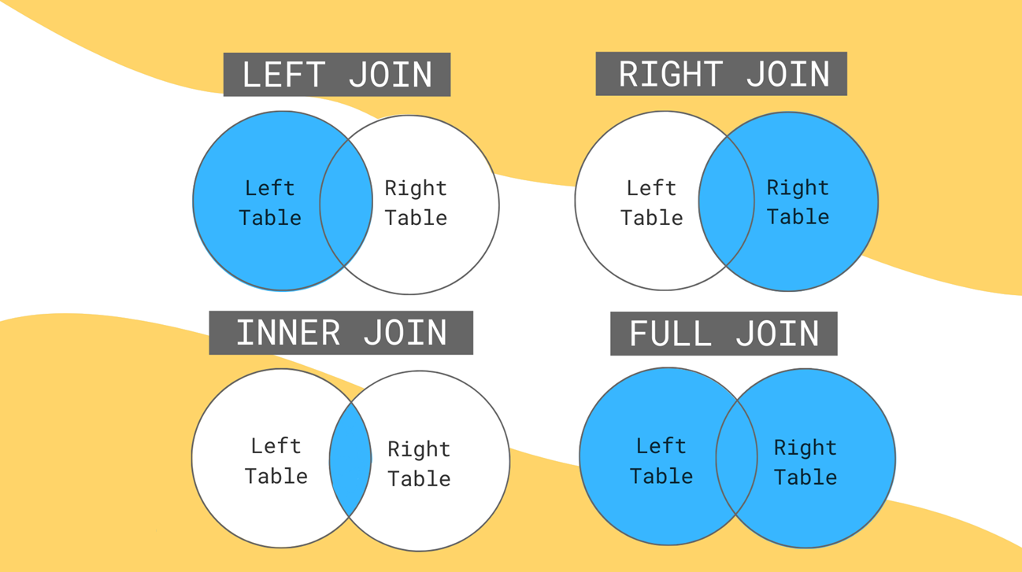
SQL JOINS

Slide 13
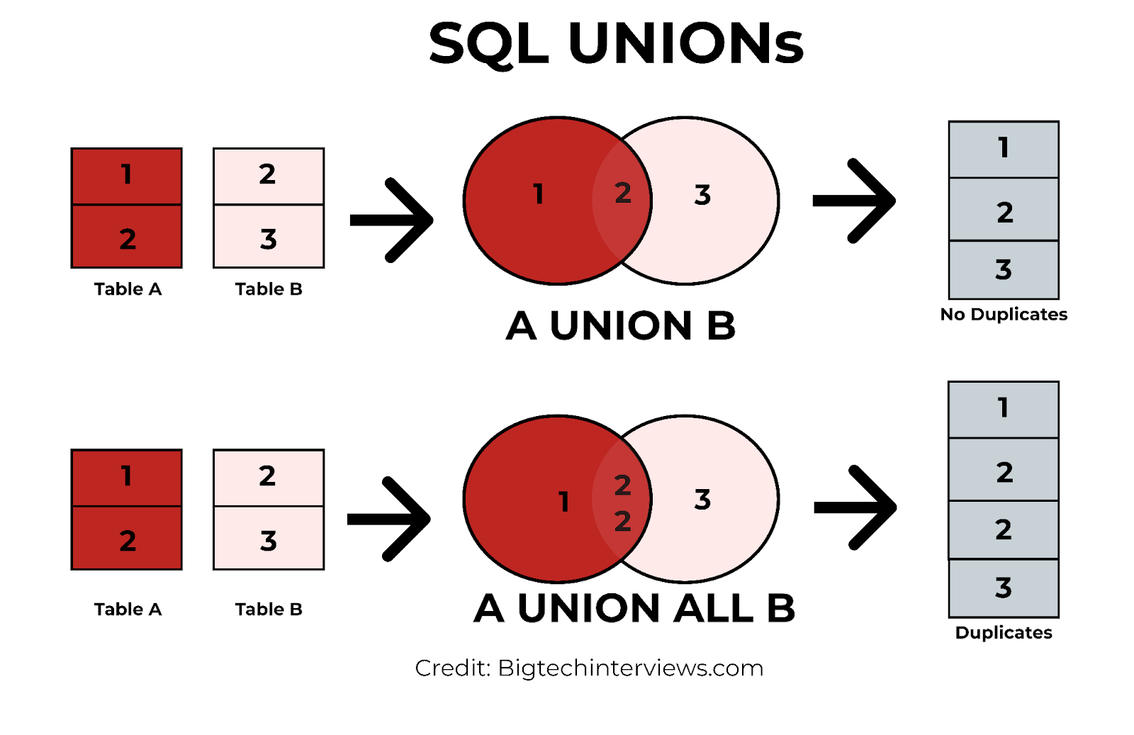
SQL UNIONS
SELECT column1, column2, … FROM table1 UNION SELECT column1, column2, … FROM table2;
UNION combines datasets from multiple SELECT statements and removes duplicate records, ensuring that the result set only contains unique entries. On the other hand, UNION ALL combines datasets and includes all records, even if some are duplicates.
SELECT column1, column2, … FROM table UNION ALL SELECT column1, column2, … FROM table2;

