Slide 1
Customer Feedback System
By….Sridhar

Slide 2
Project Abstraction
The Customer Feedback System is designed to collect, manage, and respond to customer opinions about products.
Key Functions:
• Add customers and products
• Record feedback for products
• Display all feedback with customer and product details
• Admin can reply to feedback
• Store and retrieve data using MySQL through JDBC
Purpose: Demonstrate CRUD operations In Customer Feedback System.

Slide 3
Tech Stack
Programming Language: Java
Database: MySQL
Connectivity: JDBC
Logging: Java Logging API-SLF4J
Testing: JUnit
Each layer demonstrates core database and programming principles.

Slide 4
Entities and Relationship
Tables:
Customer (Customer_ID, Customer Name, Customer Email)
2. Product (Product ID, Product Name, Category)
3. Feedback (Feedback ID, Customer_ID, Product ID, Rating, Comments, Replay)
Relationships:
• One Customer → Many Feedbacks
• One Product → Many Feedbacks
• Feedback links Customer and Product

Slide 5
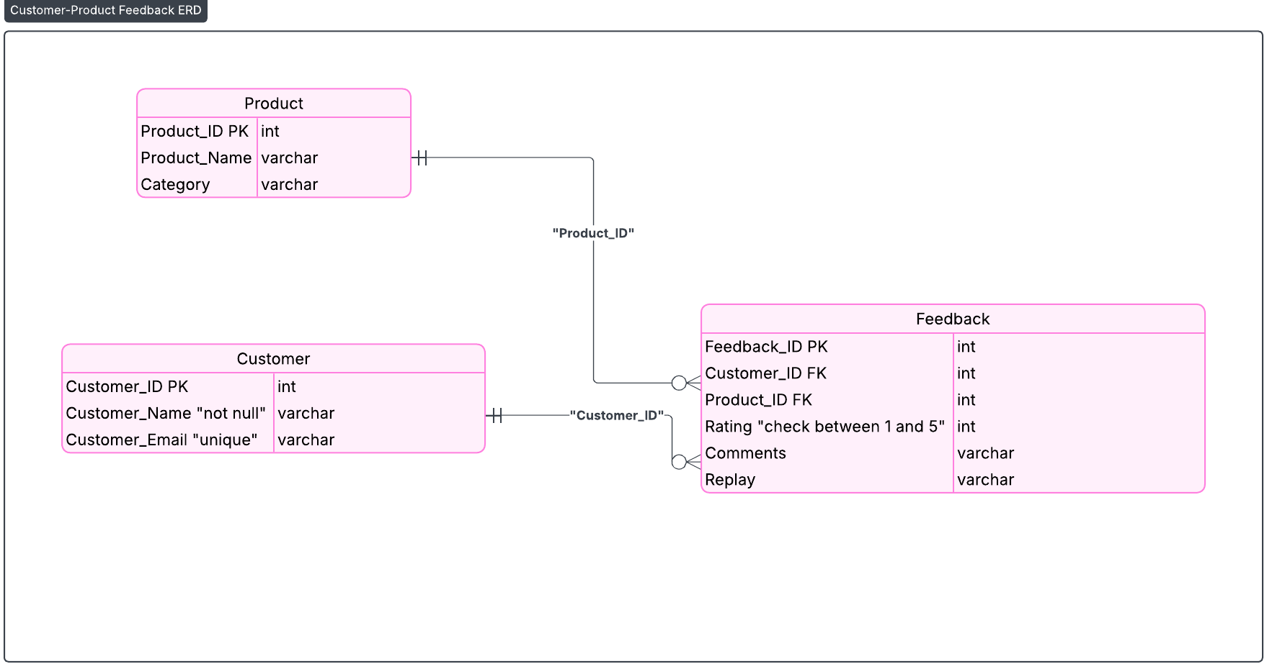
ER Diagram
[Add your er diagram here]

Slide 6
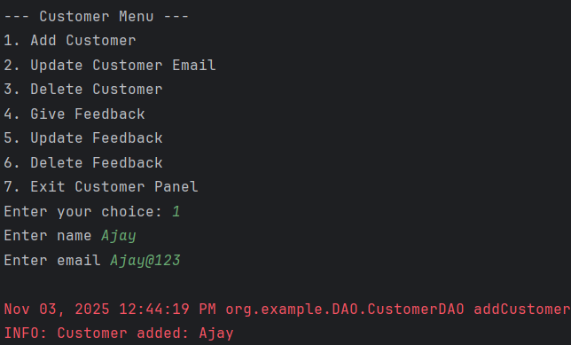
Output Screenshots

Slide 7
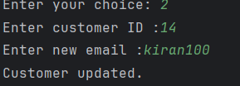

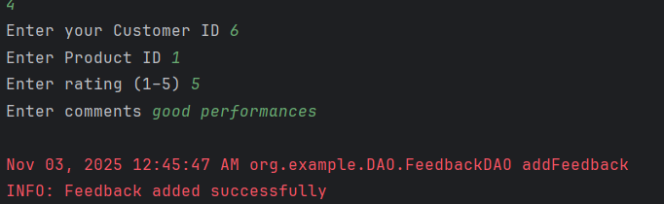
Update email
Delete Customer
Give Feedback

Slide 8
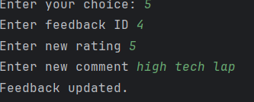

Updating Feedback
Deleting Feedback

Slide 9
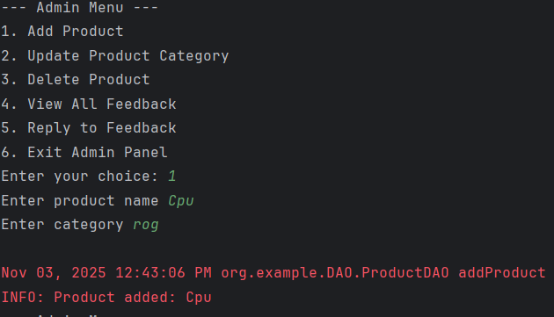
Add Product

Slide 10
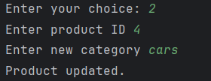


Update Product
Delete Product
Reply to Feedback

Slide 11
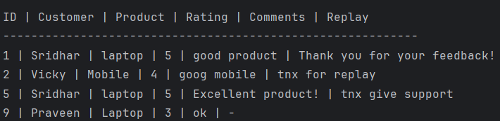
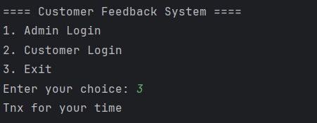
View All Feedback
Closing Console

Slide 12
Conclusion
The Customer Feedback System successfully demonstrates how to manage customer, product, and feedback data using Java, MySQL, and JDBC. It showcases core CRUD operations, modular design, and proper data relationships between entities. The system provides a simple yet functional console interface for both customers and administrators to interact efficiently.

