Slide 1


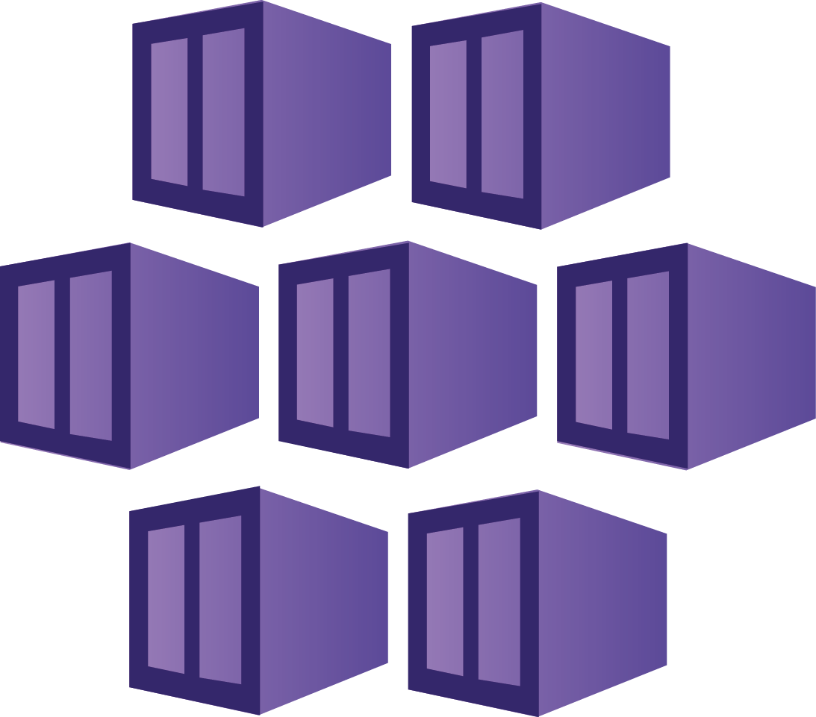





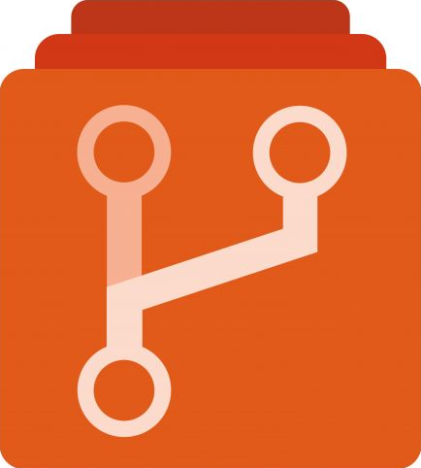
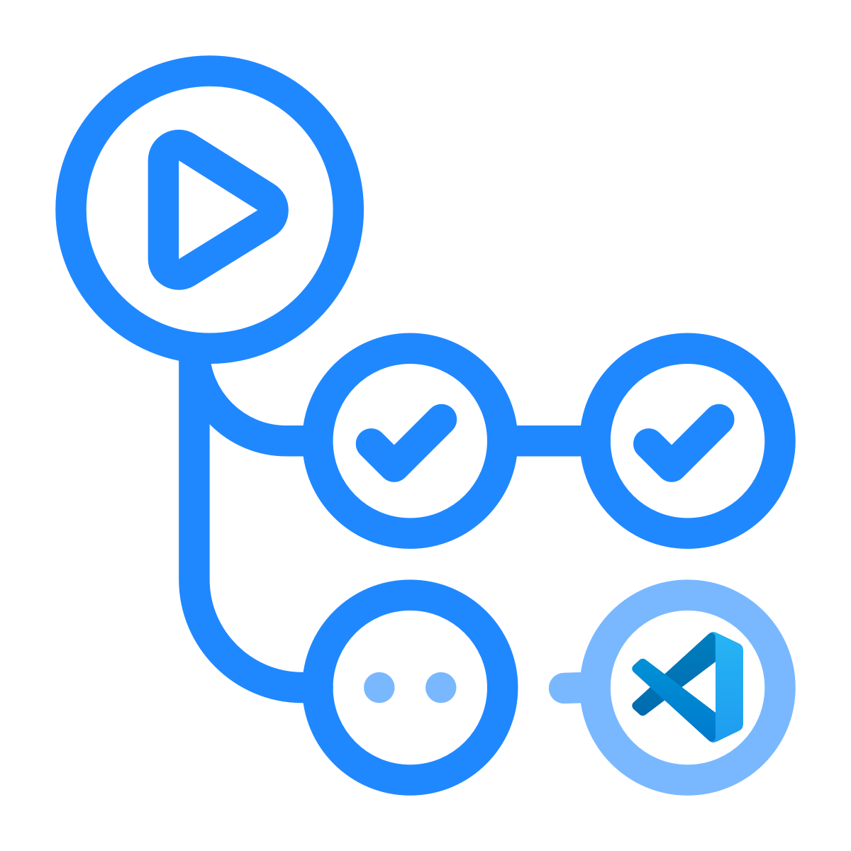
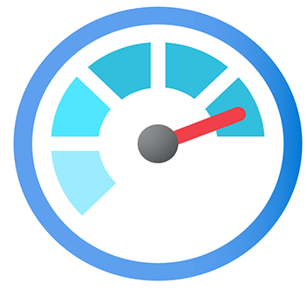

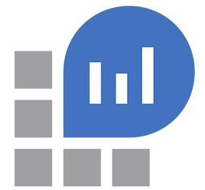




Azure DevOps HLD Implementation Design
Visual Studio
Code
AKS Dev
Cluster
Test
Debug
Azure Container Registry (NP)
Azure Container Registry (PROD)
Compliance
Protection
Dev Code
IaC
Terraform
AZ CI
AZ CD
Azure
Kubernetes
Container
Insight
Azure Data Later
Azure Monitor
Application
Insights
Log Analytics Workspace
AZ Repo
AZ Repo
Action
Get Secrets
Unit Tests
Integration Tests
Publish Build Artifacts
Publish Container Image
Deploy to staging
Acceptance tests
Promote Container Image
Release
Azure
Kubernetes
Container
Insight
Azure Data Later
SAST
DAST
Azure Policy

Slide 2
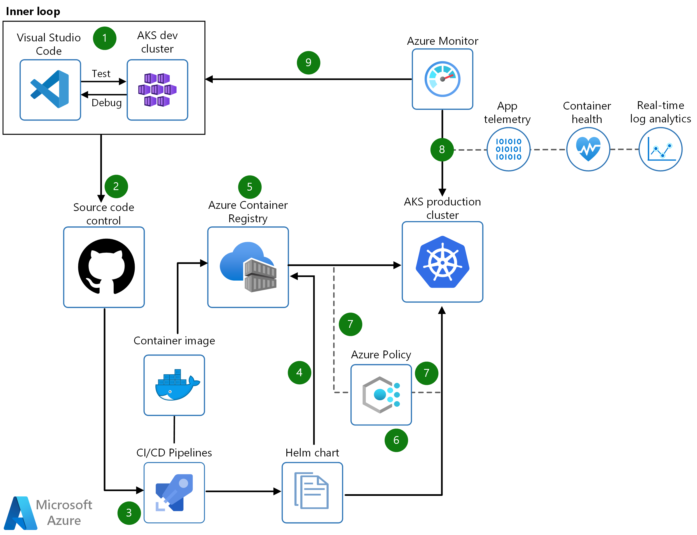
Azure DevOps HLD Implementation

Slide 3
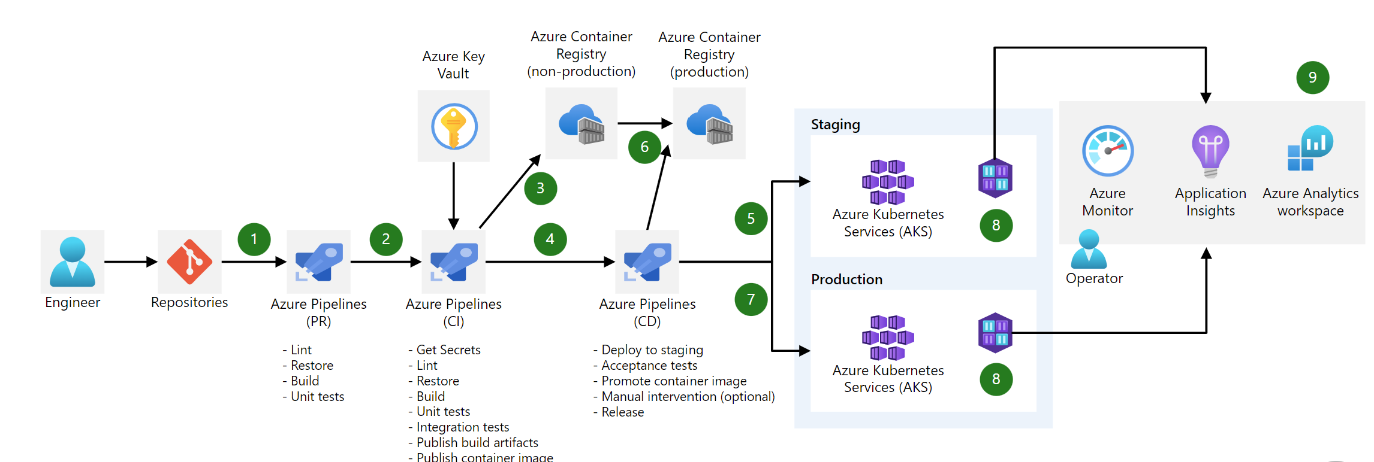
Azure DevOps HLD Implementation

Slide 4
Change application source code.
Commit Application Code.
Continuous integration triggers application build, container image build and unit tests.
Container image pushed to Azure Container Registry.
Continuous deployment trigger orchestrates deployment of application artifacts with environment-specific parameters.
Deployment to Azure Kubernetes Service (AKS).
Container is launched using Container Image from Azure Container Registry.
Application Insights collect and analyze health, performance, and usage data.
Review health, performance, and usage information.
Update backlog item.

Slide 5

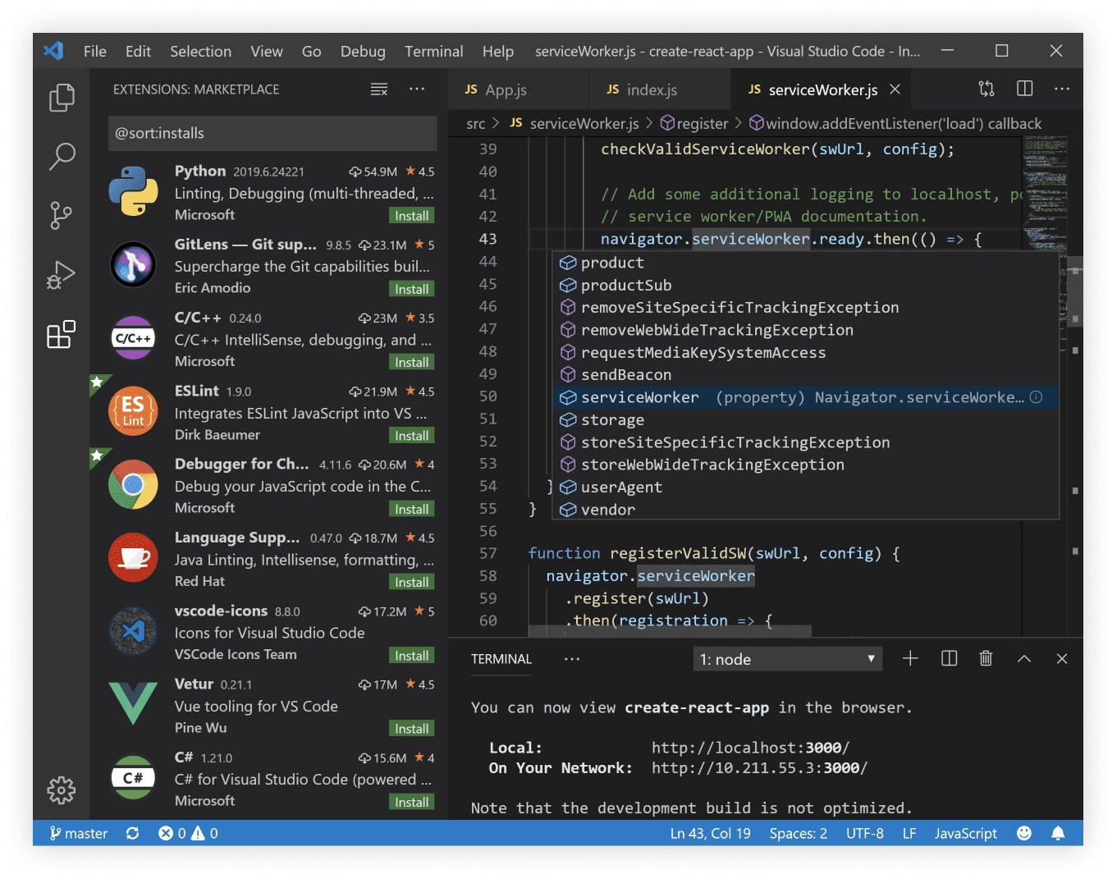
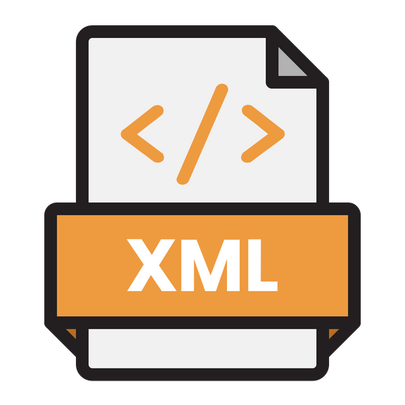


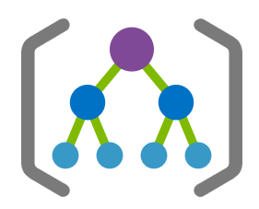


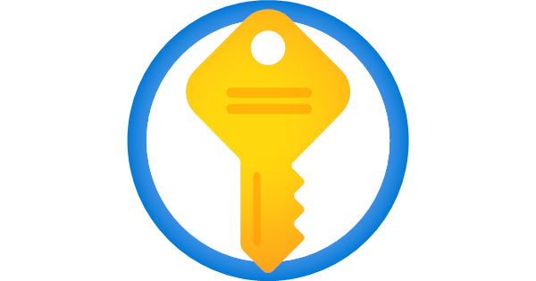
FLORIDA DEO – Azure DevOps HLD Implementation
Azure DevOps Project
SYNC/Push
Azure Repos
YAML Terraform Code
Azure Pipelines
Deploy to Azure
Management
Group
Subscription
VM
AKS
DB

